Slide 1
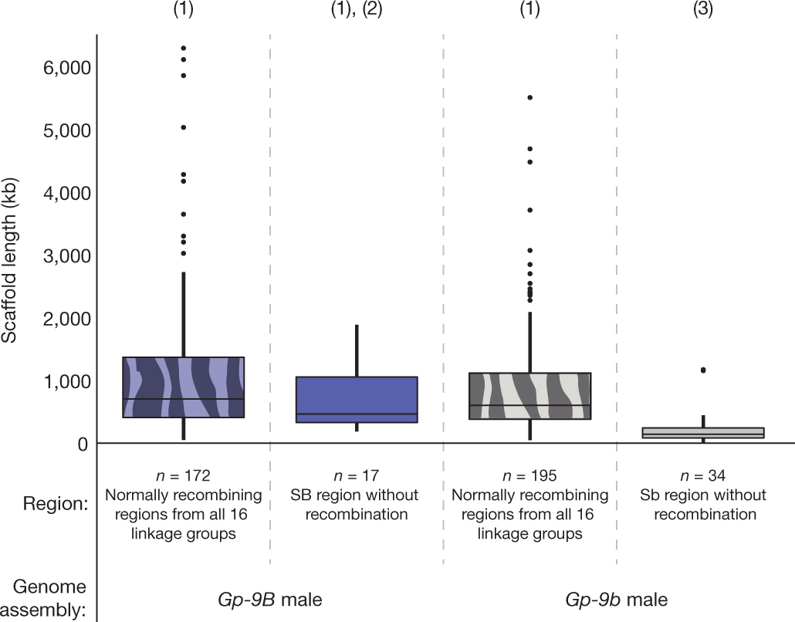

Scaffolds lengths of the non-recombining region of the social
chromosome (solid) and the rest of the genome (patterned) based on the
genome assemblies of a Gp-9B (blue) and a Gp-9b (grey) male.
J Wang et al. Nature 000, 1-5 (2013) doi:10.1038/nature11832

