Slide 1


FM Radio Receiver – System Design Exploration and Implementation in Multiple Methods
Master’s Thesis Presentation by Michael Wurm

Slide 2
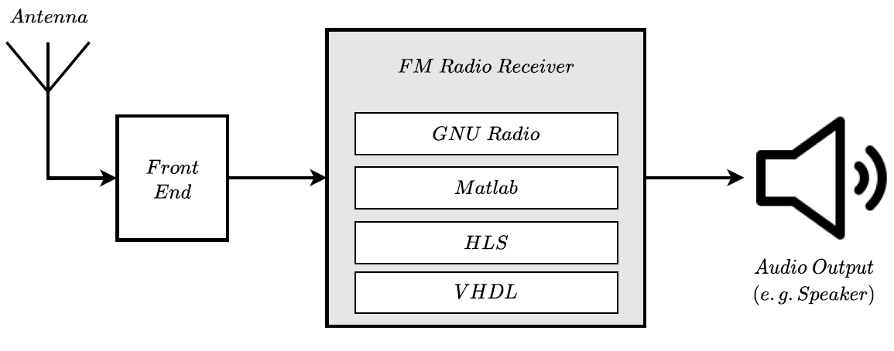
The project
FM radio receiver
Multiple implementation variants
Ultimate goal: Listen to the music of an FM radio station
ZedBoard hardware deployment
Fully integrated system design
Verification
Integration
Deployment on hardware

Slide 3
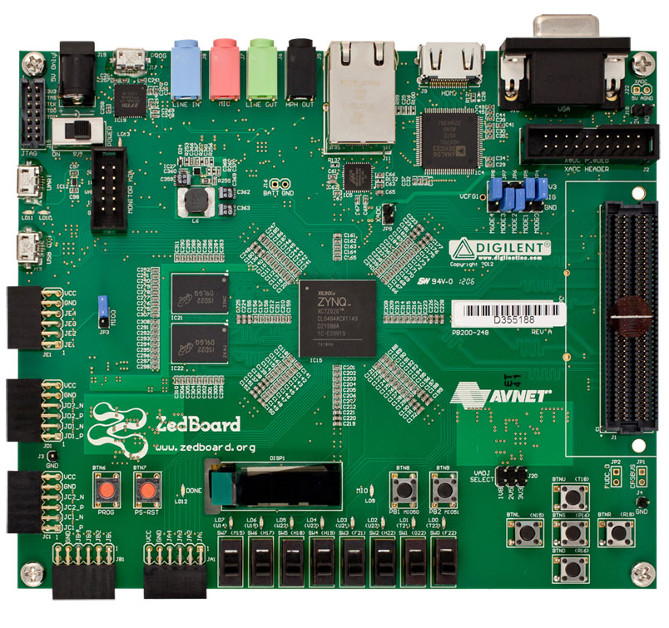
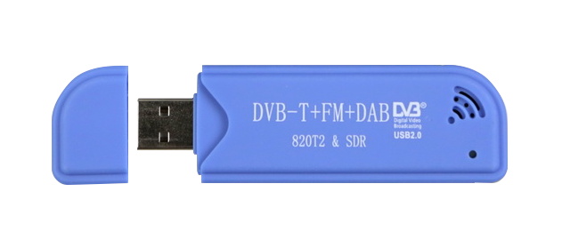
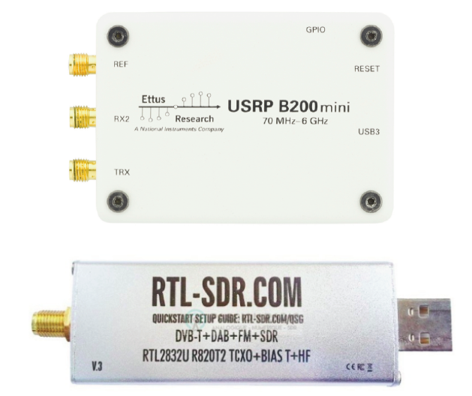
The project
FM radio receiver
Multiple implementation variants
Ultimate goal: Listen to the music of an FM radio station
ZedBoard hardware deployment
Fully integrated system design
Verification
Integration
Deployment on hardware
RTL-SDR

Slide 4
Motivation
Wide range of well-known topics
Digital Signal Processing
Chip Design, FPGA Design
Software and Firmware Development
Combine all disciplines
Implementation
Verification
Deployment on hardware
Develop a thorough system concept
Single project
Overall system concept
Choice of application
Objective

Slide 5
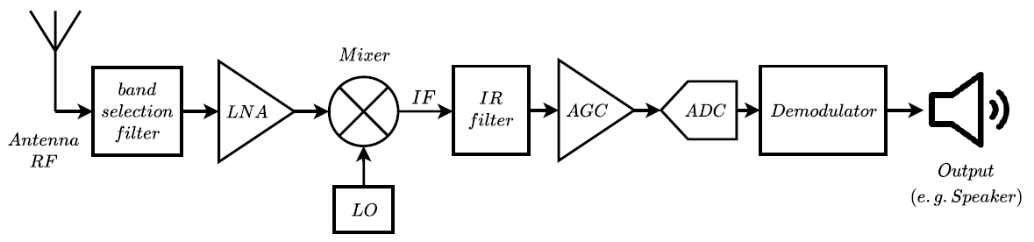
Digital signal processing
Receiver Structure
Superheterodyne
RTL-SDR

Slide 6
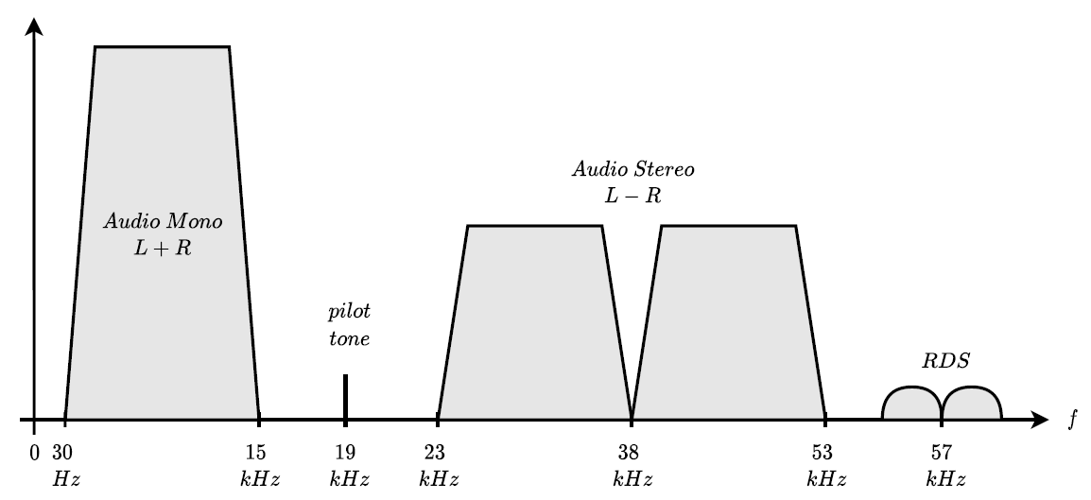
Digital signal processing
FM Radio Channel Signal
FM frequency band 87.5 - 108 MHz
Single channel bandwidth 200 MHz
Multiplex signal consists of multiple parts

Slide 7
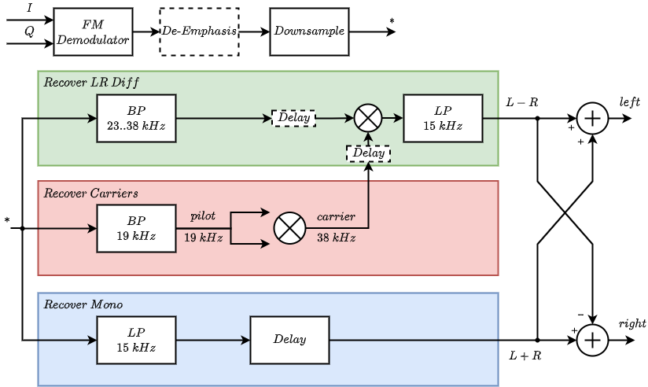

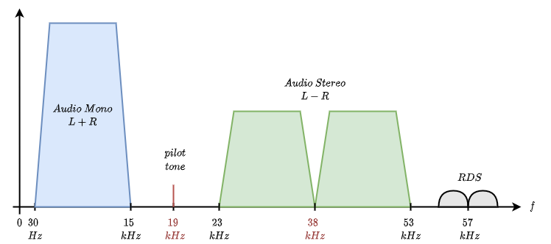
Digital signal processing
Demodulation Process for Stereo Audio

Slide 8
High-level synthesis
Transform C++ to HDL
Automatic generation
Firmware drivers
Interfaces
Structure for IP integration
Algorithm- instead of logic level
Xilinx Vivado HLS
Overview

Slide 9
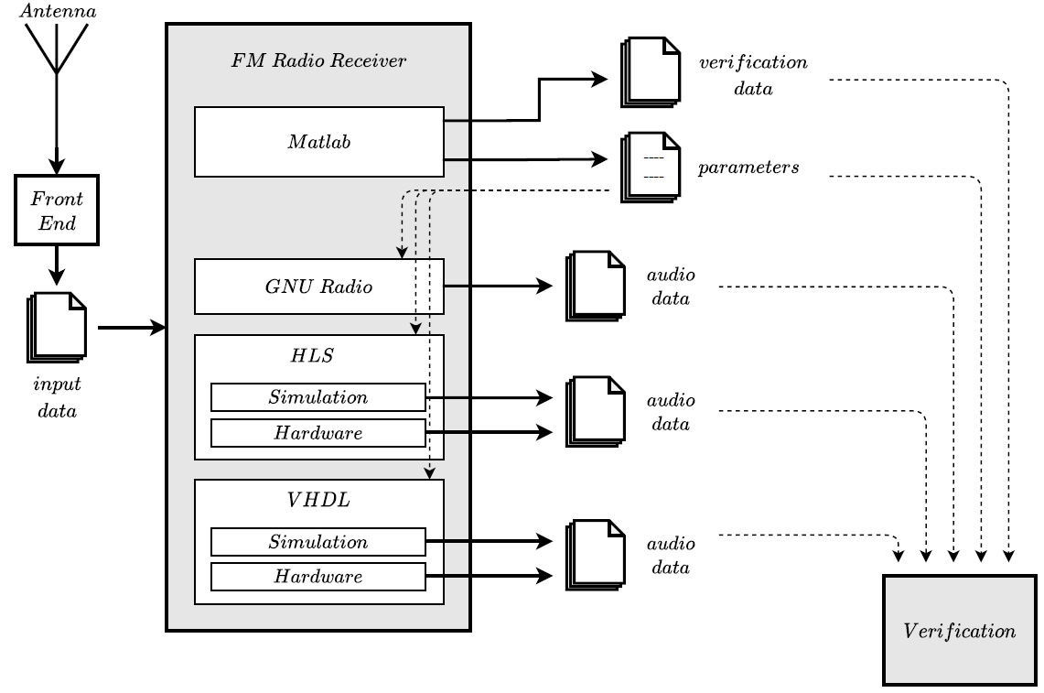
Implementation
System Design
Common input source
System model with Matlab
Common verification environment
HLS and VHDL
Automated through scripts

Slide 10
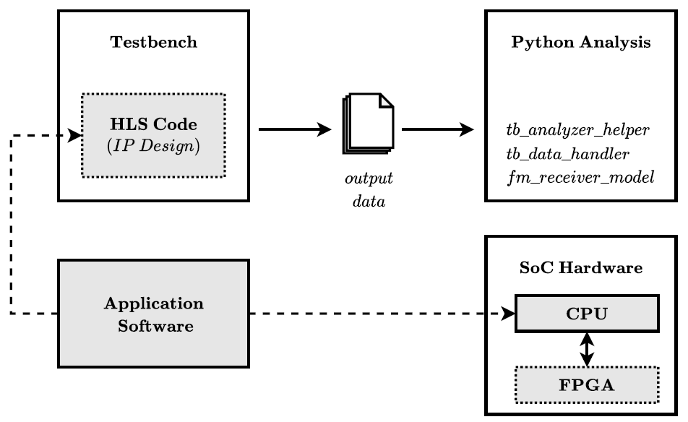
Implementation
Efficient Design Approach
Early development of software application code, before any hardware is available
Fully integrated verification
Verification

Slide 11
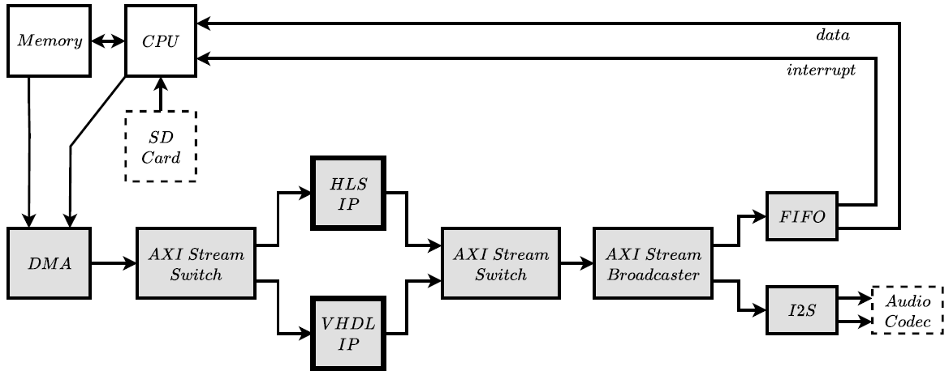
Implementation
Hardware Design
Parallel usage of multiple implementations
Direct comparison

Slide 12
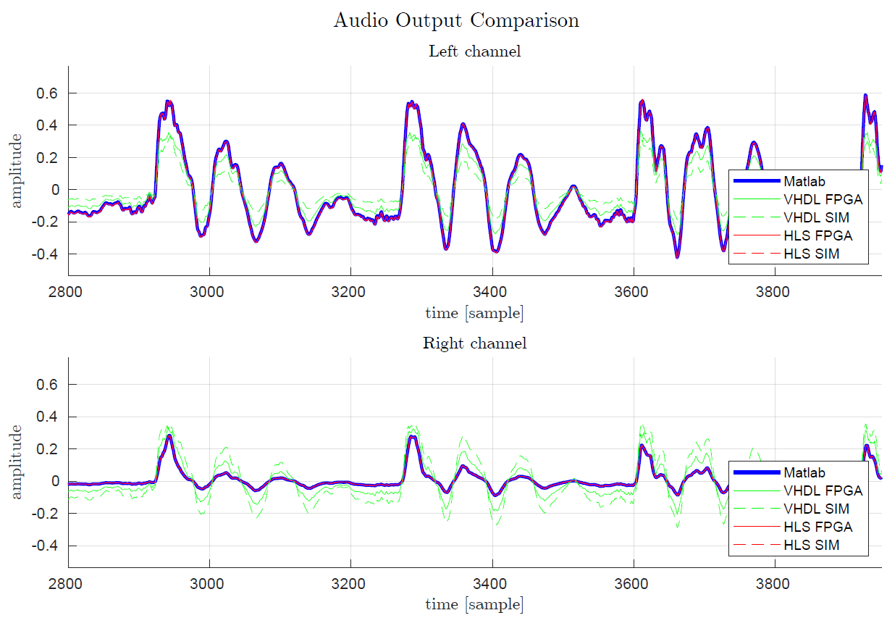
results
Audio Output
Matlab model
HLS
Testbench
Hardware
VHDL
Testbench
Hardware

Slide 13
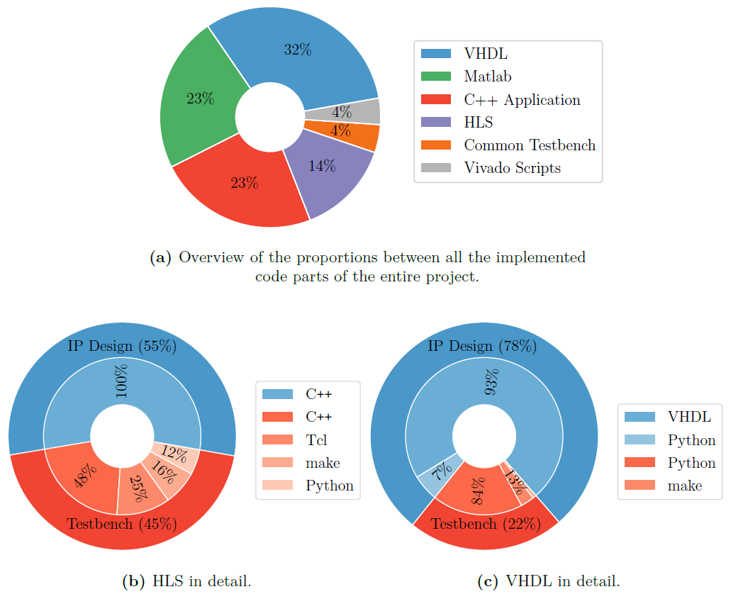
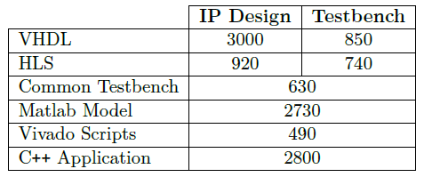
results
Code Development
Lines of Code

Slide 14
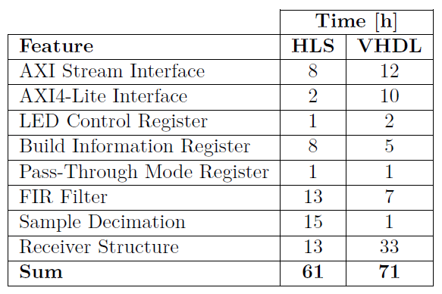
results
Code Development
Implementation time
Direct comparison per feature

Slide 15
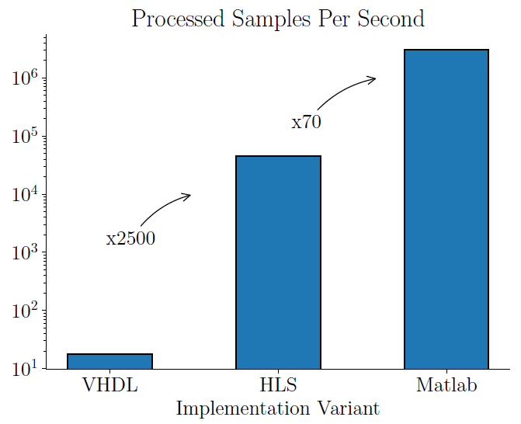
results
Simulation Speed
Comparison of multiple variants

Slide 16
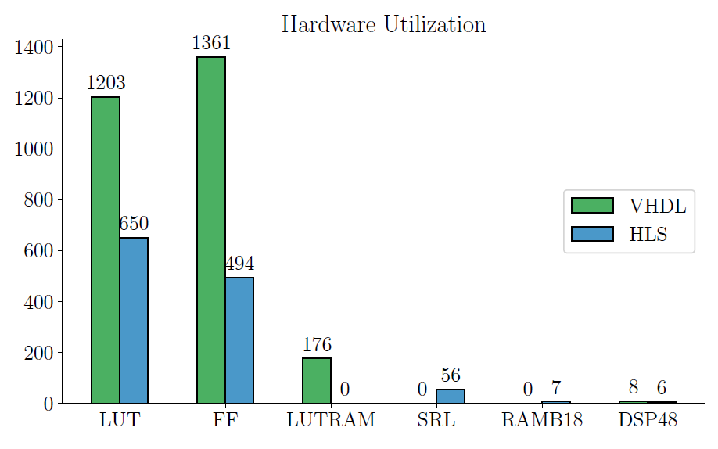
results
Hardware Utilization
VHDL versus HLS

Slide 17
Conclusion
System Design
Includes system model, development, verification and integration
Is generic and can be re-used for future DSP projects
Implementation
Working successfully with SD card data
Fully integrated solution for VHDL and HLS
Comparison of VHDL and HLS
HLS is a convenient implementation method
HLS is efficient in resource utilization
Software development can be done in an early stage
Considering HLS as first choice for future projects
System Design
Implementation
Comparison of VHDL and HLS

Slide 18
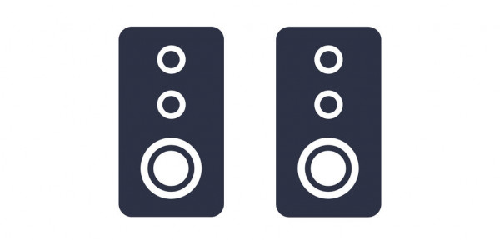
Any questions?
Thank you.

