Slide 1


UVVM Tutorial
UVVMTM
A brief introduction to UVVM.
Michael Wurm © 2020

Slide 2

UVVM Library
- Overview
UVVM
- Universal VHDL Verification Methodology
- VHDL only
- Open Source
Utility Library
- logging
- alert handling
- result checking
- sufficient for simple testbenches
VVC Framework
- advanced features
- better overview
- readability and maintainability
- support for CRV and coverage
UVVMTM

Slide 3
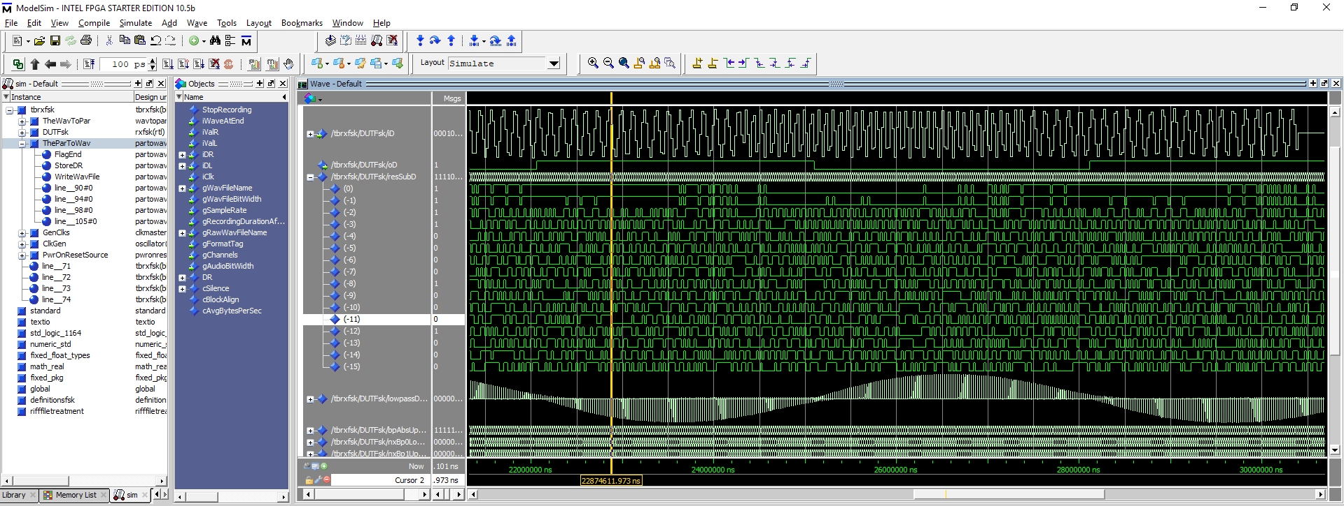
UVVM Library
- Motivation
?
UVVMTM

Slide 4
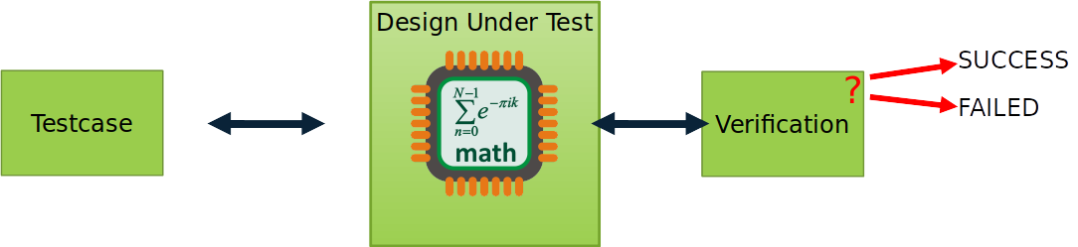
UVVM Library
- Motivation
UVVMTM

Slide 5
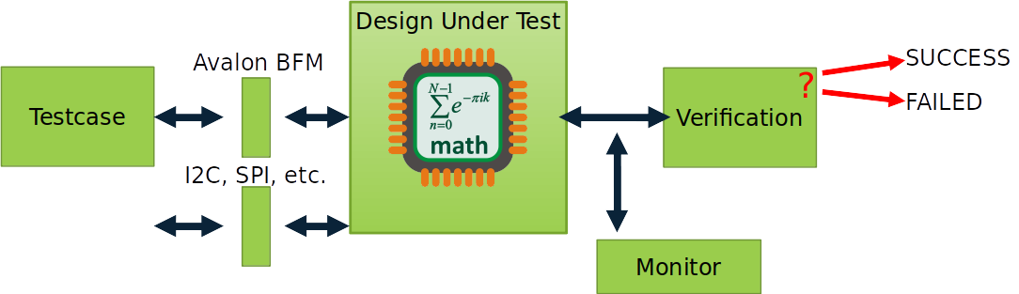
UVVM Library
- Motivation
UVVMTM

Slide 6
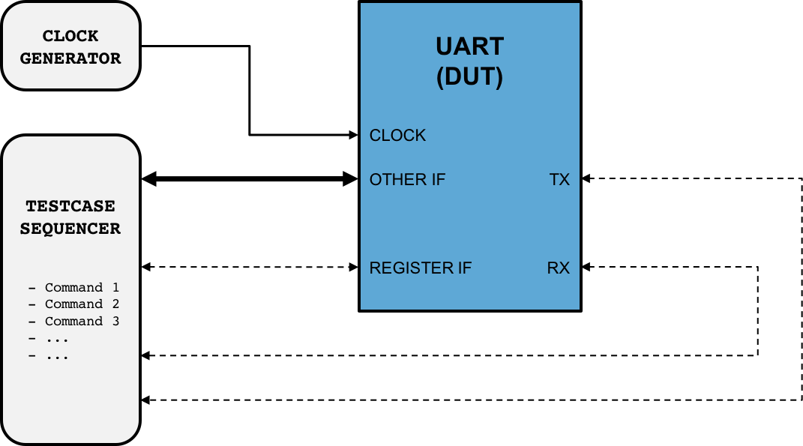
UVVM Library
- The UVVM way
UVVMTM

Slide 7
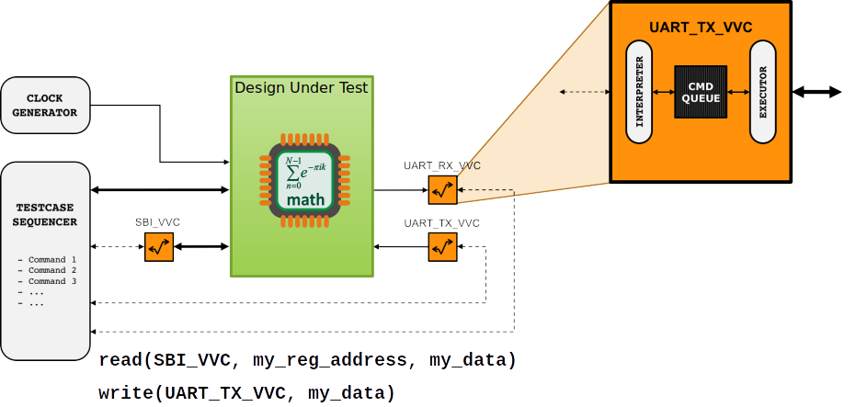
UVVM Library
- The UVVM way
UVVMTM

Slide 8
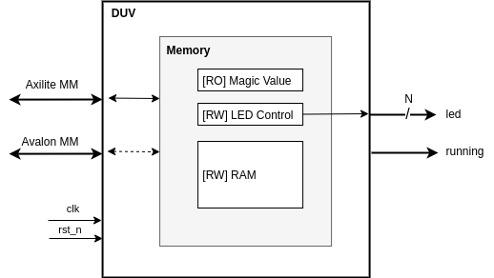
The Tutorial
- Device Under Verification
UVVMTM

Slide 9
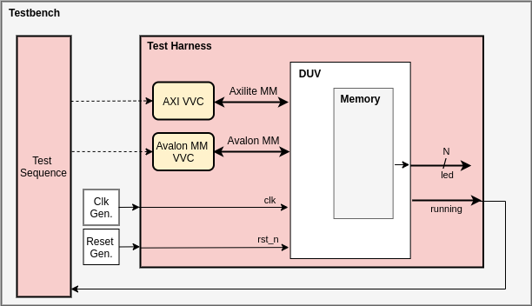
The Tutorial
- Testbench Architecture
UVVMTM

Slide 10

The Tutorial
- Hands On !
Please now open the tutorial PDF.
You will find it in the repository* under doc/the-tutorial.pdf
* https://github.com/wurmmi/uvvm-tutorial
UVVMTM

