Slide 1
ClipSAM: CLIP and SAMCollaboration for Zero-Shot Anomaly Segmentation
20250922

Slide 2
0.Abstract
either CLIP-based or SAM-based ZSAS methods still suffer from non-negligible key drawbacks：
CLIP primarily focuses on global feature alignment across different inputs, leading to imprecise segmentation of local anomalous parts;
SAM tends to generate numerous redundant masks without proper prompt constraints, resulting in complex post-processing requirements.
In conclusion, CLIP focuses on global features and SAM generate to much redundant masks.

Slide 3
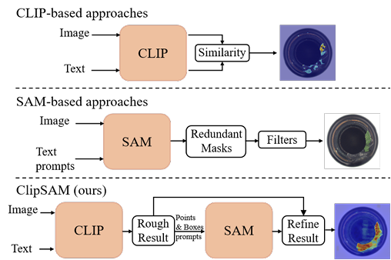
0.Abstract
The ClipSAM firstly uses clip to locating anomaly localization and uses SAM to refine the anomaly segmentation results by introduce a Unified Multiscale Cross-modal Interaction (UMCI) for interacting language with visual features at multiple scales.
what more, we design a novel Multi-level Mask Refinement (MMR) module. MMR module use positional information as prompts to query SAM’s masks and merge them.

Slide 4
1.Introduction
observation:
(1).CLIP has a strong semantic understanding capability. but it is a global semantic.
(2).SAM has a strong segmentation capability and can accept diverse prompts, including points, boxes, and text prompts. but the ambiguous prompts lead to the generation of redundant masks.

Slide 5
1.Introduction
base on the observations – we design a two-stage framework
(1).In the first stage, we employ CLIP for rough segmentation. In this part, we design a UMCI model to fusion multi-model features at different level.
(2).In the second stage, we use CLIP’s localization information to guide SAM for segmentation refinement. In this part, we propose a MMR module: use CLIP localization information to generate precise masks, and then fuse it with CLIP result.

Slide 6
2.Related Work
nothing to tell
2.1 Zero-shot Anomaly Segmentation
2.2 Foundation Models
2.3 Cross-modal Interaction

Slide 7
2.Related Work
nothing to tell
2.1 Zero-shot Anomaly Segmentation
2.2 Foundation Models
2.3 Cross-modal Interaction

Slide 8
2.Related Work
nothing to tell
2.1 Zero-shot Anomaly Segmentation
2.2 Foundation Models
2.3 Cross-modal Interaction

Slide 9
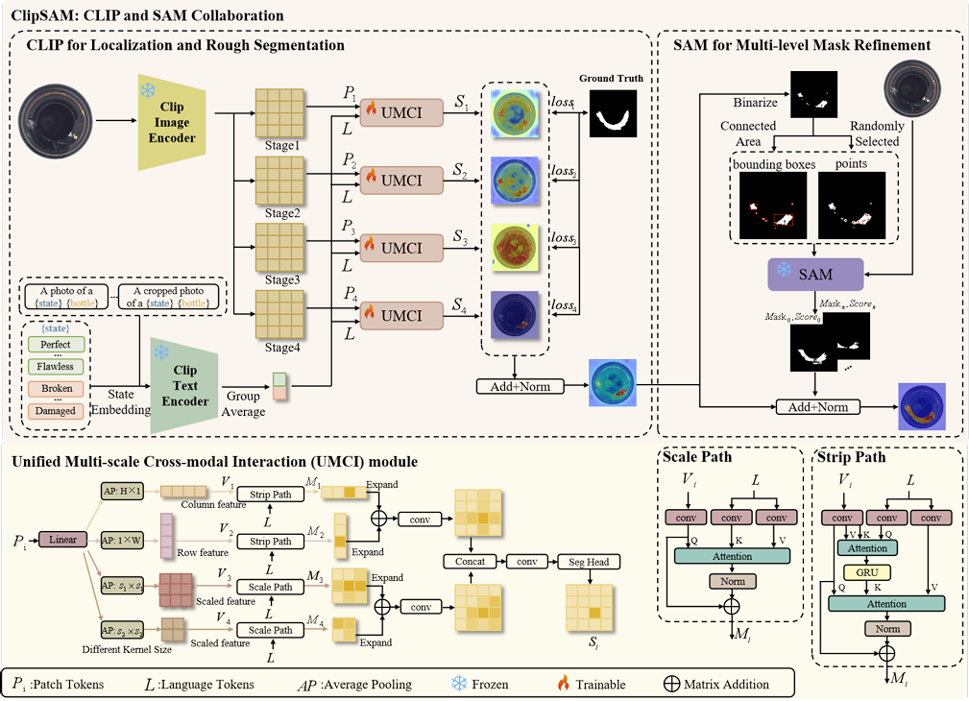
3.Methodology
we use CLIP for rough segmentation and use it to refine the segmentation result of SAM.
3.1 CLIP and SAM Collaboration
3.2 Unified Multi-scale Cross-modal Interaction
3.3 Multi-level Mask Refinement
3.4 Objective Function

Slide 10
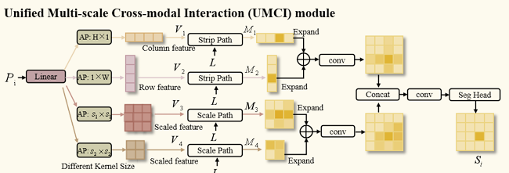
3.Methodology
3.1 CLIP and SAM Collaboration
3.2 Unified Multi-scale Cross-modal Interaction
3.3 Multi-level Mask Refinement
3.4 Objective Function

Slide 11
3.Methodology
UMCI consists of two path: Strip Paths and Scale Path.
(1).Strip Paths captures both row- and column-level features.
(2).Scale Paths grasps the image’s global features of various scales.
3.1 CLIP and SAM Collaboration
3.2 Unified Multi-scale Cross-modal Interaction
3.3 Multi-level Mask Refinement
3.4 Objective Function

Slide 12
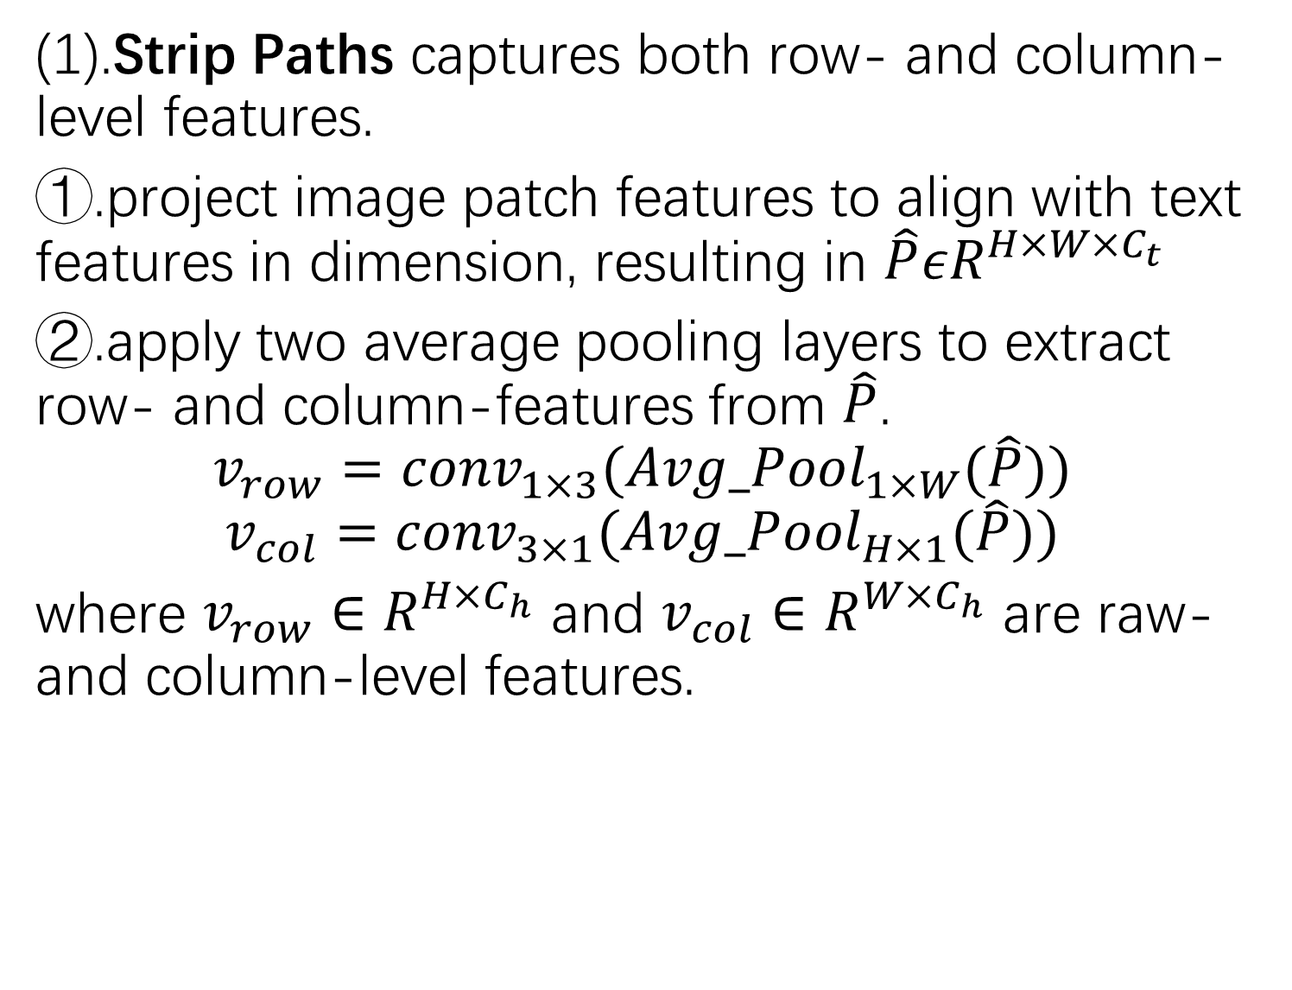
3.Methodology
(1).Strip Paths captures both row- and column-level features.
①.project image patch features to align with text features in dimension, resulting in $\hat{P}εR^{H×W×C_{t}}$
②.apply two average pooling layers to extract row- and column-features from $\hat{P}$.
$$v_{row}={conv}_{1×3}({Avg_Pool}_{1×W}(\hat{P}))$$
$$v_{col}={conv}_{3×1}({Avg_Pool}_{H×1}(\hat{P}))$$
where $v_{row}∈R^{H×C_{h}}$ and $v_{col}∈R^{W×C_{h}}$ are raw- and column-level features.
3.1 CLIP and SAM Collaboration
3.2 Unified Multi-scale Cross-modal Interaction
3.3 Multi-level Mask Refinement
3.4 Objective Function

