Slide 1
AnomalyCLIP
20250904

Slide 2
0.Abstract
The key insight of AnomalyCLIP is to learn object-agnostic text prompts that capture generic normality or abnormality in an image regardless of its foreground objects.

Slide 3
1.Introduce
the main works:
first, devises a simple yet universally-effective learnable prompt template for the two general classes – normal and abnormality
second, utilizes both image-level and pixel-level loss functions to learn the generic normality and abnormality

Slide 4
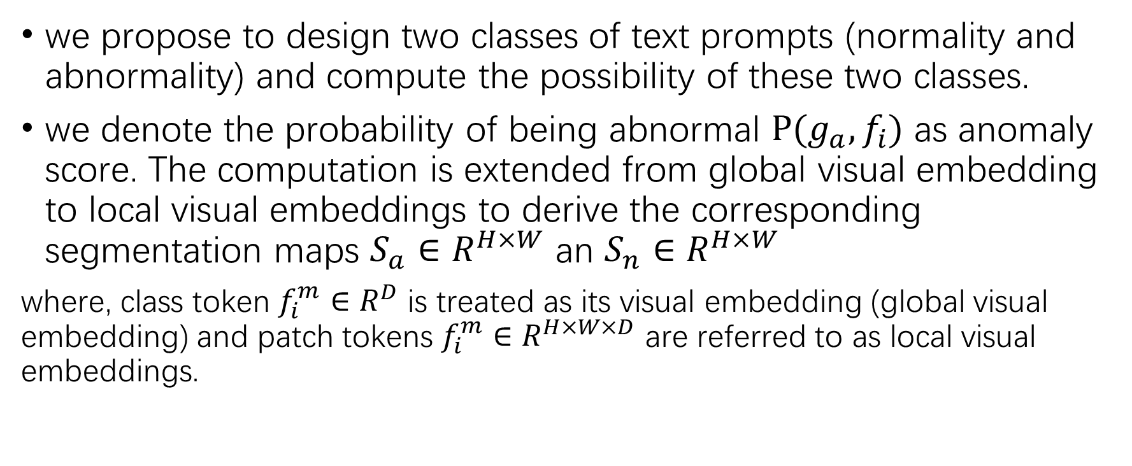
2.Preliminary
we propose to design two classes of text prompts (normality and abnormality) and compute the possibility of these two classes.
we denote the probability of being abnormal $P(g_{a},f_{i})$ as anomaly score. The computation is extended from global visual embedding to local visual embeddings to derive the corresponding segmentation maps $S_{a}∈R^{H×W}$ an $S_{n}∈R^{H×W}$
where, class token $f_{i}^{m}∈R^{D}$ is treated as its visual embedding (global visual embedding) and patch tokens $f_{i}^{m}∈R^{H×W×D}$ are referred to as local visual embeddings.

Slide 5
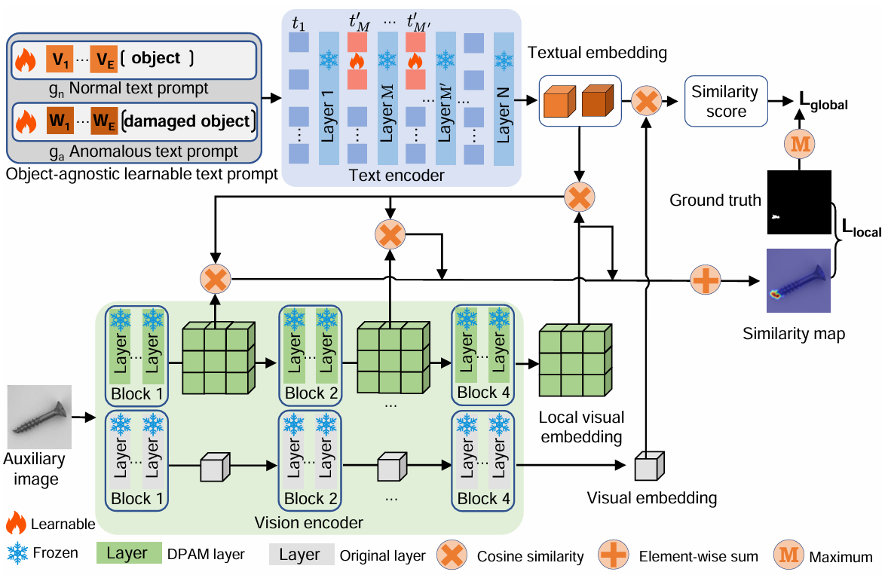
3.Anomaly CLIP: object-agnostic prompt learning 3.1 approach overview

Slide 6
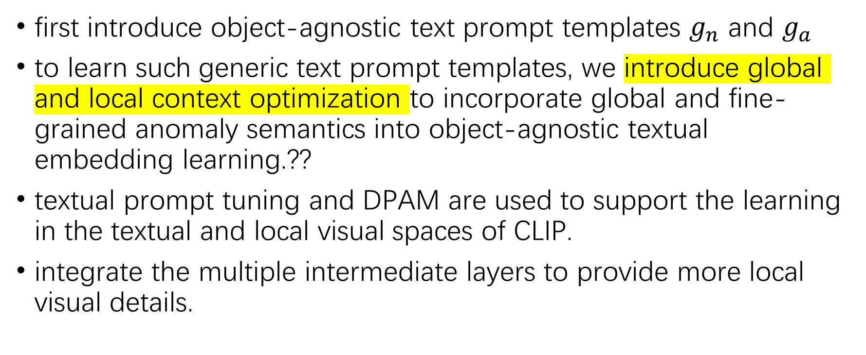
3.Anomaly CLIP: object-agnostic prompt learning 3.1 approach overview
first introduce object-agnostic text prompt templates $g_{n}$ and $g_{a}$
to learn such generic text prompt templates, we introduce global and local context optimization to incorporate global and fine-grained anomaly semantics into object-agnostic textual embedding learning.??
textual prompt tuning and DPAM are used to support the learning in the textual and local visual spaces of CLIP.
integrate the multiple intermediate layers to provide more local visual details.

Slide 7
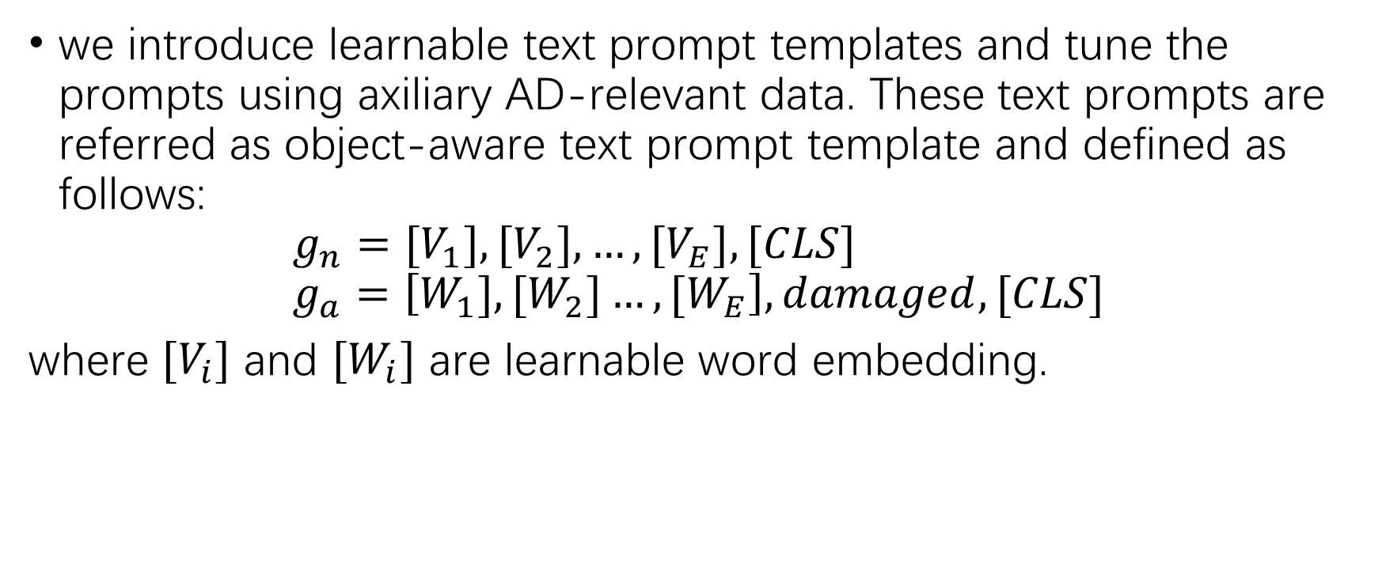
3.Anomaly CLIP: object-agnostic prompt learning 3.2 object-agnostic text prompt design
we introduce learnable text prompt templates and tune the prompts using axiliary AD-relevant data. These text prompts are referred as object-aware text prompt template and defined as follows:
$$g_{n}=[V_{1}],{[V}_{2}],…,[V_{E}], [CLS] \\ g_{a}=\left[W_{1}],{[W}_{2}]…,{[W}_{E}\right],damaged,[CLS]$$
where ${[V}_{i}]$ and ${[W}_{i}]$ are learnable word embedding.

Slide 8
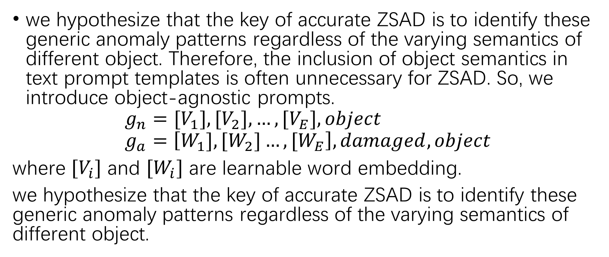
3.Anomaly CLIP: object-agnostic prompt learning 3.2 object-agnostic text prompt design
we hypothesize that the key of accurate ZSAD is to identify these generic anomaly patterns regardless of the varying semantics of different object. Therefore, the inclusion of object semantics in text prompt templates is often unnecessary for ZSAD. So, we introduce object-agnostic prompts.
$$g_{n}=[V_{1}],{[V}_{2}],…,[V_{E}], object \\ g_{a}=\left[W_{1}],{[W}_{2}]…,{[W}_{E}\right],damaged,object$$
where ${[V}_{i}]$ and ${[W}_{i}]$ are learnable word embedding.
we hypothesize that the key of accurate ZSAD is to identify these generic anomaly patterns regardless of the varying semantics of different object.

Slide 9
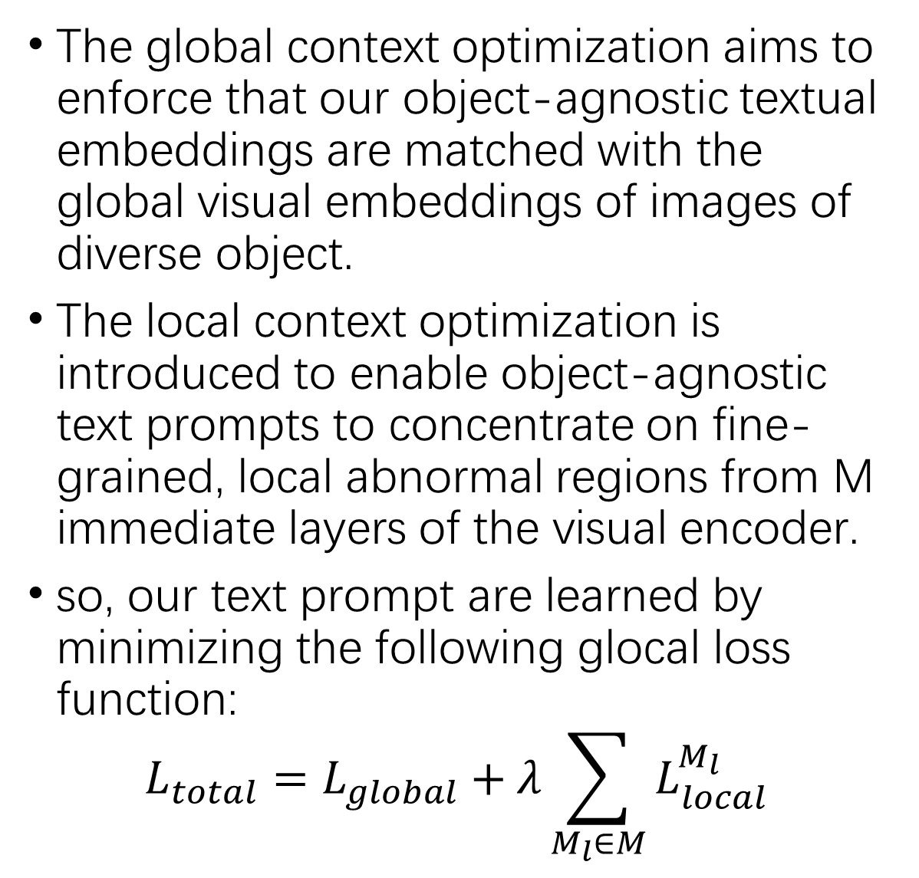
3.Anomaly CLIP: object-agnostic prompt learning 3.3 learning generic abnormality and normality prompts
The global context optimization aims to enforce that our object-agnostic textual embeddings are matched with the global visual embeddings of images of diverse object.
The local context optimization is introduced to enable object-agnostic text prompts to concentrate on fine-grained, local abnormal regions from M immediate layers of the visual encoder.
so, our text prompt are learned by minimizing the following glocal loss function:
$$L_{total}=L_{global}+λ\sum_{M_{l}∈M}{L_{local}^{M_{l}}}$$
1.Glocal Context optimization
2.refinement of the textual space
3.refinement of the local visual space
4.training and inference

Slide 10
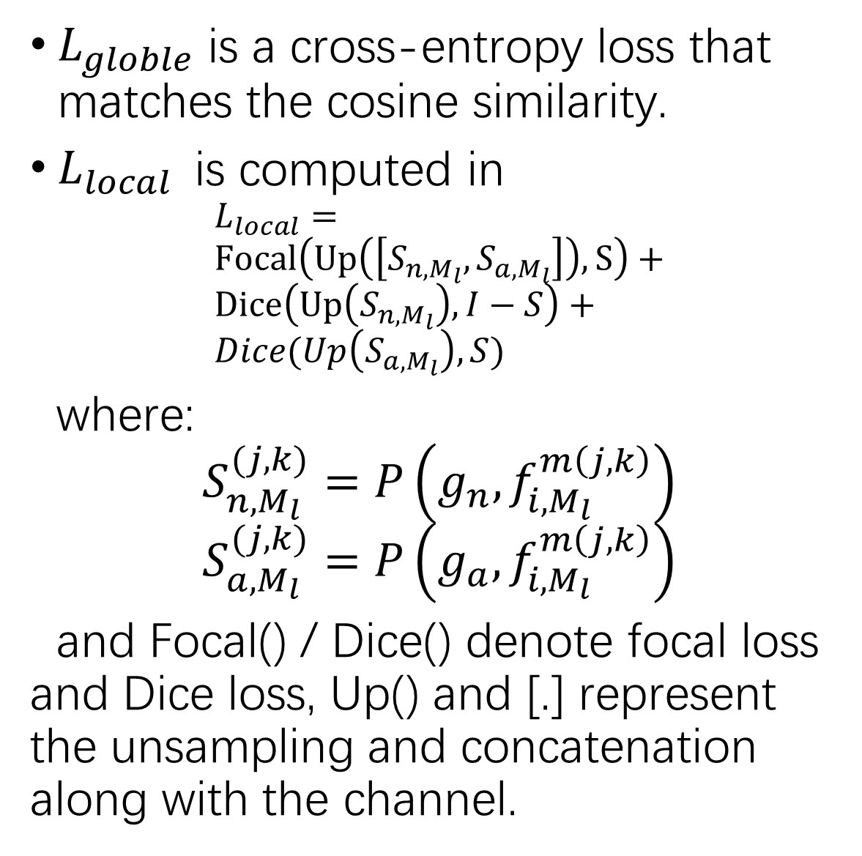
3.Anomaly CLIP: object-agnostic prompt learning 3.3 learning generic abnormality and normality prompts
$L_{globle}$ is a cross-entropy loss that matches the cosine similarity.
$L_{local}$is computed in
$$L_{local}= \\ Focal\left(Up\left(\left[S_{n, M_{l}}, S_{a, M_{l}}\right]\right), S\right)+ \\ Dice\left(Up\left(S_{n,M_{l}}\right), I−S\right)+ \\ Dice(Up\left(S_{a,M_{l}}\right), S)$$
where:
$$S_{n, M_{l}}^{(j,k)}=P\left(g_{n}, f_{i, M_{l}}^{m\left(j,k\right)}\right) \\ S_{a, M_{l}}^{(j,k)}=P\left(g_{a}, f_{i, M_{l}}^{m\left(j,k\right)}\right)$$
and Focal() / Dice() denote focal loss and Dice loss, Up() and [.] represent the unsampling and concatenation along with the channel.
1.Glocal Context optimization
2.refinement of the textual space
3.refinement of the local visual space
4.training and inference

Slide 11
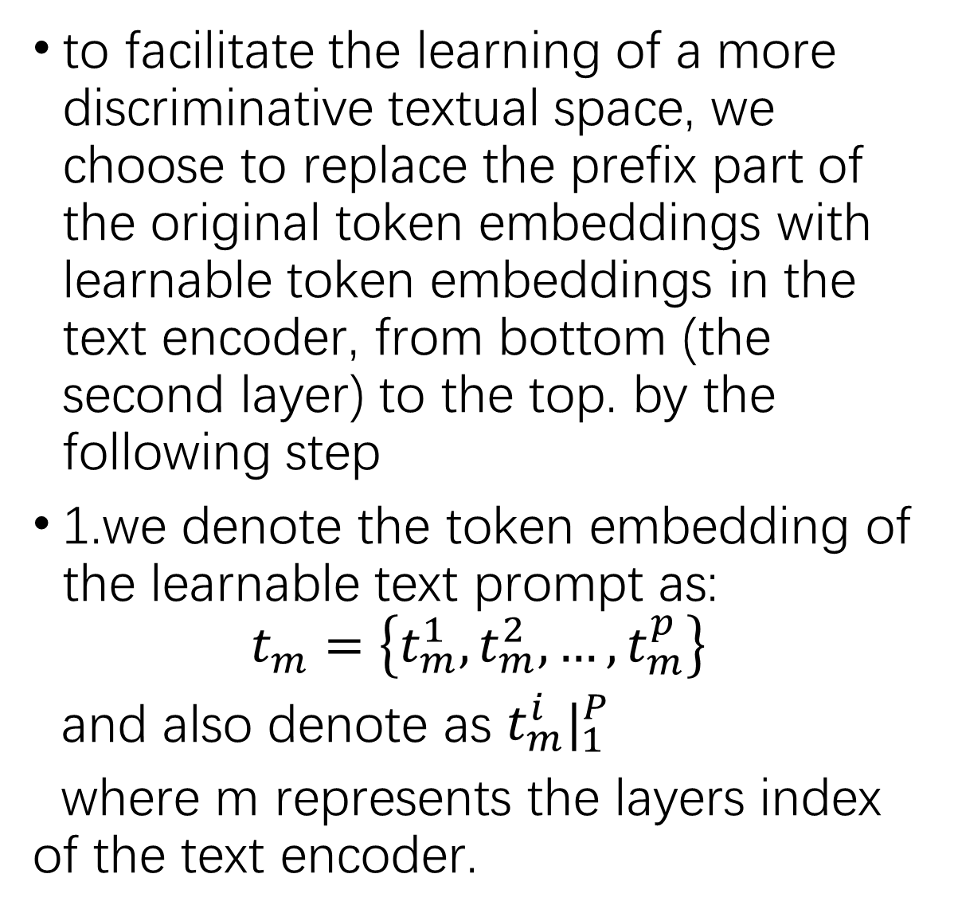
3.Anomaly CLIP: object-agnostic prompt learning 3.3 learning generic abnormality and normality prompts
to facilitate the learning of a more discriminative textual space, we choose to replace the prefix part of the original token embeddings with learnable token embeddings in the text encoder, from bottom (the second layer) to the top. by the following step
1.we denote the token embedding of the learnable text prompt as:
$$t_{m}=\left\{t_{m}^{1}, t_{m}^{2}, …,t_{m}^{p}\right\}$$
and also denote as $t_{m}^{i}|_{1}^{P}$
where m represents the layers index of the text encoder.
1.Glocal Context optimization
2.refinement of the textual space
3.refinement of the local visual space
4.training and inference

Slide 12
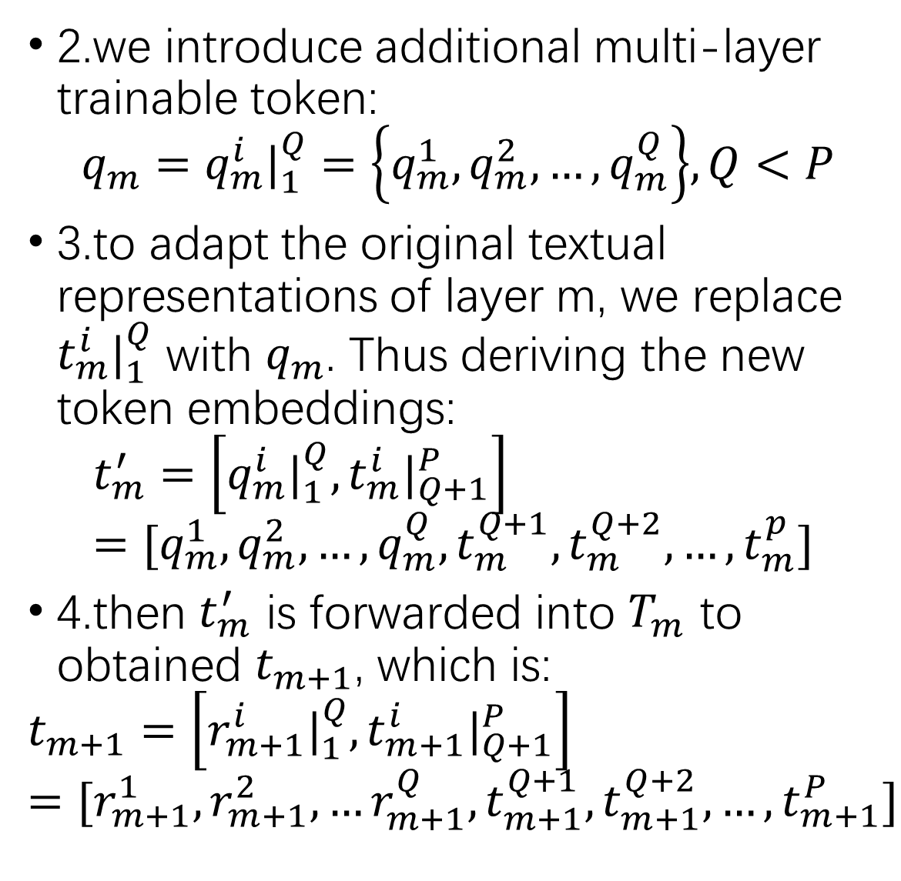
3.Anomaly CLIP: object-agnostic prompt learning 3.3 learning generic abnormality and normality prompts
2.we introduce additional multi-layer trainable token:
$$q_{m}=q_{m}^{i}|_{1}^{Q}=\left\{q_{m}^{1}, q_{m}^{2}, …,q_{m}^{Q}\right\}, Q<P$$
3.to adapt the original textual representations of layer m, we replace $t_{m}^{i}|_{1}^{Q}$ with $q_{m}$. Thus deriving the new token embeddings:
$$t_{m}^{′}=\left[q_{m}^{i}|_{1}^{Q}, t_{m}^{i}|_{Q+1}^{P}\right] \\ =[q_{m}^{1}, q_{m}^{2}, …,q_{m}^{Q},t_{m}^{Q+1}, t_{m}^{Q+2}, …,t_{m}^{p}]$$
4.then $t_{m}^{′}$ is forwarded into $T_{m}$ to obtained $t_{m+1}$, which is:
$$t_{m+1}=\left[r_{m+1}^{i}|_{1}^{Q},t_{m+1}^{i}|_{Q+1}^{P}\right] \\ =[r_{m+1}^{1},r_{m+1}^{2},…r_{m+1}^{Q},t_{m+1}^{Q+1},t_{m+1}^{Q+2},…,t_{m+1}^{P}]$$
1.Glocal Context optimization
2.refinement of the textual space
3.refinement of the local visual space
4.training and inference

Slide 13
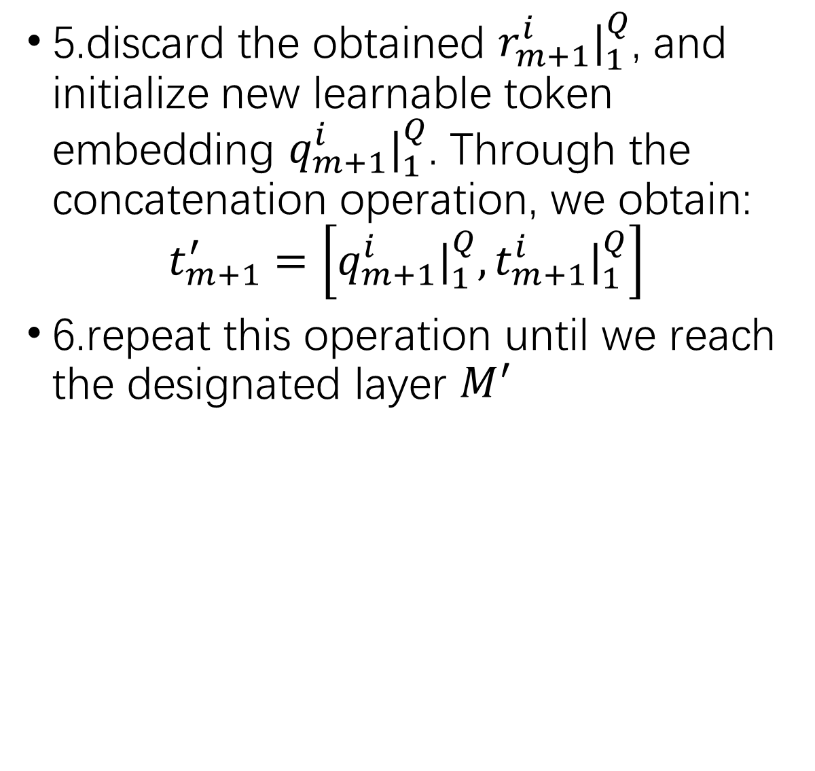
3.Anomaly CLIP: object-agnostic prompt learning 3.3 learning generic abnormality and normality prompts
5.discard the obtained $r_{m+1}^{i}|_{1}^{Q}$, and initialize new learnable token embedding $q_{m+1}^{i}|_{1}^{Q}$. Through the concatenation operation, we obtain:
$$t_{m+1}^{′}=\left[q_{m+1}^{i}|_{1}^{Q},t_{m+1}^{i}|_{1}^{Q}\right]$$
6.repeat this operation until we reach the designated layer $M_{ }^{′}$
1.Glocal Context optimization
2.refinement of the textual space
3.refinement of the local visual space
4.training and inference

Slide 14
3.Anomaly CLIP: object-agnostic prompt learning 3.3 learning generic abnormality and normality prompts
we found empirically that a diagonally prominent attention map helps reduce the disturbance from other tokens, leading to improved local visual semantics.
Therefore we propose a mechanism call Diagonally Prominent Attention Map to refine the local visual space, with the visual encoder kept frozen during training. To this end, we replace the original Q-K attention in the visual encoder with diagonally prominent attention, such as Q-Q, K-K, V-V.
1.Glocal Context optimization
2.refinement of the textual space
3.refinement of the local visual space
4.training and inference

Slide 15
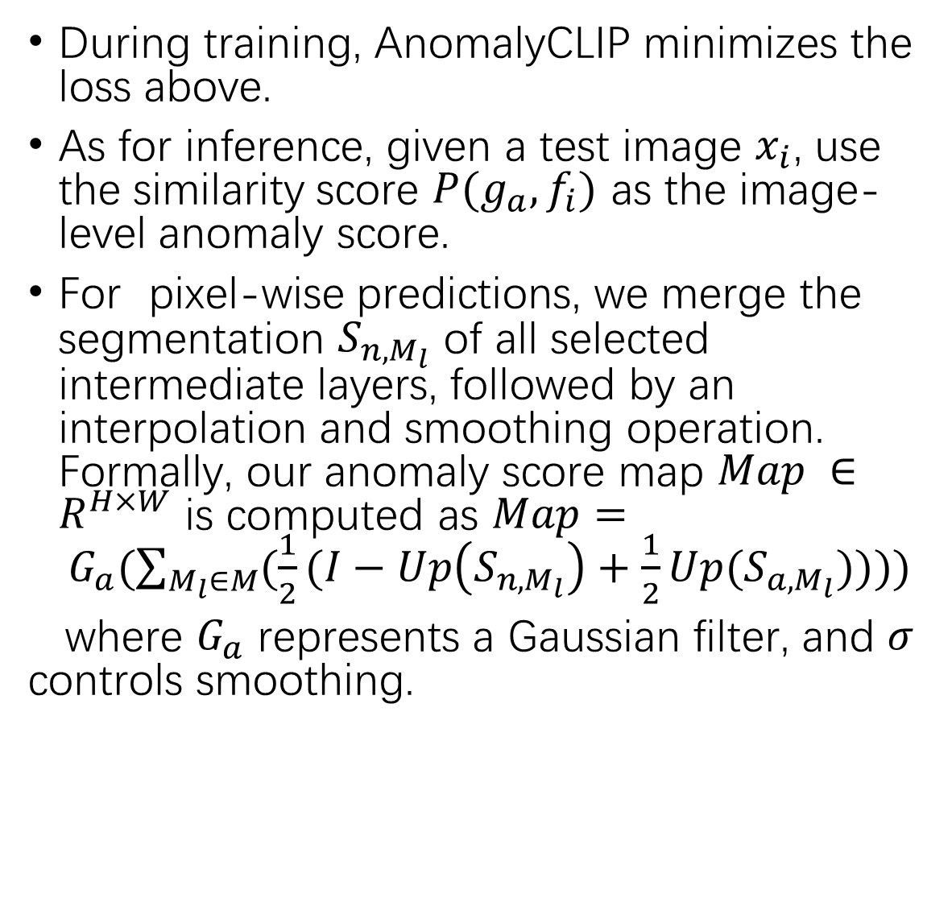
3.Anomaly CLIP: object-agnostic prompt learning 3.3 learning generic abnormality and normality prompts
During training, AnomalyCLIP minimizes the loss above.
As for inference, given a test image $x_{i}$, use the similarity score $P(g_{a}, f_{i})$ as the image-level anomaly score.
For pixel-wise predictions, we merge the segmentation $S_{n, M_{l}}$ of all selected intermediate layers, followed by an interpolation and smoothing operation. Formally, our anomaly score map $Map ∈R^{H×W}$ is computed as $Map= G_{a}(\sum_{M_{l}∈M}{(\frac{1}{2}(I−Up\left(S_{n,M_{l}}\right)+\frac{1}{2}Up(S_{a,M_{l}})))})$
where $G_{a}$ represents a Gaussian filter, and $σ$ controls smoothing.
1.Glocal Context optimization
2.refinement of the textual space
3.refinement of the local visual space
4.training and inference

Slide 16
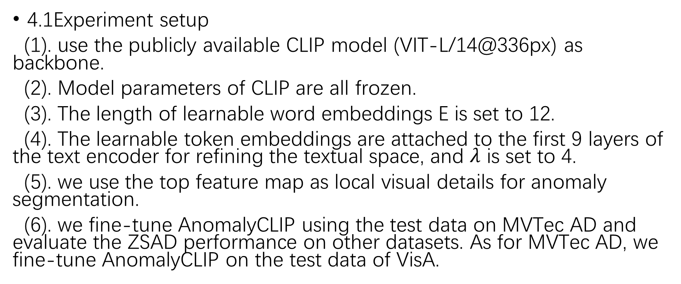
4.Experiments
4.1Experiment setup
(1). use the publicly available CLIP model (VIT-L/14@336px) as backbone.
(2). Model parameters of CLIP are all frozen.
(3). The length of learnable word embeddings E is set to 12.
(4). The learnable token embeddings are attached to the first 9 layers of the text encoder for refining the textual space, and $λ$ is set to 4.
(5). we use the top feature map as local visual details for anomaly segmentation.
(6). we fine-tune AnomalyCLIP using the test data on MVTec AD and evaluate the ZSAD performance on other datasets. As for MVTec AD, we fine-tune AnomalyCLIP on the test data of VisA.

Slide 17
4.Experiments
4.2 Main Results
beautiful result…

Slide 18
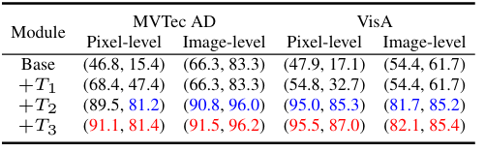
4.Experiments 4.3 Ablation Study
DPAM(T1)
object-agnostic text prompts (T2),
learnable tokens in text encoders(T3).
1.Module ablation:
2.Context optimization
3.DPAM strategy ablation

Slide 19
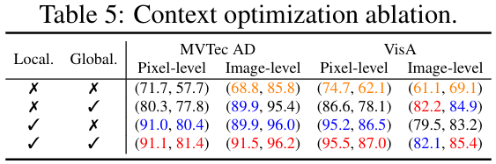
4.Experiments 4.3 Ablation Study
the object-agnostic prompt learning is the most effective module, and it is driven by our glocal context optimization
1.Module ablation:
2.Context optimization
3.DPAM strategy ablation

Slide 20
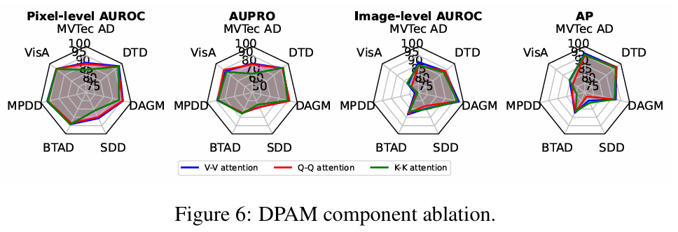
4.Experiments 4.3 Ablation Study
AnomalyCLIP use V-V self-attention by default. Here we study the effectiveness of using two other DPAM strategies, including Q-Q and K-K self-attention.
1.Module ablation:
2.Context optimization
3.DPAM strategy ablation

Slide 21
代码
# AnomalyCLIP.py:VisionTransformer
def DAPM_replace(self, DPAM_layer):
"""
这个代码的主要功能：
使用自定义的atten去替换transformer中的atten
总共替换DPAM_layer层
"""
if DPAM_layer is not None:
for i in range(1, DPAM_layer):
# 使用了自己的Attention机制（最后一层的Attention保存在self.attn中）
self.attn = Attention(self.embed_dim, self.embed_dim, self.num_heads, True)
# 将自定义Attention中的qkv权重，改成预训练的权重
self.attn.qkv.weight.data = self.transformer.resblocks[-i].attn.in_proj_weight.clone()
self.attn.qkv.bias.data = self.transformer.resblocks[-i].attn.in_proj_bias.clone()
self.attn.proj.weight.data = self.transformer.resblocks[-i].attn.out_proj.weight.clone()
self.attn.proj.bias.data = self.transformer.resblocks[-i].attn.out_proj.bias.clone()
# 使用自定义的V-V,atten替换原本transformer中的atten
self.transformer.resblocks[-i].attn = self.attn
1.DPAM
2. object-agnostic text prompts
3. learnable tokens in text encoders

Slide 22
代码
# （prompt_ensemble.py:AnomalyCLIP_PromptLearner: __init__）
# 重点1：生成可学习的上下文嵌入 和 文本前缀
# 主要生成 初始化文本/随机文本 的embeding 和 提示文本前缀（随机文本用XXX表示）
if ctx_init_pos != "" and ctx_init_neg != "":
token_pos = tokenize(ctx_init_pos)
token_neg = tokenize(ctx_init_neg)
emb_pos = clip_model.token_embedding(token_pos).type(dtype) # [1, Lp, ctx_dim]
emb_neg = clip_model.token_embedding(token_neg).type(dtype) # [1, Ln, ctx_dim]
# 下面这个4个即目标变量
ctx_emb_pos = emb_pos[0, 1:1+n_ctx_pos, :] # 去掉SOS/EOS
ctx_emb_neg = emb_neg[0, 1:1+n_ctx_neg, :]
prompt_prefix_pos = ctx_init_pos
prompt_prefix_neg = ctx_init_neg
else:
# 随机初始化（类无关）
ctx_emb_pos = empty([n_cls, normal_num, n_ctx_pos, ctx_dim], dtype).normal_(0, 0.02)
ctx_emb_neg = empty([n_cls, anormaly_num, n_ctx_neg, ctx_dim], dtype).normal_(0, 0.02)
prompt_prefix_pos = join(["X"]*n_ctx_pos, " ")
prompt_prefix_neg = join(["X"]*n_ctx_neg, " ")
# 注册为可学习参数
self.ctx_emb_pos = Parameter(ctx_emb_pos)
self.ctx_emb_neg = Parameter(ctx_emb_neg)
1.DPAM
2. object-agnostic text prompts
3. learnable tokens in text encoders

Slide 23
代码
# 重点2：构造正/负提示句 -> tokenize -> 取前/后缀 embedding -> 保存 token
classnames = [replace(name, "_", " ") for name in classnames]
prompts_pos = [f"{prompt_prefix_pos} {tpl.format(name)}." for tpl in state_normal_list for name in classnames]
prompts_neg = [f"{prompt_prefix_neg} {tpl.format(name)}." for tpl in state_anomaly_list for name in classnames]
tok_pos = concat([tokenize(p) for p in prompts_pos]) # [normal_num*n_cls, L]
tok_neg = concat([tokenize(p) for p in prompts_neg]) # [anormaly_num*n_cls, L]
with no_grad:
emb_pos = clip_model.token_embedding(tok_pos).type(dtype) # [normal_num*n_cls, L, ctx_dim]
emb_neg = clip_model.token_embedding(tok_neg).type(dtype) # [anormaly_num*n_cls, L, ctx_dim]
# 重排为 [n_cls, normal/anomaly_num, L, ctx_dim]
emb_pos = permute(reshape(emb_pos, [normal_num, n_cls, L, ctx_dim]), [1, 0, 2, 3])
emb_neg = permute(reshape(emb_neg, [anormaly_num, n_cls, L, ctx_dim]), [1, 0, 2, 3])
# 注册前缀/后缀（CLIP要求）
register_buffer("token_prefix_pos", emb_pos[:, :, :1, :]) # SOS
register_buffer("token_suffix_pos", emb_pos[:, :, 1+n_ctx_pos:, :]) # 上下文后的余部
register_buffer("token_prefix_neg", emb_neg[:, :, :1, :])
register_buffer("token_suffix_neg", emb_neg[:, :, 1+n_ctx_neg:, :])
# 保存 token 序列（重排为 [n_cls, normal/anomaly_num, L]）
tok_pos = permute(reshape(tok_pos, [normal_num, n_cls, L]), [1, 0, 2])
tok_neg = permute(reshape(tok_neg, [anormaly_num, n_cls, L]), [1, 0, 2])
register_buffer("tokenized_prompts_pos", tok_pos)
register_buffer("tokenized_prompts_neg", tok_neg)
1.DPAM
2. object-agnostic text prompts
3. learnable tokens in text encoders

Slide 24
代码
# -- 重点2 --
# 生成前9层的可学习文本（其中第0层为普通的CLIP提示词，即上面生成的提示词）
self.compound_prompts_depth = design_details["learnabel_text_embedding_depth"]
# 前9层，每层生成4个随机可学习嵌入，统一保存在self.compound_propts_text中
# 每次增加4个单词，self.text_encoder_n_ctx=4
# 每层4个可学习嵌入，组成复合提示词compound_prompts_text
# 注意这个变量名叫xx_text，但其实是embedding
self.compound_prompts_emb = nn.ParameterList([nn.Parameter(torch.empty(self.text_encoder_n_ctx, ctx_dim))
for _ in range(self.compound_prompts_depth - 1)])
# 打印每一层提示词的形状，并标准化
for single_para in self.compound_prompts_emb:
print("single_para", single_para.shape)
nn.init.normal_(single_para, std=0.02)
# 生成一个简单的映射层，用于将词嵌入映射到联合空间, 比如从512->896
single_layer = nn.Linear(ctx_dim, 896)
# 将映射层复制到所有复合提示层，所有的复合提示句子都要映射到联合空间
self.compound_prompt_projections = _get_clones(single_layer, self.compound_prompts_depth - 1)
1.DPAM
2. object-agnostic text prompts
3. learnable tokens in text encoders

Slide 25
代码
for batch in train_dataloader:
image = batch['img'].to(device) # [B, C, H, W]; torch.Size([4, 3, 518, 518])
label = batch['anomaly'].long().to(device) # [B]，0/1; torch.Size([4])
# 图像侧：冻结图像侧特征抽取（含 DPAM）
with no_grad:
image_feats, _ = model.encode_image(
image,
features_list=args.features_list,
DPAM_layer=20
) # [B, D]; torch.Size([4, 768])
image_feats = l2norm(image_feats, dim=-1)
# 文本侧：生成提示 -> 编码为两类特征（normal/abnormal）
# prompts: torch.Size([2, 77, 768])
# tok_prompts: torch.Size([2, 77])
# comp_text[0]: torch.Size([4, 768]); len(com_text) = 8
prompts, tok_prompts, comp_text = prompt_learner(cls_id=None)
text_feats = model.encode_text_learn(prompts, tok_prompts, comp_text).float() # text_feats: torch.Size([2, 768])
text_feats = stack(chunk(text_feats, chunks=2, dim=0), dim=1) # [B, 2, D]; torch.Size([1, 2, 768])
text_feats = l2norm(text_feats, dim=-1)
# 余弦相似度（归一化后点积），温度缩放
logits = (image_feats.unsqueeze(1) @ transpose(text_feats, (0,2,1))) # [B,1,2]; torch.Size([4, 1, 2])
logits = logits[:, 0, :] / 0.07 # [B,2]; torch.Size([4, 2])
image_loss = cross_entropy(logits, label) # 图像级交叉熵损失, 单一值：比如 0.8
训练过程
1.图像级损失计算
2.像素级损失计算

Slide 26
代码
for batch in train_dataloader:
# 1) 取数据与二值化掩码
image = batch['img'].to(device) # [B,C,H,W] ;[4, 3, 518, 518]
gt = binarize(batch['img_mask'].squeeze(), 0.5).to(device) # [B,H,W], {0,1} ;[4, 518, 518]
# 2) 冻结提取图像与patch特征（含DPAM）
with no_grad:
# patch_feats_list[0].shape=[4, 1370, 768]; len = 1
_, patch_feats_list = model.encode_image(image, args.features_list, DPAM_layer=20)
# 3) 文本特征（正/负两类），并L2归一化
prompts, tok_prompts, comp_text = prompt_learner(cls_id=None)
text_feats = model.encode_text_learn(prompts, tok_prompts, comp_text).float() # [B, D] ;[2, 768]
text_feats = stack(chunk(text_feats, chunks=2, dim=0), dim=1) # [B, 2, D] ;[1, 2, 768]
text_feats = l2norm(text_feats, dim=-1)
# 4) 逐层计算patch相似图（从指定层开始），收集为列表
sim_maps = []
for idx, pfeat in enumerate(patch_feats_list):
if idx < args.feature_map_layer[0]: continue
pfeat = l2norm(pfeat, dim=-1) # [B, HW, D] 或同构
# sim: [4, 1370, 2]
sim, _ = compute_similarity(pfeat, text_feats[0]) # 与两类文本对齐，text_feats[0]形状约[2,D]
sim_map = get_similarity_map(sim[:, 1:, :], args.image_size) # 去掉CLS -> [B,H,W,2]
sim_maps.append(permute(sim_map, [0, 3, 1, 2])) # [B,2,H,W]; [4, 2, 518, 518]
# 5) 像素级损失：focal + dice(正类) + dice(负类)
loss_pix = 0
for M in sim_maps: # M: [B,2,H,W], 通道1=正类, 通道0=负类
loss_pix += loss_focal(M, gt) # 多通道 focal
loss_pix += loss_dice(M[:, 1, :, :], gt) # 正类对齐缺陷
loss_pix += loss_dice(M[:, 0, :, :], 1 - gt) # 负类对齐背景
训练过程
1.图像级损失计算
2.像素级损失计算

Slide 27
代码
基本跟测试一摸一样，这里就不在进行赘述
测试过程
1.图像级损失计算

