Slide 1
ClipSAM: CLIP and SAMCollaboration for Zero-Shot Anomaly Segmentation
20250922

Slide 2
0.Abstract
either CLIP-based or SAM-based ZSAS methods still suffer from non-negligible key drawbacks：
CLIP primarily focuses on global feature alignment across different inputs, leading to imprecise segmentation of local anomalous parts;
SAM tends to generate numerous redundant masks without proper prompt constraints, resulting in complex post-processing requirements.
In conclusion, CLIP focuses on global features and SAM generate to much redundant masks.

Slide 3
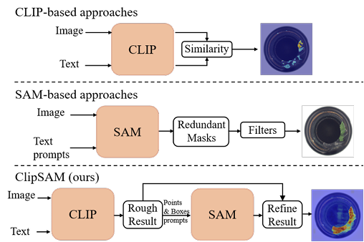
0.Abstract
The ClipSAM firstly uses clip to locating anomaly localization and uses SAM to refine the anomaly segmentation results by introduce a Unified Multiscale Cross-modal Interaction (UMCI) for interacting language with visual features at multiple scales.
what more, we design a novel Multi-level Mask Refinement (MMR) module. MMR module use positional information as prompts to query SAM’s masks and merge them.

Slide 4
1.Introduction
observation:
(1).CLIP has a strong semantic understanding capability. but it is a global semantic.
(2).SAM has a strong segmentation capability and can accept diverse prompts, including points, boxes, and text prompts. but the ambiguous prompts lead to the generation of redundant masks.

Slide 5
1.Introduction
base on the observations – we design a two-stage framework
(1).In the first stage, we employ CLIP for rough segmentation. In this part, we design a UMCI model to fusion multi-model features at different level.
(2).In the second stage, we use CLIP’s localization information to guide SAM for segmentation refinement. In this part, we propose a MMR module: use CLIP localization information to generate precise masks, and then fuse it with CLIP result.

Slide 6
2.Related Work
nothing to tell
2.1 Zero-shot Anomaly Segmentation
2.2 Foundation Models
2.3 Cross-modal Interaction

Slide 7
2.Related Work
nothing to tell
2.1 Zero-shot Anomaly Segmentation
2.2 Foundation Models
2.3 Cross-modal Interaction

Slide 8
2.Related Work
nothing to tell
2.1 Zero-shot Anomaly Segmentation
2.2 Foundation Models
2.3 Cross-modal Interaction

Slide 9
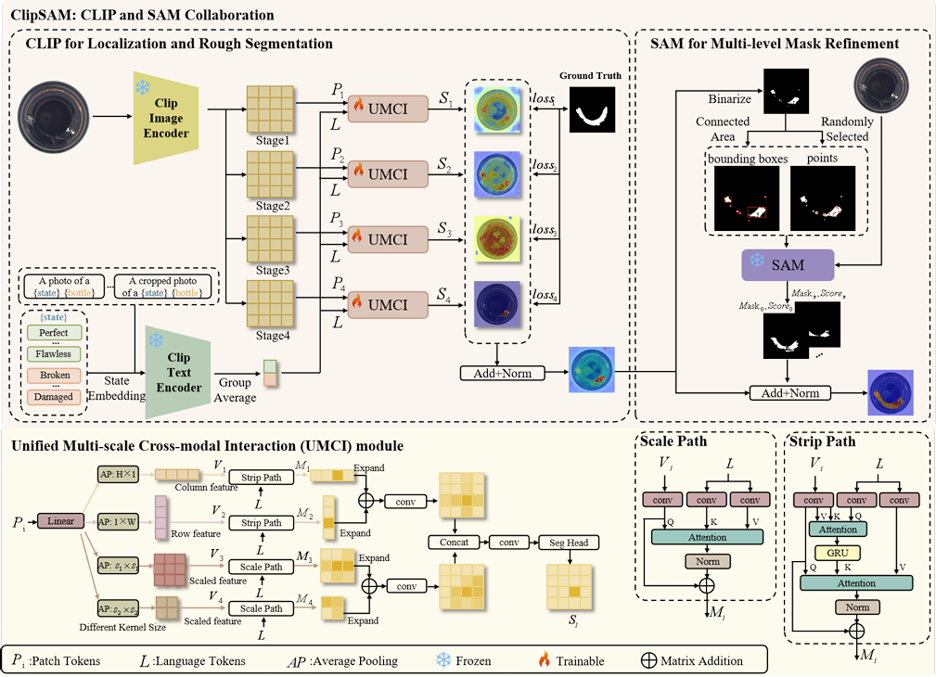
3.Methodology
we use CLIP for rough segmentation and use it to refine the segmentation result of SAM.
3.1 CLIP and SAM Collaboration
3.2 Unified Multi-scale Cross-modal Interaction
3.3 Multi-level Mask Refinement
3.4 Objective Function

Slide 10
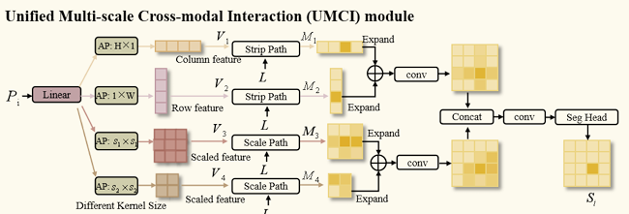
3.Methodology
3.1 CLIP and SAM Collaboration
3.2 Unified Multi-scale Cross-modal Interaction
3.3 Multi-level Mask Refinement
3.4 Objective Function

Slide 11
3.Methodology
UMCI consists of two path: Strip Paths and Scale Path.
(1).Strip Paths captures both row- and column-level features.
(2).Scale Paths grasps the image’s global features of various scales.
3.1 CLIP and SAM Collaboration
3.2 Unified Multi-scale Cross-modal Interaction
3.3 Multi-level Mask Refinement
3.4 Objective Function

Slide 12
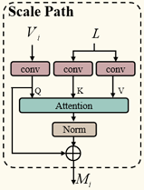
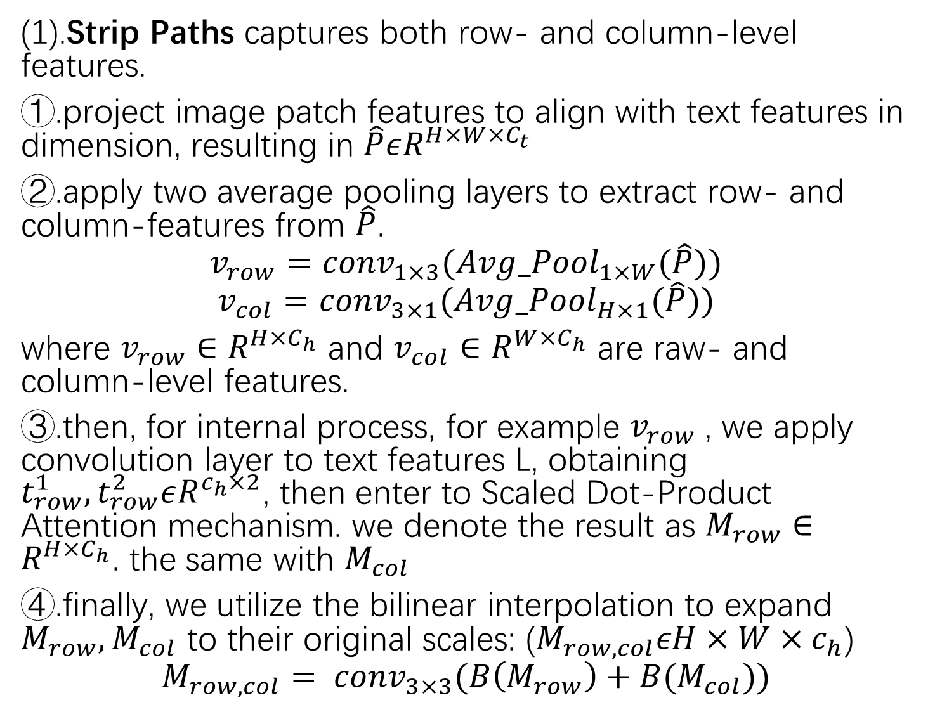
3.Methodology
(1).Strip Paths captures both row- and column-level features.
①.project image patch features to align with text features in dimension, resulting in $\hat{P}εR^{H×W×C_{t}}$
②.apply two average pooling layers to extract row- and column-features from $\hat{P}$.
$$v_{row}={conv}_{1×3}({Avg_Pool}_{1×W}(\hat{P}))$$
$$v_{col}={conv}_{3×1}({Avg_Pool}_{H×1}(\hat{P}))$$
where $v_{row}∈R^{H×C_{h}}$ and $v_{col}∈R^{W×C_{h}}$ are raw- and column-level features.
③.then, for internal process, for example $v_{row}$, we apply convolution layer to text features L, obtaining $t_{row}^{1}, t_{row}^{2}εR^{c_{h}×2}$, then enter to Scaled Dot-Product Attention mechanism. we denote the result as $M_{row}∈R^{H×C_{h}}$. the same with $M_{col}$
④.finally, we utilize the bilinear interpolation to expand $M_{row}, M_{col}$ to their original scales: ($M_{row, col}εH×W×c_{h}$)
$$M_{row, col}= {conv}_{3×3}(B\left(M_{row}\right)+B(M_{col}))$$
3.1 CLIP and SAM Collaboration
3.2 Unified Multi-scale Cross-modal Interaction
3.3 Multi-level Mask Refinement
3.4 Objective Function

Slide 13
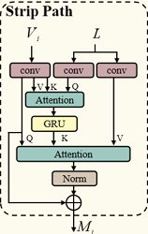
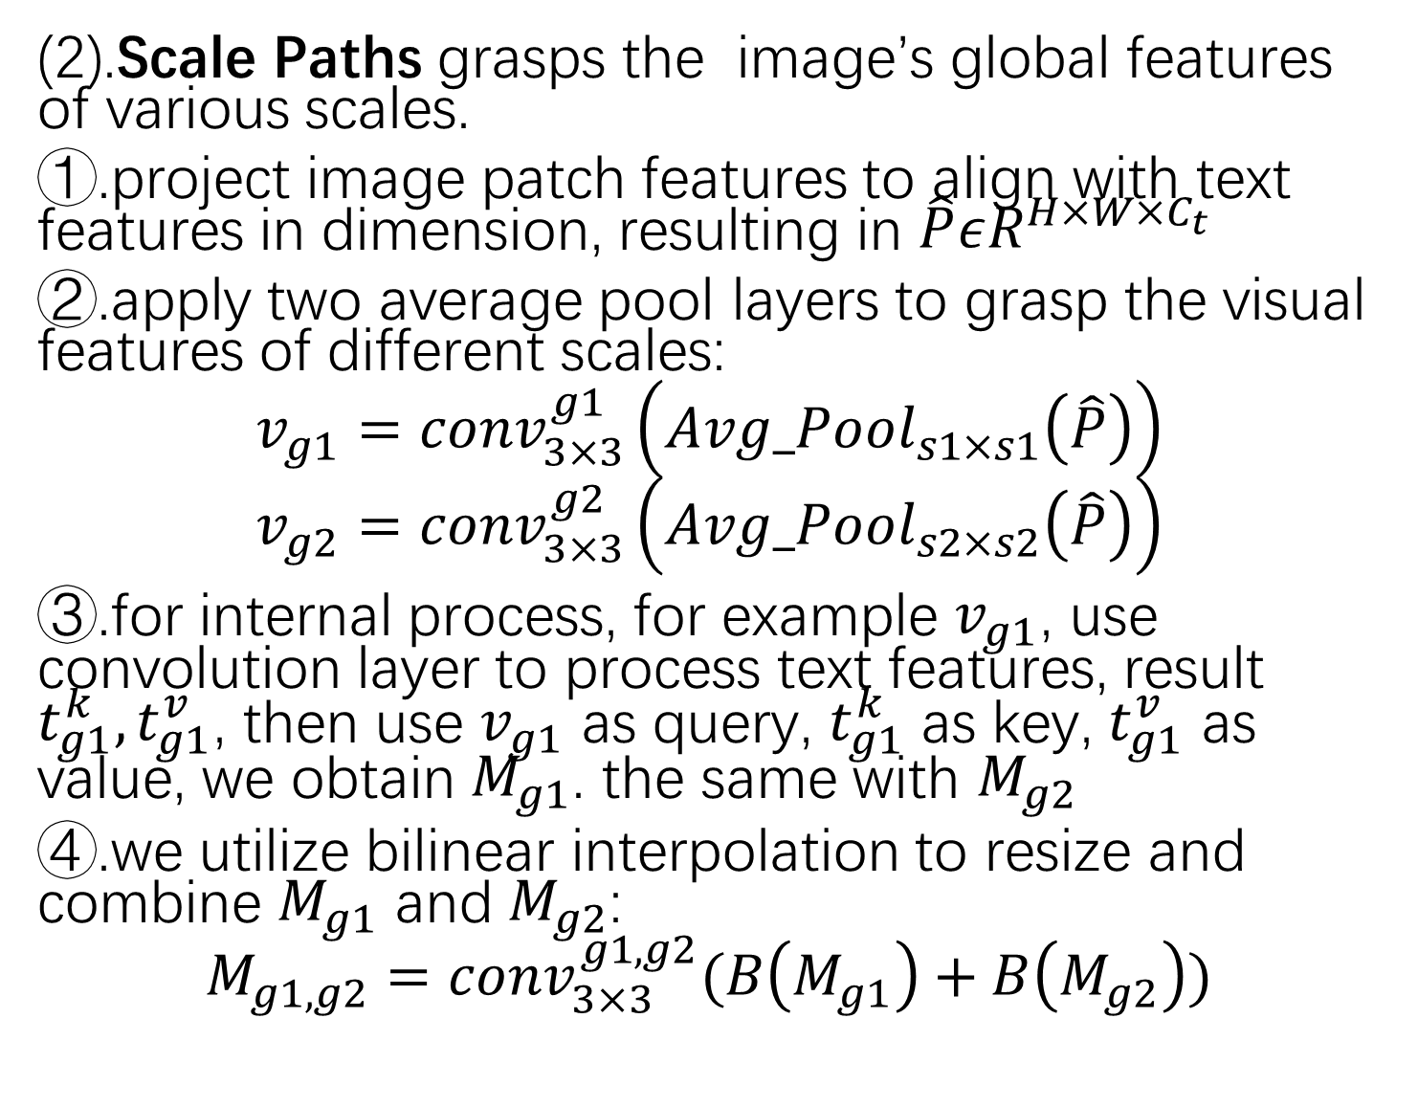
3.Methodology
(2).Scale Paths grasps the image’s global features of various scales.
①.project image patch features to align with text features in dimension, resulting in $\hat{P}εR^{H×W×C_{t}}$
②.apply two average pool layers to grasp the visual features of different scales:
$$v_{g1}={conv}_{3×3}^{g1}\left({Avg_Pool}_{s1×s1}\left(\hat{P}\right)\right)$$
$$v_{g2}={conv}_{3×3}^{g2}\left({Avg_Pool}_{s2×s2}\left(\hat{P}\right)\right)$$
③.for internal process, for example $v_{g1}$, use convolution layer to process text features, result $t_{g1}^{k},t_{g1}^{v}$, then use $v_{g1}$ as query, $t_{g1}^{k}$ as key, $t_{g1}^{v}$ as value, we obtain $M_{g1}$. the same with $M_{g2}$
④.we utilize bilinear interpolation to resize and combine $M_{g1}$ and $M_{g2}$:
$$M_{g1, g2}={conv}_{3×3}^{g1, g2}(B\left(M_{g1}\right)+B\left(M_{g2}\right))$$
3.1 CLIP and SAM Collaboration
3.2 Unified Multi-scale Cross-modal Interaction
3.3 Multi-level Mask Refinement
3.4 Objective Function

Slide 14
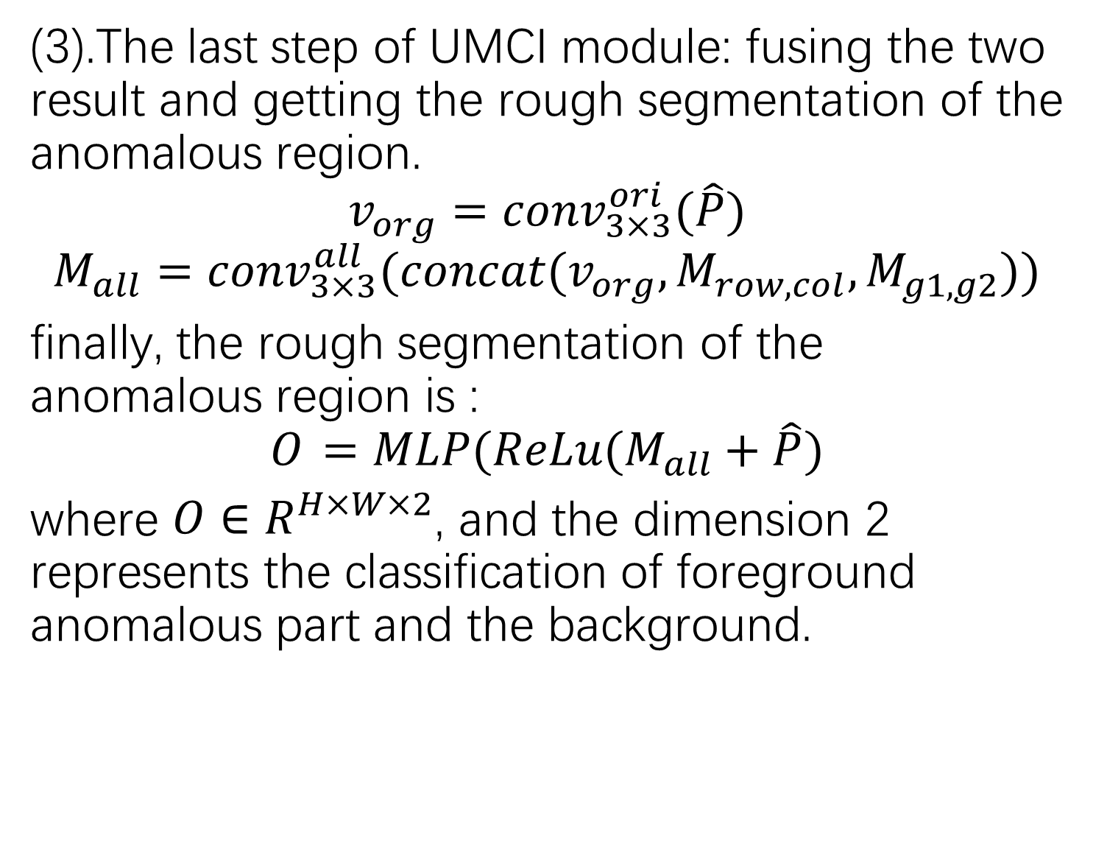
3.Methodology
(3).The last step of UMCI module: fusing the two result and getting the rough segmentation of the anomalous region.
$${v_{org}=conv}_{3×3}^{ori}(\hat{P})$$
$$M_{all}={conv}_{3×3}^{all}(concat(v_{org},M_{row,col},M_{g1,g2}))$$
finally, the rough segmentation of the anomalous region is :
$$O_{ }=MLP(ReLu(M_{all}+\hat{P})$$
where ${O∈R}_{ }^{H×W×2}$, and the dimension 2 represents the classification of foreground anomalous part and the background.
3.1 CLIP and SAM Collaboration
3.2 Unified Multi-scale Cross-modal Interaction
3.3 Multi-level Mask Refinement
3.4 Objective Function

Slide 15
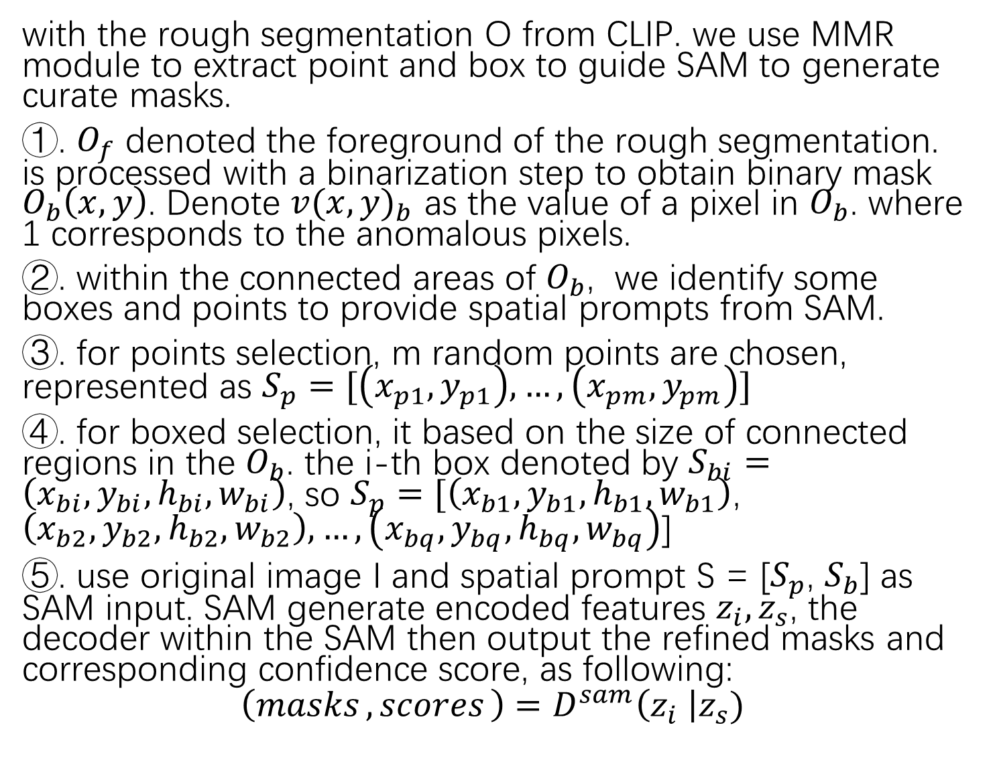
3.Methodology
with the rough segmentation O from CLIP. we use MMR module to extract point and box to guide SAM to generate curate masks.
①. $O_{f}$ denoted the foreground of the rough segmentation. is processed with a binarization step to obtain binary mask $O_{b}\left(x, y\right)$. Denote ${v(x,y)}_{b}$ as the value of a pixel in $O_{b}$. where 1 corresponds to the anomalous pixels.
②. within the connected areas of $O_{b}$, we identify some boxes and points to provide spatial prompts from SAM.
③. for points selection, m random points are chosen, represented as $S_{p}=[\left(x_{p1},y_{p1}\right), …,\left(x_{pm},y_{pm}\right)]$
④. for boxed selection, it based on the size of connected regions in the $O_{b}$. the i-th box denoted by $S_{bi}=\left(x_{bi},y_{bi},h_{bi},w_{bi}\right)$, so $S_{p}=[\left(x_{b1},y_{b1},h_{b1},w_{b1}\right)$, $\left(x_{b2},y_{b2},h_{b2},w_{b2}\right),…,\left(x_{bq},y_{bq},h_{bq},w_{bq}\right)$]
⑤. use original image I and spatial prompt S = [$S_{p}$, $S_{b}$] as SAM input. SAM generate encoded features $z_{i},z_{s}$, the decoder within the SAM then output the refined masks and corresponding confidence score, as following:
$$\left({masks}_{ },{scores}_{ }\right)=D^{sam}\left(z_{i} \right|z_{s})$$
3.1 CLIP and SAM Collaboration
3.2 Unified Multi-scale Cross-modal Interaction
3.3 Multi-level Mask Refinement
3.4 Objective Function

Slide 16
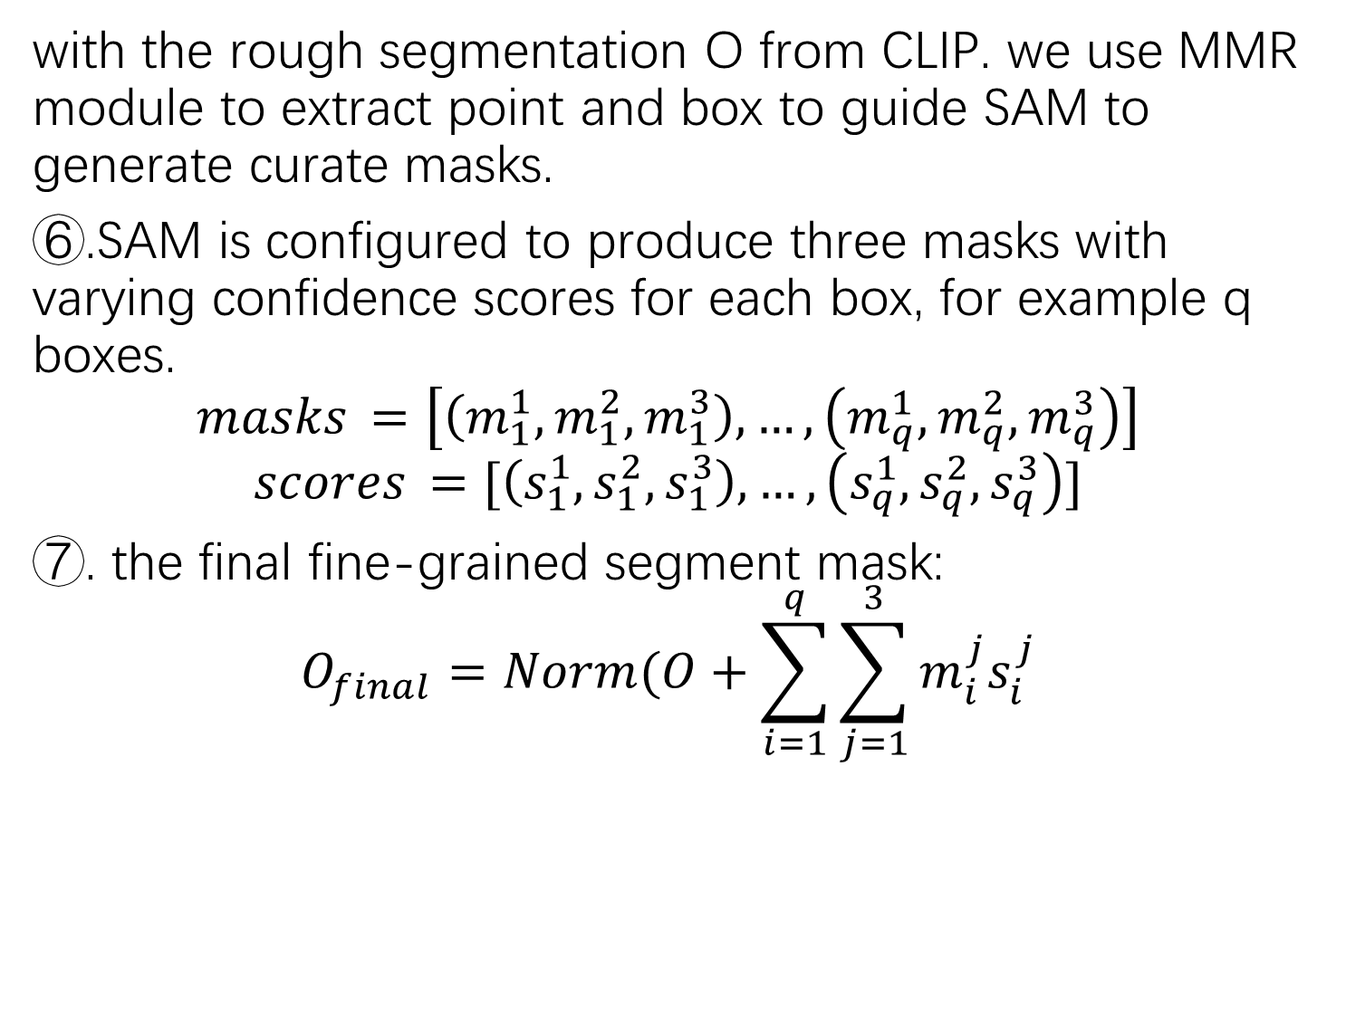
3.Methodology
with the rough segmentation O from CLIP. we use MMR module to extract point and box to guide SAM to generate curate masks.
⑥.SAM is configured to produce three masks with varying confidence scores for each box, for example q boxes.
$${masks}_{ }=\left[\left(m_{1}^{1},m_{1}^{2},m_{1}^{3}\right), …,\left(m_{q}^{1},m_{q}^{2},m_{q}^{3}\right)\right]$$
$${scores}_{ }=[\left(s_{1}^{1},s_{1}^{2},s_{1}^{3}\right), …,\left(s_{q}^{1},s_{q}^{2},s_{q}^{3}\right)]$$
⑦. the final fine-grained segment mask:
$$O_{final}=Norm(O+\sum_{i=1}^{q}{\sum_{j=1}^{3}{m_{i}^{j}s_{i}^{j}}}$$
3.1 CLIP and SAM Collaboration
3.2 Unified Multi-scale Cross-modal Interaction
3.3 Multi-level Mask Refinement
3.4 Objective Function

Slide 17
3.Methodology
we employ the Focal Loss and Dice Loss.
3.1 CLIP and SAM Collaboration
3.2 Unified Multi-scale Cross-modal Interaction
3.3 Multi-level Mask Refinement
3.4 Objective Function

Slide 18
4.Experiments
CLIP – ViT-L-14-336
extract image token at each stage (6, 12, 18, 24)
AdamW, lr=10e-4
batch size of 8 with 6 epochs.
SAM use ViT-H
4.1 experimental setup
4.2 experiments on mvtec and visa
4.3 ablation studies

Slide 19
4.Experiments
result is better
4.1 experimental setup
4.2 experiments on mvtec and visa
4.3 ablation studies

Slide 20
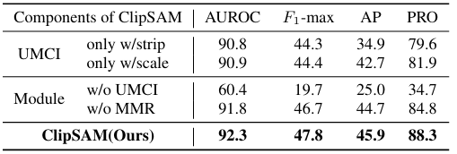
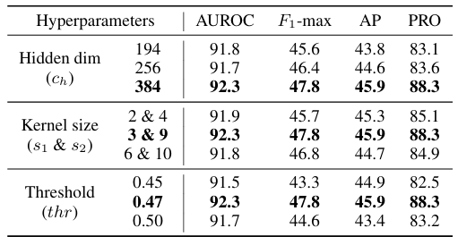
4.Experiments
Component
Hyperparameter
4.1 experimental setup
4.2 experiments on mvtec and visa
4.3 ablation studies

