Slide 1
AnomalyCLIP
20250904

Slide 2
Abstract
The key insight of AnomalyCLIP is to learn object-agnostic text prompts that capture generic normality or abnormality in an image regardless of its foreground objects.

Slide 3
Introduce
the main works:
first, devises a simple yet universally-effective learnable prompt template for the two general classes – normal and abnormality
second, utilizes both image-level and pixel-level loss functions to learn the generic normality and abnormality

Slide 4
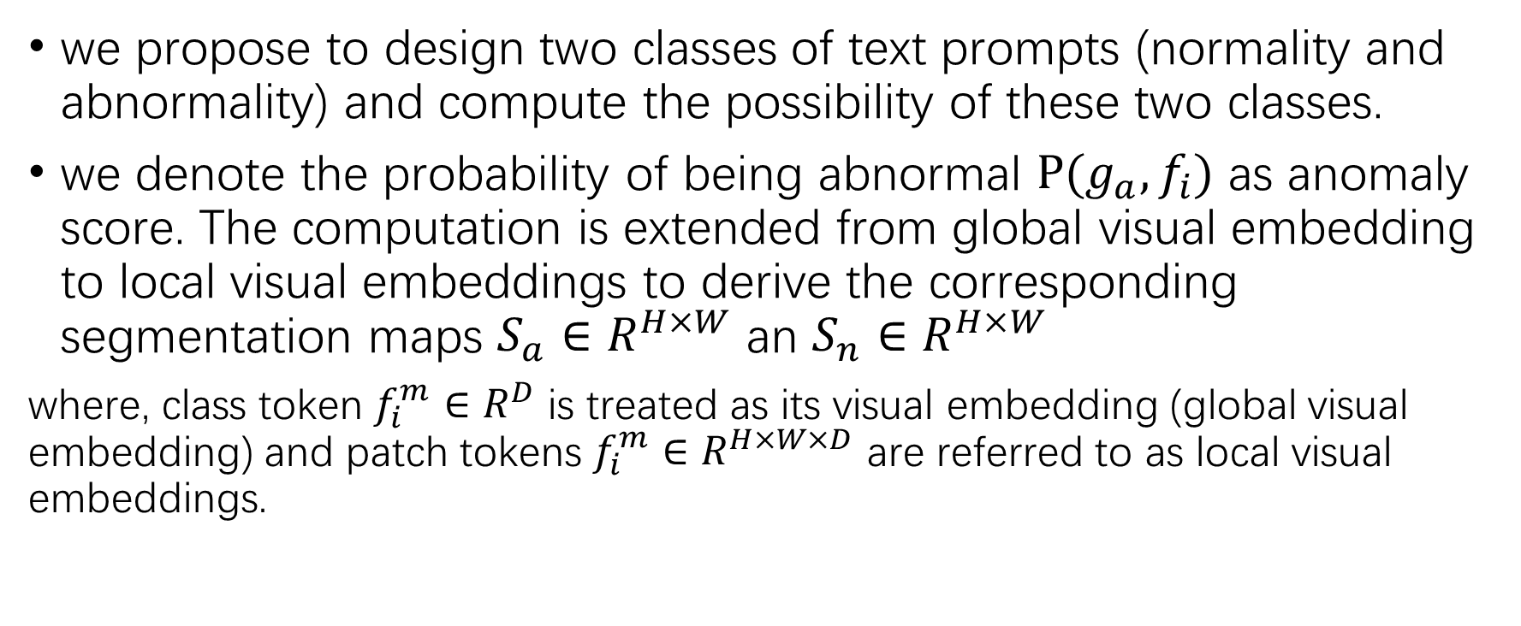
Preliminary
we propose to design two classes of text prompts (normality and abnormality) and compute the possibility of these two classes.
we denote the probability of being abnormal $P(g_{a},f_{i})$ as anomaly score. The computation is extended from global visual embedding to local visual embeddings to derive the corresponding segmentation maps $S_{a}∈R^{H×W}$ an $S_{n}∈R^{H×W}$
where, class token $f_{i}^{m}∈R^{D}$ is treated as its visual embedding (global visual embedding) and patch tokens $f_{i}^{m}∈R^{H×W×D}$ are referred to as local visual embeddings.

Slide 5
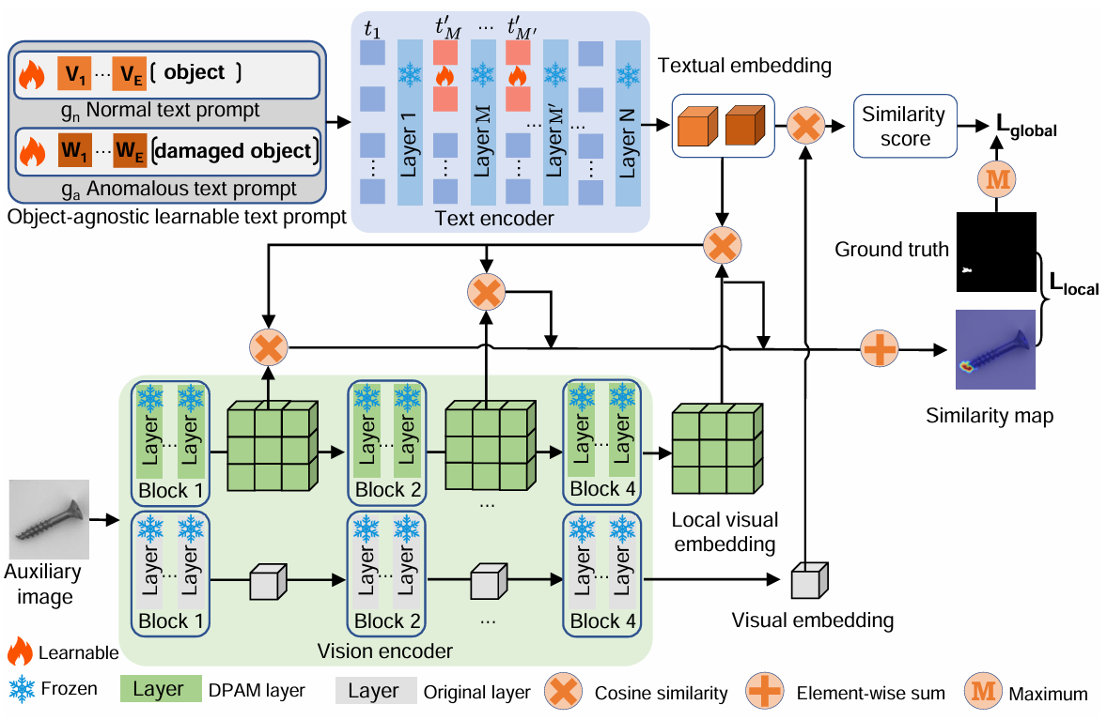
Anomaly CLIP: object-agnostic prompt learning 3.1 approach overview

Slide 6
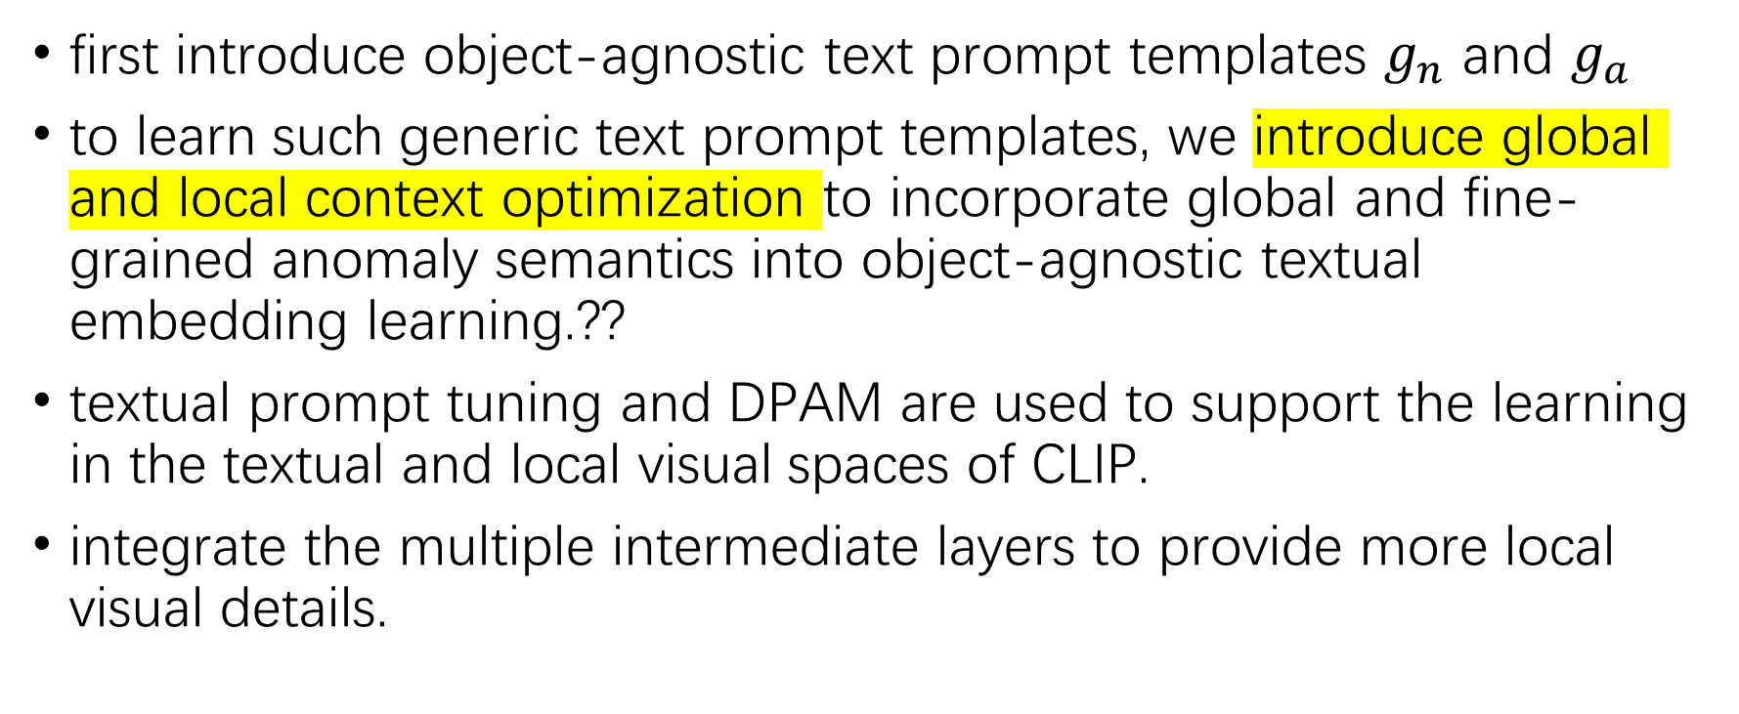
Anomaly CLIP: object-agnostic prompt learning 3.1 approach overview
first introduce object-agnostic text prompt templates $g_{n}$ and $g_{a}$
to learn such generic text prompt templates, we introduce global and local context optimization to incorporate global and fine-grained anomaly semantics into object-agnostic textual embedding learning.??
textual prompt tuning and DPAM are used to support the learning in the textual and local visual spaces of CLIP.
integrate the multiple intermediate layers to provide more local visual details.

Slide 7
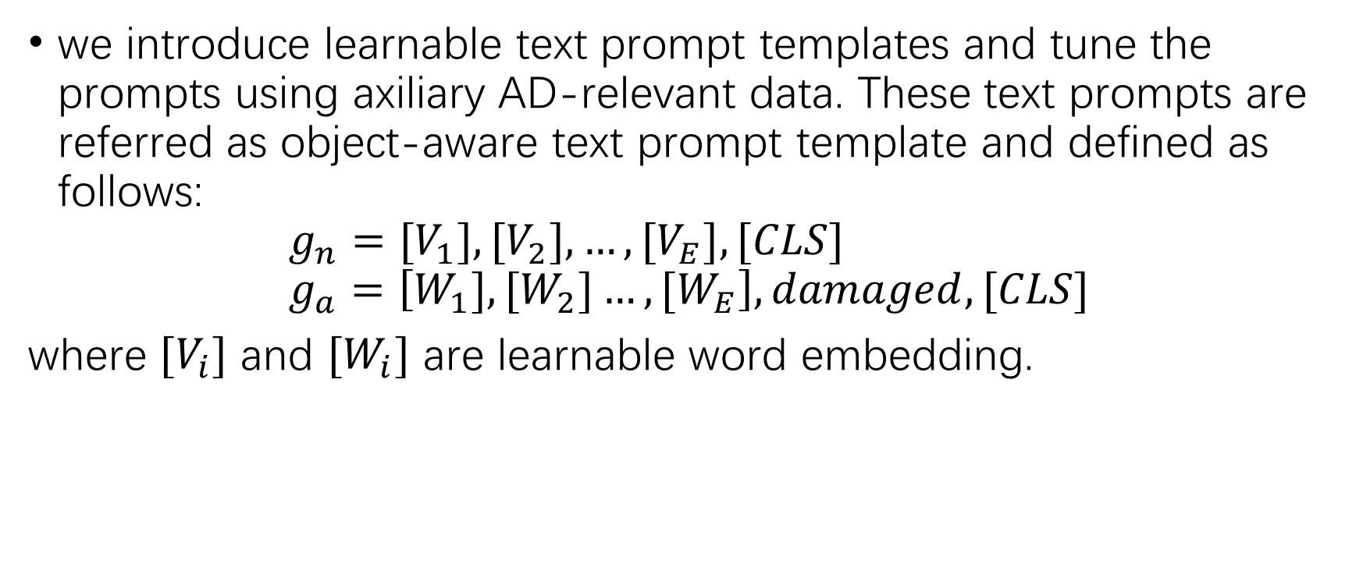
Anomaly CLIP: object-agnostic prompt learning 3.2 object-agnostic text prompt design
we introduce learnable text prompt templates and tune the prompts using axiliary AD-relevant data. These text prompts are referred as object-aware text prompt template and defined as follows:
$$g_{n}=[V_{1}],{[V}_{2}],…,[V_{E}], [CLS] \\ g_{a}=\left[W_{1}],{[W}_{2}]…,{[W}_{E}\right],damaged,[CLS]$$
where ${[V}_{i}]$ and ${[W}_{i}]$ are learnable word embedding.

Slide 8
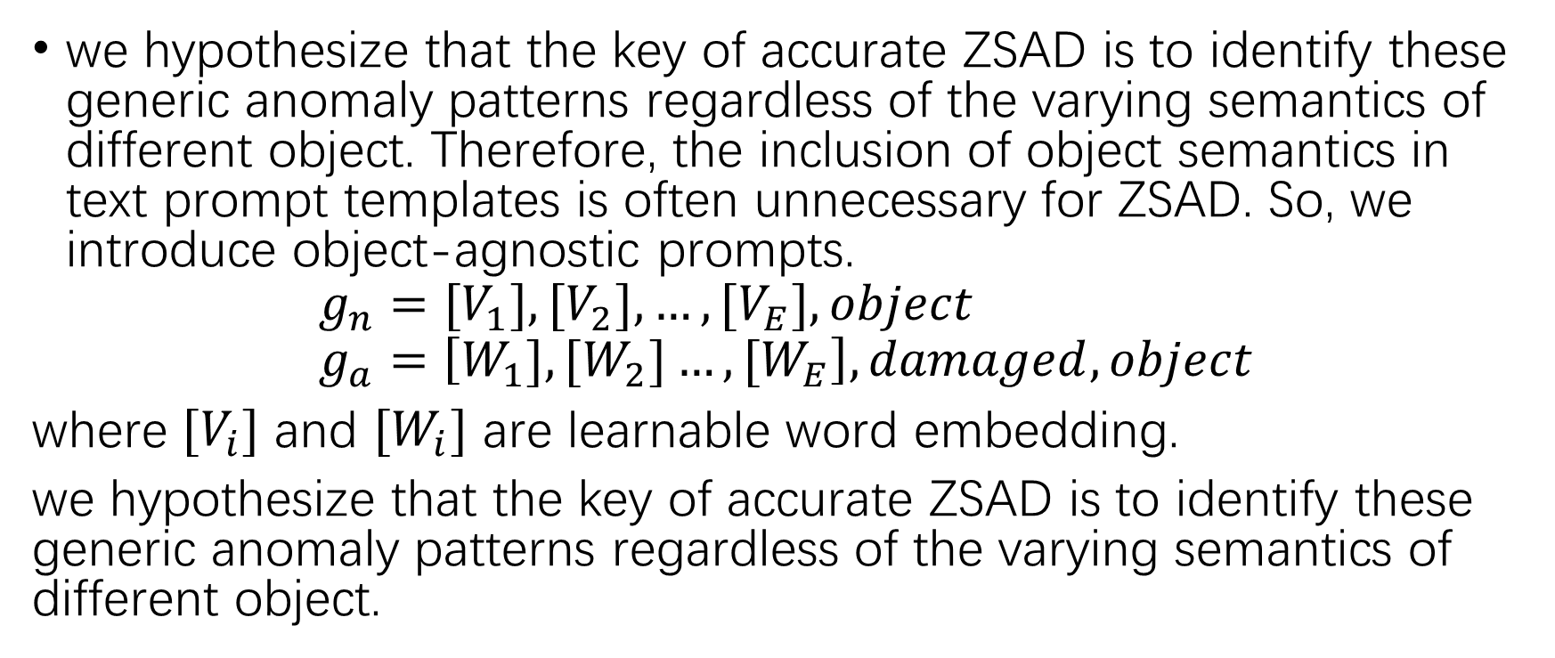
Anomaly CLIP: object-agnostic prompt learning 3.2 object-agnostic text prompt design
we hypothesize that the key of accurate ZSAD is to identify these generic anomaly patterns regardless of the varying semantics of different object. Therefore, the inclusion of object semantics in text prompt templates is often unnecessary for ZSAD. So, we introduce object-agnostic prompts.
$$g_{n}=[V_{1}],{[V}_{2}],…,[V_{E}], object \\ g_{a}=\left[W_{1}],{[W}_{2}]…,{[W}_{E}\right],damaged,object$$
where ${[V}_{i}]$ and ${[W}_{i}]$ are learnable word embedding.
we hypothesize that the key of accurate ZSAD is to identify these generic anomaly patterns regardless of the varying semantics of different object.

Slide 9
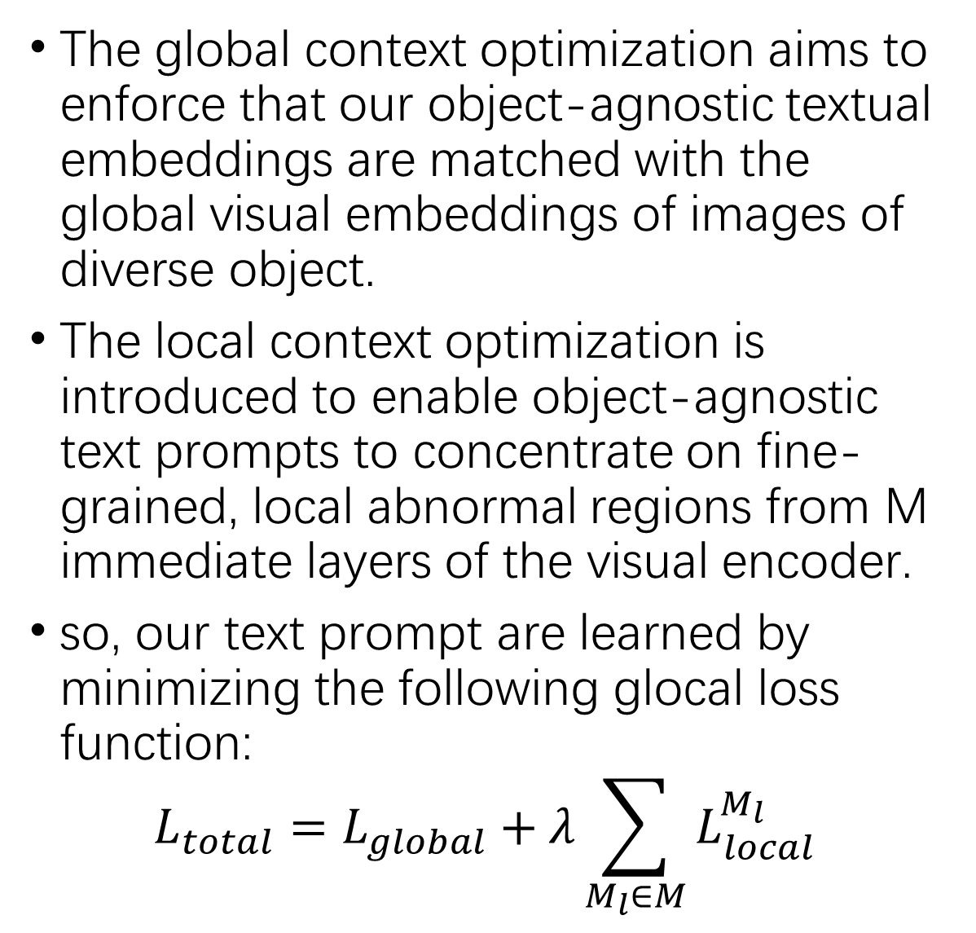
Anomaly CLIP: object-agnostic prompt learning 3.3 learning generic abnormality and normality prompts
The global context optimization aims to enforce that our object-agnostic textual embeddings are matched with the global visual embeddings of images of diverse object.
The local context optimization is introduced to enable object-agnostic text prompts to concentrate on fine-grained, local abnormal regions from M immediate layers of the visual encoder.
so, our text prompt are learned by minimizing the following glocal loss function:
$$L_{total}=L_{global}+λ\sum_{M_{l}∈M}{L_{local}^{M_{l}}}$$
1.Glocal Context optimization
2.refinement of the textual space
3.refinement of the local visual space
4.training and inference

Slide 10
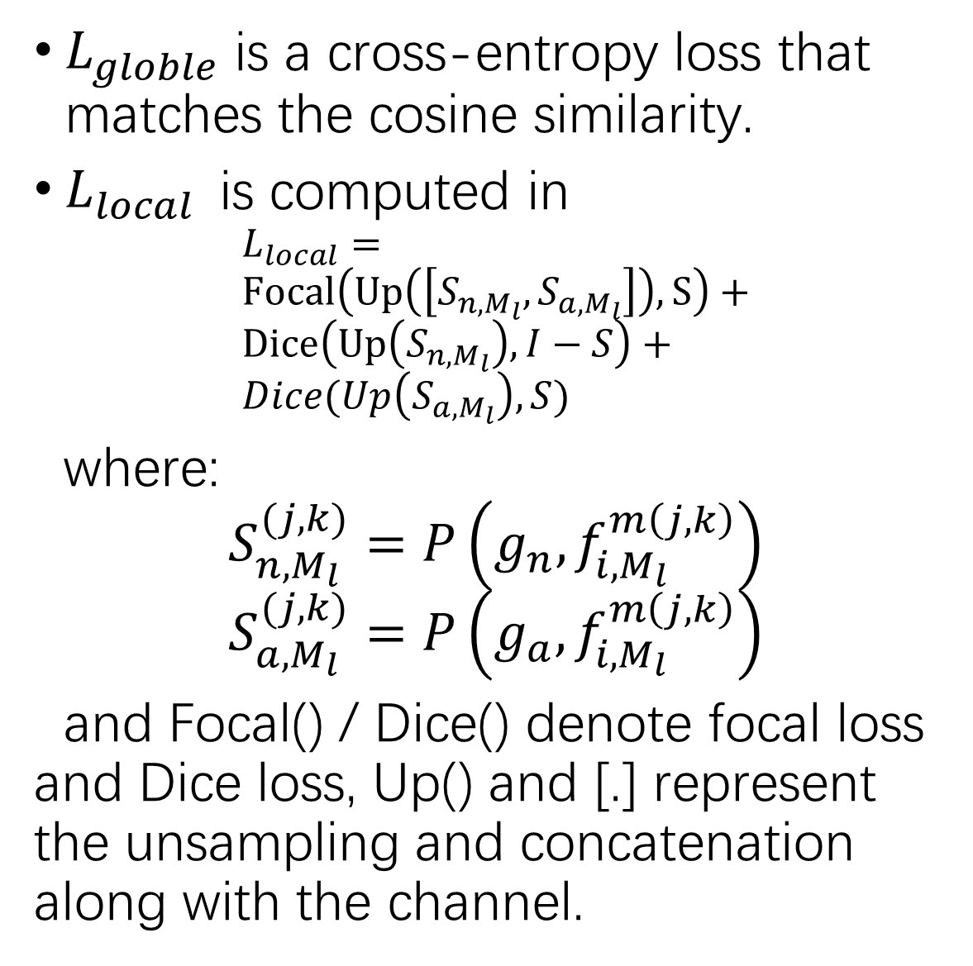
Anomaly CLIP: object-agnostic prompt learning 3.3 learning generic abnormality and normality prompts
$L_{globle}$ is a cross-entropy loss that matches the cosine similarity.
$L_{local}$is computed in
$$L_{local}= \\ Focal\left(Up\left(\left[S_{n, M_{l}}, S_{a, M_{l}}\right]\right), S\right)+ \\ Dice\left(Up\left(S_{n,M_{l}}\right), I−S\right)+ \\ Dice(Up\left(S_{a,M_{l}}\right), S)$$
where:
$$S_{n, M_{l}}^{(j,k)}=P\left(g_{n}, f_{i, M_{l}}^{m\left(j,k\right)}\right) \\ S_{a, M_{l}}^{(j,k)}=P\left(g_{a}, f_{i, M_{l}}^{m\left(j,k\right)}\right)$$
and Focal() / Dice() denote focal loss and Dice loss, Up() and [.] represent the unsampling and concatenation along with the channel.
1.Glocal Context optimization
2.refinement of the textual space
3.refinement of the local visual space
4.training and inference

Slide 11
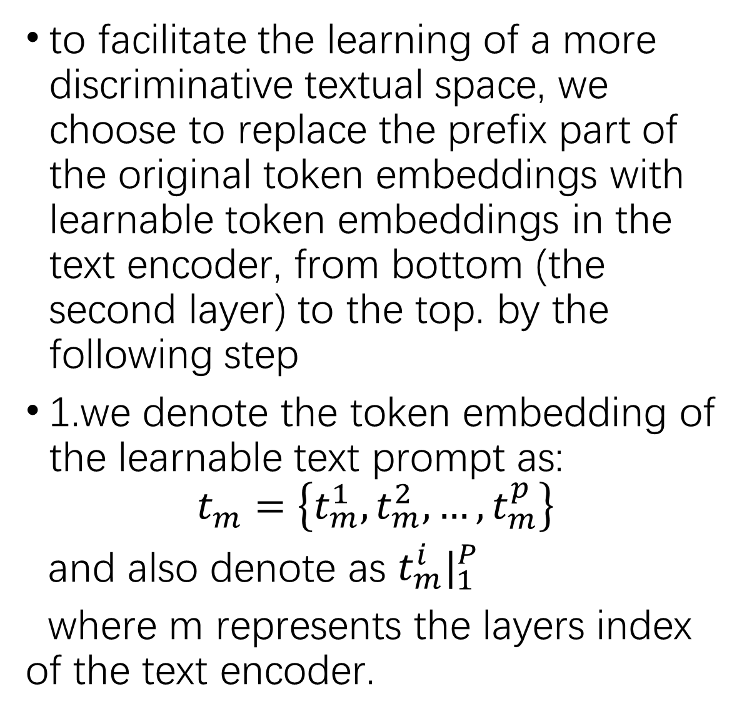
Anomaly CLIP: object-agnostic prompt learning 3.3 learning generic abnormality and normality prompts
to facilitate the learning of a more discriminative textual space, we choose to replace the prefix part of the original token embeddings with learnable token embeddings in the text encoder, from bottom (the second layer) to the top. by the following step
1.we denote the token embedding of the learnable text prompt as:
$$t_{m}=\left\{t_{m}^{1}, t_{m}^{2}, …,t_{m}^{p}\right\}$$
and also denote as $t_{m}^{i}|_{1}^{P}$
where m represents the layers index of the text encoder.
1.Glocal Context optimization
2.refinement of the textual space
3.refinement of the local visual space
4.training and inference

Slide 12
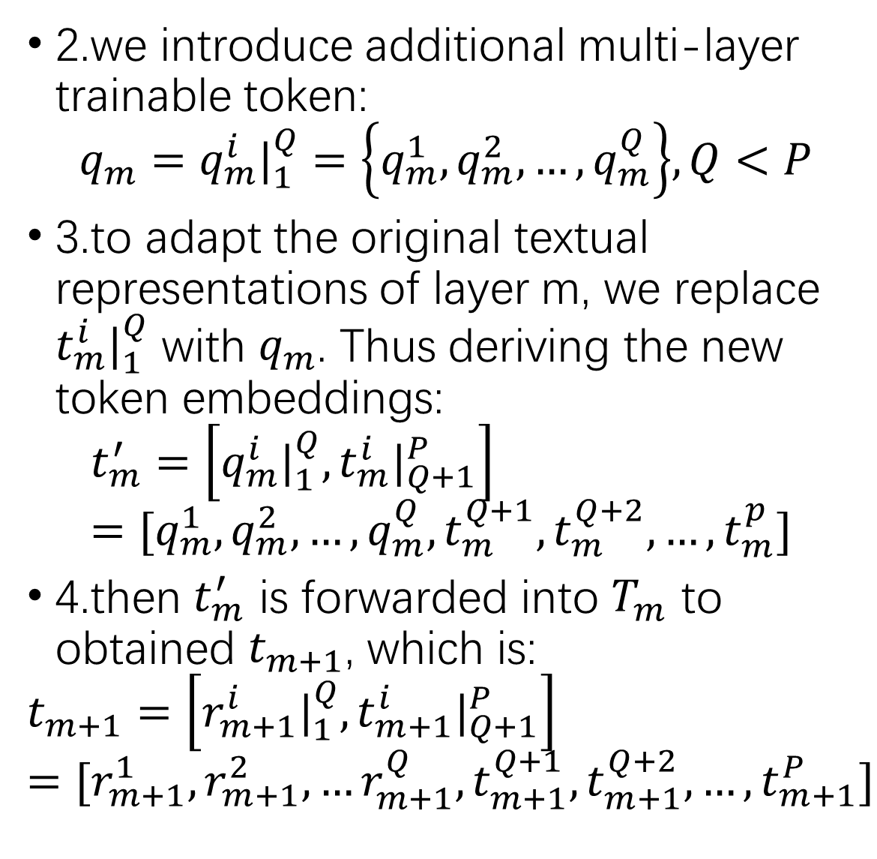
Anomaly CLIP: object-agnostic prompt learning 3.3 learning generic abnormality and normality prompts
2.we introduce additional multi-layer trainable token:
$$q_{m}=q_{m}^{i}|_{1}^{Q}=\left\{q_{m}^{1}, q_{m}^{2}, …,q_{m}^{Q}\right\}, Q<P$$
3.to adapt the original textual representations of layer m, we replace $t_{m}^{i}|_{1}^{Q}$ with $q_{m}$. Thus deriving the new token embeddings:
$$t_{m}^{′}=\left[q_{m}^{i}|_{1}^{Q}, t_{m}^{i}|_{Q+1}^{P}\right] \\ =[q_{m}^{1}, q_{m}^{2}, …,q_{m}^{Q},t_{m}^{Q+1}, t_{m}^{Q+2}, …,t_{m}^{p}]$$
4.then $t_{m}^{′}$ is forwarded into $T_{m}$ to obtained $t_{m+1}$, which is:
$$t_{m+1}=\left[r_{m+1}^{i}|_{1}^{Q},t_{m+1}^{i}|_{Q+1}^{P}\right] \\ =[r_{m+1}^{1},r_{m+1}^{2},…r_{m+1}^{Q},t_{m+1}^{Q+1},t_{m+1}^{Q+2},…,t_{m+1}^{P}]$$
1.Glocal Context optimization
2.refinement of the textual space
3.refinement of the local visual space
4.training and inference

Slide 13
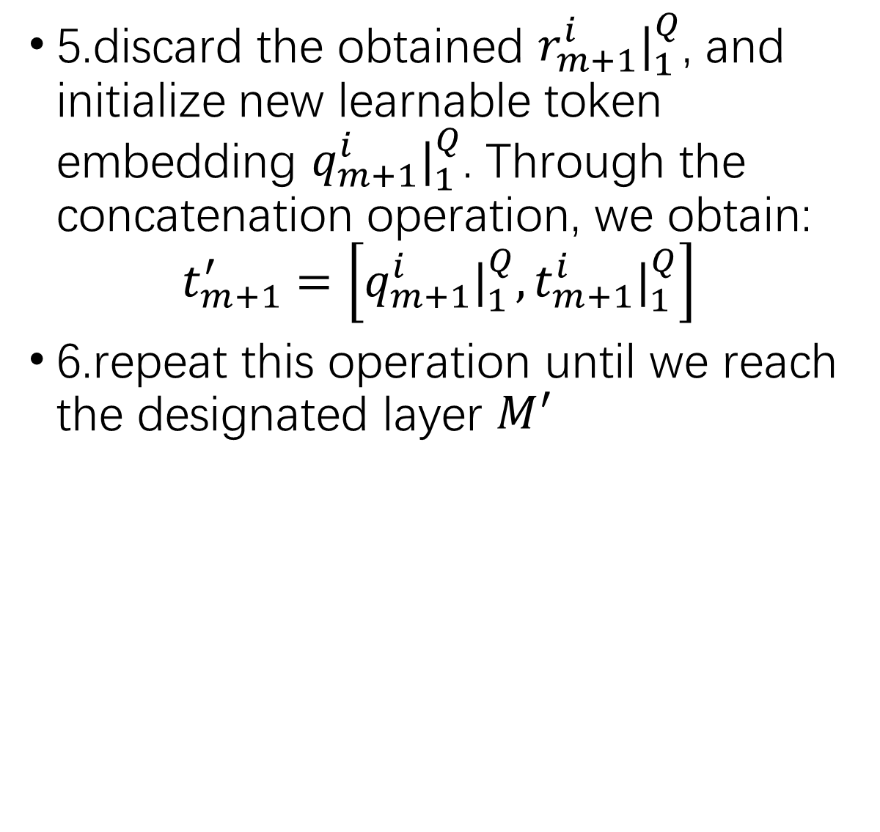
Anomaly CLIP: object-agnostic prompt learning 3.3 learning generic abnormality and normality prompts
5.discard the obtained $r_{m+1}^{i}|_{1}^{Q}$, and initialize new learnable token embedding $q_{m+1}^{i}|_{1}^{Q}$. Through the concatenation operation, we obtain:
$$t_{m+1}^{′}=\left[q_{m+1}^{i}|_{1}^{Q},t_{m+1}^{i}|_{1}^{Q}\right]$$
6.repeat this operation until we reach the designated layer $M_{ }^{′}$
1.Glocal Context optimization
2.refinement of the textual space
3.refinement of the local visual space
4.training and inference

Slide 14
Anomaly CLIP: object-agnostic prompt learning 3.3 learning generic abnormality and normality prompts
d
1.Glocal Context optimization
2.refinement of the textual space
3.refinement of the local visual space
4.training and inference

