Slide 1
ClipSAM: CLIP and SAMCollaboration for Zero-Shot Anomaly Segmentation
20250922

Slide 2
0.Abstract
either CLIP-based or SAM-based ZSAS methods still suffer from non-negligible key drawbacks：
CLIP primarily focuses on global feature alignment across different inputs, leading to imprecise segmentation of local anomalous parts;
SAM tends to generate numerous redundant masks without proper prompt constraints, resulting in complex post-processing requirements.
In conclusion, CLIP focuses on global features and SAM generate to much redundant masks.

Slide 3
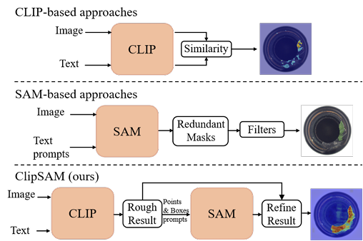
0.Abstract
The ClipSAM firstly uses clip to locating anomaly localization and uses SAM to refine the anomaly segmentation results by introduce a Unified Multiscale Cross-modal Interaction (UMCI) for interacting language with visual features at multiple scales.
what more, we design a novel Multi-level Mask Refinement (MMR) module. MMR module use positional information as prompts to query SAM’s masks and merge them.

Slide 4
1.Introduction
observation:
(1).CLIP has a strong semantic understanding capability. but it is a global semantic.
(2).SAM has a strong segmentation capability and can accept diverse prompts, including points, boxes, and text prompts. but the ambiguous prompts lead to the generation of redundant masks.

