Slide 1
WinCLIP
20250824

Slide 2
Abstract
because CLIP falls short on anomaly classification and segmentation tasks. Hence, WinCLIP propose window-based CLIP(WinCLIP) with:
a compositional ensemble on state words and prompt templates.
efficient extraction and aggregation of windows/patch/image-level features aligned with text.

Slide 3
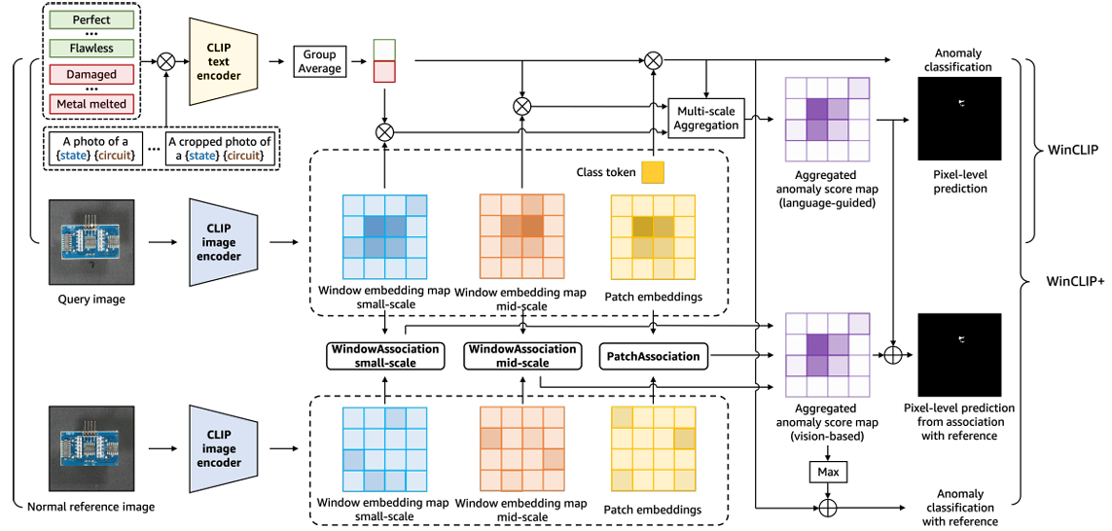
Abstract

Slide 4
Introduce
WinCLIP hypothesis is that language is perhaps even more important for zero-shot/few-normal-shot anomaly classification and segmentation. The reasons are following:
normal and anomalous are state of an object that are context-dependent, and language helps clarify these states.
language can provide additional information to distinguish defects from acceptable deviations from normality.

Slide 5
Introduce
improvements:
a state-level word ensemble
to extract dense visual features aligned with language, propose a new WINDOWS-BASE clip.(WinClip)
to leverage normal image in few-normal-shot, introduce WinClip+, which aggregates complementary information from language and visual cues.

Slide 6
Introduce
key point:
1.zero-shot models do not require any tuning for individual cases
2.few-normal-shot does not use any segmentation annotation.
facilitating applicability across a broad range of visual inspection task

Slide 7
CLIP-AC/WinCLIP/WinCLIP+
for object-level label:
adapting CLIP with two class prompts
normal [o]
anomalous [o]

Slide 8
CLIP-AC/WinCLIP/WinCLIP+
to better define the two abstract states, propose a Compositional Prompt Ensemble to generate combinations of list of:
state word
text templates
after getting all the combinations of states and templates, we compute the average of text embeddings per label to present the normal and anomalous classes.

Slide 9
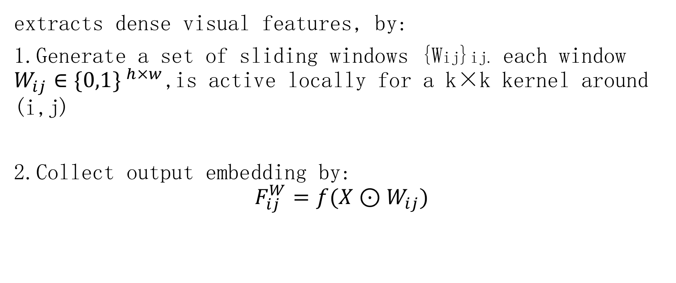
CLIP-AC/WinCLIP/WinCLIP+
extracts dense visual features, by:
1.Generate a set of sliding windows {Wij}ij. each window $W_{ij}∈\{0,1\} ^{h×w}$,is active locally for a k×k kernel around (i,j)
2.Collect output embedding by:
$$F_{ij}^{W}=f(X⊙W_{ij})$$

Slide 10
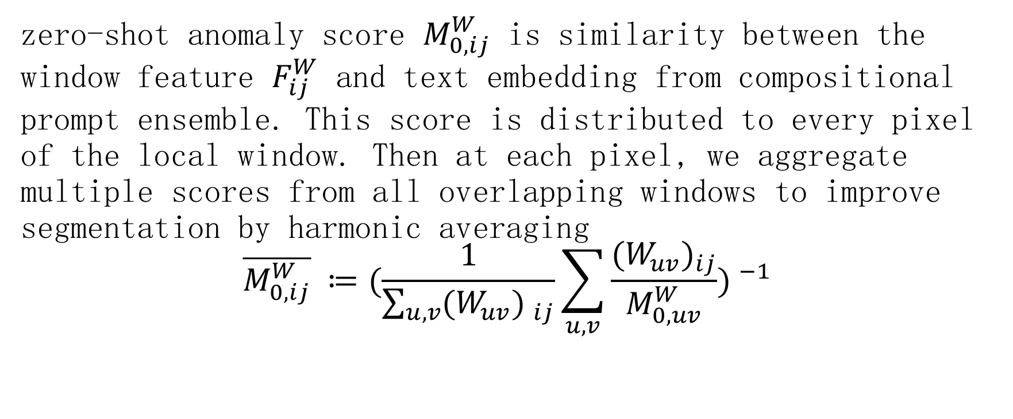
CLIP-AC/WinCLIP/WinCLIP+
zero-shot anomaly score $M_{0,ij}^{W}$ is similarity between the window feature $F_{ij}^{W}$ and text embedding from compositional prompt ensemble. This score is distributed to every pixel of the local window. Then at each pixel, we aggregate multiple scores from all overlapping windows to improve segmentation by harmonic averaging
$$\overline{M_{0,ij}^{W}} ≔(\frac{1}{\sum_{u,v}{(W_{uv}) _{ij}}}\sum_{u,v}{\frac{{(W_{uv})}_{ij}}{M_{0,uv}^{W}}}) ^{−1}$$

Slide 11
CLIP-AC/WinCLIP/WinCLIP+
the kernel size k corresponds to the amount of surrounding context for each location in computing WinCLIP features.
we aggregate predictions from multi-scale features: (a).small-scale（2×2 in patch scales of ViT; corresponds to 32*32 in pixels)
(b).mid-scale (3×3 in ViT; 48×48)
(c).image-scale feature

Slide 12
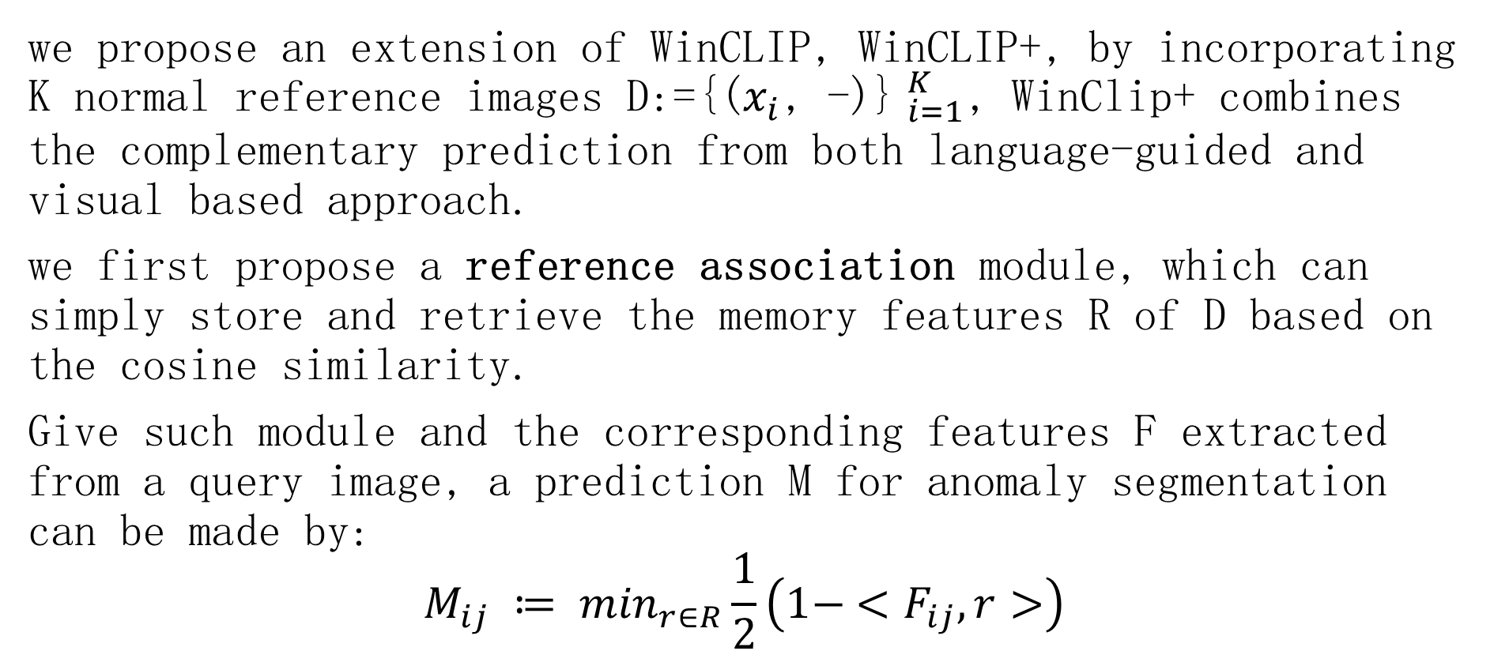
CLIP-AC/WinCLIP/WinCLIP+
we propose an extension of WinCLIP, WinCLIP+, by incorporating K normal reference images D:={($x_{i}$, -)}$_{i=1}^{K}$, WinClip+ combines the complementary prediction from both language-guided and visual based approach.
we first propose a reference association module, which can simply store and retrieve the memory features R of D based on the cosine similarity.
Give such module and the corresponding features F extracted from a query image, a prediction M for anomaly segmentation can be made by:
$$M_{ij} ≔ \min_{r∈R}\frac{1}{2}\left(1− <F_{ij}, r>\right)$$

Slide 13
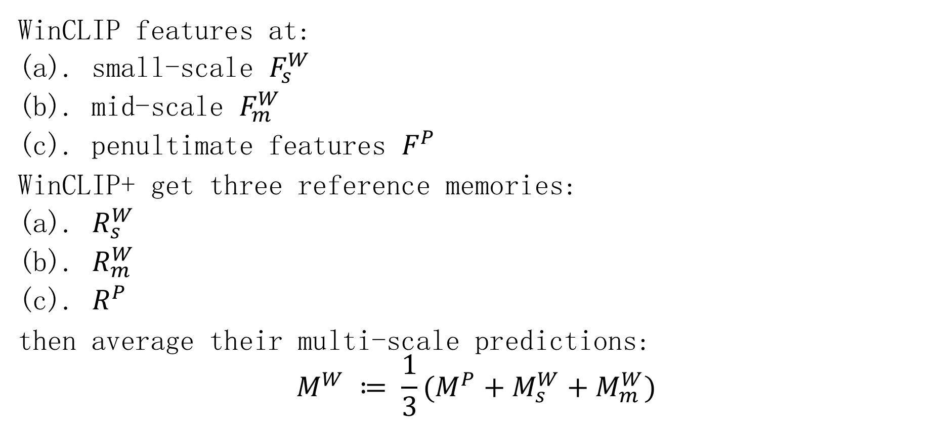
CLIP-AC/WinCLIP/WinCLIP+
WinCLIP features at:
(a). small-scale $F_{s}^{W}$
(b). mid-scale $F_{m}^{W}$
(c). penultimate features $F_{ }^{P}$
WinCLIP+ get three reference memories:
(a). $R_{s}^{W}$
(b). $R_{m}^{W}$
(c). $R_{ }^{P}$
then average their multi-scale predictions:
$$M^{W} ≔ \frac{1}{3}(M_{ }^{P}+M_{s}^{W}+M_{m}^{W})$$

Slide 14
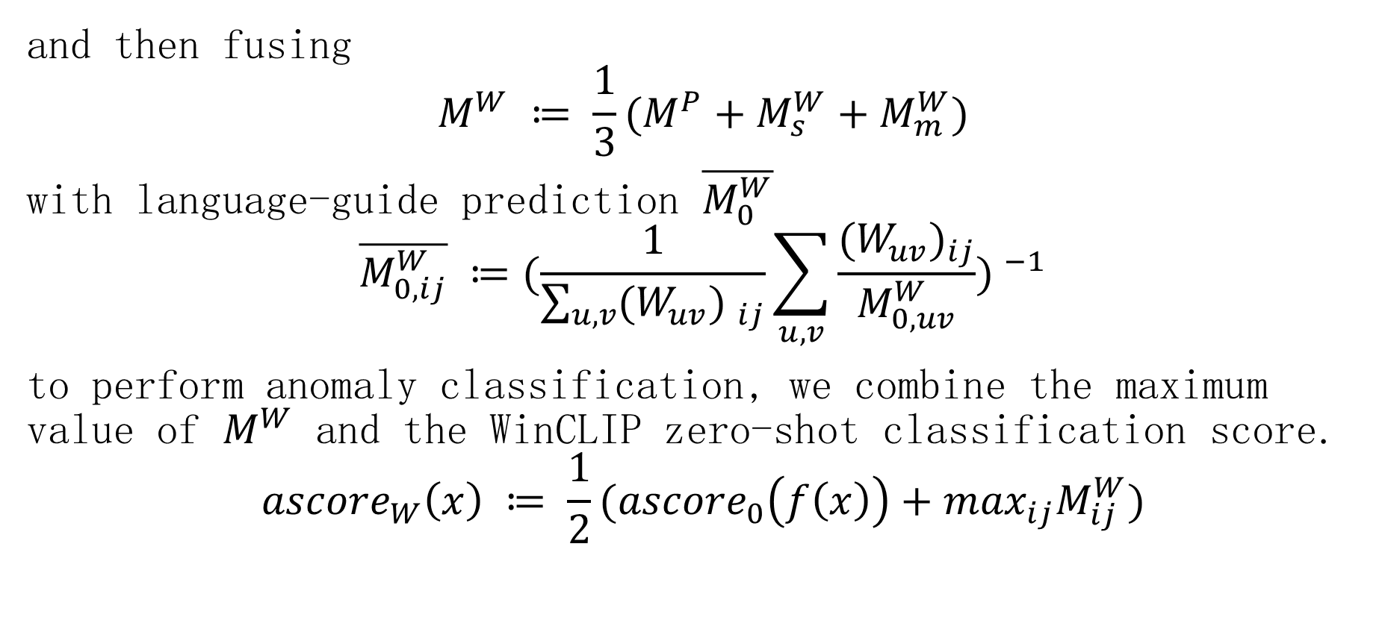
CLIP-AC/WinCLIP/WinCLIP+
and then fusing
$$M^{W} ≔ \frac{1}{3}(M_{ }^{P}+M_{s}^{W}+M_{m}^{W})$$
with language-guide prediction $\overline{M_{0}^{W}}$
$$\overline{M_{0,ij}^{W}} ≔(\frac{1}{\sum_{u,v}{(W_{uv}) _{ij}}}\sum_{u,v}{\frac{{(W_{uv})}_{ij}}{M_{0,uv}^{W}}}) ^{−1}$$
to perform anomaly classification, we combine the maximum value of $M^{W}$ and the WinCLIP zero-shot classification score.
$${ascore}_{W}\left(x\right) ≔ \frac{1}{2}({ascore}_{0}\left(f\left(x\right)\right)+\max_{ij}M_{ij}^{W})$$

Slide 15
Experiments
Datasets:
(a). MVTec-AD
(b). VisA
Evaluation metrics:(classification、segmentation)
(a). AUROC、pAUROC
(b). AUPR、PRO
(c). F1-score、pixel-wise F1-max

Slide 16
Experiments
1.zero-/few-shot anomaly classification
zero-shot
compare WinCLIP with two models: CLIP-AC[27]、CLIP-AC with the prompt ensemble[27、19];
few-normal-shot
compare SPADE、PaDiM、PatchCore. results show in table 1

Slide 17
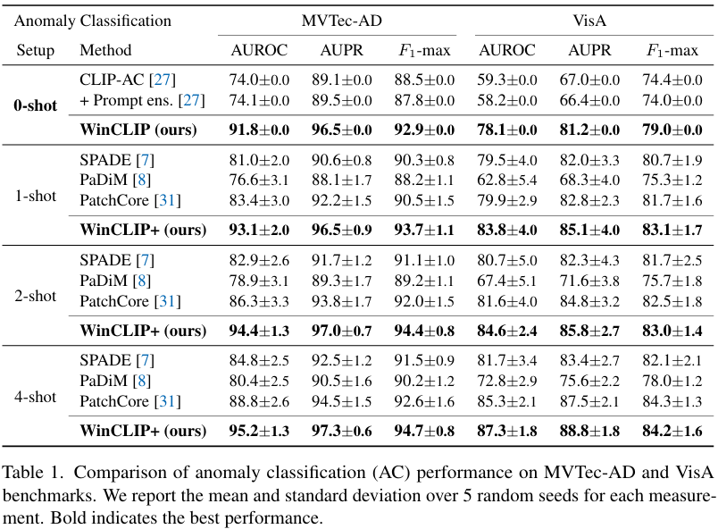
Experiments

Slide 18
Experiments
2.zero-/few-shot anomaly segmentation
zero-shot
while no prior works on zero-shot anomaly segmentation, we adapt two methods developed for other problem to our setup
(a). Trans-MM [5]
(b). MaskCLIP [55]
few-shot
compare with three prior works, designed for anomaly localization.
result show in table 4

Slide 19
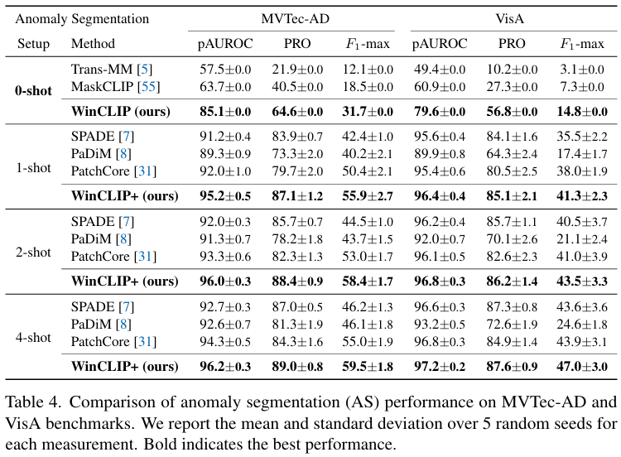
Experiments

Slide 20
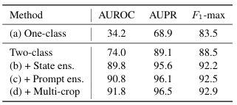
Experiments
3.Ablation study
comparison with CLIP-based Patch Core
3.1 WinCLIP for AC
(1). the textual supervision for the word “anomalous” is crucial to achieve a reasonable performance, show in (a)
(2). having a diversity in both state-level and prompt-level text are the key source of gains. show in (b) and (c)
(3). applying multi-crop prediction could also yield a minor improvement.

Slide 21
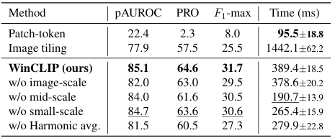
Experiments
3.Ablation study
3.2 WinCLIP for AS
(1).table top-right validates the efficiency of WinCLIP to extract local feature for zero-shot AS
(2).table to-right validates the efficiency of multi-scale and harmonic averaging to boost the result.

Slide 22
代码 WinCLIP
1.主体测试流程(eval_WinCLIP:test)
(a).获取数据data
(b).score = model(data)
(c).将score -> result (指标)
伪代码如下所示：
for (data, mask, label, name, img_type) in dataloader:
# (a) 获取/准备数据
x = stack([model.transform(Image.fromarray(f.numpy())) for f in data], dim=0).to(device)
# (b) 前向得到分数
score = model(x) # 每张一个分数图，是一个[batch, 400, 400]的形状
scores += score # 累积
# (c) 分数 -> 指标（统一分辨率 + 计算指标）
scores, gt_mask_list = resize_to(scores, gt_mask_list, size=(resolution, resolution))
result = metric_cal(np.array(scores), gt_list, gt_mask_list, cal_pro=cal_pro)
# 其中(c)分数->指标如下：
# 图像级的指标：通过score异常图中的最大值表示，用这个最大值和gt标签(1/0)进行对比
# 像素级的指标：通过整个(400，400)score与gt_mask进行计算

Slide 23
代码 WinCLIP
2.score计算过程(model:forward)
从前面看如何计算一张图片的score是重点，具体如下：
(a).计算图像特征
(b).计算图像-文本异常分图
(c).将图像-文本异常分图放大到指定分辨率
#(a) 计算图像特征, (使用ViT提取), 其中：
# images.shape = [32,3,240,240], 即原始图像
# visual_features = [365, 32, 640]，一个特征640维度, 365是mask窗口数量。大中小窗口一共365个.
visual_features = self.encode_image(images)
#(b) 计算图像-文本异常分图，其中
# textual_anomaly_map = [32,1,15,15]，每张图像一个分数图。这里把不同窗口像素分数合并了。
textual_anomaly_map = self.calculate_textual_anomaly_score(visual_features)
#(c) 将异常分图放大到指定分辨率，默认是400*400，即anomaly_map = [32,1,400,400]
anomaly_map = F.interpolate(anomaly_map, size=(self.out_size_h, self.out_size_w), mode='bilinear', align_corners=False)

Slide 24
代码 WinCLIP
3.计算（合成）每个像素异常分(model: calculate_textual_anomaly_score)
如何将不同窗口特征对应的像素异常分合并是重点。每个窗口一个视觉特征，窗口以ViT的patch为单位（不是像素为单位），比如窗口[[0,1],[15,16]]，表示patch 0-1和patch 15-16组成的窗口：
(a).根据对应窗口的vis_features和窗口mask，将vis_features和text_features计算特征相似性(异常分)，并更新到mask指定patch的位置。
(b).累加不同patch的异常分，计算平均值。
(c).将patch对应的异常分reshape一下，从[32, 15*15] -> [32, 15, 15]
# visual_features = [365, 32, 640]
for visual_feature, mask in zip(visual_features, masks):
# (a).计算相似度和异常分数, visual_feature = [32, 640] , text_features = [2, 640]
similarity = visual_feature @ text_features.T
probability = softmax(similarity, dim=-1)
normality_score = probability[:, 0]
# (a).更新到指定位置
token_anomaly_scores[:, mask] = (1. / normality_score)
token_weights[:, mask] = 1.0
# (b): 计算平均值
average_scores = token_anomaly_scores / weight_sum
# (c): 重塑为空间网格，注意这里是所有patch对应所有窗口的平均异常分数图
anomaly_map = average_scores.reshape(batch_size, patch_h, patch_w).unsqueeze(1)
return anomaly_map

Slide 25
代码 WinCLIP
4.文本特征CPE计算（model:build_text_feature_gallery）
(a).组合template和state句子
(b).获取token
(c).获取normal/anomaly embedding
(d).各自取平均值
(e).将两者拼接起来
def build_text_feature_gallery(category, template_prompts, normal_state_prompts, abnormal_state_prompts,
tokenizer, encode_text, device, version="V1"):
# 步骤 (a): 组合template和state句子
normal_phrases, abnormal_phrases = combine_prompts(
category, template_prompts, normal_state_prompts, abnormal_state_prompts
)
# 步骤 (b): 获取token
normal_tokens = tokenizer(normal_phrases).to(device)
abnormal_tokens = tokenizer(abnormal_phrases).to(device)
# 步骤 (c): 获取normal/anomaly embedding
normal_embeddings = encode_text(normal_tokens)
abnormal_embeddings = encode_text(abnormal_tokens)
normal_embeddings = normal_embeddings / normal_embeddings.norm(dim=-1, keepdim=True)
abnormal_embeddings = abnormal_embeddings / abnormal_embeddings.norm(dim=-1, keepdim=True)
# 步骤 (d): 各自取平均值
avg_normal = torch.mean(normal_embeddings, dim=0, keepdim=True)
avg_abnormal = torch.mean(abnormal_embeddings, dim=0, keepdim=True)
# 步骤 (e): 将两者拼接起来
text_features = torch.cat([avg_normal, avg_abnormal], dim=0)
text_features = text_features / text_features.norm(dim=-1, keepdim=True)
return text_features

Slide 26
代码 WinCLIP
4.图像特征计算(model:encode_image->transformer:forward)(1/5)
(a).通过conv1获取图像的embeding,并添加位置参数
# 输入x为正常图像：x = [32, 3, 240, 240]
# 输出x为模型token: x = [32, 896, 15, 15]
x = self.conv1(x) # shape = [*, width, grid, grid]
# x = [32, 896, 225] # 这个就是ViT模型的embeding
x = x.reshape(x.shape[0], x.shape[1], -1) # shape = [*, width, grid ** 2]
# x = [32, 225, 896]
x = x.permute(0, 2, 1) # shape = [*, grid ** 2, width]
# add pos embed w/o cls token (添加除了CLS以外的位置编码,CLS后面额外补充)
x = x + self.positional_embedding.to(x.dtype)[1:, :]

Slide 27
代码 WinCLIP
4.图像特征计算(model:encode_image->transformer:forward)(2/5)
(a).通过conv1获取图像的embeding,并添加位置参数
(b).获取所有图片所有窗口，每张图片共365个窗口图
# 输入 x = [32, 225, 896]
# mask_xs = [365, 32, 4/9, 896] 其中365是大中小窗口的总数,
# 即每张图片(32) 有365个窗口(大中小) 每个窗口有4/9个patch(2*2/3*3)，每个patch的embeding长度896
mask_xs = self.window_masking(x)

Slide 28
代码 WinCLIP
4.图像特征计算(model:encode_image->transformer:forward)(3/5)
(a).通过conv1获取图像的embeding,并添加位置参数
(b).获取所有图片所有窗口，每张图片共365个窗口图
(c).按照不同窗口分别处理数据
# mask_xs = [365, 32, 4/9, 896] 其中365是大中小窗口的总数
# 将mask_xs按照窗口大小，分成2*2和3*3的，分别处理
for scale_index in range(len(self.scale_begin_indx)):
if scale_index == len(self.scale_begin_indx) - 1:
scale_xs = mask_xs[self.scale_begin_indx[scale_index]:]
else:
scale_xs = mask_xs[self.scale_begin_indx[scale_index]:self.scale_begin_indx[scale_index + 1]]
# 某种类型窗口的全部数据，比如2*2
# mx = [196, 32, 4, 896], 表示每张图总共有196个2*2窗口，即每张图片切成196个小份
mx = torch.stack(scale_xs, dim=0)

Slide 29
代码 WinCLIP
4.图像特征计算(model:encode_image->transformer:forward)(4/5)
(a).通过conv1获取图像的embeding,并添加位置参数
(b).获取所有图片所有窗口，每张图片共365个窗口图
(c).按照不同窗口分别处理数据
(d).针对某类型所有窗口，比如2*2，添加CLS embeding
# 某种类型窗口的全部数据，比如2*2
# mx = [196, 32, 4, 896], 表示每张图总共有196个2*2窗口，即每张图片切成196个小份
mx = torch.stack(scale_xs, dim=0)
n_windows, n_batches, _, _ = mx.shape
# 把第一维改成: 196*32, 即将所有图片的所有小份堆叠起来
# mx = [6272, 4, 896]
mx = mx.reshape((-1, mx.shape[2], mx.shape[3]))
# 给所有图片的所有小份，添加一个CLS的embeding，并添加上位置参数
cls_tokens = self.class_embedding.to(x.dtype) + torch.zeros(mx.shape[0], 1, mx.shape[-1], dtype=x.dtype, device=x.device)
cls_tokens = cls_tokens + self.positional_embedding.to(mx.dtype)[0, :]
# mx = [6272, 5, 896]
mx = torch.cat((cls_tokens, mx), dim=1)

Slide 30
代码 WinCLIP
4.图像特征计算(model:encode_image->transformer:forward)(5/5)
(a).通过conv1获取图像的embeding,并添加位置参数
(b).获取所有图片所有窗口，每张图片共365个窗口图
(c).按照不同窗口分别处理数据
(d).针对某类型所有窗口，比如2*2，添加CLS embedding，并：
(e).dropout->ln->transformer->提取CLS->ln->pro (out:640)
# 将调整好的图片通过transformer提取特征，包括：
# dropout(0.0时原样输出) -> ln -> transformer -> global_pool(提取CLS) -> ln -> proj
mx = self.patch_dropout(mx)
mx = self.ln_pre(mx)
mx = mx.permute(1, 0, 2) # NLD -> LND
mx = self.transformer(mx)
mx = mx.permute(1, 0, 2) # LND -> NLD
# 只是分离CLS和其他token(embeding)
pooled, tokens = self._global_pool(mx)
pooled = self.ln_post(pooled)
if self.proj is not None:
pooled = pooled @ self.proj
pooled = pooled.reshape((n_windows, n_batches, pooled.shape[1]))
tokens = tokens.reshape((n_windows, n_batches, tokens.shape[1], tokens.shape[2]))
pooled_list += [p for p in pooled] # visual_features = [365, 32, 640]
tokens_list += [t for t in tokens]

Slide 31
代码 WinCLIP+
1.主要修改(1/2)：
(1).在加载数据时，多了shot图像特征计算(eval_WinCLIP:test)
# (1).加载训练集数据（训练集都是正常数据）
if kwargs['k_shot'] > 0:
train_dataloader, train_dataset_inst = get_dataloader_from_args(phase='train', perturbed=False, **kwargs)
# (2).构造shot图片特征
if train_dataloader is not None:
logger.info('begin build image feature gallery...')
for (data, mask, label, name, img_type) in train_data:
data = [model.transform(Image.fromarray(cv2.cvtColor(f.numpy(), cv2.COLOR_BGR2RGB))) for f in data]
data = torch.stack(data, dim=0)
data = data.to(device)
# 这里构造shot图片特征
model.build_image_feature_gallery(data)
logger.info('build image feature gallery finished.')

Slide 32
代码 WinCLIP+
1.主要修改(2/2)：
(1).在加载数据时，多了shot图像特征计算(eval_WinCLIP:test)
(2).在计算图像异常分时，多了与图像特征的比较的异常分计算。（model:forward，如下） (3).其余跟WinCLIP一样
def forward(self, images):
visual_features = self.encode_image(images)
# 用文本给图像打分
textual_anomaly_map = self.calculate_textual_anomaly_score(visual_features)
if self.visual_gallery is not None:
# 用shot图像特征，给图像打分
visual_anomaly_map = self.calculate_visual_anomaly_score(visual_features)
else:
visual_anomaly_map = textual_anomaly_map
# 分数计算有一点变化，WinCLIP visual_anomaly_map就是textual_anomaly_map，现在两者不同
anomaly_map = 1. / (1. / textual_anomaly_map + 1. / visual_anomaly_map)

Slide 33
代码 WinCLIP+
function calculate_visual_anomaly_score(visual_features):
N = visual_features[0].shape[0] # batch size
G = grid_h * grid_w # patch 总数
scale_scores = []
token_scores = zeros(N, G)
token_weights = zeros(N, G)
cur_scale = 0
gallery = visual_gallery[cur_scale] # 当前尺度的正常库特征 [M, D]
for i, (feat, mask) in enumerate(zip(visual_features, masks)):
# (1) 每个输入窗口与库中所有窗口算相似度并取最大
# feat: [N, D], gallery: [M, D]
sim = feat @ gallery.T # [N, M]
best_sim = max(sim, dim=1) # [N]
# (2) 将最大相似度映射为该窗口覆盖patch的异常分，并写入相应位置
anomaly = 0.5 * (1 - best_sim) # [N]
token_scores[:, mask] += anomaly[:, None]
token_weights[:, mask] += 1.0
# 尺度切换时，先对当前尺度做patch级平均并记录，再重置累积器
if i in scale_begin_indx[1:]:
scale_scores.append(token_scores / token_weights)
token_scores = zeros(N, G)
token_weights = zeros(N, G)
cur_scale += 1
gallery = visual_gallery[cur_scale]
# 处理最后一个尺度
scale_scores.append(token_scores / token_weights)
# (3) 对所有尺度的patch异常分取平均，得到最终异常图
S = mean(stack(scale_scores, dim=0), dim=0) # [N, G]
anomaly_map = reshape(S, [N, 1, grid_h, grid_w])
return anomaly_map
2.用shot特征给图片打分流程(model:calculate_visual_anomaly_score)
(1).每个输入visual窗口与所有shot对应的所有窗口计算相似度，取最大值
(2).将这个最大值作为输入visual对应patch的异常
(3).计算所有的patch异常分，取平均值，具体流程如下，与文本打分类似

Slide 34
代码 WinCLIP+
3.构造shot特征图,model:build_image_feature_gallery -> model:encode(img)
(1).跟输入图片编码一摸一样，只是将结果按窗口[365,640]拆分成两块[[196,640], [169,640]]
def build_image_feature_gallery(self, normal_images):
self.visual_gallery = []
# [365, 640]
visual_features = self.encode_image(normal_images)
for scale_index in range(len(self.scale_begin_indx)):
if scale_index == len(self.scale_begin_indx) - 1:
scale_features = visual_features[self.scale_begin_indx[scale_index]:]
else:
scale_features = visual_features[self.scale_begin_indx[scale_index]:self.scale_begin_indx[scale_index+1]]
self.visual_gallery += [torch.cat(scale_features, dim=0)]

Slide 35
使用自定义数据
主要按照VisA格式去放数据，并修改VisA路径下的VisA/split_csv/1cls.csv文件即可。
然后运行修改（主要修改16-19行的参数）并运行项目下的datasets/prepare_visa_public.py预处理的visa_pytorch
最后修改项目下datasets/visa.py，改成从新生成的目录下加载数据即可

