Slide 1
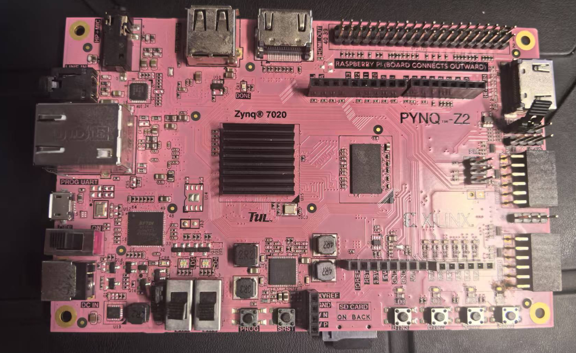
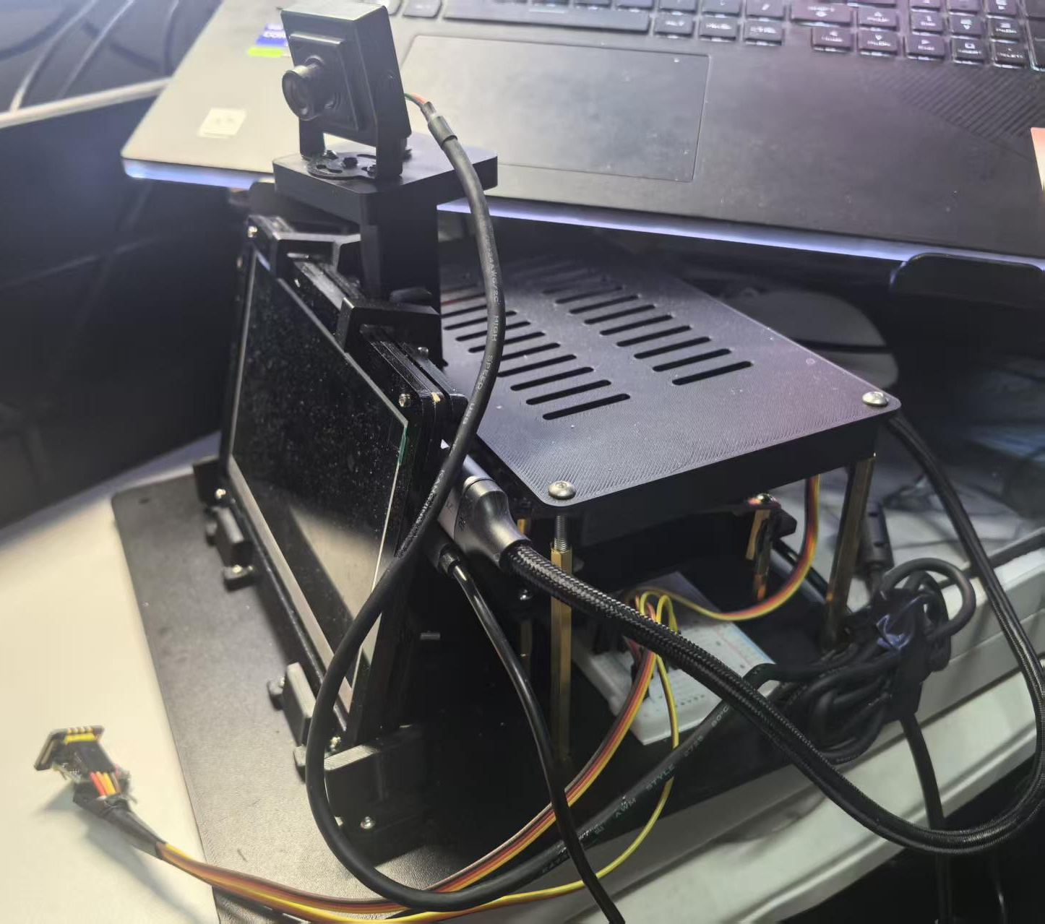

INTRODUCTION
基于FPGA的个体健康趋势预警
——面向多模态感知的可信心率观测系统
PYNQ-Z2 板卡正面实拍
MAX30102
接触式PPG
MPU6050
三轴加速度
USB摄像头
YUYV视频
PS：采集、时间配对与运行监管
PYNQ-Z2 / AMD Zynq-7020
运动与接触变化会干扰PPG，单一读数难以说明质量。系统将心率、波形、惯性与视觉观测集中呈现，帮助理解当前读数与采集状态。
典型应用与产品价值
面向本地接触式PPG观测，浏览器显示四路波形与质量，HDMI呈现心率和运动情境。
关键创新
1. 多模态同步采集与时间配对。
2. PL承担预处理、NLMS、峰值与IBI。
3. 质量选路、合格心搏历史复用与无效撤回。
4. 自主结构集成板卡、屏幕与相机；传感器以黑色绝缘胶带和魔术贴固定。
5. 八项Skills沉淀可检查、可复用的研发流程。
PL 心率主链
预处理 / NLMS
历史评估 / 峰值 / IBI
PL 视觉运动核
4×3空间分块帧差
运动像素并行统计
C
联合运行测试结果
R
R
测试项 | 测试记录
运行窗口 | 约80.7 s
处理 / 保存 | 2021 / 2021
配对 / 未配对 | 2020 / 1
未配对处理 | 保留原因，禁止数值发布
视频 | 403帧，漏目标槽0
停止 | 用户停止，资源释放
E
E
接触与采集
PPG / IMU
协同计算
PS + PL
质量与选路
发布许可
本地观测
波形与显示
PS：质量选路与数值发布许可
视觉与惯性：并行运动情境观测
A
S
T
U
HDMI：视频与数值 | 浏览器：四路波形
I
L
典型观测流程
V
T
系统架构
E
条件：PPG/IMU 25 Hz；视频目标5 fps
PL心率与视觉计算
1. 预处理、NLMS、峰值与IBI在PL完成。
2. 12个空间块并行统计帧差和运动像素。
3. PS管理质量、选路与数值发布许可。
4. 惯性与视觉形成旁路运动观测。
D
联合运行显示心率处理、视觉观测与结果记录可共同工作。无效记录保留原因并撤回数值；配对统计与心率准确性分别评价。
联合PL主时钟100 MHz，LUT 68.66%、BRAM 62.50%；WNS +0.016 ns、WHS +0.028 ns。
同输入ARM组件对照：PS尾段5.04 → 4.23 ms/点，含Pipe路径9.24 → 8.05 ms/点，消息4 → 2条/点。这是组件开销改善，不直接代表整机加速。
E
S
I
G
N
八项Skills与人工主导LLM协作
人工限定目标与开销，模型按证据纠错。
八项Skills覆盖审计、会话、性能与核验，
以及Overlay、DMA、Notebook与分段剖析。

Slide 2
INTRODUCTION
FPGA-Based Personal Health
Trend Early Warning
— Trustworthy Heart Rate Observation for Multimodal Sensing
PYNQ-Z2 board front
MAX30102
Contact PPG
MPU6050
Acceleration
USB camera
YUYV video
PS: acquisition, time pairing and supervision
PYNQ-Z2 / AMD Zynq-7020
Motion and contact changes disturb PPG. The prototype combines heart rate, waveforms and motion context to make signal quality observable.
Typical Use and Product Value
A local prototype for contact PPG observation. The browser shows four waveforms and quality; HDMI presents heart rate and motion context.
Key Engineering Contributions
1. Multimodal acquisition and time pairing.
2. PL preprocessing, NLMS, peaks and IBI.
3. Quality routing, qualified-IBI reuse and invalid-output withdrawal.
4. Custom supports integrate the board, display and camera; sensors use tape and hook-and-loop straps.
5. Eight reusable Skills support evidence-led engineering.
PL HEART RATE
Preprocess / NLMS
History / peaks / IBI
PL VISION MOTION
4 x 3 block delta
Motion pixel statistics
C
Joint Run Test Results
R
R
Metric | Recorded result
Run window | Approx. 80.7 s
Processed / saved | 2,021 / 2,021
Paired / unpaired | 2,020 / 1
Unpaired record | Reason kept; HR withheld
Video | 403 frames; target gaps 0
Stop | User stop; resources released
E
E
SENSE
PPG / IMU
COMPUTE
PS + PL
QUALIFY
Quality / gate
OBSERVE
Local display
PS: quality / routing / HR gate
Vision and IMU: parallel motion context
A
S
T
U
HDMI: video + values | Browser: four waveforms
I
L
Observation Flow
V
T
System Architecture
E
PPG/IMU: 25 Hz; video target: 5 fps
PL Heart Rate and Vision Processing
1. Preprocess, NLMS, peaks and IBI in PL.
2. Twelve blocks process image motion.
3. PS manages quality, routing and release.
4. Vision and IMU provide motion context.
D
The joint run combines heart processing, vision observation and logging. Invalid records retain reasons and withhold values; pairing counts are separate from HR accuracy.
Joint PL main clock: 100 MHz; LUT 68.66%, BRAM 62.50%; WNS +0.016 ns, WHS +0.028 ns.
Same-input ARM component comparison: PS tail 5.04 → 4.23 ms/sample; Pipe path 9.24 → 8.05; messages 4 → 2 per sample. These are component gains, not whole-system speedup.
E
S
I
G
N
Eight Skills and Human-Led LLM Work
People set scope; the model checks evidence.
Audit, sessions, timing, kernel verification;
Overlay, DMA, Notebooks and phase profiling.

