Slide 1
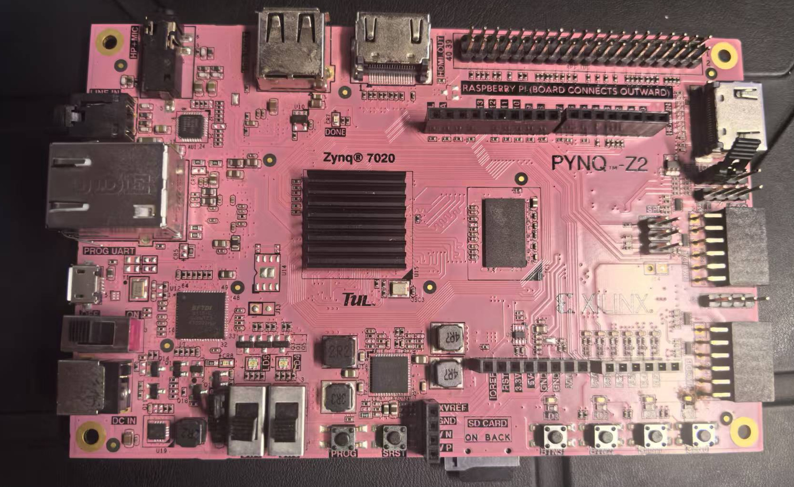
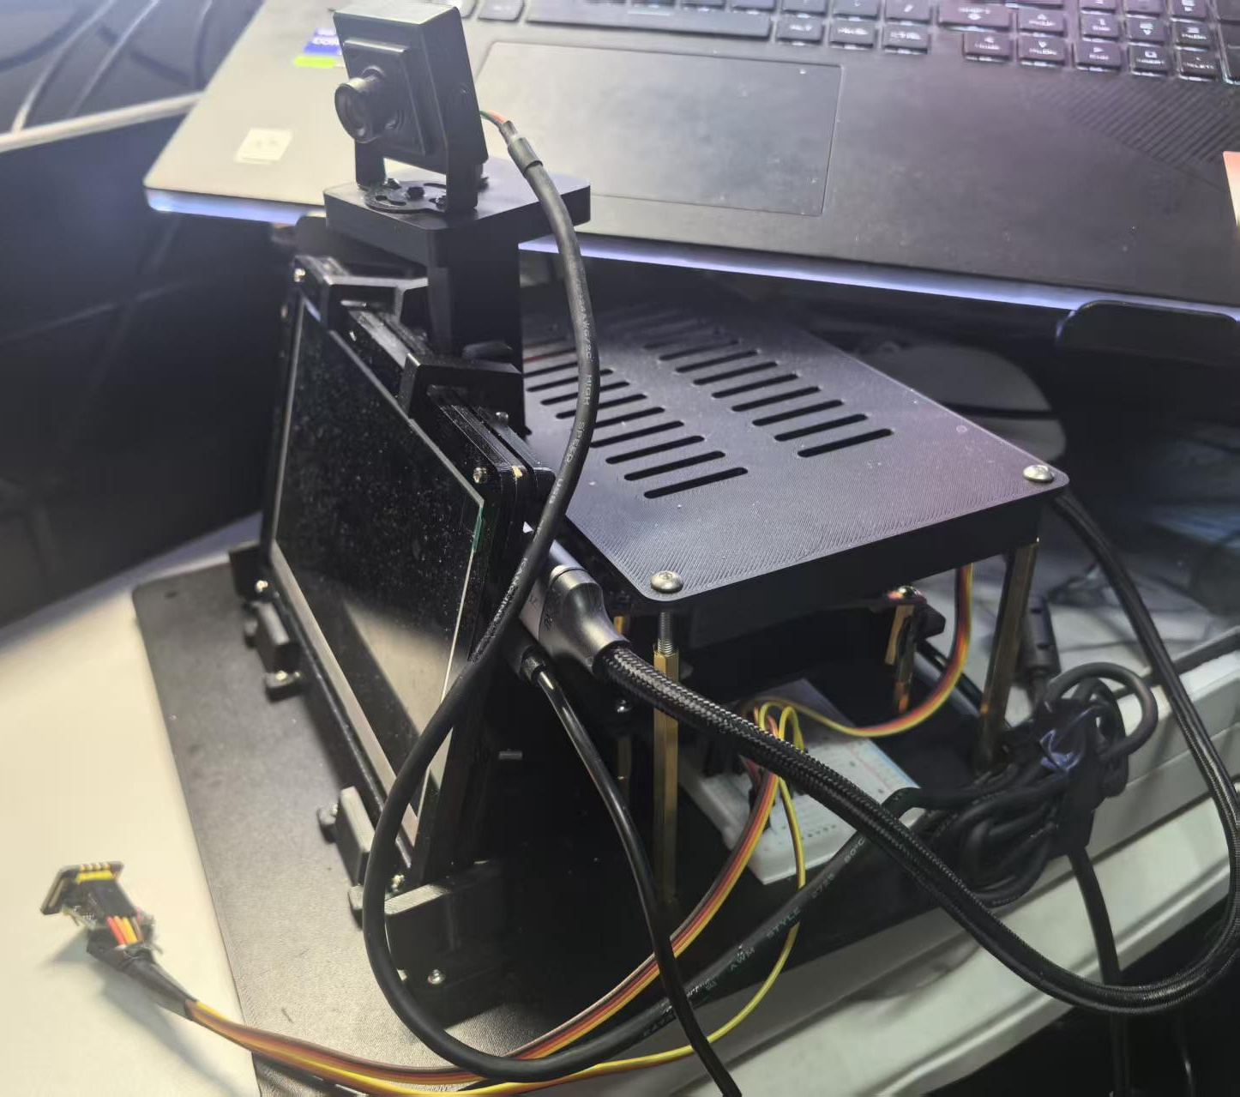

INTRODUCTION
FPGA-Based Personal Health
Trend Early Warning
— Trustworthy Heart Rate Observation for Multimodal Sensing
PYNQ-Z2 board front
MAX30102
Contact PPG
MPU6050
Acceleration
USB camera
YUYV video
PS: acquisition, time pairing and supervision
PYNQ-Z2 / AMD Zynq-7020
Motion and contact changes disturb PPG. The prototype combines heart rate, waveforms and motion context to make signal quality observable.
Typical Use and Product Value
A local prototype for contact PPG observation. The browser shows four waveforms and quality; HDMI presents heart rate and motion context.
Key Engineering Contributions
1. Multimodal acquisition and time pairing.
2. PL preprocessing, NLMS, peaks and IBI.
3. Quality routing, qualified-IBI reuse and invalid-output withdrawal.
4. Custom supports integrate the board, display and camera; sensors use tape and hook-and-loop straps.
5. Eight reusable Skills support evidence-led engineering.
PL HEART RATE
Preprocess / NLMS
History / peaks / IBI
PL VISION MOTION
4 x 3 block delta
Motion pixel statistics
C
Joint Run Test Results
R
R
Metric | Recorded result
Run window | Approx. 80.7 s
Processed / saved | 2,021 / 2,021
Paired / unpaired | 2,020 / 1
Unpaired record | Reason kept; HR withheld
Video | 403 frames; target gaps 0
Stop | User stop; resources released
E
E
SENSE
PPG / IMU
COMPUTE
PS + PL
QUALIFY
Quality / gate
OBSERVE
Local display
PS: quality / routing / HR gate
Vision and IMU: parallel motion context
A
S
T
U
HDMI: video + values | Browser: four waveforms
I
L
Observation Flow
V
T
System Architecture
E
PPG/IMU: 25 Hz; video target: 5 fps
PL Heart Rate and Vision Processing
1. Preprocess, NLMS, peaks and IBI in PL.
2. Twelve blocks process image motion.
3. PS manages quality, routing and release.
4. Vision and IMU provide motion context.
D
The joint run combines heart processing, vision observation and logging. Invalid records retain reasons and withhold values; pairing counts are separate from HR accuracy.
Joint PL main clock: 100 MHz; LUT 68.66%, BRAM 62.50%; WNS +0.016 ns, WHS +0.028 ns.
Same-input ARM component comparison: PS tail 5.04 → 4.23 ms/sample; Pipe path 9.24 → 8.05; messages 4 → 2 per sample. These are component gains, not whole-system speedup.
E
S
I
G
N
Eight Skills and Human-Led LLM Work
People set scope; the model checks evidence.
Audit, sessions, timing, kernel verification;
Overlay, DMA, Notebooks and phase profiling.

