Slide 1
Ampora: Linear Regression
AI-Generated Educational Content

Slide 2
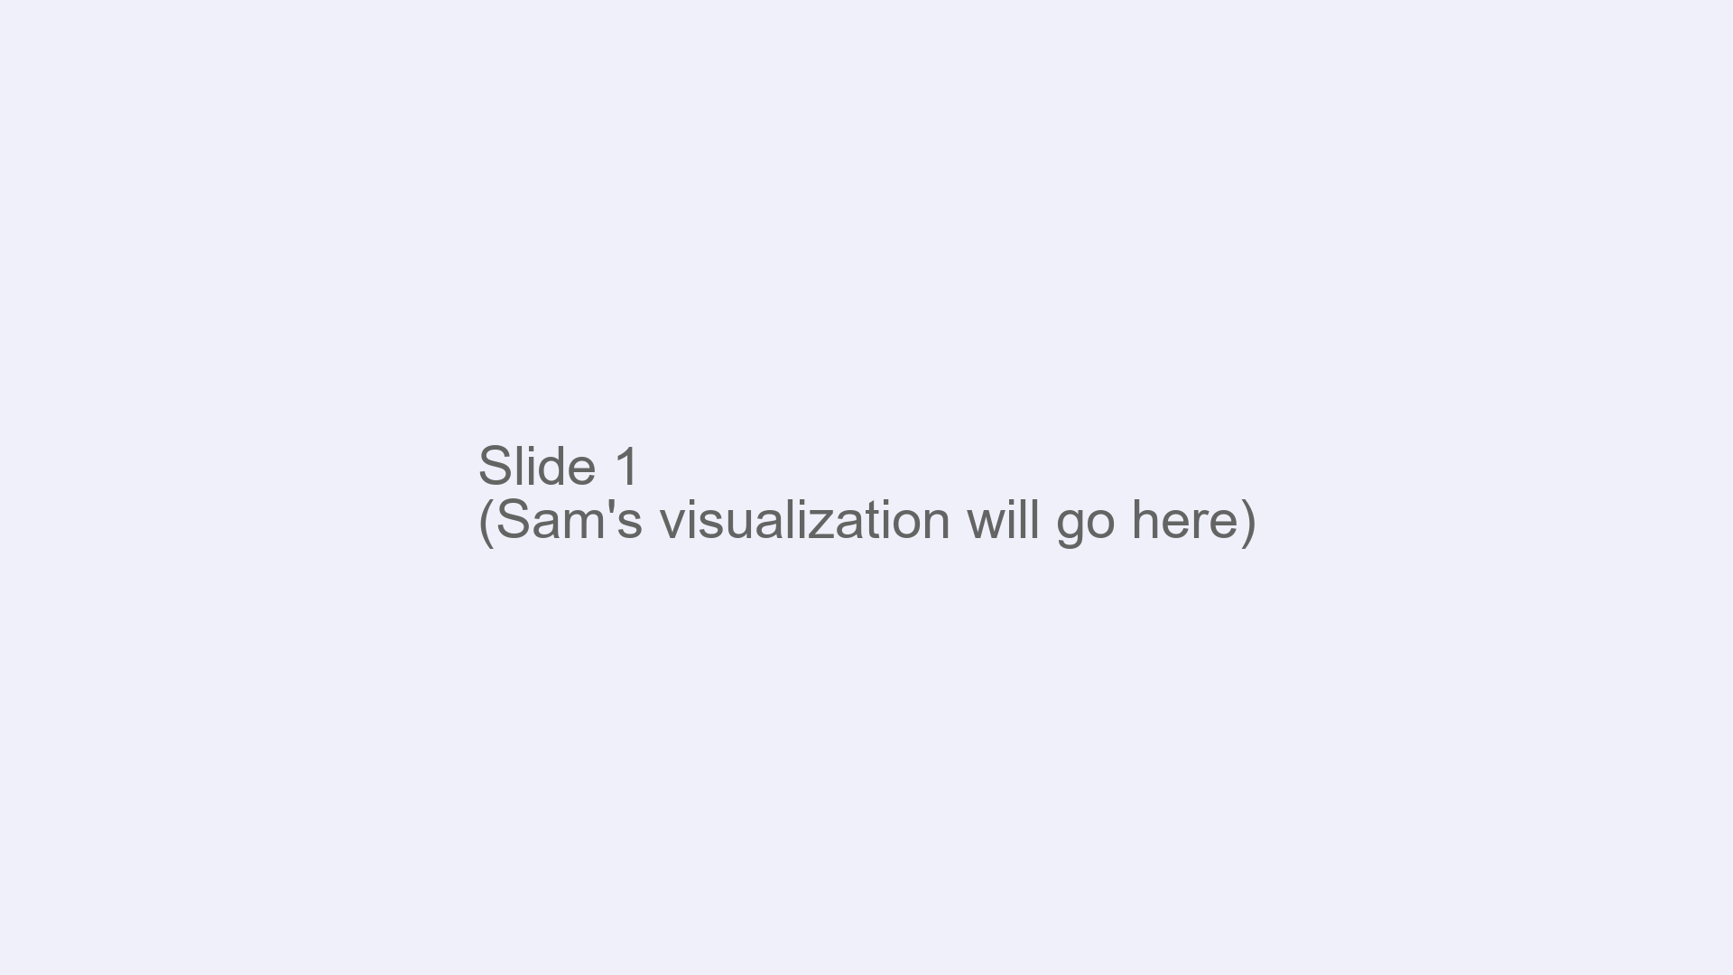
Notes:
Welcome to a friendly deep dive into linear regression with matrices. Today we are going to build the whole story from the model and its assumptions, all the way to estimation, diagnostics, and even ridge regression. We will keep it smooth, spoken, and crystal clear. First, what is the topic. Linear regression in matrix form is the idea that we model a whole set of outcomes at once by saying the outcome vector equals the design matrix times the coefficient vector plus random errors. In other words, every row of the design matrix holds the predictors for one observation, and the coefficient vector tells us how much each predictor contributes to the outcome. The error vector captures random noise and anything the predictors did not explain. Why is this important. Because this single picture unifies everything we love about regression. It gives us a clean way to estimate the best fitting line or plane, to test hypotheses, to measure uncertainty, and to diagnose problems. Even better, it is the foundation for generalized linear models, mixed effects models, and many modern machine learning methods. If you understand this, so many doors open. Bam. Where is it used.

Slide 3
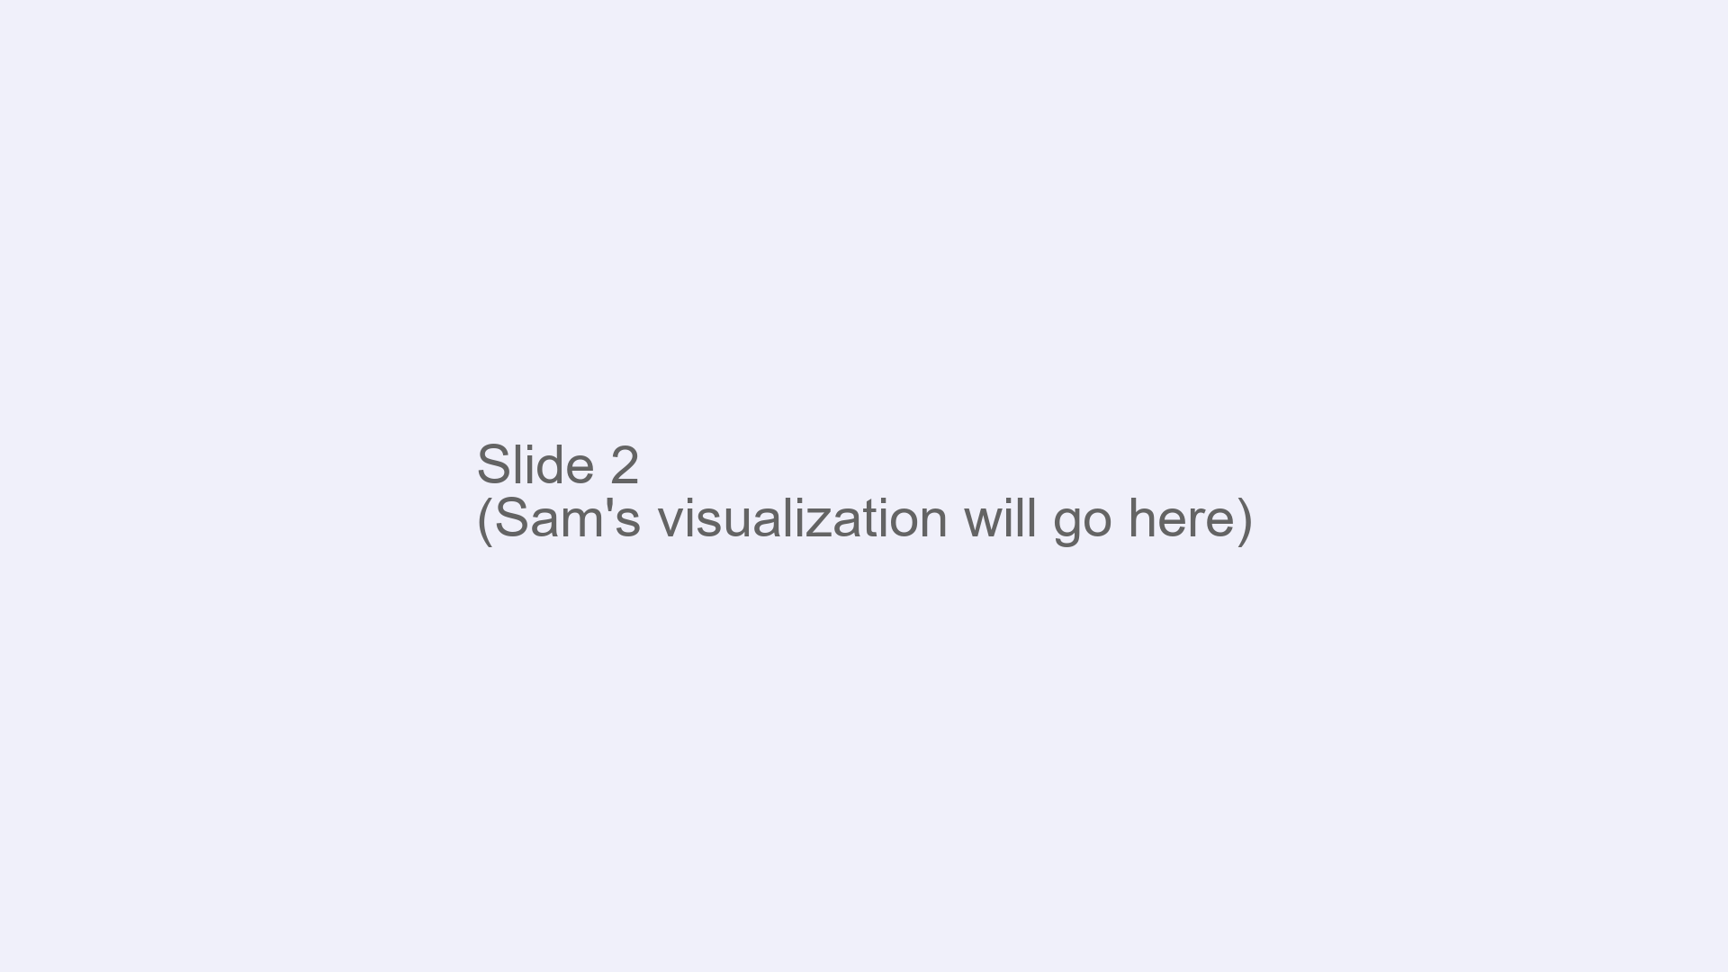
Notes:
Everywhere we want to relate a numeric outcome to features. Economists use it to estimate wage returns to education while controlling for experience. Doctors use it to predict blood pressure from age, weight, and medication. Marketers use it to estimate lift from advertising channels. Engineers use it to calibrate sensors and control systems. Scientists use it to test theories and quantify effects. It is the basic hammer in the data toolbox. Now let’s dive into the details. We start with the model and its assumptions. The model says the outcome vector equals the design matrix times the true coefficients plus errors. The classical assumptions are simple. First, the average of the errors given the design matrix is zero. That means the predictors do not systematically miss the mark in one direction. Second, the variance of the errors given the design matrix is the same constant for every observation and the errors are uncorrelated.

Slide 4

Notes:
In words, the error variance is sigma squared times the identity. Finally, to identify the coefficients, the columns of the design matrix must be linearly independent. In other words, no column can be expressed as a combination of the others. That full rank condition is what makes each coefficient uniquely defined. Next, let’s estimate the coefficients using ordinary least squares. The idea is to choose the coefficient vector that makes the sum of squared residuals as small as possible. The objective is the squared length of the residual vector, which is the outcome minus the design matrix times the coefficients. When we take the gradient of this objective with respect to the coefficients and set it to zero, we get the normal equations. In words, the design matrix transposed times the design matrix times the estimated coefficients equals the design matrix transposed times the outcomes. If the design matrix has full column rank, then the inner matrix is invertible, and we can solve by multiplying both sides by that inverse. That gives the familiar closed form solution. This solution exists and is unique exactly when the columns are linearly independent. If they are not, there are infinitely many minimizers, and we need a rule to pick one. That brings us to convexity and uniqueness.

Slide 5

Notes:
The least squares objective is a convex bowl. We can see this by looking at the Hessian, which is the second derivative with respect to the coefficients. The Hessian equals two times the design matrix transposed times the design matrix. This matrix is always positive semidefinite, so the bowl never bends downward. If the design matrix has full column rank, then this matrix is positive definite, which means the bowl has a single bottom and the minimizer is unique. If the design matrix does not have full rank, the bowl is flat along some directions, so there are many solutions. In that case, the Moore Penrose pseudoinverse gives the minimum norm solution. In words, it picks the shortest coefficient vector that still minimizes the squared residuals. Let’s ground this with a small numerical example we can do in our heads. Imagine three observations and two predictors where the first predictor is an intercept equal to one for all rows, and the second predictor takes the values negative one, zero, and one. Let the outcomes be zero, two, and one in that order. In this setup the second predictor is centered, so its average is zero. The least squares slope for the second predictor equals the sum of the product of that predictor and the outcome divided by the sum of squares of that predictor. That gives one half.

Slide 6

Notes:
Because the predictor is centered, the intercept is the average outcome, which is one. So the fitted values are one minus one half, then one, then one plus one half. That is one half, one, and one and a half. The residuals are observed minus fitted. That is negative one half, one, and negative one half. Now we can verify the key orthogonality property. If we sum the residuals we get zero, so the residuals are orthogonal to the intercept column. If we multiply each residual by its predictor value and sum, we again get zero, so the residuals are orthogonal to the second column as well. This is the geometric heart of least squares. The fitted vector is the projection of the outcome onto the column space of the design matrix, and the residual vector is perpendicular to that space. The residual sum of squares in this example is one and a half. That projection idea leads to the hat matrix. The hat matrix maps outcomes to fitted values. It is the design matrix times the inverse of the cross product times the design matrix transposed.

Slide 7

Notes:
Two beautiful properties pop out. First, it is symmetric because taking the transpose just flips the order and lands you right back where you started. Second, it is idempotent, which means when you apply it twice you get the same result as applying it once. That is because projecting onto a space and then projecting again leaves you where you already landed. The diagonal entries of the hat matrix are the leverages. They quantify how much each observation pulls on its own fitted value. High leverage means the fitted value for that observation is based heavily on itself and on a unique combination of predictors. The variance of a fitted value is the error variance times the leverage. That is why high leverage points have wide uncertainty bands. Studentized residuals divide the residual by its estimated standard deviation, and they include a correction factor based on one minus the leverage. This correction prevents us from thinking a large residual at a high leverage point is automatically evidence of a bad fit. Instead we scale it appropriately before judging. Now let’s quantify uncertainty in the estimated coefficients. Under our classical assumptions, the sampling variance of the estimated coefficients equals the error variance times the inverse of the cross product.

Slide 8

Notes:
If the errors are Gaussian, then the estimated coefficients themselves are Gaussian, centered on the true values, with that variance. We estimate the error variance with the residual sum of squares divided by the sample size minus the number of parameters. That denominator counts how many independent pieces of information remain after fitting the model. Standard errors for coefficients come from that variance estimate and the inverse of the cross product. Then we build confidence intervals using the t distribution with degrees of freedom equal to sample size minus number of parameters. Hypothesis tests for a single coefficient use a t statistic obtained by dividing the estimate by its standard error. An overall test that all slopes are zero uses an F statistic that compares explained variance to residual variance, and under the null it follows an F distribution with numerator degrees equal to the number of slopes and denominator degrees equal to sample size minus number of parameters. Time for the Gauss Markov theorem. The theorem says that, under the classical assumptions, ordinary least squares is the best linear unbiased estimator. Best means it has the smallest variance among all estimators that are linear in the outcomes and unbiased. Here is the spoken proof sketch. First, least squares is unbiased because the expected residual is zero and the model is linear in the coefficients. Second, consider any other linear unbiased estimator. We can write it as the least squares estimator plus some linear transformation of the residuals.

Slide 9

Notes:
Because the residuals are orthogonal to the columns of the design matrix, that extra term cannot improve variance without introducing bias. In fact, its variance adds a nonnegative amount to the variance of least squares. Therefore, no other linear unbiased estimator can beat least squares on variance. Bam. Note that best linear unbiased does not mean minimum variance among all unbiased estimators in the universe. Without normality, there might be nonlinear unbiased estimators with smaller variance. With normality, however, least squares is not only best among linear unbiased estimators, it is also the uniformly minimum variance unbiased estimator for linear functionals of the coefficients, thanks to sufficiency and completeness. Let’s talk interpretation. Each estimated coefficient for a continuous predictor is a partial effect. It tells us how the outcome changes as that predictor increases by one unit while holding the other predictors fixed. Centering predictors by subtracting their means makes the intercept easier to interpret as the expected outcome at typical predictor values, and it improves numerical stability by reducing correlation among columns. Scaling to unit variance helps when predictors have very different units, which stabilizes computation and can improve interpretability in models with penalties. For categorical variables, we include a set of dummy variables, one for each category except a chosen baseline. Each dummy coefficient compares that category to the baseline, holding other predictors fixed.

Slide 10

Notes:
If you include all categories and an intercept, you lose full rank, so always omit one category or drop the intercept and interpret carefully. Diagnostics help us check fit and assumptions. R squared tells us the fraction of variation explained by the model, while adjusted R squared penalizes extra parameters and is better for comparing models. Root mean squared error puts typical error back on the scale of the outcome. Residual plots against fitted values and each predictor should look like shapeless clouds with no systematic patterns. If you see a curve, consider adding transformations or interaction terms. Outliers can be spotted with large studentized residuals. High leverage points are flagged by large hat values. Influential points combine both and can be measured by Cook’s distance, which asks how much the fitted values would change if we left a point out. Remedies include transforming variables, adding interaction or polynomial terms to capture curvature, or reconsidering the data generating process and whether some points belong to a different regime. Multicollinearity is when predictors are highly correlated, making coefficient estimates unstable and standard errors large. We detect it using variance inflation factors, which show how much a coefficient variance is inflated by correlation with other predictors, and condition numbers, which summarize how close the design matrix is to losing rank. When multicollinearity is a problem, ridge regression is a classic remedy. Ridge modifies the normal equations by adding a positive constant to the diagonal of the cross product.

Slide 11

Notes:
In words, we soften the inversion and gently pull coefficients toward zero. This adds a little bias but can dramatically reduce variance, giving a lower mean squared error overall. We pick the ridge strength using cross validation, where we hold out data, try different penalty levels, and choose the one that predicts best out of sample. Before we wrap up, let’s revisit the fitted values, residuals, and orthogonality in our simple example. The fitted values were one half, one, and one and a half. The residuals were negative one half, one, and negative one half. The sum of residuals was zero and the sum of predictor times residual was zero. That orthogonality is the signature of least squares. It explains the geometry of projection, the form of the hat matrix, and the reason the normal equations hold. Summary time. We set up linear regression in matrix form and stated the core assumptions on the errors and the full rank condition on the design matrix. We minimized the sum of squared residuals, took derivatives to get the normal equations, and solved for the least squares estimator when the cross product is invertible. We saw that the objective is convex, uniqueness comes from full rank, and when rank is lost, the pseudoinverse gives the minimum norm solution. We computed a small example, verified that residuals are orthogonal to the columns of the design matrix, and connected that to the hat matrix, its symmetry and idempotence, and the leverages on the diagonal.

