Slide 1
Churn Prediction for Music Box Users -- DS-501 Capstone Project
Presenter:
Xiaoxi Wu
Date: Jan 1st, 2017

Slide 2
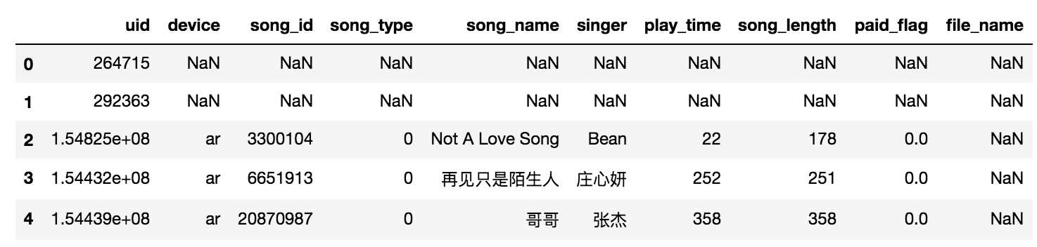
Data Source
Play logs of Music Box from March 01 ~ May 12, 2017
Large data set: play.log ~14G, down.log ~0.5G
Sample data:

Slide 3
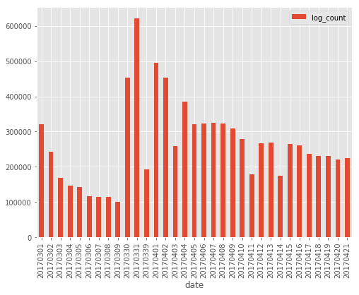
Project Description:
Observation
>50% reduction of
daily play activities
Over ~ 3 weeks
Objective:
Predict churn users
Find out correlation/ casual relation between churn and users’ behaviors

Slide 4
Churn Definition
Active users:
users who has played >= 3 times in Period 1 ( March 01 ~ April 21, 2017)
~ 740K active uses
Loyal users:
active users who had at least played once in Period 2( April 22 ~ May 12, 2017)
~240K of active users are loyal
Churn users:
active users in Period 1 but had on play activity in Period 2
~ 500K churned. Churn rate > 60%
Cut off date is April 22nd. Two reasons: (1) leave three weeks after cutoff date to determine whether user has recent activity. (2) the reduced data set before cut off date has reasonable size to be opened locally on PC.

Slide 5
Down Sampling
Down sample on the level of user_id, as this will not change the total behavior of each user.
First get the user_id set for all loyal and churn users.
Then sample 10% of each set to make sampled loyal and churn user set.
The last step is read in data line by line by matching the user_id with sampled user set.
Down sampling: 10: 1
24K good users + 50K churns

Slide 6
EDA and Feature engineering: Group by user_id
1. Count: No. of play logs in 5 time windows:
1.1 04/15 - 04/21: ”count_in_recent_1week”
1.2 04/08 – 04/14: "count_in_recent_2week”
1.3 04/01– 04/07: "count_in_recent_3week”
1.4 03/30 – 03/31: "count_in_recent_4week”
1.5 03/01 – 03/09: “count_in_recent_8week”
2. User related
2.1 Preferred device: majority vote of devices (ip or ar), if more than one device is used: "device”
3. Music related
3.1 Total time playing music: "total_play_time”
3.2 Music completion ratio for each user: "completion_ratio_avg”
3.3 Most frequent song type “major_song_type”

Slide 7
EDA and Feature engineering – Derived features
Average song completion ratio:
play_time/song_length average for each user id
How many times popular songs a user played
Popular songs: top 100 most played songs
How many times rare songs a user played
Rare songs: songs only played once in Period 1
Song popularity ratio:
The ratio between popular songs and unpopular songs played by each user
Facts: > 224k songs have only been played once

Slide 8
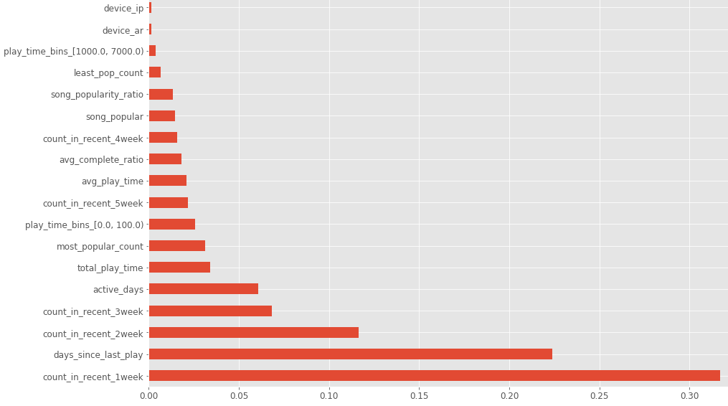
Machine Learning models: Random Forest
Best parameters from grid search:
50 trees
Max depth = 50
Min leaves = 10
Max features per tree = sqrt(n)
Metrics:
Mean Accuracy: 0.884
Cross-validation:
[ 0.883 0.883 0.885 0.882 0.887]
Most important features:
count_in_recent_1week
days_since_last_play
count_in_recent_2week
count_in_recent_3week
active_days
…

Slide 9
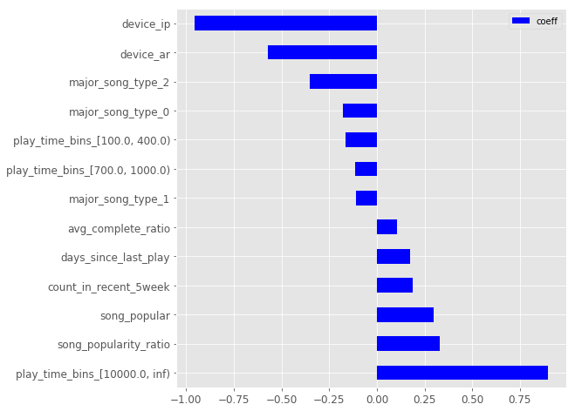
Machine Learning models: Logistic Regression
Best parameters from grid search:
penalty = ‘l1’,
C = 10
Metrics:
Accuracy: 0.862
Cross-validation:
[ 0.858 0.865 0.862 0.863 0.861]
Most important features:
Play_time_bins
Device
Song_popularity_ratio
Major_song_type
Days_since_last_play
...

Slide 10
Model selection
Random Forest
Low variance
High accuracy
Mean Accuracy: 0.884
Cross-validation:
[ 0.883 0.883 0.885 0.882 0.887]
Logistic Regression
Low variance
High accuracy
Accuracy: 0.862
Cross-validation:
[ 0.858 0.865 0.862 0.863 0.861]

Slide 11
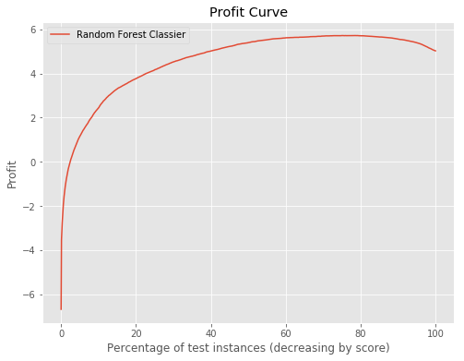
Business value
Benefit – cost matrix:
[[10,-5],
[-10,0]]
Cost for FP is only -5 as it does not hurt much to send reminder or promotion to loyal users. Cost for FN is high as this will lead to loss of potential churn users.
The best threshold is 0.215,
Gives a max profit of 5.72
Accuracy: 0.886
Precision: 0.892
Recall: 0.945

Slide 12
Future Plan
Add down and search logs in to the user behavior to get more accurate estimation on churn.
Collaborative filtering Recommendation system with Spark and cloud computation.

Slide 13
The end Thank you!

