Slide 1

How to compress LLMs?
Name: Taiqiang Wu
UID: 3030102852
Department: EEE
Date: 2024/10/22

Slide 2
Goal
Intended learning outcome (ILO)
By the end of the 10-min teaching, you will be able to:
Describe the goal of the compression for LLMs
Explain the mainstreaming methods to compress these LLMs
Combine these compression strategies to make your own method

Slide 3
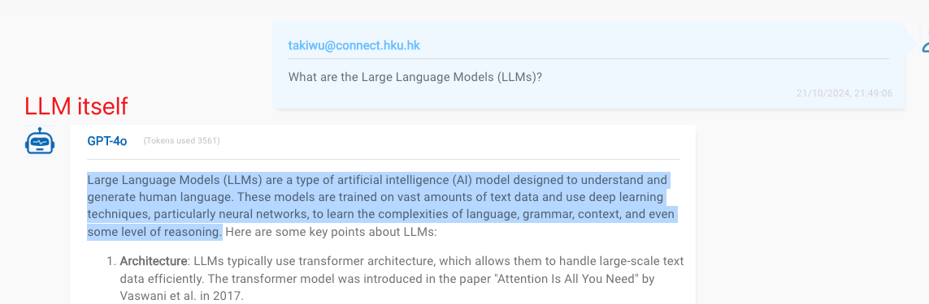
Preliminary
What are the Large Language Models (LLMs)?
Large Language Models (LLMs) are a type of artificial intelligence (AI) model designed to understand and generate human language. These models are trained on vast amounts of text data and use deep learning techniques, particularly neural networks, to learn the complexities of language, grammar, context, and even some level of reasoning.
https://chatgpt.hku.hk/

Slide 4


Why Compress
Expensive & Rich functions
Which one?
Cheap & Poor functions

Slide 5
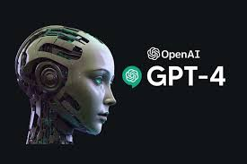
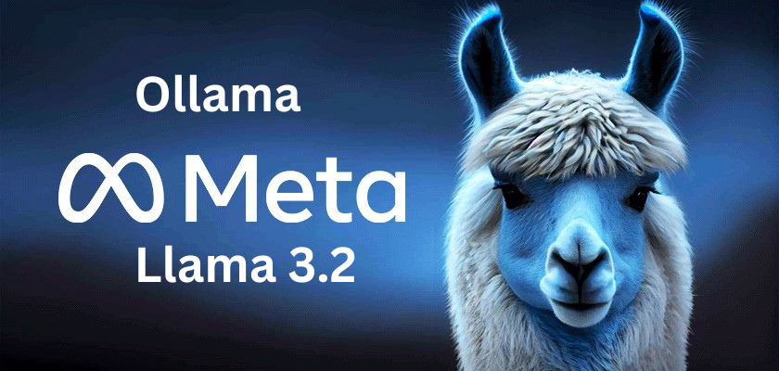
Why Compress
We want a LLM which is both brilliant and cheap!
Similar trade-off when choosing LLMs
Brilliant
1.8 trillion parameters
1,800,000,000,000
(expensive)
Smart but sometimes fails
1.24 billion parameters
1,240,000,000
(much cheaper)

Slide 6
Model Compression
Definition:
Model compression refers to a set of algorithms that aim to reduce the size and memory requirements of neural networks without significantly impacting their accuracy. This can help make models more efficient and cost-effective, allowing them to be deployed on various environments, such as edge devices and cloud services.
Taxonomy:
Knowledge distillation
Pruning
Quantization
https://unify.ai/blog/model-compression

Slide 7
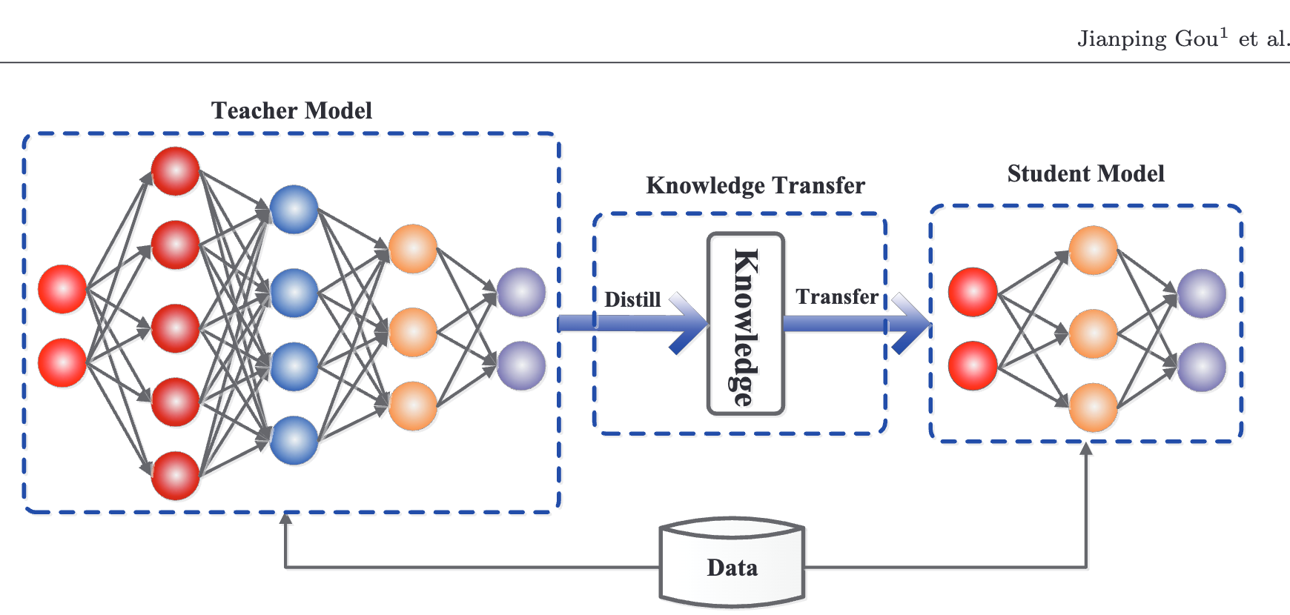
Knowledge Distillation
Definition:
Knowledge distillation is a model compression technique that involves transferring the knowledge from a large, complex neural network (teacher network) to a smaller, simpler neural network (student network). The goal of knowledge distillation is to reduce the size of the network while maintaining its accuracy by leveraging the knowledge learned by the teacher network.
Transfer the functions from iPhone to Nokia
https://unify.ai/blog/model-compression
https://arxiv.org/pdf/2006.05525

Slide 8
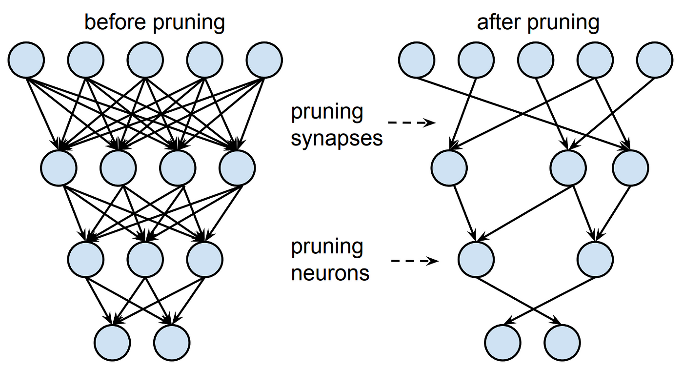
Pruning
Definition:
Pruning is a model compression technique that involves removing the unnecessary connections or weights from a neural network. The goal of pruning is to reduce the size of the network while maintaining its accuracy. Pruning can be done in different ways, such as removing the smallest weights, or removing the weights that have the least impact on the output of the network.
Remove some parts from iphone to make it affordable
https://unify.ai/blog/model-compression
https://towardsdatascience.com/pruning-neural-networks-1bb3ab5791f9

Slide 9
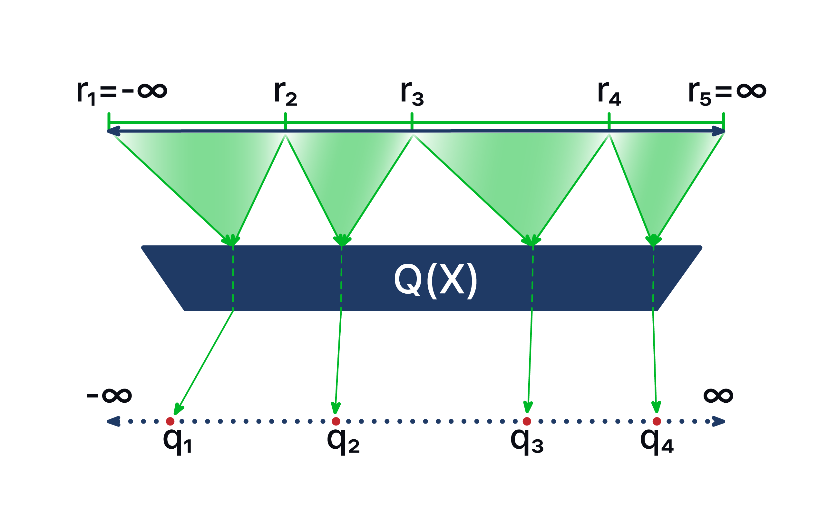
Quantization
Definition:
Quantization is a model compression technique that reduces the precision of the weights and activations of a neural network. In other words, it involves representing the weights and activations of a neural network using fewer bits than their original precision. For example, instead of using 32-bit floating-point numbers to represent weights and activations, quantization may use 8-bit integers. This transformation significantly reduces storage requirements and computational complexity.
Make the iPhone with cheaper materials
https://unify.ai/blog/model-compression
https://arxiv.org/pdf/2205.07877

Slide 10
Conclusion
Three mainstreaming methods to compress LLMs:
Knowledge distillation: transferring the knowledge from a large, complex neural network (teacher network) to a smaller, simpler neural network (student network);
Pruning: removing the unnecessary connections or weights from a neural network;
Quantization: reduces the precision of the weights and activations of a neural network.
Can we design our own methods to compress them?
We can i) improve current baselines or 2) combine these methods …

