Slide 1
APS1052 Project
LSTM for Bitcoin
Tao Wu, Zhoujie (Terrence) Zhao

Slide 2
Program Description
conda_modules.txt
The list of conda modules imported by the program
data/btc_dataset.csv
The data file, containing daily bitcoin prices along with other attributes from 10/01/2013 to 10/09/2020
plots/*
Plots and screenshots of the results
saved_models/*
Trained models that are saved in h5 files

Slide 3
Program Description
main.py
The main code to run the program which includes the pipeline of reading configurations, loading data, creating models, training/testing, and plotting results
config.json
The configuration file that specifies data, model structures, and parameter settings for training
core/dataloader.py
The data loader class for reading data and creating train/test sets for each model specified in config.json
core/model.py
The model class for building RNN, LSTM, etc.
core/utils.py
The utility file containing helper functions such as computing returns and plotting results

Slide 4
In this project, we started with the LSTM model in S10.Miscellaneous\LSTMBitcoin\core\model.py and implemented three alternatives.
The modifications we tried are:
The original LSTM
Downgrade the LSTM to an RNN
Upgrade the LSTM to a sequence-to-sequence LSTM
Implement a hybrid net combining GRU and 1-D convolutional layers
We trained these models with the bitcoin data, then evaluated the model predictions on test set with multiple metrics and plots.

Slide 5
LSTM
The original LSTM was constructed (with tensorflow.keras) as:
LSTM(units=100, return_sequences=True)
Dropout(rate=0.05)
LSTM(units=100, return_sequences=True)
LSTM(units=100, return_sequences=False)
Dropout(rate=0.05)
Dense(units=1, activation=’linear’)

Slide 6
RNN
The downgraded RNN was constructed (with tensorflow.keras) as:
SimpleRNN(units=100, return_sequences=True)
Dropout(rate=0.05)
SimpleRNN(units=100, return_sequences=True)
SimpleRNN(units=100, return_sequences=False)
Dropout(rate=0.05)
Dense(units=1, activation=’linear’)

Slide 7
Sequence-to-sequence LSTM
The sequence-to-sequence LSTM was constructed (with tensorflow.keras) as:
Denote fut_steps as the number of future steps to predict,
LSTM(units=100, return_sequences=True)
Dropout(rate=0.05)
LSTM(units=100, return_sequences=True)
LSTM(units=100, return_sequences=True)
Dropout(rate=0.05)
TimeDistributed( Dense(units=fut_steps, activation=’linear’) )

Slide 8
Hybrid net with GRU and 1D conv layer
The hybrid net combining GRU and 1D convolutional layer was constructed (with tensorflow.keras) as:
Denote fut_steps as the number of future steps to predict,
Conv1D(filters=100, kernel_size=4, strides=2, padding=’valid’)
GRU(units=100, return_sequences=True)
GRU(units=100, return_sequences=True)
TimeDistributed( Dense(units=fut_steps, activation=None) )

Slide 9
A sequence-to-sequence model takes a sequence of data as inputs and returns a sequence of predictions of length fut_steps. In our experiments, the last two models - the seq2seq LSTM and the hybrid net of GRU and 1D convolutional layer - are sequence-to-sequence models. We set input sequence_length=20 and fut_steps=3.

Slide 10
For evaluation, we created the following plots for each model:
The training curves
The predictions compared to the actual values
The strategy returns compared to the market returns
We also computed the following metrics for predictions:
CAGR
Sharpe
White’s Reality Check

Slide 11
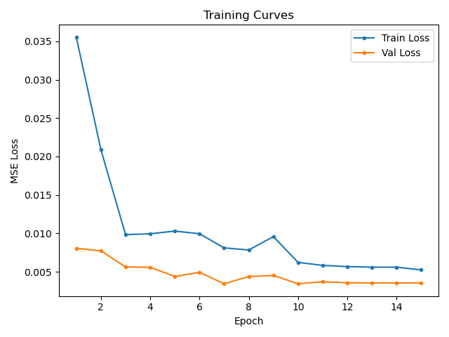
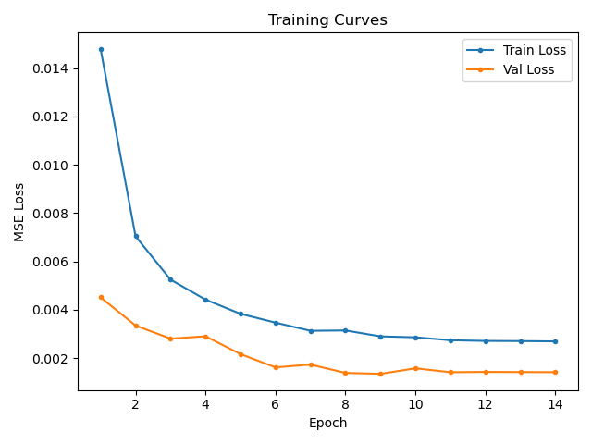
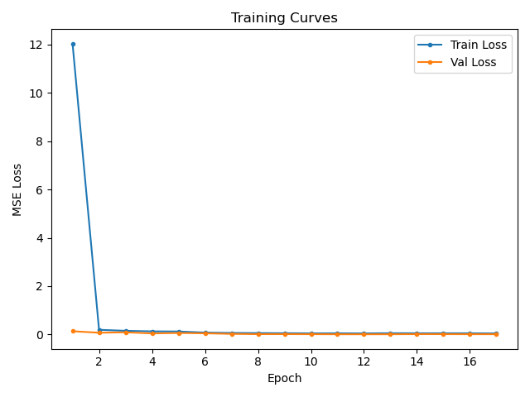
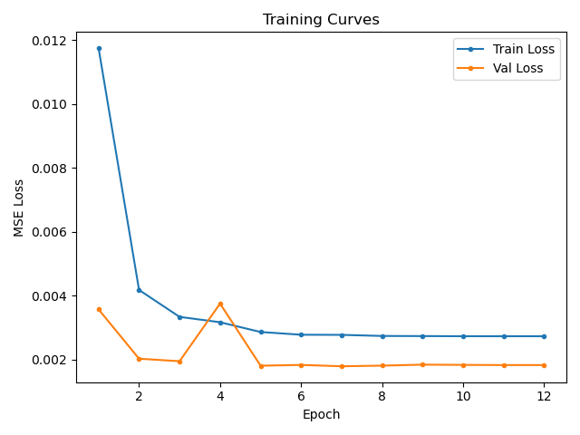
Training Curves
GRU + conv
RNN
LSTM
seq2seq LSTM

Slide 12
Training Curves
From the training curves, we can see that the simple RNN model has the worst loss during training and validation. The two sequence-to-sequence models generate slightly better losses compared to the original LSTM.

Slide 13
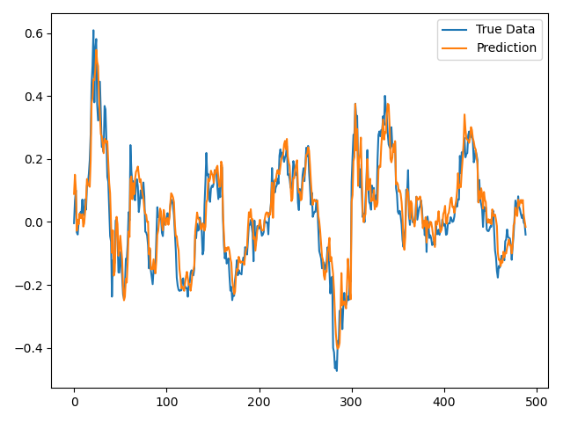
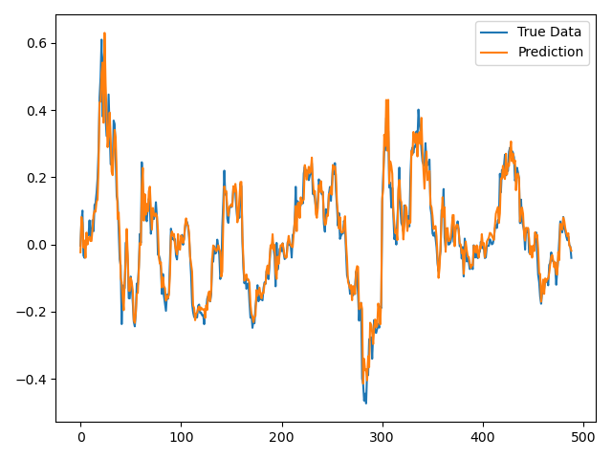
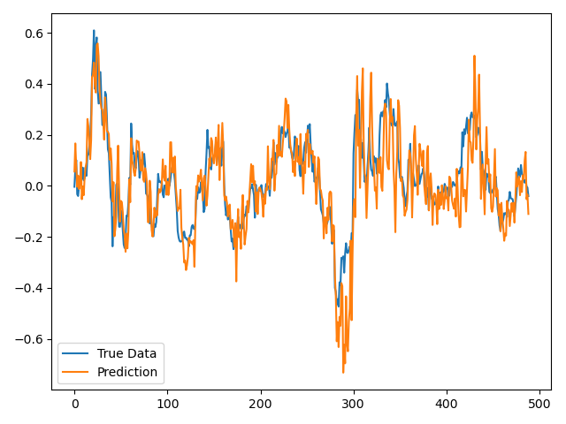
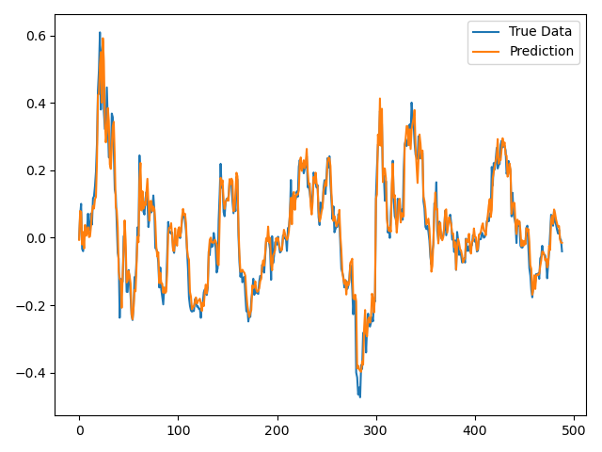
Predictions vs. Actual Values
GRU + conv
RNN
LSTM
seq2seq LSTM

Slide 14
Predictions vs. Actual Values
The plots of model predictions compared to actual values align well with the plots of training losses. The RNN model does not seem to be a good predictor, while both sequence-to-sequence models fit very well with the ground truth, and the original LSTM performs in-between.

Slide 15
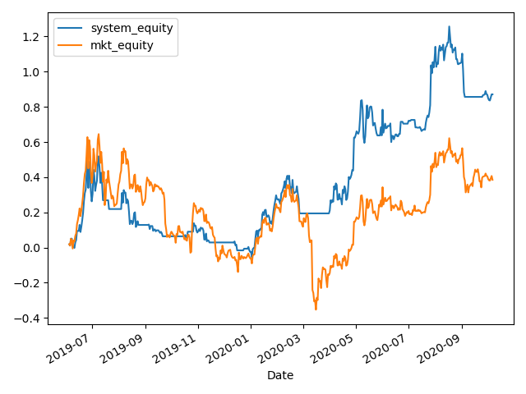
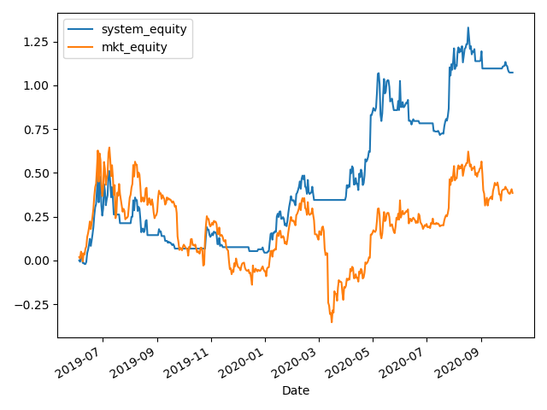
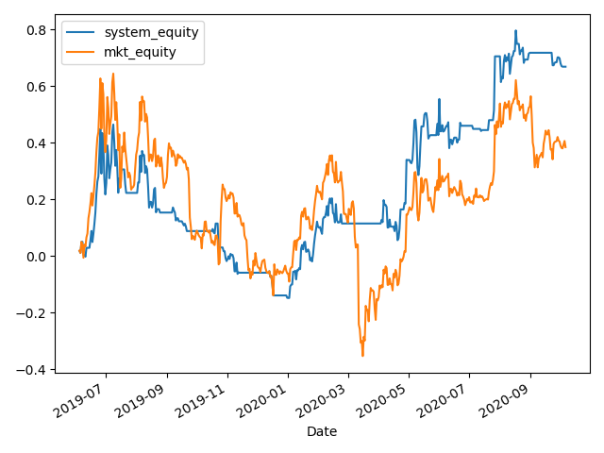
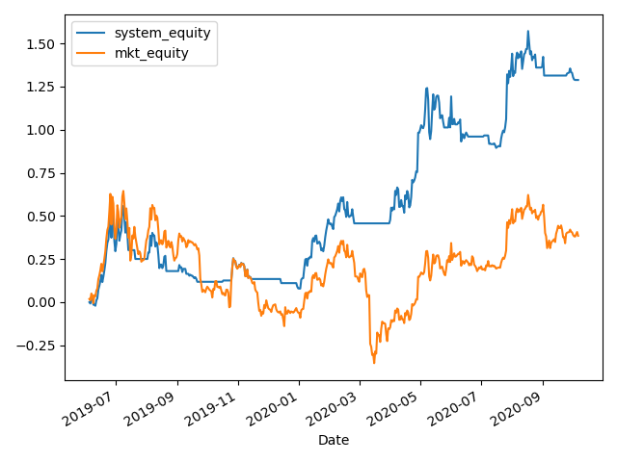
Strategy Returns vs. Market Returns
GRU + conv
RNN
LSTM
seq2seq LSTM

Slide 16
Strategy Returns vs. Market Returns
Again, RNN produces the worst results in terms of strategy returns. In these plots we can see that the hybrid net (GRU + 1D conv) achieves the highest strategy returns. The LSTMs - sequence-to-point LSTM and sequence-to-sequence LSTM - have similar performance.

Slide 17
Evaluation Metrics
 | CAGR | Sharpe | WhiteReality Check
Market | 18.2% | 0.3
LSTM | 38.0% | 0.8 | 0.102
RNN | 30.1% | 0.7 | 0.165
seq2seq LSTM | 45.5% | 1.0 | 0.070
GRU + 1D conv | 53.1% | 1.1 | 0.039

Slide 18
Evaluation Metrics
The quantified results given by these metrics confirmed our previous conclusions.
CAGR shows the rank of each predictor: GRU+1D-conv > seq2seq-LSTM > LSTM > RNN. Note that they all gain more than the market growth.
Sharpe ratio, which evaluates the return of an investment compared to its risk, follows the same rank for each model.
White’s Reality Check shows that the prediction of the hybrid model (GRU+1D-conv) is the most effective indicator to the trade returns.

Slide 19
Conclusion
We implemented 4 models to predict Bitcoin prices and evaluate their performance in several metrics.
To draw a conclusion, all models make positive predictions to help determine the trading strategies.
Their performance can be ranked as:
GRU+1D-conv > seq2seq-LSTM > LSTM > RNN
In general, sequence-to-sequence models make better predictions than sequence-to-point models.

