Slide 1
Species Selection
Software Development

Slide 2
Purpose of the Software
Originally developed by Taoyang Wu in 2014
Selects sub-sets of species in a habit that use all resources but with species that are maximally reliant on few resources (maximum and mean sensitivity values are minimised)
Allows monitoring of the health of an environment based upon the success of the selected species sub-set
Current software is essentially a command line program coded in Java

Slide 3
Dataset Size
Dataset Total species subsets
Forest_D_ALL - 18 species X 29 resources - 522 2^{n} = 2.62x10⁵ Forest2 - 46 species X 39 resources - 1794 2^{n} = 7.03x10¹³ Forest1 - 89 species X 37 resources - 3293 2^{n} = 6.19x10²⁶
Problem is NP-Hard/Complete, meaning no known algorithm can solve without exponential growth as the dataset size increases
Weighted Set Cover problem

Slide 4
Code Translation / Source Control
Original code in Java
Initially converted by SW (Jan 2018) to C++ - 100 times slower due to lack of garbage collection and use of dynamically resized vectors
Reverted to Java for ease of development
C++ and Java code version controlled in Github
Unit Test set up to ensure consistent output as software develops

Slide 5
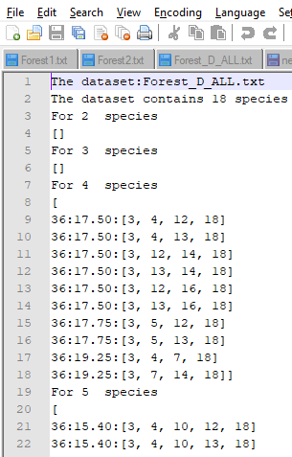
Initial Changes to Algorithm
Avoiding multiple unnecessary calls to getFirstNonCompleteLeaf() in while loop of getMinimalConstSpecTreeRootedAt() method
parallelStream replaced nested for loop in getMinDomSpecSets() (Can’t be used with multi-threaded GUI)
Sorted output species in number order (has a time penalty but important for consistent comparison of output between software versions)
GUI developed

Slide 6
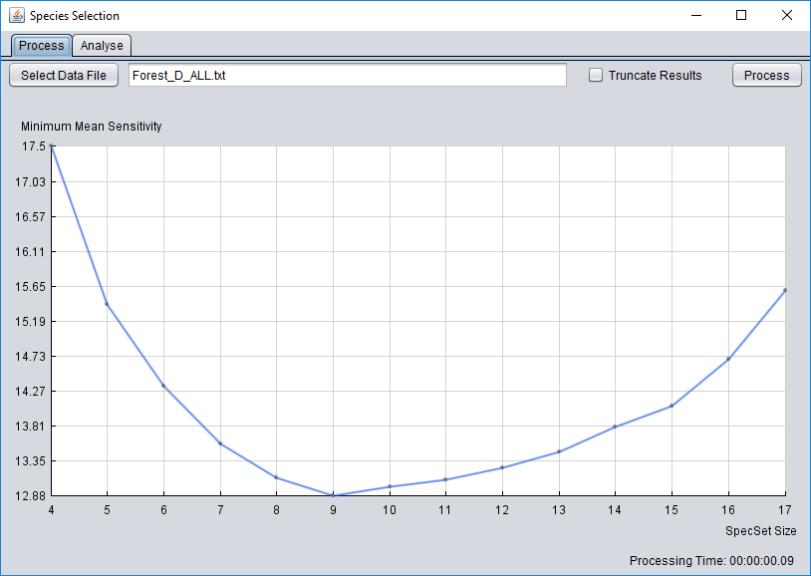
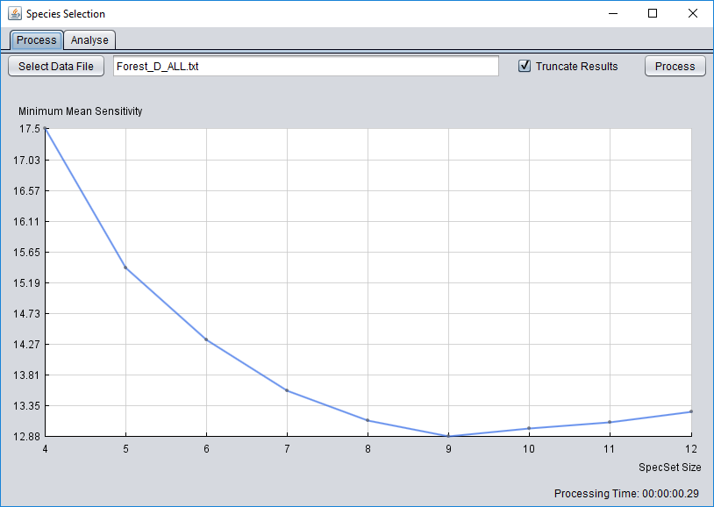
GUI
Allows dataset file selection
Allows truncation to 3 consecutive min mean sensitivity increases
Displays results plot
Displays processing time in real time
Allows cancellation of process

Slide 7
Benchmarking
Original Software
Full output Forest_D_ALL ~300ms Forest2 ~10400ms Forest1 (50m calls) ~120400ms
Revised software
Full output Truncated output Forest_D_ALL ~300ms ~260ms Forest2 ~10600ms ~2200ms Forest1 (50m calls) ~62000ms

Slide 8
Problem Species Identification
Tests carried out to determine what size datasets could be processed
Discovered that ‘problem species’ exist in Forest1 dataset that balloon MinSpecSetFamily size, and hence processing time, way beyond the exponential growth expected
Manually identified 10 species out of 89 that after removal allowed solving for 79 species within ~1 hour 8 mins

Slide 9
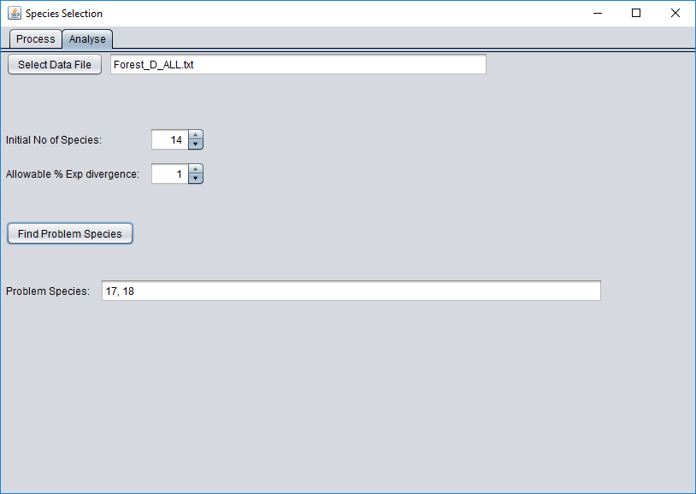
Automated Problem Species ID
Select data file
Algorithm starts with first n species
Adds additional species 1 by 1
Fits exponential curve to numSpecies vs processing time data
Identifies problem species if it adds more than allowable % exponential divergence

