Slide 1
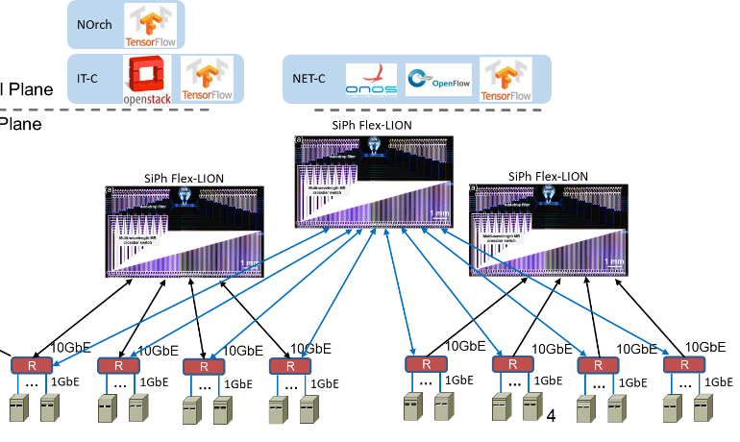
Multi-domain, multi-campus testbed experiment based on DeepRMSA
NEXT GENERATION NETWORKING SYSTEMS LABORATORY
YuFeng Chen from USTC
Mentor: Dr. Xiaoliang Chen, Dr. Roberto rproietti, Prof. S.J. Ben Yoo

Slide 2
Background
Previous work
My design
Results
Future work

Slide 3
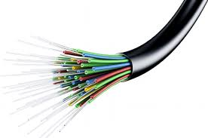


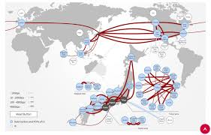
Background Information
Optical fibers
How can we transmit out messages
through these optical fibers?

Slide 4
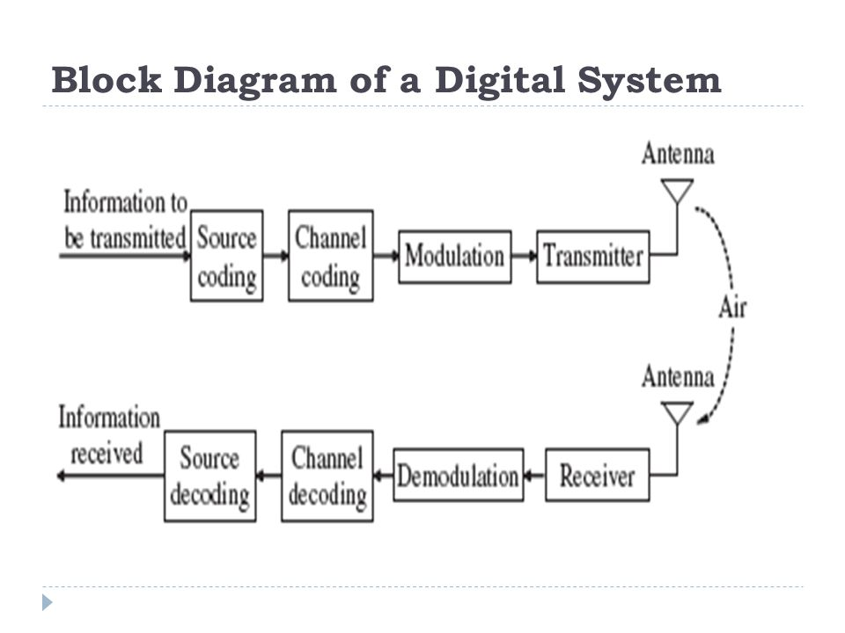
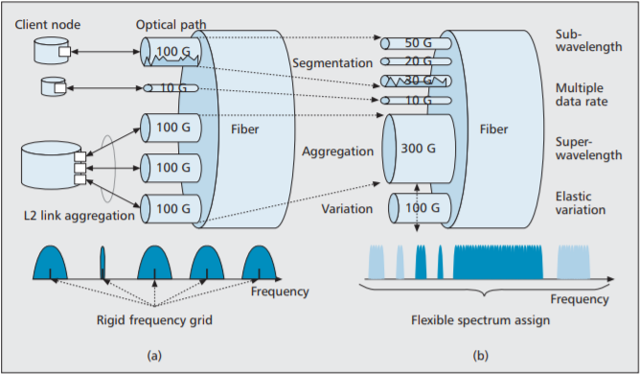
Background Information
How can we transmit out messages through these optical fibers?
Baseband signals will be added to high frequency carrier.

Slide 5
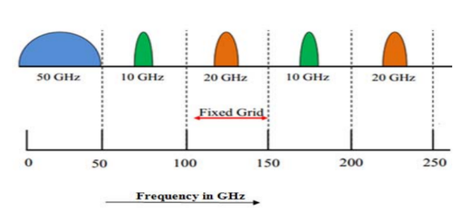
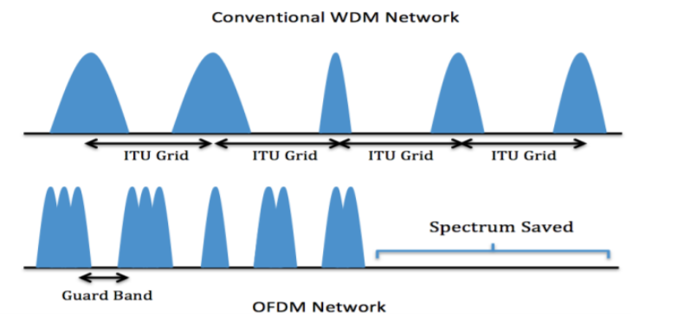
Background Information
Wavelength-division multiplexing (WDM)
Def:
A technology which multiplexes a number of optical carrier signals onto a single optical fiber by using different wavelengths
Pros:
Enables bidirectional communications over one strand of fiber, as well as multiplication of capacity.

Slide 6
Background Information
Wavelength-division multiplexing (WDM)
Cons:
1) Grid fixed.
Allocate entire wavelength to a connection even if the traffic demand is low.
2) Need more guard band.
A better choice
Elastic optical networks(EONs)
1) Able to set up bandwidth-variable superchannels by grooming series of finer-granularity(usually 6.25 GHz) subcarriers.
2) Allow subcarriers of the same light-path to overlap.

Slide 7
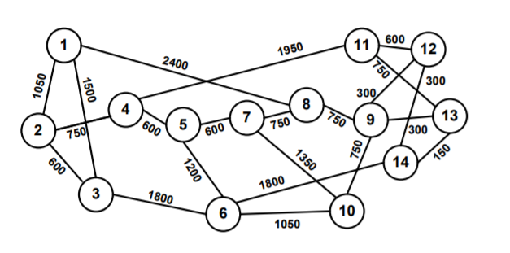
Background Information
Elastic optical networks(EONs)
1) Able to set up bandwidth-variable superchannels by grooming series of finer-granularity(usually 6.25 GHz) subcarriers.
2) Allow subcarriers of the same light-path to overlap.
Problems:
Service becomes more complicated:
Routing, modulation and spectrum assignment(RMSA)
E.g.:
Node 2->Node13
Select a light path and relevant spectrum.

Slide 8
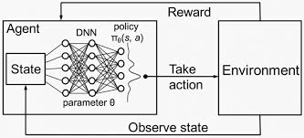
Background Information
Elastic optical networks(EONs)
Problems:
Service becomes more complicated:
Routing, modulation and spectrum assignment(RMSA)
E.g.:
Node 2->Node13
Select a light path and relevant spectrum.
A solution:
Machine Learning(Deep reinforcement learning)
->Select paths and spectrum

Slide 9
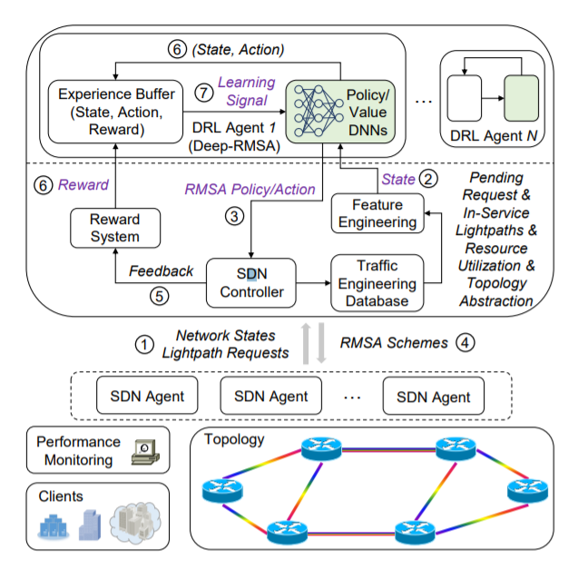




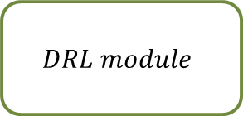

Previous Work: Routing, modulation and spectrum assignment(RMSA)
A standalone simulation by Dr.Chen.(DeepRMSA)
$$Intra Domain$$
$$Request R_{t}$$
$$SDN$$
$$Controller$$
$$\left[Reward\right]$$
$$\left[\begin{aligned}Topology, Traffic, \\ Available freq slots,…\end{aligned}\right]$$
$$\left[Path, Freq slot\right]$$
$$DRL module$$

Slide 10
Previous Work: Routing, modulation and spectrum assignment(RMSA)
A standalone simulation by Dr.Chen.(DeepRMSA)
$$Intra Domain$$
$$Request R_{t}$$
$$SDN$$
$$Controller$$
$$\left[Reward\right]$$
$$\left[\begin{aligned}Topology, Traffic, \\ Available freq slots,…\end{aligned}\right]$$
$$\left[Path, Freq slot\right]$$
$$DRL module$$

Slide 11
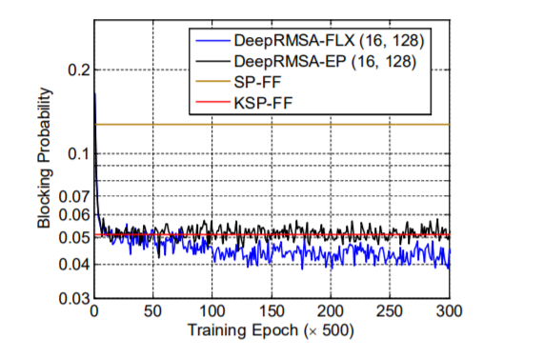
Previous Work: Routing, modulation and spectrum assignment(RMSA)
A standalone simulation by Dr.Chen.(DeepRMSA)
$$Intra Domain$$
$$Request R_{t}$$
$$SDN$$
$$Controller$$
$$\left[Reward\right]$$
$$\left[\begin{aligned}Topology, Traffic, \\ Available freq slots,…\end{aligned}\right]$$
$$\left[Path, Freq slot\right]$$
$$DRL module$$

Slide 12
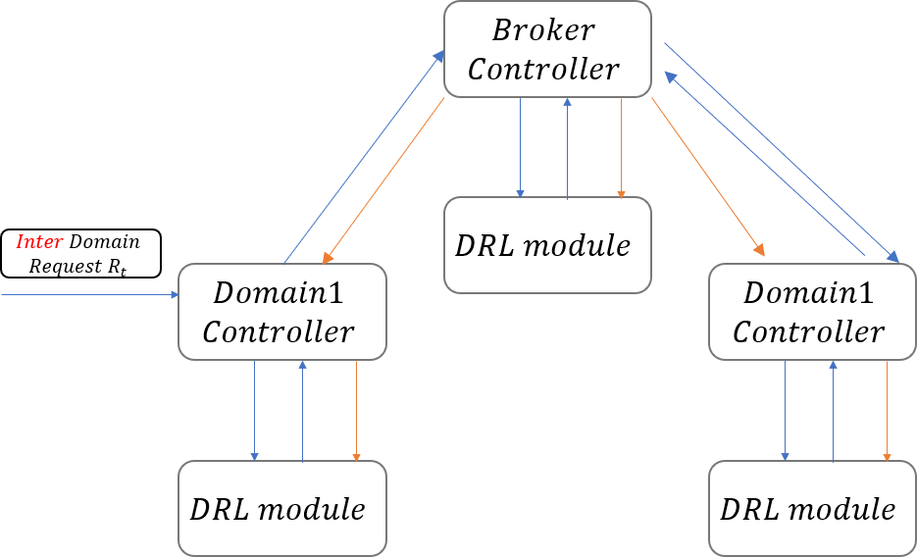
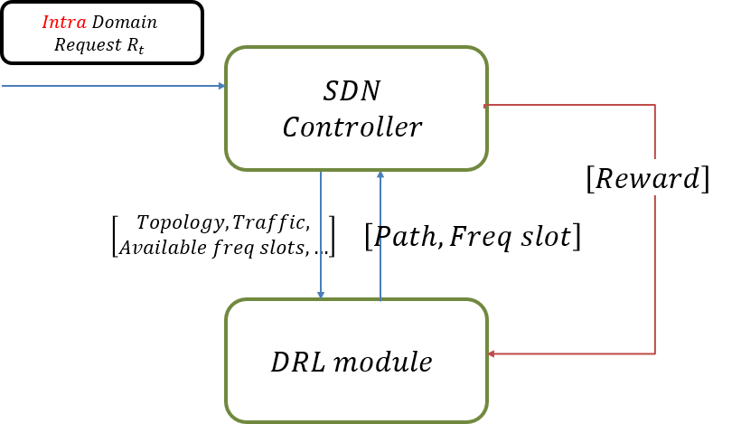
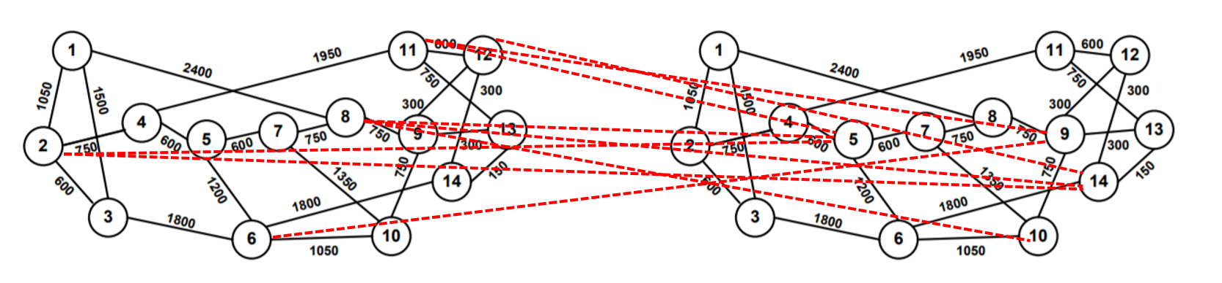
My Design: Routing, modulation and spectrum assignment(RMSA)

Slide 13
My Design: Routing, modulation and spectrum assignment(RMSA)
Extend the standalone case into a hierarchical scheme.
Make the system available in ONOS.
Reduce training time and number of steps required
Minimize blocking probability for interdomain traffic and show the training process for the broker-level agent

Slide 14
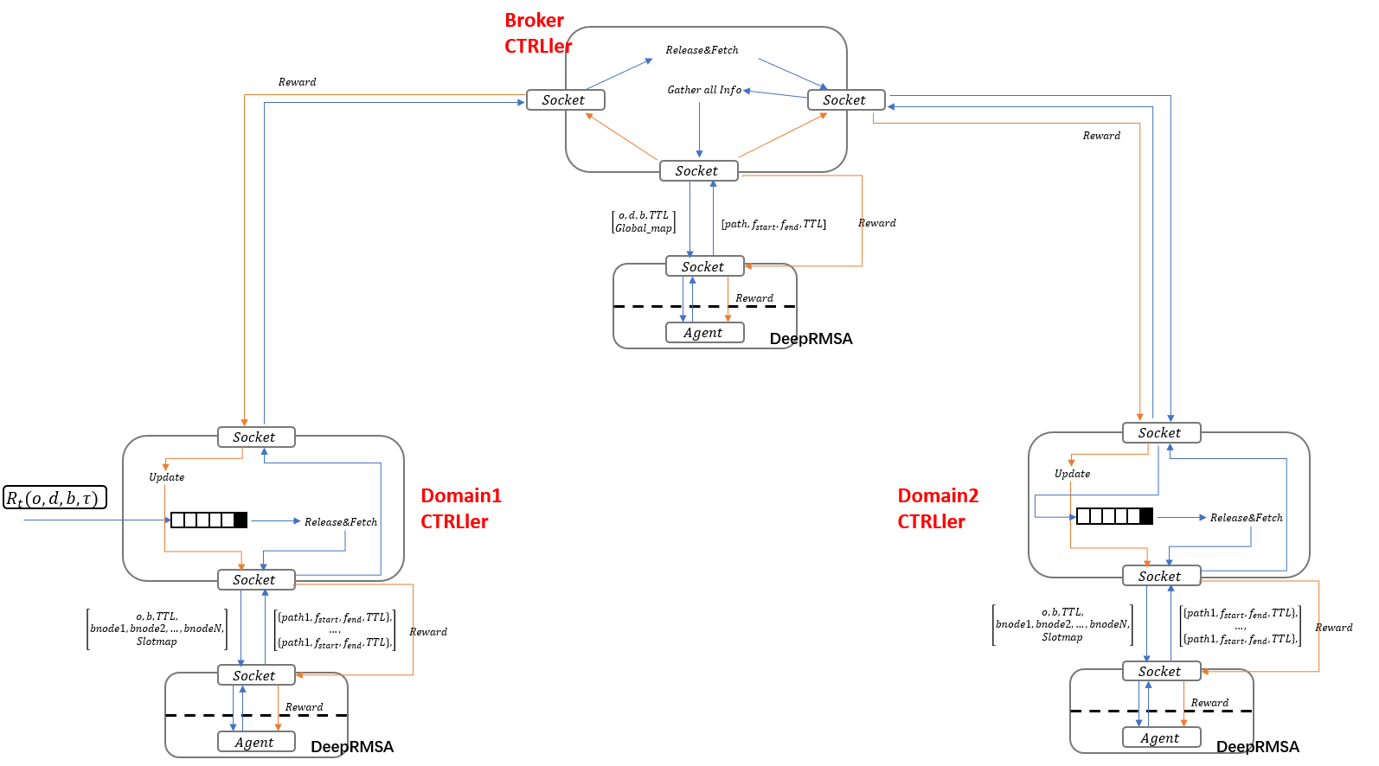
My Design: Workflow Routing, modulation and spectrum assignment(RMSA)

Slide 15
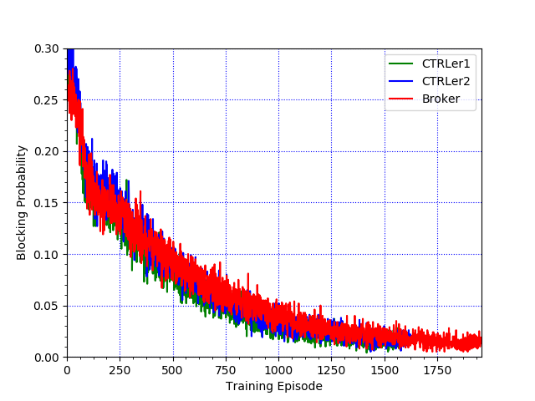
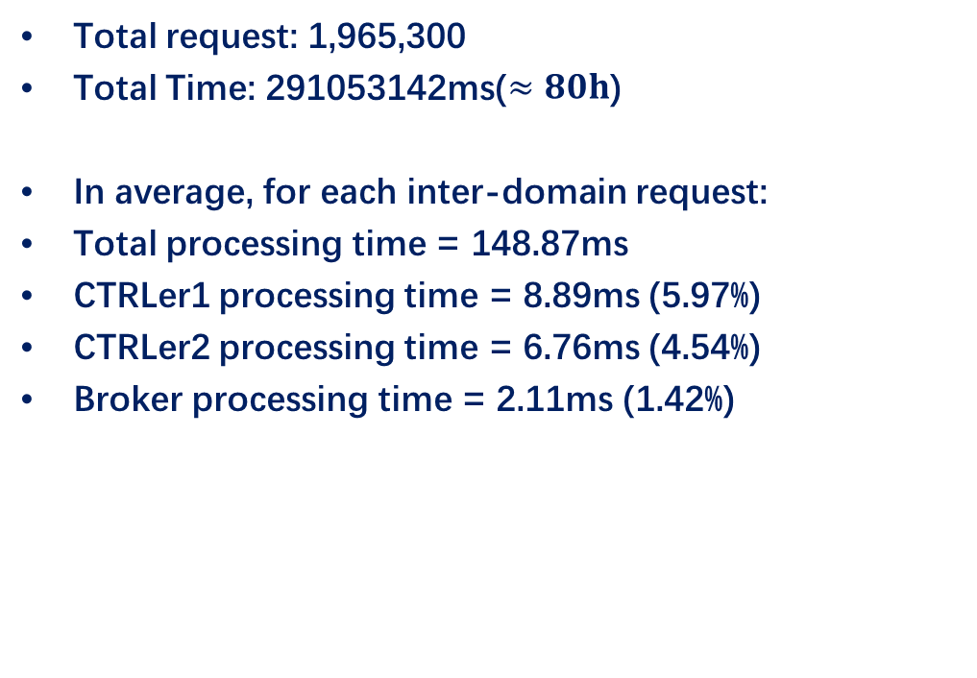
My Design: Result
Total request: 1,965,300
Total Time: 291053142ms($≈80h$)
In average, for each inter-domain request:
Total processing time = 148.87ms
CTRLer1 processing time = 8.89ms (5.97%)
CTRLer2 processing time = 6.76ms (4.54%)
Broker processing time = 2.11ms (1.42%)

Slide 16
Future Work
Make proper comparations
①Need a good baseline/benchmark
②Workload effects the final results
Employment in different machines

Slide 17
References
1. D. Sharma, S. Kumar, An overview of elastic optical networksand its enabling technologies. Int. J. Eng. Technol. (IJET)9(3),1643–1649 (2017).
2. X. Chen, B. Li, R. Proietti, H. Lu, Z. Zhu and S. J. B. Yoo, "DeepRMSA: A Deep Reinforcement Learning Framework for Routing, Modulation and Spectrum Assignment in Elastic Optical Networks," in Journal of Lightwave Technology, vol. 37, no. 16, pp. 4155-4163, 15 Aug.15, 2019, doi: 10.1109/JLT.2019.2923615.
THANKS!

Slide 18
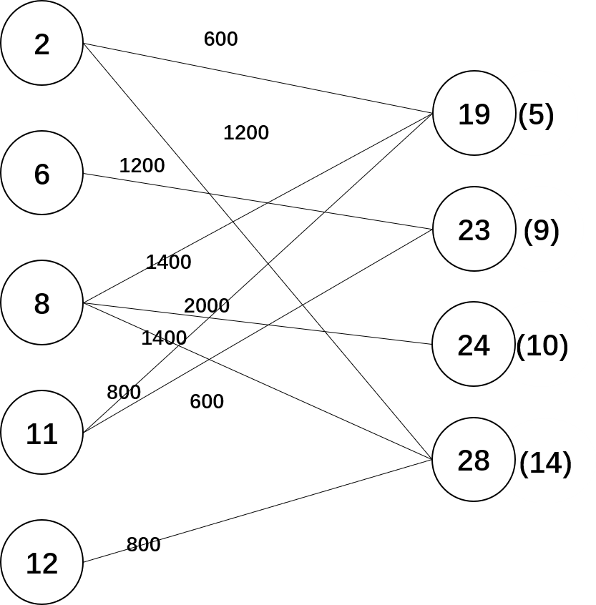
My Design: Setup
Net topologies
Episode size = 1000
Average requests number: 12 per unit time
Average service time: 7 unit time
(Exponential distribution)

