Slide 1
Hidden Markov Models (HMMs)
ChengXiang Zhai
Department of Computer Science
University of Illinois, Urbana-Champaign

Slide 2
Central Questions to Ask about a LM: “ADMI”
Application: Why do you need a LM? For what purpose?
Data: What kind of data do you want to model?
Model: How do you define the model?
Inference: How do you infer/estimate the parameters?
Topic mining and analysis
Sequential structure discovery
Evaluation metric for a LM
Data set for estimation & evaluation
Sequence of words
Assumptions to be made
Latent state, Markov assumption
Viterbi, Baum-Welch
Inference/Estimation algorithm

Slide 3
Modeling a Multi-Topic Document
A document with 2 subtopics, thus 2 types of vocabulary
…
text mining passage
food nutrition passage
text mining passage
text mining passage
food nutrition passage
…
How do we model such a document?
How do we “generate” such a document?
How do we estimate our model?
We’ve already seen one solution – unigram mixture model + EM
This lecture is about another (better) solution – HMM + EM

Slide 4
Simple Unigram Mixture Model
…
text 0.2
mining 0.1
assocation 0.01
clustering 0.02
…
food 0.00001
…
λ=0.7
Model/topic 1
p(w|θ₁)
…
food 0.25
nutrition 0.1
healthy 0.05
diet 0.02
…
1-λ=0.3
Model/topic 2
p(w|θ₂)
p(w|θ₁⊕ θ₂) = λp(w|θ₁)+(1- λ)p(w|θ₂)

Slide 5
Deficiency of the Simple Mixture Model
Adjacent words are sampled independently
Cannot ensure passage cohesion
Cannot capture the dependency between neighboring words
We apply the text mining algorithm to the nutrition data to find patterns …
Topic 1= text mining
p(w|θ₁)
Topic 1= text mining
p(w|θ₁)
Topic 2= health
p(w|θ₂)
Solution=?

Slide 6
The Hidden Markov Model Solution
Basic idea:
  Make the choice of model for a word depend on the choice of model for the previous word
  Thus we model both the choice of model (“state”) and the words (“observations”)
O: We apply the text mining algorithm to the nutrition data to find patterns …
S1: θ1 θ1 θ1 θ1 θ1 θ1 θ1 θ1 θ1 θ1 θ1 θ1 θ1
……
O: We apply the text mining algorithm to the nutrition data to find patterns …
S2: θ1 θ1 θ1 θ1 θ1 θ1 θ1 θ1 θ2 θ1 θ1 θ1 θ1
P(O,S1) > p(O,S2)?

Slide 7
Another Example: Passage Retrieval
Strategy I: Build passage index
  Need pre-processing
  Query independent boundaries
  Efficient
Strategy II: Extract relevant passages dynamically
  No pre-processing
  Dynamically decide the boundaries
  Slow
Relevant
Passages
(“T”)
Background text (“B”)
O: We apply the text mining algorithm to the nutrition data to find patterns …
S1: B T B T T T B B T T B T T
O:…......... ….. We apply the text mining … patterns. ………………
S2: BB...BB T T T T T …. T BB….. BBBB

Slide 8
A Simple HMM for Recognizing
Relevant Passages
0.8
0.8
0.5
Parameters
Initial state prob:
p(B)= 0.5; p(T)=0.5
State transition prob:
p(B→B)=0.8 p(B→T)=0.2
p(T→B)=0.5 p(T→T)=0.5
Output prob:
P(“the”|B) = 0.2 …
P(“text”|T) = 0.1 …
0.5
P(B)=0.5
P(T)=0.5
0.2
0.2
B
B
T
T
P(w|B)
P(w|B)
0.5
0.5
P(w|T)
P(w|T)
the 0.2
a 0.1
we 0.01
to 0.02
…
text 0.0001
mining 0.00005
…
…
text =0.125
mining = 0.1
association =0.1
clustering = 0.05
…
Topic
Background

Slide 9

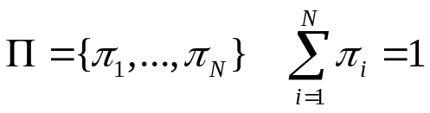



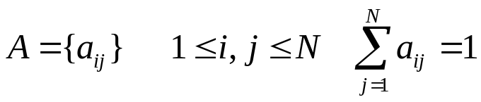

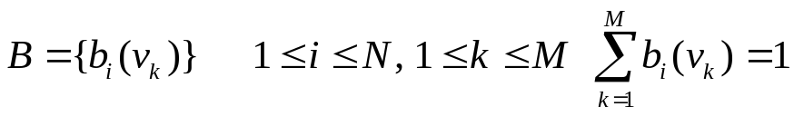
A General Definition of HMM
Initial state probability:
N states
M symbols
State transition probability:
Output probability:

Slide 10
How to “Generate” Text?
P(w|B)
0.8
P(w|T)
0.5
the 0.2
a 0.1
we 0.01
is 0.02
…
method 0.0001
mining 0.00005
…
0.2
…
text =0.125
mining = 0.1
algorithm =0.1
clustering = 0.05
…
B
T
0.5
P(B)=0.5
P(T)=0.5
B
0.2
T
0.5
T
0.5
0.5
0.8
0.2
0.5
0.5
T
B
B
T
B
0.2
0.125
0.1
0.1
0.02
0.1
0.05
0.0001
the
text
mining
algorithm
is
a
clustering
method
P(BTT…,”the text mining…”)=p(B)p(the|B) p(T|B)p(text|T) p(T|T)p(mining|T)…
= 0.5*0.2 * 0.2*0.125 * 0.5*0.1…

Slide 11
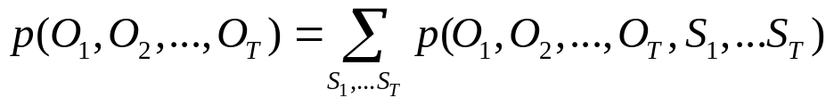
HMM as a Probabilistic Model
Time/Index: t₁ t₂ t₃ t₄ …
Data: o₁ o₂ o₃ o₄ …
Sequential data
Random
variables/
process
Observation variable: O₁ O₂ O₃ O₄ …
Hidden state variable: S₁ S₂ S₃ S₄ …
State transition prob:
Probability of observations with known state transitions:
Joint probability (complete likelihood):
Init state distr.
Output prob.
Probability of observations (incomplete likelihood):
State trans. prob.

Slide 12
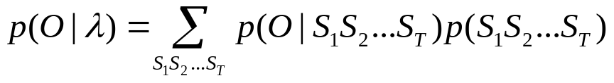
Three Problems
1. Decoding – finding the most likely path
Given: model, parameters, observations (data)
Find: most likely states sequence (path)
2. Evaluation – computing observation likelihood
Given: model, parameters, observations (data)
Find: the likelihood to generate the data

Slide 13
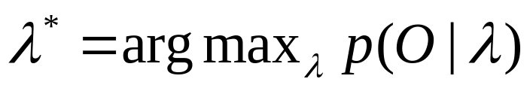
Three Problems (cont.)
3. Training – estimating parameters
Supervised
Given: model structure, labeled data( data+states sequence)
Find: parameter values
Unsupervised
Given: model structure, data (unlabeled)
Find: parameter values

Slide 14
Problem I: Decoding/Parsing
Finding the most likely path
This is the most common way of using an HMM (e.g., extraction, structure analysis)…

Slide 15
What’s the most likely path?
P(w|B)
0.8
P(w|T)
0.5
the 0.2
a 0.1
we 0.01
is 0.02
…
method 0.0001
mining 0.00005
…
0.2
…
text =0.125
mining = 0.1
algorithm =0.1
clustering = 0.05
…
B
T
0.5
P(B)=0.5
P(T)=0.5
?
?
?
?
?
?
?
?
?
?
?
?
?
?
?
?
?
?
?
?
?
?
?
?
the
text
mining
algorithm
is
a
clustering
method

Slide 16
Viterbi Algorithm: An Example
P(w|B)
0.8
P(w|T)
0.5
the 0.2
a 0.1
we 0.01
…
algorithm 0.0001
mining 0.005
text 0.001
…
the 0.05
text =0.125
mining = 0.1
algorithm =0.1
clustering = 0.05
0.2
B
T
0.5
P(T)=0.5
P(B)=0.5
t = 1 2 3 4 …
the
text
mining
algorithm
…
0.5
B
0.8
B
0.8
B
0.8
B
0.2
0.2
0.2
0.5
0.5
0.5
0.5
T
0.5
T
0.5
T
0.5
T
VP(B): 0.5*0.2 (B) 0.5*0.2*0.8*0.001(BB) … *0.5*0.005 (BTB) …*0.5*0.0001(BTTB)
VP(T) 0.5*0.05(T) 0.5*0.2*0.2*0.125(BT) … *0.5*0.1 (BTT) …*0.5*0.1(BTTT)
Winning path!
0.5

Slide 17
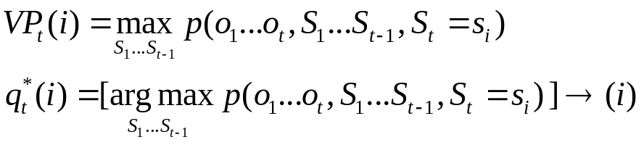
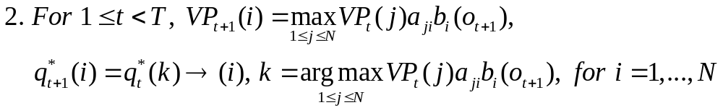
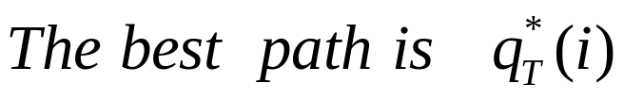
Viterbi Algorithm
Observation:
Algorithm:
Prob. of best path ending at state i
(Dynamic programming)
Best path ending at state i
Complexity: O(TN²)

Slide 18
Problem II: Evaluation
Computing the data likelihood
Another use of an HMM, e.g., as a generative model for classification
Also related to Problem III – parameter estimation

Slide 19
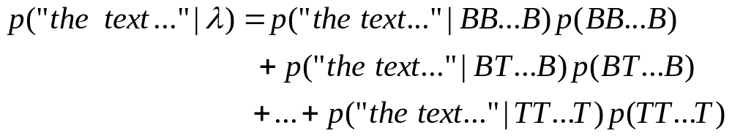
Data Likelihood: p(O|λ)
t = 1 2 3 4 …
the
text
mining
algorithm
…
0.5
B
0.8
B
0.8
B
0.8
B
0.2
0.2
0.2
0.5
0.5
0.5
0.5
T
0.5
T
0.5
T
0.5
T
In general,
enumerate all paths
BB… B
BT… B
TT… T
Complexity of a naïve approach?
0.5

Slide 20
The Forward Algorithm
…
B
B
B
B
…
T
T
T
T
α₁

Slide 21
The Forward Algorithm
…
B
B
B
B
…
T
T
T
T
α₁
α₂

Slide 22
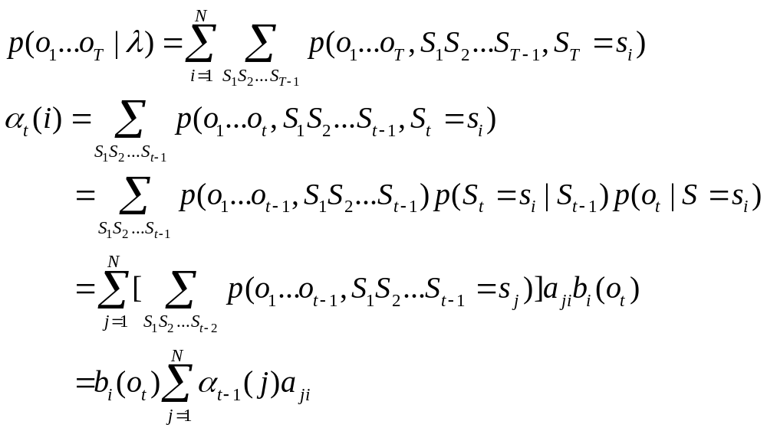
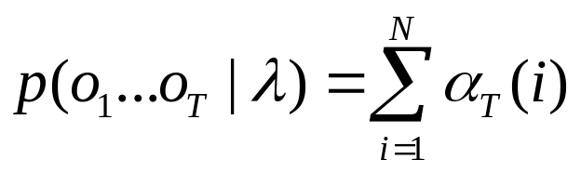
The Forward Algorithm
…
B
B
B
B
…
T
T
T
T
α₄
α₁
α₂
α₃
Generating o₁…o_{t}
with ending state s_{i}
The data likelihood is
Complexity: O(TN²)

Slide 23
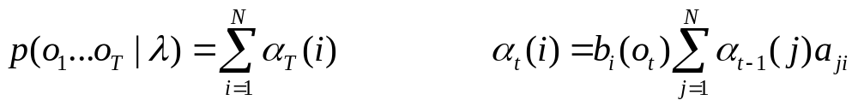
Forward Algorithm: Example
t = 1 2 3 4 …
the
text
mining
algorithm
…
0.5
B
0.8
B
0.8
B
0.8
B
0.2
0.2
0.2
0.5
0.5
0.5
0.5
T
0.5
T
0.5
T
0.5
T
α₁(B): 0.5*p(“the”|B)
α₂(B): [α₁(B)*0.8+ α₁(T)*0.5]*p(“text”|B) ……
α₁(T): 0.5*p(“the”|T)
α₂(T): [α₁(B)*0.2+ α₁(T)*0.5]*p(“text”|T) ……
P(“the text mining algorithm”) = α₄(B)+ α₄(T)

Slide 24
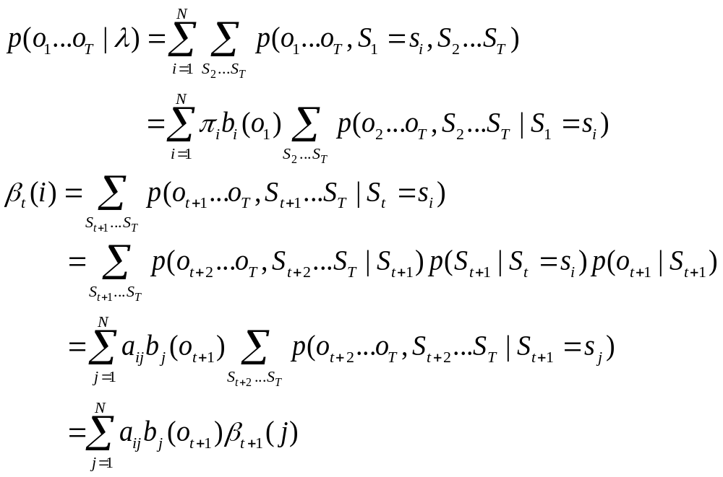
The Backward Algorithm
Observation:
Algorithm:
(o₁…o_{t} already generated)
Starting from state s_{i}
Generating o_{t+1}…o_{T}
Complexity: O(TN²)
The data likelihood is

Slide 25
Backward Algorithm: Example
t = 1 2 3 4 …
the
text
mining
algorithm
…
0.5
B
0.8
B
0.8
B
0.8
B
0.2
0.2
0.2
0.5
0.5
0.5
0.5
T
0.5
T
0.5
T
0.5
T
…
…
β₃(B): 0.8*p(“alg”|B)*β₄(B)+ 0.2*p(“alg”|T)*β₄(T)
β₄(B): 1
β₃(T): 0.5*p(“alg”|B)*β₄(B)+ 0.5*p(“alg”|T)*β₄(T)
β₄(T): 1
P(“the text mining algorithm”) = α ₁(B)*β ₁(B)+ α ₁(T)*β ₁(T)
= α ₂(B)*β ₂(B)+ α ₂(T)*β ₂(T)

Slide 26
Problem III: Training
Estimating Parameters
Where do we get the probability values for all parameters?
Supervised vs. Unsupervised

Slide 27
Supervised Training
Given:
1. N – the number of states, e.g., 2, (s1 and s2)
2. V – the vocabulary, e.g., V={a,b}
3. O – observations, e.g., O=aaaaabbbbb
4. State transitions, e.g., S=1121122222
Task: Estimate the following parameters
1. π₁, π₂
2. a₁₁, a₁₂, a₂₂, a₂₁
3. b₁(a), b₁(b), b₂(a), b₂(b)
π₁=1/1=1; π₂=0/1=0
a₁₁=2/4=0.5; a₁₂=2/4=0.5
a₂₁=1/5=0.2; a₂₂=4/5=0.8
b₁(a)=4/4=1.0; b₁(b)=0/4=0;
b2(a)=1/6=0.167; b2(b)=5/6=0.833
0.5
0.8
P(s1)=1
P(s2)=0
0.5
1
2
0.2
P(a|s1)=1
P(b|s1)=0
P(a|s2)=0.167
P(b|s2)=0.833

Slide 28
Unsupervised Training
Given:
1. N – the number of states, e.g., 2, (s1 and s2)
2. V – the vocabulary, e.g., V={a,b}
3. O – observations, e.g., O=aaaaabbbbb
4. State transitions, e.g., S=1121122222
Task: Estimate the following parameters
1. π₁, π₂
2. a₁₁, a₁₂, a₂₂, a₂₁
3. b₁(a), b₁(b), b₂(a), b₂(b)
How could this be possible?
λ
Maximum Likelihood:

Slide 29
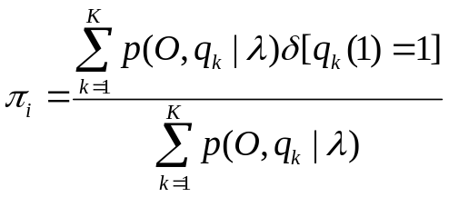
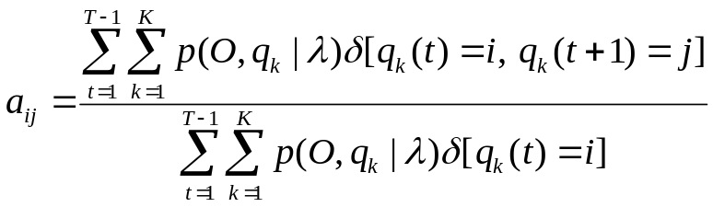
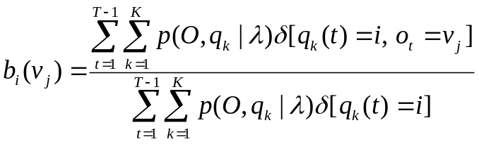
Intuition
O=aaaaabbbbb, λ
P(O,q₁|λ)
P(O,q_{K}|λ)
P(O,q₂|λ)
q₁=1111111111
q₂=11111112211 …
q_{K}=2222222222
New λ’
Computation of P(O,q_{k}|λ) is expensive …

Slide 30
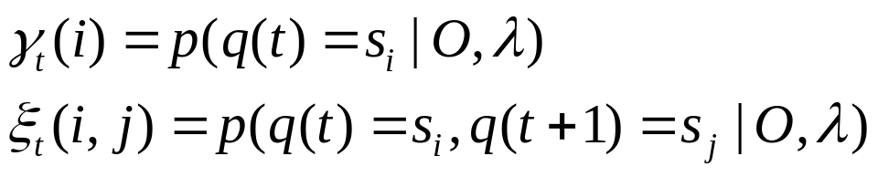
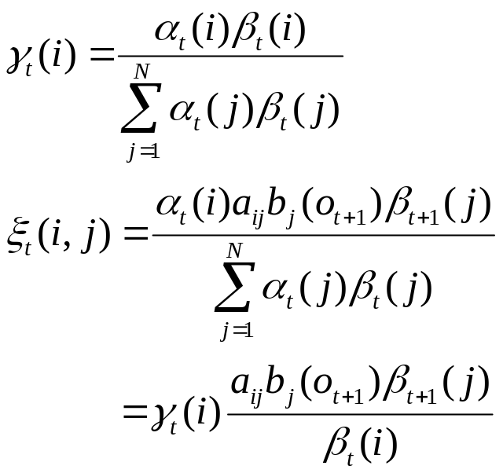
Baum-Welch Algorithm
Basic “counters”:
Being at state s_{i} at time t
Being at state s_{i} at time t and at state s_{j} at time t+1
Computation of counters:
Complexity: O(N²)

Slide 31
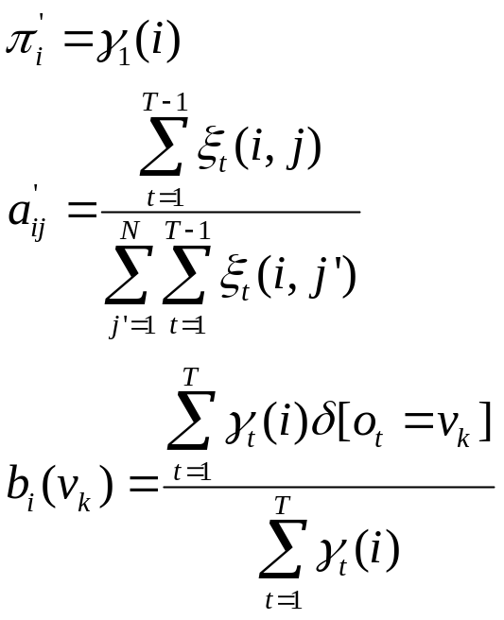
Baum-Welch Algorithm (cont.)
Updating formulas:
Overall complexity for each iteration: O(TN²)

Slide 32
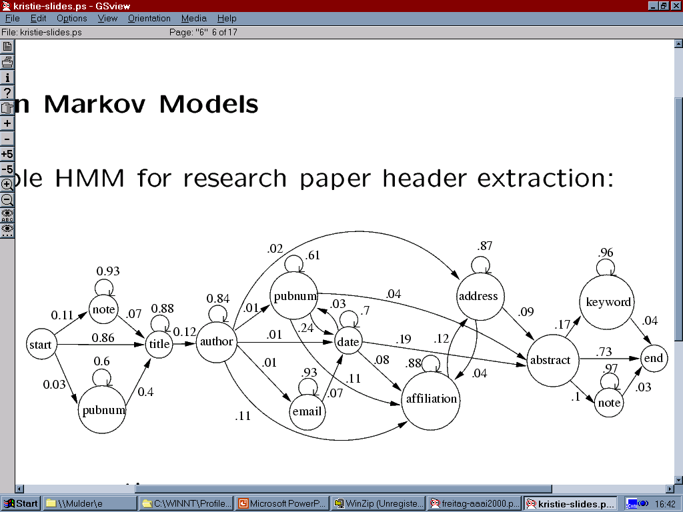
An HMM for Information Extraction
(Research Paper Headers)

Slide 33
What You Should Know
Definition of an HMM
What are the three problems associated with an HMM?
Know how the following algorithms work
  Viterbi algorithm
  Forward & Backward algorithms
Know the basic idea of the Baum-Welch algorithm

Slide 34
Readings
Read [Rabiner 89] sections I, II, III
Read the “brief note”

