Slide 1
Bayesian Inference for Mixture Language Models
Chase Geigle, ChengXiang Zhai
Department of Computer Science
University of Illinois, Urbana-Champaign

Slide 2
Deficiency of PLSA
Not a generative model
Can’t compute probability of a new document (why do we care about this?)
Heuristic workaround is possible, though
Many parameters ➔ high complexity of models
Many local maxima
Prone to overfitting
Overfitting is not necessarily a problem for text mining (only interested in fitting the “training” documents)

Slide 3
Latent Dirichlet Allocation (LDA)
Make PLSA a generative model by imposing a Dirichlet prior on the model parameters ➔
LDA = Bayesian version of PLSA
Parameters are regularized
Can achieve the same goal as PLSA for text mining purposes
Topic coverage and topic word distributions can be inferred using Bayesian inference

Slide 4
PLSA ➔ LDA
Both word distributions and
topic choices are free in PLSA
p(w|θ₁)
government 0.3 response 0.2 ...
Topic θ₁
p(θ₁)=π_{d,1}
p(w|θ₂)
city 0.2 new 0.1 orleans 0.05 ...
w
Topic θ₂
…
…
p(θ₂)=π_{d,2}
donate 0.1 relief 0.05 help 0.02 ...
p(w|θ_{k})
Topic θ_{k}
p(θ_{k})=π_{d,k}
LDA imposes a prior on both

Slide 5
Likelihood Functions for PLSA vs. LDA
PLSA
Core assumption
in all topic models
LDA
PLSA component
Added by LDA

Slide 6
Parameter Estimation and Inferences in LDA
Parameters can be estimated using ML estimator
However, {θ_{j}} and {π_{d,j}} must now be computed using posterior inference
Computationally intractable
Must resort to approximate inference
Many different inference methods are available
How many parameters in LDA vs. PLSA?

Slide 7
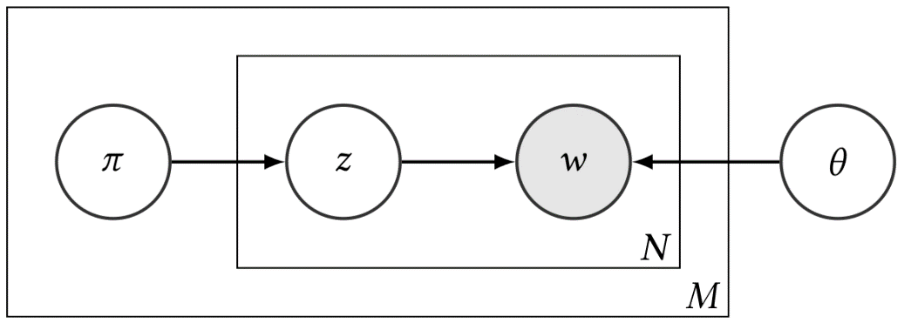
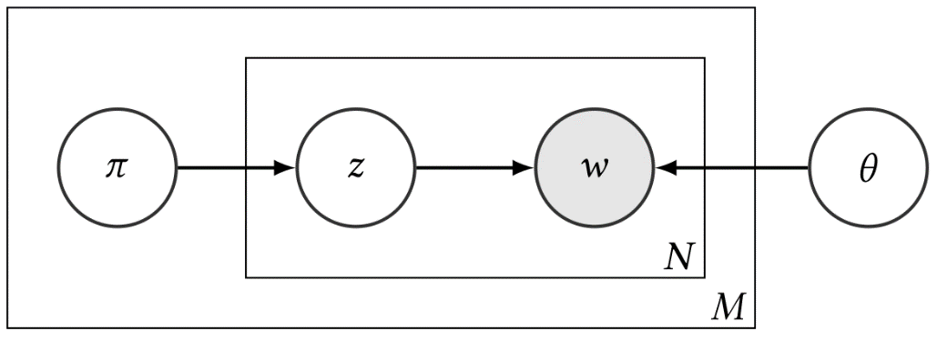
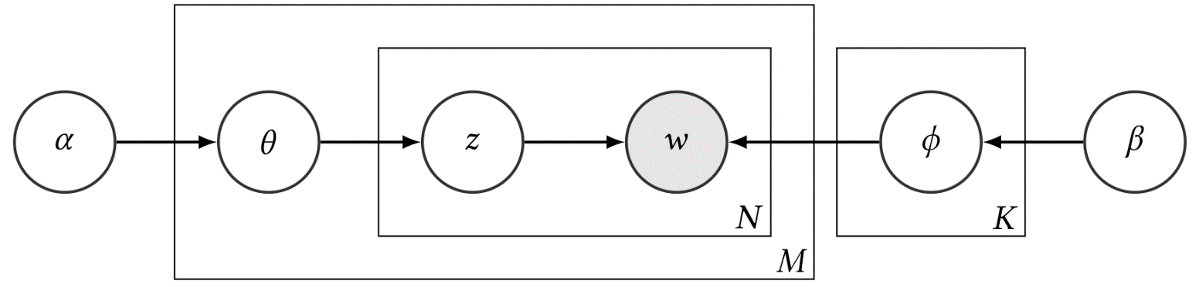
Plate Notation
PLSA:
LDA:

Slide 8
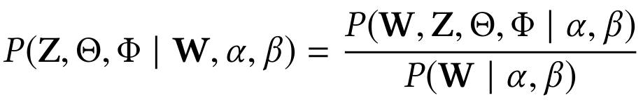
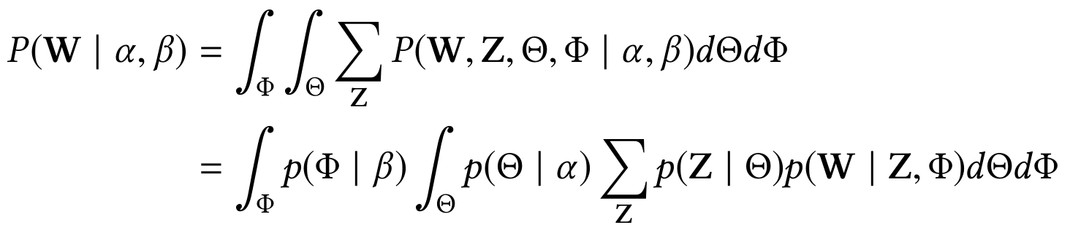
Why is exact inference intractable?
where
Denominator integral is intractable due to coupling between θ and φ in the summation over Z

Slide 9
Approximate Inference for LDA
Many different ways; each has its pros & cons
Deterministic approximation
variational Bayes [Blei et al. 03a]
collapsed variational Bayes [Teh et al. 07]
expectation propagation [Minka & Lafferty 02]
Markov chain Monte Carlo
full Gibbs sampler [Pritchard et al. 00]
collapsed Gibbs sampler [Griffiths & Steyvers 04]
Very efficient and quite popular, but can only work with conjugate priors

Slide 10
Variational Inference
Key idea: Use a surrogate distribution to approximate the posterior
Surrogate distribution is simpler than the true posterior (typically by making strong independence assumptions to break coupling)
Goal: Find the “best” surrogate distribution from a certain parametric family by minimizing the KL-divergence from the surrogate (Q) to the true posterior (P)
Transforms inference into a deterministic optimization! No free lunch: approximation quality depends on variational family chosen

Slide 11
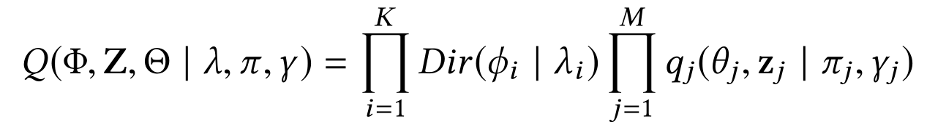
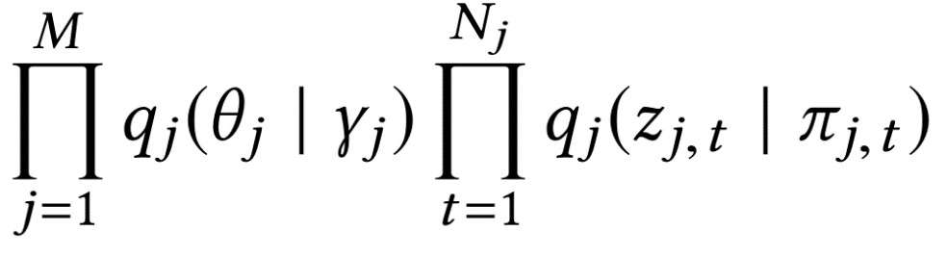
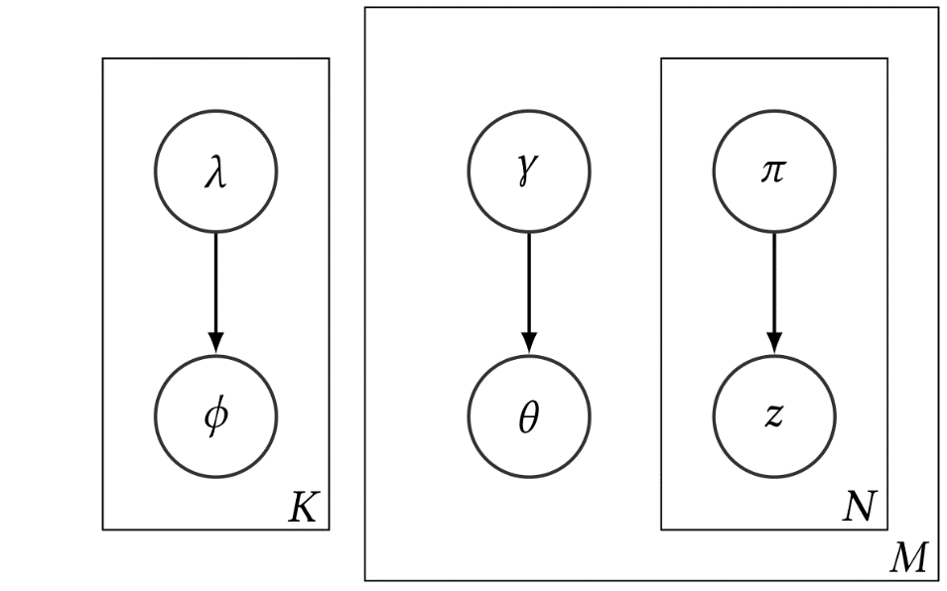
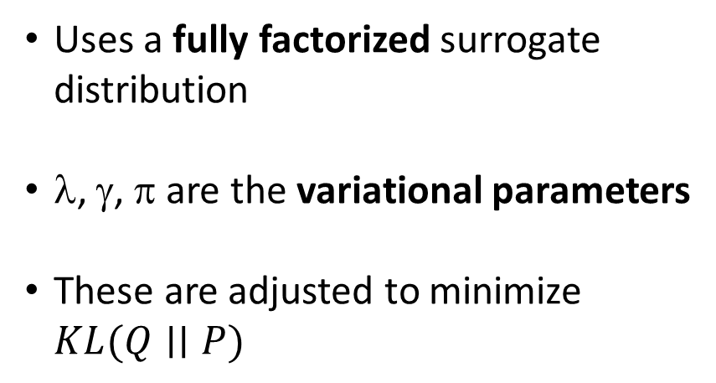
A Mean Field Approximation for LDA
Uses a fully factorized surrogate distribution
λ, γ, π are the variational parameters
These are adjusted to minimize $KL(Q∣∣P)$

Slide 12
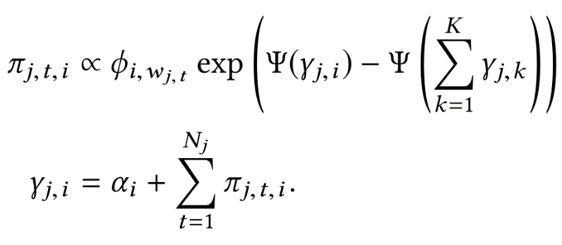
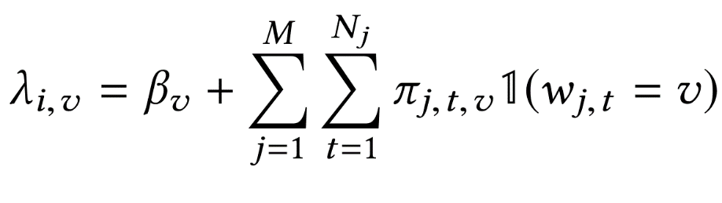
Variational Inference for LDA
Solve a series of constrained minimizations for each variational parameter (since they don’t depend on each other)
Result: a simple coordinate ascent algorithm (update each variable in turn and iterate until convergence)

Slide 13
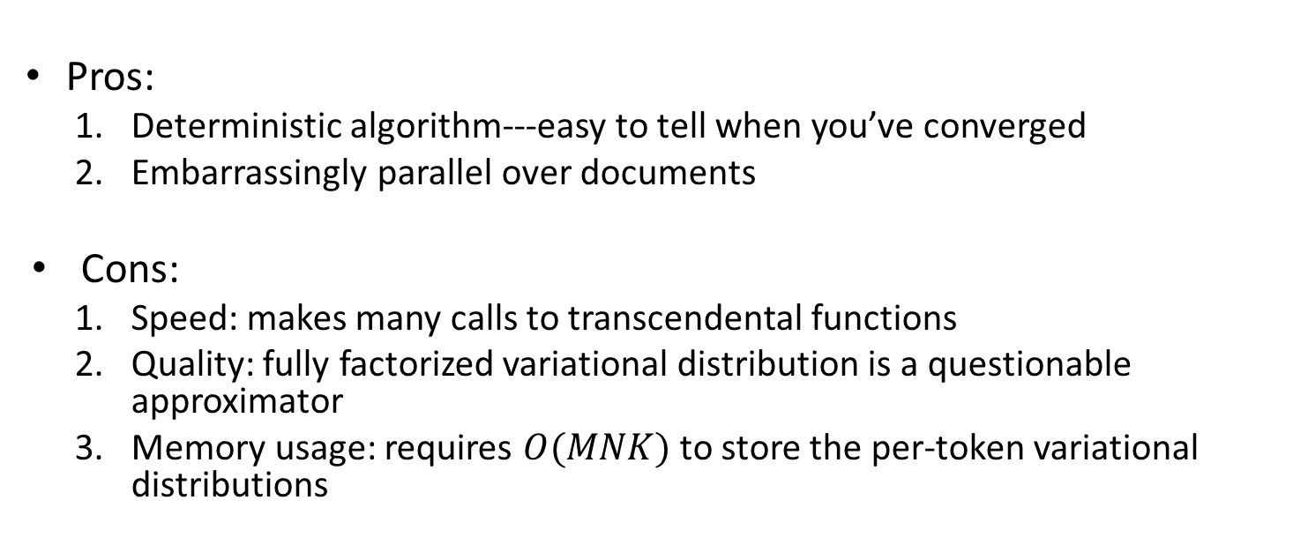
Variational Inference: (Non-exhaustive) Pros/Cons
Pros:
Deterministic algorithm---easy to tell when you’ve converged
Embarrassingly parallel over documents
Cons:
Speed: makes many calls to transcendental functions
Quality: fully factorized variational distribution is a questionable approximator
Memory usage: requires $O(MNK)$ to store the per-token variational distributions

Slide 14
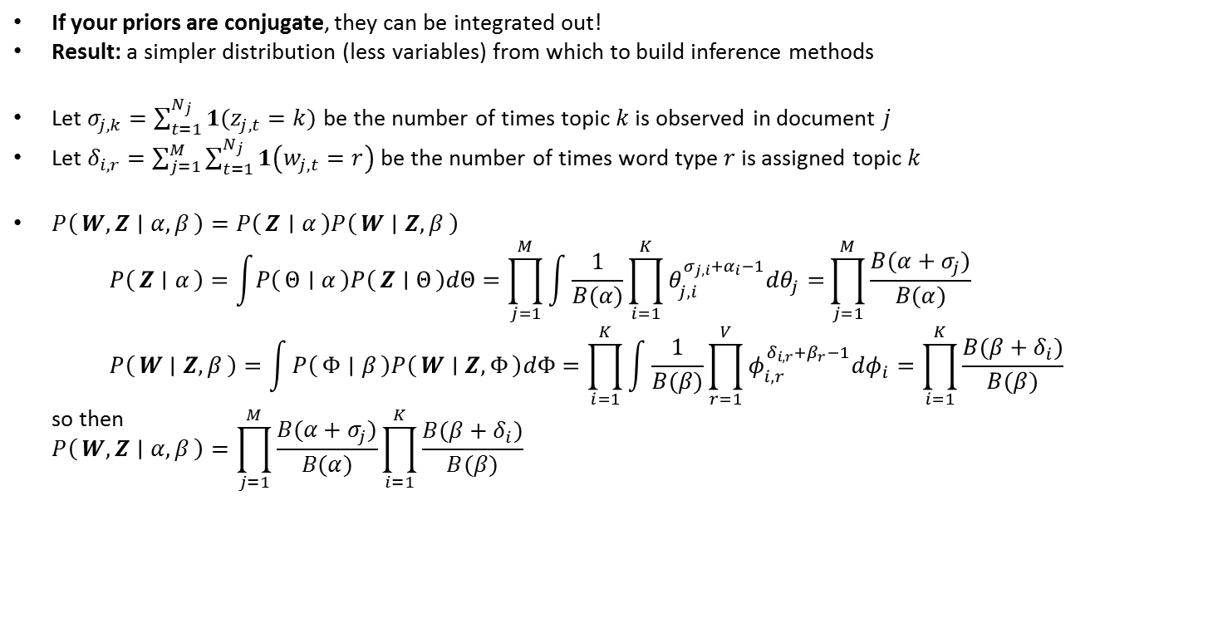
Collapsed Inference Algorithms
If your priors are conjugate, they can be integrated out!
Result: a simpler distribution (less variables) from which to build inference methods
Let $σ_{j,k}=\sum_{t=1}^{N_{j}}{1(z_{j,t}=k)}$ be the number of times topic $k$ is observed in document $j$
Let $δ_{i,r}=\sum_{j=1}^{M}{\sum_{t=1}^{N_{j}}{1\left(w_{j,t}=r\right)}}$ be the number of times word type $r$ is assigned topic $k$
$P\left(W,Z ∣ α,β\right)=P\left(Z ∣ α\right)P\left(W ∣ Z,β\right)$ $P\left(Z ∣ α\right)=\int{P\left(Θ ∣ α\right)P\left(Z ∣ Θ\right)dΘ}=\prod_{j=1}^{M}{\int{\frac{1}{B(α)}\prod_{i=1}^{K}{θ_{j,i}^{σ_{j,i}+α_{i}−1}dθ_{j}=}}}\prod_{j=1}^{M}{\frac{B(α+σ_{j})}{B(α)}}$ $P\left(W ∣ Z,β\right)=\int{P\left(Φ ∣ β\right)P\left(W ∣ Z,Φ\right)dΦ=\prod_{i=1}^{K}{\int{\frac{1}{B(β)}\prod_{r=1}^{V}{φ_{i,r}^{δ_{i,r}+β_{r}−1}dφ_{i}=\prod_{i=1}^{K}{\frac{B(β+δ_{i})}{B(β)}}}}}}$ so then $P\left(W,Z ∣ α,β\right)=\prod_{j=1}^{M}{\frac{B(α+σ_{j})}{B(α)}}\prod_{i=1}^{K}{\frac{B(β+δ_{i})}{B(β)}}$ where $B(∙)$ is the multivariate Beta function.

Slide 15
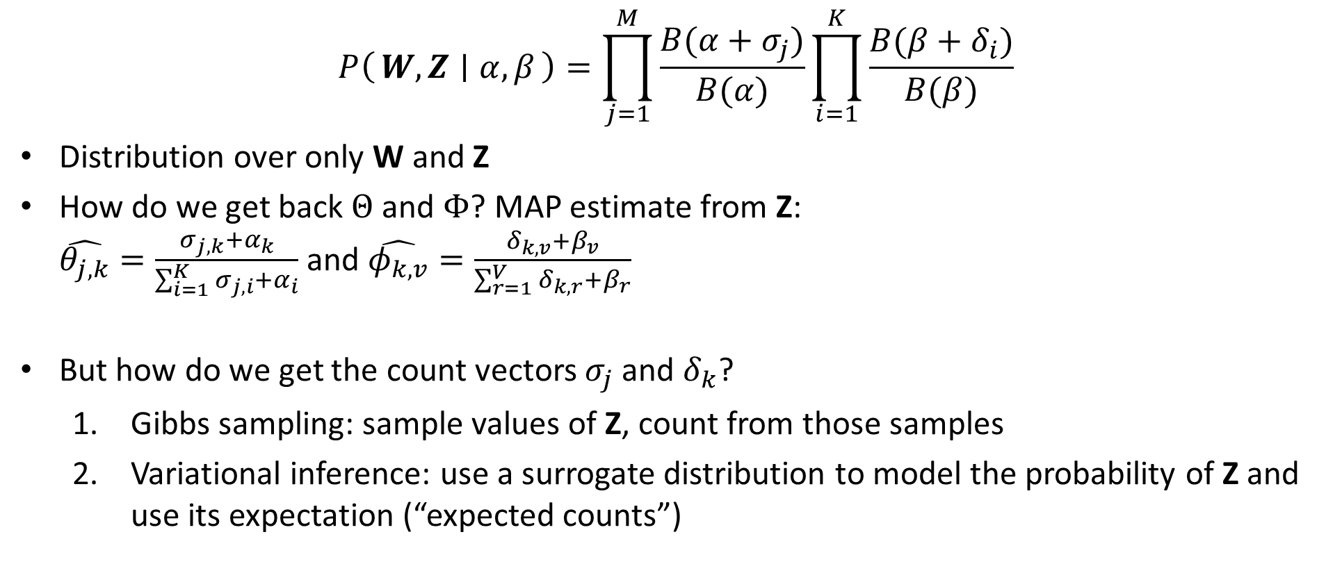
Collapsed Inference Algorithms (cont’d.)
$$P\left(W,Z ∣ α,β\right)=\prod_{j=1}^{M}{\frac{B(α+σ_{j})}{B(α)}}\prod_{i=1}^{K}{\frac{B(β+δ_{i})}{B(β)}}$$
Distribution over only W and Z
How do we get back $Θ$ and $Φ$? MAP estimate from Z: $\hat{θ_{j,k}}=\frac{σ_{j,k}+α_{k}}{\sum_{i=1}^{K}{σ_{j,i}+α_{i}}}$ and $\hat{φ_{k,v}}=\frac{δ_{k,v}+β_{v}}{\sum_{r=1}^{V}{δ_{k,r}+β_{r}}}$
But how do we get the count vectors $σ_{j}$ and $δ_{k}$?
Gibbs sampling: sample values of Z, count from those samples
Variational inference: use a surrogate distribution to model the probability of Z and use its expectation (“expected counts”)

Slide 16
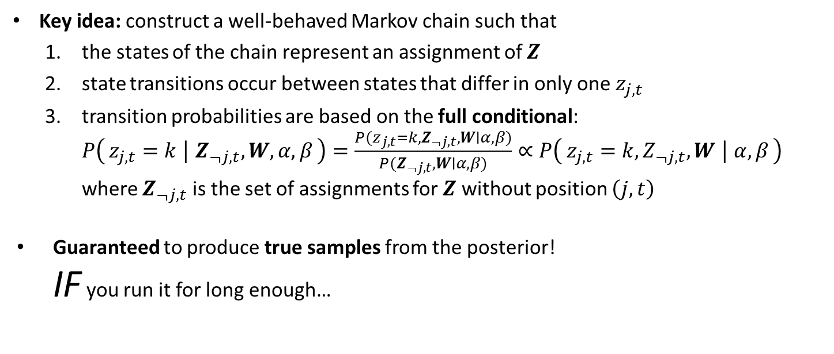
Collapsed Gibbs Sampling for LDA
Key idea: construct a well-behaved Markov chain such that
the states of the chain represent an assignment of $Z$
state transitions occur between states that differ in only one $z_{j,t}$
transition probabilities are based on the full conditional: $P\left(z_{j,t}=k ∣ Z_{¬j,t},W,α,β\right)=\frac{P(z_{j,t}=k,Z_{¬j,t},W∣α, β)}{P(Z_{¬j,t},W∣α, β)}∝P\left(z_{j,t}=k,Z_{¬j,t},W ∣ α,β\right)$ where $Z_{¬j,t}$ is the set of assignments for $Z$ without position $\left(j,t\right)$
Guaranteed to produce true samples from the posterior! IF you run it for long enough…

Slide 17
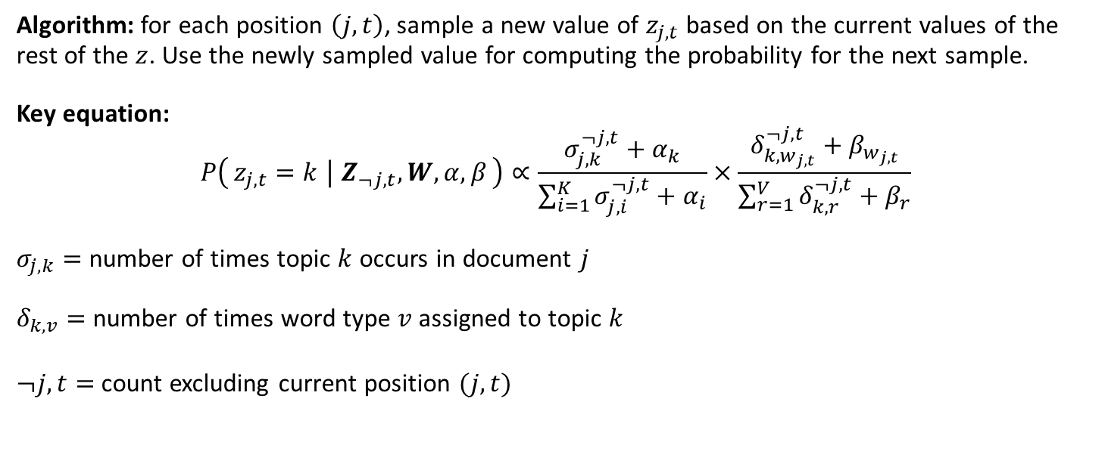
Collapsed Gibbs Sampling for LDA (cont’d.)
Algorithm: for each position $\left(j,t\right)$, sample a new value of $z_{j,t}$ based on the current values of the rest of the $z$. Use the newly sampled value for computing the probability for the next sample. Key equation: $$P\left(z_{j,t}=k ∣ Z_{¬j,t},W,α,β\right)∝\frac{σ_{j,k}^{¬j,t}+α_{k}}{\sum_{i=1}^{K}{σ_{j,i}^{¬j,t}+α_{i}}}×\frac{δ_{k,w_{j,t}}^{¬j,t}+β_{w_{j,t}}}{\sum_{r=1}^{V}{δ_{k,r}^{¬j,t}+β_{r}}}$$ $σ_{j,k}=$ number of times topic $k$ occurs in document $j$ $δ_{k,v}=$ number of times word type $v$ assigned to topic $k$
$¬j,t=$ count excluding current position $(j,t)$

Slide 18
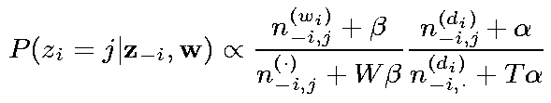
Gibbs sampling in LDA: Illustration
iteration
1 2
What’s the most likely topic for w_{i} in d_{i}?
How likely would d_{i} choose topic j?
How likely would topic j
generate word w_{i} ?
Slide source: Tom Griffiths’ presentation at https://cocosci.berkeley.edu/tom/talks/compling.ppt

Slide 19
Gibbs sampling in LDA: Illustration
iteration
1 2
words in d_{i} assigned with topic j
Count of cases where w_{i} is
assigned with topic j
Count of all words
assigned with topic j
words in d_{i} assigned with any topic
Slide source: Tom Griffiths’ presentation at https://cocosci.berkeley.edu/tom/talks/compling.ppt

Slide 20
Gibbs sampling in LDA: Illustration
iteration
1 2
Slide source: Tom Griffiths’ presentation at https://cocosci.berkeley.edu/tom/talks/compling.ppt

Slide 21
Gibbs sampling in LDA: Illustration
iteration
1 2
Slide source: Tom Griffiths’ presentation at https://cocosci.berkeley.edu/tom/talks/compling.ppt

Slide 22
Gibbs sampling in LDA: Illustration
iteration
1 2
Slide source: Tom Griffiths’ presentation at https://cocosci.berkeley.edu/tom/talks/compling.ppt

Slide 23
Gibbs sampling in LDA: Illustration
iteration
1 2 … 1000
Slide source: Tom Griffiths’ presentation at https://cocosci.berkeley.edu/tom/talks/compling.ppt

Slide 24
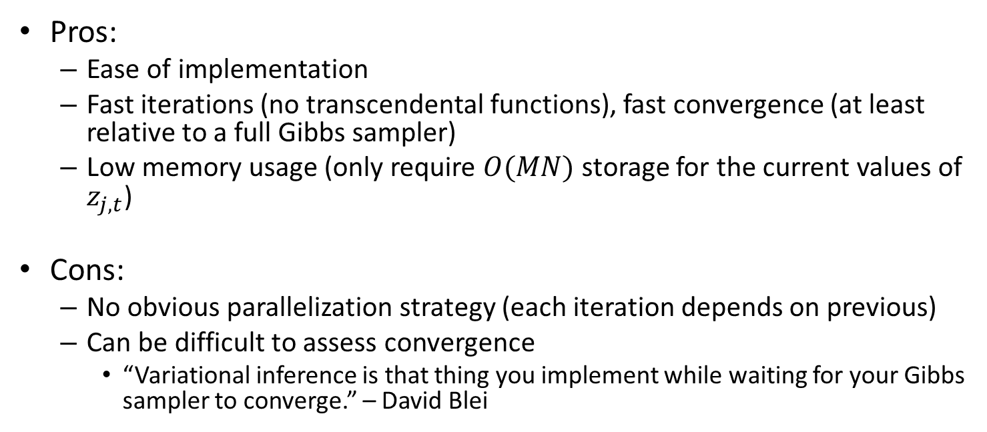
Collapsed Gibbs Sampling: (Non-exhaustive) Pros/Cons
Pros:
Ease of implementation
Fast iterations (no transcendental functions), fast convergence (at least relative to a full Gibbs sampler)
Low memory usage (only require $O(MN)$ storage for the current values of $z_{j,t}$)
Cons:
No obvious parallelization strategy (each iteration depends on previous)
Can be difficult to assess convergence
“Variational inference is that thing you implement while waiting for your Gibbs sampler to converge.” – David Blei

Slide 25
Other Inference Variations
Parallelization: AD-LDA [Newman et al. 09]
Idea: Distribute documents across cores (or machines)
locally maintain “differences” instead of updating globally shared counts
Resolve these “differences” once all documents have been sampled
Can be used for both CGS and CVB/CVB0
Online learning: Stochastic Variational Inference [Hoffman et al. 13]
Idea: Learn LDA models on streaming data (learned Wikipedia topic model with low resource usage
Stochastic Collapsed VI also possible [Foulds et al. 13]

Slide 26
Extensions of LDA
Capturing topic structures
Capturing context
With supervision

Slide 27
Learning topic hierarchies
Topic
0
Fixed hierarchies: [Hofmann 99c]
Learning hierarchies:[Blei et al. 03b]
The topics in each document form a path from root to leaf
Topic
1.1
Topic
1.2
Topic
2.1
Topic
2.2
Topic
2.3

Slide 28
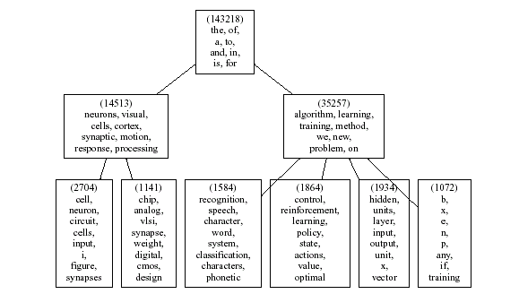
Twelve Years of NIPS [Blei et al. 03b]

Slide 29
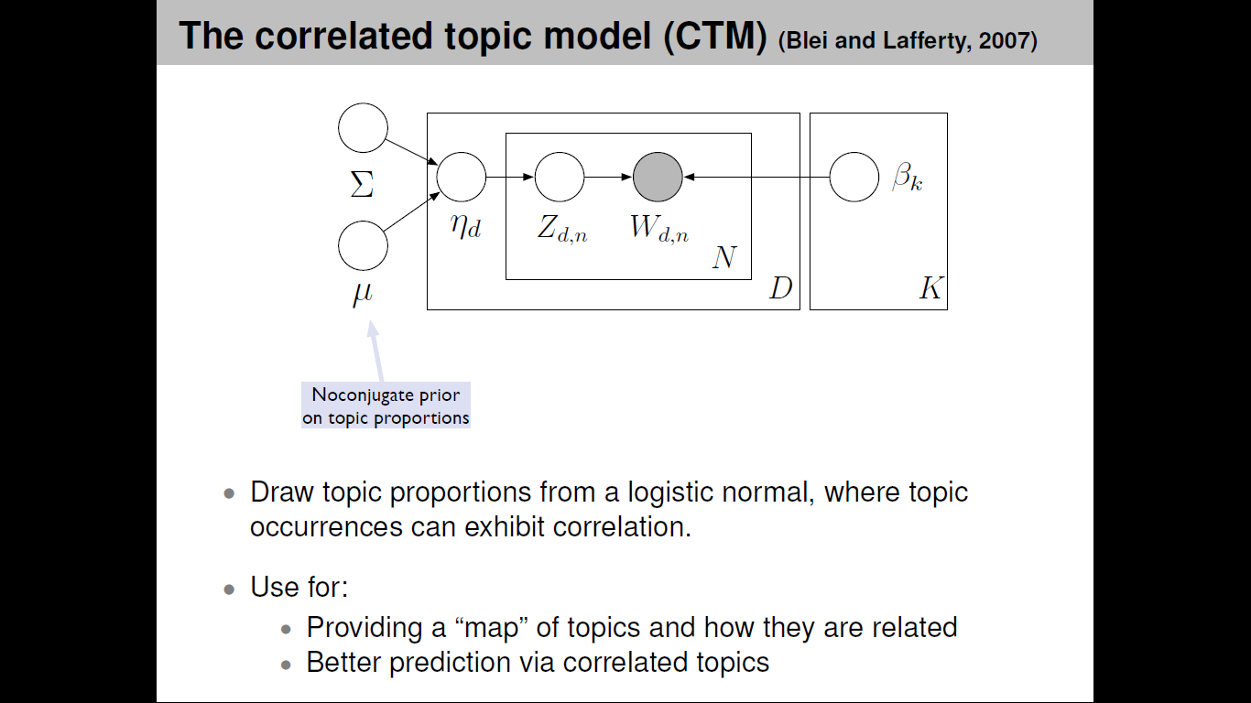
Capturing Topic Structures: Correlated Topic Model (CTM) [Blei & Lafferty 05]

Slide 30
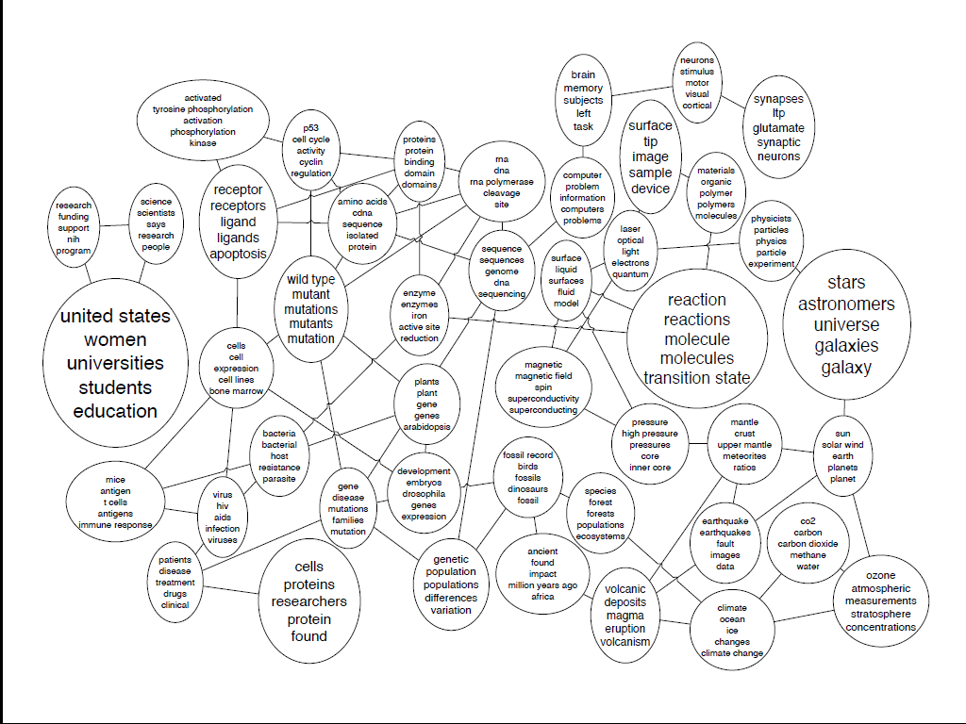
Sample Result of CTM

Slide 31
The Author-Topic model [Rosen-Zvi et al. 04]
each author has a distribution over topics
α
the author of each word is chosen uniformly at random
θ ^{(a)} ∼ Dirichlet(α)
θ ^{(a)}
A
β
x_{i}
x_{i} ∼ Uniform(A ^{(d)} )
φ ^{(j)} ∼ Dirichlet(β)
φ ^{(j)}
z_{i}
z_{i} ∼ Discrete(θ ^{(xi)} )
T
w_{i}
w_{i} ∼ Discrete(φ ^{(zi)} )
N_{d}
D

Slide 32
Four example topics from NIPS

Slide 33
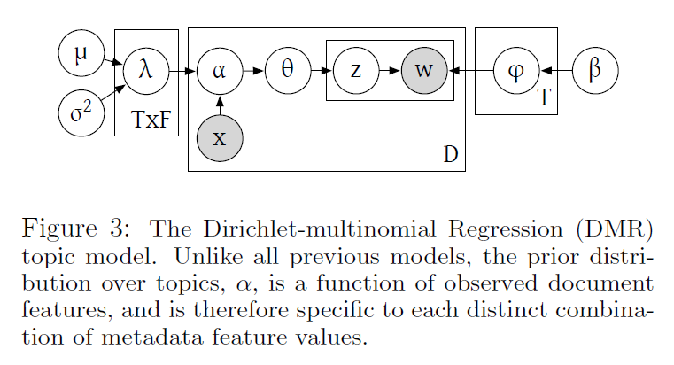
Dirichlet-multinomial Regression (DMR) [Mimno & McCallum 08]
Allows arbitrary features to be used to influence choice of topics

Slide 34
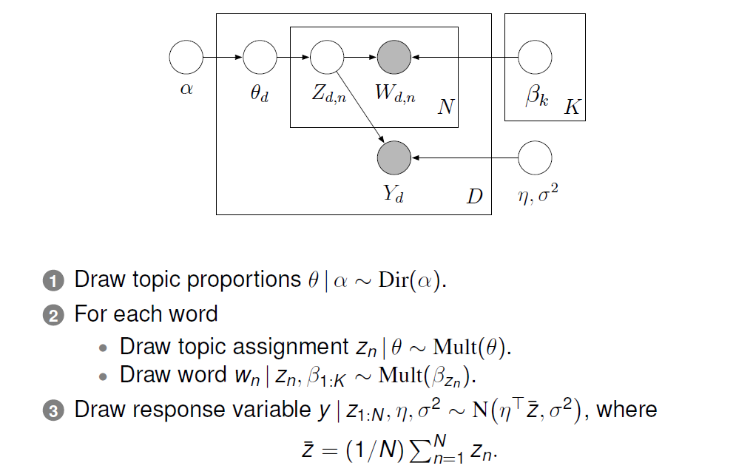
Supervised LDA [Blei & McAuliffe 07]

Slide 35
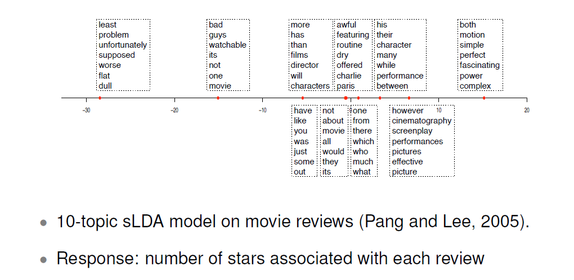
Sample Results of Supervised LDA

Slide 36
Challenges and Directions for Future Research
Challenge 1: How can we quantitatively evaluate the benefit of topic models for text mining?
Currently, most quantitative evaluation is based on perplexity which doesn’t reflect the actual utility of a topic model for text mining
Need to separately evaluate the quality of both topic word distributions and topic coverage (do more in line with “intrusion test”[Chang et al. 09])
Need to consider multiple aspects of a topic (e.g., coherent?, meaningful?) and define appropriate measures
Need to compare topic models with alternative approaches to solving the same text mining problem (e.g., traditional IR methods, non-negative matrix factorization)
Need to create standard test collections

Slide 37
Challenges and Directions for Future Research (cont.)
Challenge 2: How can we help users interpret a topic?
Most of the time, a topic is manually labeled in a research paper; this is insufficient for real applications
Automatic labeling can help, but the utility still needs to evaluated
Need to generate a summary for a topic to enable a user to navigate into text documents to better understand a topic
Need to facilitate post-processing of discovered topics (e.g., ranking, comparison)

Slide 38
Challenges and Directions for Future Research (cont.)
Challenge 3: How can we address the problem of multiple local maxima?
All topic models have the problem of multiple local maxima, causing problems with reproducing results
Need to compute the variance of a discovered topic
Need to define and report the confidence interval for a topic
Challenge 4: How can we develop efficient estimation and inference algorithms for sophisticated models?
How can we leverage a user’s knowledge to speed up inferences for topic models?
Need to develop parallel estimation/inference algorithms

Slide 39
Challenges and Directions for Future Research (cont.)
Challenge 5: How can we incorporate linguistic knowledge into topic models?
Most current topic models are purely statistical
Some progress has been made to incorporate linguistic knowledge (e.g., [Griffiths et al. 04, Wallach 08])
More needs to be done
Challenge 6: How can we incorporate more sophisticated supervision into topic modeling to maximize its support for user tasks?
Current models are mostly pre-specified with little flexibility for an analyst to “steer” the analysis process; need to develop a general analysis framework to enable an analyst to use multiple topic models together to perform complex text mining tasks
Need to combine topic modeling (as a generative model for feature learning) with deep learning to optimize task support

