Slide 1
Mixture Language Models
ChengXiang Zhai
Department of Computer Science
University of Illinois, Urbana-Champaign

Slide 2
Central Questions to Ask about a LM: “ADMI”
Application: Why do you need a LM? For what purpose?
Data: What kind of data do you want to model?
Model: How do you define the model?
Inference: How do you infer/estimate the parameters?
Evaluation metric for a LM
Topic mining and anlaysis
Data set for estimation & evaluation
Text documents & context
Mixture of unigram LMs
Assumptions to be made
Inference/Estimation algorithm
EM algorithm, Bayesian

Slide 3
Outline
Motivation
Mining one topic
Two-component mixture model
EM algorithm
Probabilistic Latent Semantic Analysis (PLSA)
Extensions of PLSA

Slide 4
Topic Mining and Analysis: Motivation
Topic ≈ main idea discussed in text data
Theme/subject of a discussion or conversation
Different granularities (e.g., topic of a sentence, an article, etc.)
Many applications require discovery of topics in text
What are Twitter users talking about today?
What are the current research topics in data mining? How are they different from those 5 years ago?
What do people like about the iPhone 6? What do they dislike?
What were the major topics debated in 2012 presidential election?

Slide 5

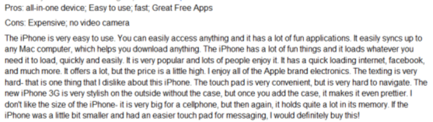



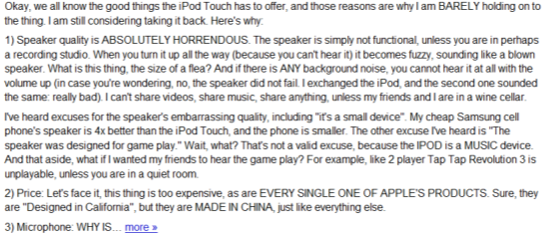
Topics As Knowledge About the World
Non-Text Data
Knowledge about the world
Text Data
Topic 1
+ Context
Time
Location
…
Real World
Topic 2
…
…
Topic k

Slide 6
Tasks of Topic Mining and Analysis
…
Task 2: Figure out which documents
cover which topics
Doc 1
Doc 2
Doc N
Text Data
Topic 1
Topic 2
…
Topic k
Task 1: Discover k topics

Slide 7
Formal Definition of Topic Mining and Analysis
Input
A collection of N text documents C={d₁, …, d_{N}}
Number of topics: k
Output
k topics: { θ₁, …, θ_{k} }
Coverage of topics in each d_{i}: { π_{i1}, …, π_{ik} }
π_{ij} = prob. of d_{i} covering topic θ_{j}
How to define θ_{i} ?

Slide 8
Initial Idea: Topic = Term
…
Doc 1
Doc 2
Doc N
Text Data
30%
θ₁
“Sports”
π₁₁
π₂₁=0
π_{N1}=0
θ₂
π₁₂
π₂₂
π_{N2}
“Travel”
…
12%
θ_{k}
“Science”
π_{1k}
π_{2k}
π_{Nk}
8%

Slide 9
Mining k Topical Terms from Collection C
Parse text in C to obtain candidate terms (e.g., term = word).
Design a scoring function to measure how good each term is as a topic.
Favor a representative term (high frequency is favored)
Avoid words that are too frequent (e.g., “the”, “a”).
TF-IDF weighting from retrieval can be very useful.
Domain-specific heuristics are possible (e.g., favor title words, hashtags in tweets).
Pick k terms with the highest scores but try to minimize redundancy.
If multiple terms are very similar or closely related, pick only one of them and ignore others.

Slide 10
Computing Topic Coverage: π_{ij}
Doc d_{i}
θ₁
“Sports”
π_{i1}
count(“sports”, d_{i})=4
θ₂
π_{i2}
count(“travel”, d_{i}) =2
“Travel”
…
θ_{k}
“Science”
π_{ik}
count(“science”, d_{i})=1

Slide 11
How Well Does This Approach Work?
Doc d_{i}
Cavaliers vs. Golden State Warriors: NBA playoff finals … basketball game … travel to Cleveland … star …
θ₁
“Sports”
1. Need to count
related words also!
θ₂
“Travel”
…
2. “Star” can be ambiguous (e.g., star in the sky).
θ_{k}
“Science”
3. Mine complicated topics?

Slide 12
Problems with “Term as Topic”
Lack of expressive power
Can only represent simple/general topics
Can’t represent complicated topics
Incompleteness in vocabulary coverage
Can’t capture variations of vocabulary (e.g., related words)
Word sense ambiguity
A topical term or related term can be ambiguous (e.g., basketball star vs. star in the sky)
➔ Topic = {Multiple Words}
+ weights on words
➔ Split an ambiguous word
A probabilistic topic model can do all these!

Slide 13
Improved Idea: Topic = Word Distribution
…
θ₁
θ₂
“Travel”
θ_{k}
“Science”
“Sports”
P(w|θ₁)
P(w|θ₂)
P(w|θ_{k})
sports 0.02
game 0.01
basketball 0.005
football 0.004
play 0.003
star 0.003
…
nba 0.001
…
travel 0.0005
…
travel 0.05
attraction 0.03
trip 0.01
flight 0.004
hotel 0.003
island 0.003
…
culture 0.001
…
play 0.0002
…
science 0.04
scientist 0.03
spaceship 0.006
telescope 0.004
genomics 0.004
star 0.002
…
genetics 0.001
…
travel 0.00001
…
Vocabulary Set: V={w1, w2,….}

Slide 14
Probabilistic Topic Mining and Analysis
Input
A collection of N text documents C={d₁, …, d_{N}}
Vocabulary set: V={w₁, …, w_{M}}
Number of topics: k
Output
k topics, each a word distribution: { θ₁, …, θ_{k} }
Coverage of topics in each d_{i}: { π_{i1}, …, π_{ik} }
π_{ij}=prob. of d_{i} covering topic θ_{j}

Slide 15
The Computation Task
OUTPUT: { θ₁, …, θ_{k} }, { π_{i1}, …, π_{ik} }
INPUT: C, k, V
…
Doc 1
Doc 2
Doc N
Text Data
30%
sports 0.02
game 0.01
basketball 0.005
football 0.004
…
θ₁
π₁₁
π₂₁=0%
π_{N1}=0%
θ₂
travel 0.05
attraction 0.03
trip 0.01
…
12%
π₁₂
π₂₂
π_{N2}
…
8%
θ_{k}
science 0.04
scientist 0.03
spaceship 0.006
…
π_{1k}
π_{2k}
π_{Nk}

Slide 16
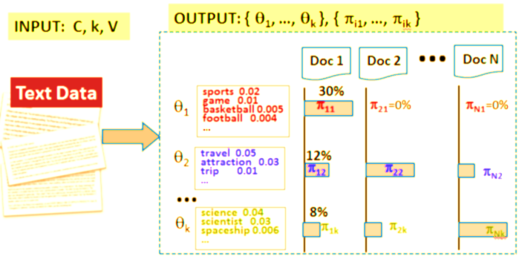
Generative Model for Text Mining
Modeling of Data Generation: P(Data |Model, Λ)
Λ=({ θ₁, …, θ_{k} }, { π₁₁, …, π_{1k} }, …, { π_{N1}, …, π_{Nk} })
How many parameters in total?
Parameter Estimation/ Inferences
Λ* = argmax _{Λ} p(Data| Model, Λ)
P(Data |Model, Λ)
Λ
Λ*

Slide 17
General Ideas of Generative Models for Text Mining
Model data generation: P(Data |Model, Λ)
Infer the most likely parameter values Λ* given a particular data set: Λ* = argmax _{Λ} p(Data| Model, Λ)
Take Λ* as the “knowledge” to be mined for the text mining problem
Adjust the design of the model to discover different knowledge

Slide 18
Simplest Case of Topic Model: Mining One Topic
OUTPUT: { θ}
INPUT: C={d}, V
P(w|θ)
Doc d
Text Data
100%
text ?
mining ?
association ?
database ?
…
query ?
…
θ

Slide 19
Language Model Setup
Data: Document d= x₁ x₂ … x_{|d|} , x_{i} ∈V={w₁ ,…, w_{M}} is a word
Model: Unigram LM θ(=topic) : {θ_{i}=p(w_{i} |θ)}, i=1, …, M; θ₁+…+θ_{M}=1
Likelihood function:
ML estimate:

Slide 20
Computation of Maximum Likelihood Estimate
Maximize p(d|θ)
Max. Log-Likelihood
Subject to constraint:
Use Lagrange multiplier approach
Normalized
Counts

Slide 21
What Does the Topic Look Like?
p(w| θ)
d
the 0.031
a 0.018
…
text 0.04
mining 0.035
association 0.03
clustering 0.005
computer 0.0009
…
food 0.000001
…
Text mining
paper
Can we get rid of
these common words?

Slide 22
Factoring out Background Words
p(w| θ)
d
the 0.031
a 0.018
…
text 0.04
mining 0.035
association 0.03
clustering 0.005
computer 0.0009
…
food 0.000001
…
Text mining
paper
How can we get rid of
these common words?

Slide 23
Generate d Using Two Word Distributions
Topic: θ_{d}
text 0.04
mining 0.035
association 0.03
clustering 0.005
…
the 0.000001
d
p(θ_{d} )+(θ_{B})=1
P(w| θ_{d})
P(θ_{d})=0.5
Text mining
paper
Topic
Choice
p(w| θ_{B})
the 0.03
a 0.02
is 0.015
we 0.01
food 0.003
…
text 0.000006
…
P(θ_{B})=0.5
Background (topic) θ_{B}

Slide 24
What’s the probability of observing a word w?
Topic: θ_{d}
text 0.04
mining 0.035
association 0.03
clustering 0.005
…
the 0.000001
d
p(θ_{d} )+(θ_{B})=1
P(“the”)=p(θ_{d})p(“the”|θ_{d}) + p(θ_{B})p(“the”| θ_{B})
= 0.5*0.000001+0.5*0.03
P(w| θ_{d})
P(θ_{d})=0.5
“the”?
Topic
Choice
“text”?
P(“text”)=p(θ_{d})p(“text”|θ_{d}) + p(θ_{B}) p(“text”| θ_{B})
= 0.5*0.04+0.5*0.000006
p(w| θ_{B})
the 0.03
a 0.02
is 0.015
we 0.01
food 0.003
…
text 0.000006
…
P(θ_{B})=0.5
Background (topic) θ_{B}

Slide 25
The Idea of a Mixture Model
text 0.04
mining 0.035
association 0.03
clustering 0.005
…
the 0.000001
Mixture Model
θ_{d}
p(θ_{d} )+(θ_{B})=1
P(w| θ_{d})
P(θ_{d})=0.5
“the”?
w
Topic
Choice
“text”?
the 0.03
a 0.02
is 0.015
we 0.01
food 0.003
…
text 0.000006
θ_{B}
p(w| θ_{B})
P(θ_{B})=0.5

Slide 26
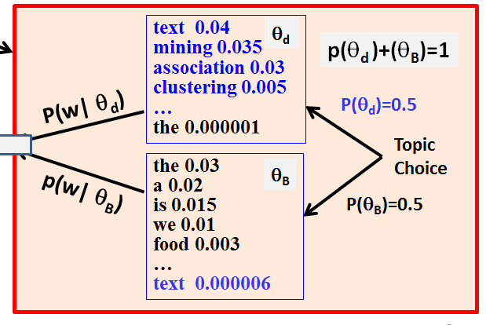
As a Generative Model…
Formally defines the following generative model:
p(w)=p(θ_{d})p(w|θ_{d}) + p(θ_{B} )p(w| θ_{B})
w
Estimate of the model “discovers”
two topics + topic coverage
What if p(θ_{d} )=1 or p(θ_{B} )=1?

Slide 27
Mixture of Two Unigram Language Models
Data: Document d
Mixture Model: parameters Λ=({p(w|θ_{d} )}, {p(w|θ_{B} )}, p(θ_{B}), p(θ_{d} ))
Two unigram LMs: θ_{d} (the topic of d); θ_{B} (background topic)
Mixing weight (topic choice): p(θ_{d} )+p(θ_{B})=1
Likelihood function:
ML Estimate:
Subject to

Slide 28
Back to Factoring out Background Words
text 0.04
mining 0.035
association 0.03
clustering 0.005
…
the 0.000001
Text Mining Paper
d
θ_{d}
p(θ_{d} )+(θ_{B})=1
P(w| θ_{d})
P(θ_{d})=0.5
… text mining... is… clustering… we…. Text.. the
Topic
Choice
the 0.03
a 0.02
is 0.015
we 0.01
food 0.003
…
text 0.000006
θ_{B}
P(θ_{B})=0.5
p(w| θ_{B})

Slide 29
Estimation of One Topic: P(w| θ_{d})
Adjust θ_{d}to maximize p(d|Λ)
(all other parameters are known)
text ?
mining ?
association ?
clustering ?
…
the ?
θ_{d}
p(θ_{d} )+(θ_{B})=1
Would the ML estimate demote
background words in θ_{d} ?
P(θ_{d})=0.5
d
Topic
Choice
the 0.03
a 0.02
is 0.015
we 0.01
food 0.003
…
text 0.000006
θ_{B}
… text mining... is… clustering… we…. Text.. the
P(θ_{B})=0.5

Slide 30
Behavior of a Mixture Model
d =
text the
Likelihood:
text ?
the ?
θ_{d}
P(“text”)=p(θ_{d})p(“text”|θ_{d}) + p(θ_{B})p(“text”| θ_{B})
= 0.5*p(“text”|θ_{d}) +0.5*0.1
P(θ_{d})=0.5
P(“the”) = 0.5*p(“the”|θ_{d}) +0.5*0.9
p(d|Λ)=p(“text”|Λ) p(“the”|Λ)
P(θ_{B})=0.5
= [0.5*p(“text”|θ_{d}) + 0.5*0.1] x
[0.5*p(“the”|θ_{d}) + 0.5*0.9]
the 0.9
text 0.1
θ_{B}
How can we set p(“text”|θ_{d}) & p(“text”|θ_{d}) to maximize it?
Note that p(“text”|θ_{d}) + p(“the”|θ_{d}) =1

Slide 31
“Collaboration” and “Competition” of θ_{d} and θ_{B}
p(d|Λ)=p(“text”|Λ) p(“the”|Λ)
d =
text the
= [0.5*p(“text”|θ_{d}) + 0.5*0.1] x
[0.5*p(“the”|θ_{d}) + 0.5*0.9]
text ?
the ?
θ_{d}
Note that p(“text”|θ_{d}) + p(“the”|θ_{d}) =1
P(θ_{d})=0.5
If $x+y=constant$, then $xy$ reaches maximum when $x=y.$
P(θ_{B})=0.5
0.5*p(“text”|θ_{d}) + 0.5*0.1= 0.5*p(“the”|θ_{d}) + 0.5*0.9
the 0.9
text 0.1
θ_{B}
➔ p(“text”|θ_{d})=0.9 >> p(“the”|θ_{d}) =0.1 !
Behavior 1: if p(w1|θ_{B})> p(w2|θ_{B}), then p(w1|θ_{d}) < p(w2|θ_{d})

Slide 32
Response to Data Frequency
p(d|Λ) = [0.5*p(“text”|θ_{d}) + 0.5*0.1]
x [0.5*p(“the”|θ_{d}) + 0.5*0.9]
d =
text the
➔ p(“text”|θ_{d})=0.9 >> p(“the”|θ_{d}) =0.1 !
p(d’|Λ) = [0.5*p(“text”|θ_{d}) + 0.5*0.1]
x [0.5*p(“the”|θ_{d}) + 0.5*0.9]
text the the the the …the
d’ =
x [0.5*p(“the”|θ_{d}) + 0.5*0.9]
x [0.5*p(“the”|θ_{d}) + 0.5*0.9]
…
What if we increase p(θ_{B})?
x [0.5*p(“the”|θ_{d}) + 0.5*0.9]
What’s the optimal solution now? p(“the”|θ_{d}) > 0.1? or p(“the”|θ_{d}) < 0.1?
Behavior 2: high frequency words get higher p(w|θ_{d})

Slide 33
Estimation of One Topic: P(w| θ_{d})
text ?
mining ?
association ?
clustering ?
…
the ?
θ_{d}
How to set θ_{d}to maximize p(d|Λ)?
(all other parameters are known)
p(θ_{d} )+(θ_{B})=1
P(θ_{d})=0.5
d
Topic
Choice
the 0.03
a 0.02
is 0.015
we 0.01
food 0.003
…
text 0.000006
θ_{B}
… text mining... is… clustering… we…. Text.. the
P(θ_{B})=0.5

Slide 34
If we know which word is from which distribution…
text ?
mining ?
association ?
clustering ?
…
the ?
θ_{d}
p(θ_{d} )+(θ_{B})=1
d’
d
P(θ_{d})=0.5
P(w| θ_{d})
Topic
Choice
… text mining... is… clustering… we…. Text.. the
the 0.03
a 0.02
is 0.015
we 0.01
food 0.003
…
text 0.000006
θ_{B}
p(w| θ_{B})
P(θ_{B})=0.5

Slide 35
Given all the parameters, infer the distribution a word is from…
Is “text” more likely from θ_{d} or θ_{B} ?
text 0.04
mining 0.035
association 0.03
clustering 0.005
…
the 0.000001
p(θ_{d} )+p(θ_{B})=1
θ_{d}
From θ_{d} (Z=0)?
P(w| θ_{d})
P(θ_{d})=0.5
p(θ_{d})p(“text”|θ_{d})
Topic
Choice
From θ_{B} (Z=1)?
the 0.03
a 0.02
is 0.015
we 0.01
food 0.003
…
text 0.000006
p(θ_{B})p(“text”|θ_{B})
θ_{B}
P(θ_{B})=0.5
p(w| θ_{B})

Slide 36
The Expectation-Maximization (EM) Algorithm
Hidden Variable:
z ∈{0, 1}
Initialize p(w|θ_{d} ) with random values.
Then iteratively improve it using E-step & M-step.
Stop when likelihood doesn’t change.
z
1
1
1
1
0
0
0
1
0
...
the
paper
presents
a
text
mining
algorithm
for
clustering
...
E-step
How likely w is from θ_{d}
M-step

Slide 37
EM Computation in Action
E-step
Assume
p(θ_{d} )=p(θ_{B})= 0.5
and p(w|θ_{B}) is known
M-step
Likelihood increasing
“By products”: Are they also useful?

Slide 38
EM As Hill-Climbing ➔ Converge to Local Maximum
Likelihood p(d| θ)
E-step = computing the lower bound
Original likelihood
Lower bound of likelihood function
next guess
current guess
M-step = maximizing the lower bound
θ

Slide 39
A General Introduction to EM
Data: X (observed) + H(hidden) Parameter: θ
“Incomplete” likelihood: L(θ )= log p(X| θ)
“Complete” likelihood: Lc(θ )= log p(X,H| θ)
EM tries to iteratively maximize the incomplete likelihood:
Starting with an initial guess θ⁽⁰⁾,
1. E-step: compute the expectation of the complete likelihood
2. M-step: compute θ^{(n)} by maximizing the Q-function

Slide 40
Convergence Guarantee
Goal: maximizing “Incomplete” likelihood: L(θ )= log p(X| θ)
I.e., choosing θ^{(n)}, so that L(θ^{(n)})-L(θ^{(n-1)})≥0
Note that, since p(X,H| θ) =p(H|X, θ) P(X| θ) , L(θ) =Lc(θ) -log p(H|X, θ)
L(θ^{(n)})-L(θ^{(n-1)}) = Lc(θ^{(n)})-Lc(θ ^{(n-1)})+log [p(H|X, θ ^{(n-1)} )/p(H|X, θ^{(n)})]
Taking expectation w.r.t. p(H|X, θ^{(n-1)}),
L(θ^{(n)})-L(θ^{(n-1)}) = Q(θ^{(n)}; θ ^{(n-1)})-Q(θ ^{(n-1)}; θ ^{(n-1)}) + D(p(H|X, θ ^{(n-1)})||p(H|X, θ ^{(n)}))
Doesn’t contain H
EM chooses θ^{(n)} to maximize Q
KL-divergence, always non-negative
Therefore, L(θ^{(n)}) ≥ L(θ^{(n-1)})!

Slide 41
EM as Hill-Climbing: converging to a local maximum
Likelihood p(X| θ)
L(θ)= L(θ^{(n-1)}) + Q(θ;θ ^{(n-1)}) -Q(θ ^{(n-1)}; θ ^{(n-1)} ) + D(p(H|X, θ ^{(n-1)} )||p(H|X, θ ))
L(θ^{(n-1)}) + Q(θ;θ ^{(n-1)}) -Q(θ ^{(n-1)}; θ ^{(n-1)} )
next guess
current guess
Lower bound
(Q function)
θ
E-step = computing the lower bound
M-step = maximizing the lower bound

Slide 42
Document as a Sample of Mixed Topics
government 0.3 response 0.2 ...
Blog article about “Hurricane Katrina”
Topic θ₁
[ Criticism of government response to the hurricane primarily consisted of criticism of its response to the approach of the storm and its aftermath, specifically in the delayed response ] to the [ flooding of New Orleans. … 80% of the 1.3 million residents of the greater New Orleans metropolitan area evacuated ] …[ Over seventy countries pledged monetary donations or other assistance]. …
city 0.2 new 0.1 orleans 0.05 ...
Topic θ₂
…
donate 0.1 relief 0.05 help 0.02 ...
Topic θ_{k}
Background θ_{B}
the 0.04 a 0.03 ...
Many applications are possible if we can
“decode” the topics in text…

Slide 43
Mining Multiple Topics from Text
OUTPUT: { θ₁, …, θ_{k} }, { π_{i1}, …, π_{ik} }
INPUT: C, k, V
…
Doc 1
Doc 2
Doc N
Text Data
30%
sports 0.02
game 0.01
basketball 0.005
football 0.004
…
θ₁
π₁₁
π₂₁=0%
π_{N1}=0%
θ₂
travel 0.05
attraction 0.03
trip 0.01
…
12%
π₁₂
π₂₂
π_{N2}
…
8%
θ_{k}
science 0.04
scientist 0.03
spaceship 0.006
…
π_{1k}
π_{2k}
π_{Nk}

Slide 44
Generating Text with Multiple Topics: p(w)=?
p(w|θ₁)
government 0.3 response 0.2 ...
(1-λ_{B})p(θ₁) p(w|θ₁)
Topic θ₁
+
p(θ₁)=π_{d,1}
(1-λ_{B})p(θ₂) p(w|θ₂)
p(w|θ₂)
city 0.2 new 0.1 orleans 0.05 ...
Topic θ₂
…
+
…
+
…
p(θ₂)=π_{d,2}
w
donate 0.1 relief 0.05 help 0.02 ...
p(w|θ_{k})
(1- λ_{B})p(θ_{k}) p(w|θ_{k})
Topic θ_{k}
p(θ_{k})=π_{d,k}
1- λ_{B}
+
Topic
Choice
p(w|θ_{B})
Background θ_{B}
the 0.04 a 0.03 ...
λ_{B} p(w|θ_{B})
p(θ_{B})= λ_{B}

Slide 45
Probabilistic Latent Semantic Analysis (PLSA)
Percentage of
background words
(known)
Background
LM (known)
Coverage of topic θ _{j} in doc d
Prob. of word w in topic θ _{j}
Unknown Parameters: Λ=({π_{d,j}}, {θ _{j}}), j=1, …, k
How many unknown parameters are there in total?

Slide 46
ML Parameter Estimation
Constrained Optimization:

Slide 47
EM Algorithm for PLSA: E-Step
Hidden Variable (=topic indicator): z_{d,w} ∈{B, 1, 2, …, k}
Probability that w in doc d is generated from topic θ _{j}
Use of Bayes Rule
Probability that w in doc d is generated from background θ _{B}

Slide 48
EM Algorithm for PLSA: M-Step
Hidden Variable (=topic indicator): z_{d,w} ∈{B, 1, 2, …, k}
ML Estimate based on “allocated” word counts to topic θ _{j}
Re-estimated probability of doc d covering topic θ _{j}
Re-estimated probability of word w for topic θ _{j}

Slide 49
Computation of the EM Algorithm
Initialize all unknown parameters randomly
Repeat until likelihood converges
E-step
M-step
What’s the normalizer
for this one?
In general, accumulate counts, and then normalize

Slide 50
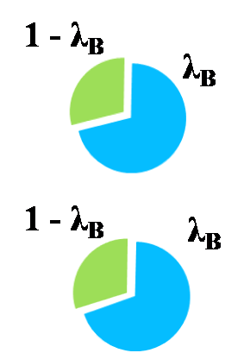
Illustration of EM Algorithm for PLSA
c(w,d)(1 - p(z_{d,w} = B))p(z_{d,w}=j)
c(w,d)p(z_{d,w} = B)
π_{d1,1} ( P(θ₁|d₁) )
π_{d1,2} ( P(θ₂|d₁) )
Topic coverage
c(w, d)
aid
7
price
d₁
5
Initial value
6
oil
π_{d2,1} ( P(θ₁|d₂) )
π_{d2,2} ( P(θ₂|d₂) )
aid
8
d₂
price
7
oil
5
Initial value
P(w| θ)
Topic 1
Topic 2
Initializing π_{d, j} and P(w| θ_{j}) with random values
Iteration 1: E Step: split word counts with different topics (by computing z’ s)
Iteration 1: M Step: re-estimate π_{d, j} and P(w| θ_{j}) by adding and normalizing the splitted word counts
Iteration 2: E Step: split word counts with different topics (by computing z’ s)
Iteration 2: M Step: re-estimate π_{d, j} and P(w| θ_{j}) by adding and normalizing the splitted word counts
Iteration 3, 4, 5, …
Until converging
aid
price
Initial value
oil

Slide 51
Applications of Mixture Models for Text Mining
Likelihood:
Application Scenarios:
p(w|θ₁) & p(w|θ₂) are known; estimate λ
p(w|θ₁) & λ are known; estimate p(w|θ₂)
p(w|θ₁) is known; estimate λ & p(w|θ₂)
λ is known; estimate p(w|θ₁)& p(w|θ₂)
Estimate λ, p(w|θ₁), p(w|θ₂)
The doc is about text mining and food nutrition,
how much percent is about text mining?
30% of the doc is about text mining, what’s the
rest about?
The doc is about text mining, is it also about some
other topic, and if so to what extent?
30% of the doc is about one topic and 70% is about
another, what are these two topics?
The doc is about two subtopics, find out what these two subtopics
are and to what extent the doc covers each.

Slide 52
Use PLSA for Text Mining
PLSA would be able to generate
Topic coverage in each document: p(π_{d} = j)
Word distribution for each topic: p(w|θ_{j})
Topic assignment at the word level for each document
The number of topics must be given in advance
These probabilities can be used in many different ways
θ_{j} naturally serves as a word cluster
π_{d,j} can be used for document clustering
Contextual text mining: Make these parameters conditioned on context, e.g.,
p(θ_{j} |time), from which we can compute/plot p(time| θ_{j} )
p(θ_{j} |location), from which we can compute/plot p(loc| θ_{j} )

Slide 53

How to Help Users Interpret a Topic Model? [Mei et al. 07b]
Use top words
automatic, but hard to make sense
Human generated labels
Make sense, but cannot scale up
term 0.16 relevance 0.08 weight 0.07 feedback 0.04 independence 0.03
model 0.03
frequent 0.02
probabilistic 0.02
document 0.02
…
insulin
foraging
foragers
collected
grains
loads
collection
nectar
…
Term, relevance,
weight, feedback
?
Retrieval Models
Question: Can we automatically generate
understandable labels for topics?

Slide 54
What is a Good Label?
Retrieval models
Semantically close (relevance)
Understandable – phrases?
High coverage inside topic
Discriminative across topics
…
term 0.1599 relevance 0.0752 weight 0.0660 feedback 0.0372 independence 0.0311
model 0.0310
frequent 0.0233
probabilistic 0.0188
document 0.0173
…
iPod Nano
じょうほうけんさく
Pseudo-feedback
A topic from
[Mei & Zhai 06b]
Information Retrieval

Slide 55
Automatic Labeling of Topics [Mei et al. 07b]
Statistical topic models
term 0.1599 relevance 0.0752 weight 0.0660 feedback 0.0372 independence 0.0311
model 0.0310
frequent 0.0233
probabilistic 0.0188
document 0.0173
…
term 0.1599 relevance 0.0752 weight 0.0660 feedback 0.0372 independence 0.0311
model 0.0310
frequent 0.0233
probabilistic 0.0188
document 0.0173
…
term 0.1599 relevance 0.0752 weight 0.0660 feedback 0.0372 independence 0.0311
model 0.0310
frequent 0.0233
probabilistic 0.0188
document 0.0173
…
Multinomial topic models
Collection (Context)
Coverage; Discrimination
Relevance Score
Re-ranking
1
2
clustering algorithm;
distance measure;
…
database system, clustering algorithm, r tree, functional dependency, iceberg cube, concurrency control, index structure …
NLP Chunker
Ngram stat.
Ranked List of Labels
Candidate label pool

Slide 56
Relevance: the Zero-Order Score
Intuition: prefer phrases well covering top words
Clustering
p(“clustering”|θ) = 0.4
Good Label (l₁): “clustering algorithm”
√
p(“dimensional”|θ) = 0.3
dimensional
Latent Topic θ
algorithm
>
birch
…
shape
p(“shape”|θ) = 0.01
Bad Label (l₂): “body shape”
…
p(w|θ)
body
p(“body”|θ) = 0.001

Slide 57
Relevance: the First-Order Score
Intuition: prefer phrases with similar context (distribution)
Clustering
Clustering
Clustering
dimension
dimension
dimension
Good Label (l₁): “clustering algorithm”
Bad Label (l₂): “hash join”
Topic
θ
…
partition
partition
algorithm
key
algorithm
algorithm
SIGMOD Proceedings
Score (l, θ )
…
…
hash
P(w|θ)
hash
hash
p(w | hash join)
p(w | clustering algorithm )
D(θ | clustering algorithm) < D(θ | hash join)

Slide 58
Results: Sample Topic Labels
sampling 0.06
estimation 0.04
approximate 0.04
histograms 0.03
selectivity 0.03
histogram 0.02
answers 0.02
accurate 0.02
north 0.02
case 0.01
trial 0.01
iran 0.01
documents 0.01
walsh 0.009
reagan 0.009
charges 0.007
selectivity
estimation …
iran contra
…
the, of, a, and, to, data, > 0.02
…
clustering 0.02
time 0.01
clusters 0.01
databases 0.01
large 0.01
performance 0.01
quality 0.005
tree 0.09
trees 0.08
spatial 0.08
b 0.05
r 0.04
disk 0.02
array 0.01
cache 0.01
clustering algorithm
clustering structure
…
r tree b tree …
large data, data
quality, high data, data application, …
indexing
methods

Slide 59
Results: Contextual-Sensitive Labeling
sampling
estimation
approximation
histogram
selectivity
histograms
…
Context: Database (SIGMOD Proceedings)
Context: IR (SIGIR Proceedings)
selectivity estimation;
random sampling;
approximate answers;
distributed retrieval;
parameter estimation;
mixture models;
dependencies
functional
cube
multivalued
iceberg
buc
…
multivalue dependency
functional dependency
Iceberg cube
term dependency;
independence
assumption;

Slide 60
Extensions of PLSA
PLSA with prior knowledge ➔ User-controlled PLSA
PLSA for text data with context ➔ Contextualized PLSA
PLSA as a generative model ➔ Latent Dirichlet Allocation (Bayesian inference for mixture models, covered later)

Slide 61
PLSA with Prior Knowledge
Users may have expectations about which topics to analyze:
We expect to see “retrieval models” as a topic in IR
We want to see aspects such as “battery” and “memory” for opinions about a laptop
Users may have knowledge about what topics are (or are NOT) covered in a document
Tags = topics ➔ A doc can only be generated using topics corresponding to the tags assigned to the document
We can incorporate such knowledge as priors of PLSA model

Slide 62
Maximum a Posteriori (MAP) Estimate
We may use p(Λ) to encode all kinds of preferences and constraints, e.g.,
p(Λ)>0 if and only if one topic is precisely “background”: p(w|θ_{B})
p(Λ)>0 if and only if for a particular doc d, π_{d,3}=0 and π_{d,1}=1/2
p(Λ) favors a Λ with topics that assign high probabilities to some particular words
The MAP estimate (with conjugate prior) can be computed using a similar EM algorithm to the ML estimate with smoothing to reflect prior preferences

Slide 63
EM Algorithm with Conjugate Prior on p(w| θ_{i})
Prior: p(w|θ’_{j})
battery 0.5 life 0.5
Pseudo counts of w
from prior θ’
+μp(w|θ’_{j})
+μ
What if μ=0? What if μ=+∞?
Sum of all pseudo counts
We may also set any parameter to a constant (including 0) as needed

Slide 64
Contextual Text Mining: Motivation
Text often has rich context information
Direct context (Meta-Data): time, location, authors, source, …
Indirect context (additional data related to meta-data): social network of the author, author’s age, other text from the same source, etc.
Any related data can be regarded as context
Context can be used to
Partition text data for comparative analysis
Provide meaning to the discovered topics

Slide 65
Context = Partitioning of Text
papers written in 1998
1998
1999
Papers about “text mining”
……
……
2005
2006
papers written by authors in the U.S.
WWW
SIGIR
ACL
KDD
SIGMOD
Enables discovery of knowledge associated with different context as needed

Slide 66
Many Interesting Questions Require Contextual Text Mining
What topics have been gaining increasing attention recently in data mining research? (time as context)
Is there any difference in the responses of people in different regions to the event? (location as context)
What are the common research interests of two researchers? (authors as context)
Is there any difference in the research topics published by authors in the USA and those outside? (author’s affiliation and location as context)
Is there any difference in the opinions about a topic expressed on one social network and another? (social network of authors and topic as context)
Are there topics in news data that are correlated with sudden changes in stock prices? (time series as context)
What issues “mattered” in the 2012 presidential election? (time series as context)

Slide 67
Contextual Probabilistic Latent Semantic Analysis (CPLSA) [Mei & Zhai 06]
General idea:
Explicitly add interesting context variables into a generative model (➔ enable discovery contextualized topics)
Context influences both coverage and content variation of topics
As an extension of PLSA
Model the conditional likelihood of text given context
Assume context-dependent views of a topic
Assume context-dependent topic coverage
EM algorithm can still be used for parameter estimation
Estimated parameters naturally contain context variables, enabling contextual text mining

Slide 68
Generation Process of CPLSA
Choose a topic
View1
View2
View3
Draw a word from θ_{i}
Criticism of government response to the hurricane primarily consisted of criticism of its response to … The total shut-in oil production from the Gulf of Mexico … approximately 24% of the annual production and the shut-in gas production … Over seventy countries pledged monetary donations or other assistance. …
Themes
government 0.3 response 0.2..
Document context:
Time = July 2005
Location = Texas
Author = xxx
Occup. = Sociologist
Age Group = 45+
…
government
government
response
donate 0.1 relief 0.05 help 0.02 ..
donate
donation
help
aid
New Orleans
city 0.2 new 0.1 orleans 0.05 ..
Orleans
new
Texas
July 2005
sociologist
Choose a view
Theme coverage:
……
Choose a Coverage
Texas
July 2005
document

Slide 69
Comparing News Articles [Zhai et al. 04] Iraq War (30 articles) vs. Afghan War (26 articles)
The common theme indicates that “United Nations” is involved in both wars
 | Cluster 1 | Cluster 2 | Cluster 3
Common Theme | united 0.042 nations 0.04 … | killed 0.035 month 0.032 deaths 0.023 … | …
Iraq Theme | n 0.03 Weapons 0.024 Inspections 0.023 … | troops 0.016 hoon 0.015 sanches 0.012 … | …
Afghan Theme | Northern 0.04 alliance 0.04 kabul 0.03 taleban 0.025 aid 0.02 … | taleban 0.026 rumsfeld 0.02 hotel 0.012 front 0.011 … | …
Collection-specific themes indicate different roles of “United Nations” in the two wars

Slide 70
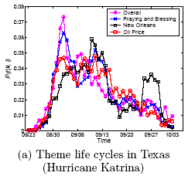
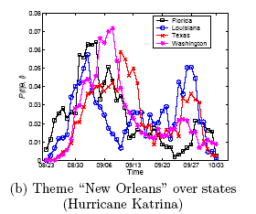
Theme Life Cycles in Blog Articles About “Hurricane Katrina” [Mei et al. 06]
Oil Price
price 0.0772 oil 0.0643 gas 0.0454 increase 0.0210 product 0.0203
fuel 0.0188
company 0.0182
…
New Orleans
Hurricane Rita
city 0.0634 orleans 0.0541 new 0.0342 louisiana 0.0235 flood 0.0227
evacuate 0.0211
storm 0.0177
…
Notes:
The upper figure is the life cycles for different themes in Texas. The red line refers to a theme with the top probability words such as price, oil, gas, increase, etc, from which we know that it is talking about “oil price”. The blue one, on the other hand, talks about events that happened in the city “new orleans”. In the upper figure, we can see that both themes were getting hot during the first two weeks, and became weaker around the mid September. The theme New Orleans got strong again around the last week of September while the other theme dropped monotonically.
In the bottom figure, which is the life cycles for the same theme “New Orleans” in different states. We observe that this theme reaches
the highest probability first in Florida and Louisiana, followed by Washington and Texas, consecutively. During early September, this theme drops significantly in Louisiana while still strong in other states. We suppose this is because of the evacuation in Louisiana. Surprisingly, around late September, a re-arising pattern can be observed in most states, which is most significant in Louisiana. Since this is the time period in which Hurricane Rita arrived, we guess that Hurricane Rita has an impact on the discussion of Hurricane Katrina. This is reasonable since people
are likely to mention the two hurricanes together or make comparisons. We can find more clues to this hypothesis from Hurricane Rita data set.

Slide 71
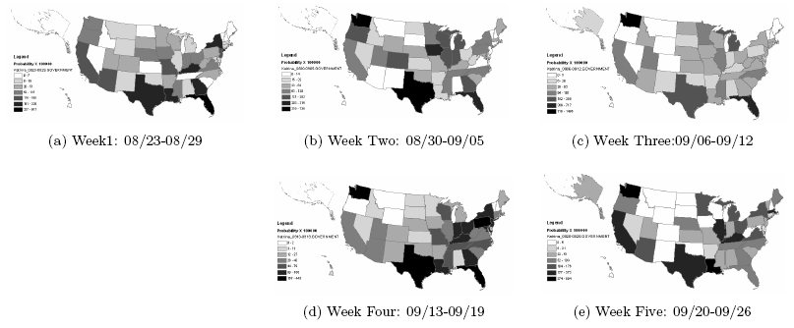
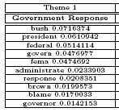
Spatial Distribution of the Topic “Government Response” in Blog Articles About Hurricane Katrina [Mei et al. 06]
Notes:
This slide shows the snapshot for theme ``Government Response'' over the first five weeks of Hurricane Katrina. The darker the color is, the hotter the discussion about this theme is. we observe that at the first week of Hurricane Katrina, the theme ``Government Response'‘ is the strongest in the southeast states, especially those along the Gulf of Mexico. In week 2, we can see the pattern that the theme is spreading towards the north and western states because the northern states are getting darker. In week 3, the theme is distributed even more uniformly, which means that it is spreading all over the states. However, in week 4, we observe that the theme converges to east states and southeast coast again. Interestingly, this week happens to overlap with the first week of Hurricane Rita, which may raise the public concern about government response again in those areas. In week 5, the theme becomes weak in most inland states and most of the remaining discussions are along the coasts.
Another interesting observation is that this theme is originally very strong in Louisiana (the one to the right of Texas, ), but dramatically weakened in Louisiana during week 2 and 3, and becomes strong again from the fourth week. Interestingly, Week 2 and 3 are consistent with the time of evacuation in Louisiana.

Slide 72
Event Impact Analysis: IR Research [Mei & Zhai 06]
vector 0.0514 concept 0.0298 extend 0.0297 model 0.0291 space 0.0236
boolean 0.0151
function 0.0123
feedback 0.0077
…
xml 0.0678 email 0.0197 model 0.0191 collect 0.0187
judgment 0.0102
rank 0.0097
subtopic 0.0079
…
Topic: retrieval models
SIGIR papers
term 0.1599 relevance 0.0752 weight 0.0660 feedback 0.0372 independence 0.0311
model 0.0310
frequent 0.0233
probabilistic 0.0188
document 0.0173
…
A seminal paper [Croft & Ponte 98]
1992
year
model 0.1687 language 0.0753 estimate 0.0520 parameter 0.0281 distribution 0.0268
probable 0.0205
smooth 0.0198
markov 0.0137
likelihood 0.0059
…
Start of TREC
1998
probabilist 0.0778 model 0.0432 logic 0.0404 ir 0.0338 boolean 0.0281
algebra 0.0200
estimate 0.0119
weight 0.0111
…

Slide 73
Topic Analysis with Network Context
The context of a text article can form a network, e.g.,
Authors of research articles may form collaboration networks
Authors of social media content form social networks
Locations associated with text can be connected to form a geographic network
Benefit of joint analysis of text and its network context
Network imposes constraints on topics in text (authors connected in a network tend to write about similar topics)
Text helps characterize the content associated with each subnetwork (e.g., difference in opinions expressed in two subnetworks?)

Slide 74
Network Supervised Topic Modeling: General Idea [Mei et al. 08]
Probabilistic topic modeling as optimization: maximize likelihood
Main idea: network imposes constraints on model parameters Λ
The text at two adjacent nodes of the network tends to cover similar topics
Topic distributions are smoothed over adjacent nodes
Add network-induced regularizers to the likelihood objective function
Any generative model
Any network
Any way to combine
Any regularizer

Slide 75
Instantiation: NetPLSA [Mei et al. 08]
Network-induced prior: Neighbors have similar topic distribution
Modified objective function
PLSA log-likelihood
Text collection
Network graph
Influence of
network constraint
Weight of
edge (u,v)
Quantify the difference in the topic coverage at node u and v

Slide 76
Mining 4 Topical Communities: Results of PLSA
Can’t uncover the 4 communities (IR, DM, ML, Web)
Topic 1 | Topic 2 | Topic 3 | Topic 4
term 0.02 | peer 0.02 | visual 0.02 | interface 0.02
question 0.02 | patterns 0.01 | analog 0.02 | towards 0.02
protein 0.01 | mining 0.01 | neurons 0.02 | browsing 0.02
training 0.01 | clusters 0.01 | vlsi 0.01 | xml 0.01
weighting 0.01 | stream 0.01 | motion 0.01 | generation 0.01
multiple 0.01 | frequent 0.01 | chip 0.01 | design 0.01
recognition 0.01 | e 0.01 | natural 0.01 | engine 0.01
relations 0.01 | page 0.01 | cortex 0.01 | service 0.01
library 0.01 | gene 0.01 | spike 0.01 | social 0.01

Slide 77
Mining 4 Topical Communities: Results of NetPLSA
Uncovers the 4 communities well
Information Retrieval
Data Mining
Machine Learning
Web
Topic 1 | Topic 2 | Topic 3 | Topic 4
retrieval 0.13 | mining 0.11 | neural 0.06 | web 0.05
information 0.05 | data 0.06 | learning 0.02 | services 0.03
document 0.03 | discovery 0.03 | networks 0.02 | semantic 0.03
query 0.03 | databases 0.02 | recognition 0.02 | services 0.03
text 0.03 | rules 0.02 | analog 0.01 | peer 0.02
search 0.03 | association 0.02 | vlsi 0.01 | ontologies 0.02
evaluation 0.02 | patterns 0.02 | neurons 0.01 | rdf 0.02
user 0.02 | frequent 0.01 | gaussian 0.01 | management 0.01
relevance 0.02 | streams 0.01 | network 0.01 | ontology 0.01

Slide 78
Text Information Network
In general, we can view text data that naturally “lives” in a rich information network with all other related data
Text data can be associated with
Nodes of the network
Edges of the network
Paths of the network
Subnetworks
…
Analysis of text should be using the entire network!

Slide 79
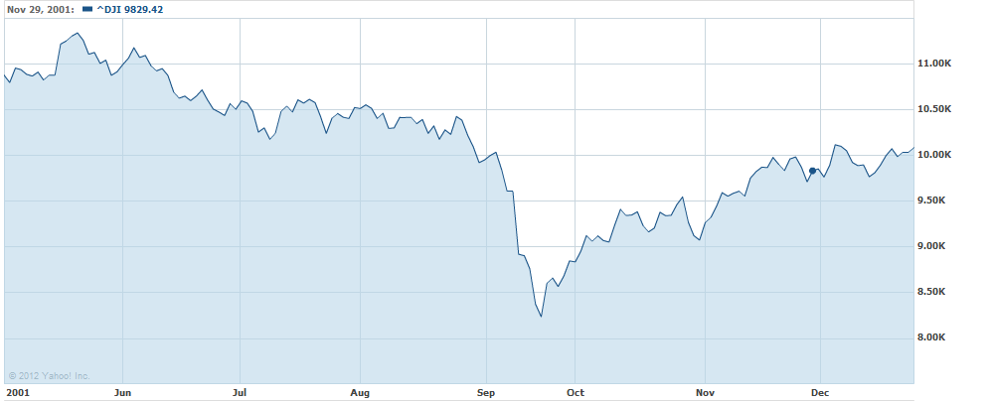
Text Mining for Understanding Time Series
What might have caused the stock market crash?
…
Time
Sept 11 attack!
Any clues in the companion news stream?
Dow Jones Industrial Average [Source: Yahoo Finance]
Notes:
If we consider external factor, there are additional challenges.
For example, this is Dow Jones Industrial Average, average stock price.
Near September, stock price crash. Actually, this is 2001, and September 11 terrorist attack happened at that time.
Like this, these days, need for analyzing text data jointly with external temporal factor is increasing.
If we can understand why this happen, automatically find reasons, it would be very useful.

Slide 80
Analysis of Presidential Prediction Markets
What might have caused the sudden drop of price for this candidate?
What “mattered” in this election?
Tax cut?
…
Time
Any clues in the companion news stream?

Slide 81

Joint Analysis of Text and Time Series to Discover “Causal Topics”
Input:
Time series
Text data produced in a similar time period (text stream)
Output
Topics whose coverage in the text stream has strong correlations with the time series (“causal” topics)
…
Tax cut
Gun control

Slide 82
When a Topic Model Applied to Text Stream
…
Time
Topic θ₁
government 0.3 response 0.2 ...
city 0.2 new 0.1 orleans 0.05 ...
Topic θ₂
…
donate 0.1 relief 0.05 help 0.02 ...
Topic θ_{k}
is 0.05 the 0.04 a 0.03 ...
Background θ_{k}

Slide 83
Iterative Causal Topic Modeling [Kim et al. 13]
Text Stream
Topic Modeling
Causal Topics
Topic 1
Topic 2
Topic 1
Topic 2
Sept. 2001
Oct. … 2001
Topic 3
Topic 4
Topic 3
Topic 4
Non-text Time Series
Zoom into
Word Level
Feedback
as Prior
Split Words
Topic 1 Pos
W1 +
W3 +
Topic 1
W1 +
W2 --
W3 +
W4 --
W5
…
Causal Words
Topic 1 Neg
W2 --
W4 --

Slide 84
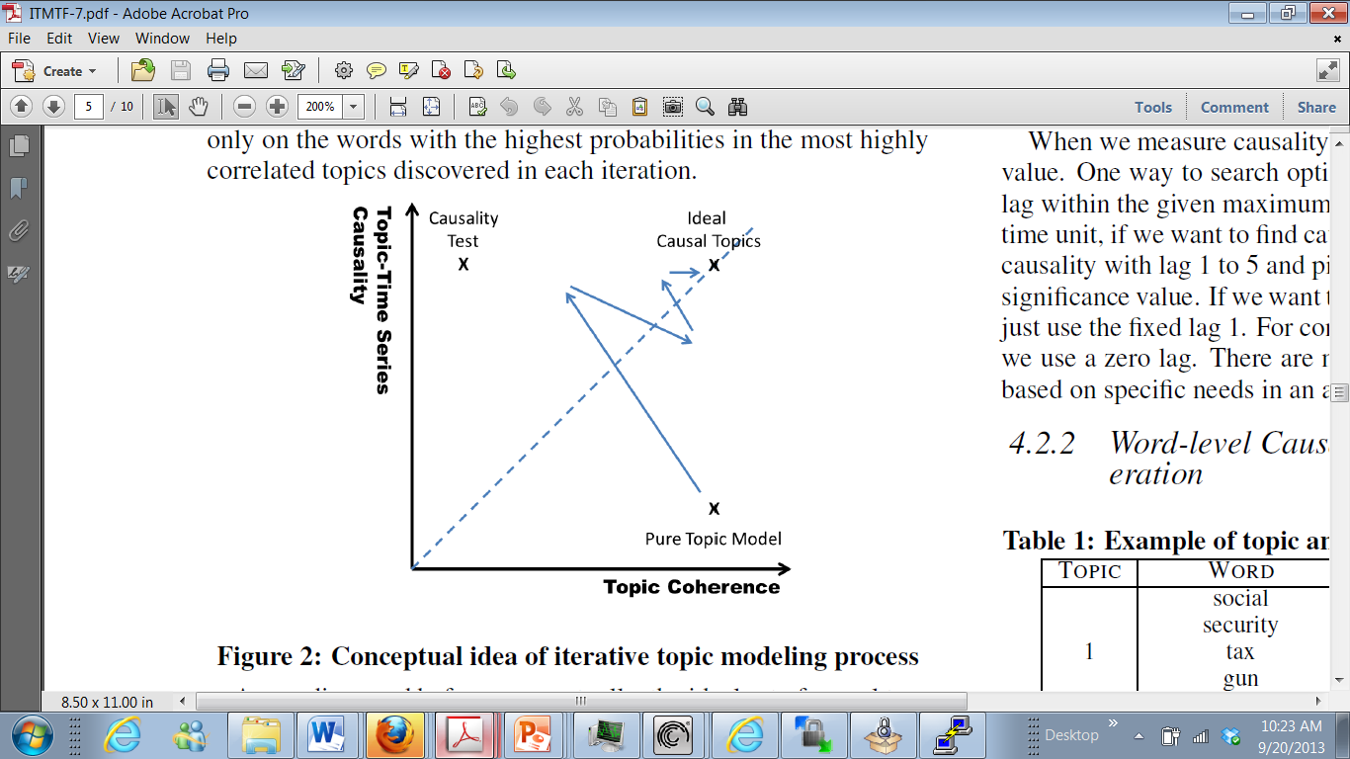
Heuristic Optimization of Causality + Coherence

Slide 85
Measuring Causality (Correlation)
…
Time
Topic θ_{i}
government 0.3 response 0.2 ...
X_{t}
Causality(X_{t},Y_{t})=?
…
Does X_{t} cause Y_{t}?
Correlation(X_{t},Y_{t})=?
External Time Series
(e.g. stock prices)
Y_{t}
Granger Causality Test is often useful [Seth 07]

Slide 86
Topics in NY Times Correlated with Stocks [Kim et al. 13]: June 2000 ~ Dec. 2011
AAMRQ (American Airlines) | AAPL (Apple)
russia russian putin europe european germany bush gore presidential police court judge airlines airport air united trade terrorism food foods cheese nets scott basketball tennis williams open awards gay boy moss minnesota chechnya | paid notice st russia russian europe olympic games olympics she her ms oil ford prices black fashion blacks computer technology software internet com web football giants jets japan japanese plane …
Topics are biased toward each time series

Slide 87
Major Topics in 2000 Presidential Election [Kim et al. 13]
Top Three Words in Significant Topics from NY Times
tax cut 1 screen pataki guiliani enthusiasm door symbolic oil energy prices news w top pres al vice love tucker presented partial abortion privatization court supreme abortion gun control nra
Text: NY Times (May 2000 - Oct. 2000)
Time Series: Iowa Electronic Market
http://tippie.uiowa.edu/iem/
Issues known to be
important in the
2000 presidential election

Slide 88
What You Should Know
What is a mixture language model, particularly mixture of unigram language model?
What is the general form of the likelihood function of a mixture model?
Why can the two-component mixture model with a background component language model factor out common words?
What is PLSA and how does it work?
How does EM algorithm work for PLSA?
Why do we want to add a prior to PLSA and how can we modify the EM algorithm to incorporate a conjugate prior?
Why is contextual topic modeling interesting? Can you give multiple examples of applications of contextual topic modeling?

