Slide 1
Perspective-n-Point (PnP) Introduction & Analysis 算法简介与代码解析
柴政
paopaorobot
2016/9/19

Slide 2
Outline
Perspective-n-Point Background
Common PnP Algorithm
P3P
EPnP
DLT
UPnP
MRE（LS Iteration, G2O）
Code analysis
Conclusion

Slide 3
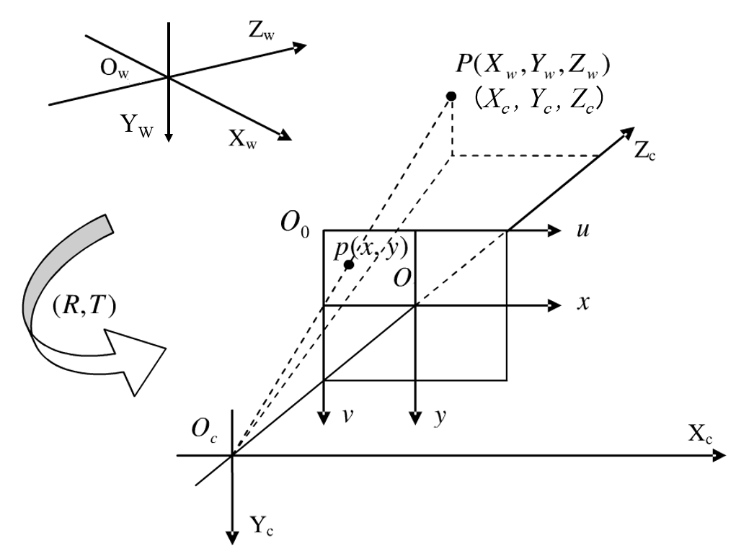
Perspective-n-Point （PnP）
Image/Camera/World Coordinate

Slide 4
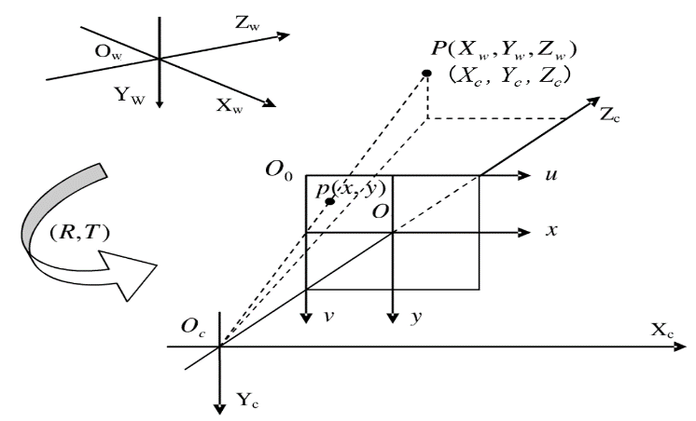




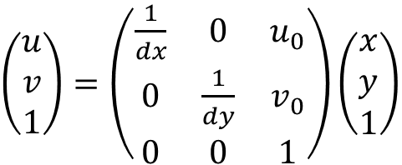

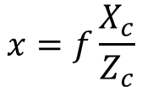
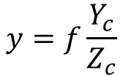


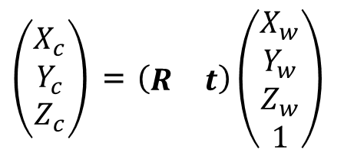
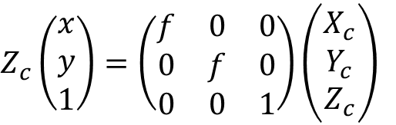



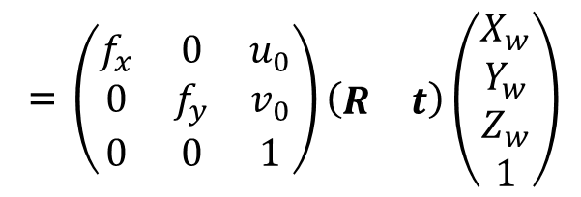
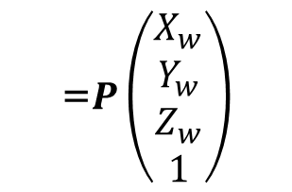
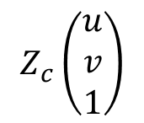
Perspective-n-Point （PnP）
Camera Projection Model
(8)

Slide 5
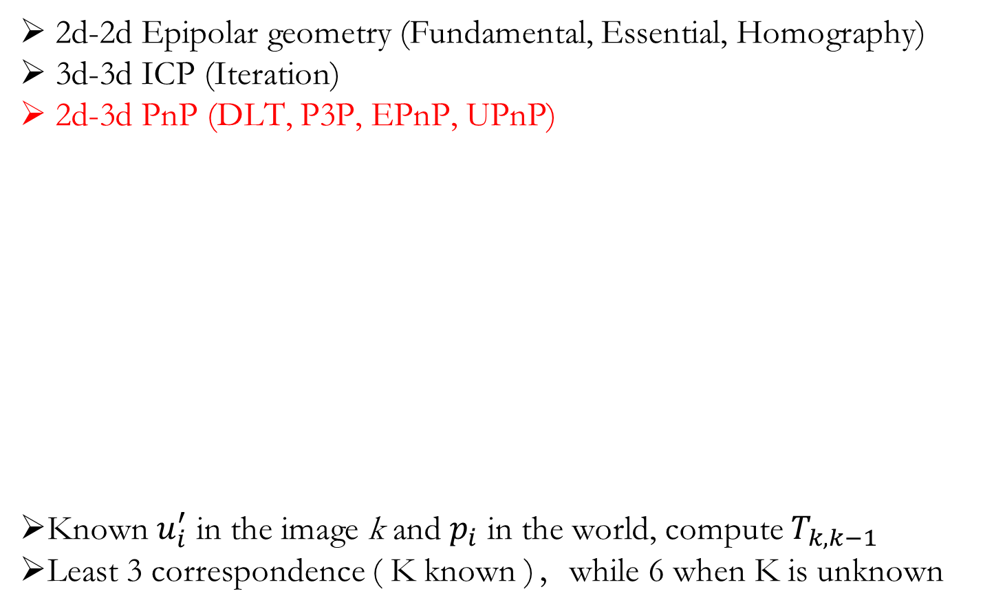
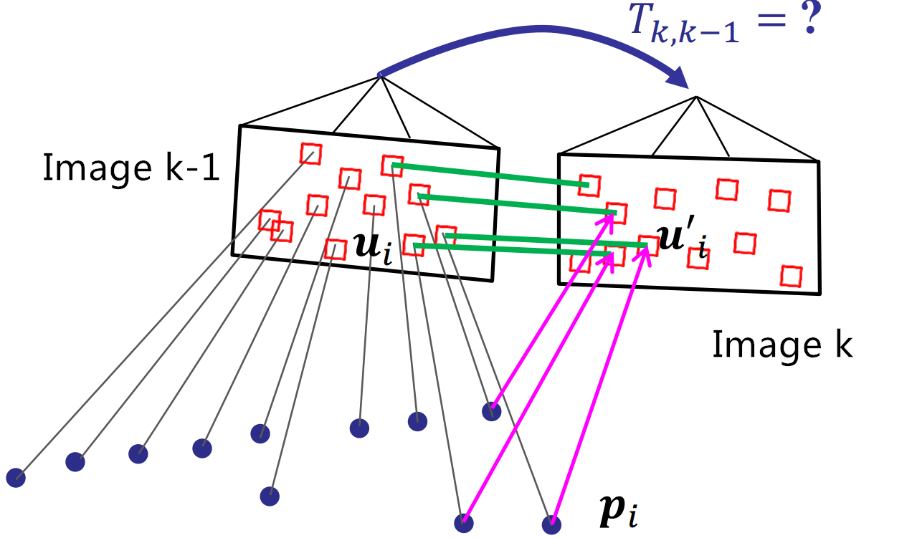
Perspective-n-Point （PnP）

Slide 6



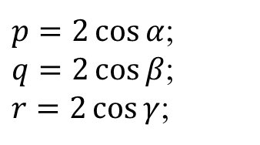
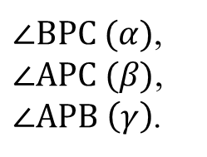
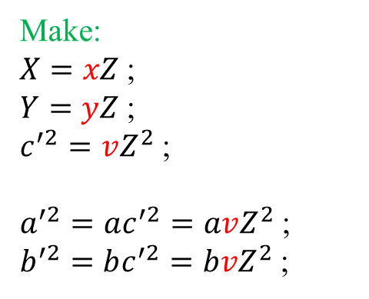
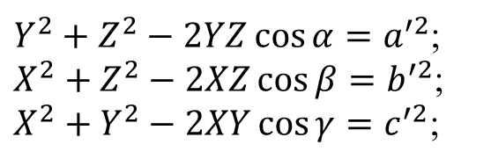
Perspective-3-Point (P3P)
Known:
BC (a’),
AC (b’),
AB (c’),
Solve:
PA (X),
PB (Y),
PC (Z).
Make:
$X=xZ$;
$Y=yZ$;
$c^{′2}=vZ^{2}$;
$a^{′2}=ac^{′2}=avZ^{2}$;
$b^{′2}=bc^{′2}=bvZ^{2}$;
$p=2\cos{α}$;
$q=2\cos{β}$;
$r=2\cos{γ}$;
P
$∠BPC (α)$,
$∠APC (β)$,
$∠APB \left(γ\right)$.
X
Z
Y
b’
$Y^{2}+Z^{2}−2YZ\cos{α}=a^{′2}$;
$X^{2}+Z^{2}−2XZ\cos{β}=b^{′2}$;
$X^{2}+Y^{2}−2XY\cos{γ}=c^{′2}$;
A
(10)
C
c’
a’
B
$P,A,B,C Non−coplanar: p^{2}+q^{2}+r^{2}−pqr−1≠0$;
(9)

Slide 7
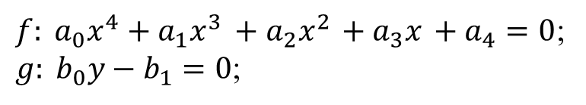
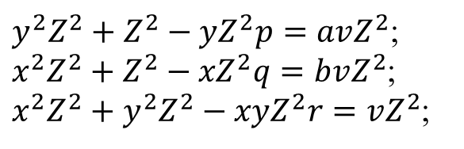
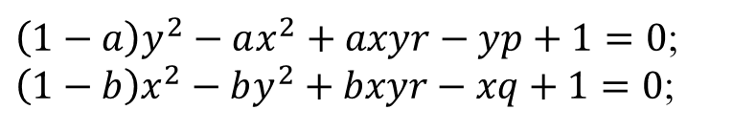

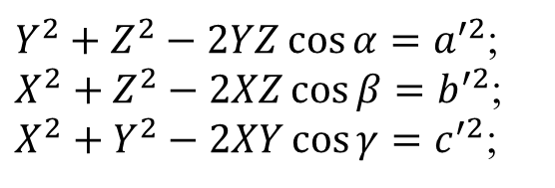


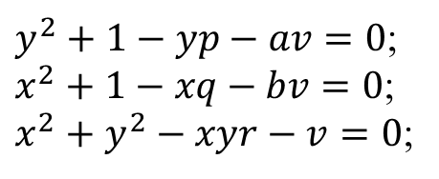
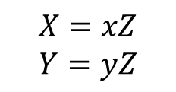

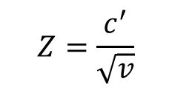
Perspective-3-Point (P3P)
$Y^{2}+Z^{2}−2YZ\cos{α}=a^{′2}$;
$X^{2}+Z^{2}−2XZ\cos{β}=b^{′2}$;
$X^{2}+Y^{2}−2XY\cos{γ}=c^{′2}$;
replace
$y^{2}Z^{2}+Z^{2}−yZ^{2}p=avZ^{2}$;
$x^{2}Z^{2}+Z^{2}−{xZ}^{2}q=bvZ^{2}$;
$x^{2}Z^{2}+y^{2}Z^{2}−{xyZ}^{2}r=vZ^{2}$;
(10)
/ $Z^{2}$
$$v=x^{2}+y^{2}−xyr$$
(11)
$y^{2}+1−yp−av=0$;
$x^{2}+1−xq−bv=0$;
$x^{2}+y^{2}−xyr−v=0$;
$\left(1−a\right)y^{2}−ax^{2}+axyr−yp+1=0$;
$\left(1−b\right)x^{2}−by^{2}+bxyr−xq+1=0$;
(12) ES
$$Zero(ES/I_{0})$$
$${Zero(TS}_{1}/T_{1})$$
$$Z=\frac{c^{′}}{\sqrt{v}}$$
$$X=xZ$$
$$Y=yZ$$
$f: a_{0}x^{4}+a_{1}x^{3}$ $+ a_{2}x^{2}$ $+ a_{3}x$ $+ a_{4}=0$;
$g: b_{0}y−b_{1}=0$;
(11)
(13)

Slide 8

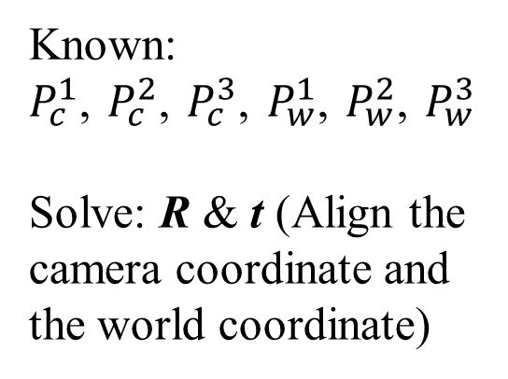
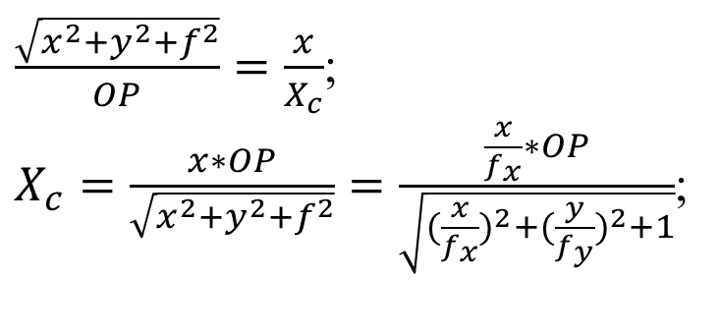


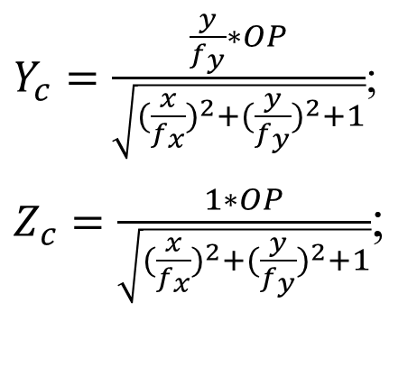
Perspective-3-Point (P3P)
$Y_{c}=\frac{\frac{y}{f_{y}}∗OP}{\sqrt{{(\frac{x}{f_{x}})}^{2}+{(\frac{y}{f_{y}})}^{2}+1}}$;
$Z_{c}=\frac{1∗OP}{\sqrt{{(\frac{x}{f_{x}})}^{2}+{(\frac{y}{f_{y}})}^{2}+1}}$;
$$❷$$
$$❸$$
Known:
$P_{c}^{1}$, $P_{c}^{2}$, $P_{c}^{3}$, $P_{w}^{1}$, $P_{w}^{2}$, $P_{w}^{3}$
Solve: R & t (Align the camera coordinate and the world coordinate)
$\frac{\sqrt{x^{2}+y^{2}+f^{2}}}{OP}=\frac{x}{X_{c}}$;
$X_{c}=\frac{x∗OP}{\sqrt{x^{2}+y^{2}+f^{2}}}=\frac{\frac{x}{f_{x}}∗OP}{\sqrt{{(\frac{x}{f_{x}})}^{2}+{(\frac{y}{f_{y}})}^{2}+1}}$;
$$❶$$

Slide 9
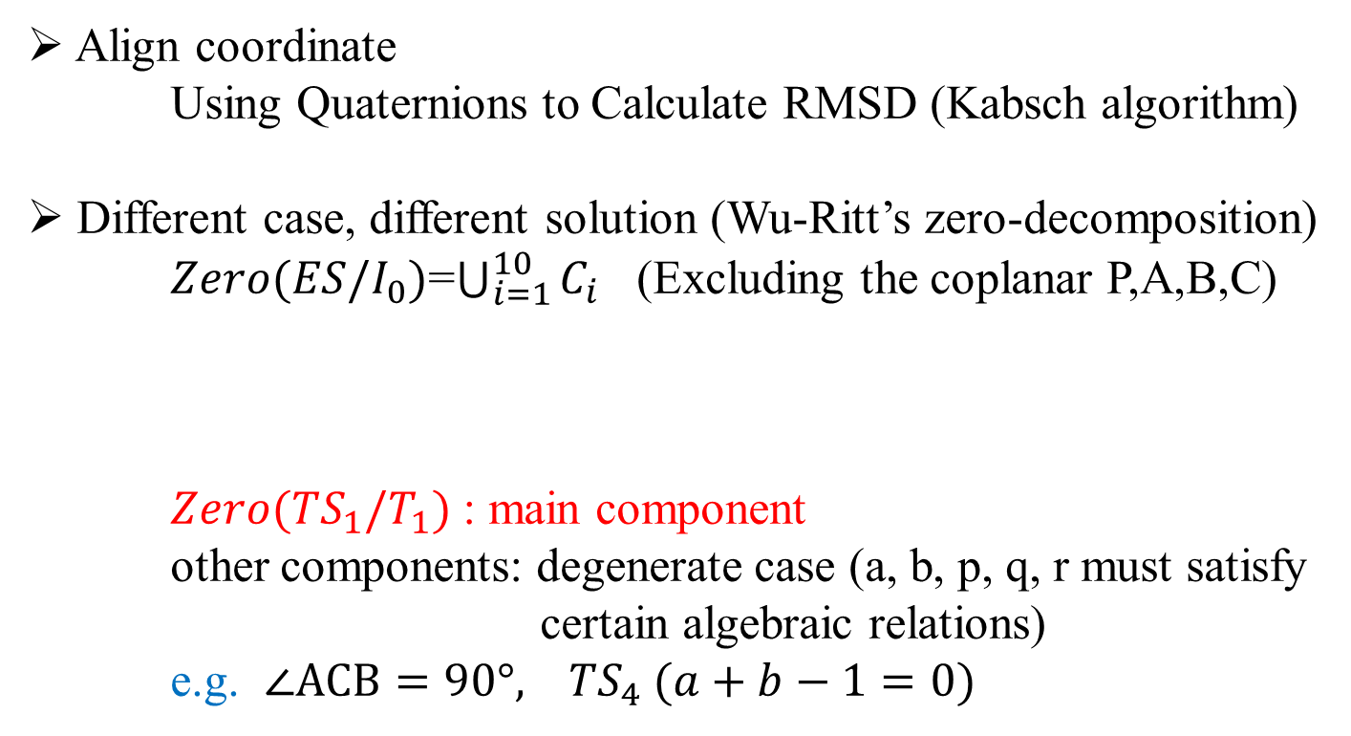
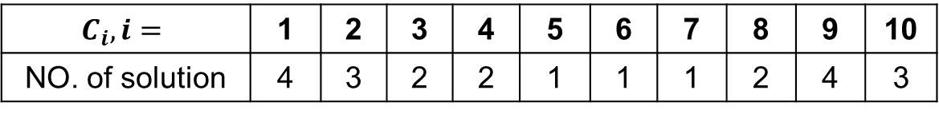
Perspective-3-Point (P3P)
Align coordinate
Using Quaternions to Calculate RMSD (Kabsch algorithm)
Different case, different solution (Wu-Ritt’s zero-decomposition)
$Zero(ES/I_{0})$=$\bigcup_{i=1}^{10}{C_{i}}$ (Excluding the coplanar P,A,B,C)
$Zero({TS}_{1}/T_{1})$ : main component
other components: degenerate case (a, b, p, q, r must satisfy certain algebraic relations)
e.g. $∠ACB=90°, {TS}_{4} (a+b−1=0)$
$$C_{i},i=$$ | 1 | 2 | 3 | 4 | 5 | 6 | 7 | 8 | 9 | 10
NO. of solution | 4 | 3 | 2 | 2 | 1 | 1 | 1 | 2 | 4 | 3

Slide 10

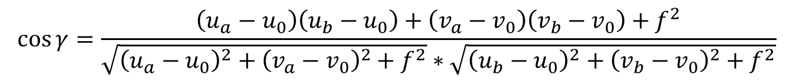
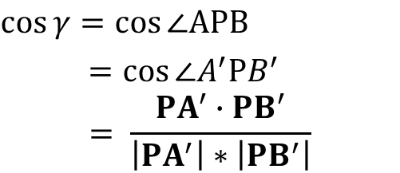
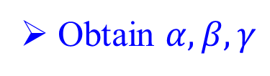

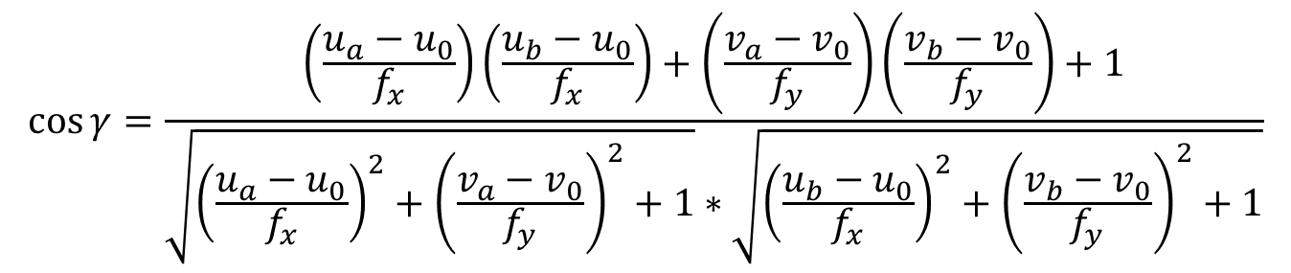



Perspective-3-Point (P3P)
P
Obtain $α,β,γ$
Z
X
f
$$\cos{γ}=\cos{∠APB}$$
$$=cos{∠A^{′}PB^{′}} = \frac{PA^{′}∙PB^{′}}{\left|PA^{′}\right|∗\left|PB^{′}\right|}$$
$$O(u_{0},v_{0})$$
$$\cos{γ}=\frac{\left(\frac{u_{a}−u_{0}}{f_{x}}\right)\left(\frac{u_{b}−u_{0}}{f_{x}}\right)+\left(\frac{v_{a}−v_{0}}{f_{y}}\right)\left(\frac{v_{b}−v_{0}}{f_{y}}\right)+1}{\sqrt{{\left(\frac{u_{a}−u_{0}}{f_{x}}\right)}^{2}+{\left(\frac{v_{a}−v_{0}}{f_{y}}\right)}^{2}+1}∗\sqrt{{\left(\frac{u_{b}−u_{0}}{f_{x}}\right)}^{2}+{\left(\frac{v_{b}−v_{0}}{f_{y}}\right)}^{2}+1}}$$
$$A^{′}(u_{a},v_{a})$$
$$B^{′}(u_{b},v_{b})$$
A
b’
Y
C
$$PA^{′}=(u_{a}−u_{0}, v_{a}−v_{0}, f)$$
c’
a’
$$PB^{′}=(u_{b}−u_{0}, v_{b}−v_{0}, f)$$
B
$$\cos{γ}=\frac{\left(u_{a}−u_{0}\right)\left(u_{b}−u_{0}\right)+\left(v_{a}−v_{0}\right)\left(v_{b}−v_{0}\right)+f^{2}}{\sqrt{{\left(u_{a}−u_{0}\right)}^{2}+{\left(v_{a}−v_{0}\right)}^{2}+f^{2}}∗\sqrt{{\left(u_{b}−u_{0}\right)}^{2}+{\left(v_{b}−v_{0}\right)}^{2}+f^{2}}}$$

Slide 11
Perspective-3-Point (P3P)
Process
1). Obtain |AB|, |BC|, |AC| and ∠BPC, ∠APC, ∠APB;
2). Solve |AP|, |BP|, |CP|;
3). Solve A_{c}, B_{c}, C_{c};
4). Compute R and t (by A_{c}, B_{c}, C_{c}, A_{w}, B_{w}, C_{w})
5). Obtain optimal R and t by D_{w} and d_{i} (reprojection error)
Advantage
1). Speed: fast
2). Coplanar: ok
Disadvantage
1). Precision: low
2). Unstable: need RANSAC

Slide 12
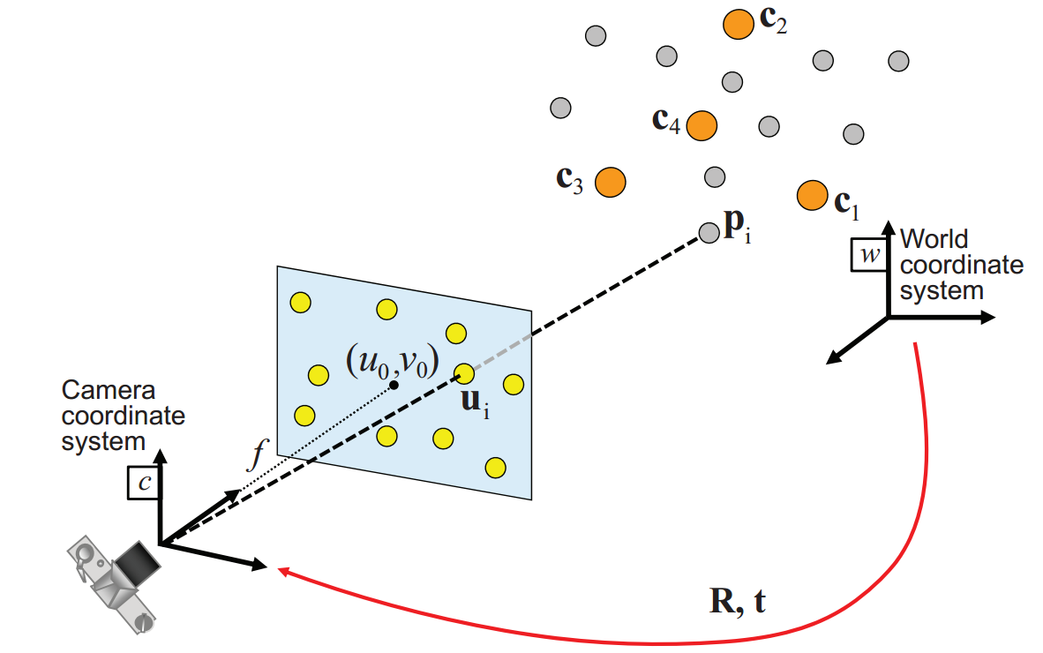
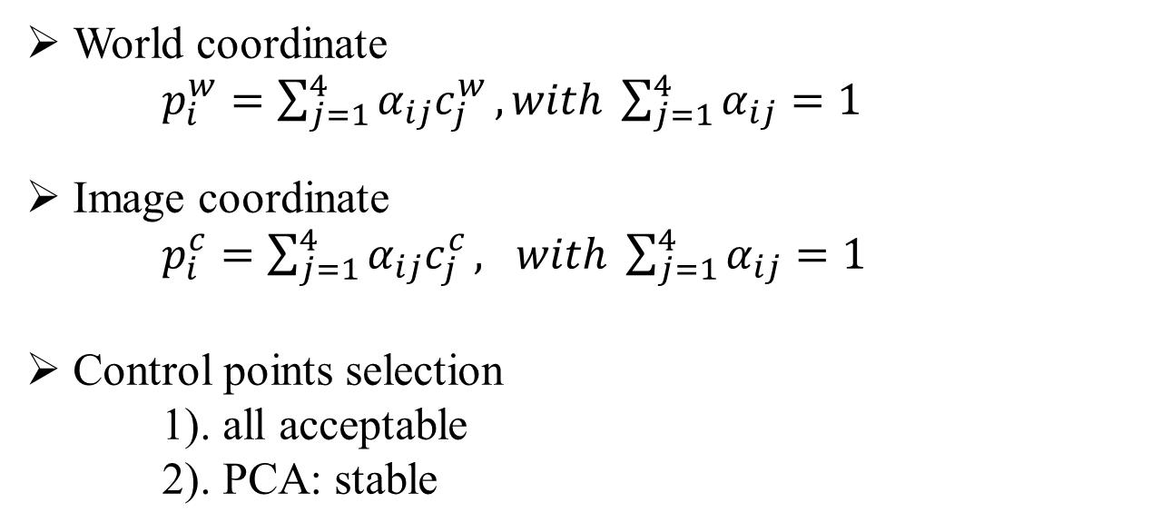
EPnP ( + Iteration)
World coordinate
$p_{i}^{w}=\sum_{j=1}^{4}{α_{ij}c_{j}^{w}}, with \sum_{j=1}^{4}{α_{ij}}=1$
Image coordinate
$p_{i}^{c}=\sum_{j=1}^{4}{α_{ij}c_{j}^{c}}, with \sum_{j=1}^{4}{α_{ij}}=1$
Control points selection
1). all acceptable
2). PCA: stable
Notes:
UPNP是EPNP的升级版，UPNP假设f未知，u0v0为图像中心。
EPNP是已知内参的情况下，根据世界坐标系中的空间点和图像上的2d对应点，求R和t
先选4个控制点，表示pw，然后根据投影模型提供的2n个方程，解出4个控制点在相机坐标系下的坐标，然后恢复所有pc。最后已知pc和pw，求R和t
理论上来说，控制点可以随便选择，UPNP直接坐标系原点，和主轴单位向量。 EPNP是选一个点为所有pw的质点，其他的点是pw的PCA之后得到的主轴上单位向量的点，提高了算法的稳定性

Slide 13
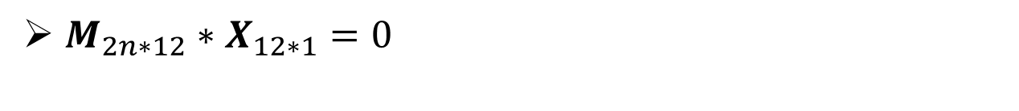
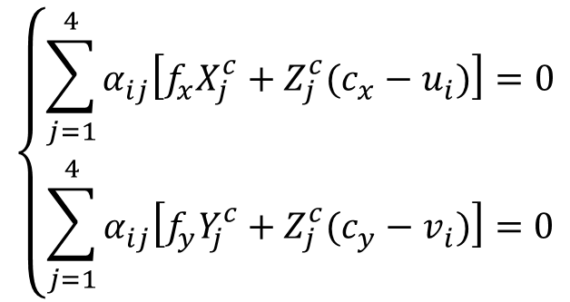
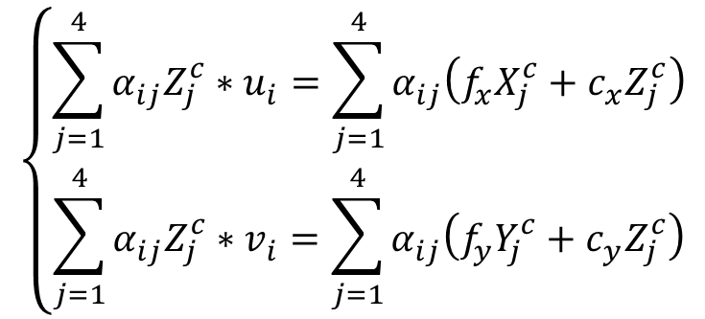
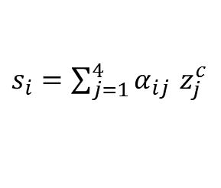
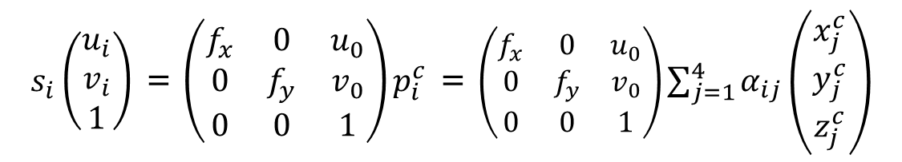
EPnP ( + Iteration)
$M_{2n∗12}∗X_{12∗1}=0$
$s_{i}\left(\begin{matrix}u_{i} \\ v_{i} \\ 1\end{matrix}\right)$ = $\left(\begin{matrix}f_{x} & 0 & u_{0} \\ 0 & f_{y} & v_{0} \\ 0 & 0 & 1\end{matrix}\right)p_{i}^{c}$ = $\left(\begin{matrix}f_{x} & 0 & u_{0} \\ 0 & f_{y} & v_{0} \\ 0 & 0 & 1\end{matrix}\right)\sum_{j=1}^{4}{α_{ij}}\left(\begin{matrix}x_{j}^{c} \\ y_{j}^{c} \\ z_{j}^{c}\end{matrix}\right)$
$s_{i}=\sum_{j=1}^{4}{α_{ij}}$ $z_{j}^{c}$
$$\left\{\begin{aligned}\sum_{j=1}^{4}{α_{ij}Z_{j}^{c}}∗u_{i}=\sum_{j=1}^{4}{α_{ij}\left(f_{x}X_{j}^{c}+c_{x}Z_{j}^{c}\right)} \\ \sum_{j=1}^{4}{α_{ij}Z_{j}^{c}}∗v_{i}=\sum_{j=1}^{4}{α_{ij}\left(f_{y}Y_{j}^{c}+c_{y}Z_{j}^{c}\right)}\end{aligned}\right.$$
$$\left\{\begin{aligned}\sum_{j=1}^{4}{α_{ij}\left[f_{x}X_{j}^{c}+Z_{j}^{c}(c_{x}−u_{i})\right]}=0 \\ \sum_{j=1}^{4}{α_{ij}\left[f_{y}Y_{j}^{c}+Z_{j}^{c}(c_{y}−v_{i})\right]}=0\end{aligned}\right.$$

Slide 14
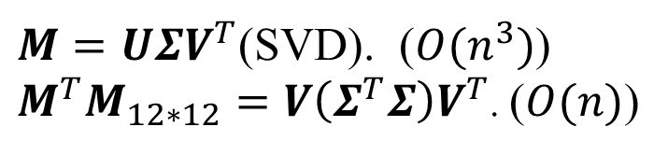
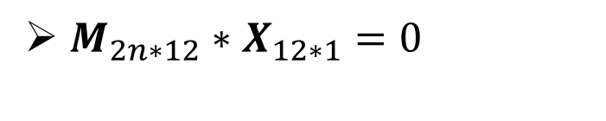


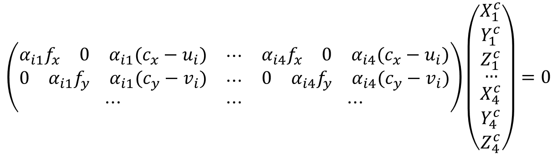

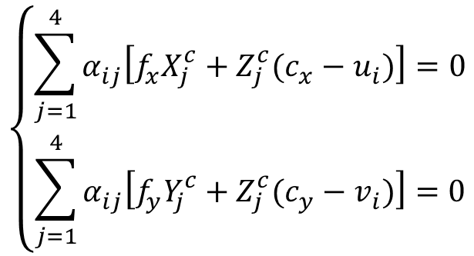

EPnP ( + Iteration)
$M_{2n∗12}∗X_{12∗1}=0$
2*3
3*4
$$\left\{\begin{aligned}\sum_{j=1}^{4}{α_{ij}\left[f_{x}X_{j}^{c}+Z_{j}^{c}(c_{x}−u_{i})\right]}=0 \\ \sum_{j=1}^{4}{α_{ij}\left[f_{y}Y_{j}^{c}+Z_{j}^{c}(c_{y}−v_{i})\right]}=0\end{aligned}\right.$$
3
* 4
* 2
$M_{12∗2n}^{T}M_{2n∗12}$: O(2n*12*12)
$$X_{12∗1}$$
$$\left(\begin{matrix}\begin{matrix}α_{i1}f_{x} & 0 & α_{i1}(c_{x}−u_{i})\end{matrix} & ⋯ & \begin{matrix}α_{i4}f_{x} & 0 & α_{i4}(c_{x}−u_{i})\end{matrix} \\ \begin{matrix}0 & α_{i1}f_{y} & α_{i1}(c_{y}−v_{i})\end{matrix} & ⋯ & \begin{matrix}0 & α_{i4}f_{y} & α_{i4}(c_{y}−v_{i})\end{matrix} \\ ⋯ & ⋯ & ⋯\end{matrix}\right)\left(\begin{matrix}\begin{matrix}X_{1}^{c} \\ Y_{1}^{c} \\ Z_{1}^{c}\end{matrix} \\ \begin{matrix}… \\ X_{4}^{c} \\ Y_{4}^{c}\end{matrix} \\ Z_{4}^{c}\end{matrix}\right)=0$$
$$M_{2n∗12}$$
$M=UΣV^{T}$(SVD). ($O(n^{3})$)
${M^{T}M}_{12∗12}=V\left(Σ^{T}Σ\right)V^{T}$. ($O(n)$)
$X=\sum_{k=1}^{N}{β_{k}}V_{k}$

Slide 15
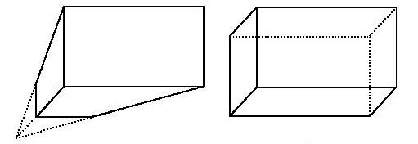
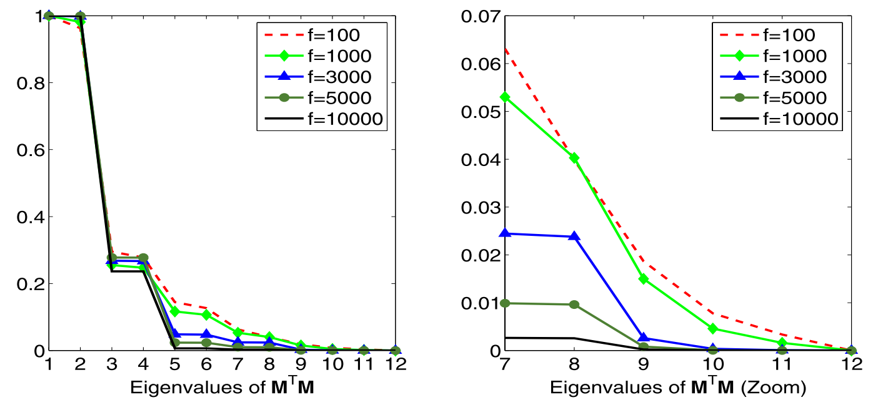
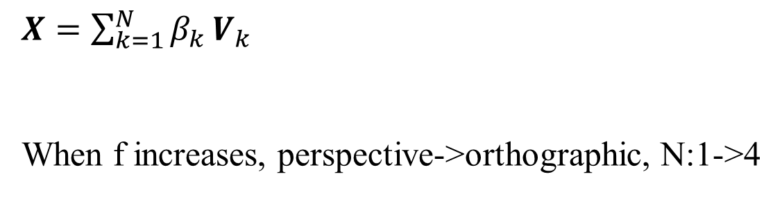
EPnP ( + Iteration)
$X=\sum_{k=1}^{N}{β_{k}}V_{k}$
When f increases, perspective->orthographic, N:1->4
Notes:
透视投影，正交投影
100次实验结果合成，f越大，camera越正交，控制点的depth影响越小（投影差距越小），N越大； 特征点少，N也大

Slide 16
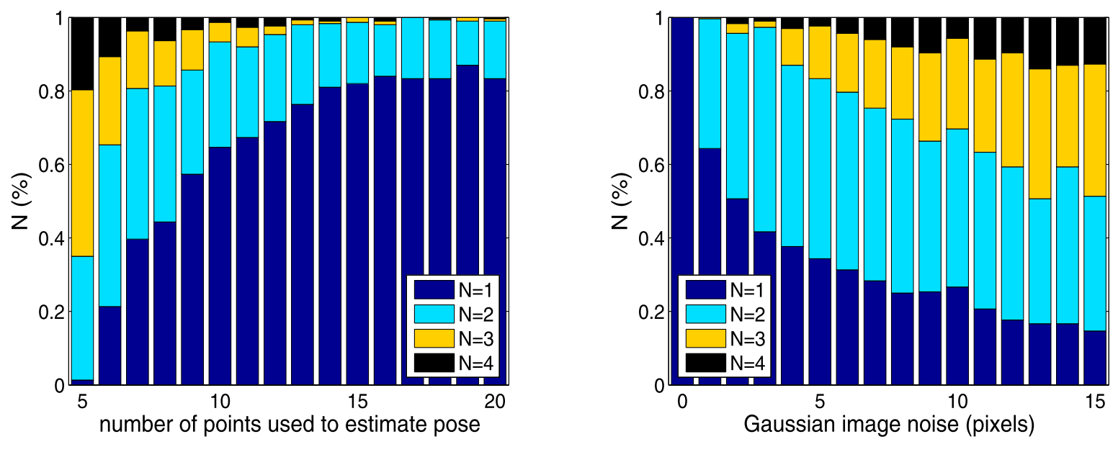
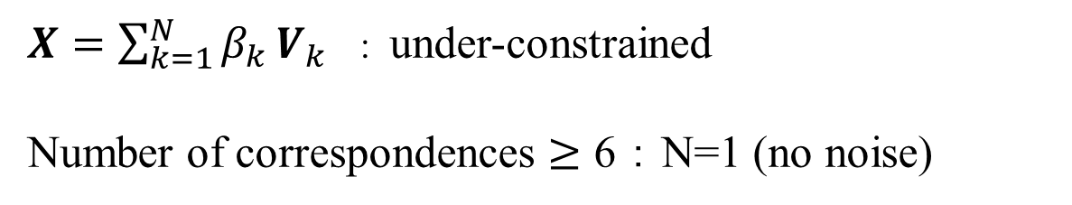
EPnP ( + Iteration)
$X=\sum_{k=1}^{N}{β_{k}}V_{k}$ : under-constrained
Number of correspondences $≥$ 6 ： N=1 (no noise)
Noise: 10 pixels No. of correspondences: 6
Notes:
对应点数越多，最后一个特征向量越能代表最终解X
噪声越小，最后一个特征向量越能代表最终解X

Slide 17

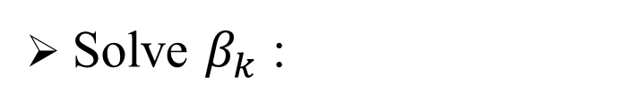

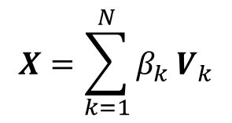



EPnP ( + Iteration)
$$X=\sum_{k=1}^{N}{β_{k}}V_{k}$$
$$V_{2}^{\left[1\right]}$$
Solve $β_{k}$ :
…
…
$$V_{1}^{\left[1\right]}$$
…
Constraint:
$${\left\|c_{i}^{c}−c_{j}^{c}\right\|}^{2}={\left\|c_{i}^{w}−c_{j}^{w}\right\|}^{2}$$
…
…
…
…
…
…
…
$$V_{1}^{\left[4\right]}$$
…
N=1 :
$${\left\|βV^{[i]}−βV^{[j]}\right\|}^{2}={\left\|c_{i}^{w}−c_{j}^{w}\right\|}^{2}$$
N=2 :
$${\left\|(β_{1}V_{1}^{\left[i\right]}+β_{2}V_{2}^{\left[i\right]})−(β_{1}V_{1}^{\left[j\right]}+β_{2}V_{2}^{\left[j\right]})\right\|}^{2}={\left\|c_{i}^{w}−c_{j}^{w}\right\|}^{2}$$
N=3 :
$${\left\|(β_{1}V_{1}^{\left[i\right]}+β_{2}V_{2}^{\left[i\right]}+β_{3}V_{3}^{\left[i\right]})−(…)\right\|}^{2}={\left\|c_{i}^{w}−c_{j}^{w}\right\|}^{2}$$
N=4 :
$${\left\|(β_{1}V_{1}^{\left[i\right]}+β_{2}V_{2}^{\left[i\right]}+β_{3}V_{3}^{\left[i\right]}+β_{4}V_{4}^{\left[i\right]})−(…)\right\|}^{2}={\left\|c_{i}^{w}−c_{j}^{w}\right\|}^{2}$$

Slide 18



EPnP ( + Iteration)
$$X=\sum_{k=1}^{N}{β_{k}}V_{k}$$
Solve $β_{k}$ :
N=1 :
$${\left\|βV^{[i]}−βV^{[j]}\right\|}^{2}={\left\|c_{i}^{w}−c_{j}^{w}\right\|}^{2}$$
closed-form solutions:
$$β=\frac{\sum_{\left\{i,j\right\}∈\left[1,4\right]}{\left\|V^{[i]}−V^{[j]}\right\|∙\left\|c_{i}^{w}−c_{j}^{w}\right\|}}{\sum_{\left\{i,j\right\}∈\left[1,4\right]}{{\left\|V^{[i]}−V^{[j]}\right\|}^{2}}}$$

Slide 19


EPnP ( + Iteration)
$$X=\sum_{k=1}^{N}{β_{k}}V_{k}$$
Solve $β_{k}$ :
N=2 :
$${\left\|(β_{1}V_{1}^{\left[i\right]}+β_{2}V_{2}^{\left[i\right]})−(β_{1}V_{1}^{\left[j\right]}+β_{2}V_{2}^{\left[j\right]})\right\|}^{2}={\left\|c_{i}^{w}−c_{j}^{w}\right\|}^{2}$$
$${(β_{1}V_{1}^{\left[i\right]}+β_{2}V_{2}^{\left[i\right]})}^{2}−2\left(β_{1}V_{1}^{\left[i\right]}+β_{2}V_{2}^{\left[i\right]}\right)(β_{1}V_{1}^{\left[j\right]}+β_{2}V_{2}^{\left[j\right]})+{(β_{1}V_{1}^{\left[j\right]}+β_{2}V_{2}^{\left[j\right]})}^{2}={\left\|c_{i}^{w}−c_{j}^{w}\right\|}^{2}$$
$$\left[\begin{matrix}{(V_{1}^{\left[i\right]}−V_{1}^{\left[j\right]})}^{2} & (V_{1}^{\left[i\right]}−V_{1}^{\left[j\right]})(V_{2}^{\left[i\right]}−V_{2}^{\left[j\right]}) & {(V_{2}^{\left[i\right]}−V_{2}^{\left[j\right]})}^{2}\end{matrix}\right]\left[\begin{matrix}β_{11} \\ β_{12} \\ β_{22}\end{matrix}\right]={\left\|c_{i}^{w}−c_{j}^{w}\right\|}^{2}$$
$$\left\{i,j\right\}∈\left[1,4\right] L_{6∗3} ∗ β_{3∗1}= ρ_{6∗1}$$
pseudo-inverse:
$$β={(L^{T}L)}^{−1}L^{T}ρ$$

Slide 20



EPnP ( + Iteration)
$$X=\sum_{k=1}^{N}{β_{k}}V_{k}$$
Solve $β_{k}$ :
N=3 :
$${\left\|(β_{1}V_{1}^{\left[i\right]}+β_{2}V_{2}^{\left[i\right]}+β_{3}V_{3}^{\left[i\right]})−(β_{1}V_{1}^{\left[j\right]}+β_{2}V_{2}^{\left[j\right]}+β_{3}V_{3}^{\left[j\right]})\right\|}^{2}={\left\|c_{i}^{w}−c_{j}^{w}\right\|}^{2}$$
$${(β_{1}V_{1}^{\left[i\right]}+β_{2}V_{2}^{\left[i\right]}+β_{3}V_{3}^{\left[i\right]})}^{2}−2\left(β_{1}V_{1}^{\left[i\right]}+β_{2}V_{2}^{\left[i\right]}+β_{3}V_{3}^{\left[i\right]}\right)\left(β_{1}V_{1}^{\left[j\right]}+β_{2}V_{2}^{\left[j\right]}+β_{3}V_{3}^{\left[j\right]}\right)$$
$$+{(β_{1}V_{1}^{\left[j\right]}+β_{2}V_{2}^{\left[j\right]}+β_{3}V_{3}^{\left[j\right]})}^{2}={\left\|c_{i}^{w}−c_{j}^{w}\right\|}^{2}$$
$$\left[\begin{matrix}\begin{matrix}β_{11} \\ β_{12}\end{matrix} \\ \begin{matrix}β_{22} \\ β_{13}\end{matrix} \\ \begin{matrix}β_{23} \\ β_{33}\end{matrix}\end{matrix}\right]={\left\|c_{i}^{w}−c_{j}^{w}\right\|}^{2}$$
$$\left[\begin{matrix}\begin{matrix}{(V_{1}^{\left[i\right]}−V_{1}^{\left[j\right]})}^{2} & (V_{1}^{\left[i\right]}−V_{1}^{\left[j\right]})(V_{2}^{\left[i\right]}−V_{2}^{\left[j\right]})\end{matrix} & \begin{matrix}{(V_{2}^{\left[i\right]}−V_{2}^{\left[j\right]})}^{2} & (V_{1}^{\left[i\right]}−V_{1}^{\left[j\right]})(V_{3}^{\left[i\right]}−V_{3}^{\left[j\right]})\end{matrix} & \begin{matrix}(V_{2}^{\left[i\right]}−V_{2}^{\left[j\right]})(V_{3}^{\left[i\right]}−V_{3}^{\left[j\right]}) & {(V_{3}^{\left[i\right]}−V_{3}^{\left[j\right]})}^{2}\end{matrix}\end{matrix}\right]$$
$$\left\{i,j\right\}∈\left[1,4\right] L_{6∗6} ∗ β_{6∗1}= ρ_{6∗1}$$
inverse:
$$β=L^{−1}ρ$$

Slide 21




EPnP ( + Iteration)
$$X=\sum_{k=1}^{N}{β_{k}}V_{k}$$
Solve $β_{k}$ :
N=4 :
$${\left\|(β_{1}V_{1}^{\left[i\right]}+β_{2}V_{2}^{\left[i\right]}+β_{3}V_{3}^{\left[i\right]}+β_{4}V_{4}^{\left[i\right]})−(β_{k}V_{k}^{[j]})\right\|}^{2}={\left\|c_{i}^{w}−c_{j}^{w}\right\|}^{2}$$
$$\left[\begin{matrix}\begin{matrix}β_{11} \\ β_{12}\end{matrix} \\ \begin{matrix}β_{22} \\ β_{13}\end{matrix} \\ \begin{matrix}β_{23} \\ \begin{matrix}β_{33} \\ β_{14} \\ \begin{matrix}β_{24} \\ β_{34} \\ β_{44}\end{matrix}\end{matrix}\end{matrix}\end{matrix}\right]={\left\|c_{i}^{w}−c_{j}^{w}\right\|}^{2}$$
$$[\begin{matrix}\begin{matrix}{(V_{1}^{\left[i\right]}−V_{1}^{\left[j\right]})}^{2} & (V_{1}^{\left[i\right]}−V_{1}^{\left[j\right]})(V_{2}^{\left[i\right]}−V_{2}^{\left[j\right]})\end{matrix} & {(V_{2}^{\left[i\right]}−V_{2}^{\left[j\right]})}^{2} & \begin{matrix}(V_{1}^{\left[i\right]}−V_{1}^{\left[j\right]})(V_{3}^{\left[i\right]}−V_{3}^{\left[j\right]}) & (V_{2}^{\left[i\right]}−V_{2}^{\left[j\right]})(V_{3}^{\left[i\right]}−V_{3}^{\left[j\right]})\end{matrix}\end{matrix}$$
$$\begin{matrix}\begin{matrix}{(V_{3}^{\left[i\right]}−V_{3}^{\left[j\right]})}^{2} & (V_{1}^{\left[i\right]}−V_{1}^{\left[j\right]})(V_{4}^{\left[i\right]}−V_{4}^{\left[j\right]})\end{matrix} & (V_{2}^{\left[i\right]}−V_{2}^{\left[j\right]})(V_{4}^{\left[i\right]}−V_{4}^{\left[j\right]}) & \begin{matrix}(V_{3}^{\left[i\right]}−V_{3}^{\left[j\right]})(V_{4}^{\left[i\right]}−V_{4}^{\left[j\right]}) & {(V_{4}^{\left[i\right]}−V_{4}^{\left[j\right]})}^{2}\end{matrix}\end{matrix}]$$
$$\left\{i,j\right\}∈\left[1,4\right] L_{6∗10} ∗ β_{10∗1} = ρ_{6∗1}$$
Relinearization technique:
$$β_{ij}=β_{i}β_{j}$$
Subset approximation:
$β_{11},β_{12},$ $β_{13},$ $β_{14}$
$$(L_{6∗4},SVD)$$
Notes:
重线性：增加约束

Slide 22




EPnP ( + Iteration)
Gauss-Newton algorithm to minimize:
$$Error(β)=\sum_{\left(i,j\right) s.t. i<j}{({\left\|c_{i}^{c}−c_{j}^{c}\right\|}^{2}−{\left\|c_{i}^{w}−c_{j}^{w}\right\|}^{2})}$$
$$Lβ−ρ$$
$$Error(β)=\sum_{\left(i,j\right) s.t. i<j}{(\sum_{k=1}^{4}{{\left\|β_{k}V_{k}^{[i]}−β_{k}V_{k}^{[j]}\right\|}^{2}}−{\left\|c_{i}^{w}−c_{j}^{w}\right\|}^{2})}$$
$$Error\left(β_{0}+∆β\right)=Error\left(β_{0}\right)+{Error}^{′}\left(β\right)∆β=0$$
$${Error}^{′}\left(β\right)∆β=−Error\left(β_{0}\right)=ρ−Lβ_{0}$$
$$A x = b$$

Slide 23



EPnP ( + Iteration)
Gauss-Newton algorithm to minimize:
$$\left[\begin{matrix}\begin{matrix}β_{11} \\ β_{12}\end{matrix} \\ \begin{matrix}β_{22} \\ β_{13}\end{matrix} \\ \begin{matrix}β_{23} \\ \begin{matrix}β_{33} \\ β_{14} \\ \begin{matrix}β_{24} \\ β_{34} \\ β_{44}\end{matrix}\end{matrix}\end{matrix}\end{matrix}\right]−ρ$$
$${Error}^{′}\left(β\right)∆β=−Error\left(β_{0}\right)=ρ−Lβ_{0}$$
$$A_{6∗4} x_{4∗1} = b_{6∗1}$$
$$Error\left(β\right)=[\begin{matrix}\begin{matrix}L_{1} & L_{2} & L_{3}\end{matrix} & \begin{matrix}L_{4} & L_{5} & L_{6}\end{matrix} & \begin{matrix}L_{7} & L_{8} & \begin{matrix}L_{9} & L_{10}\end{matrix}\end{matrix}\end{matrix}]$$
$$A=[\begin{matrix}\begin{matrix}\frac{∂Error\left(β\right)}{∂β_{1}} & \frac{∂Error\left(β\right)}{∂β_{2}}\end{matrix} & \begin{matrix}\frac{∂Error\left(β\right)}{∂β_{3}} & \frac{∂Error\left(β\right)}{∂β_{4}}\end{matrix}\end{matrix}]$$
$$=[\begin{matrix}\begin{matrix}2L_{1}β_{1}+L_{2}β_{2}+L_{4}β_{3}+L_{7}β_{4} & L_{2}β_{1}+2L_{3}β_{2}+L_{5}β_{3}+L_{8}β_{4}\end{matrix} & \begin{matrix}… & …\end{matrix}\end{matrix}]$$
$$A=QR, x=R^{−1}Q^{−1}b, β^{′}=β_{0}+∆β$$
Notes:
一般迭代5-10次

Slide 24




EPnP ( + Iteration)
Recover 3d points
in the camera coordinate:
Recover control points
in the camera coordinate:
$$X=\sum_{k=1}^{4}{β_{k}V_{k}}$$
$$c_{j}^{c}=\sum_{k=1}^{4}{β_{k}}V_{k}^{j}$$
$$p_{i}^{c}=\sum_{j=1}^{4}{α_{ij}c_{j}^{c}}$$
Known $p_{i}^{c}$ and $p_{i}^{w}$, solve R and t:
1). compute center: $p_{c}^{c}=\frac{\sum{p_{c}^{i}}}{N},p_{w}^{c}=\frac{\sum{p_{w}^{i}}}{N}$
2). remove center: $q_{c}^{i}=p_{c}^{i}−p_{c}^{c},q_{w}^{i}=p_{w}^{i}−p_{w}^{c}$
3). compute $H=\sum_{i=1}^{N}{q_{c}^{i}{q_{w}^{i}}^{T}}$
4). SVD: $H=UΣV^{T}, R=VU^{T}, t=p_{c}^{c}−Rp_{w}^{c}$
$$(if\det\left(R\right)<0, R\left(2,.\right)=−R(2,.))$$

Slide 25




EPnP ( + Iteration)
Process:
1). Select four control points $c_{j}^{w}$(PCA)
2). Compute the coefficient $α$
3). Compute the $c_{j}^{c}$ in the camera coordinate
3.1) $Mx=0$ 3.2) $Lβ=ρ$ 3.3) GN
4). Recover 3d points in the camera coordinate
5). Compute the R and t (Horn,…)
Advantage:
1). Speed : fast
2). Precision : high
3). Coplanar: ok (3 control point, $M_{2n∗9}$,$ρ_{3∗1}$, $N≥3$: Relinearization)
$$N=2: L_{3∗3} ∗ β_{3∗1}= ρ_{3∗1}$$
$$N=3: L_{3∗6} ∗ β_{6∗1}= ρ_{3∗1}$$
Notes:
速度快，跟p3p（一次操作快）不同，多个点对时速度最快算法。

Slide 26



UPnP
$M_{2n∗12}∗X_{12∗1}=0$
unknown
center
$s_{i}\left(\begin{matrix}u_{i} \\ v_{i} \\ 1\end{matrix}\right)$ = $\left(\begin{matrix}f & 0 & u_{0} \\ 0 & f & v_{0} \\ 0 & 0 & 1\end{matrix}\right)p_{i}^{c}$ = $\left(\begin{matrix}f & 0 & u_{0} \\ 0 & f & v_{0} \\ 0 & 0 & 1\end{matrix}\right)\sum_{j=1}^{4}{α_{ij}}\left(\begin{matrix}x_{j}^{c} \\ y_{j}^{c} \\ z_{j}^{c}\end{matrix}\right)$
Sort out
$$\left\{\begin{aligned}\sum_{j=1}^{4}{α_{ij}\left[fX_{j}^{c}+Z_{j}^{c}(c_{x}−u_{i})\right]}=0 \\ \sum_{j=1}^{4}{α_{ij}\left[fY_{j}^{c}+Z_{j}^{c}(c_{y}−v_{i})\right]}=0\end{aligned}\right.$$
$$\left\{\begin{aligned}\sum_{j=1}^{4}{α_{ij}\left[X_{j}^{c}+(c_{x}−u_{i})\frac{Z_{j}^{c}}{f}\right]}=0 \\ \sum_{j=1}^{4}{α_{ij}\left[Y_{j}^{c}+(c_{y}−v_{i})\frac{Z_{j}^{c}}{f}\right]}=0\end{aligned}\right.$$
/ f

Slide 27






UPnP
$$\left\{\begin{aligned}\sum_{j=1}^{4}{α_{ij}\left[X_{j}^{c}+(c_{x}−u_{i})\frac{Z_{j}^{c}}{f}\right]}=0 \\ \sum_{j=1}^{4}{α_{ij}\left[Y_{j}^{c}+(c_{y}−v_{i})\frac{Z_{j}^{c}}{f}\right]}=0\end{aligned}\right.$$
$$X_{12∗1}$$
$$\left(\begin{matrix}\begin{matrix}α_{i1} & 0 & α_{i1}(c_{x}−u_{i})\end{matrix} & ⋯ & \begin{matrix}α_{i4} & 0 & α_{i4}(c_{x}−u_{i})\end{matrix} \\ \begin{matrix}0 & α_{i1} & α_{i1}(c_{y}−v_{i})\end{matrix} & ⋯ & \begin{matrix}0 & α_{i4} & α_{i4}(c_{y}−v_{i})\end{matrix} \\ ⋯ & ⋯ & ⋯\end{matrix}\right)\left(\begin{matrix}\begin{matrix}X_{1}^{c} \\ Y_{1}^{c} \\ {Z_{1}^{c}}/f\end{matrix} \\ \begin{matrix}… \\ X_{4}^{c} \\ Y_{4}^{c}\end{matrix} \\ {Z_{4}^{c}}/f\end{matrix}\right)=0$$
$$M_{2n∗12}$$
${M^{T}M}_{12∗12}=V\left(Σ^{T}Σ\right)V^{T}$. ($O(n)$)
$X=\sum_{k=1}^{N}{β_{k}}V_{k}$

Slide 28



UPnP
Solve $β_{k}$ and f :
$$c_{j}^{c}=\left[\begin{matrix}X_{j}^{c} \\ Y_{j}^{c} \\ z_{j}^{c}\end{matrix}\right]=\sum_{k=1}^{N}{\left[\begin{matrix}β_{k}V_{k,x}^{j} \\ β_{k}V_{k,y}^{j} \\ fβ_{k}V_{k,z}^{j}\end{matrix}\right]}$$
Constraint:
$${\left\|c_{i}^{c}−c_{j}^{c}\right\|}^{2}={\left\|c_{i}^{w}−c_{j}^{w}\right\|}^{2}$$
N=1 :
$${(β_{1}V_{1,x}^{i}−β_{1}V_{1,x}^{j})}^{2}+{(β_{1}V_{1,y}^{i}−β_{1}V_{1,y}^{j})}^{2}+{({fβ}_{1}V_{1,z}^{i}−{fβ}_{1}V_{1,z}^{j})}^{2}={\left\|c_{i}^{w}−c_{j}^{w}\right\|}^{2}$$
$$\left[\begin{matrix}{(V_{1,x}^{i}−V_{1,x}^{j})}^{2}+{(V_{1,x}^{j}−V_{1,y}^{j})}^{2} & {(V_{1,z}^{i}−V_{1,z}^{j})}^{2}\end{matrix}\right]\left[\begin{matrix}β_{11} \\ ffβ_{11}\end{matrix}\right]={\left\|c_{i}^{w}−c_{j}^{w}\right\|}^{2}$$
$$\left\{i,j\right\}∈\left[1,4\right] L_{6∗2} ∗ β_{2∗1}= ρ_{6∗1}$$
least squares: $β_{1}=\sqrt{β_{11}} , f=\sqrt{\left|ffβ_{11}\right|}/\left|β_{1}\right|$
Notes:
N>=6, 无噪点

Slide 29


UPnP
Solve $β_{k}$ and f :
$$\begin{aligned}{[(β_{1}V_{1,x}^{i}+β_{2}V_{2,x}^{i})−(β_{1}V_{1,x}^{j}+β_{2}V_{2,x}^{j})]}^{2} \\ +{[(β_{1}V_{1,y}^{i}+β_{2}V_{2,y}^{i})−(β_{1}V_{1,y}^{j}+β_{2}V_{2,y}^{j})]}^{2} \\ +{[(fβ_{1}V_{1,z}^{i}+fβ_{2}V_{2,z}^{i})−(fβ_{1}V_{1,z}^{j}+fβ_{2}V_{2,z}^{j})]}^{2}\end{aligned}={\left\|c_{i}^{w}−c_{j}^{w}\right\|}^{2}$$
N=2 :
$$\left[\begin{matrix}\begin{matrix}{(V_{1,x}^{i}−V_{1,x}^{j})}^{2}+{(V_{1,x}^{j}−V_{1,y}^{j})}^{2} & \left(V_{1,x}^{i}−V_{1,x}^{j}\right)\left(V_{2,x}^{i}−V_{2,x}^{j}\right)+(V_{1,y}^{i}−V_{1,y}^{j})(V_{2,y}^{i}−V_{2,y}^{j}) & {(V_{2,x}^{i}−V_{2,x}^{j})}^{2}+{(V_{2,x}^{j}−V_{2,y}^{j})}^{2}\end{matrix} & \begin{matrix}{(V_{1,z}^{i}−V_{1,z}^{j})}^{2} & \left(V_{1,z}^{i}−V_{1,z}^{j}\right)\left(V_{2,z}^{i}−V_{2,zz}^{j}\right) & {(V_{2,z}^{i}−V_{2,z}^{j})}^{2}\end{matrix}\end{matrix}\right]\left[\begin{matrix}\begin{matrix}β_{11} \\ β_{12} \\ β_{22}\end{matrix} \\ \begin{matrix}ffβ_{11} \\ ffβ_{12} \\ ffβ_{22}\end{matrix}\end{matrix}\right]={\left\|c_{i}^{w}−c_{j}^{w}\right\|}^{2}$$
$$\left\{i,j\right\}∈\left[1,4\right] L_{6∗6} ∗ β_{6∗1}= ρ_{6∗1}$$
exhaustive linearization:
$C_{6}^{3}−\left\{\begin{matrix}β_{11} & β_{12} & β_{22}\end{matrix}\right\}−\left\{\begin{matrix}ffβ_{11} & ffβ_{12} & {ffβ}_{22}\end{matrix}\right\}=18$ or $C_{3}^{2}∗3∗2=18$
Notes:
最小二乘解带来的不一致性

Slide 30





UPnP
Solve $β_{k}$ and f :
N=2 :
exhaustive linearzation:
$$L_{6∗3} ∗ β_{3∗1}= ρ_{6∗1}$$
$$\left\{\begin{matrix}β_{11} & β_{12} & ffβ_{11}\end{matrix}\right\}, \left\{\begin{matrix}β_{12} & {ffβ}_{12} & {ffβ}_{22}\end{matrix}\right\}, …$$
$$M=\left[\begin{matrix}2 & 0 & 0 \\ 1 & 1 & 0 \\ 2 & 0 & 2\end{matrix}\right]$$
$$M^{−1}=\left[\begin{matrix}0.5 & 0 & 0 \\ −0.5 & 1 & 0 \\ −0.5 & 0 & 0.5\end{matrix}\right]$$
$$I=\left[\begin{matrix}\ln{β_{11}} \\ \ln{β_{12}} \\ \ln{ffβ_{11}}\end{matrix}\right]$$
$$S=e^{M^{−1}I}=\exp\left(\left[\begin{matrix}0.5 & 0 & 0 \\ −0.5 & 1 & 0 \\ −0.5 & 0 & 0.5\end{matrix}\right]\left[\begin{matrix}\ln{β_{11}} \\ \ln{β_{12}} \\ \ln{ffβ_{11}}\end{matrix}\right]\right)=\left[\begin{matrix}e^{0.5∗\ln{β_{11}}} \\ e^{−0.5∗\ln{β_{11}}}+e^{\ln{β_{12}}} \\ e^{−0.5∗\ln{β_{11}}}+e^{0.5∗\ln{ffβ_{12}}}\end{matrix}\right]=\left[\begin{matrix}β_{1} \\ β_{2} \\ f\end{matrix}\right]$$
Reprojection error, optimal R and t

Slide 31




UPnP
Solve $β_{k}$ and f :
N=2 :
Reprojection error, optimal R and t
$$S=e^{M^{−1}I}=\exp\left(\left[\begin{matrix}0.5 & 0 & 0 \\ −0.5 & 1 & 0 \\ −0.5 & 0 & 0.5\end{matrix}\right]\left[\begin{matrix}\ln{β_{11}} \\ \ln{β_{12}} \\ \ln{ffβ_{11}}\end{matrix}\right]\right)=\left[\begin{matrix}e^{0.5∗\ln{β_{11}}} \\ e^{−0.5∗\ln{β_{11}}}+e^{\ln{β_{12}}} \\ e^{−0.5∗\ln{β_{11}}}+e^{0.5∗\ln{ffβ_{12}}}\end{matrix}\right]=\left[\begin{matrix}β_{1} \\ β_{2} \\ f\end{matrix}\right]$$
$$c_{j}^{c}=\left[\begin{matrix}X_{j}^{c} \\ Y_{j}^{c} \\ z_{j}^{c}\end{matrix}\right]=\sum_{k=1}^{N}{\left[\begin{matrix}β_{k}V_{k,x}^{j} \\ β_{k}V_{k,y}^{j} \\ fβ_{k}V_{k,z}^{j}\end{matrix}\right]}$$
$$p_{i}^{c}=\sum_{j=1}^{4}{α_{ij}c_{j}^{c}}$$
Known $p_{i}^{c}$ and $p_{i}^{w}$, solve R and t,
Select the optimal R and t by reprojection error (from 18 solutions)

Slide 32






UPnP
Solve $β_{k}$ and f :
N=3 :
$$\begin{aligned}{[(β_{1}V_{1,x}^{i}+β_{2}V_{2,x}^{i}+β_{3}V_{3,x}^{i})−(β_{1}V_{1,x}^{j}+β_{2}V_{2,x}^{j}+β_{3}V_{3,x}^{j})]}^{2} \\ +{[(β_{1}V_{1,y}^{i}+β_{2}V_{2,y}^{i}+β_{3}V_{3,y}^{i})−(β_{1}V_{1,y}^{j}+β_{2}V_{2,y}^{j}+β_{3}V_{3,y}^{j})]}^{2} \\ +{[(fβ_{1}V_{1,z}^{i}+fβ_{2}V_{2,z}^{i}+fβ_{3}V_{3,z}^{i})−(fβ_{1}V_{1,z}^{j}+fβ_{2}V_{2,z}^{j}+fβ_{3}V_{3,z}^{j})]}^{2}\end{aligned}={\left\|c_{i}^{w}−c_{j}^{w}\right\|}^{2}$$
$$\left\{i,j\right\}∈\left[1,4\right] L_{6∗12} ∗ β_{12∗1}= ρ_{6∗1}$$
exhaustive relinearization:
$$\left[\begin{matrix}L & −ρ\end{matrix}\right]\left[\begin{matrix}β \\ s\end{matrix}\right]=0$$
$$L_{6∗13}^{′}β_{13∗1}^{′}=0$$
$$β^{′}=\sum_{i=1}^{M}{λ_{i}V_{i}}$$
$$L^{′}=UΣV^{T}$$

Slide 33





UPnP
Gauss-Newton algorithm to minimize:
$$Error(β)=\sum_{\left(i,j\right) s.t. i<j}{({\left\|c_{i}^{c}−c_{j}^{c}\right\|}^{2}−{\left\|c_{i}^{w}−c_{j}^{w}\right\|}^{2})}$$
$$\left[\begin{matrix}\begin{matrix}β_{11} \\ β_{12}\end{matrix} \\ \begin{matrix}β_{13} \\ β_{22}\end{matrix} \\ \begin{matrix}β_{23} \\ \begin{matrix}β_{33} \\ {ffβ}_{11} \\ \begin{matrix}\begin{matrix}{ffβ}_{12} \\ ffβ_{13} \\ {ffβ}_{22}\end{matrix} \\ {ffβ}_{23} \\ {ffβ}_{33}\end{matrix}\end{matrix}\end{matrix}\end{matrix}\right]$$
$${Error}^{′}\left(β\right)∆β=−Error\left(β_{0}\right)=ρ−Lβ_{0}$$
$$A_{6∗4} x_{4∗1} = b_{6∗1}$$
$$Error\left(β\right)=[\begin{matrix}\begin{matrix}L_{1} & L_{2} & L_{3}\end{matrix} & \begin{matrix}L_{4} & L_{5} & L_{6}\end{matrix} & \begin{matrix}L_{7} & L_{8} & \begin{matrix}L_{9} & \begin{matrix}L_{10} & L_{11} & L_{12}\end{matrix}\end{matrix}\end{matrix}\end{matrix}]$$
$$−ρ$$
$$A=[\begin{matrix}\begin{matrix}\frac{∂Error\left(β\right)}{∂β_{1}} & \frac{∂Error\left(β\right)}{∂β_{2}}\end{matrix} & \begin{matrix}\frac{∂Error\left(β\right)}{∂β_{3}} & \frac{∂Error\left(β\right)}{∂f}\end{matrix}\end{matrix}]$$
$$=[\begin{matrix}\begin{matrix}2L_{1}β_{1}+L_{2}β_{2}+L_{3}β_{3}+{2ff(L}_{7}β_{1}+L_{8}β_{2}+L_{9}β_{3}) & …\end{matrix} & \begin{matrix}… & 2f(L_{7}β_{11}+…)\end{matrix}\end{matrix}]$$
$$A=QR, x=R^{−1}Q^{−1}b, β^{′}=β_{0}+∆β$$
Notes:
一般迭代5-10次

Slide 34



UPnP
Recover control points
in the camera coordinate:
Recover 3d points
in the camera coordinate:
$$c_{j}^{c}=\left[\begin{matrix}X_{j}^{c} \\ Y_{j}^{c} \\ z_{j}^{c}\end{matrix}\right]=\sum_{k=1}^{N}{\left[\begin{matrix}β_{k}V_{k,x}^{j} \\ β_{k}V_{k,y}^{j} \\ fβ_{k}V_{k,z}^{j}\end{matrix}\right]}$$
$$p_{i}^{c}=\sum_{j=1}^{4}{α_{ij}c_{j}^{c}}$$
Known $p_{i}^{c}$ and $p_{i}^{w}$, solve R and t,
Select the optimal R and t by reprojection error (from 3 solutions)
if ${Error}_{N=1,2}>{Error}_{min}$, consider the case of N=3.

Slide 35




UPnP
Process:
1). Select four control points $c_{j}^{w}$(PCA)
2). Compute the coefficient $α$
3). Compute the $c_{j}^{c}$ in the camera coordinate
3.1) $Mx^{(f)}=0$ 3.2) $Lβ^{(f)}=ρ$ 3.3) GN
4). Recover 3d points in the camera coordinate
5). Compute the R and t (Horn)
Advantage:
1). Speed : fast (big N)
2). Intrinsic parameters: No need to know
3). Coplanar: ok (3 control point, $M_{2n∗9}$,$ρ_{3∗1}$, $N≥2$: Relinearization)
$$N=1: L_{3∗2} ∗ β_{2∗1}= ρ_{3∗1}$$
$$N=2: L_{3∗6} ∗ β_{6∗1}= ρ_{3∗1}$$
Disadvantage:
1). Precision : not high 2). Speed: slow (N<6，or big f)

Slide 36

OpenCV (SOLVEPNP_ITERATIVE)
Coplanar (Homography matrix):
1). ${ P}^{T}P$, Covariance matrix, SVD, w[2]/w[1]<1e-3
2). Number of correspondences < 4
Non-coplanar (DLT):
1). Projection model : $A_{2n∗12}∗P_{12∗1}=0$
2). Number of correspondences $≥$ 6
3). $P=K\left[R | t\right]=\left[KR | −KRC\right]=\left[M | −MC\right]$
LevMarq iterative algorithm:
1). Minimize reprojection error
2). Lie algebra $𝔰𝔢\left(3\right)$ : 6*1

Slide 37




DLT
$A_{2n∗12}∗P_{12∗1}=0$
$Z_{c}\left(\begin{matrix}u \\ v \\ 1\end{matrix}\right)$ = $P\left(\begin{matrix}X_{w} \\ Y_{w} \\ \begin{aligned}Z_{w} \\ 1\end{aligned}\end{matrix}\right)$= $\left(\begin{matrix}\begin{matrix}p_{1} & p_{2}\end{matrix} & \begin{matrix}p_{3} & p_{4}\end{matrix} \\ \begin{matrix}p_{5} & p_{6}\end{matrix} & \begin{matrix}p_{7} & p_{8}\end{matrix} \\ \begin{matrix}p_{9} & p_{10}\end{matrix} & \begin{matrix}p_{11} & p_{12}\end{matrix}\end{matrix}\right)\left(\begin{matrix}X_{w} \\ Y_{w} \\ \begin{aligned}Z_{w} \\ 1\end{aligned}\end{matrix}\right)$
$$\left\{\begin{aligned}u=\frac{p_{1}X_{w}+p_{2}Y_{w}+p_{3}Z_{w}+p_{4}}{p_{9}X_{w}+p_{10}Y_{w}+p_{11}Z_{w}+p_{12}} \\ v=\frac{p_{5}X_{w}+p_{6}Y_{w}+p_{7}Z_{w}+p_{8}}{p_{9}X_{w}+p_{10}Y_{w}+p_{11}Z_{w}+p_{12}}\end{aligned}\right.$$
$$\left(\begin{matrix}\begin{matrix}\begin{matrix}X_{w} & Y_{w}\end{matrix} & \begin{matrix}Z_{w} & 1\end{matrix}\end{matrix} & \begin{matrix}\begin{matrix}0 & 0\end{matrix} & \begin{matrix}0 & 0\end{matrix}\end{matrix} & \begin{matrix}\begin{matrix}−uX_{w} & −uY_{w}\end{matrix} & \begin{matrix}−uZ_{w} & −u\end{matrix}\end{matrix} \\ \begin{matrix}\begin{matrix}0 & 0\end{matrix} & \begin{matrix}0 & 0\end{matrix}\end{matrix} & \begin{matrix}\begin{matrix}X_{w} & Y_{w}\end{matrix} & \begin{matrix}Z_{w} & 1\end{matrix}\end{matrix} & \begin{matrix}\begin{matrix}−vX_{w} & −vY_{w}\end{matrix} & \begin{matrix}−vZ_{w} & −v\end{matrix}\end{matrix} \\ \begin{matrix}\begin{matrix}⋯ & ⋯\end{matrix} & \begin{matrix}⋯ & ⋯\end{matrix}\end{matrix} & \begin{matrix}\begin{matrix}⋯ & ⋯\end{matrix} & \begin{matrix}⋯ & ⋯\end{matrix}\end{matrix} & \begin{matrix}\begin{matrix}⋯ & ⋯\end{matrix} & \begin{matrix}⋯ & ⋯\end{matrix}\end{matrix}\end{matrix}\right)\left(\begin{matrix}\begin{matrix}p_{1} \\ p_{2} \\ p_{3}\end{matrix} \\ \begin{matrix}… \\ p_{10} \\ p_{11}\end{matrix} \\ p_{12}\end{matrix}\right)=0$$

Slide 38

DLT
No noise: rank(A)=11, Exact Solution, (5.5 correspondences)
Noise case: N>=6, $A=UΣV^{T}$(SVD), $P=V_{n}$. ($O(n^{3})$)
${A^{T}A}_{12∗12}=V\left(Σ^{T}Σ\right)V^{T}$, $P=V_{n}$. ($O(n)$)
$P=K\left[R | t\right]=\left[KR | −KRC\right]=\left[M | −MC\right]$
$M=KR，M^{−1}=R^{−1}K^{−1}$(QR decomposition), $t=K^{−1}\left[−MC\right]$
$C=(−M^{−1})∗(−MC) \text{or} PC=0\text{,} P=UΣV^{T}\text{(}\text{SVD}\text{),}C=V_{n}\text{.}$
$t=−RC$
QR decomposition: fast but lower precision than SVD
$M=KR=UΣV^{T}=UΣ{U^{T}UV}^{T}$, $R=UV^{T}$, $t=K^{−1}\left[−MC\right]$
Q
R
K
R
Notes:
Q正交，R上三角, 上三角的逆还是上三角

Slide 39

Least Square Iteration (G2O)
Minimize the
reprojection error

Slide 40
Least Square Iteration (G2O)
Minimize the reprojection error
G2O

Slide 41



Least Square Iteration (G2O)
Notes:
一元边，位姿调整而空间点不优化

Slide 42

Least Square Iteration (G2O)
Optimizer::PoseOptimization()
Tracking::TrackReferenceKeyFrame(); TrackLocalMap(); Relocalization();
Notes:
一元边，位姿调整而空间点不优化

Slide 43



Ransac
Random sampling
Model building
k
Thresholding
Inlier counting
Probability of choosing an inlier:
$w=\frac{Number of inliers}{Number of samples}$
Probability of building a correct model: $w^{n}$,
where n is the number of samples to build a model.
t
Probability of not build a correct model during k iterations:
${(1−w^{n})}^{k}=1−p$, $k=\log_{1−w^{n}}{1−p}=\frac{\log_{10}{1−p}}{\log_{10}{1−w^{n}}}$
where p is the desired RANSAN success rate.

Slide 44


Ransac

Slide 45
Conclusion
PnP method | need K? | No. of correspond-dences at least | precision | speed
P3P | Yes | 3 (4) | Medium | Fast
EPnP | Yes | 4 | high | Fast
UPnP | No | 4 | Medium | Fast
DLT | No | 6 | Medium | Fast
MRE(LSI) | Yes | 3 | highest | Slow
Suggestion:
Intrinsic K is known: EPnP + Iteration
Intrinsic K is unknown: UPnP + Iteration
Notes:
EPNP UPNP n>=6时，N=1，好解。 n=4-6，N=2，3也可以解， 具体啥时候N=4（EPNP，UPNP的话N=3），不好说，可以肯定的是不好解，或者说时间长。UPNP的N=3时要想得到最优解，常常要遍历10w个等式集，实际一般是500次。（代码中甚至没写。。）

Slide 46
^_^
Thank you for listening!
Any questions are welcome!

