Slide 1

Tracing the arc
A Glimpse into the Past, Present, and Future of Artificial Intelligence
Dr. Edward Brash
A Lecture Series for the CNU Lifelong Learning Society
Fall 2023

Slide 2
Main Ideas for Today’s Discussion
There is a monumental difference between creating a system that can MIMIC human intelligence and creating a truly artificially intelligent machine:
Narrow AI (Weak AI) vs. General AI (Strong AI)
Even within Weak AI, artificially intelligent system are already making many incredible positive contributions to our world!
A large part of our “fear” about AI may come from the fact that when AI gets it wrong, it gets it REALLY wrong, and in a manner that is not consistent with our expectations for what “normal” expert performance should look like!
How did we get here? When we look at a more detailed history of the development of AI, it would appear that the desire and drive to create artificially intelligent machines is something that is ingrained in the human spirit ☺

Slide 3
Applications of AI in Our World

Slide 4
Modern Approaches and Subfields of AI
Machine Learning (ML): A subset of AI that allows systems to learn from data, improve from experience, and make predictions or decisions.
Example: classification systems – Captcha!
Deep Learning: A type of ML that utilizes neural networks with many layers (deep neural networks) to analyze various factors of data.
Example: understanding the stock market
Robotics: Design, construction, and operation of robots to perform tasks autonomously or semi-autonomously.
Examples: self-driving cars, drones
Natural Language Processing (NLP): Enabling machines to understand, interpret, generate, and respond to human language in a valuable way.
Examples: Siri, Alexa
Computer Vision: Allowing machines to interpret and make decisions based on visual data, i.e., images and videos.
Examples: Facial recognition systems

Slide 5
Applications of AI in Our World
Healthcare:
Diagnostic Aid: AI algorithms can analyze medical images, such as X-rays and MRIs, assisting in the early detection of conditions like cancer, diabetes, and cardiac diseases.
Treatment Personalization: AI facilitates personalized medicine by predicting patient responses to various treatments based on their medical history and genetic makeup.
Drug Development: AI accelerates the drug discovery process by analyzing complex biochemical interactions.

Slide 6
Applications of AI in Our World
Education:
Personalized Learning: AI can tailor educational experiences to meet individual student needs, adapting content and learning pathways to enhance knowledge acquisition.
Administrative Tasks: Automating administrative duties, such as grading assignments, allows educators to devote more time to teaching and student interaction.
Intelligent Tutoring Systems: AI tutors can offer additional support to students, guiding them through challenging topics outside classroom hours.

Slide 7
Applications of AI in Our World
Finance:
Algorithmic Trading: Employing algorithms to analyze market trends and execute trades at high speeds, optimizing financial outcomes.
Fraud Detection: AI systems can detect unusual patterns and activities within financial data, providing alerts related to potential fraud.
Customer Service: Chatbots and virtual assistants cater to customer inquiries and perform tasks like managing accounts and processing transactions.

Slide 8
Applications of AI in Our World
Manufacturing:
Quality Control: AI-driven systems monitor production lines, identifying and correcting imperfections, ensuring product quality.
Supply Chain Optimization: AI analyzes data to optimize inventory management and streamline supply chains, reducing operational costs.
Predictive Maintenance: Utilizing AI to predict when machinery is likely to fail or require maintenance, minimizing downtime.

Slide 9
Applications of AI in Our World
Retail:
Customer Experience: AI empowers retailers to offer personalized shopping experiences through recommendation engines and personalized marketing.
Inventory Management: Automating inventory control ensures optimal stock levels, reducing carrying costs, and preventing stockouts.
Virtual Try-Ons: Augmented Reality (AR) and AI enable customers to virtually try on products, enhancing online shopping experiences.

Slide 10
Applications of AI in Our World
Transportation and Automotive:
Autonomous Vehicles: Self-driving cars utilize AI to interpret sensor data, make decisions, and navigate roads with minimal human intervention.
Traffic Management: AI algorithms optimize traffic flow through smart signal control, reducing congestion and enhancing mobility.
Predictive Maintenance: AI predicts vehicle maintenance needs, enhancing reliability and reducing unexpected breakdowns.

Slide 11
Applications of AI in Our World
Agriculture:
Precision Farming: AI-driven technologies enable precise application of fertilizers and pesticides, optimizing yield while minimizing environmental impact.
Crop Monitoring: Employing drones and AI to monitor crop health, detect diseases, and predict yields.
Automated Harvesting: Developing autonomous machinery for tasks like harvesting, reducing labor needs, and enhancing efficiency.

Slide 12
Applications of AI in Our World
Environment and Climate Change:
Wildlife Preservation: Utilizing AI to monitor wildlife, predict threats, and develop conservation strategies.
Climate Modeling: Employing AI to enhance the predictive accuracy of climate models, aiding in the development of mitigation and adaptation strategies.
Resource Optimization: AI aids in optimizing resource utilization in various industries, contributing to sustainability and reducing environmental footprints.

Slide 13
Applications of AI in Our World
Legal:
Document Review: Automating the review of legal documents, AI can identify relevant materials, reducing manual labor and enhancing efficiency.
Legal Research: AI can streamline legal research, rapidly retrieving relevant case law and statutory provisions.
Contract Analysis: Employing AI to review and analyze contracts, identifying potential issues and providing insights.

Slide 14
So, why do we fear AI so much?????? Why do we not trust AI??????
We will get into this question a LOT more in the coming lectures, but for now, I would like to consider an analogy that I think illustrates nicely one aspect of human psychology that is a big part of answering these questions.
Consider the sport of archery …
Imagine an archer launching 1000 arrows towards a standard archery target … what might the “distribution” look like?

Slide 15
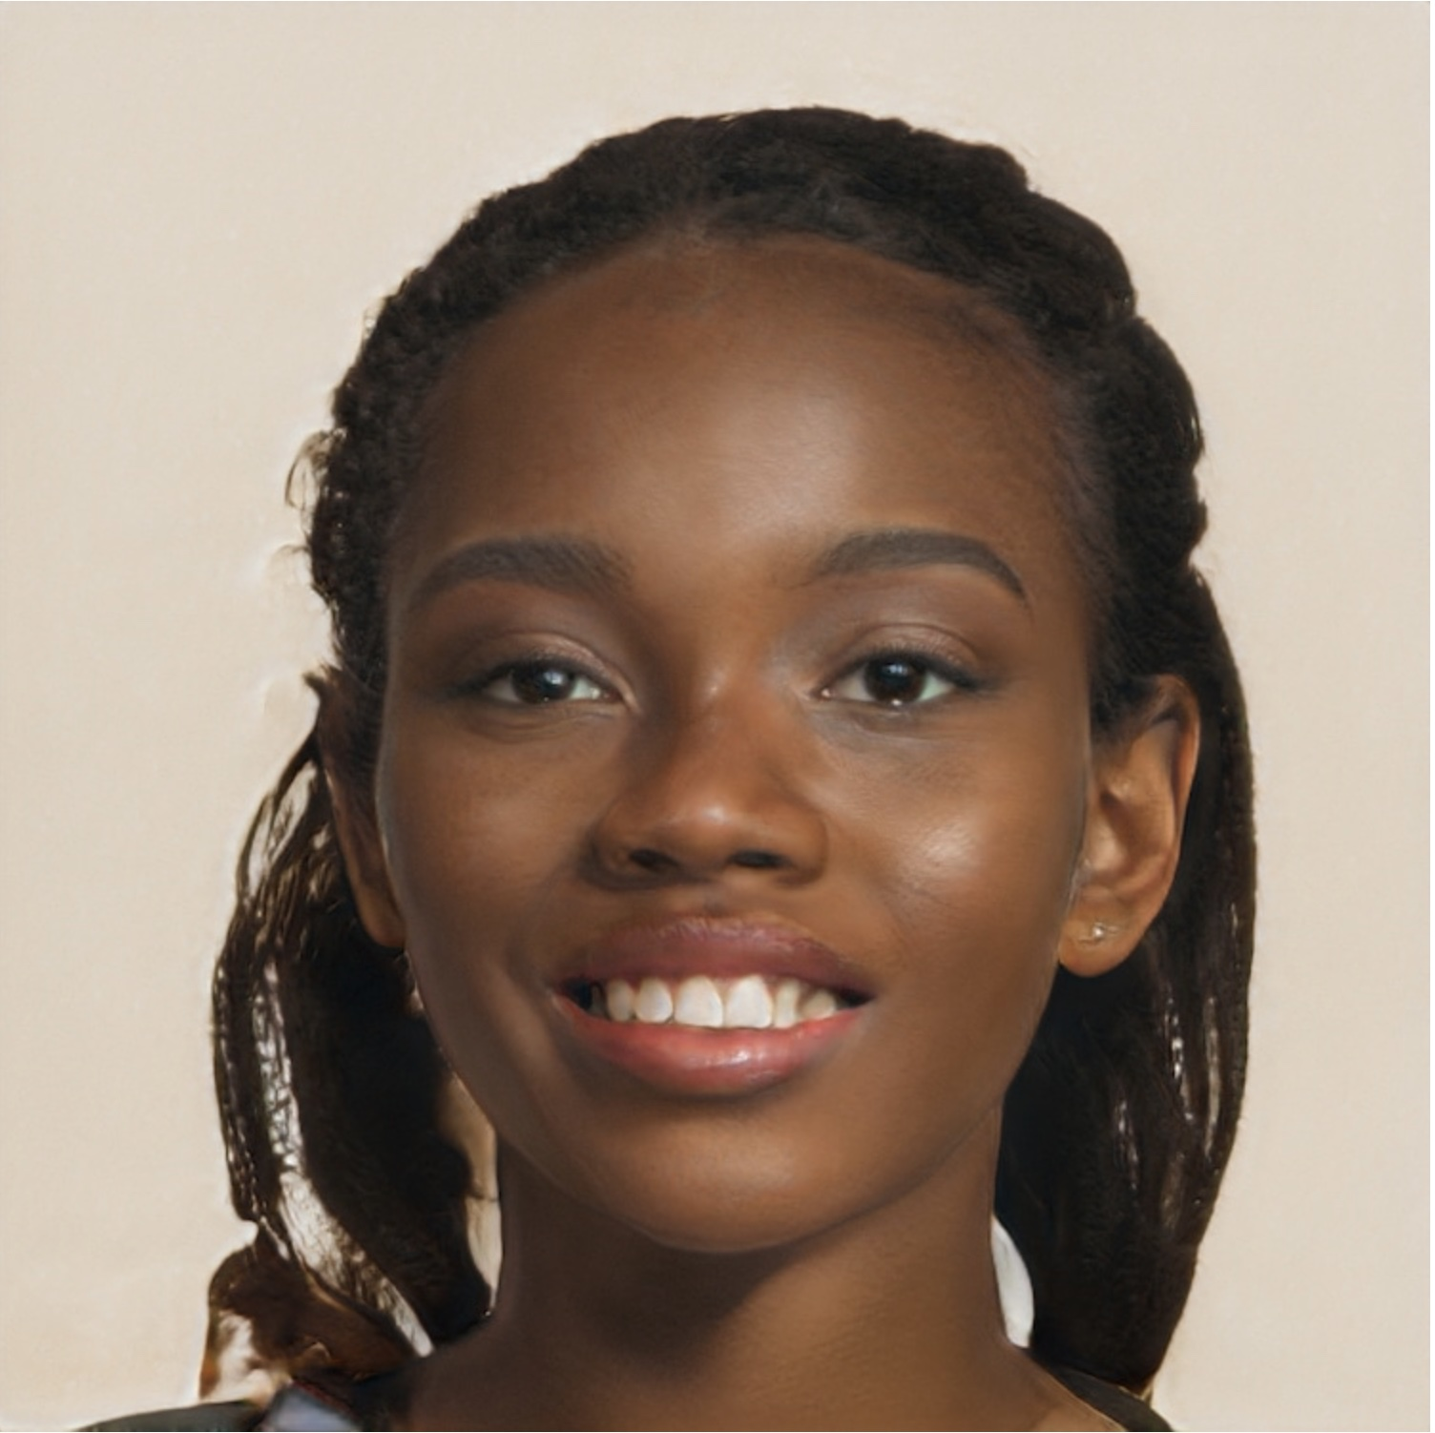
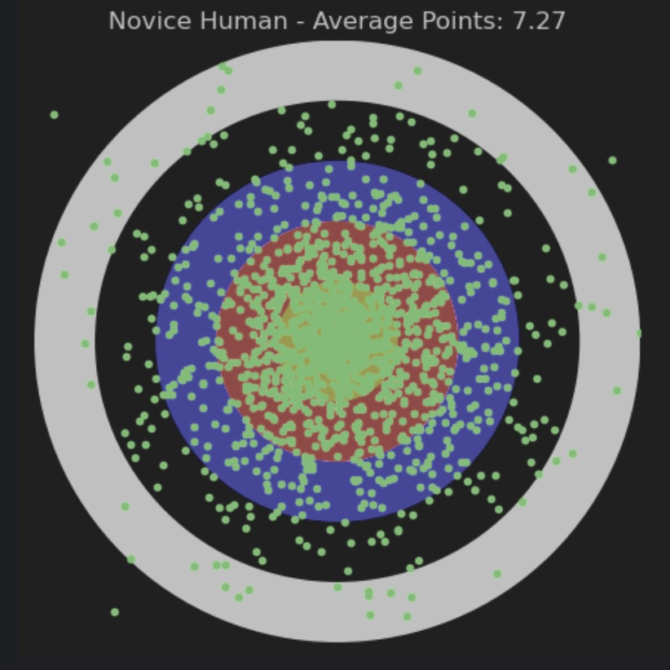
Novice Human Archer
Mehwish Mazari – 14 years old
2 years archery experience

Slide 16
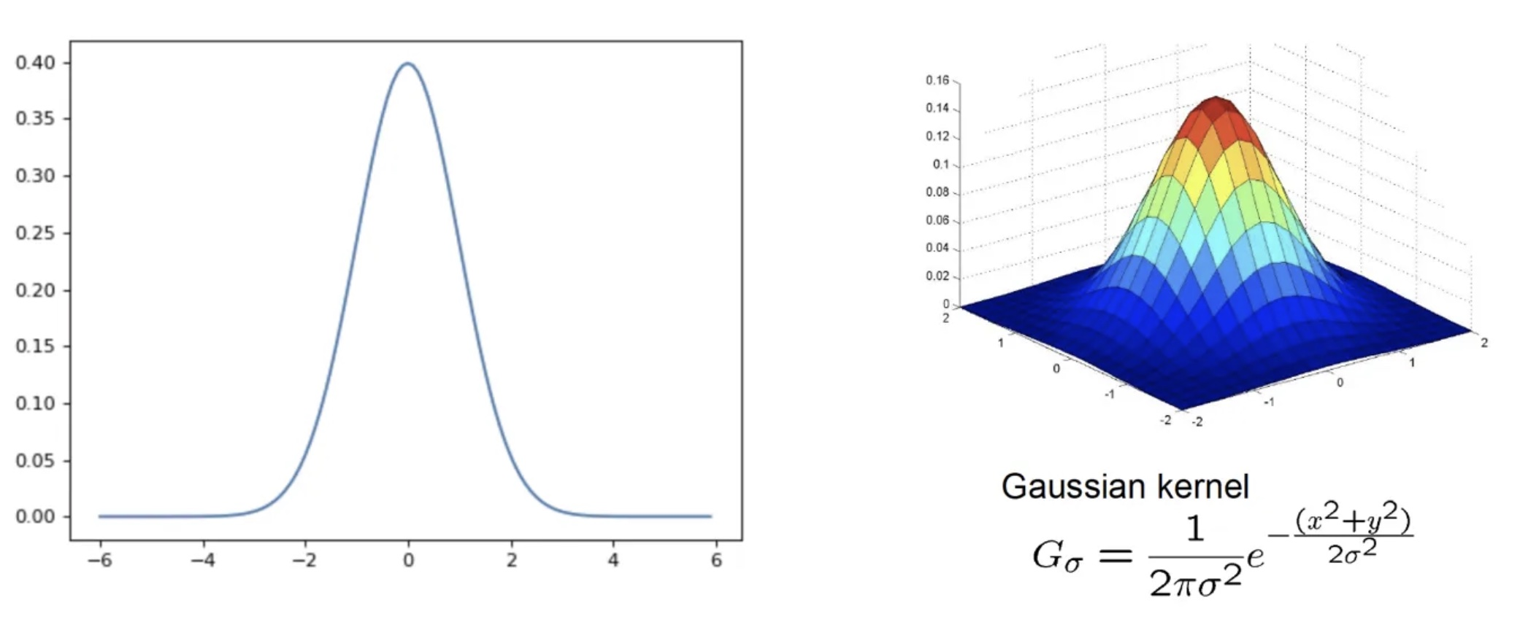
The Gaussian Distribution
“Bell Curve”, or, the NORMAL distribution
It is called the normal distribution, because it is “normally” what happens in natural systems

Slide 17
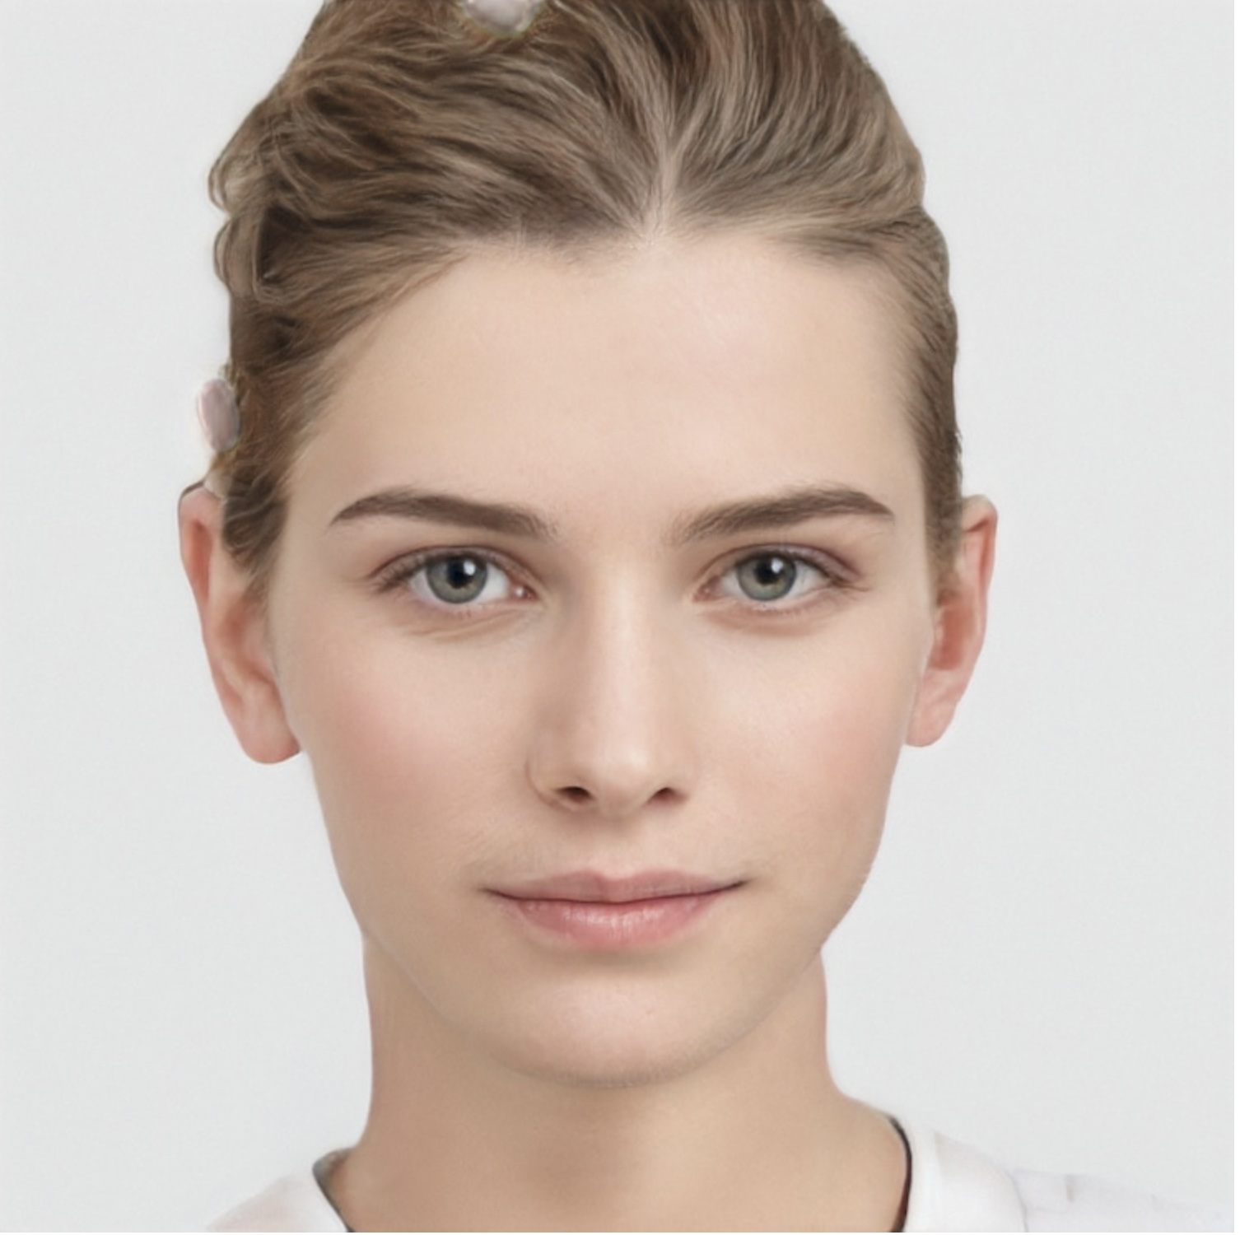
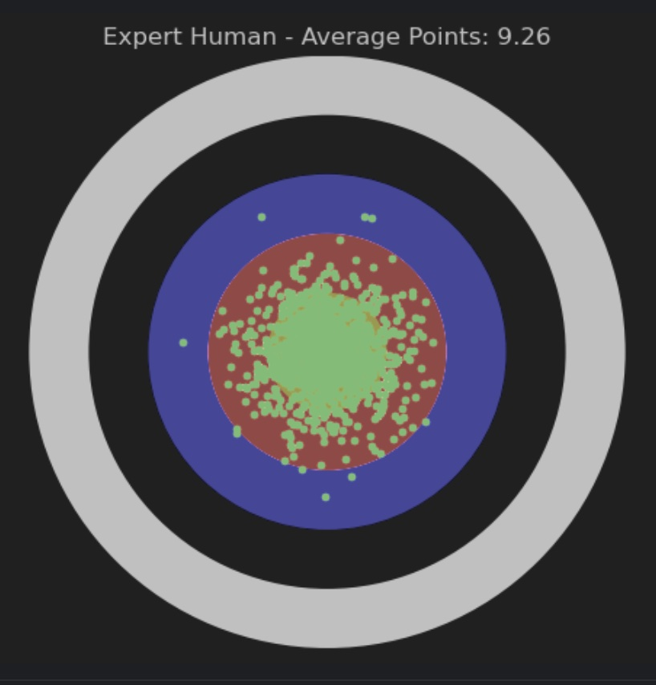
Expert Human Archer
Kristina Larsson
Swedish Olympic Archery Team - 2000

Slide 18
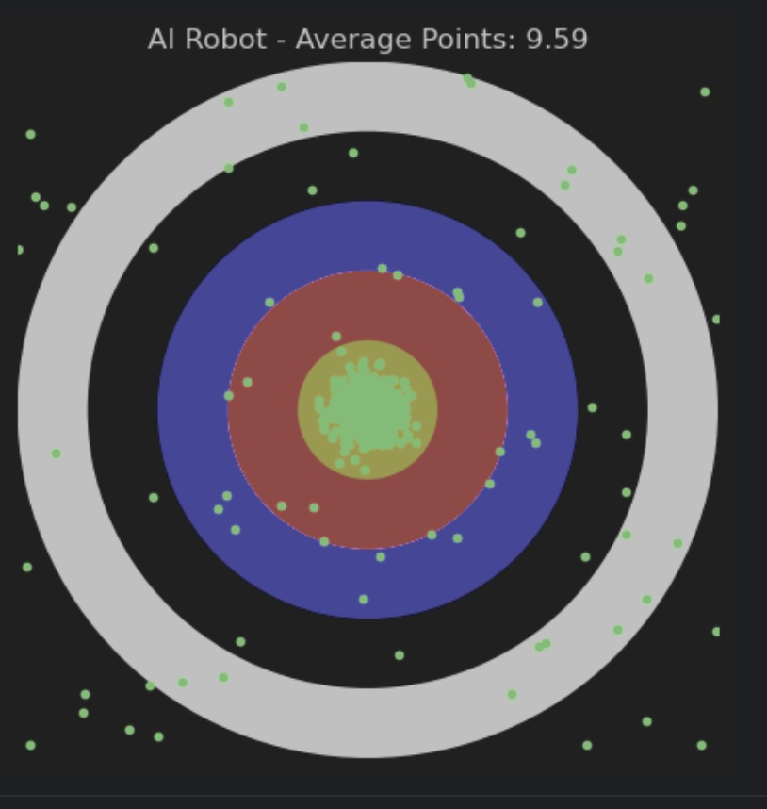
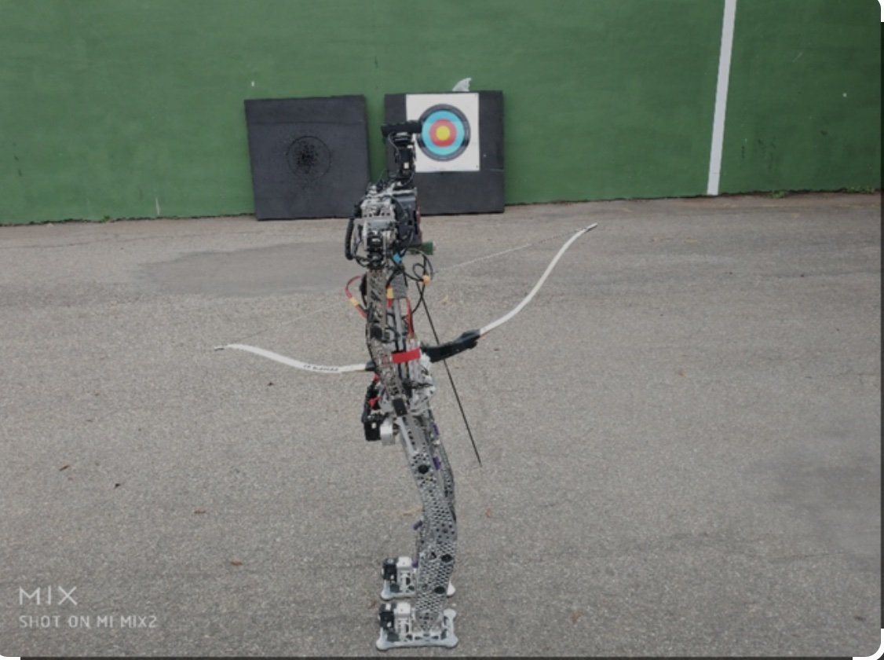
AI Robot Archer

Slide 19
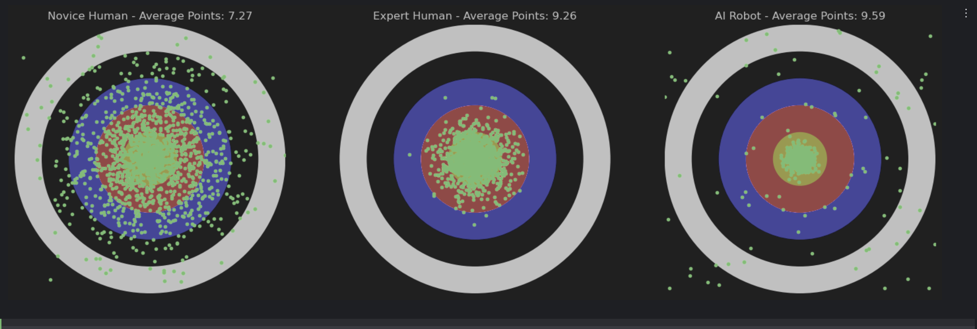
Archery Analogy

Slide 20
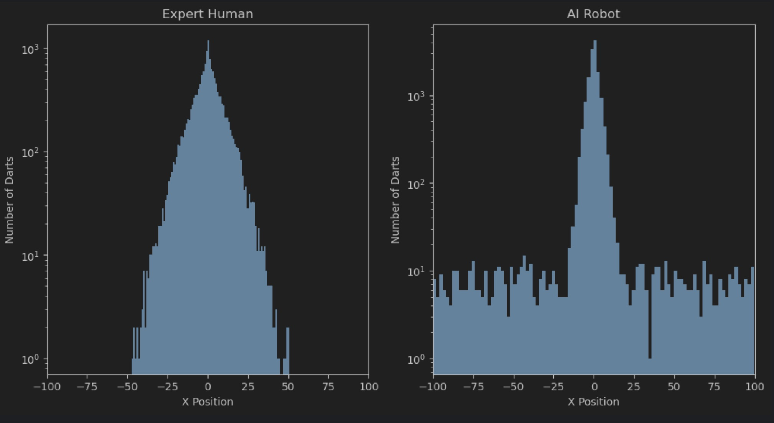
Human vs. AI Distributions

