Slide 1
Predicting Medical Insurance Cost
General Assembly Data Science Course − Final Presentation
Xinru Huang
2019 – 8 -27

Slide 2
Agenda
01
Problem Statement
Data Preparation
Modeling summary
02
03

Slide 3
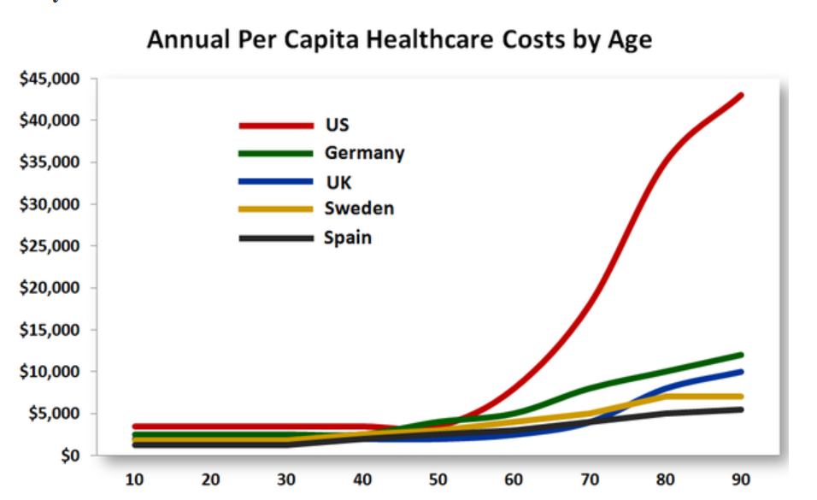
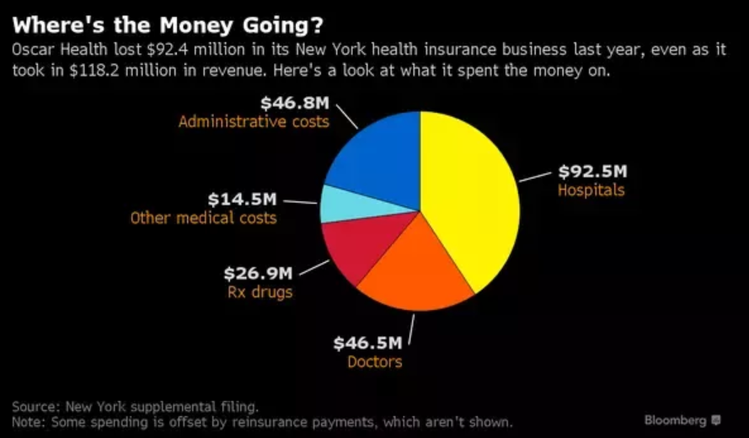
Lack of transparency in the US healthcare industry leads to unpredictable medical insurance cost
Source: https://www.quora.com/How-expensive-is-medical-insurance-and-medication-in-the-US

Slide 4
Agenda
01
Problem Statement
Data Preparation
Modeling Summary
02
03

Slide 5
Very clean data with no missing values
Data Source:
Kaggle.com (medical cost personal database)
Target Variable:
Medical insurance charges
Feature Variable:
Age, Sex, BMI (Body Mass Index), Smoke or not, Region
Training data set:
(1003,5)
Test data set:
(335,5)
Source: https://www.kaggle.com/mirichoi0218/insurance

Slide 6
Agenda
01
Problem Statement
Data Preparation
Modeling Summary
02
03

Slide 7
Overall cross validation with random forest model gives the best prediction performance
Training set score
Test set Score
Linear Regression
0.76
0.72
Decision Tree
0.99
0.66
Random Forest
0.98
0.81
GridSearchCV (Random Forest)
0.98
0.83

