Slide 1

TCC Web-BASED INFORMATION SYSTEM
Prepared by:
Nelia C. Rocamora

Slide 2
Description
TCCWIS is an information system consists of the following modules: Admission, Evaluation, Pre-enrolment, Enrolment and Grading System.
Admission- this module will be used for accepting an applicant who passed in the qualifying examination and interview of becoming a TCC student. Initially all the requirements needed for enrolment will be collected here before an applicant can proceed for enrolment.
Submodules-
Submission of Requirements
Posting of Names for Admission
Posting of Requirements and Deadlines related to admission.

Slide 4
2. Evaluation- it is a module that will check on the curriculum offerings, courses taken or credited, year level, academic standing, grades of each student to generate a report on the current standing of the student, allowed course and no. of units to enroll for a specific semester.
Submodules
Viewing of Prospectus with Grade
Viewing of No. of Courses with Failing and Passing Remarks
Viewing No. of times a course was enrolled and reason/s: Dropped and Failing Mark
Select Courses to be taken for the incoming semester
Activation/Deactivation of Evaluation Module

Slide 5
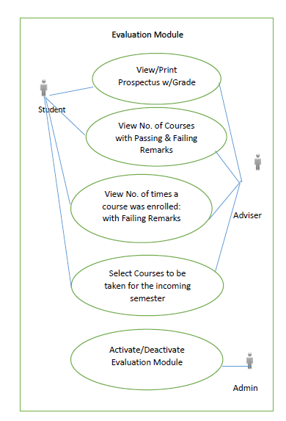

Slide 6
3. Pre-Enrollment- this module will allow students to select schedule and section, preferably a block section for regular students, for irregular students, it will be based on the units allowed, available schedule and section, in advance, a month before the end of each semester.
Submodules
Viewing of Course offering for the semester
Viewing of available Schedule for the incoming semester
Pre-Enroll
Printing of PEF (pre enrolment form)
Activation/Deactivation of Pre-Enrolment Module

Slide 8
4. Enrolment- this module allows the student to continue what has been started in the pre enrolment. In this module student’s grade will be part of the consideration, a student will just enroll with the help of the adviser, if all courses taken is of passing remarks. But for those students who got a failing grade, they have to make some adjustments, again with the assistance of the adviser. Either the student will drop, add or change the schedule or in case the subject does not have any pre-requisite then, a student can continue with his enrolment like any other regular student.
Submodules
Viewing of Pre-enrolled courses/schedule
Adding/changing/dropping of course in case it is necessary.
Printing of Pre-Enrolment Form (PEF) for Adviser’s signature for enrolment.
Enroll
Viewing/Printing of Enrolment Form (EF)
View/Deletion of Unenrolled Students
View/Print Class List
View/Print Enrolment Report per Program
View/Print Enrolment Summary
Activation/Deactivation of Enrolment Module
View Dissolved Course/s

Slide 10
5. Grading- this module will provide the faculty to post the term grade based on their assigned teaching load in a semestral basis. This module will be activated for 1 week after the major examination. There will be a monitoring of faculty members who will post the grade and those who did not make it on the deadline. For late submission of grades, there will be a need for the faculty to submit an explanation or reason for not submitting on time before the deactivation of his/her account. Faculty members will also be reminded thru email notification before the deadline to keep them informed so as to avoid delays.
Submodules
Posting of grades per course
Monitoring of Submission of Grades
Printing of Grade Slip
Printing of Grading Sheet
Activation/Deactivation of Grade Module

Slide 12
Users (Level or Role)
Admin User – The admin prepare the set up for schedule, semester, schoolyear, student number, course, program, user (faculty & staff), unit, room, academic status, section.
Student User- Allow students to interact with the system; student’s profile, grade, courses taken and courses to be taken, schedule per semester.
Registrar User- Monitoring of submitted and posted term grades. Viewing of term grades, Midterm and Finals. Monitor student’s academic status. Keep track of enrolment. Crediting of courses is also included.
Adviser User- Assists students specially the irregular in terms of the number of subjects and of units to be enrolled as well as dropping, adding and changing of schedule. Monitoring of student’s academic status is also included.
Admission User- will record applicant’s information, examination, interview result and credentials. Checklist will be provided in order for the admission staff to make sure that the requirements for enrolment are all set. Missing or incomplete requirements will hinder the student’s desire to enroll.
Instructor User- will input and post term grades.
Registrar
VP for Acad
VP for Students

