Slide 1
Advanced Computer Architecture
Midterm Presentation
Student: Guan-Ting Wu

Slide 2
Workload
EfficientNet-Lite0:
  R. Liu, “Higher accuracy on vision models with EfficientNet-Lite,” TensorFlow Blog, Mar. 16, 2020. [Online].
  Available: https://github.com/tensorflow/tpu/tree/master/models/official/efficientnet/lite

Slide 3
Workload
Reason
  Fit the Spec：4.7 M Parameters / ~0.39 GMAC
  Officially provides TFLite model with integer-only quantization.
  ImageNet Top-1: 75.1% FP32 / 74.4% INT8
      I ran it on 50000 images of image-1K dataset.
Notes:
Not only… but also…
I can skip doing…
Also, … , this gives me more achievement while optimizing it.
Lastly,I got this numbers on……

Slide 4
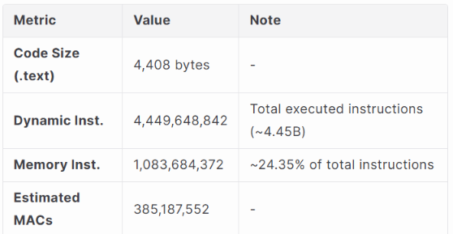
Baseline
Implement TFLite reference into an end-to-end C model for
baseline.
Profiling
Notes:
The Baseline result and its profilig.
Calculate and estimate the Macs.

Slide 5
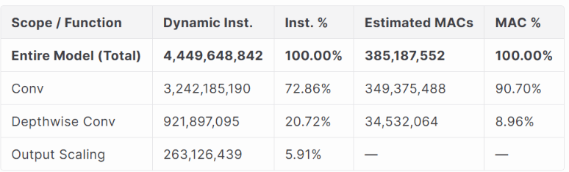
Optimization – B1 for Conv
Observe
  1 3x3 filter Conv
  32 1x1 filter Conv (to be optimized)
Notes:
Start to optimize for B1.
Observe that…
After inspection, I…

Slide 6
Optimization – B1
Implement 1
  Simplify the general kernel of TFLite in B0 into a fast path for 1x1 filter Conv.
  E.g. Skip the filter loops, pad, etc.

Slide 7
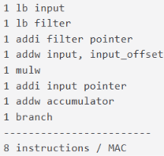
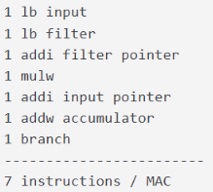
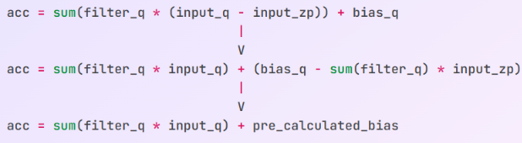
Optimization – B1
Implement 2
  In 1x1 filter Conv, the main path doing MAC can be simplified.
Estimated Instruction counts of MAC of 1x1 Conv
MAC Math

Slide 8
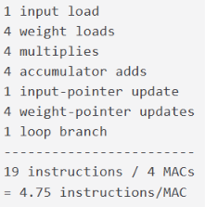
Optimization – B1
Implement 3
  4 output-channel accumulators can be calculated continuously.
  Increase register utility
MAC of 1x1 Conv
Notes:
After experiments, I found that…

Slide 9
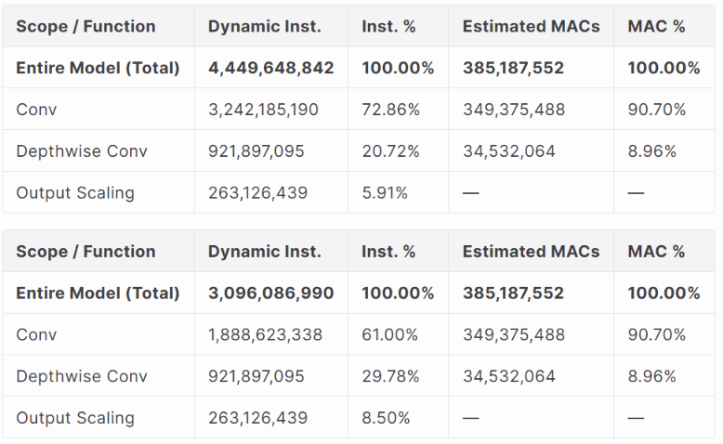
Optimization – B1
Result
  Instruction reduction: 30.4%
B0
B1

Slide 10
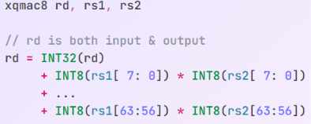
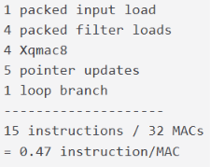
Optimization – X1 for Conv
Implement
  Xqmac8 instruction.
  Make Input & weight 8-byte aligned -> ld load 8 elements in one cycle.
Xqmac8 Contract
MAC of 1x1 Conv

Slide 11
Optimization – X1
Note:
  Design software (B1) & hardware (X1) together
  Xqmac8 work more beautifully.
Software design in B1
Xqmac8 Contract
Notes:
I designed B1 and X1 together.

Slide 12
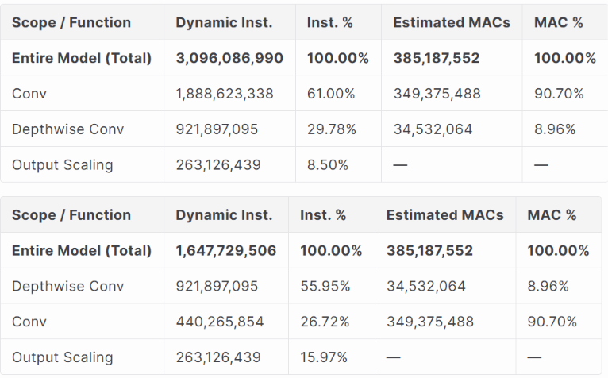
Optimization – X1
Result
  Instruction reduction: 46.8%
B1
X1

Slide 13
Optimization – B2 for Depthwise Conv
Observe
  The addressing & control instructions may be important at Depthwise Conv.

Slide 14
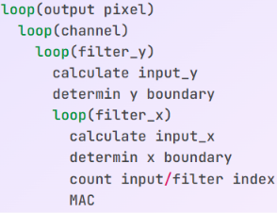
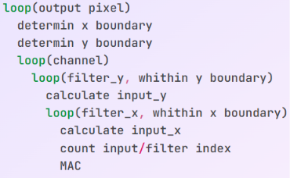
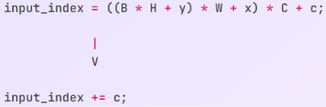
Optimization – B2
Implement 1
  Move the determination of filter ranges outside channel loop.
  Walking pointer, calculate less in inner loop
Notes:
Arrangement.

Slide 15
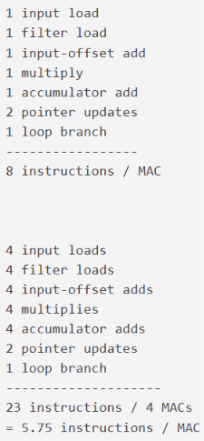
Optimization – B2
Implement 2
  4 output channels for MAC
  Reduce loop instructions & pointer updates
inner loop of Depthwise conv
Notes:
After experiments, I conclude that …

Slide 16
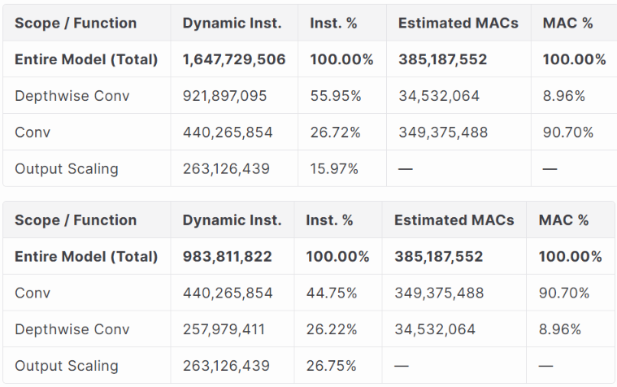
Optimization – B2
Result
  Instruction reduction: 40.3%
X1
B2

Slide 17
Optimization – B3 for Requantization
Observe
  Constraints below allows me to simplify the general requantization kernel of TFLite.
      All multipliers > 0
      -29 < all shifts < -2
      activation_min = -128
      activation_max = 127
Notes:
I found there is these constraints I can conclude form this workload.

Slide 18
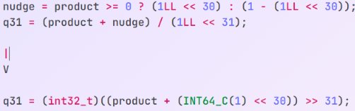
Optimization – B3
Implement
  Simplify controls for a less-general fast path
  Modify rounding paths
ex: Round to nearest, ties toward +∞
TFLite
Me
Notes:
Faster, fewer instructions

Slide 19
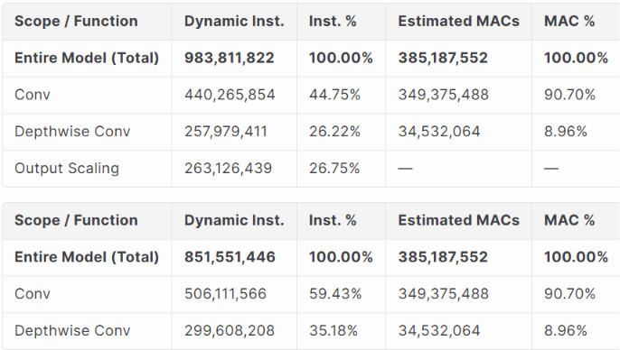
Optimization – B3
Result
  Instruction reduction: 13.4%
B2
B3

Slide 20
Optimization – X3 for Requantization
Observe
  Not sure how difficult the CVWally implantation will be.
  For not introducing complicated hardware, I only added a simple Xclip8 instruction here.
  More complex requantization instructions will be considered with RTL later.

Slide 21
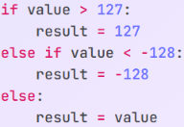
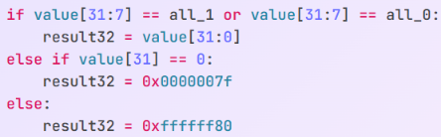
Optimization – X3
Implement
  Xclip8 comparator + mux in RTL
TFLite C clip operation
Xclip8 Contract

Slide 22
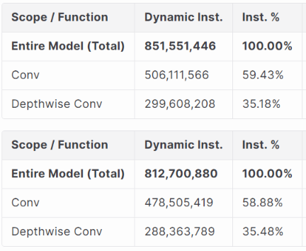
Optimization – X3
Result
  Instruction reduction: 4.56%
B3
X3

Slide 23
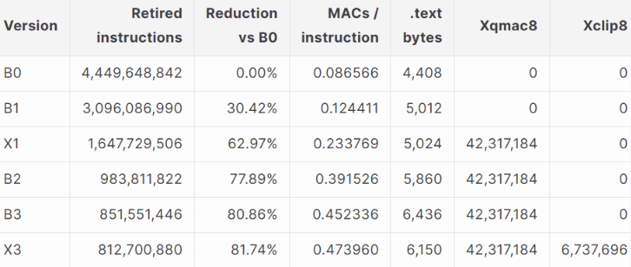
Conclusion
Result
  5.5x with only Software & Xqmac8 & Xclip8 optimization.

Slide 24
Thank You

