Slide 1
Circumventing non-executable stack protection with return oriented programming
Techzone Sundvollen 2014

Slide 2
Who the hell are we? (pwa + dbu)
Why do we do this?
Where are we from?
Why should you care?
Why do we care?

Slide 3
What is ROP? (dbu + pwa)
“Return-oriented programming (ROP) is a computer security exploit technique that allows an attacker to execute code in the presence of security defenses” - Wikipedia
Theoretically, one can perform ROP in a few different ways, but we will focus on buffer overflows
Notes:
Little warning: Beneficial with a basic understanding of x86 assembler

Slide 4
Reasons for doing ROP (dbu)
Circumvent Data Execution Prevention (DEP)
Bypass code signing
Notes:
To understand ROP you need to understand it’s predecessor

Slide 5
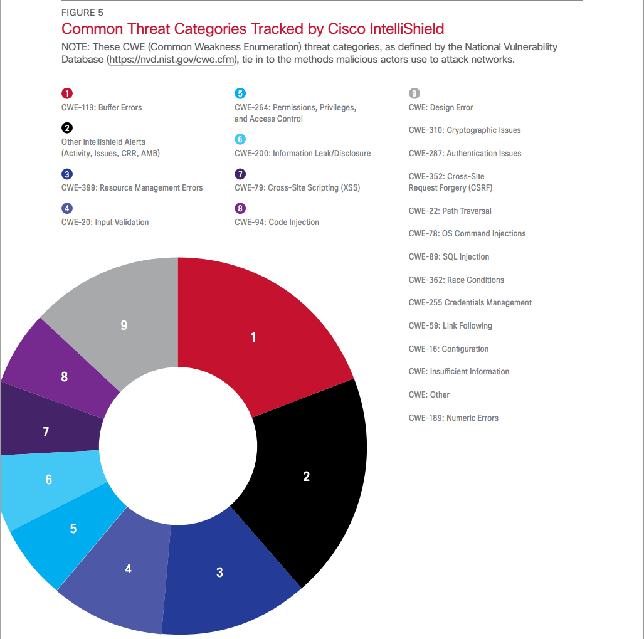

Slide 6
History of buffer overflow exploitation (dbu)
Paper published documenting it in ‘72
First documented exploitation ‘88
Morris Worm
“Rediscovered” in ’95
‘Smashing the stack for fun and profit’ - ’96
One of the original articles explaining the basic technique.

Slide 7
Traditional Stack Overflow (dbu)
Write more data to a buffer than the buffer has space allocated
This can overwrite the return address of the calling function
When ret is performed the attacker controls the address and can point that at her own payload
If the attacker doesn’t exactly know which address the payload starts at, she can use a nop sled to maximize her chances of successful exploitation
Notes:
- Most of us have experienced it
The consequence of overflowing the variable boundary can be bad
We will get back to how a NOP sled works

Slide 8
Evolution: then (pwa)
Can you spot the bug(s)?

Slide 9
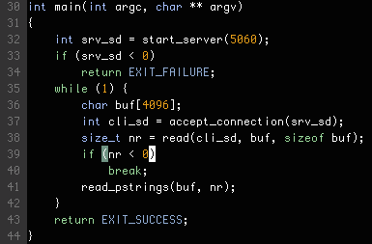
Notes:
Program reads pascal type strings from a remote connection

Slide 10
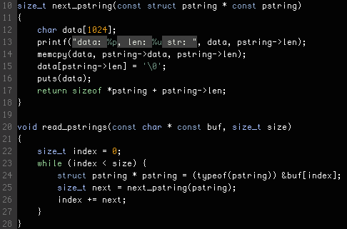
Notes:
Spot the bug
- Read many chunks from a string where each chunk is prefixed with a 32 bit unsigned integer length

Slide 11
Evolution: then (pwa)
Vanilla stack
Exploit RET

Slide 12
Buffer overflow mitigations (dbu)
Stack canaries
Map libraries to addresses starting with 0x00
ASLR
Non-executable stack (DEP)
Notes:
Mitigations are defences against exploitation techniques
DEP was a challenge due to
self-modifying code (JAVA)

Slide 13
TODO: Canaries slides (pwa)
Historie
Gcc / glibc
Vise pro / epilog slide
Vise stack med SSP
Forklare info leak
Vise slide med exploit med SSP
DEMO

Slide 14
Evolution: then and now (dbu)???
Return-to-libc attack
Overwrite the return address like in the traditional attack and point it to a function in libc
When ret is performed the attacker controls the address (e.g. the system() function call)
She can write her own stack frame data beyond the ret address: (e.g. pointer to “/bin/sh”)
Limited to one function call (which might not be enough in all cases)
Notes:
Circumvents non-executable stack protection
/bin/sh string could exist in libc
One function call : remote exploitation

Slide 15
TODO: ASLR slides (pwa)
Historie
ASLR slide
Gcc / glibc
Vise at addressen endrer seg I gdb
Vise info leak
DEMO?
Notes:
Non-executable stack:
Stack only has read and write permissions, therefore pointing the return address to the stack raises SIGSEGV.
Map libraries to addresses starting with 0x00
With strcpy no NULL bytes can be placed in the middle of the payload or the full payload will not be copied
Stack canaries:
A small bit of random information is added to the stack between the return address and local variables and is checked to be the same value before fetching the return address.
ASLR (Address Space Layout Randomization):
Each time the program is run, the position of the stack, heap and libraries are randomized.
Slight performance impact on linux

Slide 16
TODO: Dep slides (pwa)
Historie
Implementasjon
Vise /proc/sys/maps

Slide 17
Return Oriented Programming (dbu)
Extension of return-to-libc
Create multiple stack frames after each other
Chain together addresses with instructions ending in ret (known as gadgets)
The hard part is finding suitable gadgets and where they are mapped in the address space
Notes:
- Remote exploits: you don’t have access to inspection of memory layout

Slide 18
ROP challenges
If exploiting strcpy no NUL bytes may be present in the payload
Use xor / incr / decr in a gadget to create 0x00 bytes
Finding usable gadgets can be hard work
Use a tool where you can filter on useful gadgets
There exists tools to generate a complete ROP payload based on the flora of available gadgets
An attacker can abuse non-aligned instructions
Notes:
NUL – Look it up!
We don’t use tools!
Next: Let’s get into some code

Slide 19
Tools for writing ROP chains (dbu) ???
metasploit/msfrop – a gadget finder
gogo – pwahlman’s gadget finder
ropc – a ROP payload compiler
A plethora of other tools

Slide 20
Gogo (pwa)
Find stack pivot

Slide 21
Demo (pwa)
ROP Exploit

Slide 22
Lessons learned
Be careful what you log!
User controlled data
-Wall -Werror

Slide 23
Thank you!
Questions?

