Slide 1
Circumventing modern exploitation mitigations
Techzone Sundvollen 2014

Slide 2
Who are we? (pwa + dbu)
David
Petter
Who are we?
Why should you do this?

Slide 3
What is ROP? (dbu + pwa)
“Return-oriented programming (ROP) is a computer security exploit technique that allows an attacker to execute code in the presence of security defenses” - Wikipedia
Theoretically, one can perform ROP in a few different ways, but we will focus on buffer overflows
Notes:
Little warning: Beneficial with a basic understanding of x86 assembler

Slide 4
Reasons for doing ROP (dbu)
Circumvent Data Execution Prevention (DEP)
Bypass code signing
Notes:
To understand ROP you need to understand it’s predecessor

Slide 5
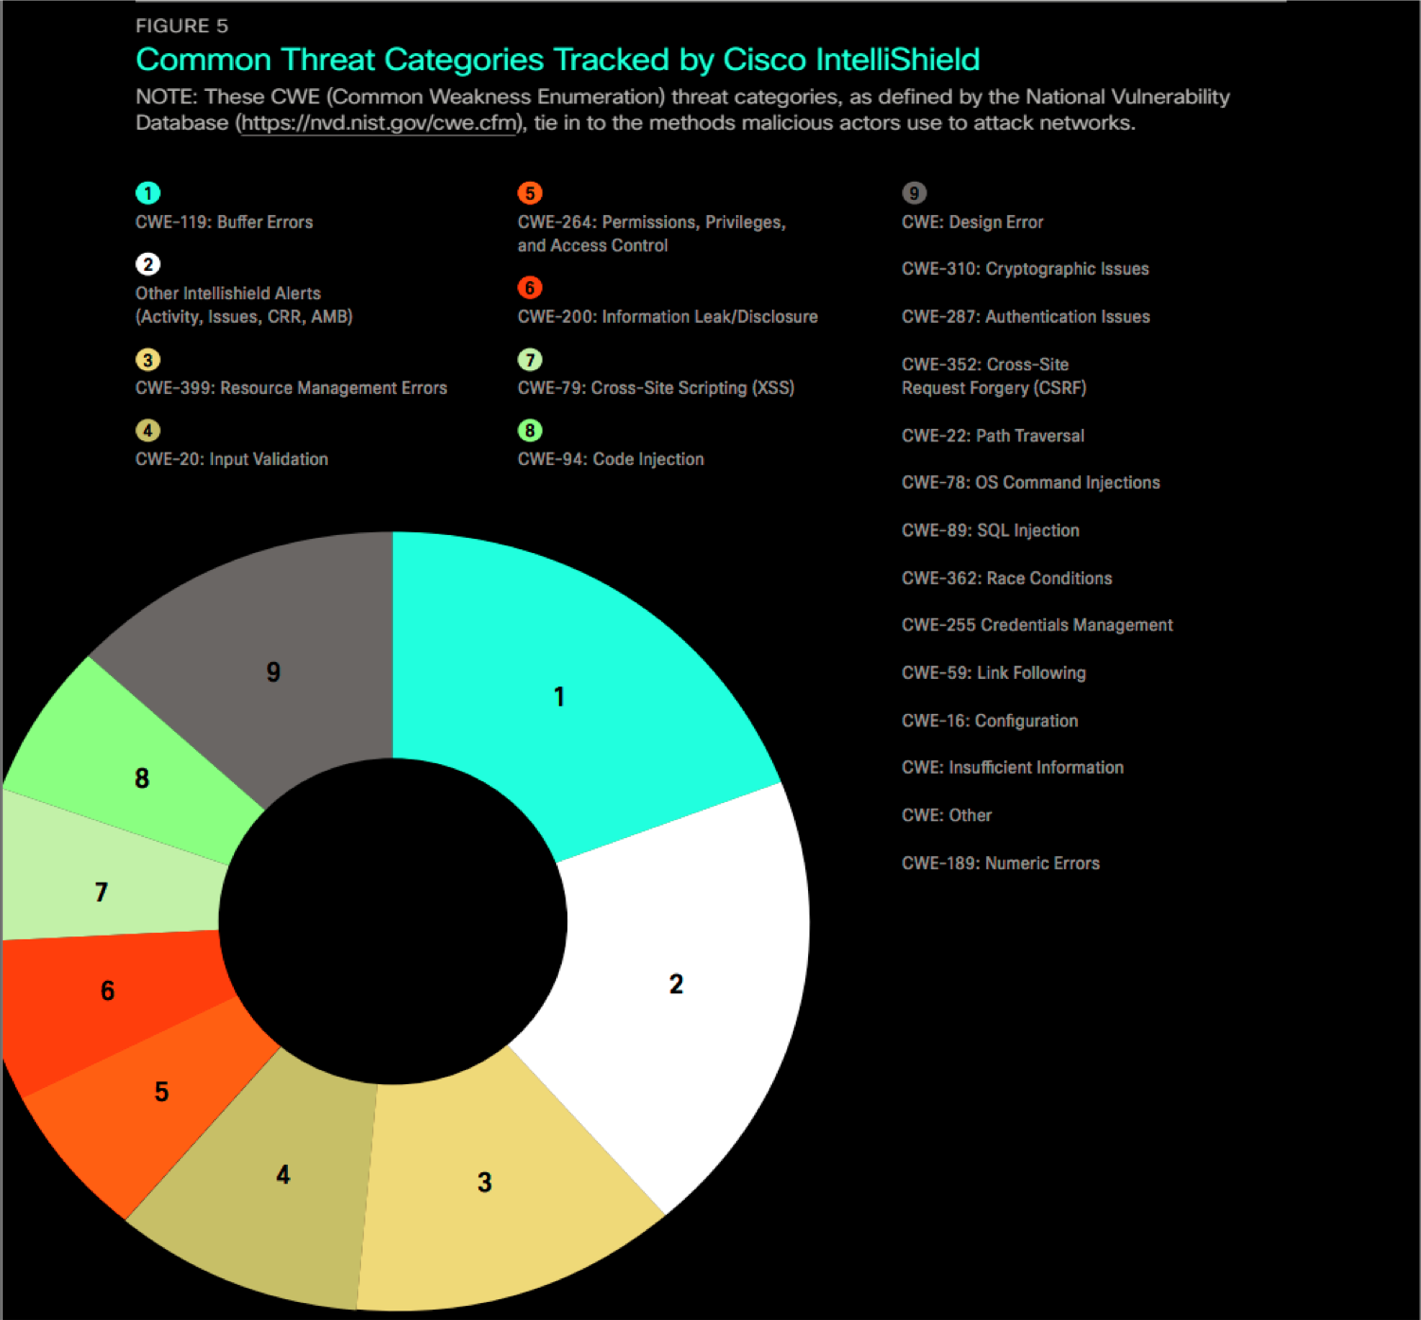

Slide 6
History of buffer overflow exploitation (dbu)
Paper published documenting it in ‘72
First documented exploitation ‘88
Morris Worm
“Rediscovered” in ’95
‘Smashing the stack for fun and profit’ - ’96
One of the original articles explaining the basic technique.

Slide 7
Traditional Stack Overflow (dbu)
Write more data to a buffer than the buffer has space allocated
This can overwrite the return address of the calling function
When ret is performed the attacker controls the address and can point that at her own payload
Notes:
- Most of us have experienced it
The consequence of overflowing the variable boundary can be bad
We will get back to how a NOP sled works

Slide 8
pwa
Demo
make

Slide 9
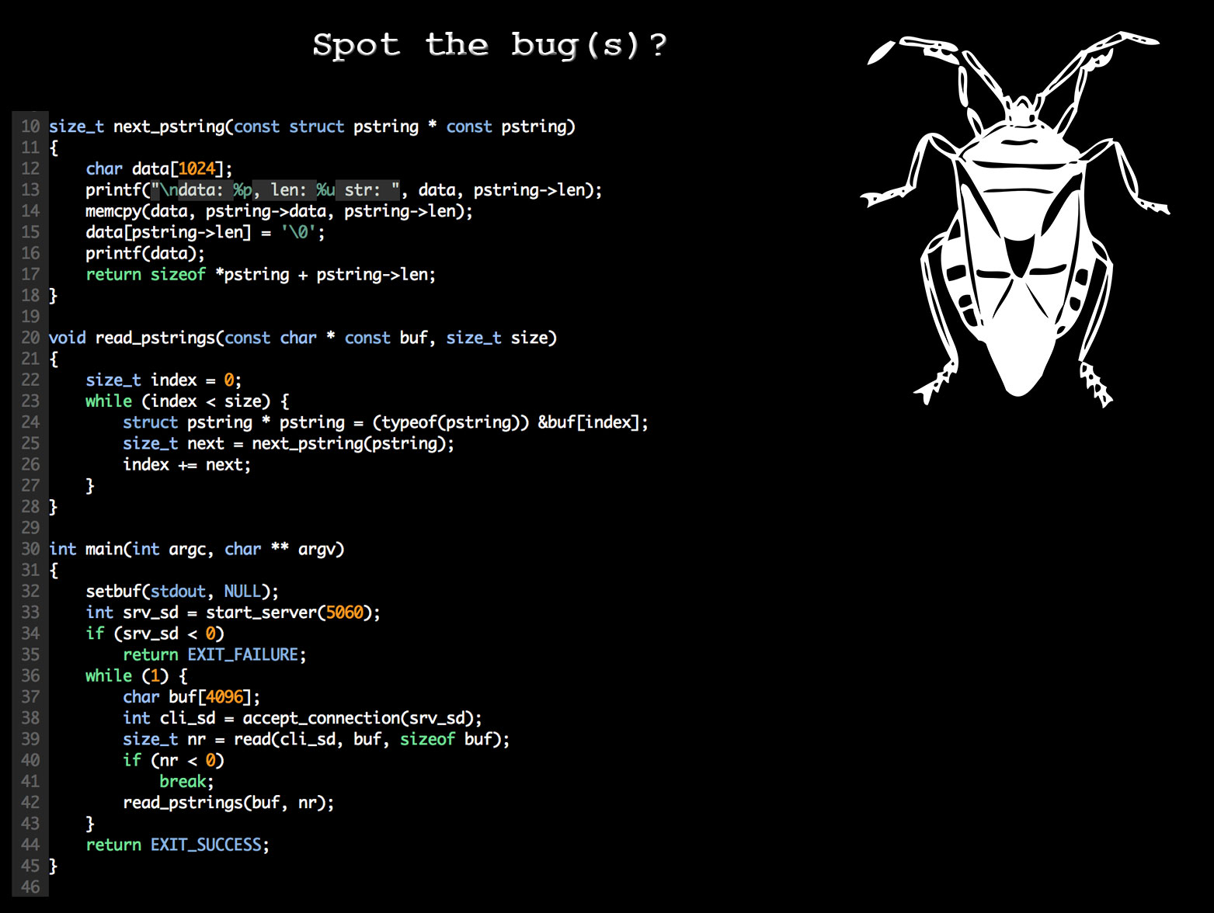

Slide 10
Demo
Intended use

Slide 11
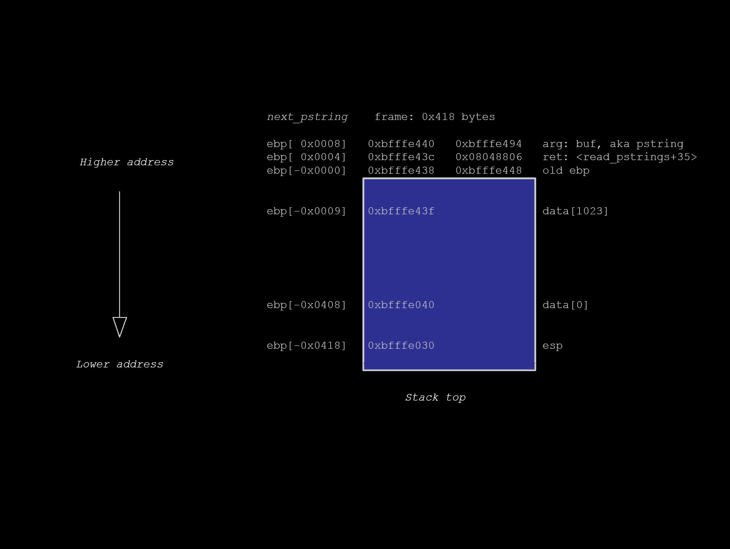

Slide 12
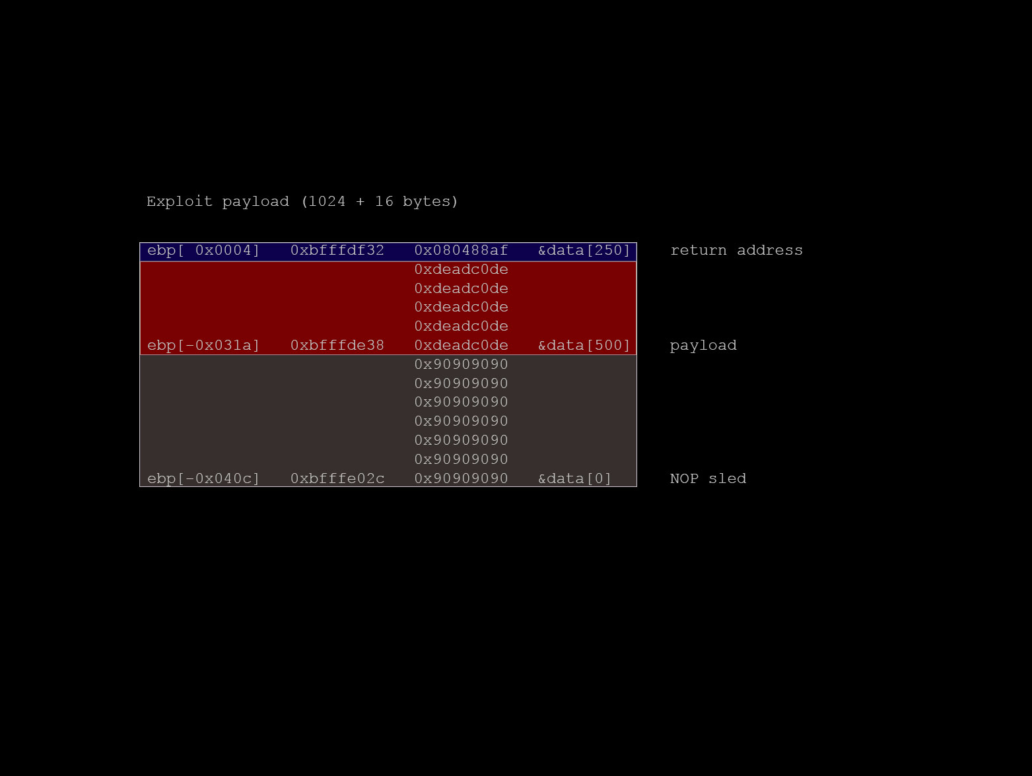

Slide 13
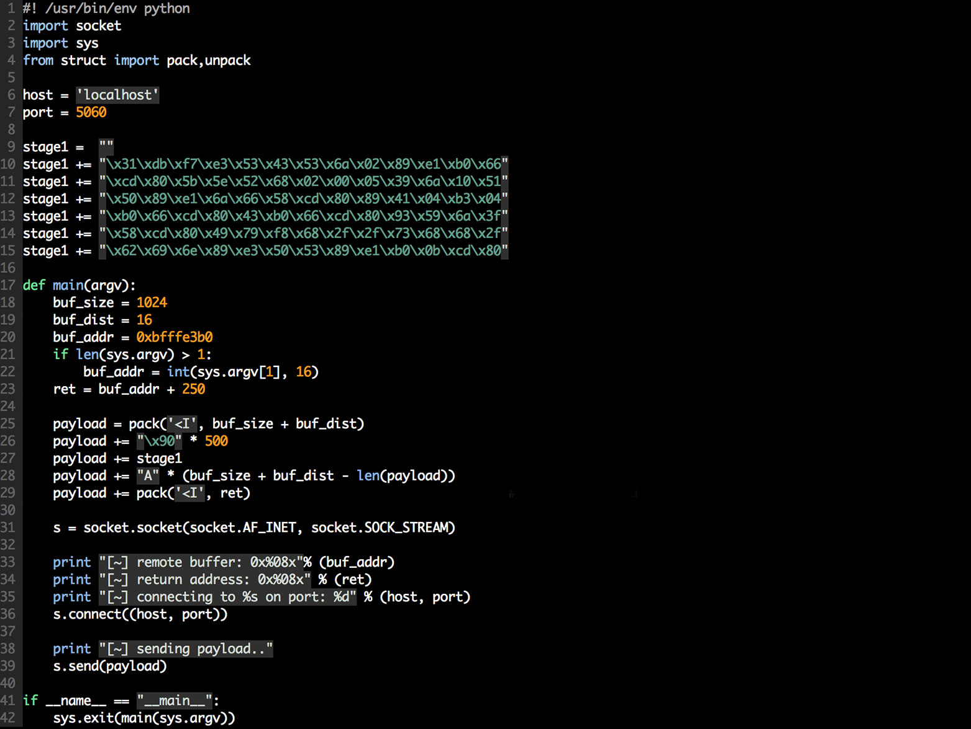
Demo
Exploit time!

Slide 14
Demo
Exploit
Apply SSP / exploit

Slide 15
Buffer overflow mitigations (dbu)
Stack Smashing Prevention (SSP)
Map libraries to addresses starting with 0x00
ASLR
Non-executable stack (DEP)
Notes:
Mitigations are defences against exploitation techniques
DEP was a challenge due to
self-modifying code (JAVA)

Slide 16
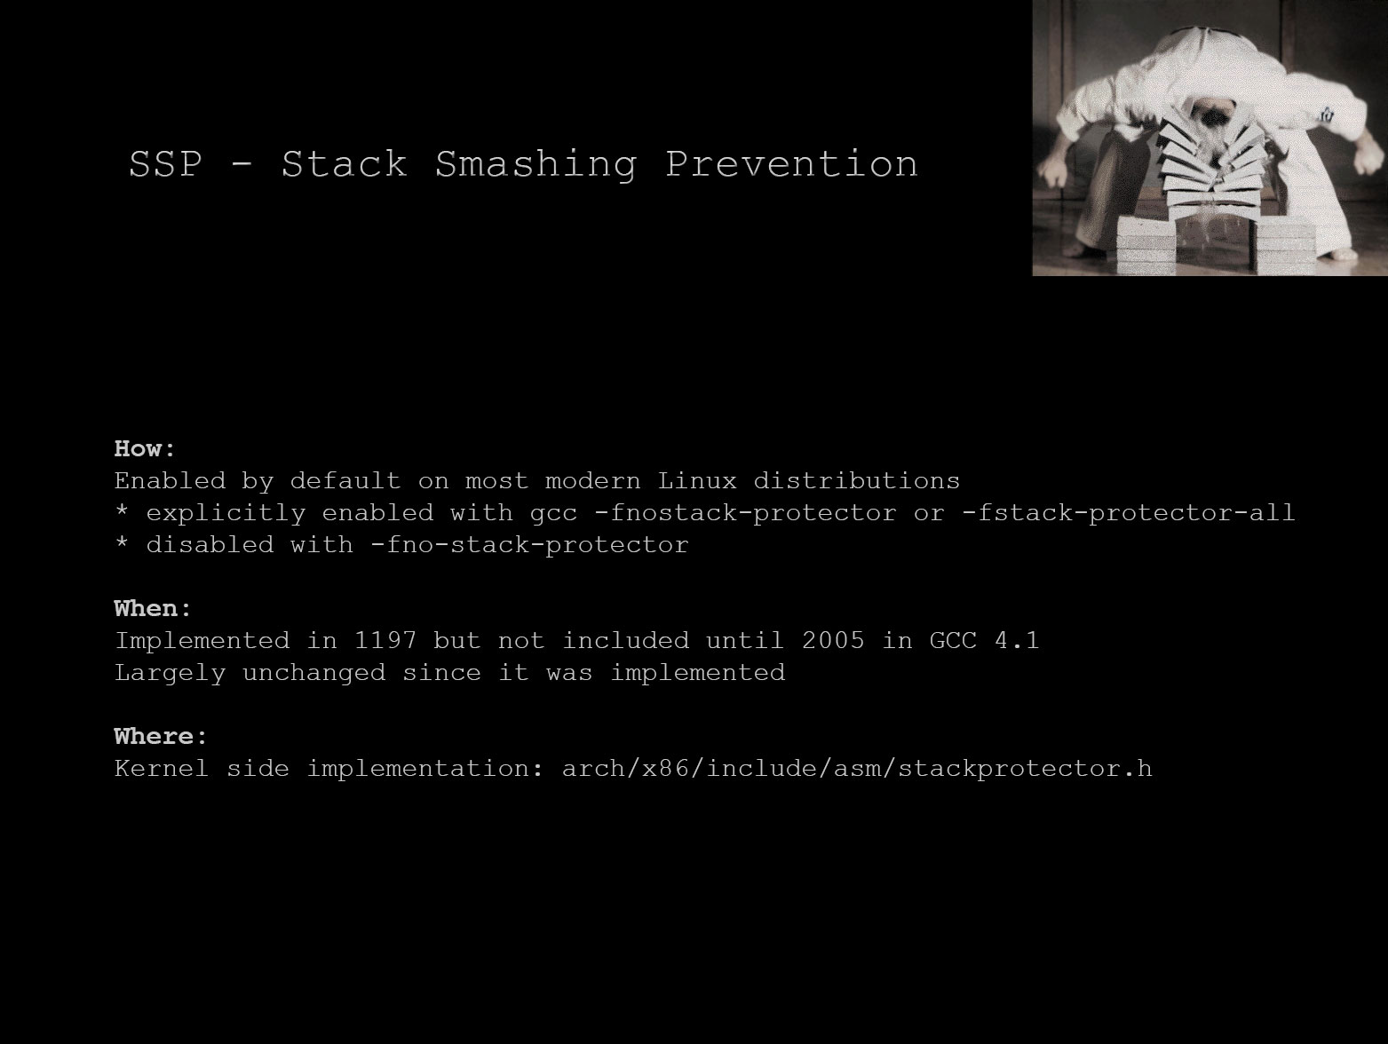

Slide 17
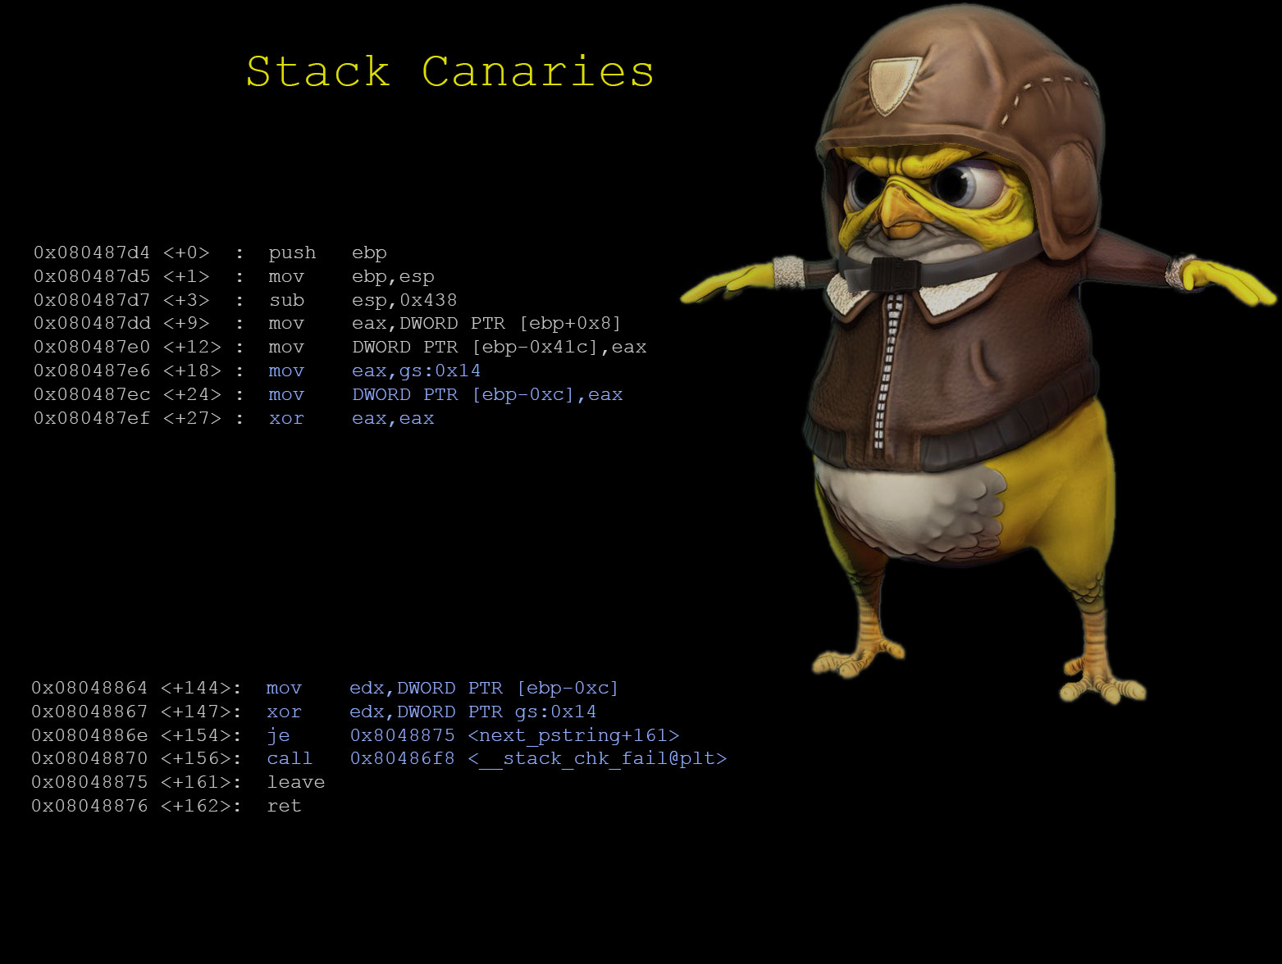

Slide 18
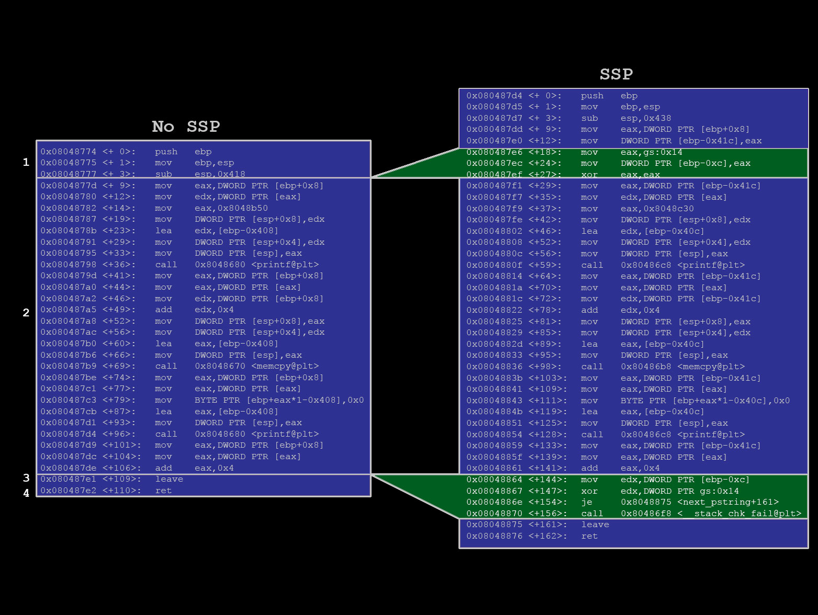

Slide 19
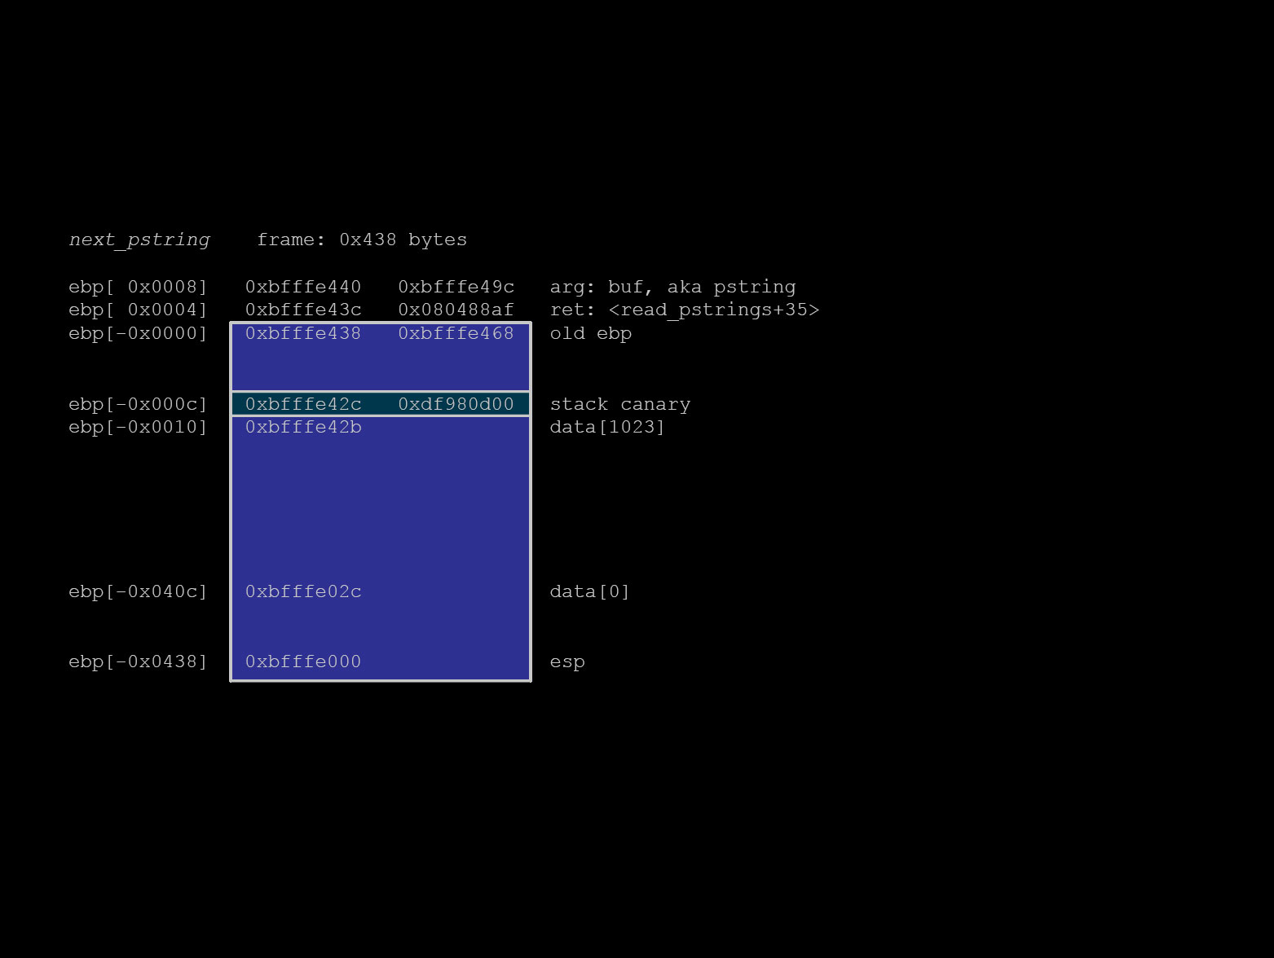

Slide 20
Demo
Info leak
Exploit

Slide 21
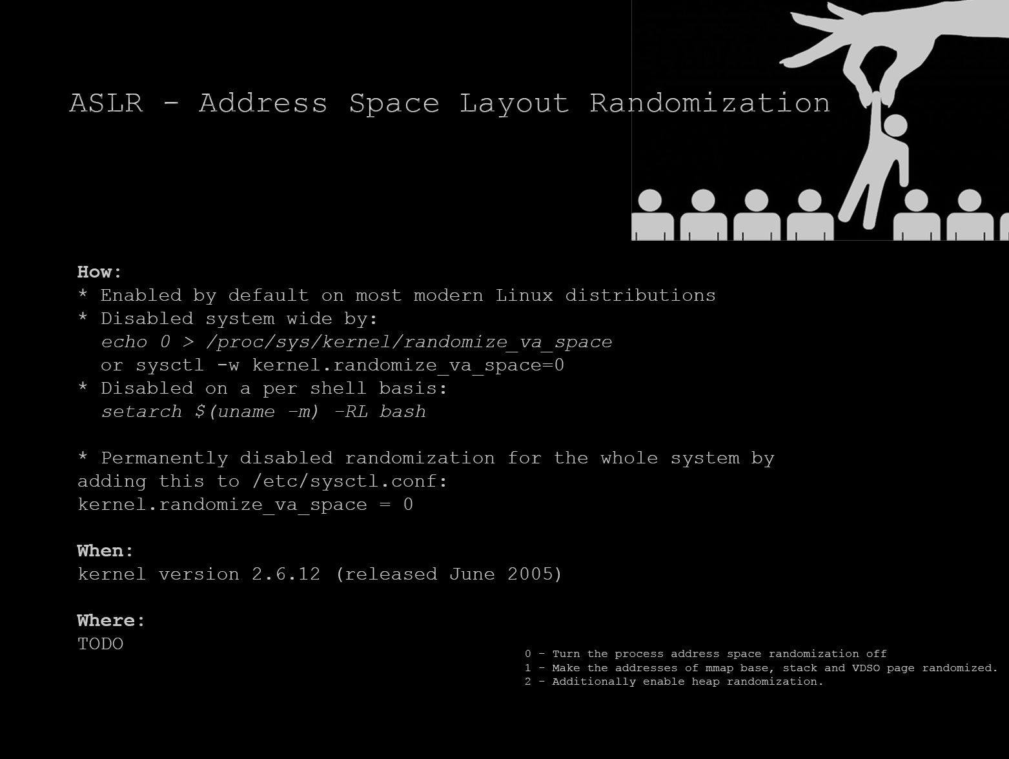

Slide 22
Demo
Previous Exploit (with ASLR enabled)
Apply DEP mitigation / exploit

Slide 23
WTF?

Slide 24
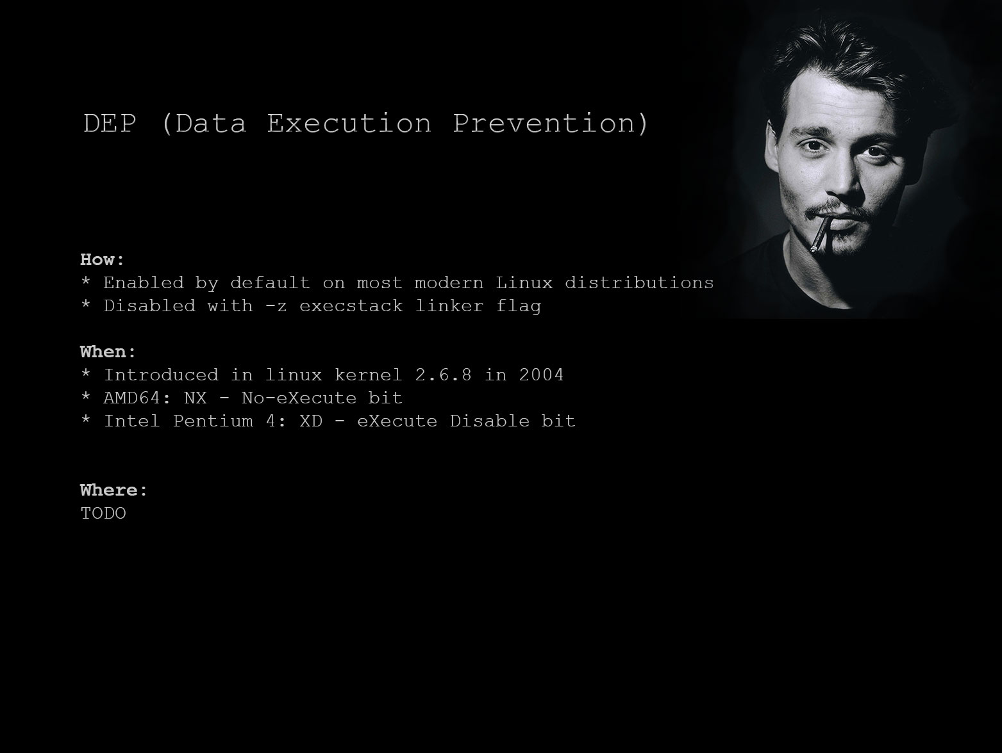

Slide 25
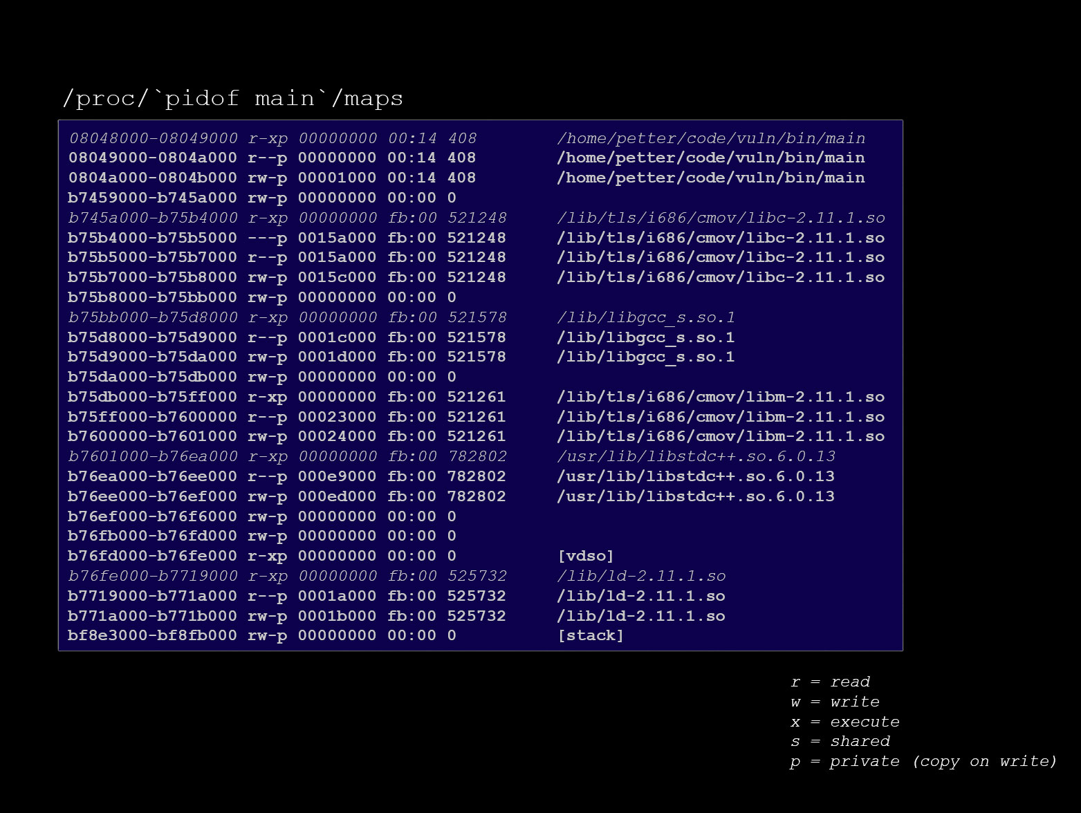

Slide 26
Return-to-libc attack (dbu)
Overwrite the return address like in the traditional attack and point it to a function in libc
When ret is performed the attacker controls the address (e.g. the system() function call)
She can write her own stack frame data beyond the ret address: (e.g. pointer to “/bin/sh”)
Limited to one function call (which might not be enough in all cases)
Notes:
Circumvents non-executable stack protection
/bin/sh string could exist in libc
One function call : remote exploitation

Slide 27
Return Oriented Programming (dbu)
Extension of return-to-libc
Create multiple stack frames after each other
Chain together addresses with instructions ending in ret (known as gadgets)
The hard part is finding suitable gadgets and where they are mapped in the address space
Notes:
- Remote exploits: you don’t have access to inspection of memory layout

Slide 28
ROP challenges
If exploiting strcpy no NUL bytes may be present in the payload
Use xor / incr / decr in a gadget to create 0x00 bytes
Finding usable gadgets can be hard work
Use a tool where you can filter on useful gadgets
There exists tools to generate a complete ROP payload based on the flora of available gadgets
An attacker can abuse non-aligned instructions
Notes:
NUL – Look it up!
We don’t use tools!
Next: Let’s get into some code

Slide 29
Tools for writing ROP chains (dbu)
metasploit/msfrop – a gadget finder
gogo – pwahlman’s gadget finder
ropc – a ROP payload compiler
A plethora of other tools

Slide 30
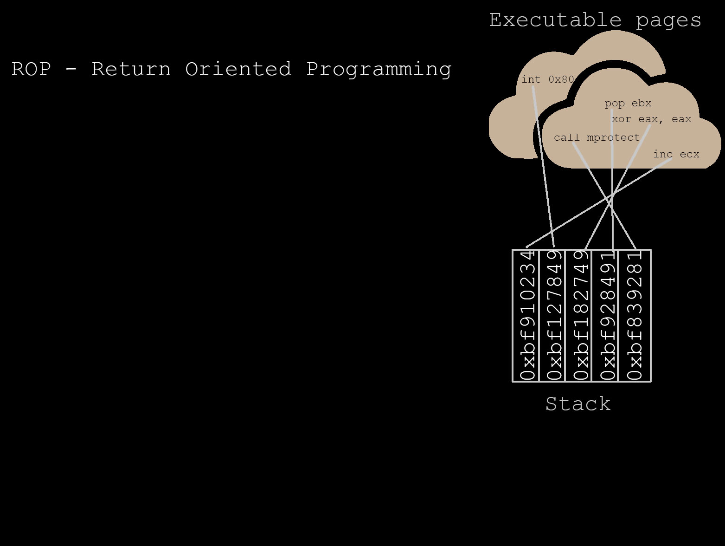

Slide 31
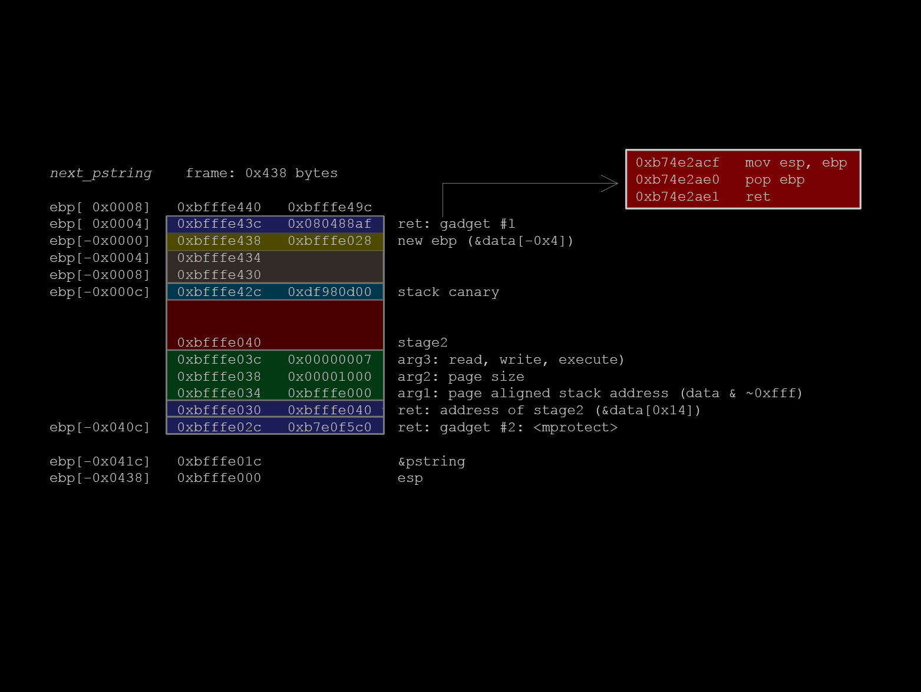
ROP SSP Slide

Slide 32
Demo (pwa)
ROP Exploit

Slide 33
Lessons learned
Be careful what you log!
User controlled data
-Wall
Use a recent compiler and apply mitigations

Slide 34
Thank you!
Questions?

