Slide 1
Circumventing non-executable stack protection with return oriented programming
Techzone Sundvollen 2014

Slide 2
What is ROP?
“Return-oriented programming (ROP) is a computer security exploit technique that allows an attacker to execute code in the presence of security defenses” - Wikipedia
Theoretically, one can perform ROP in a few different ways, but we will focus on buffer overflows
Notes:
Little warning: Beneficial with a basic understanding of x86 assembler

Slide 3
Reasons for doing ROP
Circumvent Data Execution Prevention (DEP)
Bypass code signing
Notes:
To understand ROP you need to understand it’s predecessor

Slide 4
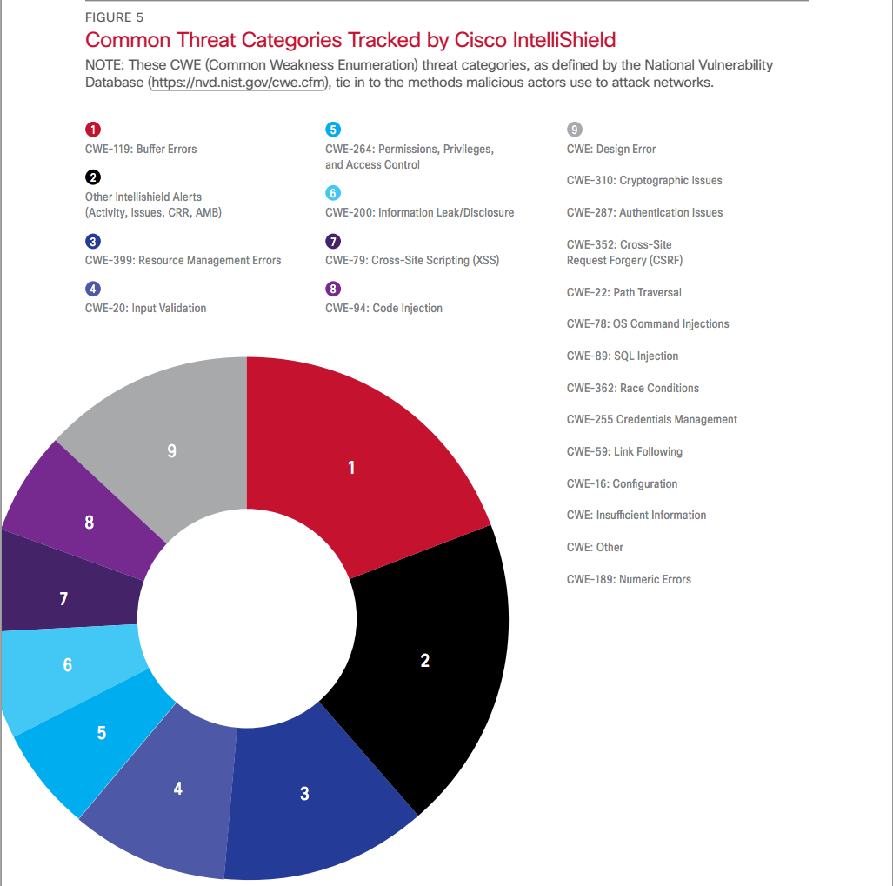

Slide 5
History of buffer overflow exploitation
Paper published documenting it in ‘72
First documented exploitation ‘88
Morris Worm
“Rediscovered” in ’95
‘Smashing the stack for fun and profit’ - ’96
One of the original articles explaining the basic technique.

Slide 6
Evolution: then
Traditional stack overflow
Write more data to a buffer than the buffer has space allocated
This can overwrite the return address of the calling function
When ret is performed the attacker controls the address and can point that at her own payload
If the attacker doesn’t exactly know which address the payload starts at, she can use a nop sled to maximize her chances of successful exploitation
Notes:
- Most of us have experienced it
The consequence of overflowing the variable boundary can be bad
We will get back to how a NOP sled works

Slide 7
Evolution: then and now
Return-to-libc attack
Overwrite the return address like in the traditional attack and point it to a function in libc
When ret is performed the attacker controls the address (e.g. the system() function call)
She can write her own stack frame data beyond the ret address: (e.g. pointer to “/bin/sh”)
Limited to one function call (which might not be enough in all cases)
Notes:
Circumvents non-executable stack protection
/bin/sh string could exist in libc
One function call : remote exploitation

Slide 8
Now
Return-oriented-programming
Extension of return-to-libc
Create multiple stack frames after each other
Chain together addresses with instructions ending in ret (known as gadgets)
The hard part is finding suitable gadgets and where they are mapped in the address space
Notes:
- Remote exploits: you don’t have access to inspection of memory layout

Slide 9
Evolution of buffer overflow mitigations
Type
Traditional stack overflow
Return-to-libc attack
Return-oriented programming
Mitigations
Non-executable stack (DEP)
Map libraries to addresses starting with 0x00
Stack canaries
ASLR
Notes:
Mitigations are defences against exploitation techniques
DEP was a challenge due to
self-modifying code (JAVA)

Slide 10
Mitigations
Non-executable stack
Map libraries to addresses starting with 0x00
Stack canaries
ASLR (Address Space Layout Randomization)
Notes:
Non-executable stack:
Stack only has read and write permissions, therefore pointing the return address to the stack raises SIGSEGV.
Map libraries to addresses starting with 0x00
With strcpy no NULL bytes can be placed in the middle of the payload or the full payload will not be copied
Stack canaries:
A small bit of random information is added to the stack between the return address and local variables and is checked to be the same value before fetching the return address.
ASLR (Address Space Layout Randomization):
Each time the program is run, the position of the stack, heap and libraries are randomized.
Slight performance impact on linux

Slide 11
Bypassing mitigations
Non-executable stack:
Return-to-libc / ROP
Stack canaries:
An info leak
Overwrite the stack cookie
Brute-force
ASLR (Address Space Layout Randomization):
Info leak (the relative addresses are the same)
Brute-force
Notes:
Brute-force can be very simple on 32 bit architectures
Stack canary:
- esoteric method glibc specific - Overwrite enough data to overwrite the memory used in the exception handler (and use ROP from there)
- Weak PRNG
Info leak: e.g. heartbleed, printf with user controlled first argument

Slide 12
ROP challenges
If exploiting strcpy no NUL bytes may be present in the payload
Use xor / incr / decr in a gadget to create 0x00 bytes
Finding usable gadgets is hard work
Use a tool where you can filter on useful gadgets
There exists tools to generate a complete ROP payload based on the flora of available gadgets
Notes:
NUL – Look it up!
We don’t use tools!
Next: Let’s get into some code

Slide 13
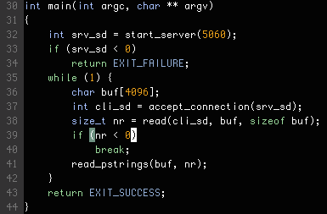
Notes:
Program reads pascal type strings from a remote connection

Slide 14
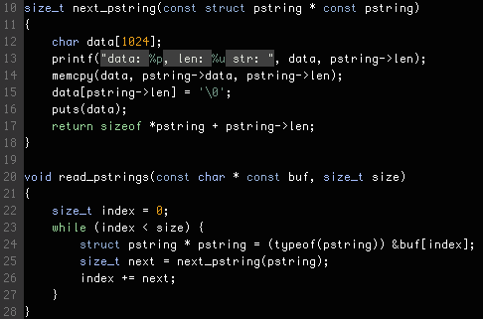
Notes:
Spot the bug
- Read many chunks from a string where each chunk is prefixed with a 32 bit unsigned integer length

Slide 15
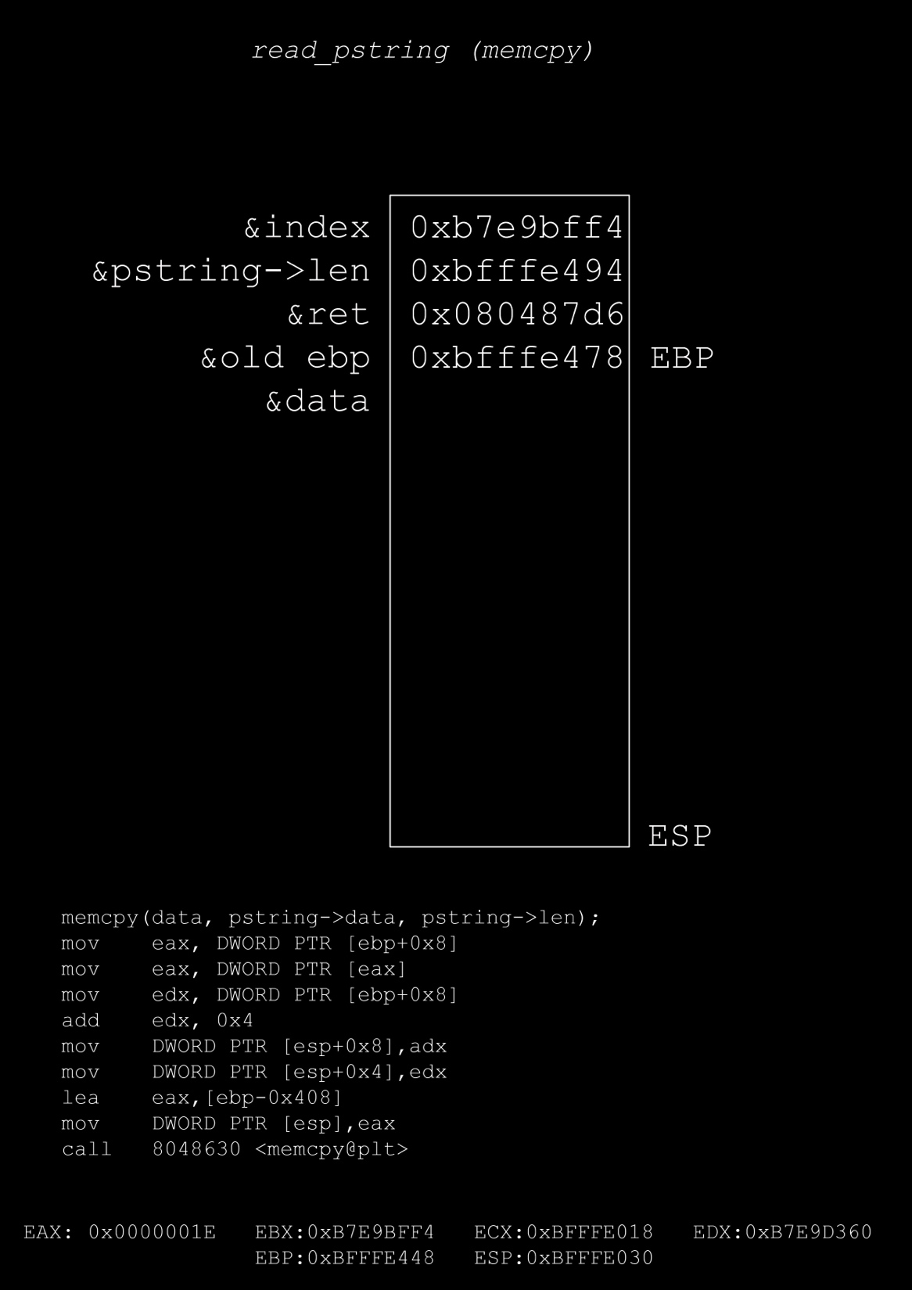

Slide 16
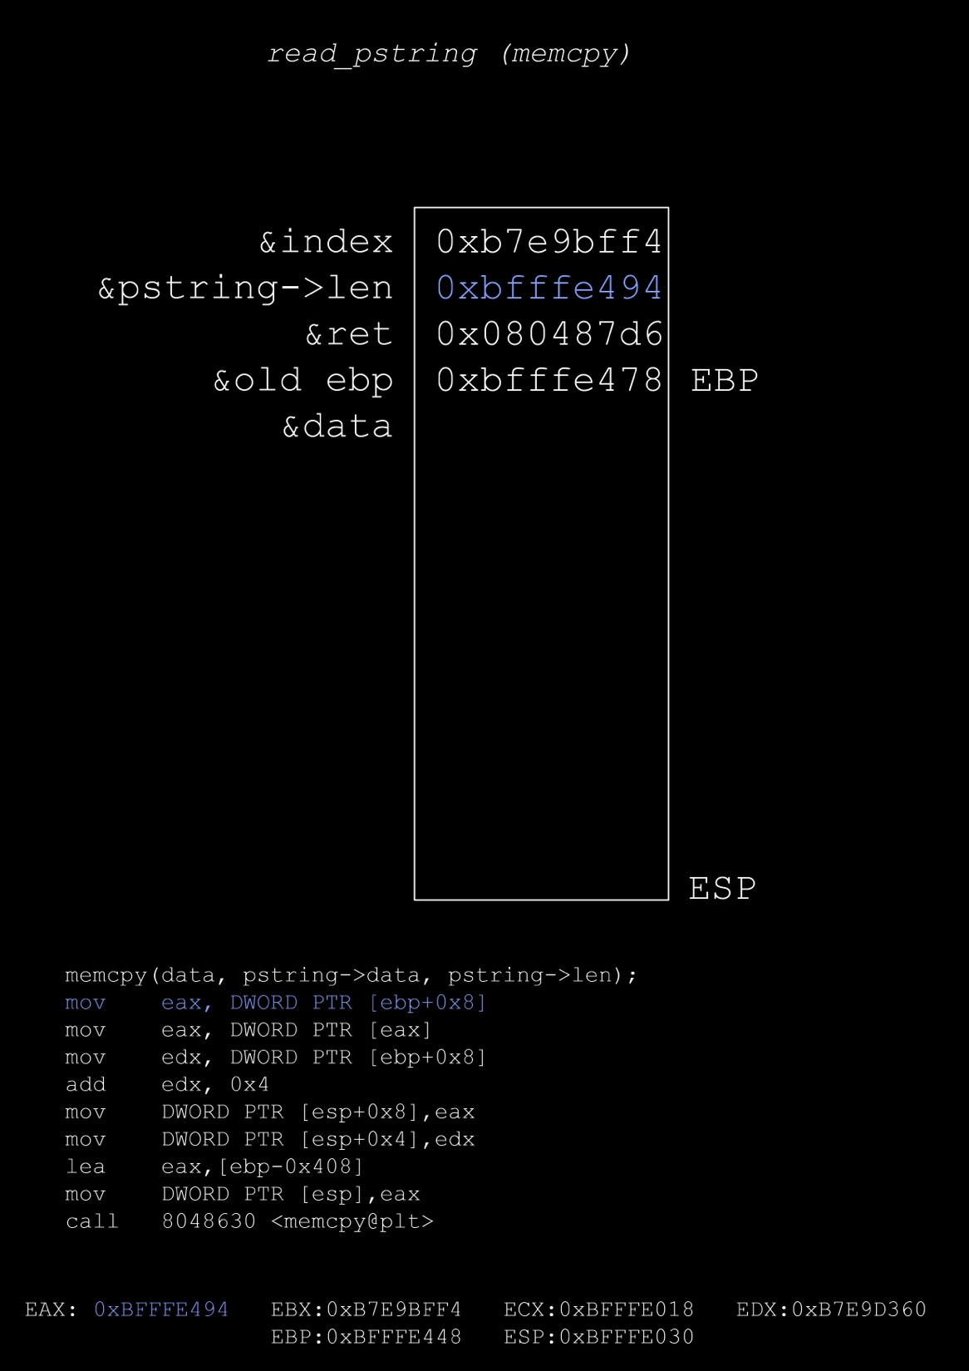

Slide 17
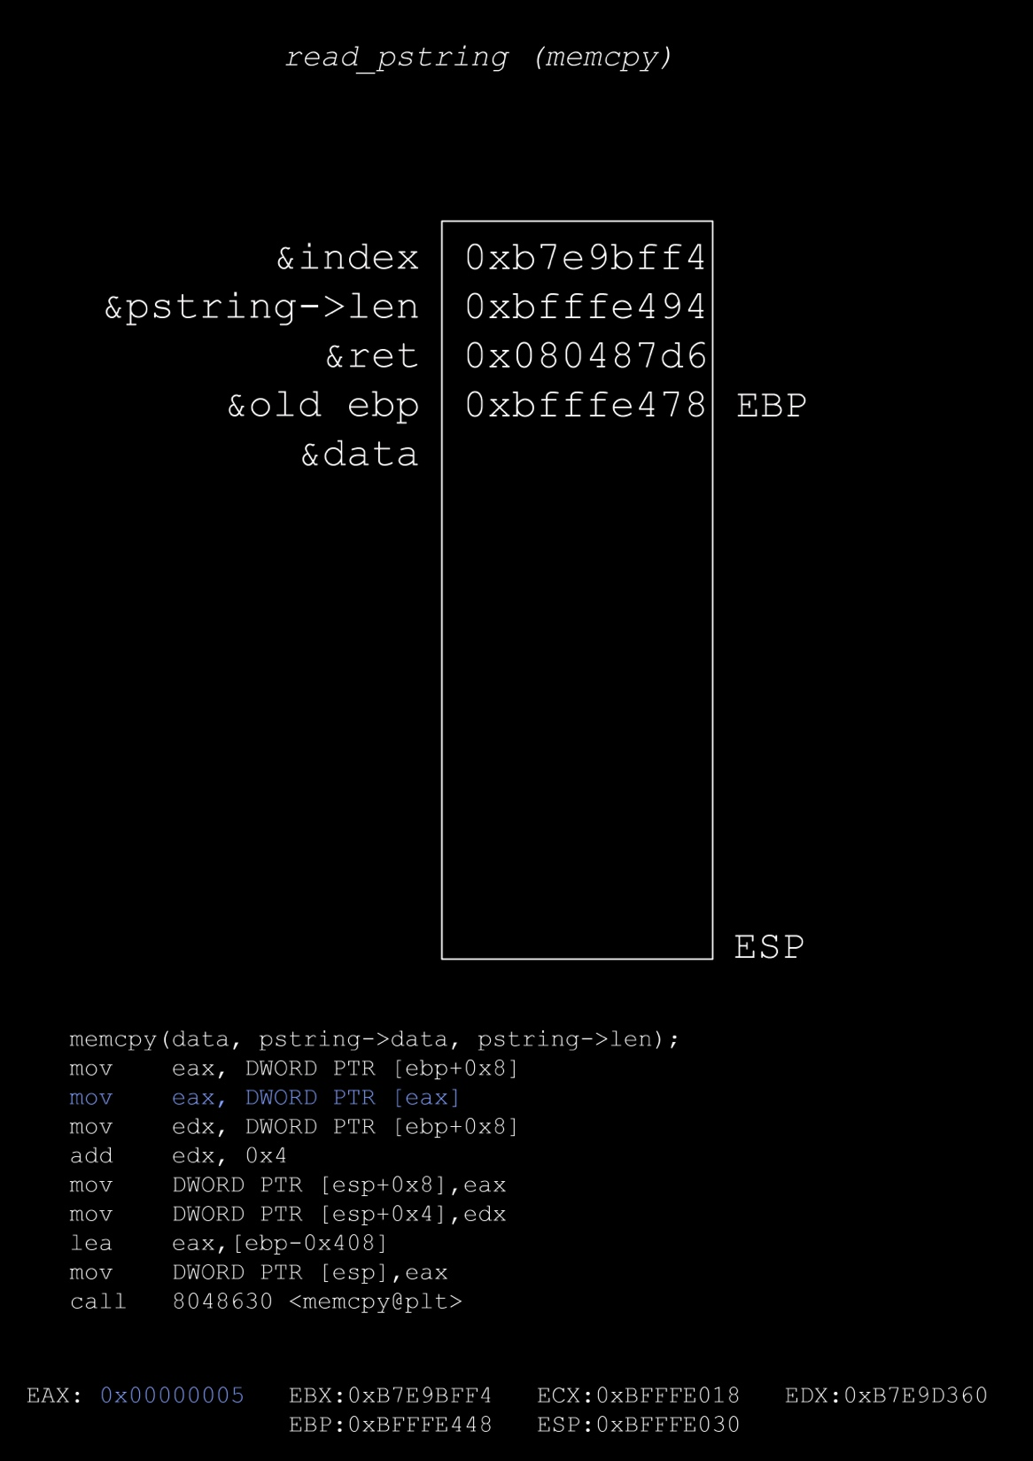

Slide 18
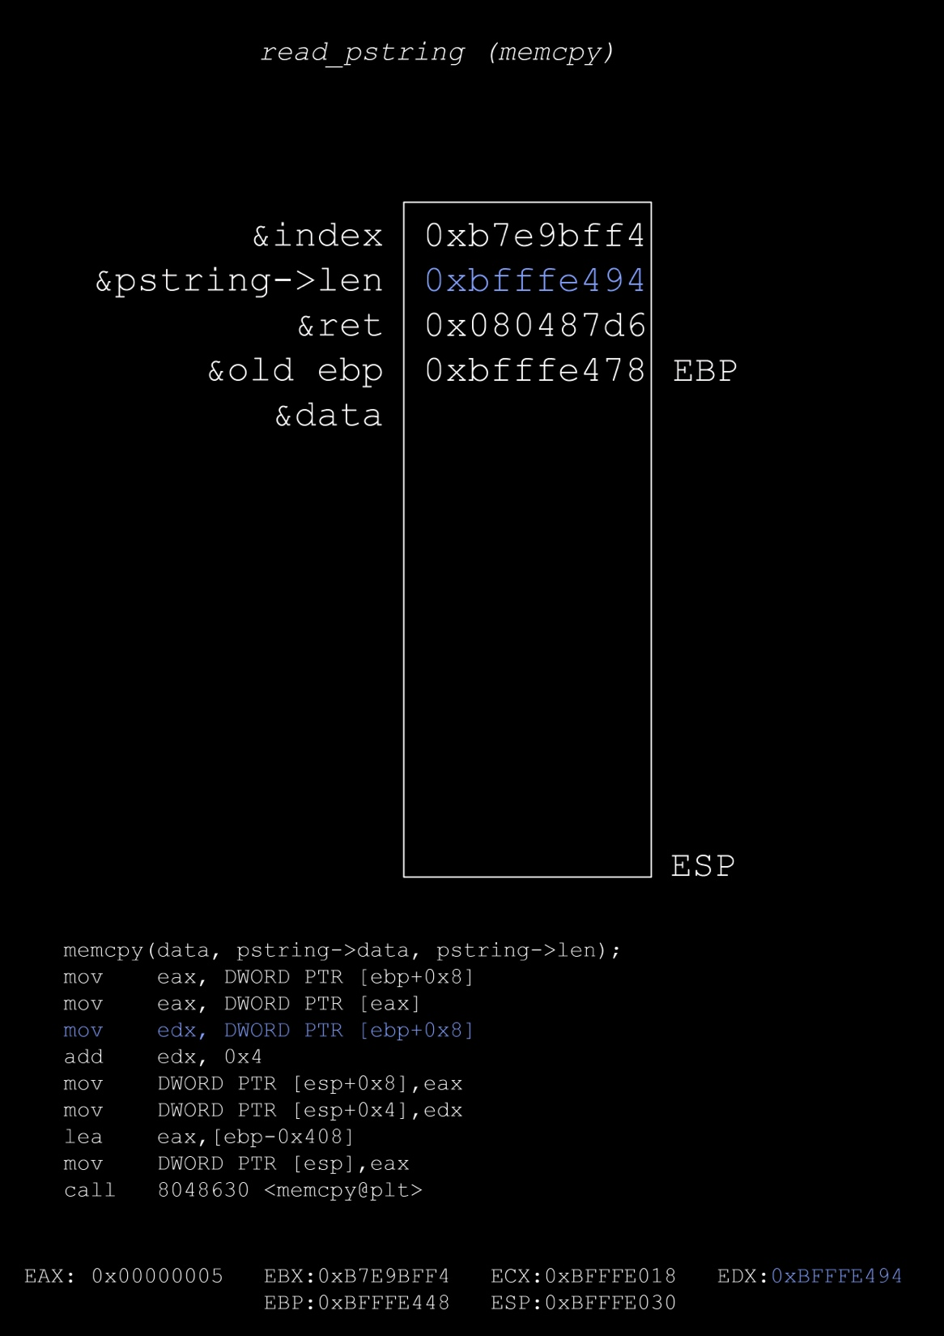

Slide 19
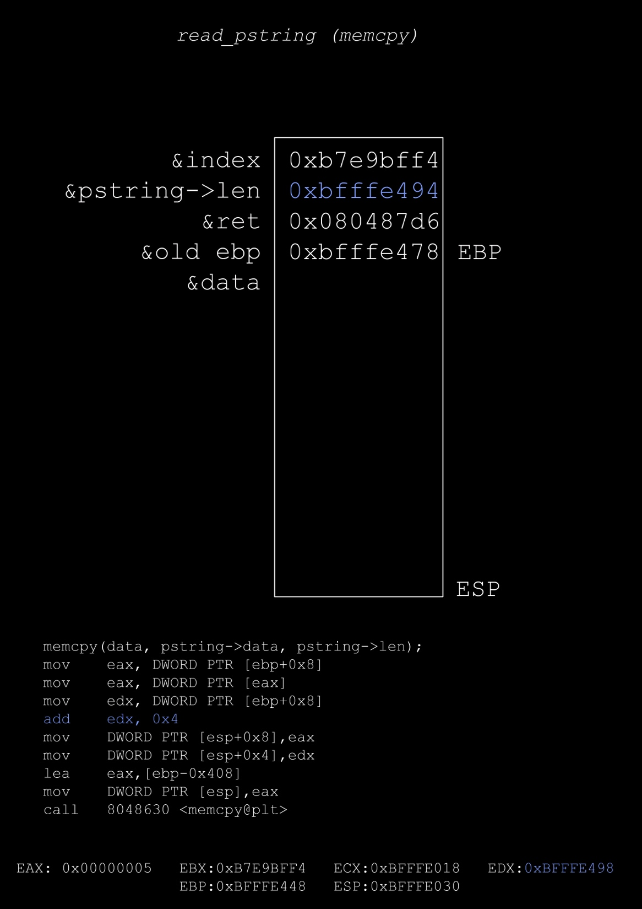

Slide 20
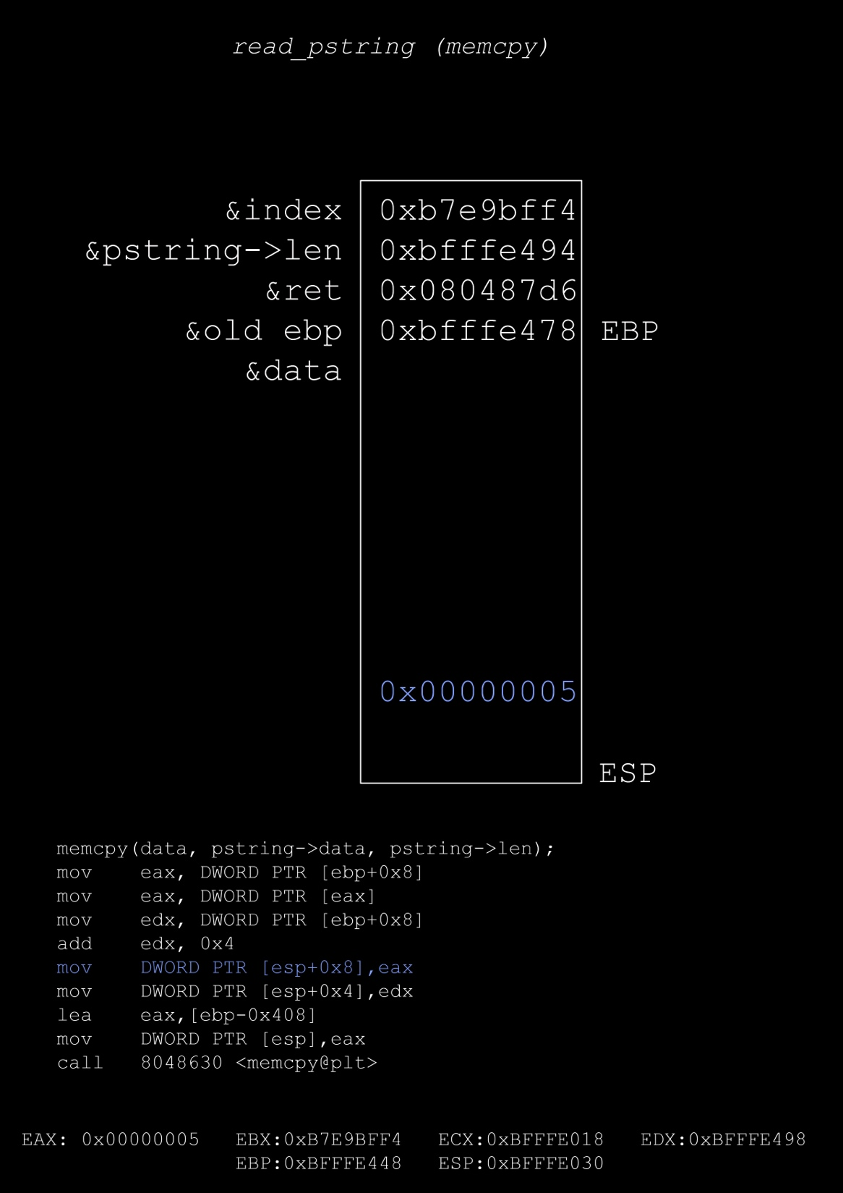

Slide 21
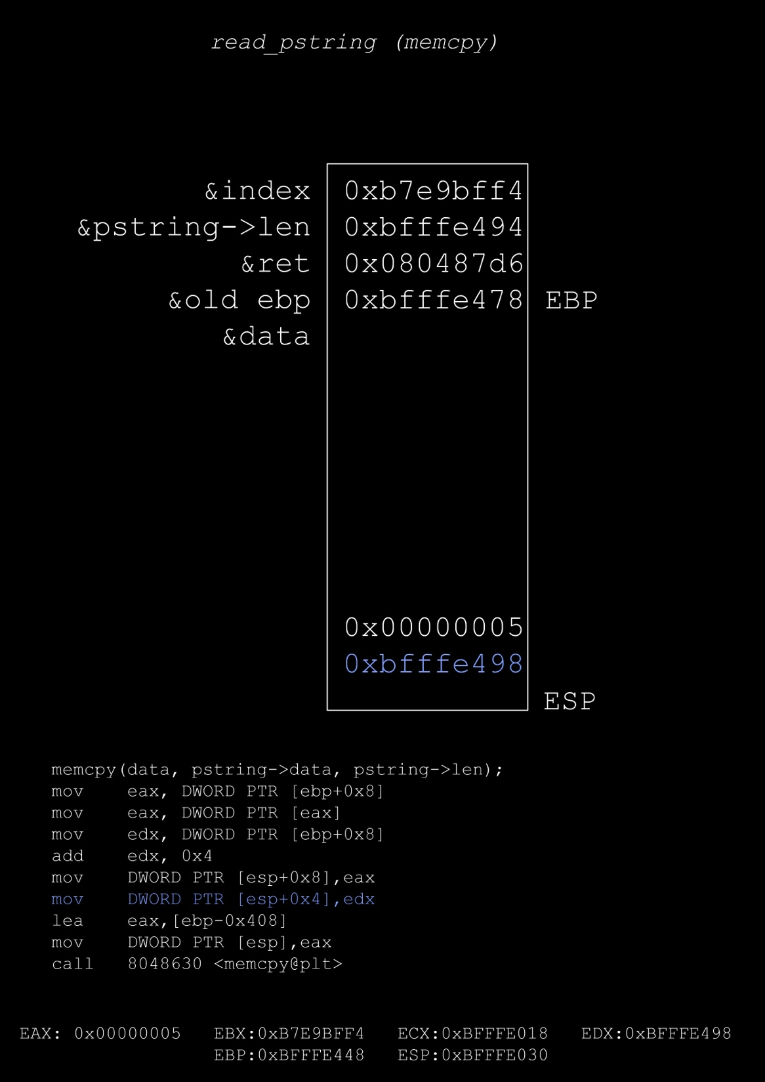

Slide 22
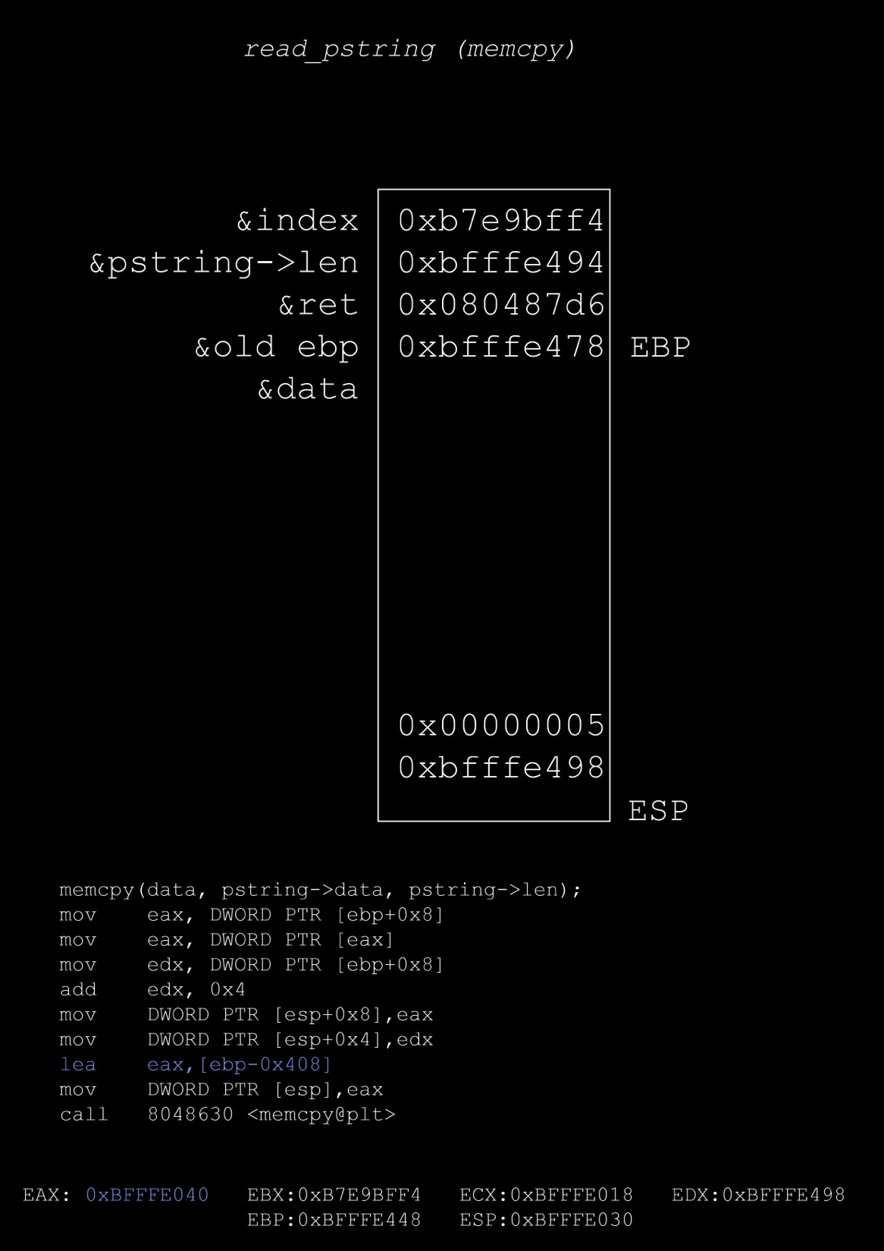

Slide 23
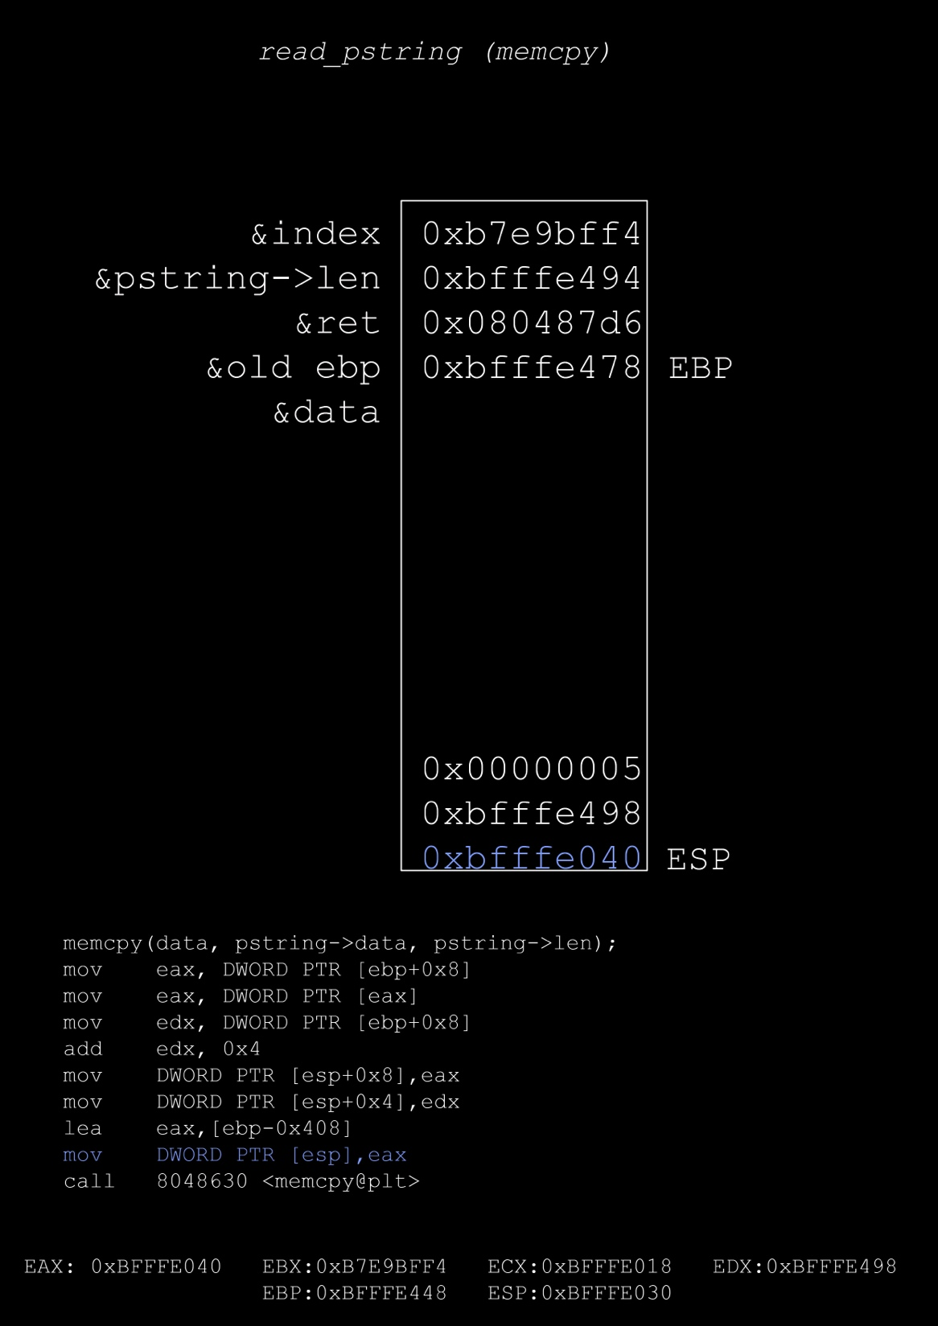

Slide 24
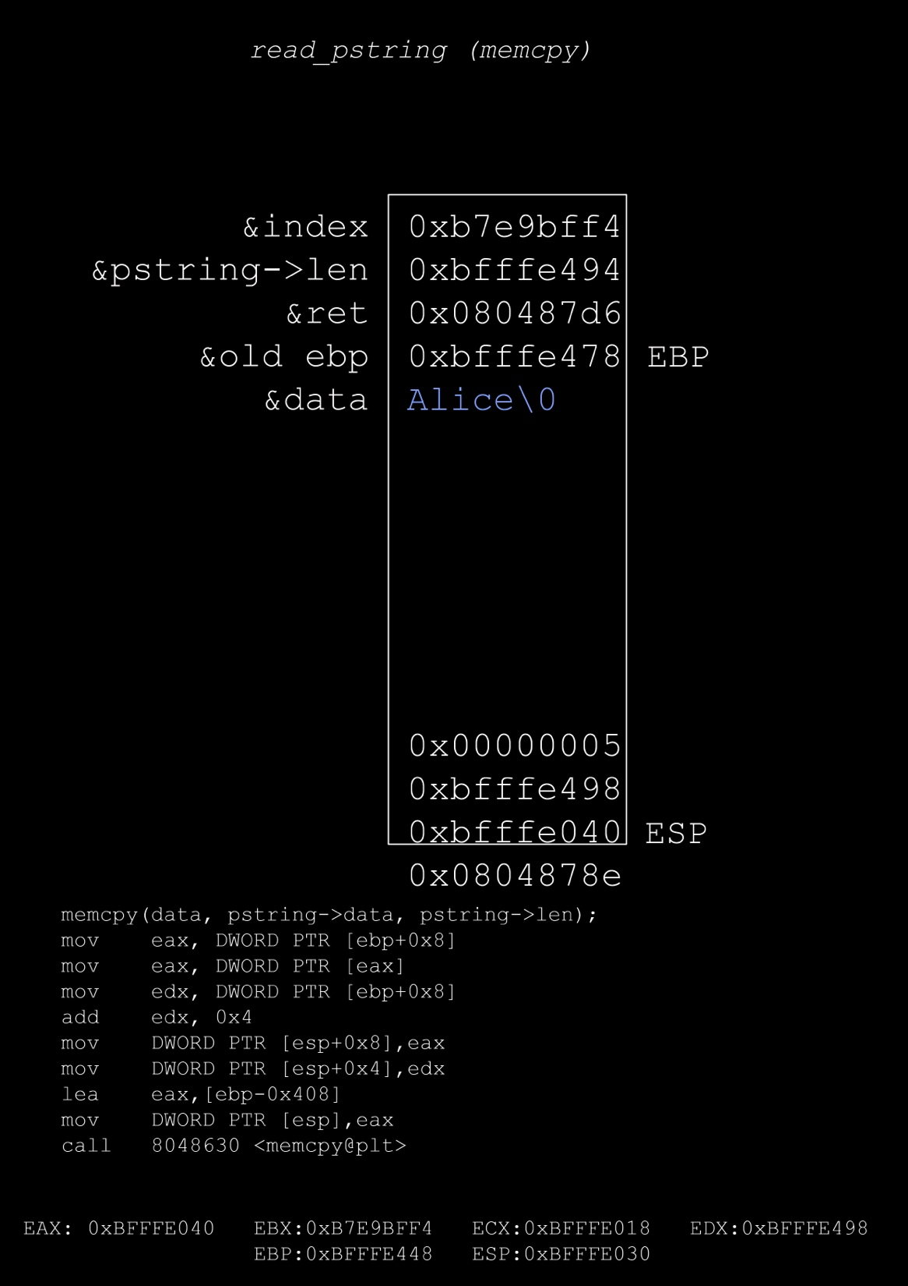

Slide 25
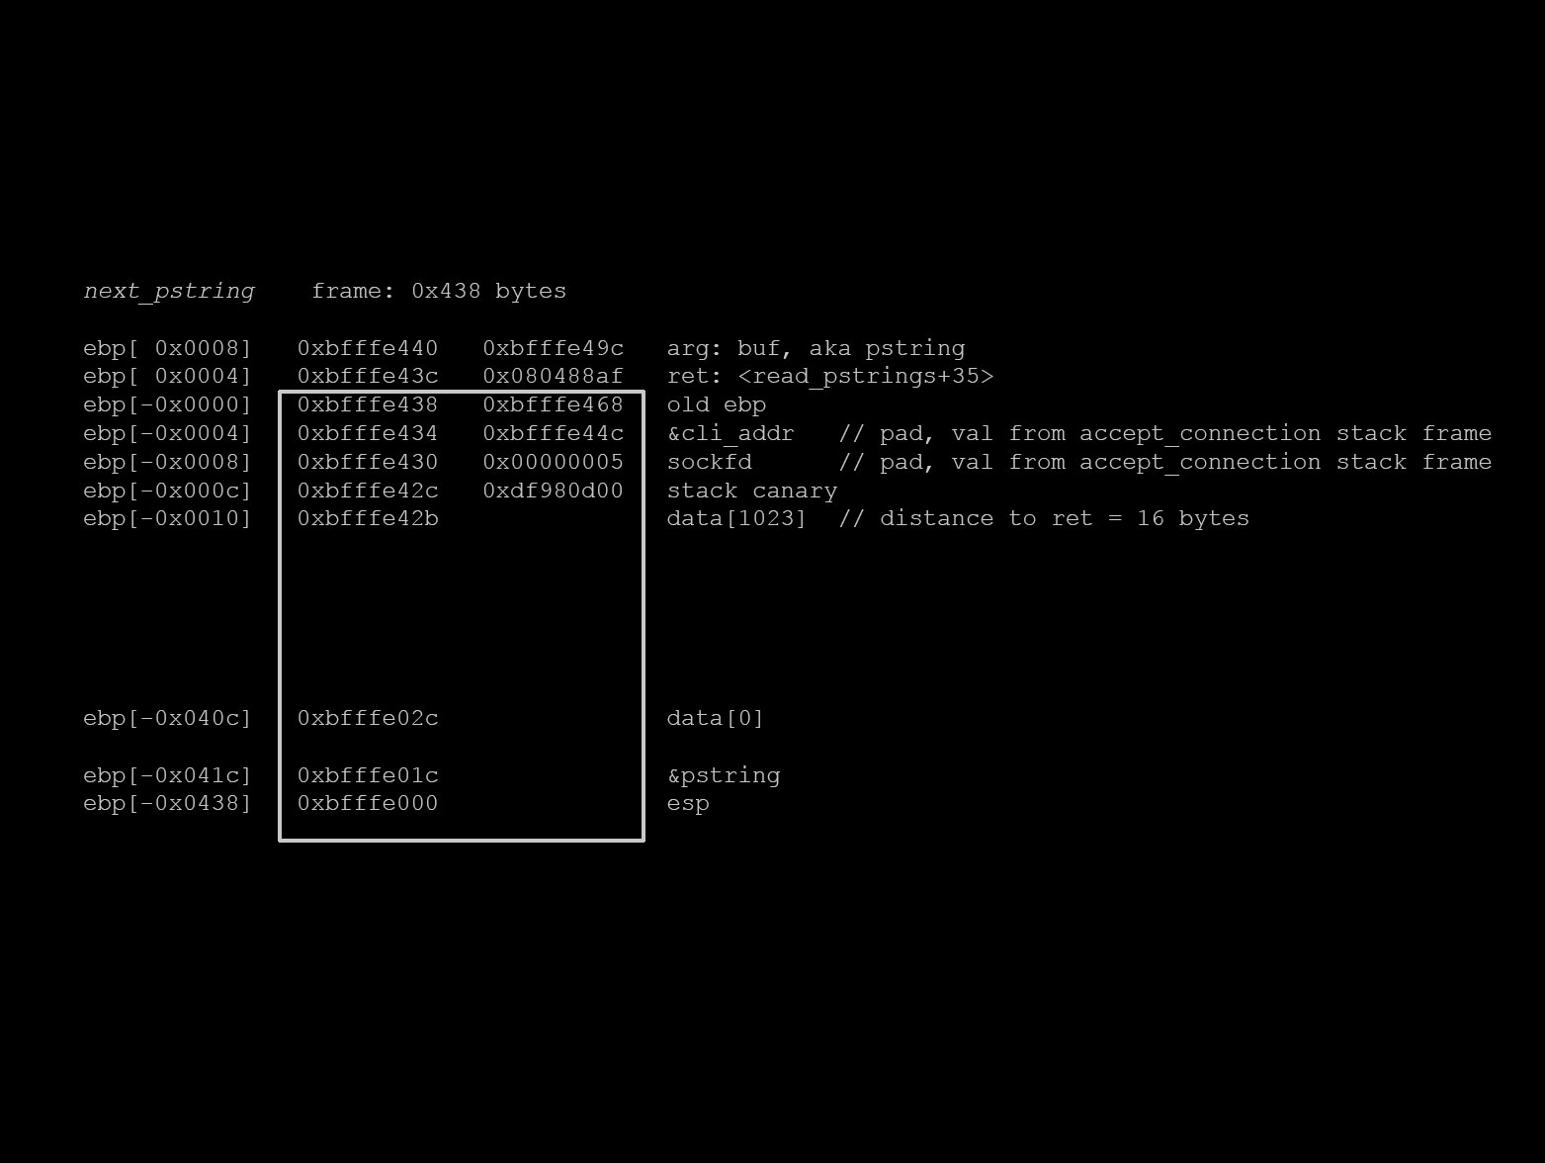

Slide 26
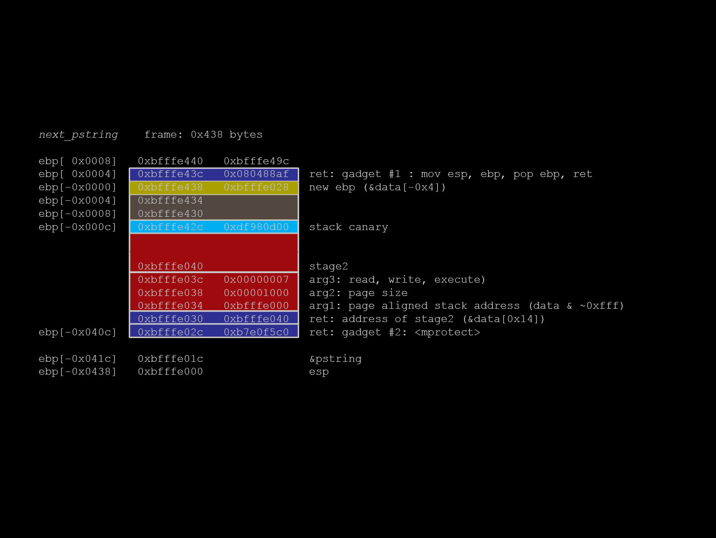

Slide 27
Demo time!
Best case scenario

Slide 28
TODO: Fill in traditional stack overflow

Slide 29
Demo time!
Traditional stack overflow
gcc -Wall –fno-stack-protector –z execstack
gcc -Wall –fno-stack-protector

Slide 30
TODO: Fill in ROP

Slide 31
Demo time!
ROP
gcc –Wall –fno-stack-protector
Notes:
To simplify the presentation we did not enable stack cookies or ASLR

Slide 32
Tools for writing ROP chains
metasploit/msfrop – a gadget finder
gogo – pwahlman’s gadget finder
ropc – a ROP payload compiler
A plethora of other tools

Slide 33
Thank you!
Questions?

