Slide 1
Predictive Maintenance
For industrial Automation

Slide 2
Reducing downtime in Machine operations
The time consuming nature of machine maintenance in large manufacturing and industrial processes, most of the troubleshooting and fault finding when a machine fails is done manually and as a result requires long hours and sometimes days. To address this we propose a solution to enable individuals with the foresight to rapidly resolve issues.

Slide 3
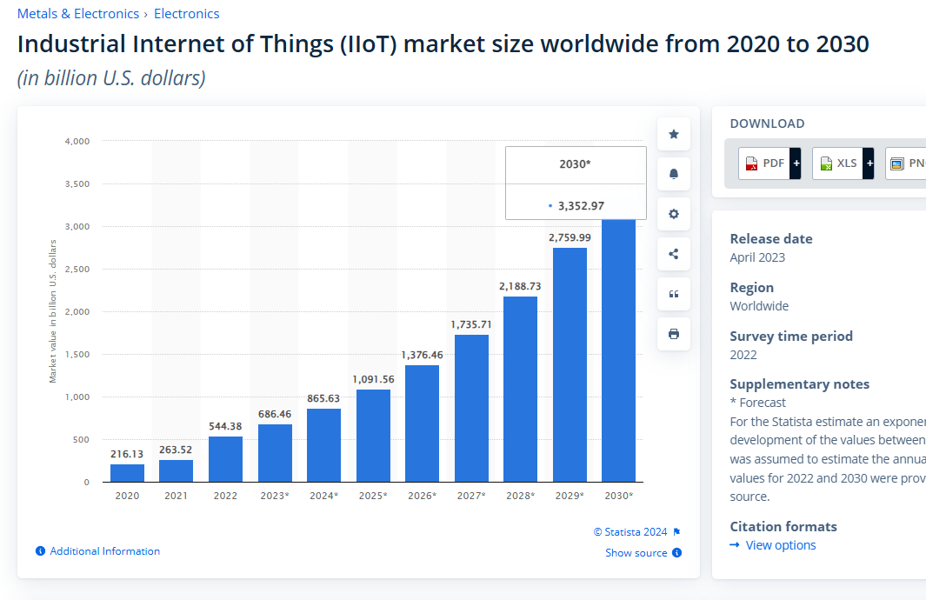
Market Size
The industrial automation space is projected to increase in not just market size but overall connected devices, as businesses try to reduce inefficiencies and boost productivity.
Source : https://www.statista.com/statistics/611004/global-industrial-internet-of-things-market-size/

Slide 4
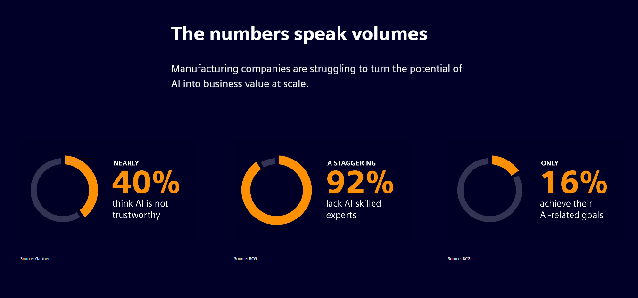
Challenges
Most data collected from IOT devices is structured and highly reliable, the connectivity of these large industrial machines and the use of the information(data) sent between them is highly neglected mainly due to lack of skilled-personnel and trust
Source : https://www.siemens.com/global/en/products/automation/topic-areas/artificial-intelligence-in-industry.html

Slide 5
Opportunities and Solutions
AI/ML will be tools that enhance overall work in terms of production forecasting and machine maintenance. Most manufacturing companies use IOT enabled devices to allow for communication between different components on their factory floor. This presents us with the opportunity not just to gather the different data points and gain meaningful insights from them but also as a way to educate individuals from floor managers to machine operators to become more familiar with the systems. At the core the predictive maintenance solution aims to address a common issue in the field of industrial automation where fault finding and repairs in large machines are time consuming, the solution aims to reduce the overall duration of the process

Slide 6
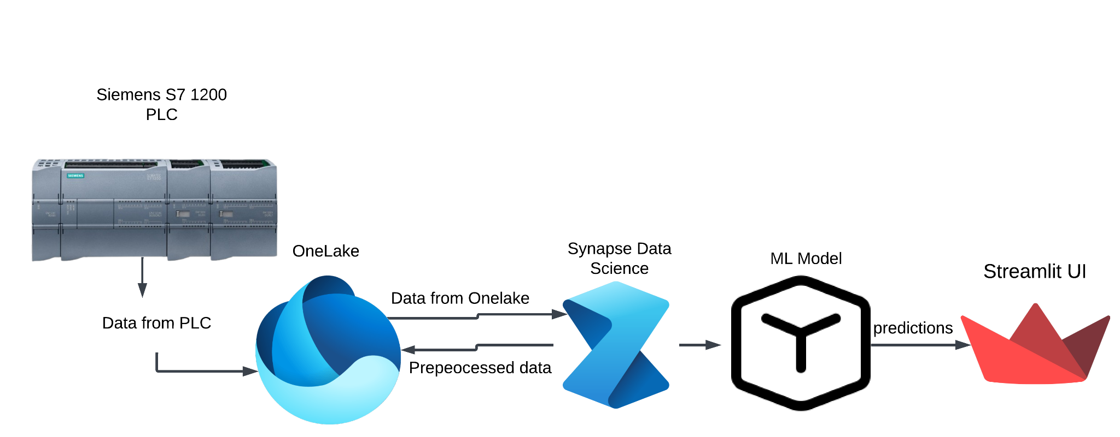
Process Flow

