Slide 1
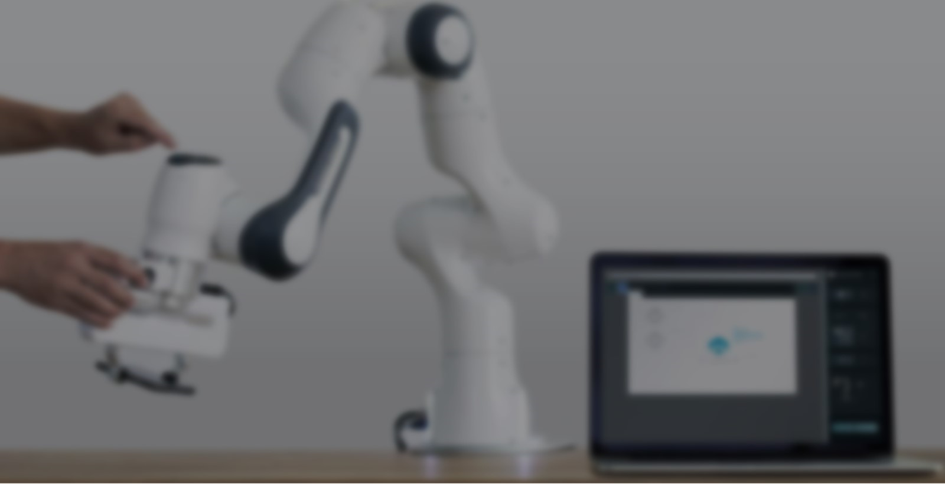
Automatic 3D Terrain
Construction System
Based on ROS and MoveIt
🖥️ Operating Environment
ROS Noetic + MoveIt + RViz
🤖 Actuator
Franka Emika Panda 7-joint robot arm
📋 Core task
Project Team
2026.6.23
▸ Contour to 32×32 matrix
▸ Hundreds of high-precision pick-and-place cycles
▸ Imitate real terrain
Terrain Builder

Slide 2
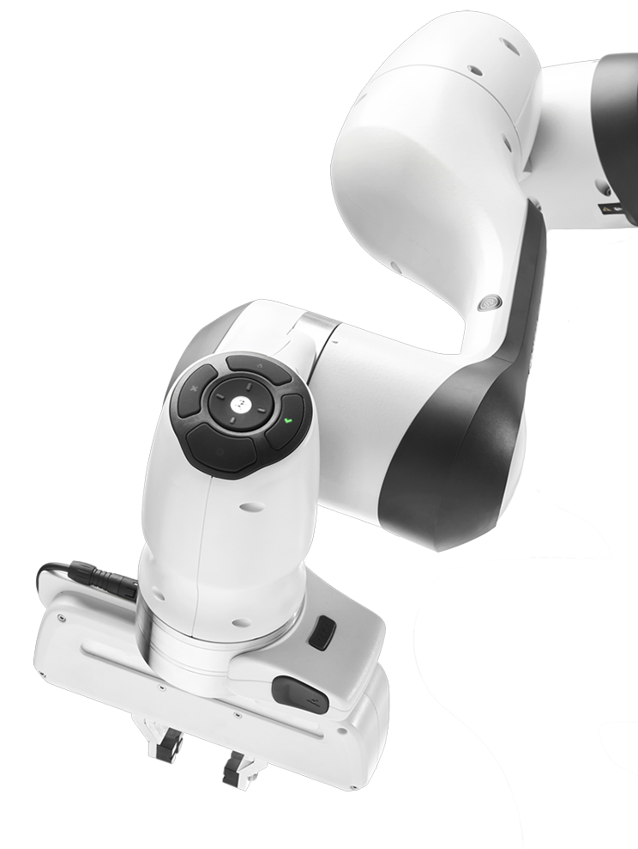
Project Overview and Task Goals
🖥️ Operating Environment
ROS Noetic + MoveIt + RViz
🔧 Driver layer
📐 Recognition layer
🎮 Control layer
🤖 Actuator
▸ ROS + MoveIt + RViz
▸ Panda-moveit package
▸ contour_to_heightmap.py
▸ easy contour to matrix
▸ 32×32 matrix for terrain
▸ terrain_builder.py
▸ Launch file
▸ Robot arm control
▸ Block control
Franka Emika Panda 7-joint robot arm
📋 Core task
▸ Contour to 32×32 matrix
▸ Hundreds of high-precision pick-and-place cycles
▸ Imitate real terrain

Slide 3
System Design
🖥️ Operating Environment
ROS Noetic + MoveIt + RViz
🔧 Driver layer
📐 Recognition layer
🎮 Control layer
🤖 Actuator
Franka Emika Panda 7-joint robot arm
▸ ROS + MoveIt + RViz
▸ Panda-moveit package
▸ contour_to_heightmap.py
▸ easy contour to matrix
▸ 32×32 matrix for terrain
▸ terrain_builder.py
▸ Launch file
▸ Robot arm control
▸ Block control
📋 Core task indicators
▸ 32 × 32 Grid desktop （ 1024 squares ）
▸ Up to 8 layers stacked
▸ Hundreds of high-precision pick-and-place cycles
▸ Perfectly Fit Pyramid Terrain
Contour with colors respresenting heights
32×32 Matrix with max element up to 8 in Heightmap.npy

Slide 4
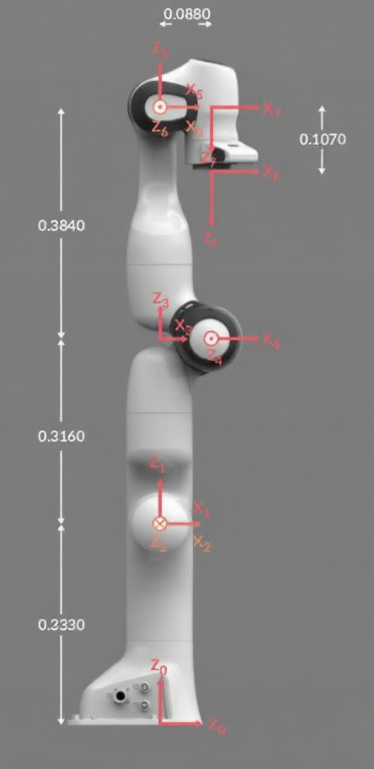
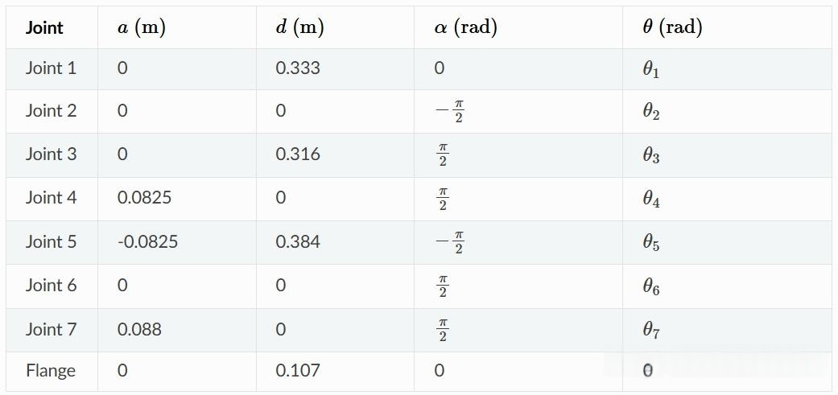
Robot Arm Structure and
D-H Parameters

Slide 5
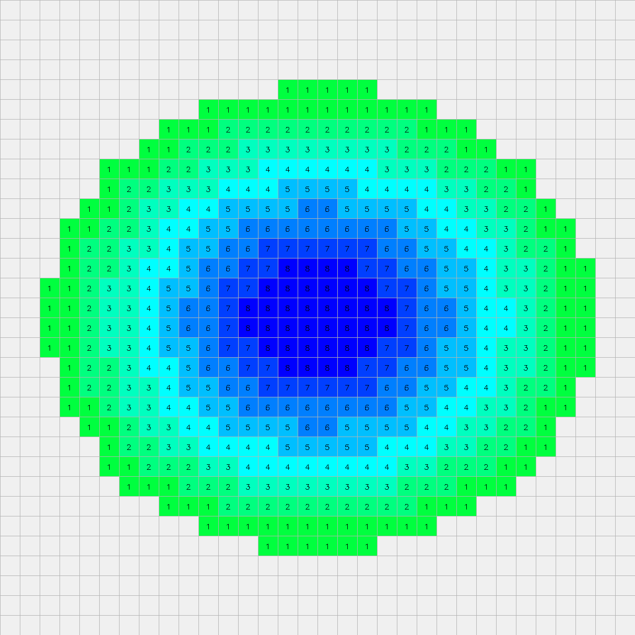
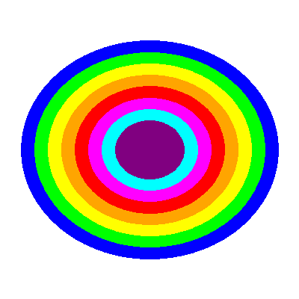
Recognition Layer
Pixel sampling
Color-height
matching
Contour with colors respresenting heights
32×32 Matrix with max element up to 8 in Heightmap.npy

Slide 6
terrain_builder_demo.launch
Control Layer
Robot arm type
Block generating
Mode → simulation
Visualization settings
Controller → OMPL → RRT + collision detection…
Related nodes
terrain_builder.py
initialization
Variables settings: block, grid…
Node
recognition
contour_to_heightmap.py
Arm motion
Up the block
Down to grasp position
Close the gripper
Pick up
Loose the gripper
14cm above destination
Move with block
Block motion
Generate
Move with arm
Drop with g acceleration
Block count
Change block ID

Slide 7
terrain_builder_demo.launch
Robot arm type
Block generating
Mode → simulation
Visualization settings
Controller → OMPL → RRT + collision detection…
Related nodes
Control Layer
terrain_builder.py
initialization
Variables settings: block, grid…
Node
recognition
contour_to_heightmap.py
Arm motion
Up the block
Down to grasp position
Close the gripper
Pick up
Loose the gripper
14cm above destination
Move with block
Block motion
Generate
Move with arm
Drop with g acceleration
Position Control
Block count
Change block ID
TF2 Query for pose

Slide 8
Result
Able to recognize simple contours
Able to build a 32×32×8 terrain model
No planning error in hundreds of pick-and-place cycles

Slide 9
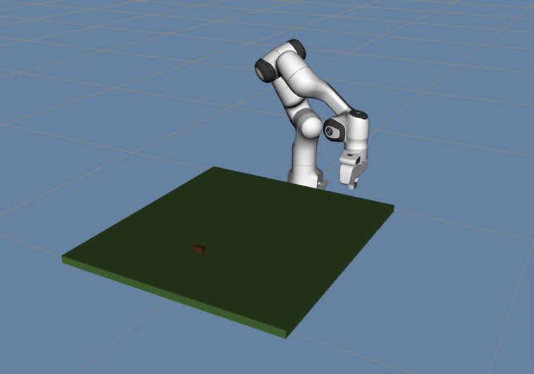
Demo
(speed up a bit)
Software, documentation, and presentation
Documentation
Software and demo recording
Presentation

Slide 10
Thanks for listening
Software, documentation, and presentation
Documentation
Software and demo recording
Presentation

