Slide 1
Population Change

Slide 2
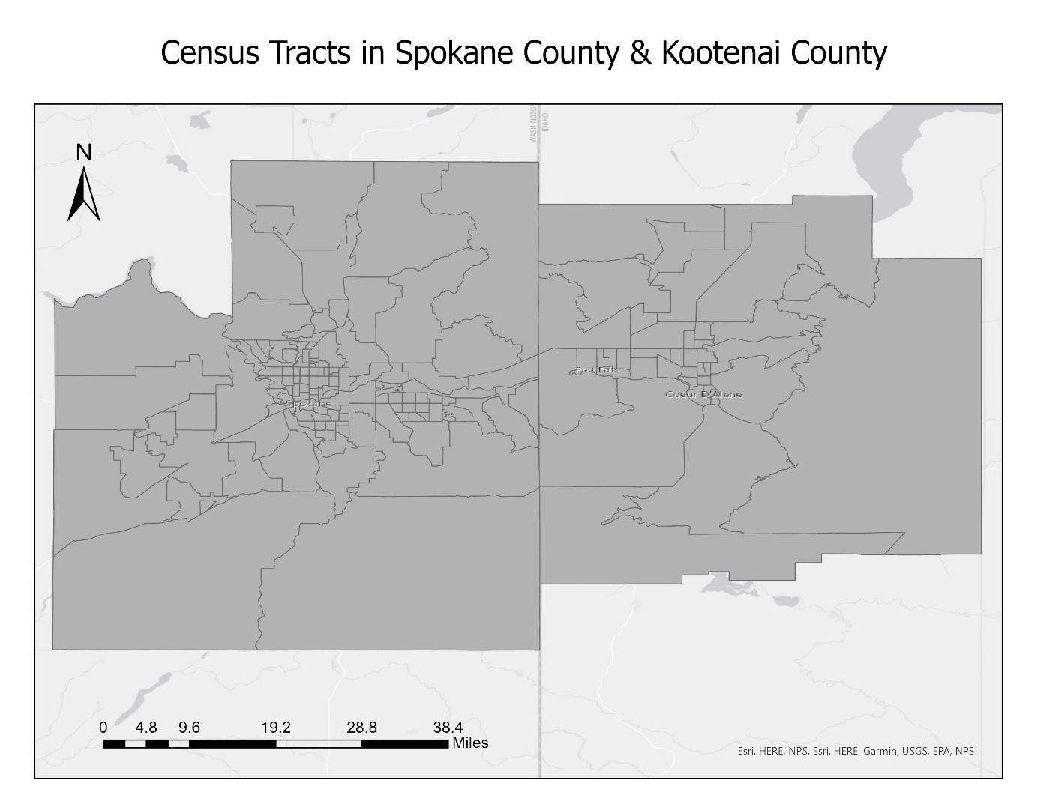
Background
Population change around Coeur d Alene Area
Study Area: 169 Census Tracts
Census Tract definition

Slide 3
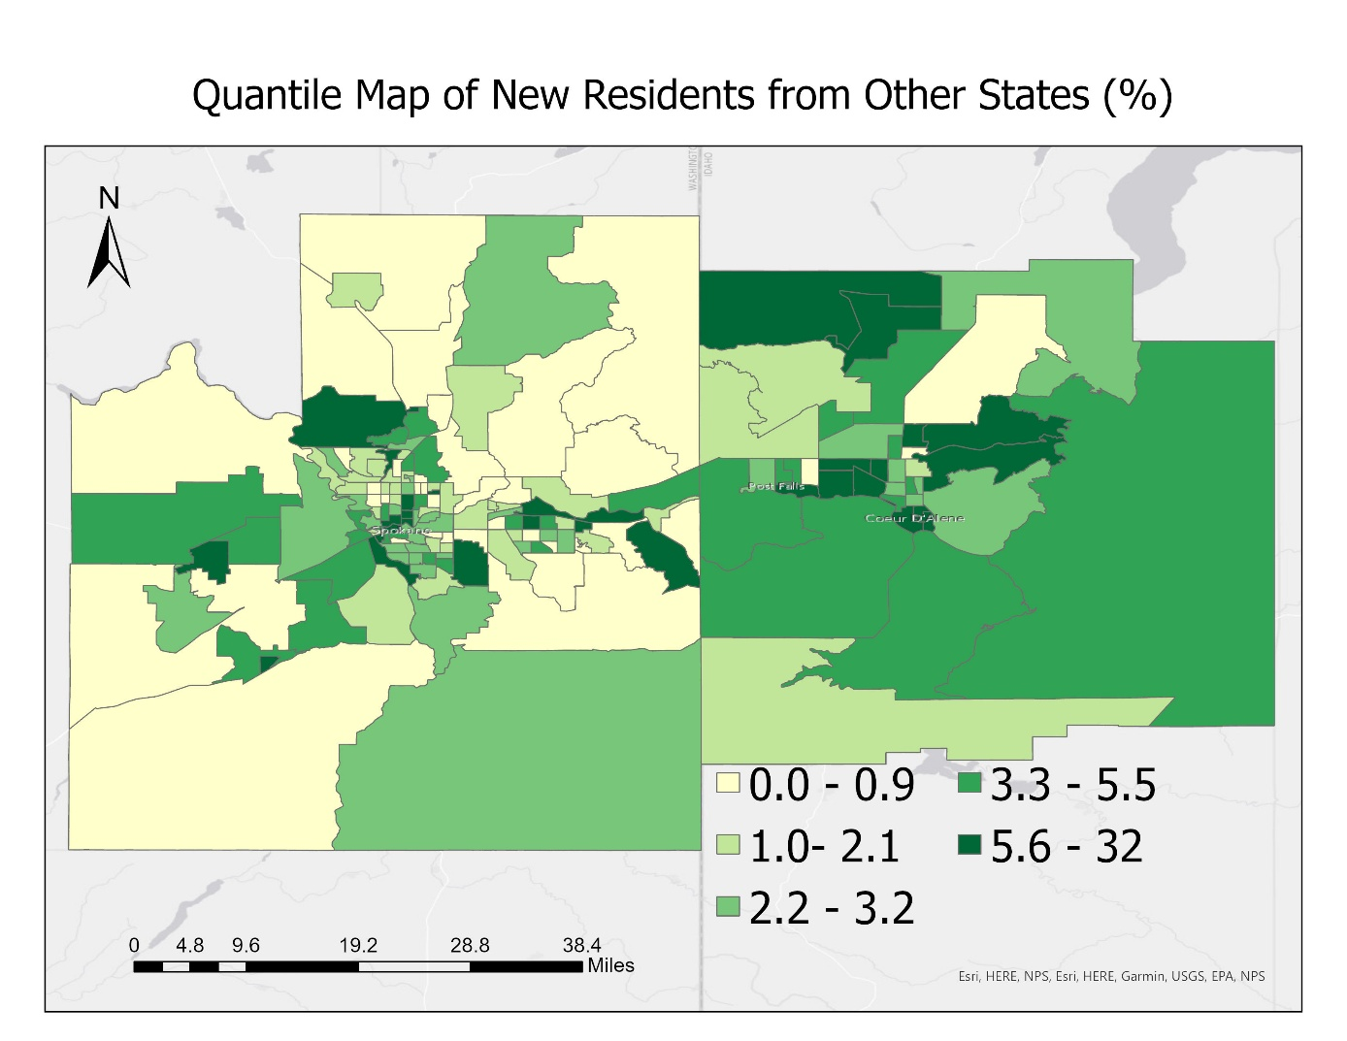
Questions to Ask and Answer
Where are people moved in?
What are the reasons?
For each possible factor, is it the same across areas?

Slide 4
Data
Factors: socioeconomic -> neighborhood context
Demographics
ACS 2021 5-year estimates

Slide 5
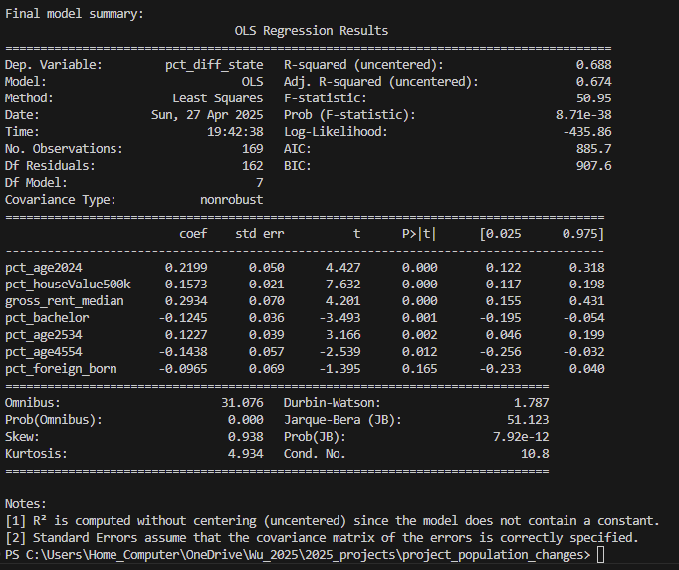
OLS Regression Results
Pct_age2024
House value
Rent
Bachelor

Slide 6
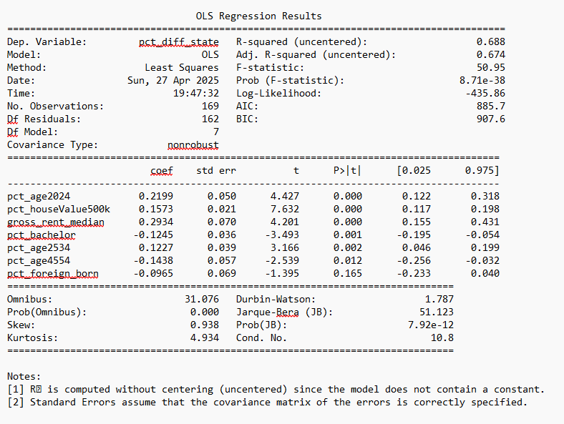

Slide 7
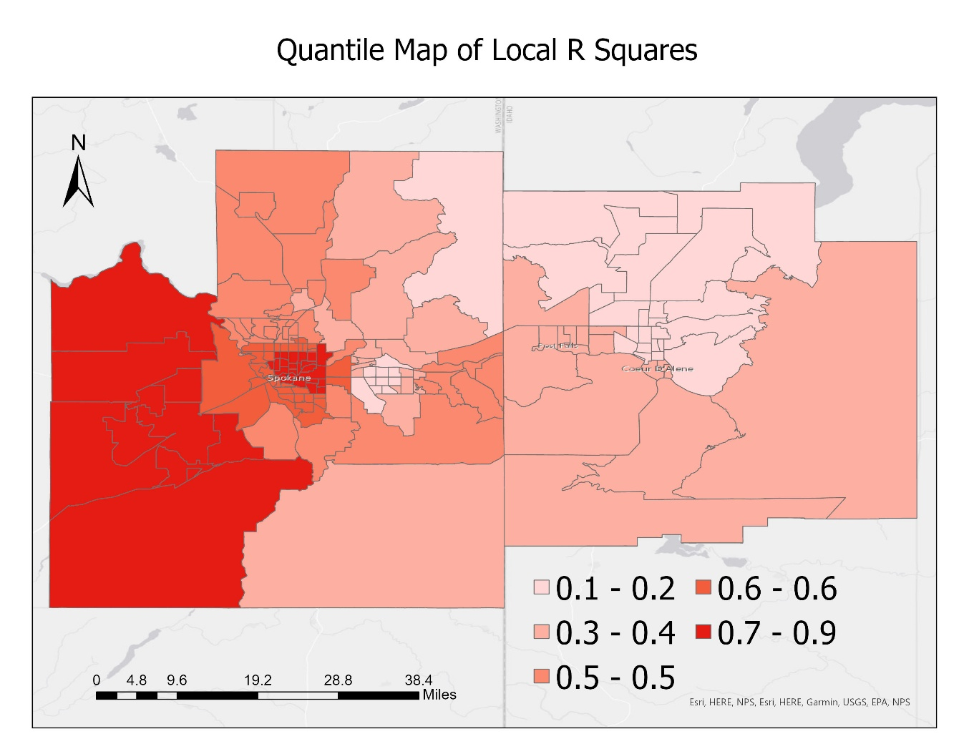

Slide 8
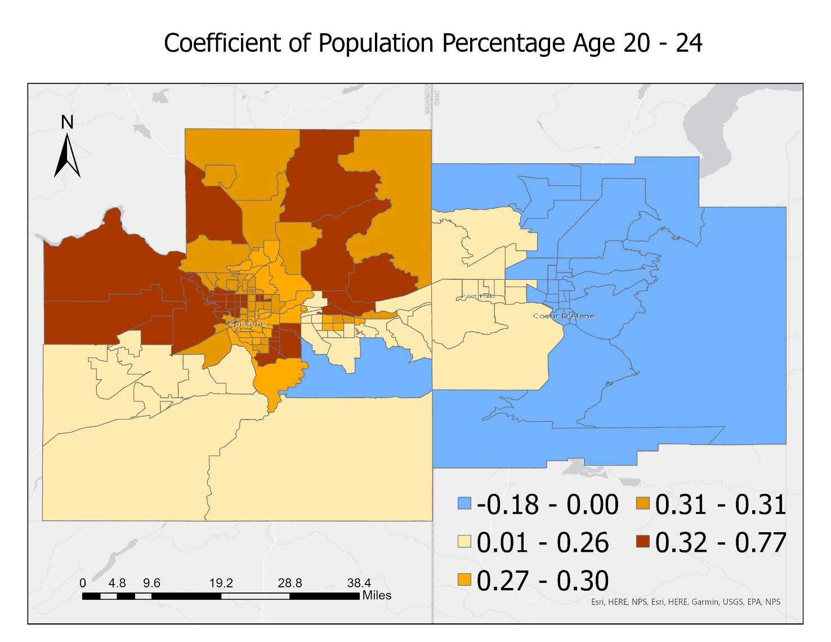
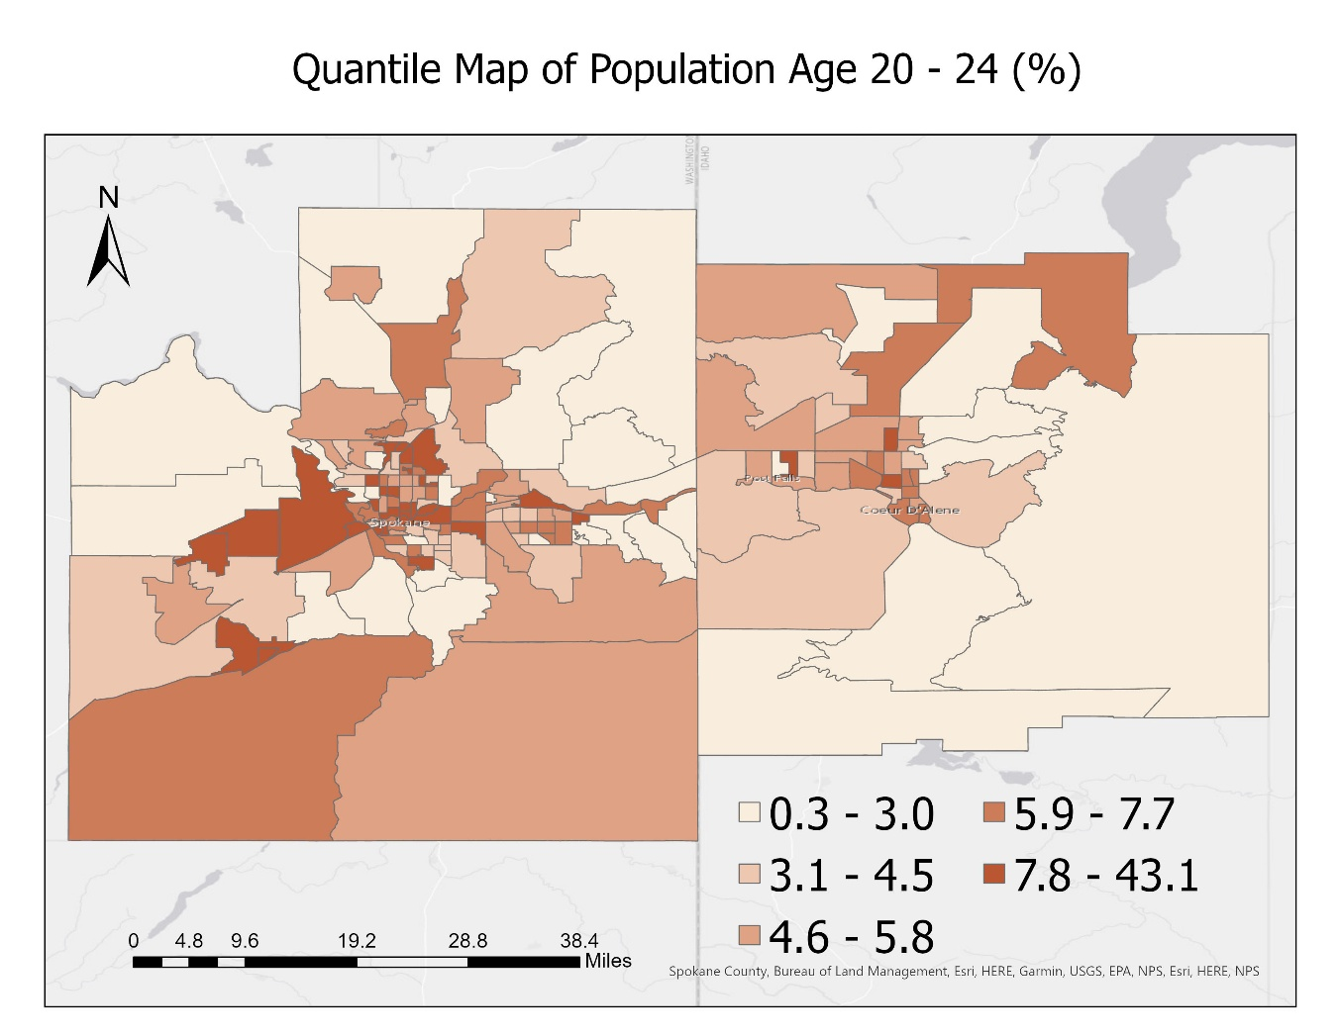
Age 20 - 24

Slide 9
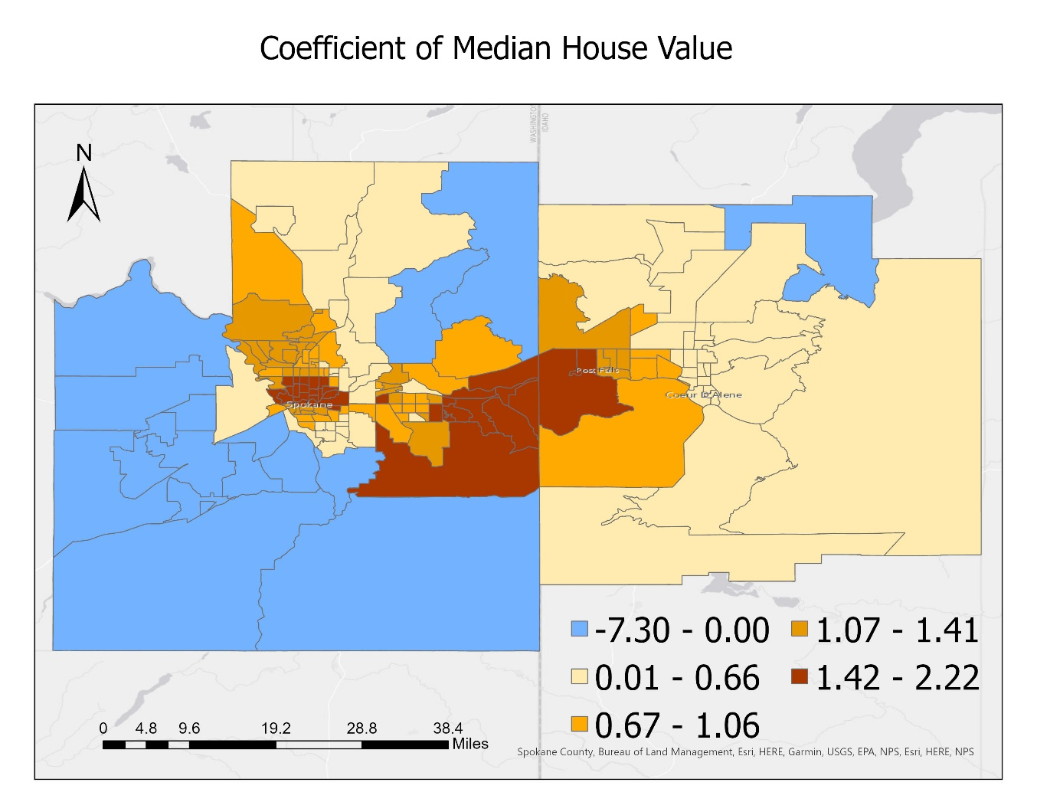
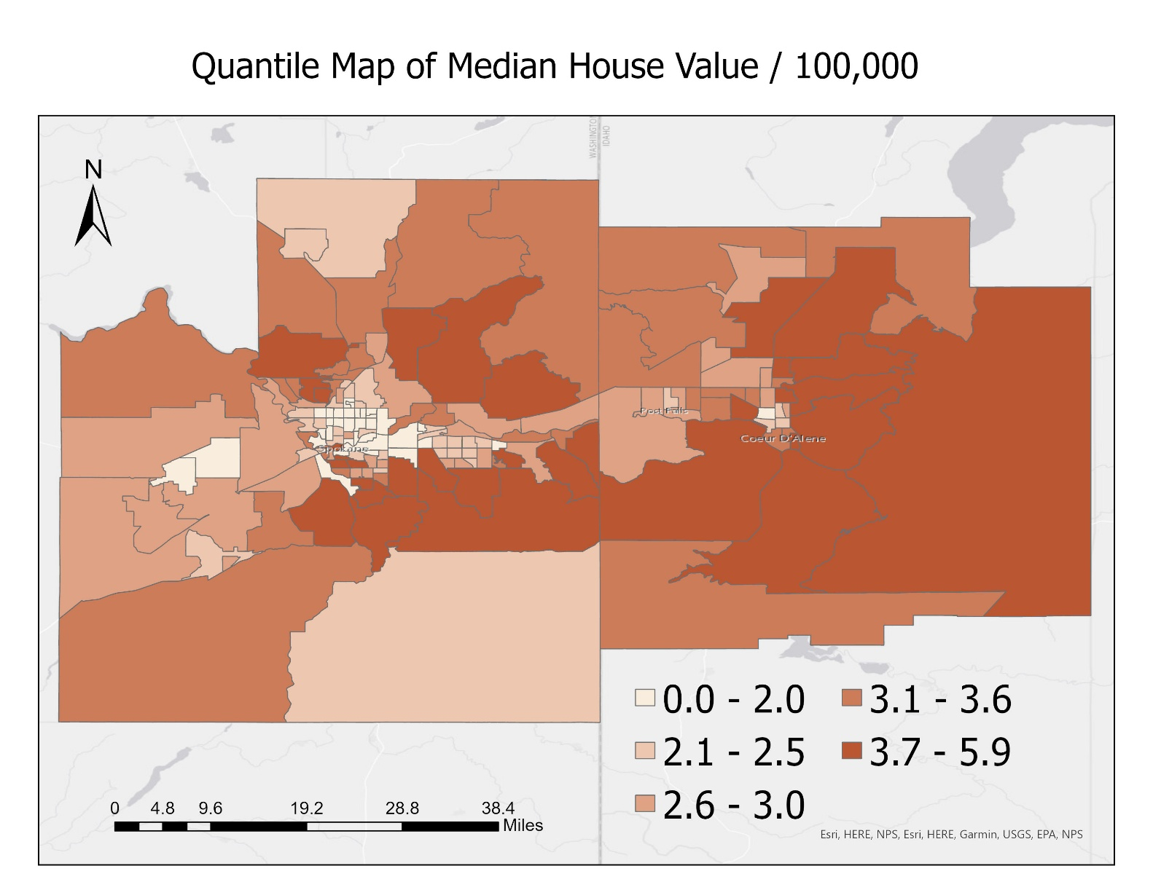
House value

Slide 10
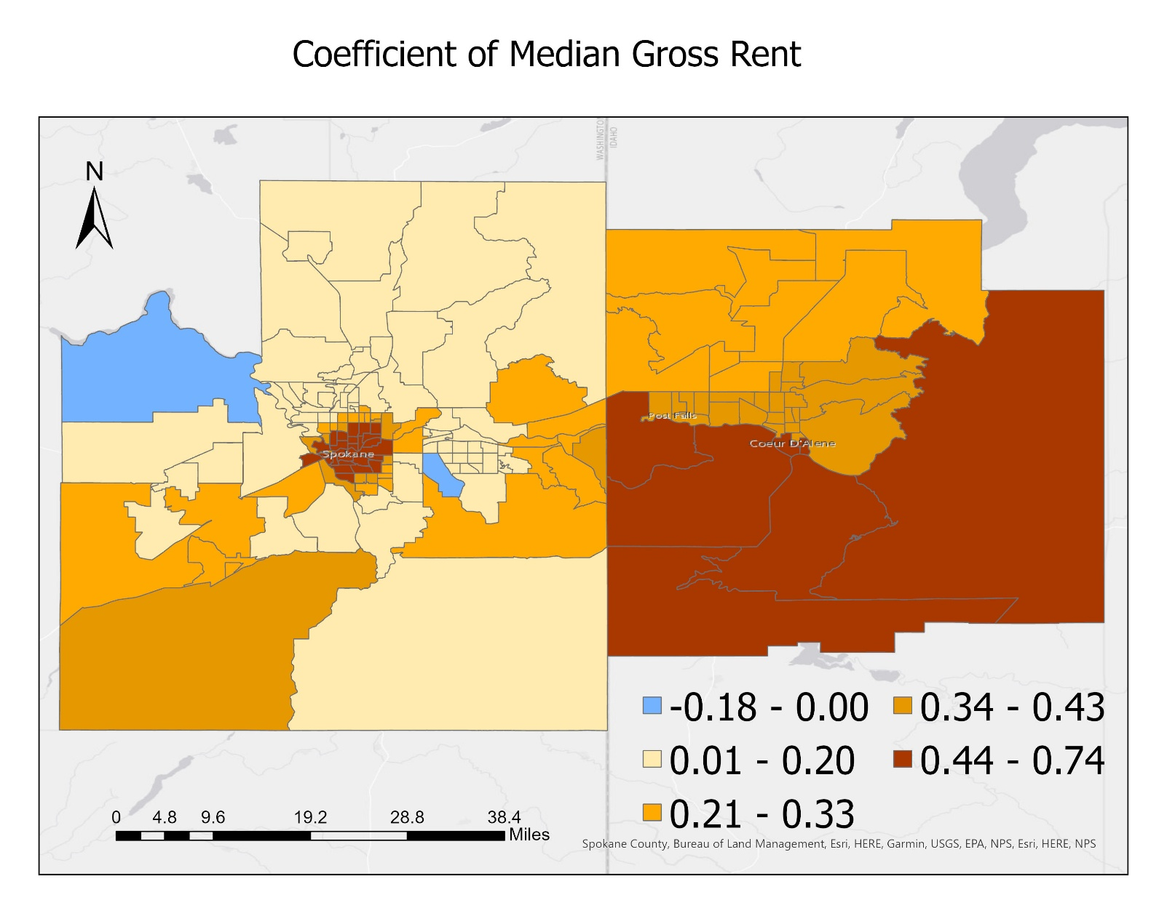
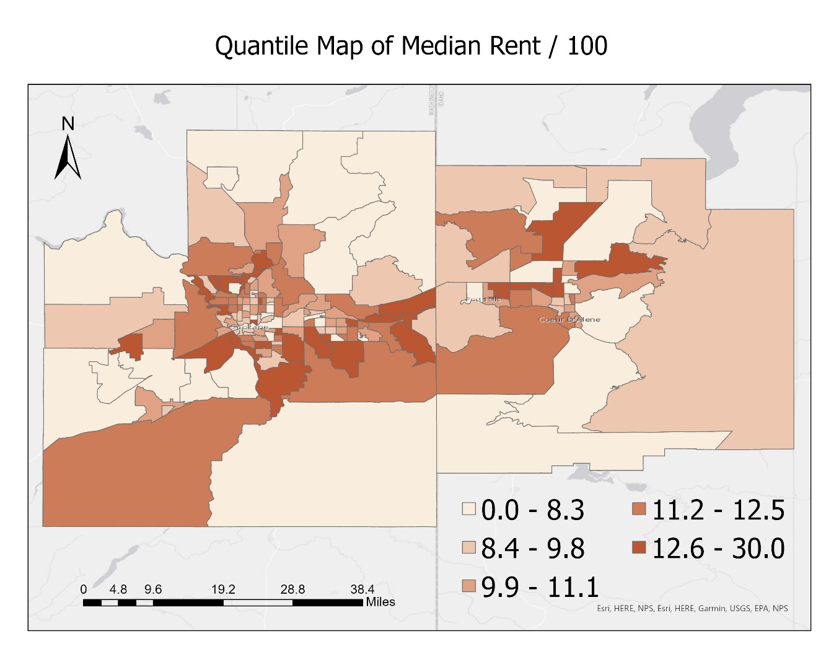
rent

Slide 11
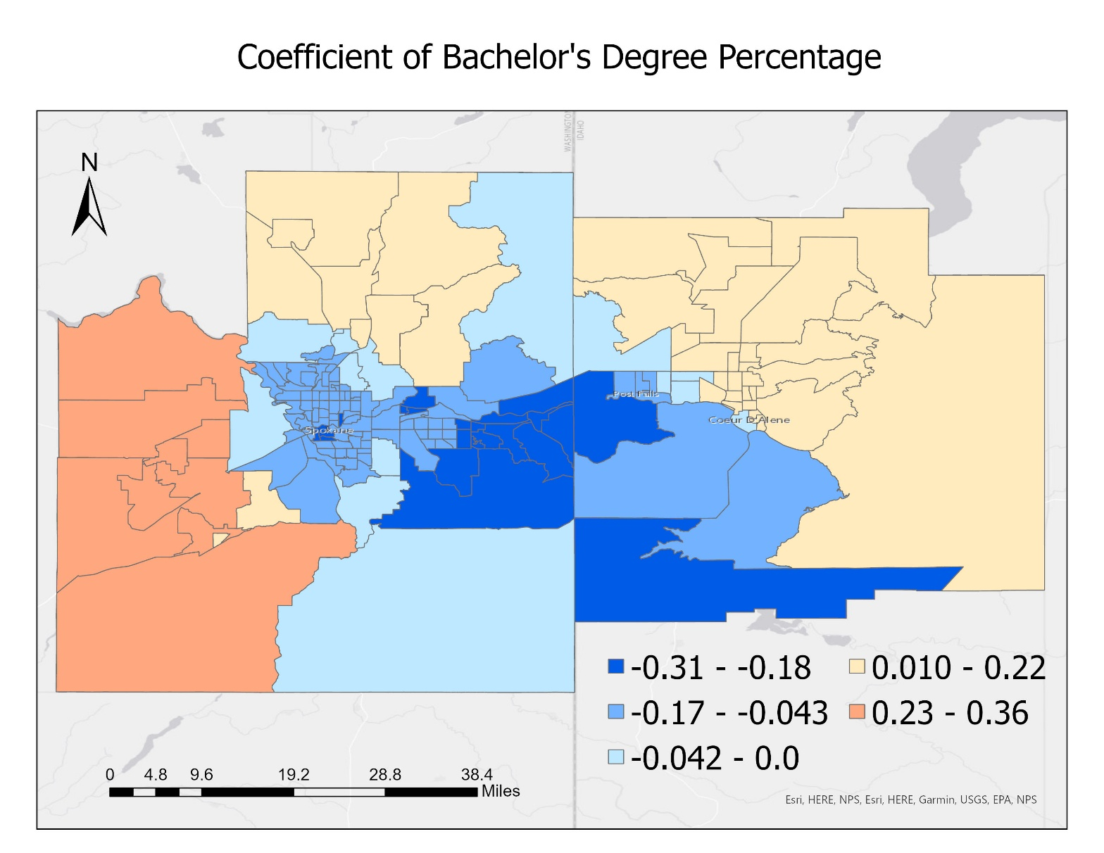
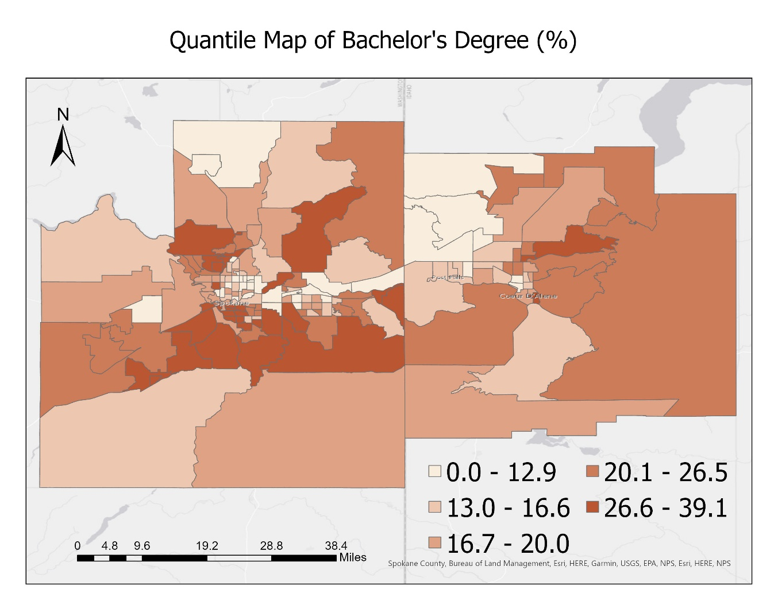

Slide 12
Results
Take away
Limitations and Future improvement
Natural amenities, family bonds…
R squares
Cause-effect impact
Missing values – filled with mean

Slide 13
Add more Geography into Data Science
Time:
Kpi tracking, trend, comparison, pattern
Location
Demographics
Impossible to target each individual customer vs whole sale
Time + Location + Demographics =

