Slide 1
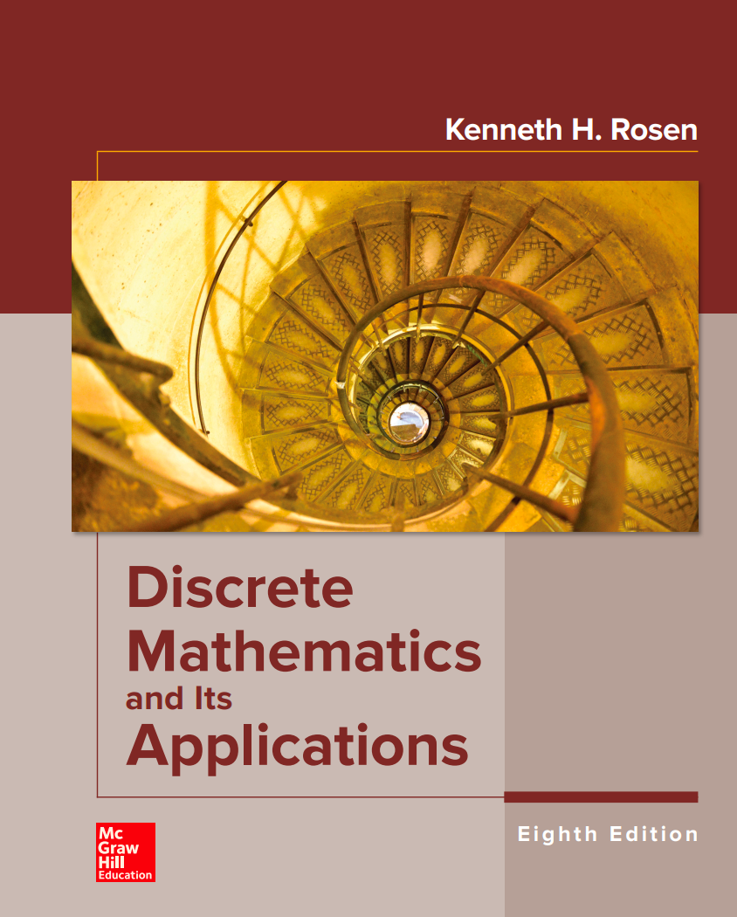
COMP 2711 Discrete Math
Mingxun Zhou
CSE, HKUST

Slide 2
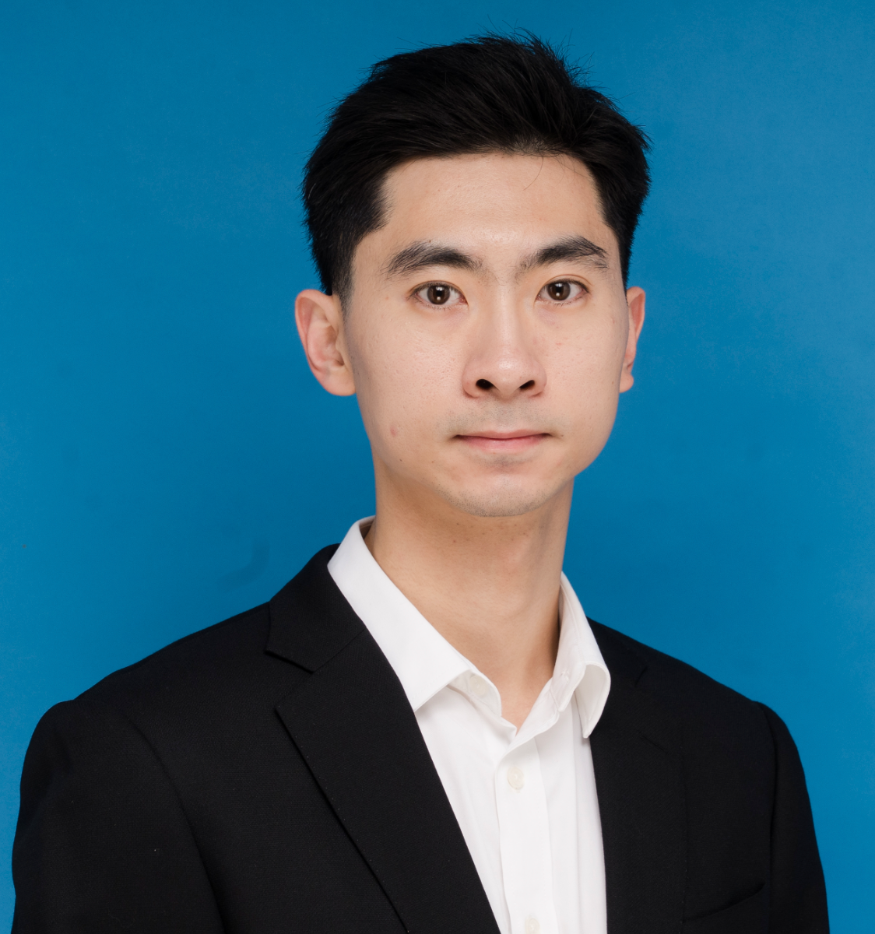
About me
Assistant Professor in HKUST CSE (since 2026)
PhD at Carnegie Mellon University (2025)
Undergrad at Peking University (2020)
ICPC / NOI Gold Medalist (Currently: Coach of HKUST ICPC team)

Slide 3


My research (1)
Information Retrieval
Annoying Professor in HKUST
Mingxun

Slide 4
My research (1)
Private Information Retrieval
Through careful algorithm designs
Preprocessing, Algebraic Encodings, Recursion…
???
Annoying Professor in HKUST
Mingxun

Slide 5
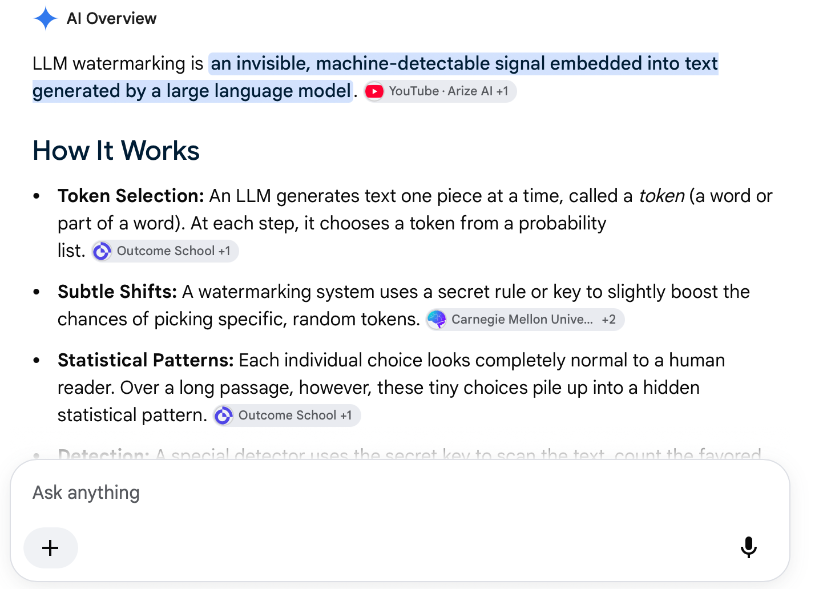
My research (2)
AI Model Watermarking
Add “invisible signal” in AI output
Usage: detect AI-gen content
In fact: GPT, Gemini and Claude all have this ☺

Slide 6
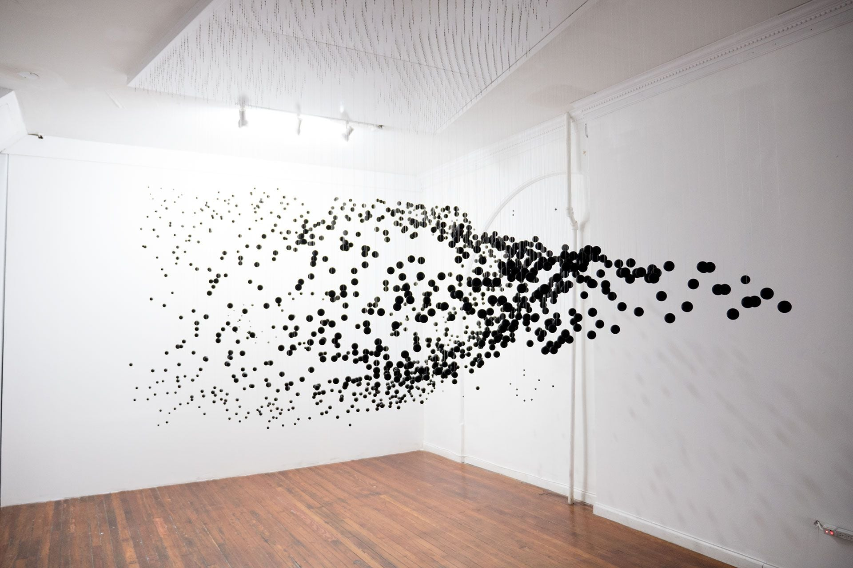
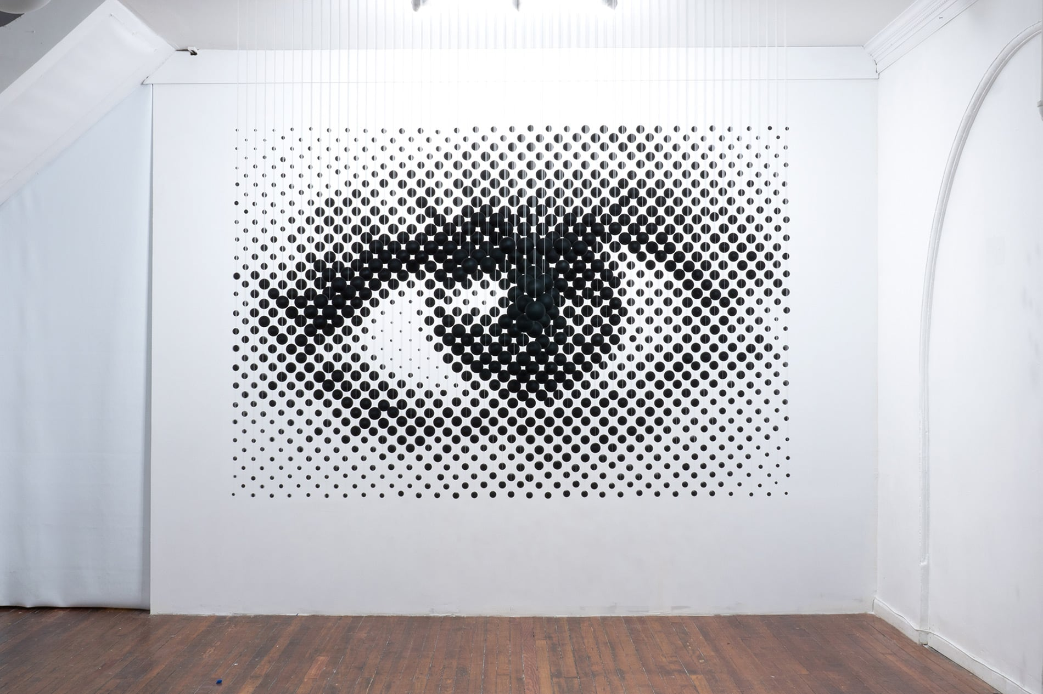
My research (2)
AI Model Watermarking
“invisible signal”?
Ours: “Anamorphic Effect” based on the embedding vectors
(歪像视觉效果)
Cr. Michael Murphy
Ordinary Direction…
Only at 1 special angle…

Slide 7
About me
Research Interest:
Data security / Privacy
Cryptography, Algorithms
AI Governance
Email: mingxunz@ust.hk
Webpage: https://wuwuz.github.io/
I speak Mandarin, Cantonese and English

Slide 8
Why Discrete Math?
One of four fundamental math classes for CS major
Discrete Math
Calculus
Linear Algebra
Probability and Statistics

Slide 9
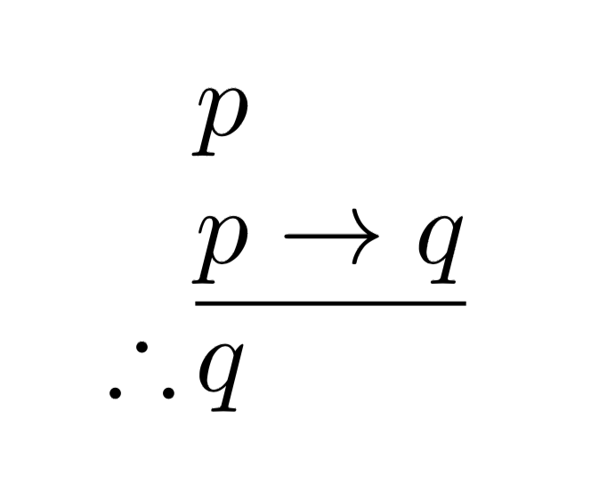
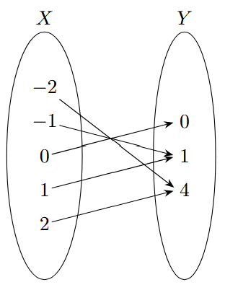
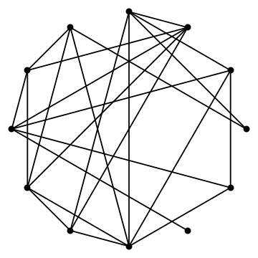
What you are going to learn (1)
Basic Logics and Proofs
The grammar of math
Sets , Functions, Graphs
The most fundamental objects in math

Slide 10

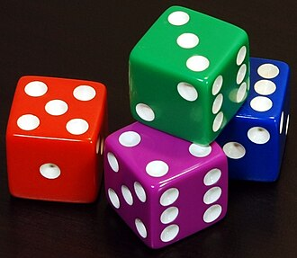
What you are going to learn (2)
Counting
Human’s first instincts of math
Basic Probability
Your first step to understand “randomness”

Slide 11
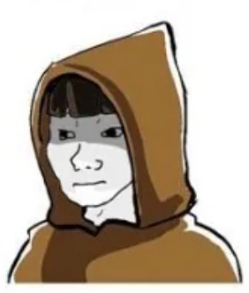

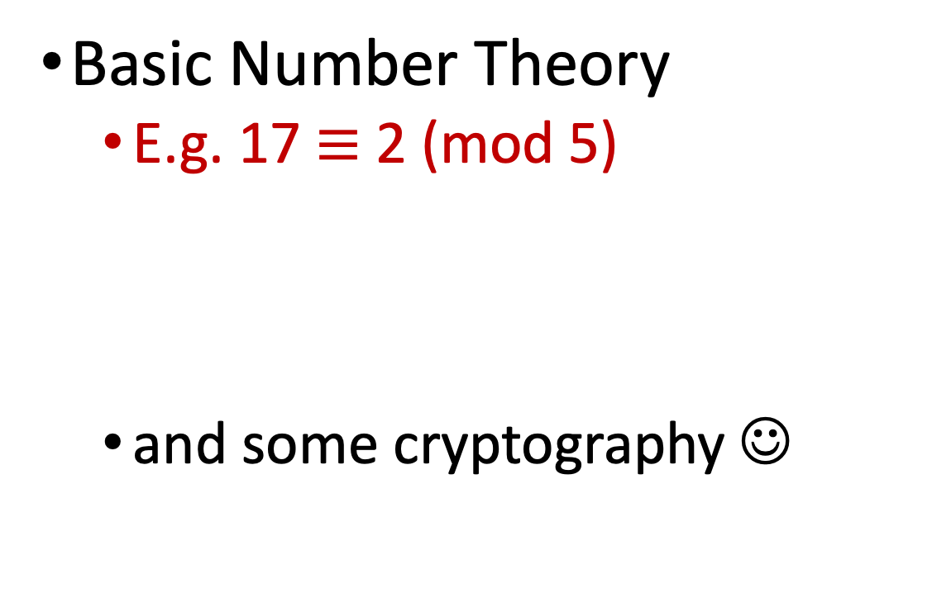
What you are going to learn (3)
Basic Number Theory
E.g. 17 $≡$ 2 (mod 5)
and some cryptography ☺
”Number theory is hard”
”Yes, it’s really hard”

Slide 12
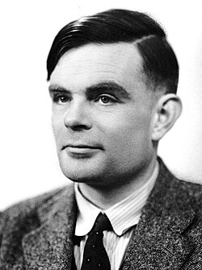
What you are going to learn (4)
Basic Algorithms
“What can a computer do?”
“At what cost?”

Slide 13
About the Class

Slide 14
Everything starts here
Canvas
https://canvas.ust.hk/courses/71954
Web page for this session:
https://wuwuz.github.io/COMP2711/ (our materials will be posted here)

Slide 15
People
Multi-Session Class (shared topics / assignments / exams)
Instructors
Prof. Dimitrios Papadias <dimitris@ust.hk> (Core Coordinator)
Prof. Lionel Parreaux <parreaux@ust.hk>
Prof. Mingxun Zhou <mingxunz@ust.hk>
Leading Instructor Assistant (IA)
HAGHIGHI Arman armanh@ust.hk
TAs: (found them in Canvas ☺)

Slide 16
Time & Location
Main Lectures
Time: Tuesday Thursday 01:30PM - 02:50PM
Location:
Lecture Theatre B (01 Sep 2026 - 29 Sep 2026)
LG4101 (06 Oct 2026 - 26 Nov 2026)
---> remember this! Location change in the middle
Tutorial / Q&A sessions (starting week 2)
Go to whatever session that suits you

Slide 17
Communication
Daily
Q&A sessions
Canvas - Announcement
Canvas – Discussion
Telegram group (links on canvas)
Urgent
Email title with [COMP2711]
Example: “[COMP2711] Can’t do the midterm – Health Conditions”

Slide 18
Grading
Attending classes
Strongly recommended
Recordings not guaranteed …
Homework (20%)
4 units, each with 10-14 days window (tentative)
View / Submit: Canvas, 1 page of pdf submission (handwritten or typeset)
AI / Collaboration Policy: declarative usage (warning: you will fail in the exams if you never practice)
Late Submission: 1 hour late = 1 point deduction

Slide 19
Grading
Mid-term (35%) Final Exam (45%)
In-person, so no AI ☺
One page of handwritten cheat sheet is allowed

Slide 20
Grading
Grade Distribution?
Percentage of A+/A?
Number of Fails?
https://registry.hkust.edu.hk/resource-library/grading-courses

Slide 21
Materials
Course notes / slides
Textbook
Discrete Mathematics and Its Applications (Physical Textbook) Rosen
Others
A Course in Discrete Structures by Pass and Tseng
(Chinese Textbook) 离散数学与结构 by 邓小铁 王畅
You can find them in our homepage https://wuwuz.github.io/COMP2711/

Slide 22
Q&A?

Slide 23
Motivating Problems

Slide 24

Three boxes and one rabbit
A
B
c
“It’s in box B.”
“It’s not in box B”
“It’s not in box A”
Only one description is correct. Where’s the rabbit?

Slide 25
Three boxes and one rabbit
“It’s in box B.”
“It’s not in box B”
“It’s not in box A”
Can’t be B, otherwise 1st and 3rd are right.

Slide 26
Three boxes and one rabbit
“It’s in box B.”
“It’s not in box B”
“It’s not in box A”
Can’t be B, otherwise 1st and 3rd are both right.
Can’t be C, otherwise 2nd and 3rd are both right.

Slide 27
Three boxes and one rabbit
“It’s in box B.”
“It’s not in box B”
“It’s not in box A”
Can’t be B, otherwise 1st and 3rd are both right.
Can’t be C, otherwise 2nd and 3rd are both right.
In A – only 2nd is right.
In the class, you will see how we can use formal logic to solve this

Slide 28
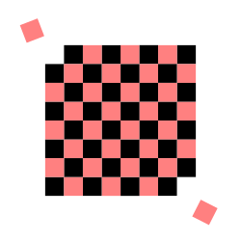
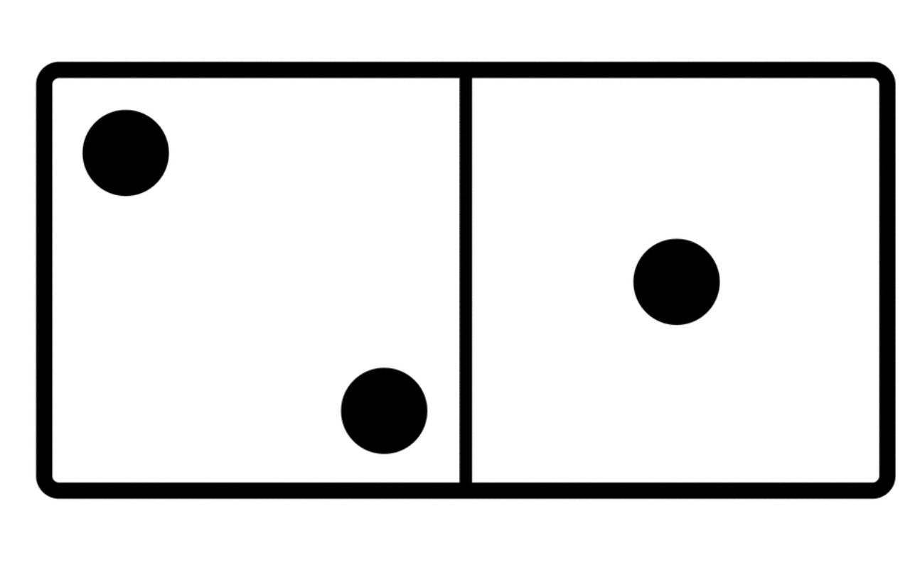
Chessboard problem
Suppose a 8x8 chessboard has two diagonally opposite corners removed, leaving 62 squares.
Can you cover the remaining board with 1x2 (or 2x1) dominos?

Slide 29
Chessboard problem
No – because each domino covers exactly two opposite-color grid.
The remaining 62 squares has 30 light-color grids and 32 black grids.
Never balance!

Slide 30
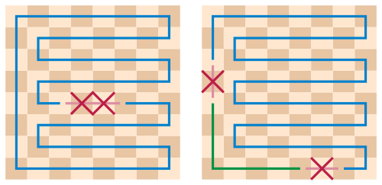
Chessboard problem (continue)
What if we remove two opposite color grids? Can we always cover the remaining part?
Yes – It’s called Gomory's theorem and can be proved by simple graph theory ☺
Chessboard can be covered by a Hamilton cycle.
Removing any two opposite color grids partitions the cycle into one or two “paths”.
Each path can be perfectly cover.

Slide 31
Birthday Paradox
What’s the chance that the tallest student in this class share the same birthday as mine?
~1/365

Slide 32
Birthday Paradox
What’s the chance that the there is at least one student here that share the same birthday as mine? (assuming 150 students)
1-(1-1/365)^150
Around 0.33
My Birthday
May 20

Slide 33
Birthday Paradox
What’s the chance that the there is any two students here share the same birthday? (assuming 150 students)
>99% ☺ Why?
Because we have around 150*149 / 2 = 11175 different pairs, which is >> 365 ☺.

