Slide 1

S/4HANA Machine Learning Workshop Bangalore, Shanghai, Walldorf Q3/2018
S/4HANA Architecture and Enablement, Palo Alto

Slide 2
A Classification of Some ML Algorithms
Machine Learning
Supervised Learning
Unsupervised
Learning
Regression
Cluster Analysis
Dimensionality Reduction
Classification
SVM
Decision Trees
Linear Regression
Hierarchical Clustering
PCA
t-SNE
K-Means
KNN
Logistic Regression

Slide 3
Dimensionality Reduction – Principle Component Analysis (PCA)
PCA is a technique for dimensionality reduction
Apply linear transformations to project data to a lower dimensional subspace without “losing too much information”
PCA returns the directions (principal components) that maximize the variance of the data
Approach:
Standardize the data (all features should have a mean (μ) of zero and standard deviation (σ) of 1)
Calculate eigenvectors and eigenvalues from covariance matrix, correlation matrix, or singular value decomposition (SVD)
Sort the eigenvectors according to their eigenvalues in descending order
Create a projection matrix W by selecting the the first k eigenvectors (k <= d)
Use W to transform the original dataset X to a k dimensional subspace

Slide 4
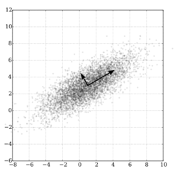
PCA – Intuition
Use an orthogonal transformation to convert a dataset of possibly correlated features into a set of linearly uncorrelated features, so-called principle components.
Number of principle components: Less or equal to the number of features in the original dataset
The transformation ensures that the first principle component has the largest variance
Each succeeding component in turn has the highest variability under the condition that it is orthogonal to the preceding components
The resulting vectors constitute an uncorrelated orthogonal basis set

Slide 5
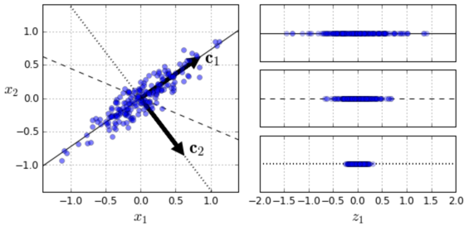
PCA – Intuition

Slide 6
PCA – Via Singular Value Decomposition
X_centered = X – X.mean(axis=0)
U, s, V = np.linalg.svd(X_centered)
# The following are the principle components:
c1 = V.T[:, 0]
c2 = V.T[:, 1]
# Project the data into a plane based on the first 2 components:
B = V.T[:, :2]
Xin2D = X_centered.dot(B)

Slide 7
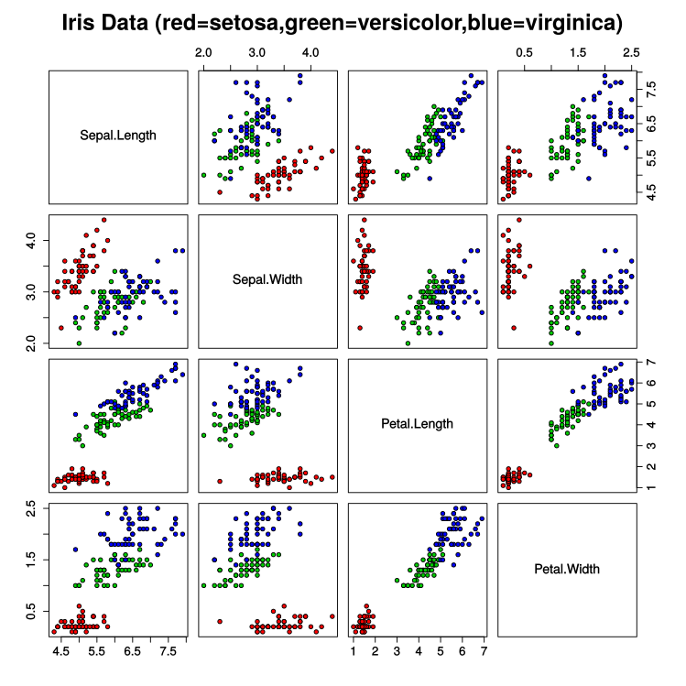
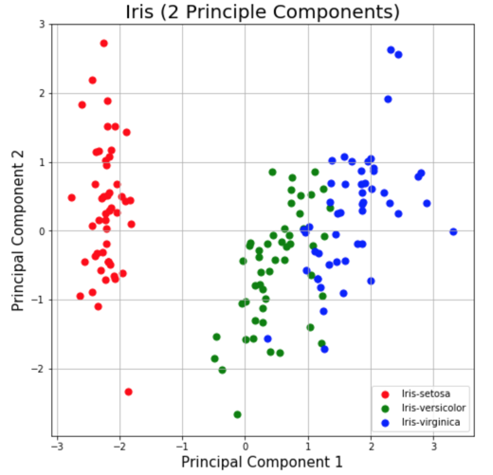
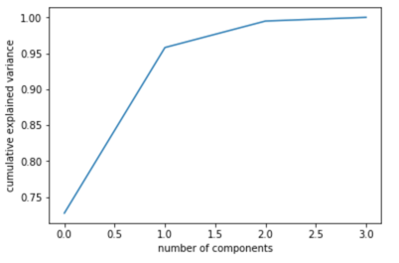
Iris Dataset (Dim. Reduction for Visualization)

Slide 8
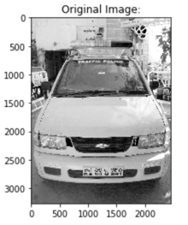
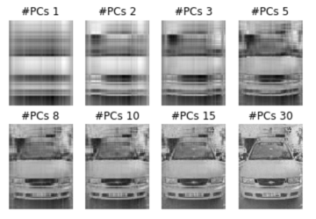
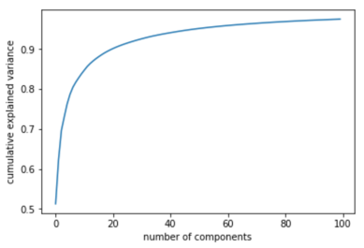
Image Compression

