Slide 1
Data Science Pipeline
Satish Verma

Slide 2
Machine Learning
Tasks:
Classification
Regression
Clustering
Data
Knowledge
1982 book Megatrends, John Naisbitt wrote “We are drowning in information but starved for knowledge.”

Slide 3
ML PIPELINE
Iterative
Model Training
Final Model
Data
Preprocessing
Cleaning
Scaling
Normalization
Dimensionality Reduction
Feature Engineering
Model Eval
Knowledge

Slide 4
ML PIPELINE
Iterative
Model Training
Final Model
Data
Preprocessing
Cleaning
Scaling
Normalization
Dimensionality Reduction
Feature Engineering
Model Eval
Code step-by-step or use SCIKIT PIPELINE to Automate

Slide 5
ML PIPELINE
Iterative
Fit(X,Y)
Build 100s of Models for different setting, dataset
GridSearch, CrossValidation
100s of models
Compute Intensive
Model Training
Final Model
Data
Preprocessing
Cleaning
Scaling
Normalization
Dimensionality Reduction
Feature Engineering
Model Eval
Code step-by-step or use SCIKIT PIPELINE to Automate

Slide 6
Build 100s of Models
Execute Pipeline
Model 1
Model 625
SELECT BEST MODEL
Final Knowledge Model

Slide 7
Scikit Estimator Base Class http://www.datarobot.com/blog/classification-with-scikit-learn/

Slide 8
Scikit
ESTIMATOR
Data Transformers
Machine Learning (Classifier, Regressor, Clustering)
Key Methods:
fit , fit_transform, transform
Preprocessing (Scaling, Normalization)
PCA (Dimensional Reduction)
Key Methods:
fit(X,Y), predict(Y)
Class specific methods and parameters
DecisionTreeClassifier, DecisionTreeRegressor, MultinomialNB

Slide 9
Scikit Pipeline
100s of possible set-up, transformation, model building options in 1 line of code
Data
Transformer 1
Transformer 2
Transformer N
MODEL BUILDING

Slide 10
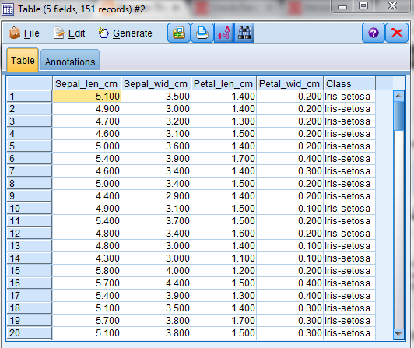
IRIS Data

Slide 11
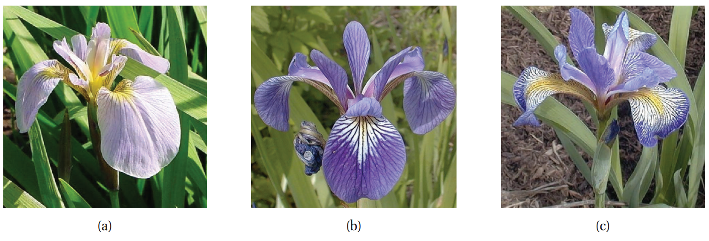
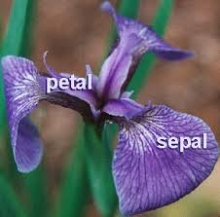
Setosa, Virginica, Versicolor

Slide 12
Goal: Classification
Input [Petal Length, Sepal Length, Sepal Width, Petal Width]
Question: Which Flower is this ???
Setosa , Versicolor or Virginica ???
How Can we do this ????

Slide 13
Solution
Take some example
Key-Value pairs :
[Petal Length, Sepal Length, Sepal Width, Petal Width] : FlowerType
take 50 example for each of the 3 flower types and learn the pattern.
Call this learnt pattern the Machine Learning Model.
Use the model to predict Flower type, given the Input Feature Vector
[Petal Length, Sepal Length, Sepal Width, Petal Width]

Slide 14
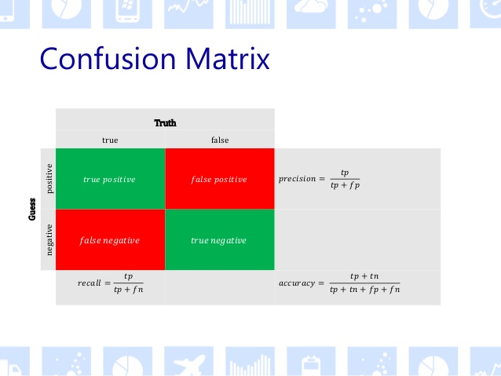
ML Model Evaluation

Slide 15
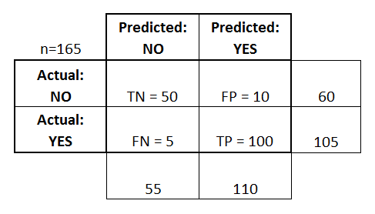
Precision/Recall/F1-Score/Accuracy
Precision = 100/110 ,TP/(TP+FP)
Recall=100/105, TP/(TP+FN)

Slide 16
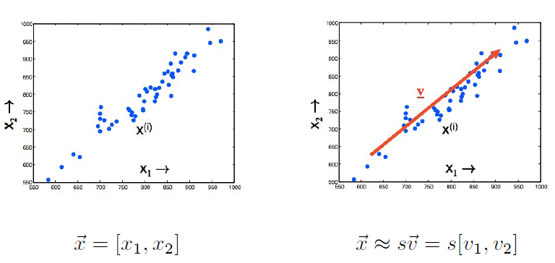
Dimensionality Reduction 1

Slide 17
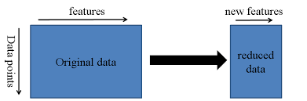
Dimensionality Reduction 2

Slide 18
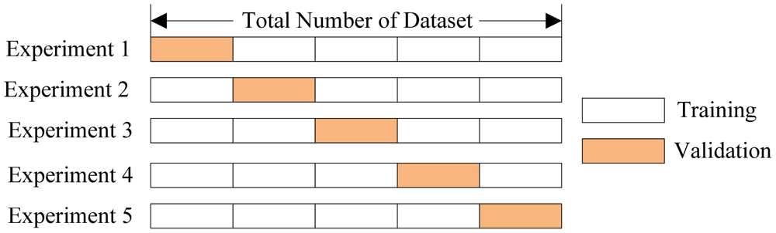
CrossValidation: Generate More DataSets

