Slide 1
Leader Election
Advanced Operating Systems (CSC 8320)
Fall 2011
Shagun Kariwala

Slide 2
Outline
Introduction
Design Topologies and algorithms
Recent Studies
Future work

Slide 3
Introduction
What is Leader Election?
In distributed computing, leader election is the process of designating a single process as the organizer, coordinator, initiator or sequencer of some task distributed among several computers (nodes). ---- (Chow et al, 1997)
Leader election is the process of determining a process as the manager of some task distributed among several processes (computers). ---- (Garcia, Molina 1982)

Slide 4
Why Leader Election?
Centralized controller simplifies process synchronization.
However, it is a single point of failure and can limit service.
Solution is to choose a new controller(leader), upon failure of the existing controller.
Many algorithms for leader election.

Slide 5
When Leader Election?
During system initiation or when an existing leader fails.
A process that gets no response from the leader for a predefined time-out interval suspects a failure and initiates leader election.

Slide 6
Two election criteria
Extrema finding: It is based on global priority. Every process is characterized by fixed evaluation value.
Preference-based: Processes in the group can vote for a leader based on a personal preference (e.g. locality, reliability estimation, etc).

Slide 7
Leader Election VS Mutual Exclusion
Leader Election
Mutual Exclusion
Process may yield to others and execute normally as long as leader is selected.
Concerned with fast and successful termination of election process.
Result of leader election must be known to other processes.
Process competes until it succeeds.
Must ensure that no process is starved.
Does not care which process is running in critical section.

Slide 8
Design Topologies
Complete Topology
Logical Ring Topology
Tree Topology

Slide 9
Complete Topology
Each process can reach any other process in the same group in one message hop.
Assumptions:
All process ids are unique and know to every process.
Communication network is reliable and only the communicating processes may fail.
Process takes a known finite amount of time to handle a message.
Bully algorithm is based on complete topology network.

Slide 10
Bully algorithm
Introduced by Garcia-Molina.
An extrema-finding algorithm.
Process with the highest priority is elected as a leader, hence named Bully algorithm.
Algorithm:
Process P starts a leader election if it suspects the failure of existing leader.
P sends inquiry message to nodes (processes) with higher priority.
If any response then, P gives up the election and waits for higher priority node to elect itself leader.
If no response then P becomes a leader.

Slide 11
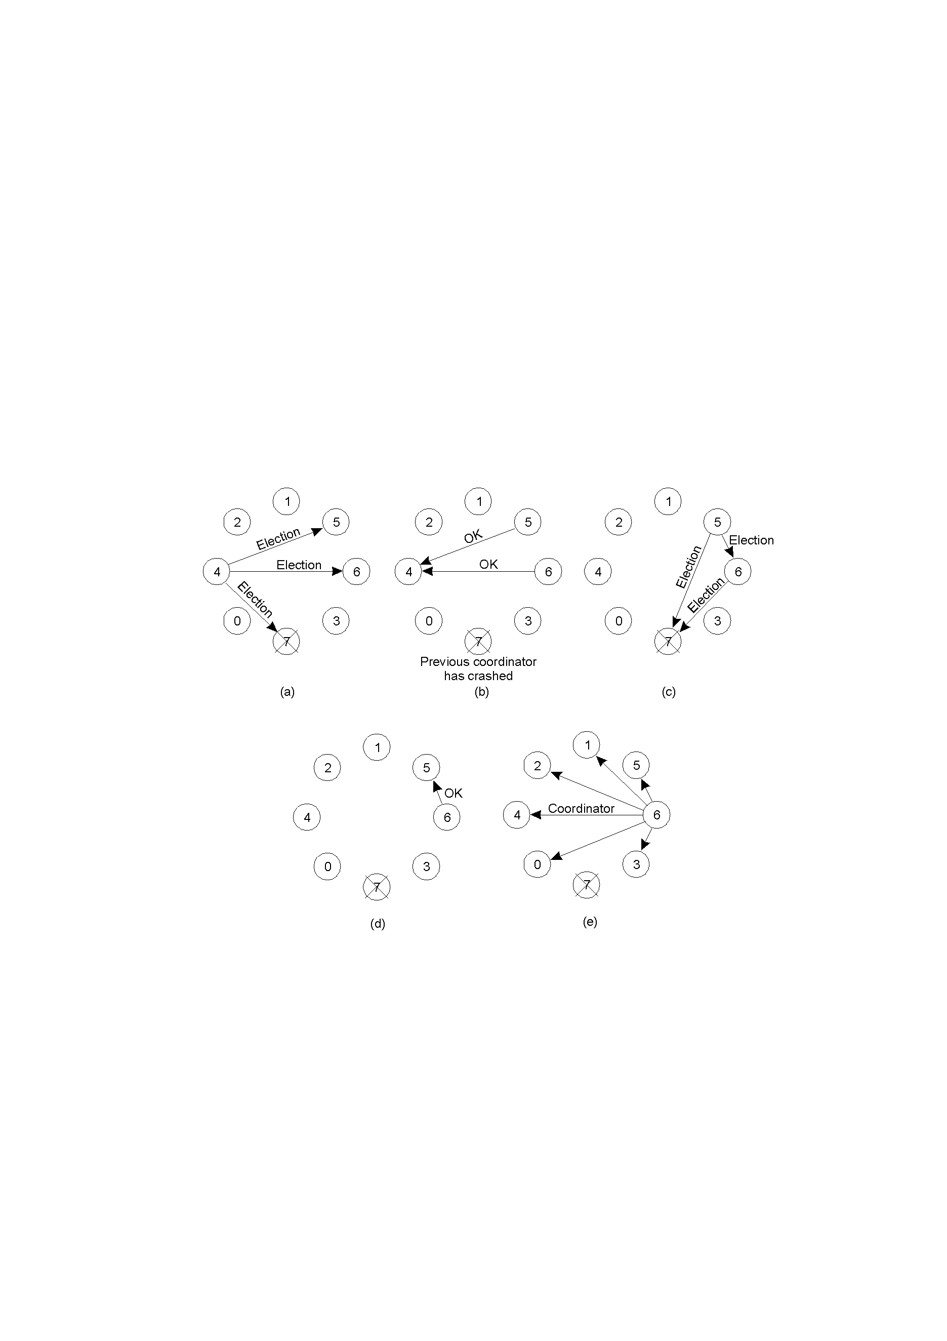
Bully algorithm (cont…)
Process 4 detected leader failure and initiated an election.
Processes 5 and 6 respond telling 4 to stop.
Now 5 and 6 each hold an election

Slide 12
Bully algorithm (cont…)
d. Process 6 responds to the call from 5 and tells it to stop.
e. Process 6 wins and tells everyone.

Slide 13
Logical Ring Topology
Simplest and easy to construct.
Unique property: message initiated by node will return to the node.
Eliminates the need of acknowledgement.
Ring Algorithm:
On detection of leader failure, process starts election by circulating a message with priorities appended to the message by each node along the ring.
Message comes back to initiator, it chooses the highest priority and broadcast the new leader identity to all nodes.

Slide 14
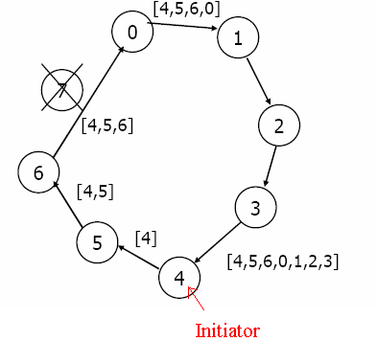
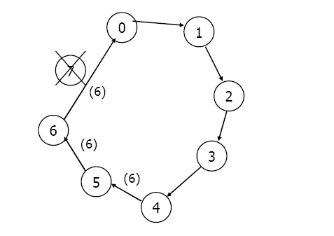
Ring Algorithm
(a) Process 4 sends the election message to it successor with its ID.
(b) Each process adds its own ID and then forwards the message to the next process.
(c) Message is sent back to the initiator which is 4.
(b) Initiator announces the winner by sending another message around the ring.

Slide 15
Chang and Robert Ring Algorithm
Chang and Robert developed improved ring election algorithm.
Improvements:
Does not collect all ids into a single massage. To find the maximal id, each node forwards the larger of its id and the received value to the next node.
Already involved node doesn’t forward the message unless the message value is higher than the node’s id.
Best and worst cases are O(N) and O(N²).

Slide 16
Tree Topology
Construction and management of a logical ring is easier if underlying network supports broadcast facility.
In irregular network topology, broadcast is simulated by multiple point-to-point unicasts.
Logical topology in an irregular network.
Tree is used as a topological structure.
Minimum spanning tree is used for leader election in tree topology.

Slide 17
Gallager, Humbelt and Spira Algo.
Gallager, Humbelt and Spira developed an algorithm for distributed minimum spanning tree
Based on searching and combining.
The fragments are merge level by level in a bottom-up fashion until a final fragment, MST results.
Leader is the last node that merges and yields to the final MST.

Slide 18
Recent Studies
An algorithm for selecting the cluster leader in a partially connected sensor network.
Laura Vanzago, Luciano Lavagno(2008)
Conventional algorithms in distributed systems present particular methods to resolve any leader crash. A new method based on electing a leader and assistant was introduced. If the leader crashes, the assistant takes care of the leader's responsibilities.
Zargarnataj, 2007
Power-based leader selection in ad-hoc wireless networks. Using a link loss matrix, an approach is proposed for selection of a network leader that takes into consideration link losses and transmitter powers.
Mehul J . Shah and Paul G . Flikkema (1999)

Slide 19
Recent Studies
Average Execution Time Analysis of a Self-stabilizing Leader Election Algorithm. This paper shows that average execution time for leader election algorithm based on tree graph is O(N²).
Juan Paulo, Jos´e Alberto (2007)
SEFA (Secure Extrema Finding Algorithm) is a round-based hierarchy-building approach which is considered a secure problem. This algorithm designed for Ad-Hoc networks handles frequent topology changes and dynamic nature of mobile networks too.
Vasudevan, Kurose, Towsley (2003)

Slide 20
Future Work
Improvement in time complexity by reducing no. of election messages.
Leader election algorithm for mobile ad hoc networks.
Fast detection of failure of centralized controller.

Slide 21
References
Distributed Operating Systems & Algorithms, Randy Chow and Theodore Johnson, 1997
http://en.wikipedia.org/wiki/Leader_election
http://en.wikipedia.org/wiki/Chang_and_Roberts_algorithm
An algorithm for selecting the cluster leader in a partially connected sensor network, Laura Vanzago (2008)
Power-based leader selection in ad-hoc wireless networks, Mehul Shah and Paul fikkema (1999)
Average Execution Time Analysis of a Self-stabilizing Leader Election Algorithm, Juan and Jos´e Alberto (2007)
New Election Algorithm based on Assistant in Distributed Systems, Zargarnataj, M (2007)
Election Algorithms for Wireless Ad Hoc Networks. In: DARPA Information Survivability Conference and Exposition, Vasudevan, Kurose, Towsley (2003)

