Slide 1
Dial Problem
Machine Learning Course
Spring 2015
Tsinghua University

Slide 2
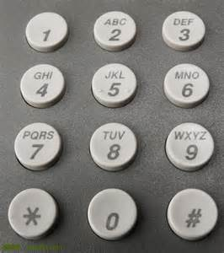
Problem
Description
We have a dial as the figure shows. Suppose we dial a phone number (containing only digits 0-9) in the following way using two fingers.
Initially, we put index figure on 1 and middle finger on 2 (denoted by (1,2)).
If a digit is under either of your finger, it can be dialed.
We can move our hand vertically and horizontally each time, but not rotate. Suppose we are on (4,5) now. We can move to (5,6), (1,2),(7,8) by one movement, and move to (2,3),(8,9) by two movements.
Given a phone number, a string of digits, what’s the minimum number of movements to dial the number?
Use dynamic programming to solve the problem.
Input
The first line is a positive integer m, the number of test cases.
In the following m lines, each line is a string of digits(0-9) to dial. Each line contains less than 10000 characters.
Output
M lines, line i is the minimum number of movements to dial the i-th phone number.
Sample input
3
26986
74562398701
198807021991080120150503
Sample Output
4
12
41

Slide 3
Submission
Before Apr.7
A zip file, containing：
Source code
Read from ./input.in as input
Write output into ./output.out
Readme file
How to compile and run your code

Slide 4
Thank You

