Slide 1
L-BFGS Optimization for Softmax Regression
徐麟
124106010749
2024.11.1

Slide 2
Content
1. Newton Method
2. Quasi-Newton Method
2.1 DFP Method
2.2 BFGS Method
3. L-BFGS Method
4. Softmax Regression
5. Result Analysis

Slide 3
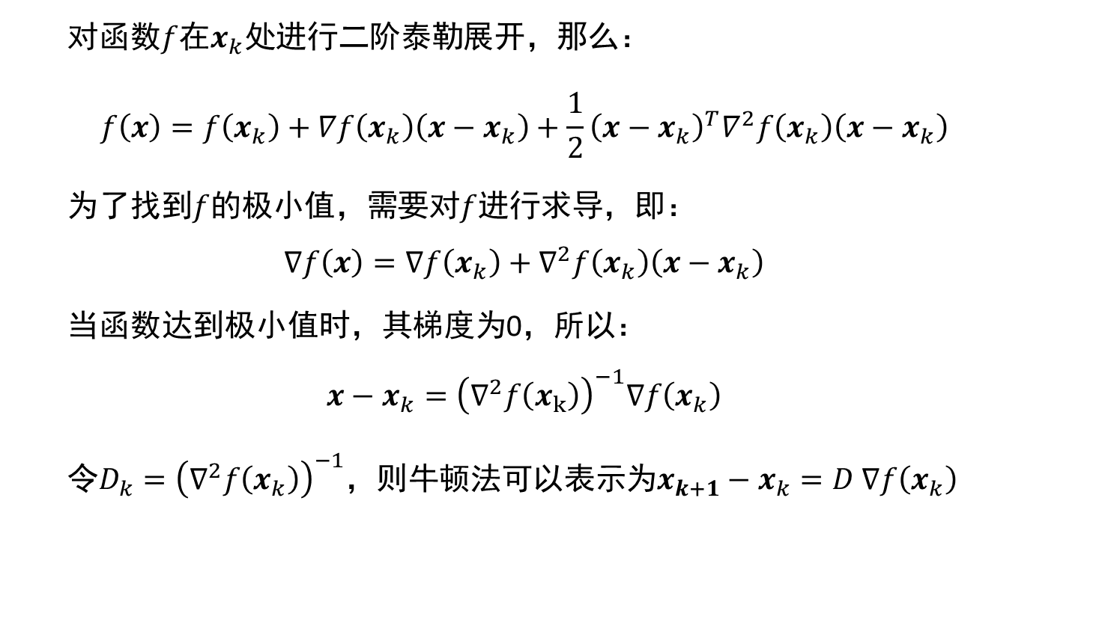
Newton Method
对函数$f$在$x_{k}处$进行二阶泰勒展开，那么：
$$f\left(x\right)=f\left(x_{k}\right)+∇f\left(x_{k}\right)\left(x−x_{k}\right)+\frac{1}{2}{\left(x−x_{k}\right)}^{T}∇^{2}f\left(x_{k}\right)\left(x−x_{k}\right)$$
为了找到$f$的极小值，需要对$f$进行求导，即：
$$∇f\left(x\right)=∇f\left(x_{k}\right)+∇^{2}f\left(x_{k}\right)\left(x−x_{k}\right)$$
当函数达到极小值时，其梯度为0，所以：
$$x−x_{k}={\left(∇^{2}f\left(x_{k}\right)\right)}^{−1}∇f\left(x_{k}\right)$$
令$D_{k}={\left(∇^{2}f\left(x_{k}\right)\right)}^{−1}$，则牛顿法可以表示为$x_{k+1}−x_{k}=D ∇f\left(x_{k}\right)$

Slide 4
Newton Method
牛顿法有以下优点：
利用了函数的二阶导数信息
具有二次收敛性
少量迭代即可达到更高的精度
然而，牛顿法也存在一定的问题：
Hessian矩阵的逆计算困难甚至不可解
矩阵计算需要消耗大量内存
Hessian阵不一定正定，收敛性无法保证

Slide 5
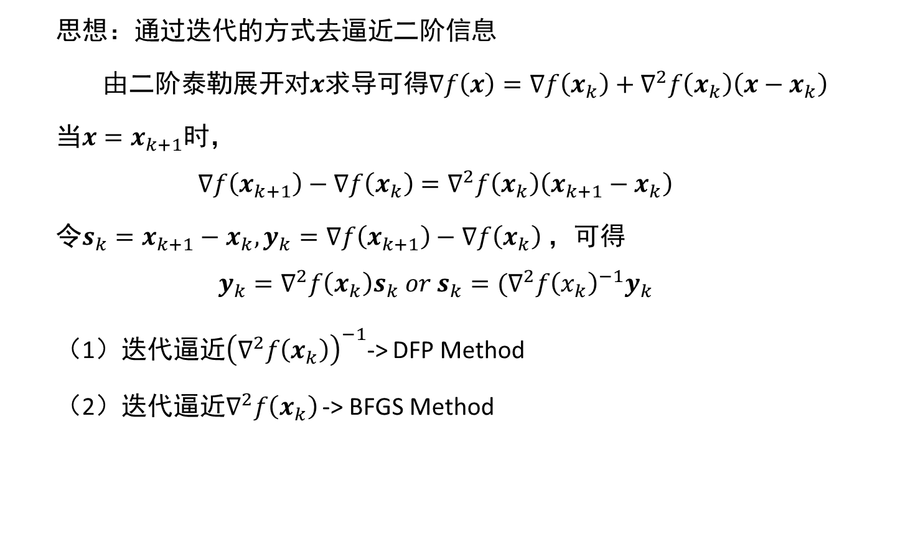
Quasi-Newton Method
思想：通过迭代的方式去逼近二阶信息
由二阶泰勒展开对$x$求导可得$∇f\left(x\right)=∇f\left(x_{k}\right)+∇^{2}f\left(x_{k}\right)\left(x−x_{k}\right)$
当$x=x_{k+1}$时，
$$∇f\left(x_{k+1}\right)−∇f\left(x_{k}\right)=∇^{2}f\left(x_{k}\right)\left(x_{k+1}−x_{k}\right)$$
令$s_{k}=x_{k+1}−x_{k},y_{k}=∇f\left(x_{k+1}\right)−∇f\left(x_{k}\right)$，可得
$$y_{k}=∇^{2}f\left(x_{k}\right)s_{k} or s_{k}=(∇^{2}f{\left(x_{k}\right)}^{−1}y_{k}$$
（1）迭代逼近${\left(∇^{2}f\left(x_{k}\right)\right)}^{−1}$-> DFP Method
（2）迭代逼近$∇^{2}f\left(x_{k}\right)$ -> BFGS Method

Slide 6
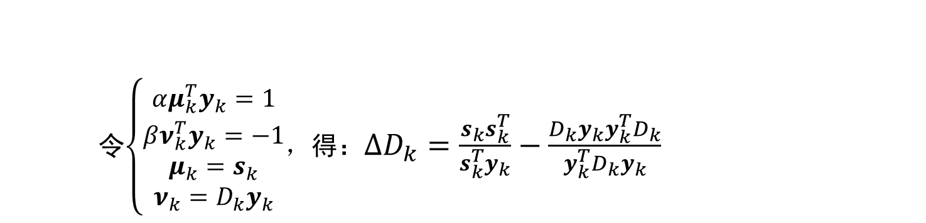
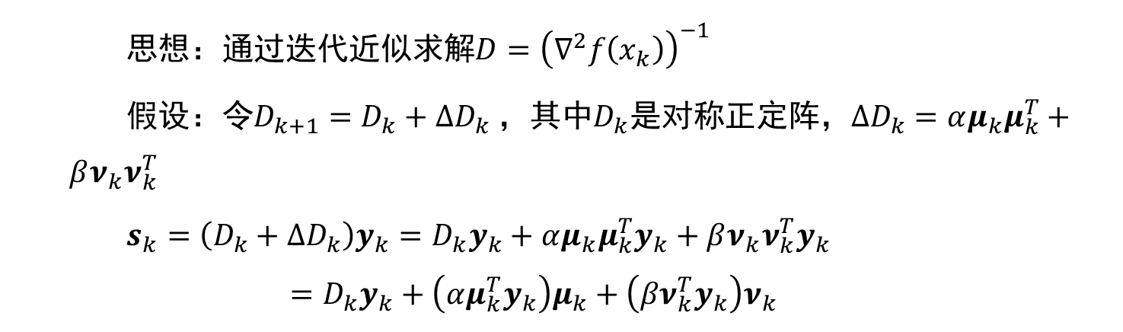
DFP Method
思想：通过迭代近似求解$D={\left(∇^{2}f\left(x_{k}\right)\right)}^{−1}$
假设：令$D_{k+1}=D_{k}+∆D_{k}$，其中$D_{k}$是对称正定阵，$∆D_{k}=αμ_{k}μ_{k}^{T}+βν_{k}ν_{k}^{T}$
$s_{k}=\left(D_{k}+∆D_{k}\right)y_{k}=D_{k}y_{k}+αμ_{k}μ_{k}^{T}y_{k}+βν_{k}ν_{k}^{T}y_{k}$ $$=D_{k}y_{k}+\left(αμ_{k}^{T}y_{k}\right)μ_{k}+\left({βν}_{k}^{T}y_{k}\right)ν_{k}$$
令$\left\{\begin{aligned}αμ_{k}^{T}y_{k}=1 \\ βν_{k}^{T}y_{k}=−1 \\ μ_{k}=s_{k} \\ {ν_{k}=D}_{k}y_{k}\end{aligned}\right.$，得：$∆D_{k}=\frac{s_{k}s_{k}^{T}}{s_{k}^{T}y_{k}}−\frac{D_{k}y_{k}y_{k}^{T}D_{k}}{y_{k}^{T}D_{k}y_{k}}$

Slide 7
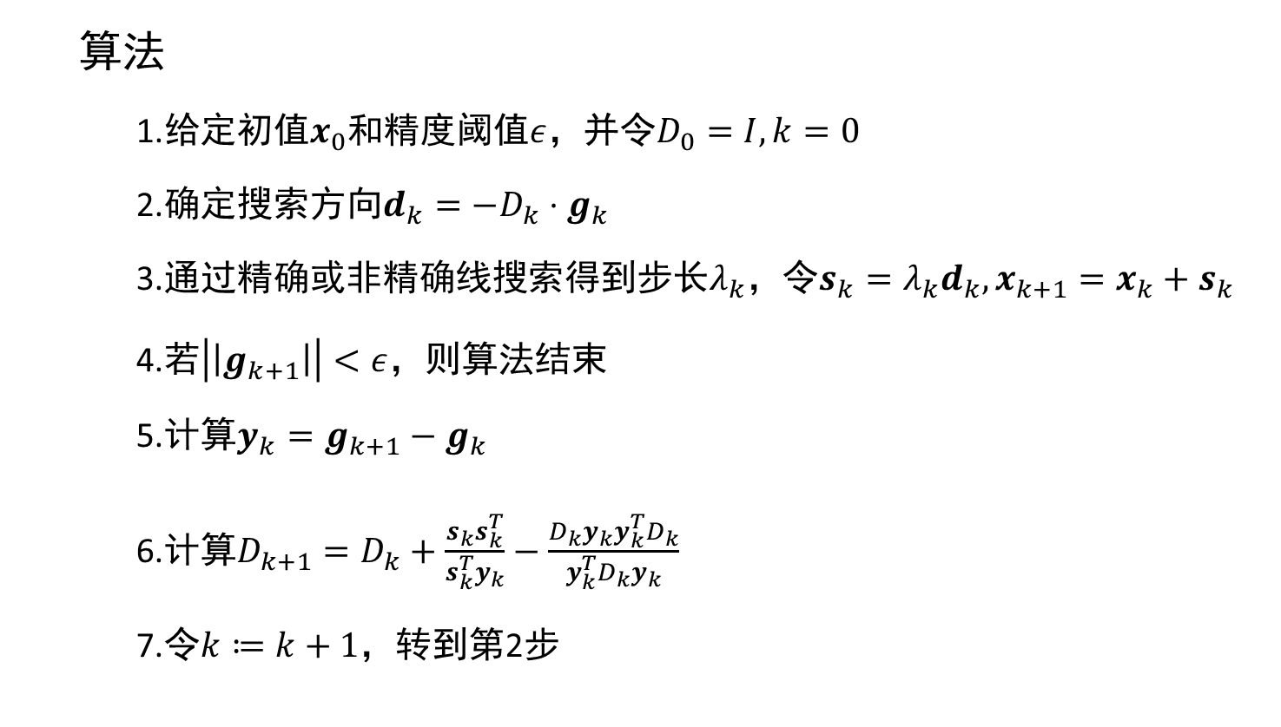
DFP Method
算法
1.给定初值$x_{0}$和精度阈值$ε$，并令$D_{0}=I,k=0$
2.确定搜索方向$d_{k}=−D_{k}⋅g_{k}$
3.通过精确或非精确线搜索得到步长$λ_{k}$，令$s_{k}=λ_{k}d_{k},x_{k+1}=x_{k}+s_{k}$
4.若$\left|\left|g_{k+1}\right|\right|<ε$，则算法结束
5.计算$y_{k}=g_{k+1}−g_{k}$
6.计算$D_{k+1}=D_{k}+\frac{s_{k}s_{k}^{T}}{s_{k}^{T}y_{k}}−\frac{D_{k}y_{k}y_{k}^{T}D_{k}}{y_{k}^{T}D_{k}y_{k}}$
7.令$k≔k+1$，转到第2步

Slide 8
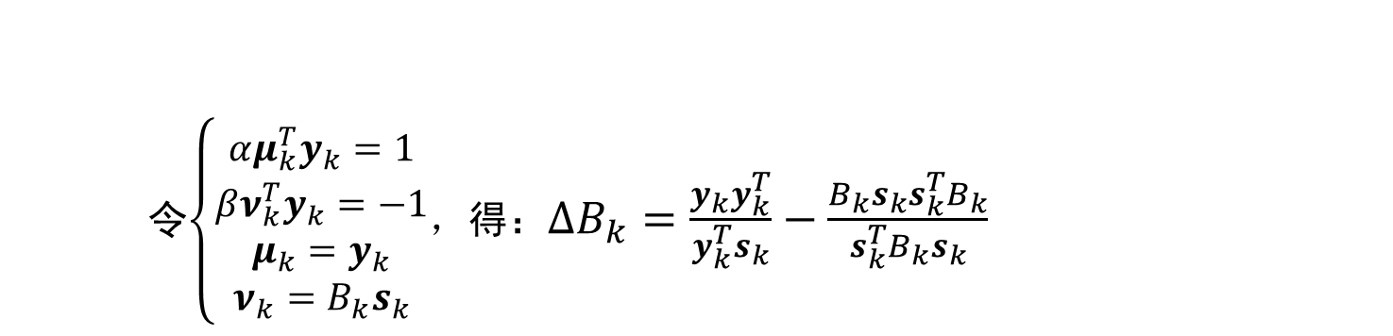
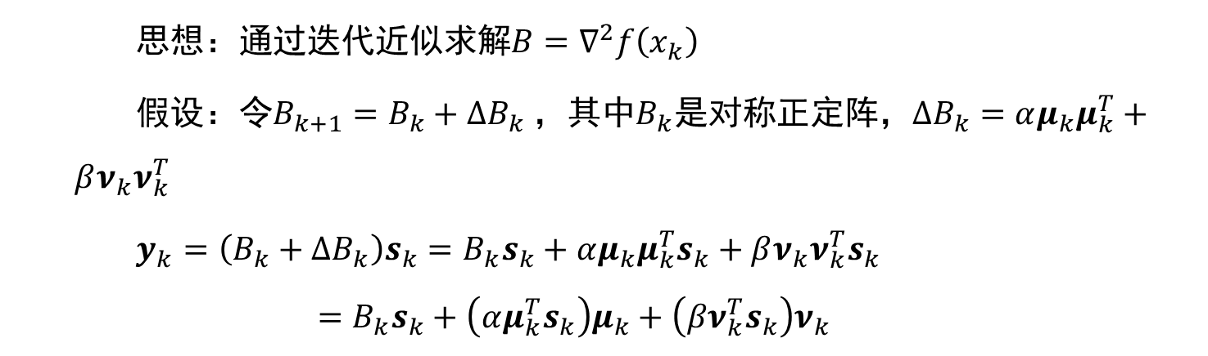
BFGS Method
思想：通过迭代近似求解$B=∇^{2}f\left(x_{k}\right)$
假设：令$B_{k+1}=B_{k}+∆B_{k}$，其中$B_{k}$是对称正定阵，$∆B_{k}=αμ_{k}μ_{k}^{T}+βν_{k}ν_{k}^{T}$
$y_{k}=\left(B_{k}+∆B_{k}\right)s_{k}=B_{k}s_{k}+αμ_{k}μ_{k}^{T}s_{k}+βν_{k}ν_{k}^{T}s_{k}$ $$=B_{k}s_{k}+\left(αμ_{k}^{T}s_{k}\right)μ_{k}+\left({βν}_{k}^{T}s_{k}\right)ν_{k}$$
令$\left\{\begin{aligned}αμ_{k}^{T}y_{k}=1 \\ βν_{k}^{T}y_{k}=−1 \\ μ_{k}=y_{k} \\ {ν_{k}=B}_{k}s_{k}\end{aligned}\right.$，得：$∆B_{k}=\frac{y_{k}y_{k}^{T}}{y_{k}^{T}s_{k}}−\frac{B_{k}s_{k}s_{k}^{T}B_{k}}{s_{k}^{T}B_{k}s_{k}}$

Slide 9
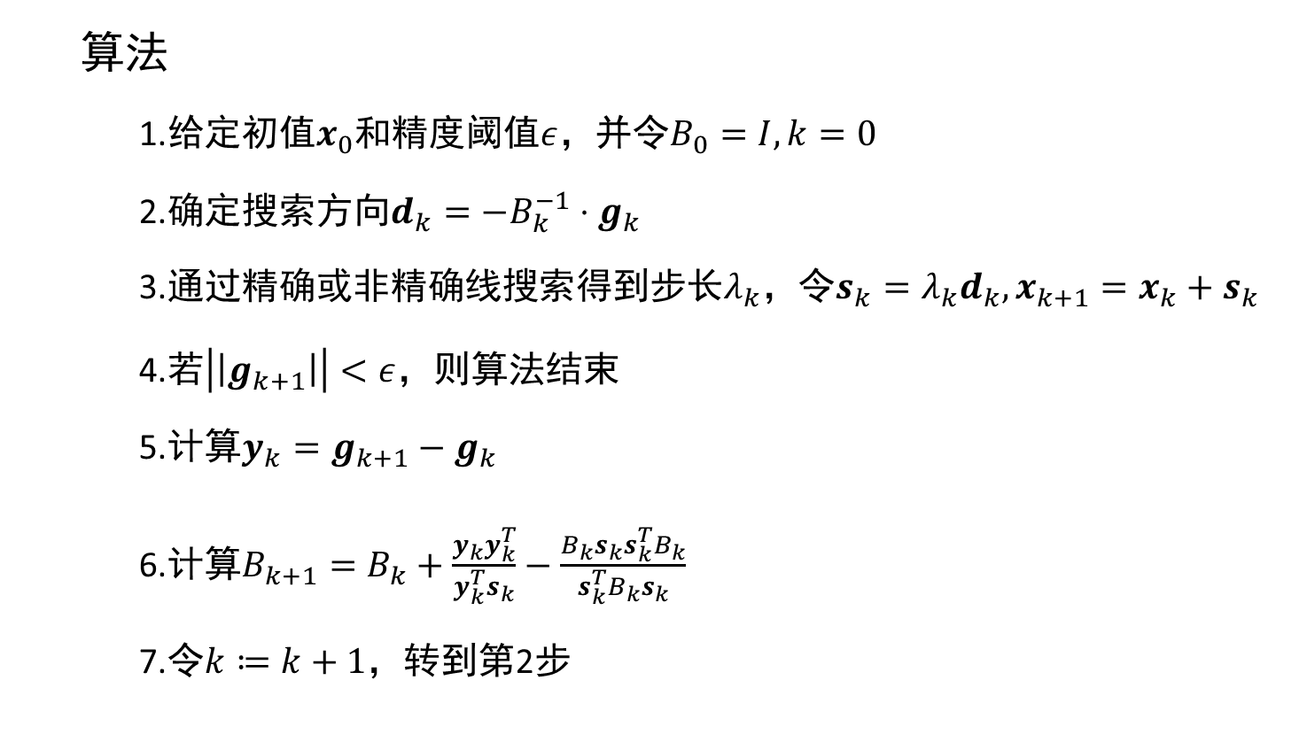
BFGS Method
算法
1.给定初值$x_{0}$和精度阈值$ε$，并令$B_{0}=I,k=0$
2.确定搜索方向$d_{k}=−B_{k}^{−1}⋅g_{k}$
3.通过精确或非精确线搜索得到步长$λ_{k}$，令$s_{k}=λ_{k}d_{k},x_{k+1}=x_{k}+s_{k}$
4.若$\left|\left|g_{k+1}\right|\right|<ε$，则算法结束
5.计算$y_{k}=g_{k+1}−g_{k}$
6.计算$B_{k+1}=B_{k}+\frac{y_{k}y_{k}^{T}}{y_{k}^{T}s_{k}}−\frac{B_{k}s_{k}s_{k}^{T}B_{k}}{s_{k}^{T}B_{k}s_{k}}$
7.令$k≔k+1$，转到第2步

Slide 10
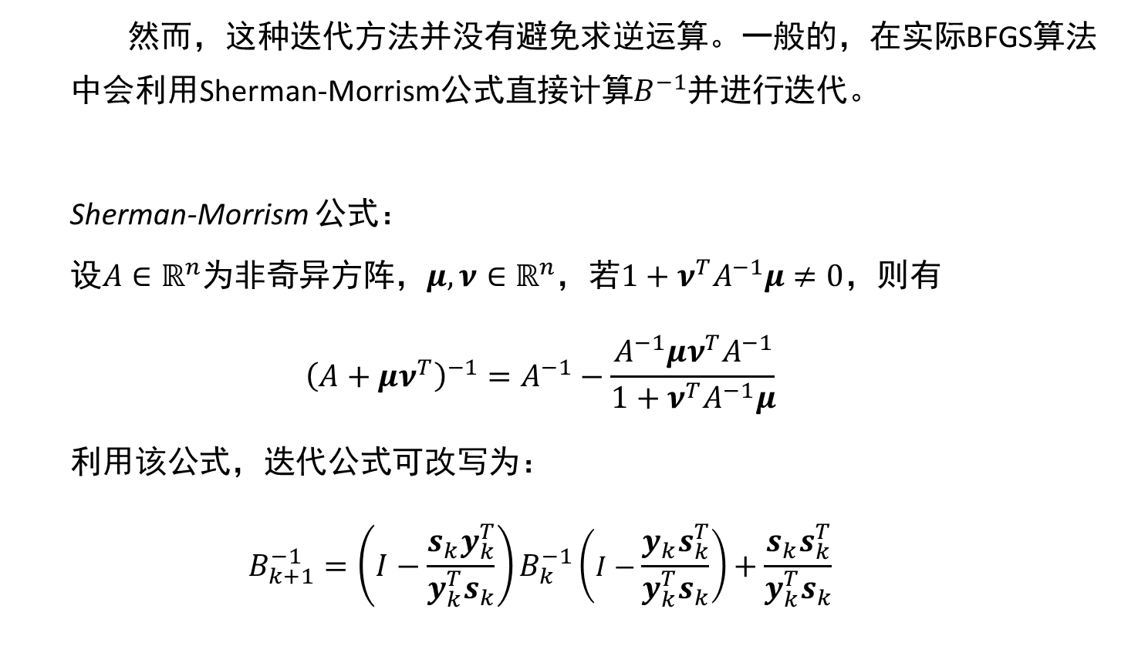
BFGS Method
然而，这种迭代方法并没有避免求逆运算。一般的，在实际BFGS算法中会利用Sherman-Morrism公式直接计算$B^{−1}$并进行迭代。
Sherman-Morrism 公式：
设$A∈ℝ^{n}$为非奇异方阵，$μ,ν∈ℝ^{n}$，若$1+ν^{T}A^{−1}μ≠0$，则有
$${\left(A+μν^{T}\right)}^{−1}=A^{−1}−\frac{A^{−1}μν^{T}A^{−1}}{1+ν^{T}A^{−1}μ}$$
利用该公式，迭代公式可改写为：
$$B_{k+1}^{−1}=\left(I−\frac{s_{k}y_{k}^{T}}{y_{k}^{T}s_{k}}\right)B_{k}^{−1}\left(I−\frac{y_{k}s_{k}^{T}}{y_{k}^{T}s_{k}}\right)+\frac{s_{k}s_{k}^{T}}{y_{k}^{T}s_{k}}$$

Slide 11
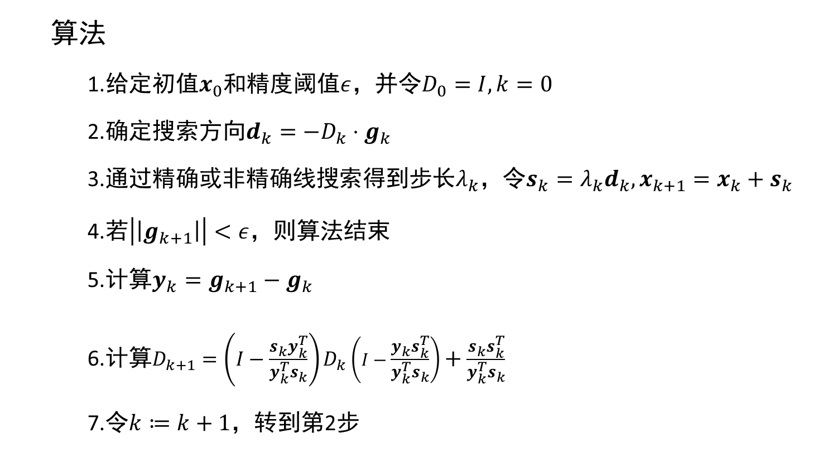
BFGS Method
算法
1.给定初值$x_{0}$和精度阈值$ε$，并令$D_{0}=I,k=0$
2.确定搜索方向$d_{k}=−D_{k}⋅g_{k}$
3.通过精确或非精确线搜索得到步长$λ_{k}$，令$s_{k}=λ_{k}d_{k},x_{k+1}=x_{k}+s_{k}$
4.若$\left|\left|g_{k+1}\right|\right|<ε$，则算法结束
5.计算$y_{k}=g_{k+1}−g_{k}$
6.计算$D_{k+1}=\left(I−\frac{s_{k}y_{k}^{T}}{y_{k}^{T}s_{k}}\right)D_{k}\left(I−\frac{y_{k}s_{k}^{T}}{y_{k}^{T}s_{k}}\right)+\frac{s_{k}s_{k}^{T}}{y_{k}^{T}s_{k}}$
7.令$k≔k+1$，转到第2步

Slide 12
Quasi-Newton Method
拟牛顿法有以下优点：
不需要计算Hessian及其逆
通过迭代维护对称正定性
拟牛顿法仍有以下缺点：
内存消耗大
实现复杂

Slide 13
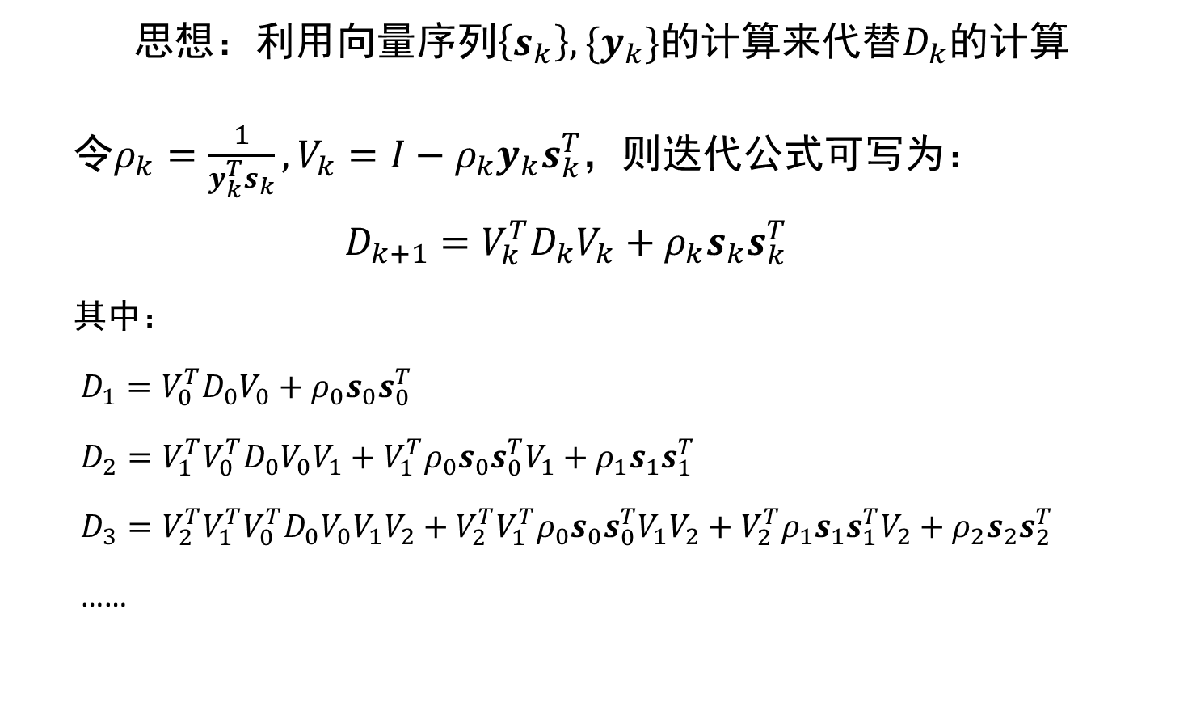
L-BFGS Method
思想：利用向量序列$\left\{s_{k}\right\},\{y_{k}\}$的计算来代替$D_{k}$的计算
令$ρ_{k}=\frac{1}{y_{k}^{T}s_{k}},V_{k}=I−ρ_{k}y_{k}s_{k}^{T}$，则迭代公式可写为：
$$D_{k+1}=V_{k}^{T}D_{k}V_{k}+ρ_{k}s_{k}s_{k}^{T}$$
其中：
$D_{1}=V_{0}^{T}D_{0}V_{0}+ρ_{0}s_{0}s_{0}^{T}$
$D_{2}=V_{1}^{T}V_{0}^{T}D_{0}V_{0}V_{1}+V_{1}^{T}ρ_{0}s_{0}s_{0}^{T}V_{1}+ρ_{1}s_{1}s_{1}^{T}$
$D_{3}=V_{2}^{T}V_{1}^{T}V_{0}^{T}D_{0}V_{0}V_{1}V_{2}+V_{2}^{T}V_{1}^{T}ρ_{0}s_{0}s_{0}^{T}V_{1}V_{2}+V_{2}^{T}ρ_{1}s_{1}s_{1}^{T}V_{2}+ρ_{2}s_{2}s_{2}^{T}$
……

Slide 14

L-BFGS Method
一般地，我们有
$$D_{k+1}=\left(V_{k}^{T}V_{k−1}^{T}⋯V_{1}^{T}V_{0}^{T}\right)D_{0}\left(V_{0}V_{1}⋯V_{k−1}V_{k}\right) \\ +\left(V_{k}^{T}V_{k−1}^{T}⋯V_{2}^{T}V_{1}^{T}\right)\left(ρ_{0}s_{0}s_{1}^{T}\right)\left(V_{1}V_{2}⋯V_{k−1}V_{k}\right) \\ +\left(V_{k}^{T}V_{k−1}^{T}⋯V_{3}^{T}V_{2}^{T}\right)\left(ρ_{1}s_{1}s_{1}^{T}\right)\left(V_{2}V_{3}⋯V_{k−1}V_{k}\right) \\ +⋯ \\ +\left(V_{k}^{T}V_{k−1}^{T} \right)\left(ρ_{k−2}s_{k−2}s_{k−2}^{T}\right)(V_{k−1}V_{k}) \\ +V_{k}^{T}\left(ρ_{k−1}s_{k−1}s_{k−1}^{T}\right)V_{k} \\ +ρ_{k}s_{k}s_{k}^{T}$$

Slide 15
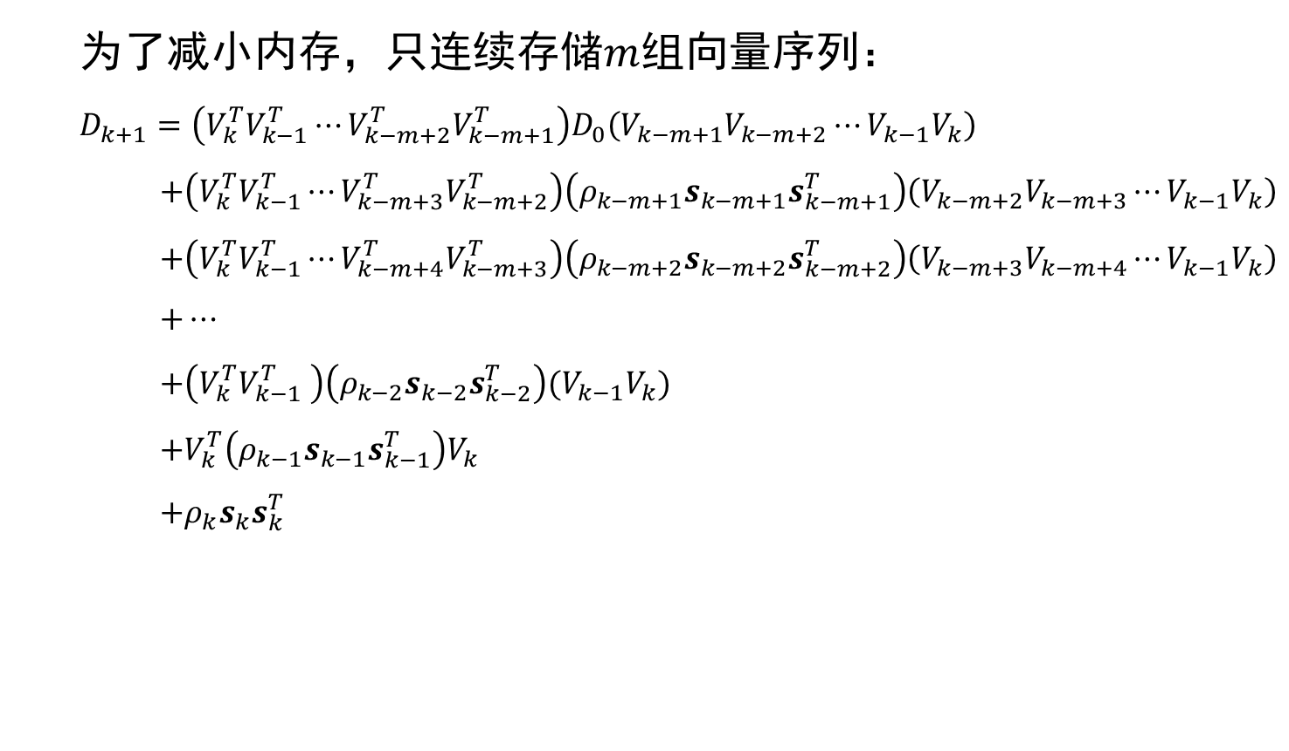
L-BFGS Method
为了减小内存，只连续存储$m$组向量序列：
$$D_{k+1}=\left(V_{k}^{T}V_{k−1}^{T}⋯V_{k−m+2}^{T}V_{k−m+1}^{T}\right)D_{0}\left(V_{k−m+1}V_{k−m+2}⋯V_{k−1}V_{k}\right) \\ +\left(V_{k}^{T}V_{k−1}^{T}⋯V_{k−m+3}^{T}V_{k−m+2}^{T}\right)\left(ρ_{k−m+1}s_{k−m+1}s_{k−m+1}^{T}\right)\left(V_{k−m+2}V_{k−m+3}⋯V_{k−1}V_{k}\right) \\ +\left(V_{k}^{T}V_{k−1}^{T}⋯V_{k−m+4}^{T}V_{k−m+3}^{T}\right)\left(ρ_{k−m+2}s_{k−m+2}s_{k−m+2}^{T}\right)\left(V_{k−m+3}V_{k−m+4}⋯V_{k−1}V_{k}\right) \\ +⋯ \\ +\left(V_{k}^{T}V_{k−1}^{T} \right)\left(ρ_{k−2}s_{k−2}s_{k−2}^{T}\right)(V_{k−1}V_{k}) \\ +V_{k}^{T}\left(ρ_{k−1}s_{k−1}s_{k−1}^{T}\right)V_{k} \\ +ρ_{k}s_{k}s_{k}^{T}$$

Slide 16
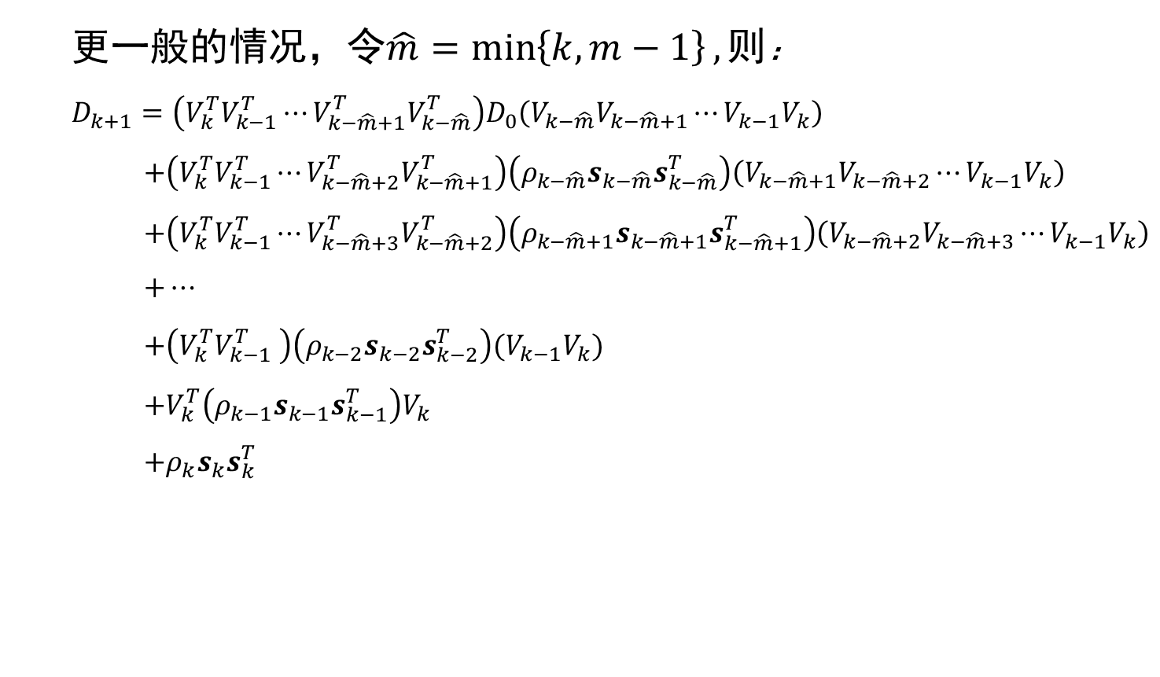
L-BFGS Method
更一般的情况，令$\hat{m}=\min\left\{k,m−1\right\},则$：
$$D_{k+1}=\left(V_{k}^{T}V_{k−1}^{T}⋯V_{k−\hat{m}+1}^{T}V_{k−\hat{m}}^{T}\right)D_{0}\left(V_{k−\hat{m}}V_{k−\hat{m}+1}⋯V_{k−1}V_{k}\right) \\ +\left(V_{k}^{T}V_{k−1}^{T}⋯V_{k−\hat{m}+2}^{T}V_{k−\hat{m}+1}^{T}\right)\left(ρ_{k−\hat{m}}s_{k−\hat{m}}s_{k−\hat{m}}^{T}\right)\left(V_{k−\hat{m}+1}V_{k−\hat{m}+2}⋯V_{k−1}V_{k}\right) \\ +\left(V_{k}^{T}V_{k−1}^{T}⋯V_{k−\hat{m}+3}^{T}V_{k−\hat{m}+2}^{T}\right)\left(ρ_{k−\hat{m}+1}s_{k−\hat{m}+1}s_{k−\hat{m}+1}^{T}\right)\left(V_{k−\hat{m}+2}V_{k−\hat{m}+3}⋯V_{k−1}V_{k}\right) \\ +⋯ \\ +\left(V_{k}^{T}V_{k−1}^{T} \right)\left(ρ_{k−2}s_{k−2}s_{k−2}^{T}\right)(V_{k−1}V_{k}) \\ +V_{k}^{T}\left(ρ_{k−1}s_{k−1}s_{k−1}^{T}\right)V_{k} \\ +ρ_{k}s_{k}s_{k}^{T}$$

Slide 17
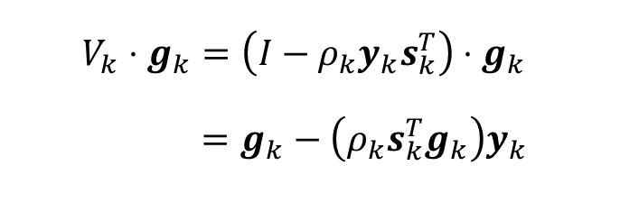
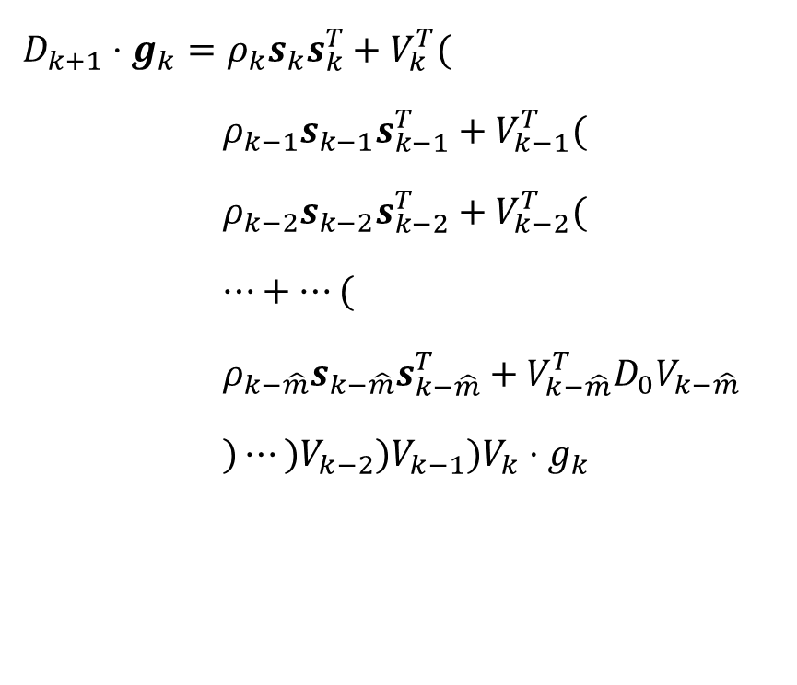
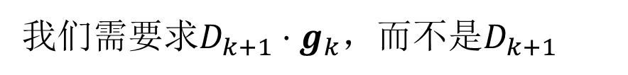
L-BFGS Method
我们需要求$D_{k+1}⋅g_{k}$，而不是$D_{k+1}$
$D_{k+1}⋅g_{k}=ρ_{k}s_{k}s_{k}^{T}+V_{k}^{T}($
$ρ_{k−1}s_{k−1}s_{k−1}^{T}+V_{k−1}^{T}($
$ρ_{k−2}s_{k−2}s_{k−2}^{T}+V_{k−2}^{T}($
$⋯+⋯($
$ρ_{k−\hat{m}}s_{k−\hat{m}}s_{k−\hat{m}}^{T}+V_{k−\hat{m}}^{T}D_{0}V_{k−\hat{m}}$
$)⋯)V_{k−2})V_{k−1})V_{k}⋅g_{k}$
$$V_{k}⋅g_{k}=\left(I−ρ_{k}y_{k}s_{k}^{T}\right)⋅g_{k}$$
$=g_{k}−\left(ρ_{k}s_{k}^{T}g_{k}\right)y_{k}$

Slide 18
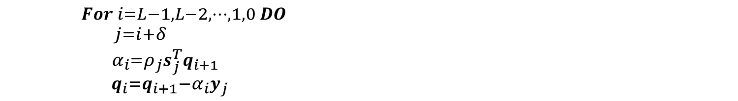
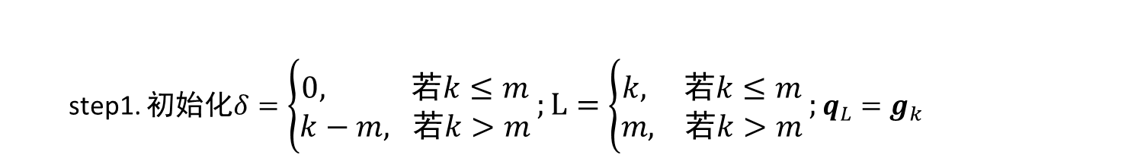
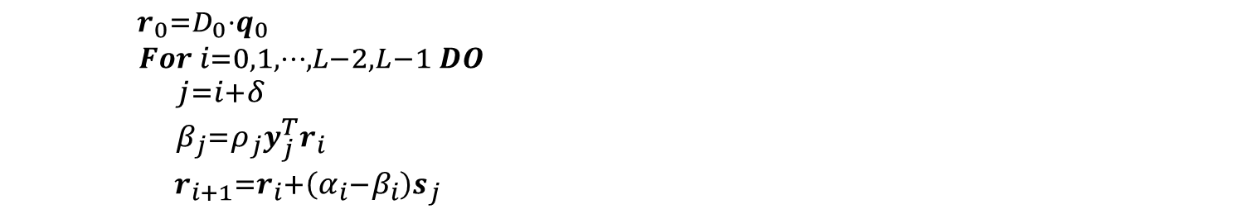
L-BFGS Method
$D_{k}⋅g_{k}$的快速算法
step1. 初始化$δ=\left\{\begin{aligned}0, 若k≤m \\ k−m, 若k>m\end{aligned}\right.;L=\left\{\begin{aligned}k, 若k≤m \\ m, 若k>m\end{aligned}\right.;q_{L}=g_{k}$
step2. 后向循环
${For i=L−1,L−2,⋯,1,0 DO \atop \begin{aligned}j=i+δ \\ α_{i}=ρ_{j}s_{j}^{T}q_{i+1} \\ q_{i}=q_{i+1}−α_{i}y_{j} \end{aligned}}$
step3. 前向循环
${\begin{aligned}r_{0}=D_{0}⋅q_{0} \\ For i=0,1,⋯,L−2,L−1 DO\end{aligned} \atop \begin{aligned}j=i+δ \\ β_{j}=ρ_{j}y_{j}^{T}r_{i} \\ r_{i+1}=r_{i}+\left(α_{i}−β_{i}\right)s_{j} \end{aligned}}$
最后得到的$r_{L}$即为$D_{k}⋅g_{k}$的值

Slide 19

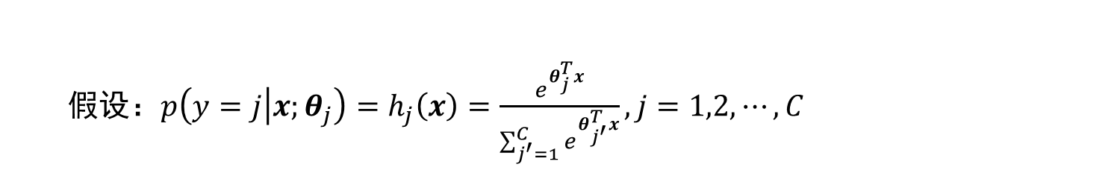
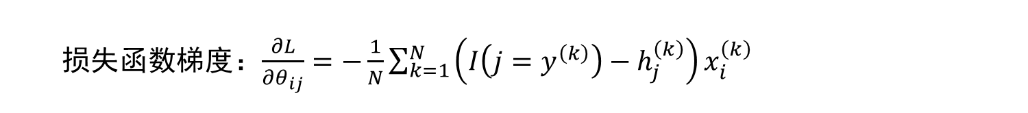
Softmax Regression
假设：$p\left(y=j | x;θ_{j}\right)=h_{j}\left(x\right)=\frac{e^{θ_{j}^{T}x}}{\sum_{j^{′}=1}^{C}{e^{θ_{j^{′}}^{T}x}}},j=1,2,⋯,C$
损失函数：$−\frac{1}{N}\sum_{k=1}^{N}{\sum_{j=1}^{C}{I\left({j=y}^{\left(k\right)}\right)logh_{j}\left(x^{\left(k\right)}\right)}}$
损失函数梯度：$\frac{∂L}{∂θ_{ij}}=−\frac{1}{N}\sum_{k=1}^{N}{\left(I\left(j=y^{\left(k\right)}\right)−h_{j}^{\left(k\right)}\right)x_{i}^{\left(k\right)}}$

Slide 20
Binary Softmax Regression Result
Notes:
1001 1000
24.361046832173287

Slide 21
Binary Softmax Regression Result
Notes:
12 12
23.787425094235026

Slide 22
Multiple Softmax Regression Result
Notes:
1001 1000
42.562121577562124

Slide 23
Multiple Softmax Regression Result
Notes:
500 500
26.358810970151808

Slide 24

感谢各位老师的观看和聆听
演讲人：徐麟

