Slide 2
Outline
介绍
数据仓库
关系图
Hadoop不足
Spark
系统架构
优势
Resilient Distributed Datasets (RDDs)
举例
Shark
系统架构
Fault Tolerance Guarantees
Executing SQL over RDDs
Shark——Engine Extensions
Partial DAG Execution (PDE)
Join Optimization
Skew-handling and Degree of Parallelism
Columnar Memory Store
Data Co-partitioning
Partition Statistics and Map Pruning
Shark——Machine Learning Support
Language Integration
Execution Engine Integration
Implementation
Memory-based Shuffle
Temporary Object Creation
Bytecode Compilation of Expression Evaluators
Specialized Data Structures

Slide 3
数据仓库
定义：数据仓库是支持管理决策过程的、面向主题的、集成的、随时间而变的、持久的数据集合。
用途：将组织透过资讯系统之联机交易处理(OLTP)经年累月所累积的大量资料，透过数据仓库理论所特有的资料储存架构，作一有系统的分析整理，以利各种分析方法如线上分析处理(OLAP)、数据挖掘(Data Mining)之进行，并进而支持如决策支持系统(DSS)、主管资讯系统(EIS)之创建，帮助决策者能快速有效的自大量资料中，分析出有价值的资讯，以利决策拟定及快速回应外在环境变动，帮助建构商业智能(BI)。

Slide 4
关系图
基于Hadoop的数据仓库：Hive
基于Spark的数据仓库：Shark

Slide 5
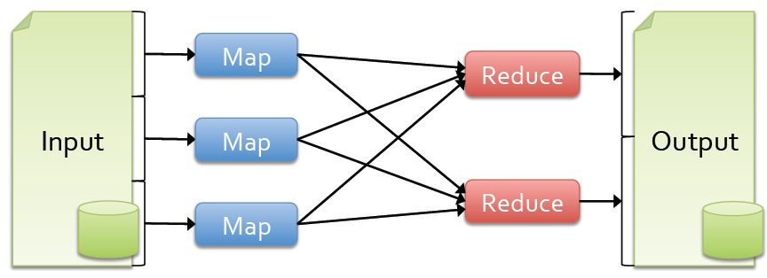
Hadoop不足
基于磁盘的中间结果输出
数据格式和布局（没有“数据协作分区”控制）
执行策略（缺乏基于数据统计的优化）
任务调度和启动开销

Slide 6
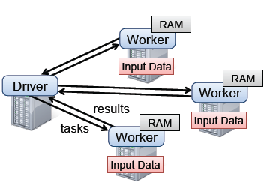
Spark
Spark runtime. The user’s driver program launches multiple workers, which read data blocks from a distributed file system and can persist computed RDD partitions in memory.

Slide 7
Spark系统架构
Spark是UC Berkeley AMP lab所开源的类Hadoop MapReduce的通用的并行计算框架，Spark基于map reduce算法实现的分布式计算，拥有Hadoop MapReduce所具有的优点；但不同于MapReduce的是Job中间输出和结果可以保存在内存中，从而不再需要读写HDFS，因此Spark能更 好地适用于数据挖掘与机器学习等需要迭代的map reduce的算法
Spark SQL
Mllib
(machine leaning)
GraphX
(graph)
Spark Steaming
Apache Spark
Local mode
standalone
Amazon EC2
Hadoop
YARN
Apache Mesos
HDFS, HBase, Cassandra, etc

Slide 8
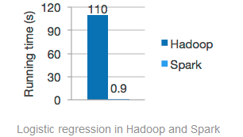
Spark优势
Speed
Run programs up to 100x faster than Hadoop MapReduce in memory, or 10x faster on disk.
Spark has an advanced DAG execution engine that supports cyclic data flow and in-memory computing.
Ease of Use
Write applications quickly in Java, Scala or Python.
Spark offers over 80 high-level operators that make it easy to build parallel apps. And you can use it interactively from the Scala and Python shells.
Generality
Combine SQL, streaming, and complex analytics.
Spark powers a stack of high-level tools including Shark for SQL, MLlib for machine learning, GraphX, and Spark Streaming. You can combine these frameworks seamlessly in the same application.
Integrated with Hadoop
Spark can run on Hadoop 2's YARN cluster manager, and can read any existing Hadoop data.
If you have a Hadoop 2 cluster, you can run Spark without any installation needed. Otherwise, Spark is easy to run standalone or on EC2 or Mesos. It can read from HDFS, HBase, Cassandra, and any Hadoop data source.

Slide 9
RDD
Spark revolves around the concept of a resilient distributed dataset (RDD), which is a fault-tolerant collection of elements that can be operated on in parallel. There are currently two types of RDDs: parallelized collections, which take an existing Scala collection and run functions on it in parallel, and Hadoop datasets, which run functions on each record of a file in Hadoop distributed file system or any other storage system supported by Hadoop. Both types of RDDs can be operated on through the same methods.

Slide 10
RDD
Parallelized Collections
Hadoop Datasets
Parallelized collections are created by calling SparkContext’s parallelize method on an existing Scala collection (a Seq object). The elements of the collection are copied to form a distributed dataset that can be operated on in parallel. For example, here is some interpreter output showing how to create a parallel collection from an array:
Spark can create distributed datasets from any file stored in the Hadoop distributed file system (HDFS) or other storage systems supported by Hadoop (including your local file system, Amazon S3, Hypertable, HBase, etc). Spark supports text files, SequenceFiles, and any other Hadoop InputFormat.
Text file RDDs can be created using SparkContext’s textFile method. This method takes an URI for the file (either a local path on the machine, or a hdfs://, s3n://, kfs://, etc URI). Here is an example invocation:
scala> val data = Array(1, 2, 3, 4, 5)
data: Array[Int] = Array(1, 2, 3, 4, 5)
scala> val distData = sc.parallelize(data)
distData: spark.RDD[Int] = spark.ParallelCollection@10d13e3e
scala> val distFile = sc.textFile("data.txt")
distFile: spark.RDD[String] = spark.HadoopRDD@1d4cee08

Slide 11
RDD Operations
两种操作：transformation和action
所有的transformations是惰性的（lazy）,只有当某一个action请求结果以返回给驱动程序（ driver program ）才回被执行
默认情况，每个被转化的RDD在执行action操作时需要重新计算。然而，用户可以指定RDD的持久化方法
Transformations (定义新的RDD) | map filter sample groupByKey reduceByKey sortByKey | flatMap union join cogroup cross mapValues
Actions (返回结果至驱动程序) | collect reduce | count save lookupKey

Slide 12
RDD Persistence
Storage Level | Meaning
MEMORY_ONLY | Store RDD as deserialized Java objects in the JVM. If the RDD does not fit in memory, some partitions will not be cached and will be recomputed on the fly each time they're needed. This is the default level.
MEMORY_AND_DISK | Store RDD as deserialized Java objects in the JVM. If the RDD does not fit in memory, store the partitions that don't fit on disk, and read them from there when they're needed.
MEMORY_ONLY_SER | Store RDD as serialized Java objects (one byte array per partition). This is generally more space-efficient than deserialized objects, especially when using a fast serializer, but more CPU-intensive to read.
MEMORY_AND_DISK_SER | Similar to MEMORY_ONLY_SER, but spill partitions that don't fit in memory to disk instead of recomputing them on the fly each time they're needed.
DISK_ONLY | Store the RDD partitions only on disk.

Slide 13
举例

