Slide 1

Optimization toolbox
Team members
方利翔、吴鑫杰、屠嘉骏、胡明贵

Slide 2
1、Linear programming
(线性规划)
2、Quadratic programming
（二次规划）

Slide 3
Linear programming(线性规划)
Linear programming is a method for the optimization of linear objective functions and constraints.

Slide 4
objective function minimization
目标函数最小化
Standard form of linear
programming
（线性规划的标准型）
the constraint is to take the equation
约束条件取等式
nonnegative variables
变量非负
Nonstandard form of
linear programming
(线性规划的非标准型)

Slide 5

Linear programming function
X=linprog ( f, A, b）
X=linprog ( f, A, b, Aeq, beq)
X=linprog ( f, A, b, Aeq, beq, lb, ub)
X=linprog ( f, A, b, Aeq, beq, lb, ub, x0)
X=linprog ( f, A, b, Aeq, beq, lb, ub, x0, options)
求解min $f^{T}x$，约束条件为Ax⩽b;
增加等式约束Aeqx=beq;
定义x的下界lb和上界ub,使x始终在范围内；
设置初值x0;
用options指定的优化参数进行最小化；

Slide 6
Linear programming function
[x, fval]=linprog ( f, A, b, Aeq, beq)
[x, fval, exitflag]=linprog ( f, A, b, Aeq, beq, lb, ub)
[x, fval, exitflag, output]=linprog ( f, A, b, Aeq, beq, lb, ub, x0)
[x, fval, exitflag, output, lambda]=linprog ( f, A, b, Aeq, beq, lb, ub, x0, options)
返回解x处的目标函数值fval；
返回exitflag值，描述函数计算的退出条件；
返回包含优化信息的输出变量output；
将解x处的拉格朗日乘子返回到lambda参数中；

Slide 7
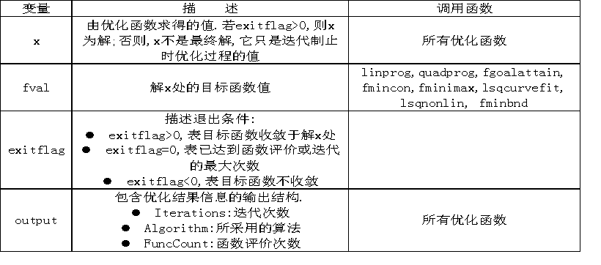

Slide 8
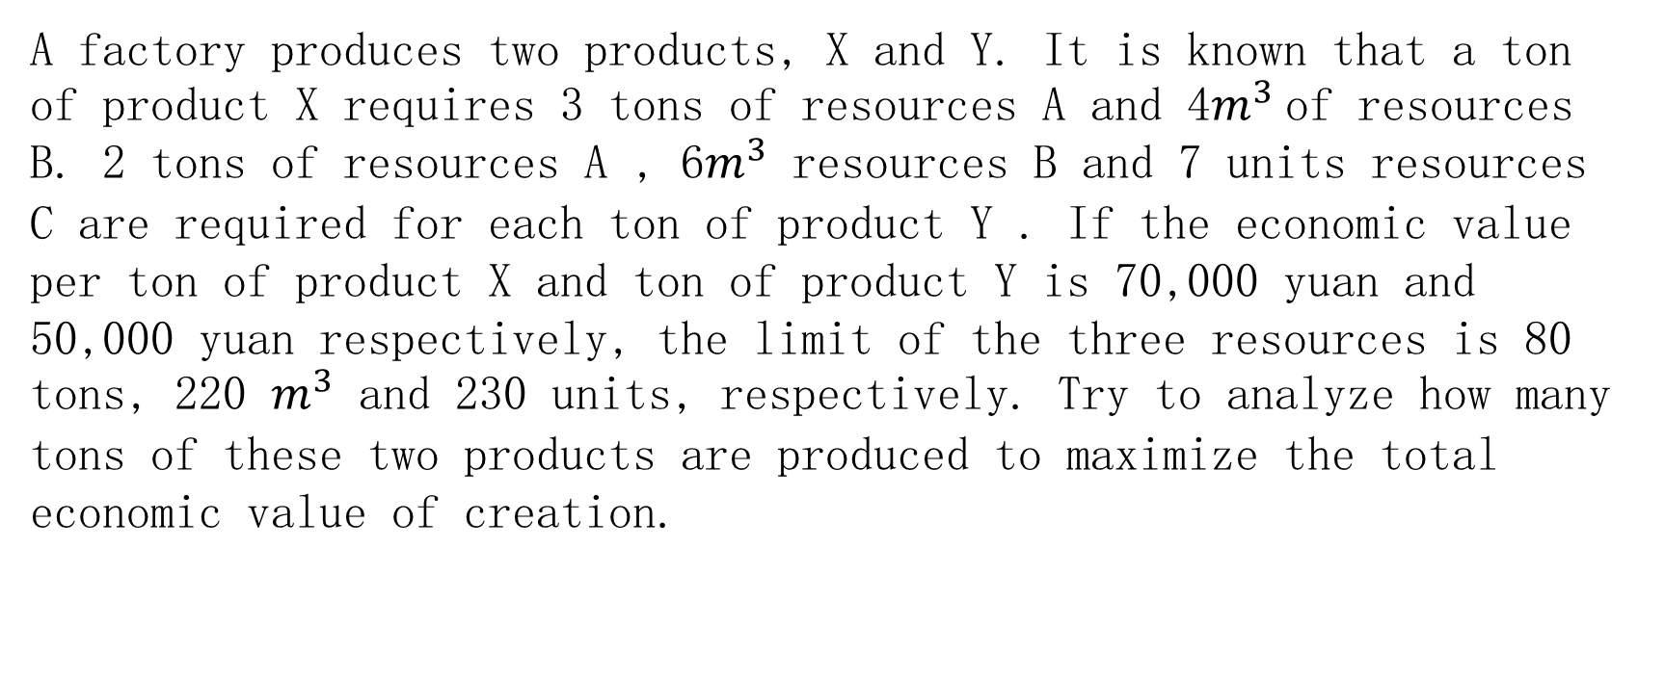
Application of linear programming problems
A factory produces two products, X and Y. It is known that a ton of product X requires 3 tons of resources A and 4$m^{3}$of resources B. 2 tons of resources A , 6$m^{3}$ resources B and 7 units resources C are required for each ton of product Y . If the economic value per ton of product X and ton of product Y is 70,000 yuan and 50,000 yuan respectively, the limit of the three resources is 80 tons, 220 $m^{3}$ and 230 units, respectively. Try to analyze how many tons of these two products are produced to maximize the total economic value of creation.

Slide 9
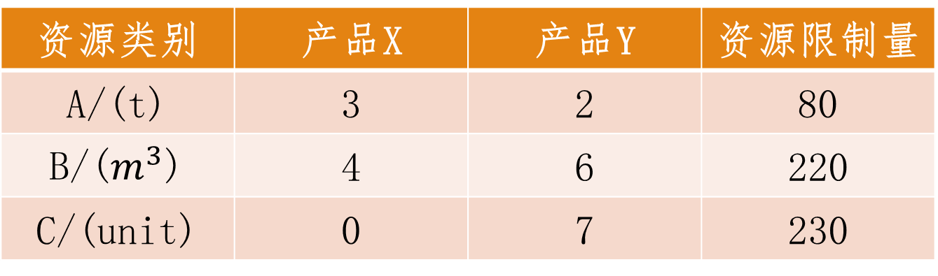
资源类别 | 产品X | 产品Y | 资源限制量
A/(t) | 3 | 2 | 80
B/($m^{3}$) | 4 | 6 | 220
C/(unit) | 0 | 7 | 230
每吨产品X和产品Y的经济价值分别为7万元和5万元，求各生产这两种产品多少吨，才能使总的经济价值最高？

Slide 10

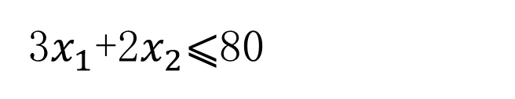
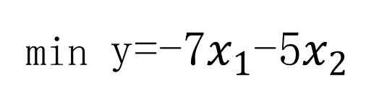

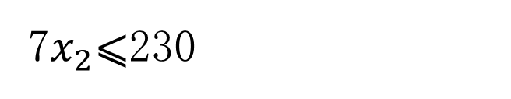
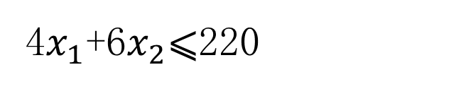

Mathematical model：
假设产品X的数量为$x_{1}吨$，产品Y的数量为$x_{2}吨$。
A x ⩽ b
3$x_{1}$+2$x_{2}$⩽80
2
6
0 7
$$x_{1}$$
80
220
230
Restrictions
约束条件
转化
⩽
4$x_{1}$+6$x_{2}$⩽220
$$x_{2}$$
7$x_{2}$⩽230
f=[-7;-5]
Objective function
目标函数
转化
min y=-7$x_{1}$-5$x_{2}$
max y=7$x_{1}$+5$x_{2}$

Slide 11
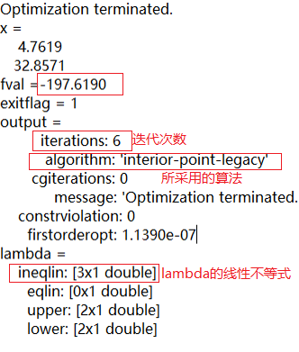
Code settings and results
clc
clear
f=[-7;-5];
A=[3 2
4 6
0 7];
b=[80;220;230];
lb=zeros(2,1);
[x, fval, exitflag, output, lambda]=
linprog (f, A, b, [], [], lb)

Slide 12
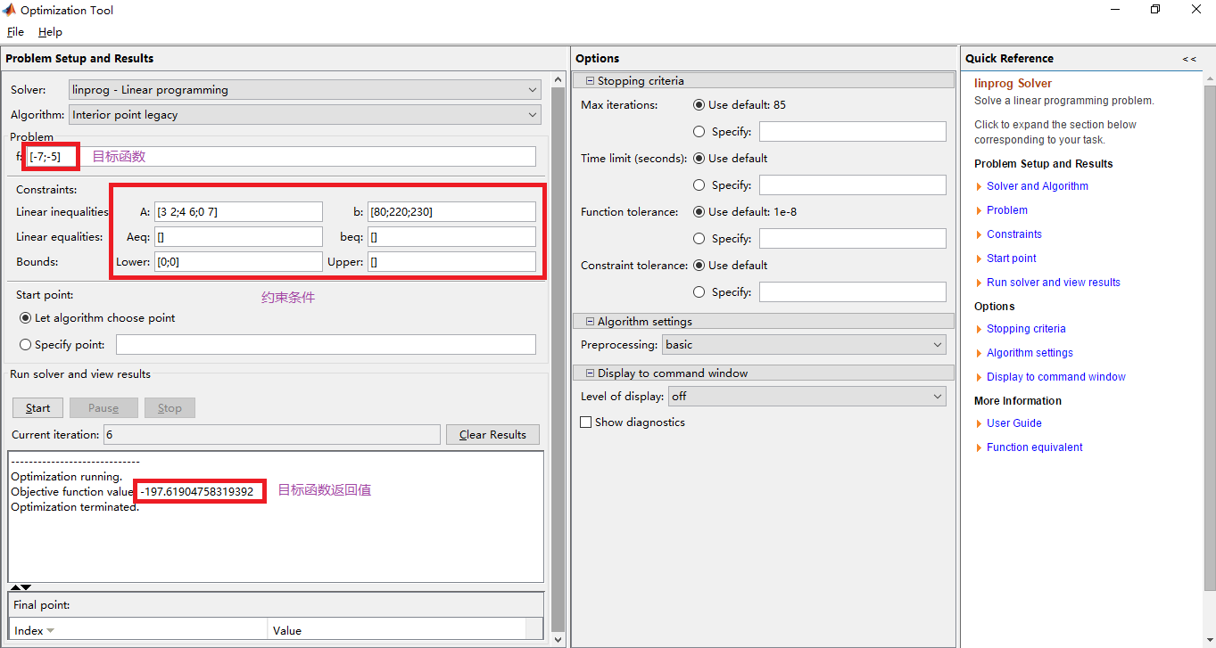

Slide 13
Quadratic programming(二次规划)
If the objective function of a nonlinear programming is a quadratic function of independent variables and the constraints are all linear functions, it is called a quadratic programming.

Slide 14
Quadratic programming function
x = quadprog(H,f,A,b)
x = quadprog(H,f,A,b,Aeq,beq)
x = quadprog(H,f,A,b,Aeq,beq,lb,ub)
x = quadprog(H,f,A,b,Aeq,beq,lb,ub,x0)
x = quadprog(H,f,A,b,Aeq,beq,lb,ub,x0,options)
[x,fval] = quadprog(H,f,...)
[x,fval,exitflag] = quadprog(H,f,...)
[x,fval,exitflag,output] = quadprog(H,f,...)
[x,fval,exitflag,output,lambda] = quadprog(H,f,...)

Slide 15
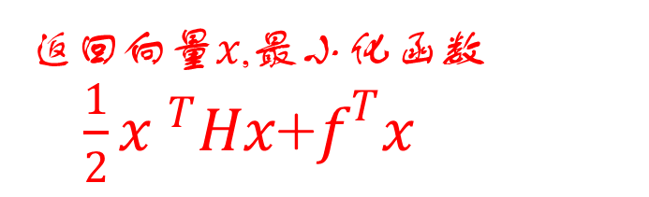
x = quadprog(H,f,A,b)
返回向量$x$,最小化函数$\frac{1}{2}{x }^{T}Hx$+$f^{T}x$
Hesse矩阵
对称矩阵
向量f只与变量的一次项有关,矩阵H只与变量的二次项有关。

Slide 16

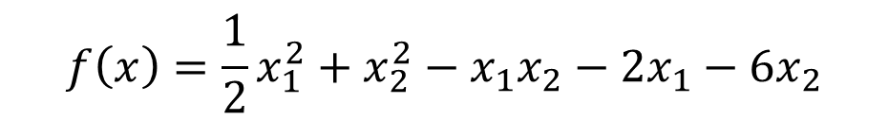
Example:
不需要转化成标准型
Find the value of x that minimizes the function：
$$f\left(x\right)=\frac{1}{2}x_{1}^{2}+x_{2}^{2}−x_{1}x_{2}−2x_{1}−{6x}_{2}$$
$x_{1}$+$x_{2}$⩽2
-$x_{1}$+2$x_{2}$⩽2
2$x_{1}$+$x_{2}$⩽3
0 ⩽$x_{1},$ 0 ⩽$x_{2}$
其中

Slide 17



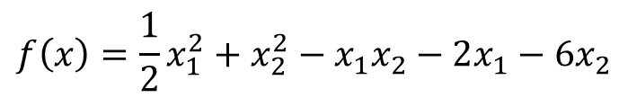



key problem
The solution of the H matrix
f=[-2;-6]
$$f\left(x\right)=\frac{1}{2}x_{1}^{2}+x_{2}^{2}−x_{1}x_{2}−2x_{1}−{6x}_{2}$$
最小化函数$\frac{1}{2}{x }^{T}Hx$+$f^{T}x$
$$a_{11}$$
$$a_{12}$$
H=
$a_{ij}就是x_{i}x_{j}$前面系数的两倍
$$a_{21}$$
$$a_{22}$$
-1
-1 2
H=

Slide 18
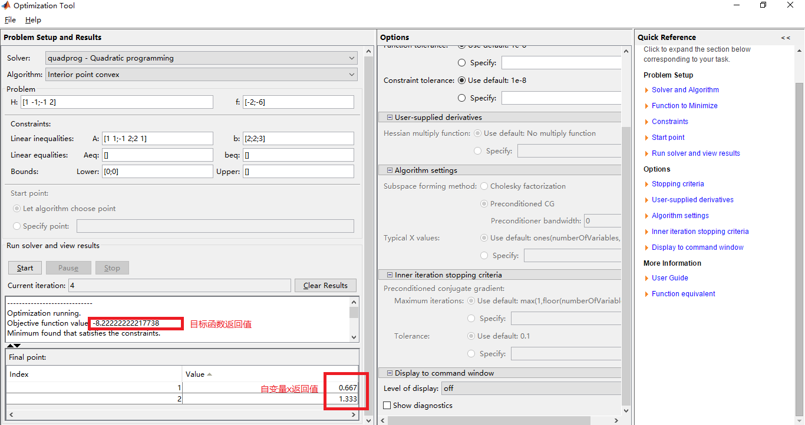

Slide 19
Thanks!

