Slide 1
Advanced Computer Architecture (ACA2020)
Dr. ZHANG Chun-yuan
College of Computer, NUDT
Fall, 2020

Slide 2
Lecture 05 Advanced Branch Predictions and Tomasulo's Algorithm
November 17, 2020

Slide 3

Computers in the News – From David Patterson cs252-s06
C. Al Gore, 2000
"Again, I'd repeat to you that if we can remain the most competitive nation in the world, it will benefit the worker here in America. People have got to understand, when we talk about spending your taxpayers' money on research and development, there is a correlating benefit, particularly to your children. See, it takes a while for some of the investments that are being made with government dollars to come to market. I don't know if people realize this, but the Internet began as the Defense Department project to improve military communications. In other words, we were trying to figure out how to better communicate, here was research money spent, and as a result of this sound investment, the Internet came to be.
The Internet has changed us. It's changed the whole world."

Slide 4
A Bad Graduate Career: David Patterson
Concentrate on getting good grades:
Postpone research involvement: might lower GPA(?)
Minimize number and flavors of courses
Why take advantage of 1 of the top departments with an emphasis on excellent grad courses?
Why take advantage of a campus with 35/36 courses in the top 10?
May affect GPA

Slide 5
How to Have a Bad Graduate Career
Don’t trust your advisor
Advisor is only interested in his or her own career, not your’s
Advisor may try to mentor you, use up time, interfering with GPA
Only work the number of hours per week you are paid!
Don’t let master class exploit the workers!
Work at home as much as possible
Avoid distractions of talking to others

Slide 6
Concentrate on Graduating as Fast as Possible
Winner is first in class to PhD!
People only care about that you have a PhD and your GPA, not on what you know
Nirvana: graduating in 3.5 years with a 4.0 GPA!
Don’t spend a summer in industry: takes longer
How could industry experience help with selecting PhD topic?

Slide 7
Concentrate on Graduating as Fast as Possible
Don’t work on large projects: takes longer
Have to talk to others, have to learn different areas
Synchronization overhead of multiple people
You’ll get lost
Don’t do a systems PhD: takes longer
Don’t waste time polishing writing or talks
Again, that takes time

Slide 8
Concentrate on Graduating as Fast as Possible
Don’t go to conferences
It costs money and takes time; you’ll have plenty of time to learn the field after graduating
( This may not be true in our situation )
You may take the conference opportunities to travel/tour around, especially during the vacation

Slide 9
Next …
Correlating Branch Predictors (m, n)

Slide 10
A One Bit Correlation Predictor (1, 1)
A two bits predictor
One bit for the last branch not taken
The other for the last branch taken
In general, the last branch executed is not the same instruction as the branch being predicted
Although this can occur in simple loops consisting of a single basic block
A two BPSs predictor

Slide 11
Implementation of a 1-bit Correlation Predictor (1, 1) and (0, 2)
(1,1) | (1-bit) |  | (1-bit)
Lower bits of a branch address
 | NT | Last branch selector (1-bit) | T
(0,2) | (1-bit) | (1-bit)
Lower bits of a branch address
How can two BPBs
work together?
The same memory capacities

Slide 12
Two-Level Branch Predictor (2, 2)
0
0
Fetch PC
k
2-bit global branch history shift register
Shift in Taken/¬Taken results of each branch
Taken/¬Taken?
Pentium Pro uses the result from the last two branches to select one of the four sets of BHT(BPB) bits (~95% correct)

Slide 13
Correlating Branches: Another View
(2,2) predictor
Behavior of recent branches selects between four predictions of next branch, updating just that prediction
Branch address
4
2-bits per branch predictor
Prediction
2-bit global branch history

Slide 14
Comparison of 2-bit Predictors: Mis

Slide 15
Tournament Predictors
Multilevel branch predictor
Adaptively combining local and global predictors
Use n-bit saturating counter to choose between predictors
Usual choice between global and local predictors

Slide 16
Branch Predictions
Basic 2-bit predictor:
For each branch, predict taken or not taken
If the prediction is wrong two consecutive times, change prediction
Correlating predictor:
Multiple 2-bit predictors for each branch
One for each possible combination of outcomes of preceding n branches
Local predictor:
Multiple 2-bit predictors for each branch
One for each possible combination of outcomes for the last n occurrences of this branch
Tournament predictor:
Combine correlating predictor with local predictor

Slide 17
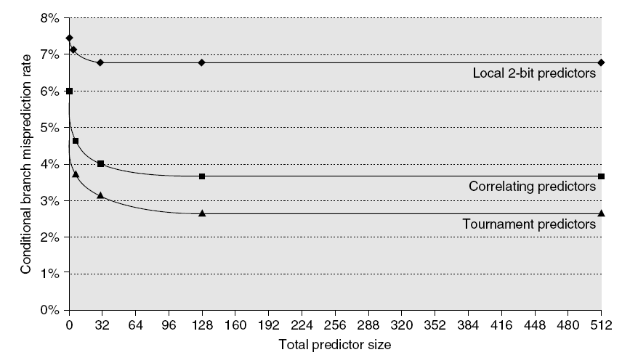
Branch predictor performance

Slide 18
The Intel Core i7 Branch Predictor
Intel has released only limited amounts of information about the Core i7’s branch predictor, which is based on earlier predictors used in the Core Duo chip
Each predictor combines three different predictors
(1) the simple two-bit predictor
(2) a global history predictor
(3) a loop exit predictor
The loop exit predictor uses a counter to predict the exact number of taken branches (which is the number of loop iterations) for a branch that is detected as a loop branch

Slide 19
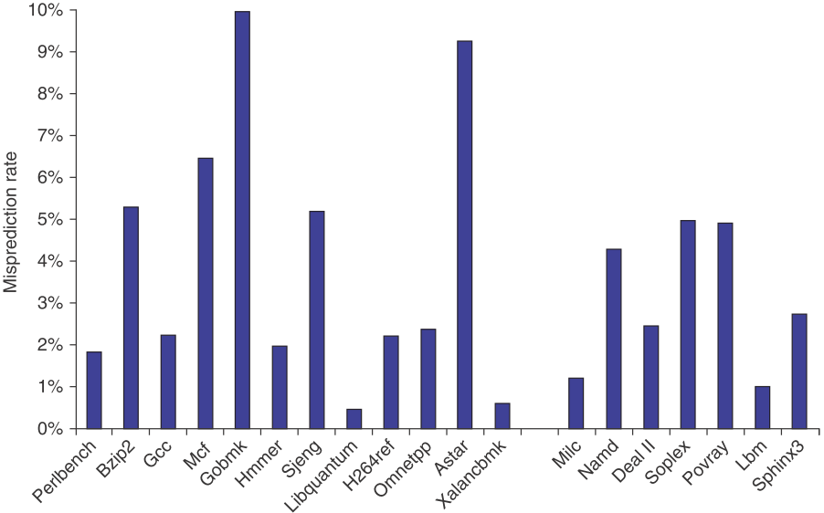
The Misprediction Rate for 19 of the SPECCPU2006

Slide 20
Next …
Overcoming Data Hazards with Dynamic Scheduling

Slide 21
Dynamic Scheduling Advantages and …
Hardware rearrange order of instructions to reduce stalls while maintaining data flow
Advantages:
Compiler doesn’t need to have knowledge of microarchitecture
Handles cases where dependencies are unknown at compile time
It allows code that compiled for one pipeline to run efficiently on a different pipeline
Disadvantage:
Substantial increase in hardware complexity
Complicates exceptions

Slide 22
Dynamic Scheduling Needs …
Dynamic scheduling implies
Out-of-order execution
Out-of-order completion
Dynamic execution creates the possibility for WAR and WAW hazards
Hardware register renaming
Tomasulo’s Approach: IBM 360/91
Tracks when operands are available
Introduces register renaming in hardware
Minimizes WAW and WAR hazards

Slide 23
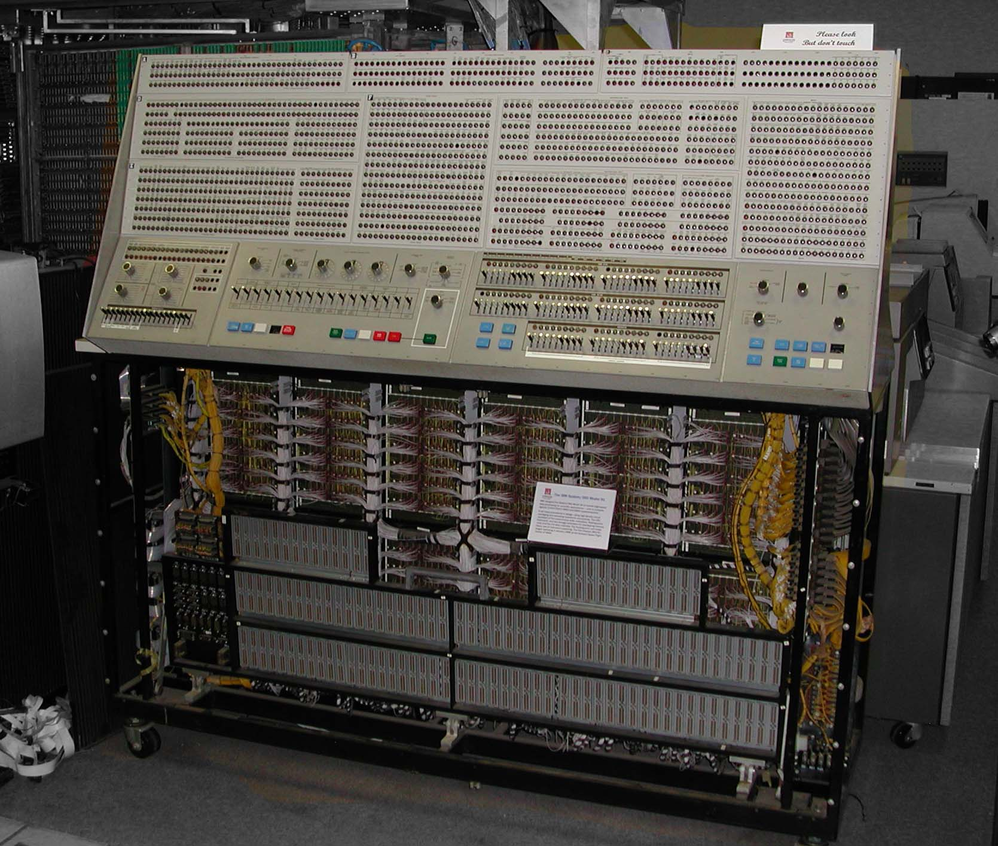
The Front Panel of System 360 Model 91

Slide 24
Another Dynamic Algorithm: Tomasulo’s Algorithm
Differences between IBM 360 & CDC 6600 ISA
IBM has only 2 register vs. 3 in CDC 6600
IBM has 4 FP registers vs. 8 in CDC 6600
IBM has memory-register ops
Why Study?
Lead to Alpha 21264, HP 8000, MIPS 10000, Pentium II, PowerPC 604, …

Slide 25
Tomasulo Organization
From Mem
FP Op
Queue
FP Registers
Load Buffers
Load1
Load2
Load3
Load4
Load5
Load6
Store
Buffers
Add1
Add2
Add3
Mult1
Mult2
Reservation
Stations
To Mem
FP adders
FP multipliers
Common Data Bus (CDB)

Slide 26
Three Stages of Instruction Goes
The ID and EX stages of the five-stage pipeline are replaced with three new stages
Issue
Execute
Write result

Slide 27
Tomasulo Algorithm 1/2
Control & buffers distributed with FU
FU buffers called reservation stations (RS) have pending operands
Load Buffer and Stores Buffer treated as FUs with RSs as well
Registers replaced by values or pointers to RS called register renaming
Renaming avoids WAR, WAW hazards
More reservation stations than registers, so can do optimizations compilers can’t

Slide 28
Tomasulo Algorithm 2/2
Results to FU from RS, not through registers, but over Common Data Bus (CDB) that broadcasts results to all FUs
Avoids RAW hazards by executing an instruction only when its operands are available
Integer instructions can go past branches (predict taken), allowing FP ops beyond basic block in FP queue

Slide 29
Fields of Reservation Stations
Op: The operation to perform
Vj, Vk: value of the source operands
Only one of V or Q is valid for each operand
Qj, Qk: RSs producing source registers
Qj, Qk = 0 => ready
Busy: indicates this reservation station and its accompanying FUs are occupied

Slide 30
Register File Has a Field
Qi: the reservation station that contains the operation whose result should be stored into this register
If the value of Qi is blank (0), no currently active instruction is computing a result for this register (where is the value?)

Slide 31
Load And Store Buffers
Each have a filed A
A: hold the effective address
The store buffer also has a V field
V: value of the operands

Slide 32
How It Works: Previous Example
L.D F6, 34(R2)
L.D F2, 45(R3)
MUL.D F0, F2, F4
SUB.D F8, F2, F6
DIV.D F10, F0, F6
ADD.D F6, F8, F2

Slide 33
Tomasulo Example
Instruction stream
3 Load/Buffers
FU count
down
3 FP Adder R.S.
2 FP Mult R.S.
Clock cycle counter

Slide 34
Tomasulo Example Cycle 1

Slide 35
Tomasulo Example Cycle 2
Note: Can have multiple loads outstanding

Slide 36
Tomasulo Example Cycle 3
Note: MULT issued, registers are removed (“renamed”) in RSs
Load1 exec completing; what is waiting for Load1?

Slide 37
Tomasulo Example Cycle 4
Load2 exec completing

Slide 38
Tomasulo Example Cycle 5
Timer starts down for Add1, Mult1

Slide 39
Tomasulo Example Cycle 6
Issue ADDD here despite name dependency on F6?

Slide 40
Tomasulo Example Cycle 7
Add1 (SUBD) completing; what is waiting for it?

Slide 41
Tomasulo Example Cycle 8

Slide 42
Tomasulo Example Cycle 9

Slide 43
Tomasulo Example Cycle 10
Add2 (ADDD) completing; what is waiting for it?

Slide 44
Tomasulo Example Cycle 11
Write result of ADDD here?
All quick instructions complete in this cycle!

Slide 45
Tomasulo Example Cycle 12

Slide 46
Tomasulo Example Cycle 13

Slide 47
Tomasulo Example Cycle 14

Slide 48
Tomasulo Example Cycle 15
Mult1 (MULTD) completing; what is waiting for it?

Slide 49
Tomasulo Example Cycle 16
Just waiting for Mult2 (DIVD) to complete

Slide 50
Tomasulo Example Cycle 16-54
Faster than light computation (skip a couple of cycles)

Slide 51
Tomasulo Example Cycle 55

Slide 52
Tomasulo Example Cycle 56
Mult2 (DIVD) is completing; what is waiting for it?

Slide 53
Tomasulo Example Cycle 57
57
Once again: In-order issue, out-of-order execution and out-of-order completion.

Slide 54
The Code
LOOP: L.D F0,0(R1)
MUL.D F4,F0,F2
S.D 0(R1),F4
DADDUI R1,R1,#-8
BNE R1,R2,LOOP

Slide 55
Predict
All branches are taken!
The reservation stations will allow multiple executions of the loop
The loop is unrolled dynamically by the hardware

Slide 56
Snapshot Time Assume
All of the instructions in two successive iterations of the loop have issued
But none has completed
The load and store buffers contain the addresses to be loaded from and stored to
The load values are in the load buffers
The store buffers indicate that the multiply destinations are the values to store

Slide 57
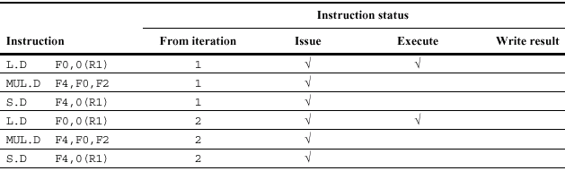
Instruction Status

Slide 58
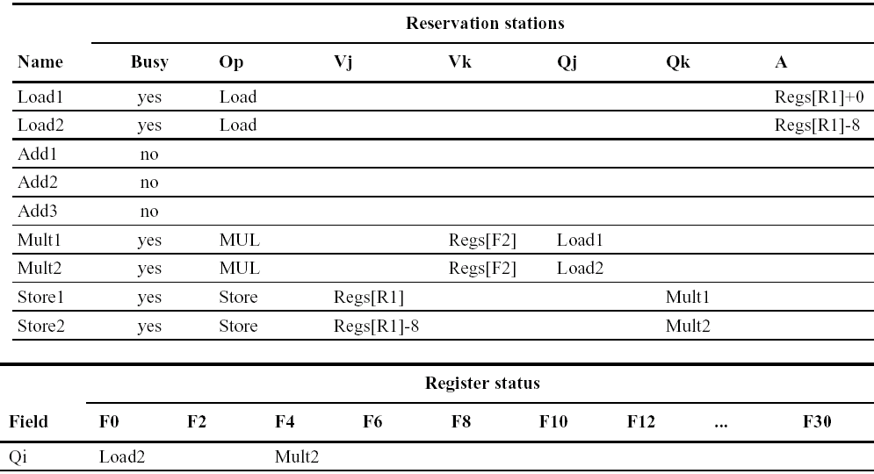
Status of FUs and Registers

Slide 59
Instruction Status
The distribution of the hazard detection logic
Distributed reservation stations and the CDB
The waited operands can be released simultaneously by broadcast on CDB
The elimination of WAW and WAR hazards

Slide 60
WAR Hazard Involving F6
If the first L.D which provides the value of F6 for DIV.D has completed, then Vk will store the result allowing DIV.D to execute independent of ADD.D
If L.D has not completed, then Qk would point to the first L.D and DIV.D would still be independent of ADD.D

Slide 61
4-bit Tag Fields of RS
In our example, the tag field is a 4-bit quantity that denotes
4 registers
5 reservation stations
6 load buffers
Value 0000b indicate that the operand is already available in the registers

Slide 62
Notes
A table of instruction status is used to illustrate the algorithm, but it is NOT part of the hardware
The entries in the table are distributed throughout the hardware

Slide 63
Tomasulo Drawbacks
Complexity
Performance limited by CDB
CDB must go to multiple functional units ⇒ high capacitance, high wiring density
Number of functional units that can complete per cycle limited to one!
Multiple CDBs ⇒ more FU logic for parallel assoc stores
Non-precise interrupts!
We will address this later

Slide 64
Issue FP Operation
Station r empty
Bookkeeping
if (RegisterStat[rs].Qi ≠ 0) //Vj
{RS[r].Qj ← RegisterStat[rs].Qi}
else {RS[r].Vj ← Regs[rs]; RS[r].Qj ← 0};
if (RegisterStat[rt].Qi ≠ 0) //Vk
{RS[r].Qk ← RegisterStat[rt].Qi}
else {RS[r].Vk ← Regs[rs]; RS[r].Qk ← 0};
RS[r].busy ← yes; RegisterStat[rd]. Qi ← r；
RS[r].Op ← OP;

Slide 65
Issue Load or Store 1/2
Buffer r empty
Common bookkeeping
if (RegisterStat[rs].Qi ≠ 0)
{Buffer[r].Qj ← RegisterStat[rs].Qi}
else {RS[r].Vj ← Regs[rs]; Buffer[r].Qj ← 0};
Buffer[r]. A ← imm；Buffer[r].busy ← yes；
Buffer[r].Op ← OP；

Slide 66
Issue Load or Store 2/2
Load only:
RegisterStat[rt].Qi ← r
Store only:
if (RegisterStat[rt].Qi ≠ 0)
{RS[r].Qk ← RegisterStat[rs].Qi}
else
{RS[r].Vk ← Regs[rt];
RS[r].Qk ← 0};

Slide 67
Execution of FP operation
Wait until (RS[r].Qj=0) and (RS[r].Qk=0)
Action or bookkeeping
None-operands are in Vj and Vk

Slide 68
Execution Load-Store Step 1
(RS[r].Qj=0) and r is head of load-store queue (buffer)
Action or bookkeeping:
RS[r].A ← RS[r].Vj + RS[r].A;

Slide 69
Execution Load-Store: Load Step
Load-store step 1 complete
Action or bookkeeping:
Read from Mem[RS[r].A]

Slide 70
Write Result: FP Operation or Load
Execution complete at r & CDB available
Bookkeeping
∀x(if (RegisterStat[x].Qi=r) {Regs[x] ← result; RegisterStat[x].Qi←0} );
∀x(if (RS[x].Qj=r) {RS[x].Vj ← result; RS[x].Qj ← 0});
∀x(if (RS[x].Qk=r) {RS[x].Vk ← result;RS[x].Qk ← 0});
RS[r].Busy ← no;

Slide 71
Write Result: Store
Wait until execution complete at r & RS[r].Qk=0
Action or bookkeeping
Mem[RS[r].A]←RS[r].Vk;
RS[r].Busy← no;

Slide 72
Loop and Unrolling
To fully understand how Tomasulo's algorithm eliminates WAW and WAR hazards, we need to look at a loop
Consider an example similar to the one we used to demonstrate loop unrolling where the elements of an array are multiplied by a scalar in F2

Slide 73
Bob Tomasulo Created An Approach
The reservation stations extent the real register set via the renaming process
The 360 architecture: only 4 FP registers
Supports overlapped execution of multiple copies of the same loop with only a small number of registers used by the program

Slide 74
The Code
LOOP: L.D F0,0(R1)
MUL.D F4,F0,F2
S.D 0(R1),F4
DADDUI R1,R1,#-8
BNE R1,R2,LOOP

Slide 75
Predict
All branches are taken!
The reservation stations will allow multiple executions of the loop
The loop is unrolled dynamically by the hardware

Slide 76
Snapshot Time Assume
All of the instructions in two successive iterations of the loop have issued
But none has completed
The load and store buffers contain the addresses to be loaded from and stored to
The load values are in the load buffers
The store buffers indicate that the multiply destinations are the values to store

Slide 77
Instruction Status

Slide 78
Status of FUs and Registers

Slide 79
What Can We Found?
CPI close to 1
The load instruction from the second iteration could easily complete before the store from the first iteration
The load and store can safely be done in a different order, provided they access different addresses
The load is before the store
Interchanging them results in a WAR hazard
The store is before the load
Interchanging them results in a RAW hazard

Slide 80
Load
Completed effective address calculation
Check an address conflict by examining the A field of all active store buffers
If load address = any active store address
The load instruction is not sent to the load buffer
Until the conflicting store completes
(?)

Slide 81
Stores
Similarly
Except must check for conflicts in both the load buffers and the store buffers
Since conflicting stores cannot be reordered with respect to either a load (WAR) or a store (WAW)
Meny research you may do in memory access to optimize the ...

Slide 82
Usage of Tomasulo’s Scheme
The designer is forced to pipeline an architecture obtain high performance without pipeline specific compiler
Difficult to schedule code
A shortage of registers

Slide 83
Key Components in Tomasulo’s
Dynamic scheduling with RSs
Permit instruction issue past branches
Buffer old values of registers - avoiding WAR
Register renaming
Multiple iterations use different physical destinations for registers
Dynamic memory disambiguation
Other perspective: Tomasulo building data flow dependency graph on the fly

Slide 84
Homework
Book reading
3.3~3.5
Paper reading
"An Efficient Algorithm for Exploiting Multiple Arithmetic units", Tomasulo, IBM Journal, January 1967
Coding
Tomasulo’ algorithm with the following loop test
LOOP: L.D F0,0(R1)
MUL.D F4,F0,F2
S.D 0(R1),F4
DADDUI R1,R1,#-8
BNE R1,R2,LOOP

Slide 85
Next…
Speculation

