Slide 1
Advanced Computer Architecture (ACA2020)
Dr. ZHANG Chun-yuan
College of Computer, NUDT
Fall, 2020

Slide 2
Lecture 10 Vector Processor, SIMD and GPU

Slide 3
Chapter 4 DLP in Vector, SIMD, and GPU
Data-Level Parallelism in Vector, SIMD, and GPU Architectures (pp262-334)
4.1 Introduction
4.2 Vector Architecture
4.3 SIMD Instruction Set Extensions for Multimedia
4.4 Graphics Processing Units
4.5 Detecting and Enhancing Loop-Level Parallelism
4.6 Crosscutting Issues
4.7 Putting It All Together: Mobile versus Server GPUs and Tesla versus Core i7

Slide 4
App G. Vector Processors in More Depth
G.1 Introduction
G.2 Vector Performance in More Depth
G.3 Vector Memory Systems in More Depth
G.4 Enhancing Vector Performance
G.5 Effectiveness of Compiler Vectorization
G.6 Putting It All Together: Performance of Vector Processors
G.7 A Modern Vector Supercomputer: The Cray X1

Slide 5
SIMD Parallelism
Vector architectures
SIMD extensions
Graphics Processor Units (GPUs)

Slide 6
Vector Architectures
The most efficient way to execute a vectorizable application is a vector processor. Jim Smith, ISCA (1994)
Basic idea:
Read sets of data elements into “vector registers”
Operate on those registers
Disperse the results back into memory
Registers are controlled by compiler
Used to hide memory latency
Leverage memory bandwidth

Slide 7
Supercomputer Applications
Typical application areas
Military research (nuclear weapons, cryptography)
Scientific research
Weather forecasting
Oil exploration
Industrial design (car crash simulation)
Bioinformatics
Cryptography
All involve huge computations on large data set
Supercomputers: CDC6600, CDC7600, Cray-1, …
In 70s-80s, Supercomputer ≡ Vector Machine

Slide 8
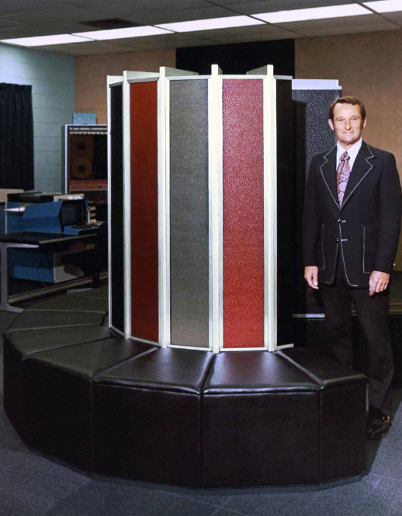
Vector Supercomputers
Cray-1, 1976
Scalar Unit
Load/Store Architecture
Vector Extension
Vector Registers
Vector Instructions
Implementation
Hardwired Control
Highly Pipelined Functional Units
Interleaved Main Memory System
No Data Caches
Local memory
No Virtual Memory
[©Cray Research, 1976]

Slide 9
Vector Programming Model
Scalar Registers
Vector Registers
x31
v31
x0
v0
[0]
[1]
[2]
[VLRMAX-1]
Vector Length Register
VLR
v1
Vector Arithmetic Instructions
vadd v3, v1, v2
v2
+
+
+
+
+
+
v3
[0]
[1]
[VLR-1]
Vector Load and Store Instructions
vld v1, x1, x2
Vector Register
v1
Base, x1
Stride, x2
Memory

Slide 10
Vector Code Example
# C code
for (i=0; i<64; i++)
C[i] = A[i] + B[i];
# Vector Code
li x4, 64
setvlr x4
vfld v1, x1
vfld v2, x2
vfadd.d v3,v1,v2
vfsd v3, x3
# Scalar Code
li x4, 64
loop:
fld f1, 0(x1)
fld f2, 0(x2)
fadd.d f3,f1,f2
fsd f3, 0(x3)
addi x1, 8
addi x2, 8
addi x3, 8
subi x4, 1
bnez x4, loop

Slide 11
Cray-1 (1976)
V0
V_{i}
V. Mask
64 Element Vector Registers
V1
V_{j}
V2
V. Length
V3
V_{k}
Single Port
Memory
16 banks of 64-bit words
+
8-bit SECDED
80MW/sec data load/store
320MW/sec instruction
buffer refill
V4
V5
V6
V7
FP Add
( (A_{h}) + j k m )
S0
S_{j}
FP Mul
S1
S_{k}
FP Recip
S_{i}
S2
(A₀)
64
T Regs
S3
S_{i}
T_{jk}
S4
Int Add
S5
S6
Int Logic
S7
Int Shift
( (A_{h}) + j k m )
A0
Pop Cnt
A1
A_{i}
A2
A_{j}
(A₀)
64
B Regs
A3
A_{k}
Addr Add
B_{jk}
A4
A5
A_{i}
Addr Mul
A6
A7
64-bitx16
NIP
CIP
4 Instruction Buffers
LIP
memory bank cycle 50 ns processor cycle 12.5 ns (80MHz)

Slide 12
Vector Instruction Set Advantages
Compact
one short instruction encodes N operations
Expressive, tells hardware that these N operations:
are independent
use the same functional unit
access disjoint registers
access registers in same pattern as previous instructions
access a contiguous block of memory (unit-stride load/store)
access memory in a known pattern (strided load/store)
Scalable
can run same code on more parallel pipelines (lanes)
2020/12/16

Slide 13
Vector Arithmetic Execution
Use deep pipeline (=> fast clock) to execute element operations
Simplifies control of deep pipeline because elements in vector are independent (=> no hazards!)
v1
v2
v3
Six-stage multiply pipeline
v3 <- v1 * v2

Slide 14
Vector Instruction Execution
vfadd.d vc, va, vb
Execution using one pipelined functional unit
Execution using four pipelined functional units
A[6]
B[6]
A[24]
B[24]
A[25]
B[25]
A[26]
B[26]
A[27]
B[27]
A[5]
B[5]
A[20]
B[20]
A[21]
B[21]
A[22]
B[22]
A[23]
B[23]
A[4]
B[4]
A[16]
B[16]
A[17]
B[17]
A[18]
B[18]
A[19]
B[19]
A[3]
B[3]
A[12]
B[12]
A[13]
B[13]
A[14]
B[14]
A[15]
B[15]
C[2]
C[8]
C[9]
C[10]
C[11]
C[1]
C[4]
C[5]
C[6]
C[7]
C[0]
C[0]
C[1]
C[2]
C[3]

Slide 15
Interleaved Vector Memory System
Bank busy time: Time before bank ready to accept next request
Cray-1, 16 banks, 4 cycle bank busy time, 12 cycle latency
Base
Stride
Vector Registers
Address Generator
+
0
1
2
3
4
5
6
7
8
9
A
B
C
D
E
F
Memory Banks
2020/12/16

Slide 16
Vector Unit Structure
Functional Unit
Vector
Registers
Elements 0, 4, 8, …
Elements 1, 5, 9, …
Elements 2, 6, 10, …
Elements 3, 7, 11, …
Lane
Memory Subsystem

Slide 17
Vector Instruction Parallelism
Can overlap execution of multiple vector instructions
example machine has 32 elements per vector register and 8 lanes
Load Unit
Multiply Unit
Add Unit
load
mul
add
time
load
mul
add
Instruction issue
Complete 24 operations/cycle while issuing 1 short instruction/cycle
2020/12/16

Slide 18
Vector Chaining
Vector version of register bypassing
introduced with Cray-1
V1
V2
V3
V4
V5
vld v1
vfmul v3,v1,v2
Vfadd v5, v3, v4
Chain
Chain
Load Unit
Mult.
Add
Memory

Slide 19
Vector Chaining Advantage
Without chaining, must wait for last element of result to be written before starting dependent instruction
Load
Mul
Time
Add
With chaining, can start dependent instruction as soon as first result appears
Load
Mul
Add

Slide 20
Vector Startup
Two components of vector startup penalty
functional unit latency (time through pipeline)
dead time or recovery time (time before another vector instruction can start down pipeline)
Functional Unit Latency
R
X
X
X
W
R
X
X
X
W
First Vector Instruction
R
X
X
X
W
R
X
X
X
W
R
X
X
X
W
Dead Time
R
X
X
X
W
R
X
X
X
W
R
X
X
X
W
Dead Time
R
X
X
X
W
Second Vector Instruction
R
X
X
X
W

Slide 21
Dead Time and Short Vectors
No dead time
T0, Eight lanes
No dead time
100% efficiency with 8 element vectors
4 cycles dead time
64 cycles active
Cray C90, Two lanes
4 cycle dead time
Maximum efficiency 94% with 128 element vectors

Slide 22
Vector Memory-Memory versus Vector Register Machines
Vector memory-memory instructions hold all vector operands in main memory
The first vector machines, CDC Star-100 (‘73) and TI ASC (‘71), were memory-memory machines
Cray-1 (’76) was first vector register machine
Vector Memory-Memory Code
ADDV C, A, B
SUBV D, A, B
Example Source Code
Vector Register Code
for (i=0; i<N; i++)
{
C[i] = A[i] + B[i];
D[i] = A[i] - B[i];
}
LV V1, A
LV V2, B
ADDV V3, V1, V2
SV V3, C
SUBV V4, V1, V2
SV V4, D

Slide 23
Vector Memory-Memory vs. Vector Register Machines
Vector memory-memory architectures (VMMA) require greater main memory bandwidth, why?
All operands must be read in and out of memory
VMMAs make if difficult to overlap execution of multiple vector operations, why?
Must check dependencies on memory addresses
VMMAs incur greater startup latency
Scalar code was faster on CDC Star-100 for vectors < 100 elements
For Cray-1, vector/scalar breakeven point was around 2-4 elements
Apart from CDC follow-ons (Cyber-205, ETA-10) all major vector machines since Cray-1 have had vector register architectures
(we ignore vector memory-memory from now on)

Slide 24
Automatic Code Vectorization
for (i=0; i < N; i++)
C[i] = A[i] + B[i];
Scalar Sequential Code
load
Vectorized Code
Iter. 1
load
load
load
add
load
load
Time
store
add
add
load
store
store
Iter. 2
load
Iter. 1
Iter. 2
Vector Instruction
add
Vectorization is a massive compile-time reordering of operation sequencing
⇒ requires extensive loop dependence analysis
store

Slide 25
Vector Stripmining
Problem: Vector registers have finite length
Solution: Break loops into pieces that fit in registers, “Stripmining”
andi x1, xN, 63 # N mod 64
setvlr x1 # Do remainder
loop:
vld v1, xA
sll x2, x1, 3 # Multiply by 8
add xA, x2 # Bump pointer
vld v2, xB
add xB, x2
vfadd.d v3, v1, v2
vsd v3, xC
add xC, x2
sub xN, x1 # Subtract elements
li x1, 64
setvlr x1 # Reset full length
bgtz xN, loop # Any more to do?
for (i=0; i<N; i++)
C[i] = A[i]+B[i];
A
B
C
+
Remainder
+
64 elements
+
2020/12/16

Slide 26
Vector Conditional Execution
Problem: Want to vectorize loops with conditional code:
for (i=0; i<N; i++)
if (A[i]>0) then
A[i] = B[i];
Solution: Add vector mask (or flag) registers
vector version of predicate registers, 1 bit per element
…and maskable vector instructions
vector operation becomes bubble (“NOP”) at elements where mask bit is clear
Code example:
cvm # Turn on all elements
vld vA, xA # Load entire A vector
vfsgts.d vA, f0 # Set bits in mask register where A>0
vld vA, xB # Load B vector into A under mask
vsd vA, xA # Store A back to memory under mask

Slide 27
Masked Vector Instructions
Density-Time Implementation
scan mask vector and only execute elements with non-zero masks
Simple Implementation
execute all N operations, turn off result writeback according to mask
M[7]=1
A[7]
B[7]
M[7]=1
M[6]=0
A[6]
B[6]
M[6]=0
A[7]
B[7]
M[5]=1
A[5]
B[5]
M[5]=1
M[4]=1
A[4]
B[4]
M[4]=1
M[3]=0
A[3]
B[3]
C[5]
M[3]=0
M[2]=0
C[4]
M[2]=0
C[2]
M[1]=1
M[1]=1
C[1]
M[0]=0
C[1]
M[0]=0
C[0]
Write data port
Write Enable
Write data port

Slide 28
Compress/Expand Operations
Compress packs non-masked elements from one vector register contiguously at start of destination vector register
population count of mask vector gives packed vector length
Expand performs inverse operation
M[7]=1
A[7]
A[7]
A[7]
M[7]=1
M[6]=0
A[6]
A[5]
B[6]
M[6]=0
M[5]=1
A[5]
A[4]
A[5]
M[5]=1
M[4]=1
A[4]
A[1]
A[4]
M[4]=1
M[3]=0
A[3]
A[7]
B[3]
M[3]=0
M[2]=0
A[2]
A[5]
B[2]
M[2]=0
M[1]=1
A[1]
A[4]
A[1]
M[1]=1
M[0]=0
A[0]
A[1]
B[0]
M[0]=0
Compress
Expand
Used for density-time conditionals and also for general selection operations

Slide 29
Vector Reductions
Problem: Loop-carried dependence on reduction variables
sum = 0;
for (i=0; i<N; i++)
sum += A[i]; # Loop-carried dependence on sum
Solution: Re-associate operations if possible, use binary tree to perform reduction
# Rearrange as:
sum[0:VL-1] = 0 # Vector of VL partial sums
for(i=0; i<N; i+=VL) # Stripmine VL-sized chunks
sum[0:VL-1] += A[i:i+VL-1]; # Vector sum
# Now have VL partial sums in one vector register
do {
VL = VL/2; # Halve vector length
sum[0:VL-1] += sum[VL:2*VL-1] # Halve no. of partials
} while (VL>1)

Slide 30
Vector Scatter/Gather
Want to vectorize loops with indirect accesses:
for (i=0; i<N; i++)
A[i] = B[i] + C[D[i]]
Indexed load instruction (Gather)
vld vD, xD # Load indices in D vector
vdli vC, xC, vD # Load indirect from rC base
vld vB, xB # Load B vector
vfadd.d vA,vB,vC # Do add
vsd vA, xA # Store result

Slide 31
Vector Scatter/Gather
Histogram example:
for (i=0; i<N; i++)
A[B[i]]++;
Is following a correct translation?
vld vB, xB # Load indices in B vector
vldi vA, xA, vB # Gather initial A values
vadd vA, vA, 1 # Increment
vsdi vA, xA, vB # Scatter incremented values

Slide 32
Vector Memory Models
Most vector machines have a very relaxed memory model, e.g.
vsd v1, x1 # Store vector to x1
vld v2, x1 # Load vector from x1
No guarantee that elements of v2 will have value of elements of v1 even when store and load execute by same processor!
Requires explicit memory barrier or fence
vsd v1, x1 # Store vector to x1
fence.vs.vl # Enforce ordering s->l
vld v2, x1 # Load vector from x1
Vector machines support highly parallel memory systems (multiple lanes and multiple load and store units) with long latency (100+ clock cycles)
hardware coherence checks would be prohibitively expensive
vectorizing compiler can eliminate most dependencies

Slide 33
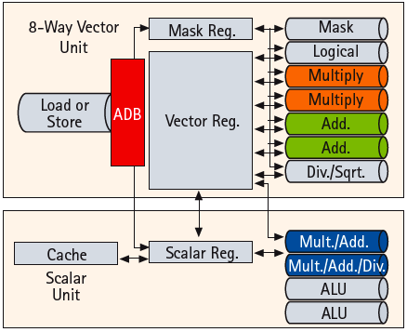
A Recent Vector Super: NEC SX-9 (2008)
65nm CMOS technology
Vector unit (3.2 GHz)
8 foreground VRegs + 64 background VRegs (256x64-bit elements/VReg)
64-bit functional units: 2 multiply, 2 add, 1 divide/sqrt, 1 logical, 1 mask unit
8 lanes (32+ FLOPS/cycle, 100+ GFLOPS peak per CPU)
1 load or store unit (8 x 8-byte accesses/cycle)
Scalar unit (1.6 GHz)
4-way superscalar with out-of-order and speculative execution
64KB I-cache and 64KB data cache
[ ©NEC ]
Memory system provides 256GB/s DRAM bandwidth per CPU
Up to 16 CPUs and up to 1TB DRAM form shared-memory node
total of 4TB/s bandwidth to shared DRAM memory
Up to 512 nodes connected via 128GB/s network links (message passing between nodes)
[ New announcement SX-ACE, 4x16-lane vector CPUs on one chip]
Notes:
Picture from NEC article “A hardware overview of SX-6 and SX-7 supercomputer”

Slide 34
Memory Banks Example: Cray T90 (Cray T932)
32 processors, each generating 4 loads and 2 stores/cycle
Clock cycle is 2.167 ns, SRAM cycle is 15 ns
How many memory banks needed?
Answer
The maximum number of memory references each cycle is 192: 32 processors times 6 references per processor
Each SRAM bank is busy for 15/2.167 = 6.92 clock cycles, which we round up to 7 processor clock cycles
We require a minimum of 192 × 7 = 1344 memory banks
The Cray T932 actually has 1024 memory banks

Slide 35
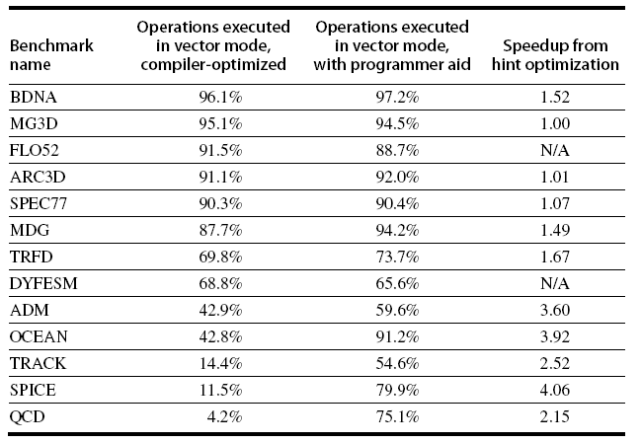
Programming Vector Architectures
Compilers can provide feedback
Programmers can provide hints to compiler

Slide 36
Seymour Cray’s Lecture
I’m certainly not inventing vector processors. There are three kinds that I know of existing today. They are represented by the Illiac-IV, the (CDC) Star processor, and the TI (ASC) processor
Those three were all pioneering processors. . . . One of the problems of being a pioneer is you always make mistakes and I never, never want to be a pioneer
It’s always best to come second when you can look at the mistakes the pioneers made
1976

Slide 37
Vector Summary
Vector is alternative model for exploiting ILP
If code is vectorizable, then simpler hardware, more energy efficient, and better real-time model than Out-of-order machines
Design issues include number of lanes, number of functional units, number of vector registers, length of vector registers, exception handling, conditional operations
Fundamental design issue is memory bandwidth
Will multimedia popularity revive vector architectures?

Slide 38
Next…
SIMD processing

Slide 39
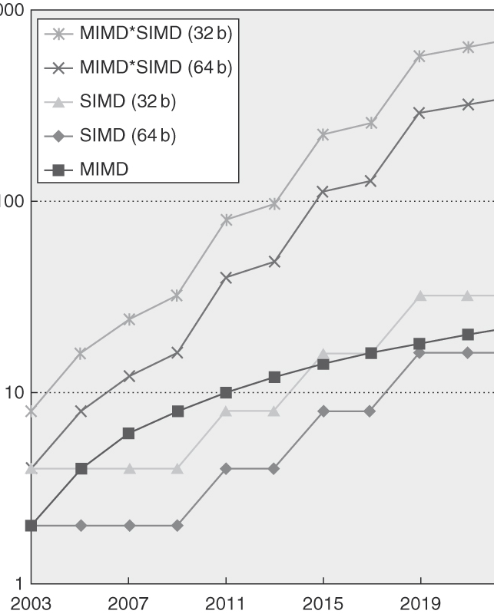
For x86 Computers
Potential speedup via parallelism from MIMD, SIMD, and both MIMD and SIMD over time
Expect two additional cores per chip per year
SIMD width to double every four years
Potential speedup from SIMD to be twice that from MIMD!

Slide 40
SIMD Extensions
Media applications operate on data types narrower than the native word size
Example: disconnect carry chains to “partition” adder
Limitations, compared to vector instructions:
Number of data operands encoded into op code
No sophisticated addressing modes (strided, scatter-gather)
No mask registers

Slide 41
SIMD Implementations
Intel MMX (1996)
Eight 8-bit integer ops or four 16-bit integer ops
Operands must be consecutive and aligned memory locations
Streaming SIMD Extensions (SSE) (1999)
Eight 16-bit integer ops
Four 32-bit integer/fp ops or two 64-bit integer/fp ops
Advanced Vector eXtensions (AVX) (2010)
Four 64-bit integer/fp ops

Slide 42
Multimedia Extensions
Very short vectors existing ISAs for micros
Usually 64-bit registers split into 2x32b or 4x16b or 8x8b
Newer designs have 128-bit registers (Altivec, SSE2)
Limited instruction set:
no vector length control
no strided load/store or scatter/gather
unit-stride loads must be aligned to 64/128-bit boundary

Slide 43
Multimedia Extensions
Limited vector register length:
requires superscalar dispatch to keep multiply/add/load units busy
loop unrolling to hide latencies increases register pressure
Trend towards fuller vector support in microprocessors

Slide 44
MMX Instructions
Move 32b, 64b
Add, Subtract in parallel: 8*8b, 4*16b, 2*32b
opt. signed/unsigned saturate (set to max) if overflow
Shifts (sll,srl, sra), And, And Not, Or, Xor in parallel: 8*8b, 4*16b, 2*32b
Multiply, Multiply-Add in parallel: 4*16b
Compare = , > in parallel: 8*8b, 4*16b, 2*32b
sets field to 0s (false) or 1s (true); removes branches
Pack/Unpack
Convert 32b<–> 16b, 16b <–> 8b
Pack saturates (set to max) if number is too large

Slide 45
Example SIMD Code: DXPY
L.D F0,a ;load scalar a
MOV F1, F0 ;copy a into F1 for SIMD MUL
MOV F2, F0 ;copy a into F2 for SIMD MUL
MOV F3, F0 ;copy a into F3 for SIMD MUL
DADDIU R4,Rx,#512 ;last address to load
Loop: L.4D F4,0[Rx] ;load X[i], X[i+1], X[i+2], X[i+3]
MUL.4D F4,F4,F0 ;a×X[i],a×X[i+1],a×X[i+2],a×X[i+3]
L.4D F8,0[Ry] ;load Y[i], Y[i+1], Y[i+2], Y[i+3]
ADD.4D F8,F8,F4 ;a×X[i]+Y[i], ..., a×X[i+3]+Y[i+3]
S.4D 0[Ry],F8 ;store into Y[i], Y[i+1], Y[i+2], Y[i+3]
DADDIU Rx,Rx,#32 ;increment index to X
DADDIU Ry,Ry,#32 ;increment index to Y
DSUBU R20,R4,Rx ;compute bound
BNEZ R20,Loop ;check if done
The multiply MUL.4D does F4*F0, F5*F1, F6*F2, and F7*F3

Slide 46
Roofline Performance Model
Basic idea:
Plot peak floating-point throughput as a function of arithmetic intensity
Ties together floating-point performance and memory performance for a target machine
Arithmetic intensity
Floating-point operations per byte read

Slide 47
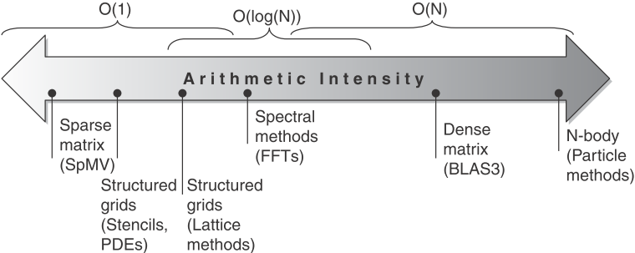
Roofline Performance Model

Slide 48
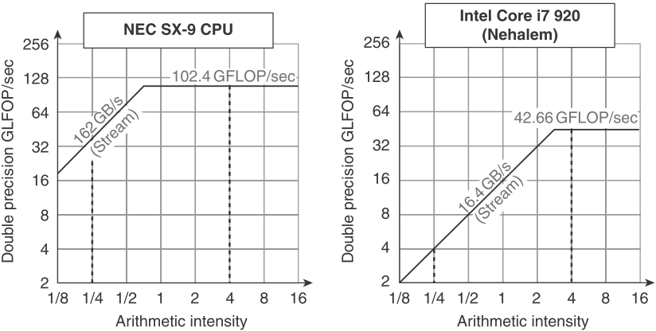
Examples
Attainable GFLOPs/sec Min = (Peak Memory BW × Arithmetic Intensity, Peak Floating Point Perf.)

Slide 49
Next…
Graphics Processing Units (GPU)

Slide 50
Graphical Processing Units
Given the hardware invested to do graphics well
How can be supplement it to improve performance of a wider range of applications?
Basic idea:
Heterogeneous execution model
CPU is the host, GPU is the device
Develop a C-like programming language for GPU
Unify all forms of GPU parallelism as CUDA thread
Programming model is “Single Instruction Multiple Thread”

Slide 51
Threads and Blocks
A thread is associated with each data element
Threads are organized into blocks
These threads are blocked together and executed in groups of 32 threads, called a Thread Block
GPU hardware handles thread management, not applications or OS
Blocks are organized into a grid
The hardware that executes a whole block of threads a multithreaded SIMD Processor

Slide 52
NVIDIA GPU Architecture
Similarities to vector machines:
Works well with data-level parallel problems
Scatter-gather transfers
Mask registers
Large register files
Differences:
No scalar processor
Uses multithreading to hide memory latency
Has many functional units, as opposed to a few deeply pipelined units like a vector processor

Slide 53
Few Details of a CUDA Program
CUDA functions
for the GPU (device) uses __device__ or __global__
for the system processor (host) uses __host__
CUDA GPU Memory variables declared as in the __device__ or __global__functions
Accessible by all multithreaded SIMD processors.
The function name that runs on the GPU is
name<<<dimGrid, dimBlock>>>(... parameter list ...)
dimGrid: dimensions of the code (in blocks)
dimBlock: dimensions of a block (in threads)
The identifier for blocks ( blockIdx )
The identifier for threads per block ( threadIdx ),
The number of threads per block ( blockDim )
Which comes from the dimBlock parameter in the bullet above

Slide 54
DAXPY
Conventional C code
// DAXPY in C
void daxpy(int n,
double a,
double *x,
double *y)
{
for (int i = 0; i < n; ++i)
y[i] = a*x[i] + y[i];
}
// Perform SAXPY on 1M elements
daxpy (4096*256, 2.0, x, y);
The CUDA version
// DAXPY in CUDA
__device__
//__Global__
void daxpy(int n,
double a,
double *x,
double *y)
{
int i = blockIdx.x*blockDim.x + threadIdx.x;
if (i < n) y[i] = a*x[i] + y[i];
}
// Perform SAXPY on 1M elements
daxpy<<<4096,256>>>(n, 2.0, x, y);

Slide 55
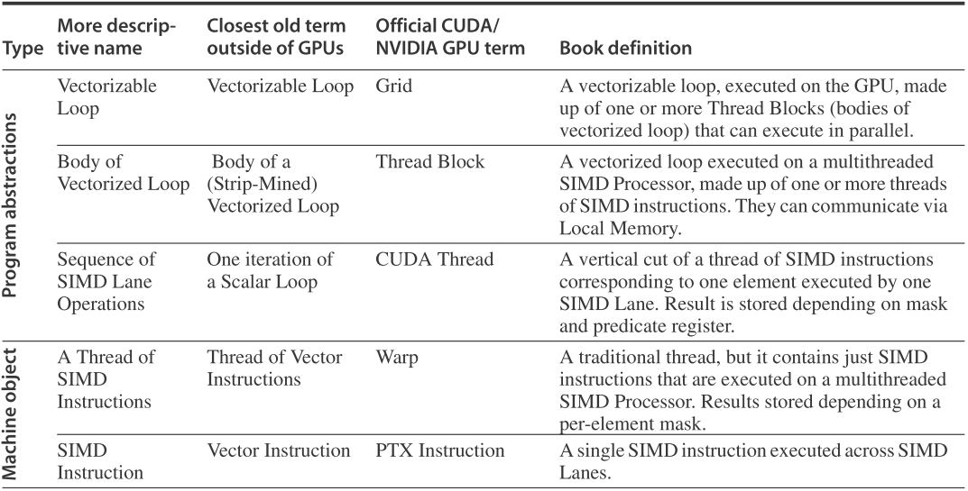
GPU terms in book and NVIDIA and OpenCL - 1

Slide 56
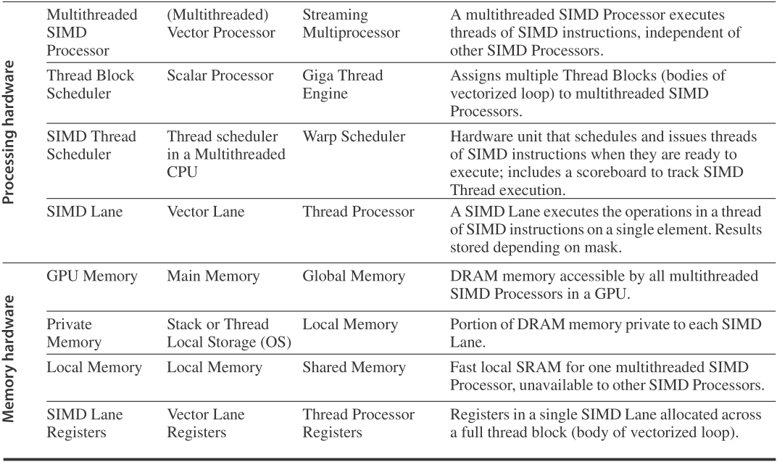
GPU terms in book and NVIDIA and OpenCL - 2

Slide 57
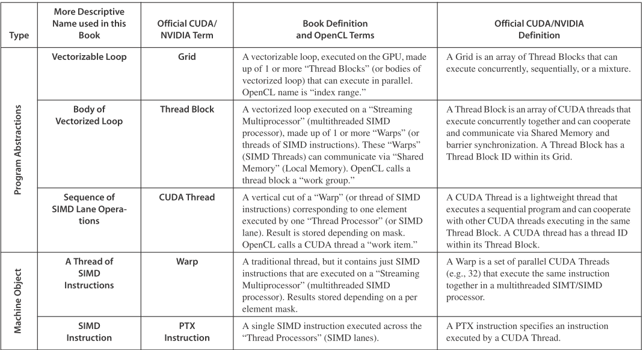
GPU terms in book and NVIDIA and OpenCL – 1 ( from back cover)

Slide 58
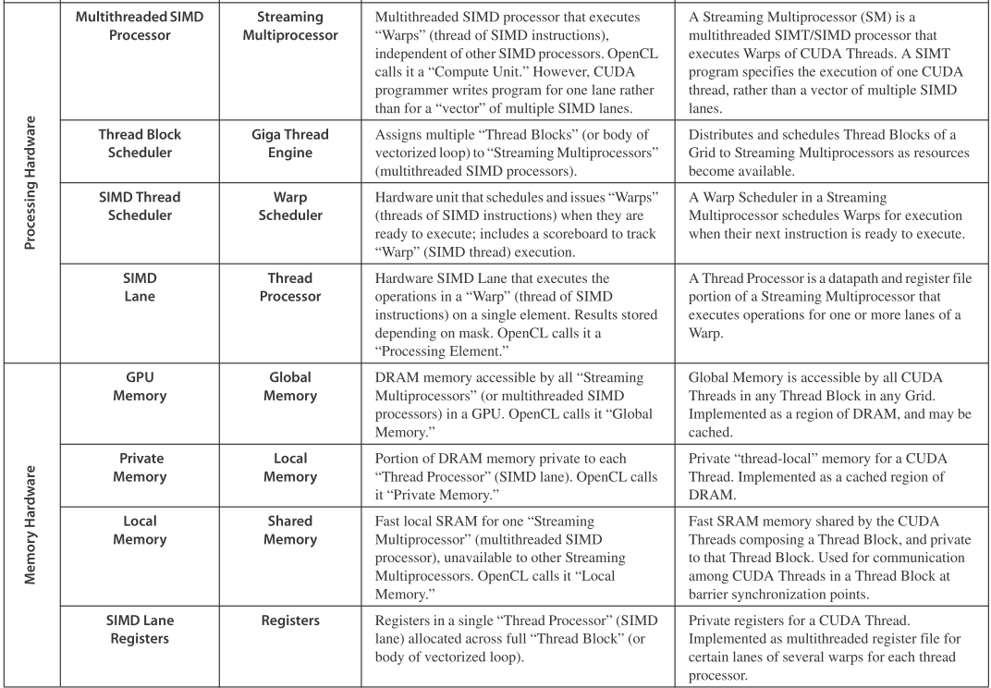
GPU terms in book and NVIDIA and OpenCL - 2 ( from back cover)

Slide 59
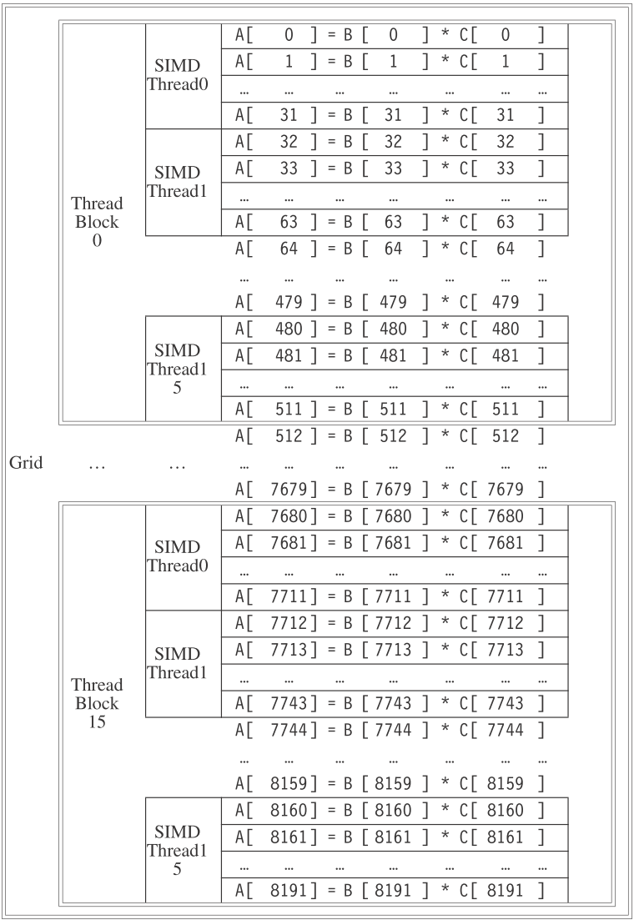
Grid, Thread Blocks and SIMD Threads
The mapping of a Grid (vectorizable loop), Thread Blocks (SIMD basic blocks), and threads of SIMD instructions
The GPU code that works on the whole 8192 element multiply is called a Grid (or vectorized loop)
A Grid is composed of Thread Blocks (or body of a vectorized loop), each with up to 512 elements
A SIMD instruction (Thread) executes 32 elements at a time

Slide 60
Example: Multiply two vectors of length 8192
A Thread Block is assigned to a processor that executes that code, which we call a multithreaded SIMD Processor, by the Thread Block Scheduler
The Thread Block Scheduler has some similarities to a control processor in a vector architecture
It determines the number of thread blocks needed for the loop and keeps allocating them to different multithreaded SIMD Processors until the loop is completed
In this example, it would send 16 Thread Blocks to multithreaded SIMD Processors to compute all 8192 elements of this loop
Current-generation GPUs (Fermi) have 7-15 multithreaded SIMD processors

Slide 61
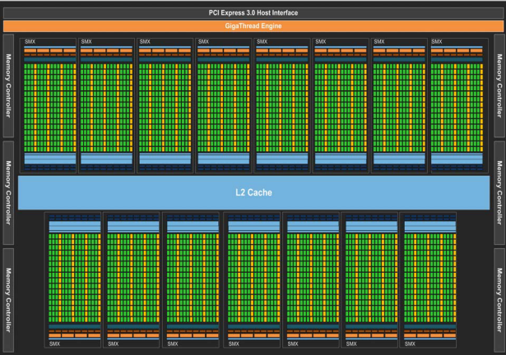
Kepler GK110 Full Chip Block Diagram

Slide 62
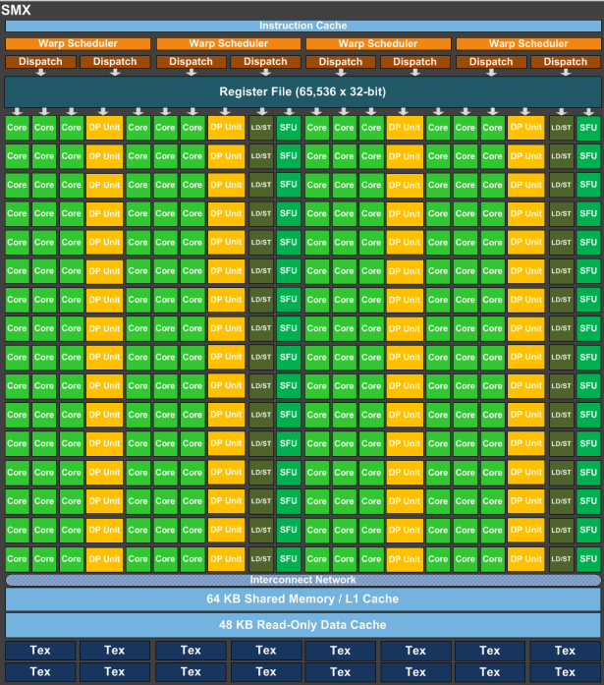
Streaming Multiprocessor (SMX) Architecture
SMX: 192 single-precision CUDA cores, 64 double-precision units, 32 special function units (SFU), and 32 load/store units (LD/ST)

Slide 63
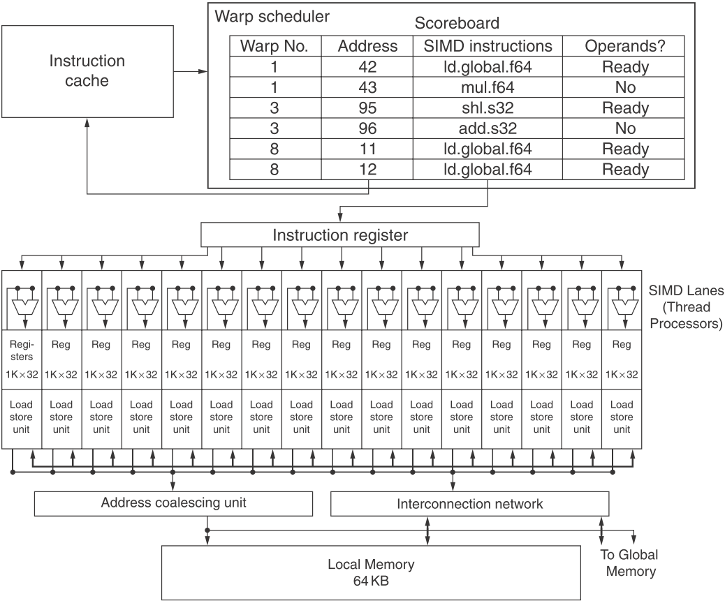
A Multithreaded SIMD Processor
16 SIMD lanes
The SIMD Thread Scheduler has, say, 48 independent threads of SIMD instructions that it schedules with a table of 48 PCs

Slide 64
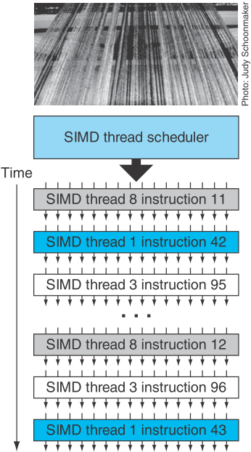
Terminology
Threads of SIMD instructions
Each has its own PC
Thread scheduler uses scoreboard to dispatch
No data dependencies between threads!
Keeps track of up to 48 threads of SIMD instructions
Hides memory latency
Thread block scheduler schedules blocks to SIMD processors
Because threads of SIMD instructions are independent, the scheduler may select a different SIMD thread each time

Slide 65
Example
NVIDIA GPU has 32,768 registers
Divided into lanes
Each SIMD thread is limited to 64 registers
SIMD thread has up to:
64 vector registers of 32 32-bit elements
32 vector registers of 32 64-bit elements
Fermi has 16 physical SIMD lanes, each containing 2048 registers

Slide 66
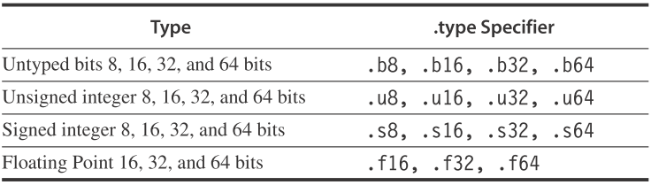
NVIDIA Instruction Set Architecture
ISA is an abstraction of the hardware instruction set
“Parallel Thread Execution (PTX)”
Uses virtual registers
Translation to machine code is performed in software

Slide 67
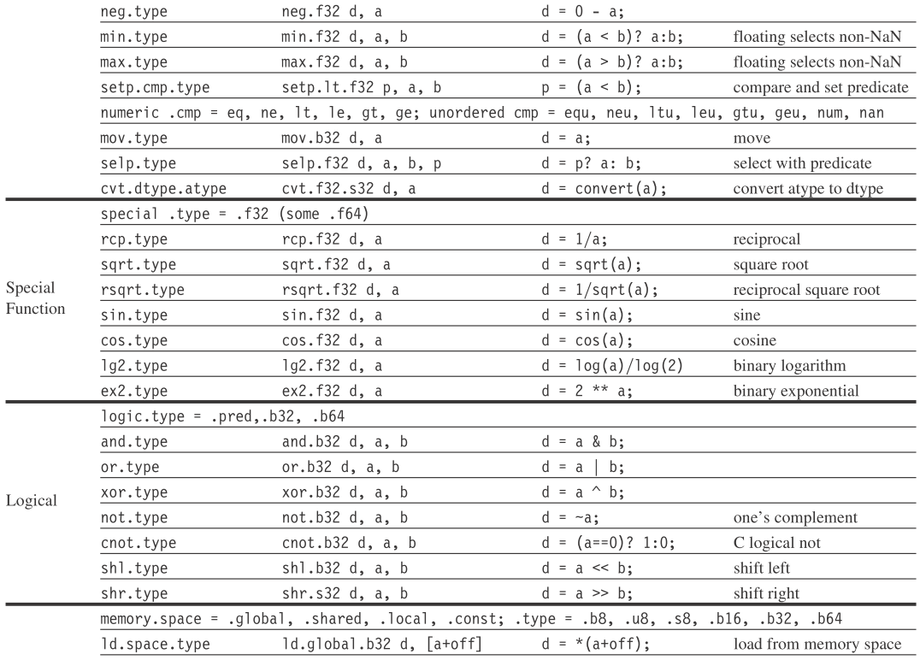
Basic PTX GPU Thread Instructions

Slide 68
DAXPY Example
shl.s32 R8, blockIdx, 9
add.s32 R8, R8, threadIdx
ld.global.f64 RD0, [X+R8]
ld.global.f64 RD2, [Y+R8]
mul.f64 R0D, RD0, RD4
add.f64 R0D, RD0, RD2
st.global.f64 [Y+R8], RD0
; Thread Block ID * Block size (512 or 2⁹)
; R8 = i = my CUDA thread ID
; RD0 = X[i]
; RD2 = Y[i]
; Product in RD0 = RD0 * RD4 (scalar a)
; Sum in RD0 = RD0 + RD2 (Y[i])
; Y[i] = sum (X[i]*a + Y[i])

Slide 69
Loop-Level Parallelism
Focuses on determining whether data accesses in later iterations are dependent on data values produced in earlier iterations
Loop-carried dependence
Example 1:
for (i=999; i>=0; i=i-1)
x[i] = x[i] + s;
No loop-carried dependence

Slide 70
Loop-Level Parallelism
Example 2:
for (i=0; i<100; i=i+1) {
A[i+1] = A[i] + C[i]; /* S1 */
B[i+1] = B[i] + A[i+1]; /* S2 */
}
S1 and S2 use values computed by S1 in previous iteration
S2 uses value computed by S1 in same iteration

Slide 71
Loop-Level Parallelism
Example 3:
for (i=0; i<100; i=i+1) {
A[i] = A[i] + B[i]; /* S1 */
B[i+1] = C[i] + D[i]; /* S2 */
}
S1 uses value computed by S2 in previous iteration but dependence is not circular so loop is parallel
Transform to:
A[0] = A[0] + B[0];
for (i=0; i<99; i=i+1) {
B[i+1] = C[i] + D[i];
A[i+1] = A[i+1] + B[i+1];
}
B[100] = C[99] + D[99];

Slide 72
Loop-Level Parallelism
Example 4:
for (i=0;i<100;i=i+1) {
A[i] = B[i] + C[i];
D[i] = A[i] * E[i];
}
Example 5:
for (i=1;i<100;i=i+1) {
Y[i] = Y[i-1] + Y[i];
}

Slide 73
Finding Dependencies
Assume indices are affine:
a x i + b (i is loop index)
Assume:
Store to a x i + b, then
Load from c x i + d
i runs from m to n
Dependence exists if:
Given j, k such that m ≤ j ≤ n, m ≤ k ≤ n
Store to a x j + b, load from a x k + d, and a x j + b = c x k + d

Slide 74
Finding Dependencies
Generally cannot determine at compile time
Test for absence of a dependence:
GCD test:
If a dependency exists, GCD(c,a) must evenly divide (d-b)
Example:
for (i=0; i<100; i=i+1) {
X[2*i+3] = X[2*i] * 5.0;
}

Slide 75
Finding Dependencies
Example 2:
for (i=0; i<100; i=i+1) {
Y[i] = X[i] / c; /* S1 */
X[i] = X[i] + c; /* S2 */
Z[i] = Y[i] + c; /* S3 */
Y[i] = c - Y[i]; /* S4 */
}
Watch for antidependencies and output dependencies

Slide 76
Reductions
Reduction Operation:
for (i=9999; i>=0; i=i-1)
sum = sum + x[i] * y[i];
Transform to…
for (i=9999; i>=0; i=i-1)
sum [i] = x[i] * y[i];
for (i=9999; i>=0; i=i-1)
finalsum = finalsum + sum[i];
Do on p processors:
for (i=999; i>=0; i=i-1)
finalsum[p] = finalsum[p] + sum[i+1000*p];
Note: assumes associativity!

Slide 77
Homework
Review
4.1~4.4
G.1~G.5
Reading papers
The CRAY-1 Computer System

