Slide 1
Advanced Computer Architecture (ACA2020)
Dr. ZHANG Chun-yuan
College of Computer, NUDT
Fall, 2020

Slide 2
Lecture 10 Processor Examples
December 15, 2020

Slide 3
学术不端行为三宗罪（FFP）
一、伪造（Fabrication）：编造研究记录或结果
无中生有地捏造
二、虚假（Falsification）：对材料、设备、过程、结果等进行作假，包括故意地筛选、篡改研究记录等
有点影子，确实做过，但得不到想要的结果，就往自己希望看到的方向修改结果
用PS加工试验图表（国内比较常见）
三、剽窃（Plagiarism）：窃取他人的想法、过程、结果、文字等，而未给他人的贡献已足够的承认
盗用他人的物件是偷，盗用他人的文字也是偷
不包括：能力不足的错误和观点的分歧
这一点往往导致法律和道德上的争议

Slide 4
剽窃的5个层次（摘自IEEE指南）
最严重地是未注明出处地全文复制一篇论文
吊销违规者在IEEE刊物上的发表权利5年
其次是未注明出处地大量复制一篇论文，达一半的篇幅
处罚和上面的是一样的
第三是未注明出处地照搬句子、段落或插图
第四是未注明出处地不恰当地复述整页或整段内容，通过改变个别单词、词组或重排句子顺序
最后是注明出处地复制一篇论文的很大一部分，而没有清楚地表明谁做了或写了什么

Slide 5
抄别人的描述，把数据换成自己的, OK?
“因为英文水平有限，所以我写英文文章时借鉴了那些母语为英语的同行发表的相关文章，甚至原封不动地摘抄了一些语句，这是我个人的问题，以后我肯定会多加注意！
与文科类文献不同，即使在化学专业学术论文中原封不动地借鉴了文献中的某些语句，但只要报道的是自己的研究结果和结论，就和抄袭没有任何关系！因为化学文献注重的是实验方法、数据和结论，而不是个别单词或者语句的写法。”

Slide 6
剽窃与引用
你用了别人的大段文字，注明了出处，但是没有对别人的文字做恰当的改写，也是剽窃
如果是直接引用别人的文字，要用引号给引起来表示是引用，光是注明出处还不行
有的人写论文的引言部分去抄别人的，抄完了注明引自这篇论文。那也是剽窃
重要、重要、重要……
你在介绍别人的成果的时候，必须用自己的语言进行复述，而不能不用引号地直接用别人的话
这是国际学术界公认的一条准则

Slide 7
署名、一稿多投和会议转杂志
导师署名：你既然署了名，就要承担责任
署名是一种荣誉，也是一种责任
不能说好事都归你，坏事就都不负责
学术行为不当中还有一种情况：一稿多投
原因：看了新文章，没有新收获
一稿多投在国际上被认为是不正当的行为
国际学术期刊一般都是反对一稿多投的
会议转杂志，一般会有一个修改比例
例如：正文内容有30%以上不同
国内会议和多数杂志没有这个要求
一稿多投？没有完全禁止！

Slide 8
一稿多投的“技巧”：不当行为
一次投多个刊物：刊物文章的组织带来不便
提高命中率
挑选高档次
挑选能够快速发表的
在国外刊物和国内刊物同时一稿多投
国外转国内：外文发表后又翻译成中文发表
纯粹就是为了增加论文数
“遍地开花”大法
题目、摘要、正文修改数个字
一稿三投、四投、……、十五投

Slide 9
发现抄袭和一稿多投的利器
提供论文相似度对比的网站
原始目的：为研究者提供关相关研究的查找
英文网站：
中文网站：CNKI（中国知网）、军网
知网节技术
不足：跨语种机器难以识别，“反相似”的处理……
打击学术不端行为的网站
新语丝

Slide 10
Advanced Computer Architecture 2017
Dr. Chun-yuan ZHANG
College of Computer, NUDT
Fall, 2017

Slide 11
Processor Examples

Slide 12
First of All, We Ought to Know What We have Done
Why electronic computer?
What is the road and who are the pioneers?
What is the elements or the base of building a computer?
What is the near future look like?
What is your chance?
This is what I really out of my imagenation!

Slide 13
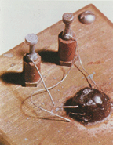
Where It Came From?
1940 - PN junction
Russel Ohl at Bell Labs develops the PN junction that produces 0.5 volts when exposed to light

Slide 14
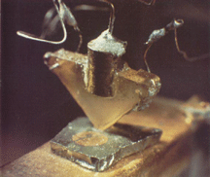
Point Contact Transistor

Slide 15
Junction Transistor
The point contact transistor was difficult to produce and was replaced by the junction transistor by the mid fifties
In 1956 the importance of the invention of the transistor by Bardeen, Brattain and Shockley was recognized by the Nobel Prize in physics

Slide 16
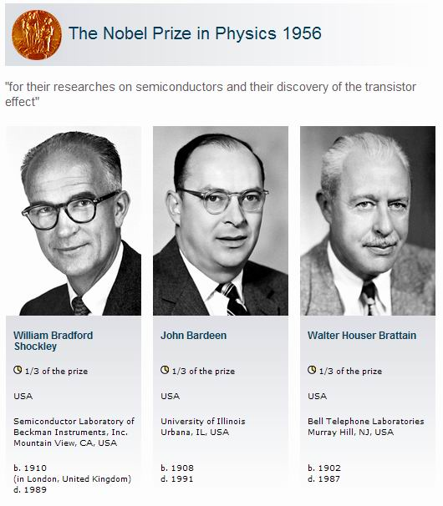
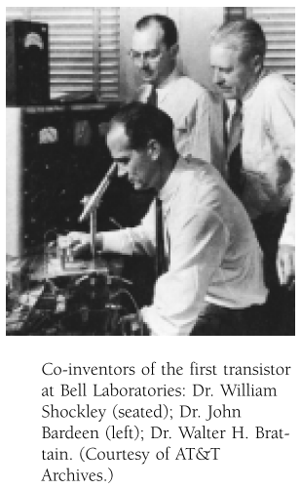
http://www.nobelprize.org/
In 1951,the junction transistor was developed

Slide 17
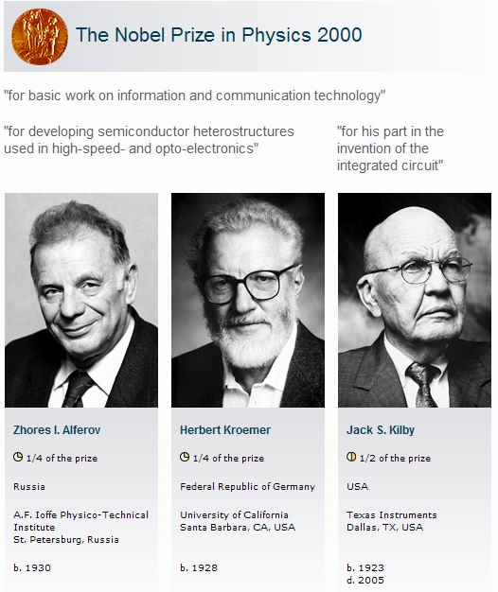
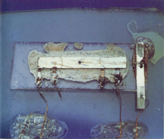
http://www.nobelprize.org/
In July of 1958, Jack Kilby was a recent hire at Texas Instruments
On July 24, 1958 in the quiet of the miniaturization lab…

Slide 18
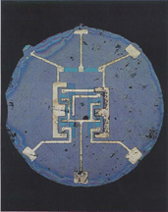
The 1st Planar IC
By late 1958 Swiss-born physicist - Jean Hoerni at Fairchild had developed a structure with N and P junctions formed in silicon.
Over the junctions a thin layer of silicon dioxide was used as an insulator and holes were etched open in the silicon dioxide to connect to the junctions
Czech-born physicist - Kurt Lehovec of Sprague Electric developed the technique of using PN junctions to electrically isolate components
In 1959, Robert Noyce also of Fairchild had the idea to create an integrated circuit by combing Hoerni's and Lehovec's processes and evaporating a thin metal layer over the circuits
The metal layer connected down to the junctions through the holes in the silicon dioxide and was then etched into a pattern to interconnect the circuit

Slide 19
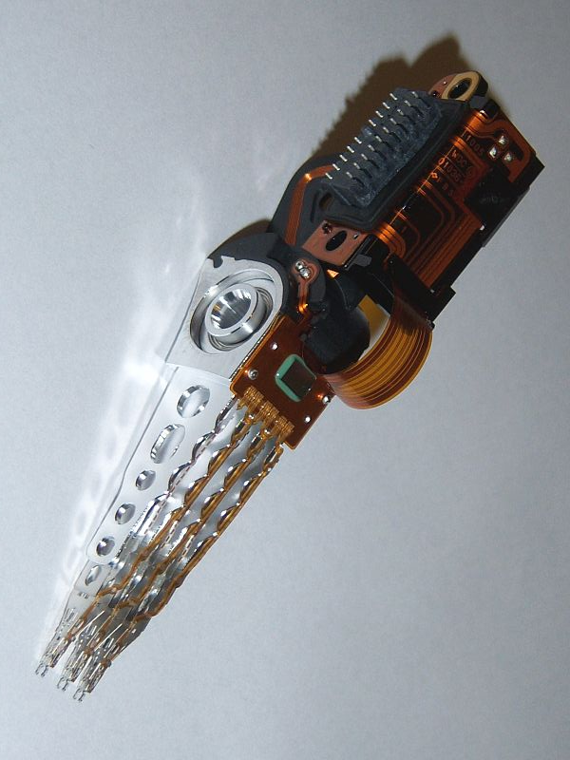
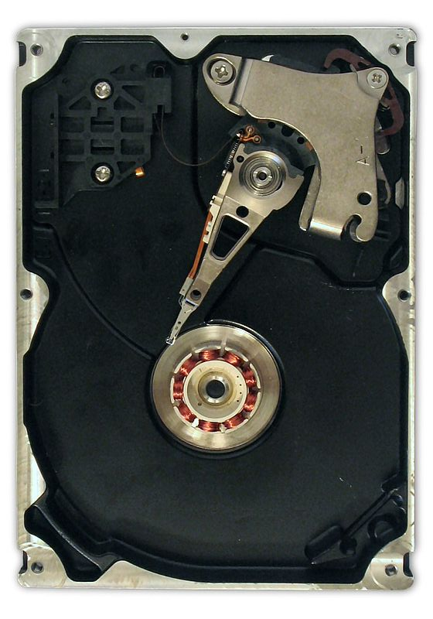
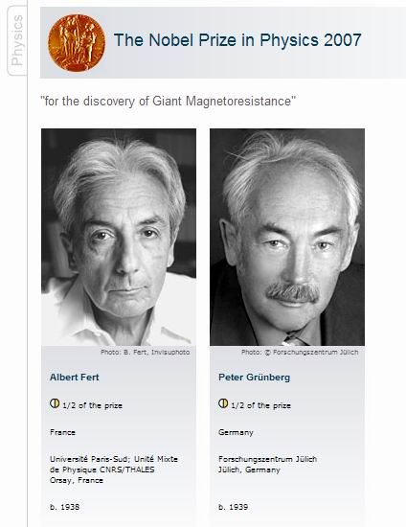
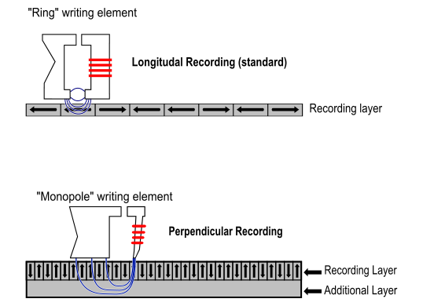
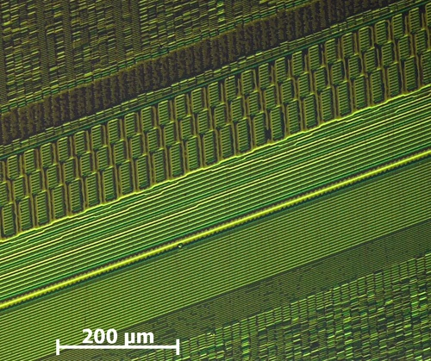
Hard Disk

Slide 20

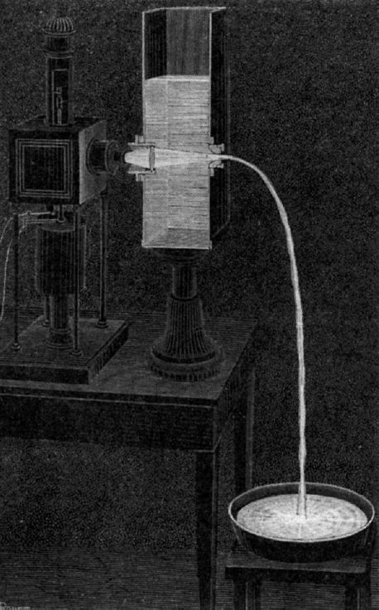
Optical Fiber

Slide 21
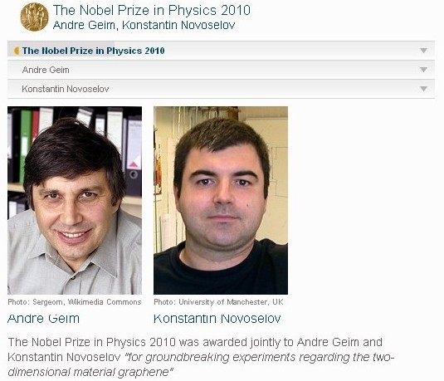

Electronic Properties (wikipedia)

Slide 22

http://www.nobelprize.org/
法国科学研究中心（CNRS, The French National Center for Scientific Research ）
美国国家标准技术研究所（NIST, National Institute of Standards and Technology）

Slide 23
Next...
Processor Examples
1. The ARM Cortex-A8 ...

Slide 24
ARM Cortex-A8
the ARM Cortex-A8 core is used
Apple A9 processor in the iPad, as well as the processor in the Motorola Droid and the iPhones 3GS and 4
The A8 is a dual-issue, statically scheduled superscalar
with dynamic issue detection, which allows the processor to issue one or two instructions per clock

Slide 25
The A8 Dynamic Branch Predictor
A 512-entry two-way set associative branch target buffer (BTB)
A 4K-entry global history buffer (BPB)
Indexed by the branch history and the current PC
In the event that the branch target buffer misses, a prediction is obtained from the global history buffer, which can then be used to compute the branch address
An eight-entry return stack is kept to track return addresses
An incorrect prediction results in a 13-cycle penalty as the pipeline is flushed

Slide 26
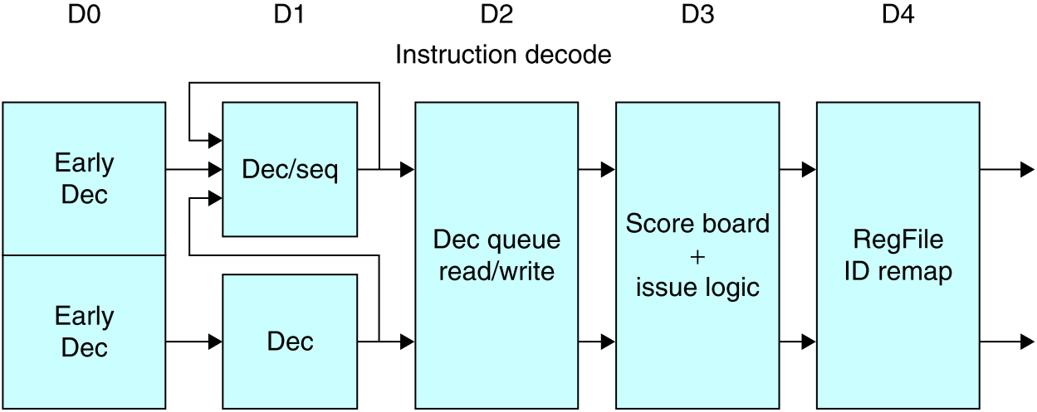
The Five-stage Instruction Decode of The A8

Slide 27
The Five-stage Instruction Decode of The A8
In the first stage, a PC produced by the fetch unit (either from the branch target buffer or the PC incrementer) is used to retrieve an 8-byte block from the cache
Up to two instructions are decoded and placed into the decode queue; if neither instruction is a branch, the PC is incremented for the next fetch
Once in the decode queue, the scoreboard logic decides when the instructions can issue
In the issue, the register operands are read; recall that in a simple scoreboard, the operands always come from the registers
The register operands and opcode are sent to the instruction execution portion of the pipeline

Slide 28
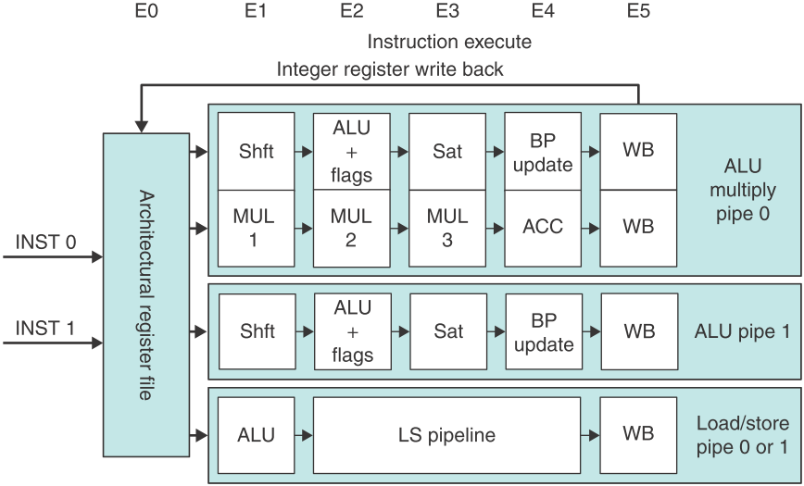
The Execution Pipeline for The A8 Processor

Slide 29
The Execution Pipeline for The A8 Processor
Either instruction 1 or instruction 2 can go to the load/store pipeline
Fully bypassing is supported among the pipelines
The ARM Cortex-A8 pipeline uses a simple two-issue statically scheduled superscalar to allow reasonably high clock rate with lower power

Slide 30
Performance of the A8 Pipeline
The A8 has an ideal CPI of 0.5 due to its dual-issue structure
Pipeline stalls can arise from three sources
1. Functional hazards
2. Data hazards, which are detected early in the pipeline and may stall either both instructions or the second of a pair
If the first cannot issue, the second is always stalled
The compiler is responsible for preventing such stalls when possible
3. Control hazards, which arise only when branches are mispredicted

Slide 31
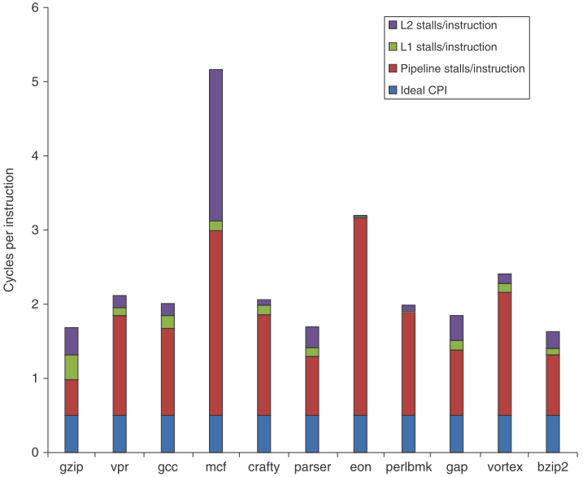
The Estimated of The CPI on The ARM A8

Slide 32
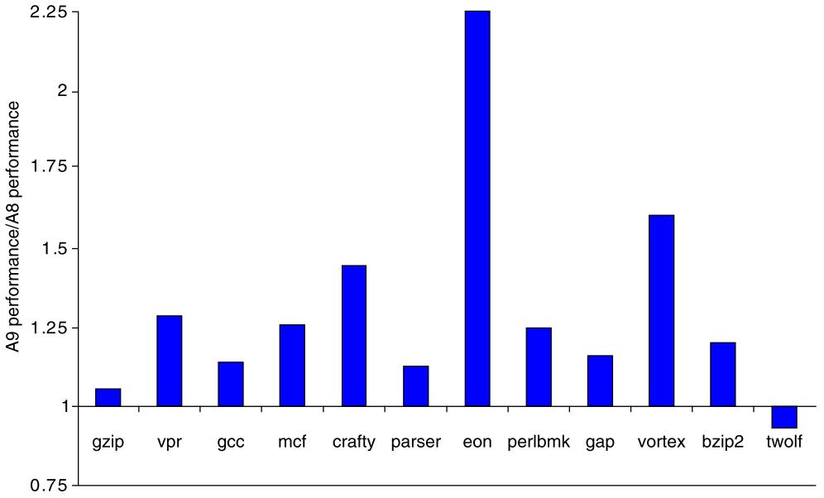
The Performance Ratio for The A9 Compared to The A8
Both using a 1 GHz clock and the same size caches for L1 and L2
The A9 is about 1.28 times faster

Slide 33
ARM Cortex-A9
The ARM Cortex-A9 is a dynamically scheduled superscalar processor
The A9, like the A8, issues up to two instructions per clock, but it uses dynamic scheduling and speculation
Up to four pending instructions (two ALUs, one load/store or FP/multimedia, and one branch) can begin execution in a clock cycle
The A9 uses a more powerful branch predictor, instruction cache prefetch, and a nonblocking L1 data cache

Slide 34
Next…
Example 2: PowerPC 604e

Slide 35
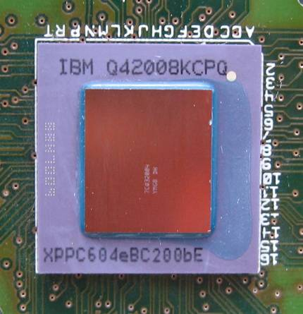
PowerPC 604e, Introduced in 1996
Manufactured by IBM and Motorola respectively
separate 32 KB data and instruction L1 caches
5.1 million transistors on a 0.35 µm fabrication process
The die was 148 mm² or 96 mm² large, drawing 16-18W at 233 MHz
Operated at speeds between 166 and 233 MHz and supported a memory bus up to 66 MHz

Slide 36
PowerPC 604e : Features
The PowerPC 604e includes we have discussed
Four-way superscale: ability to fetch, issue and complete up to four instructions per cycle
Dynamic branch prediction
Speculation
Out-of-order execution
The Tomasulo's algorithm, speculation extended
The 604e has seven separate execution units, each of which can initiate execution independently from its own reservation stations

Slide 37
The Seven Function Units 1/2
Two separate simple integer units (XSU0 and XSU1) for add, sub, etc
One cycle per simple operation
One complex integer unit (MCFXU) for integer multiply/divide
3-20 cycles per operation
One condition register unit
One branch processing unit (BPU)

Slide 38
The Seven Function Units 2/2
One load/store unit (LSU)
One cycle per integer loads
Two cycles per FP loads
One floating-point unit (FPU)
Two cycles for FP add, multiply, or multiply/add
31 cycles for FP divide
The 604e pipeline varies from 5 to 7 clock cycles
Instructions like divide take longer

Slide 39
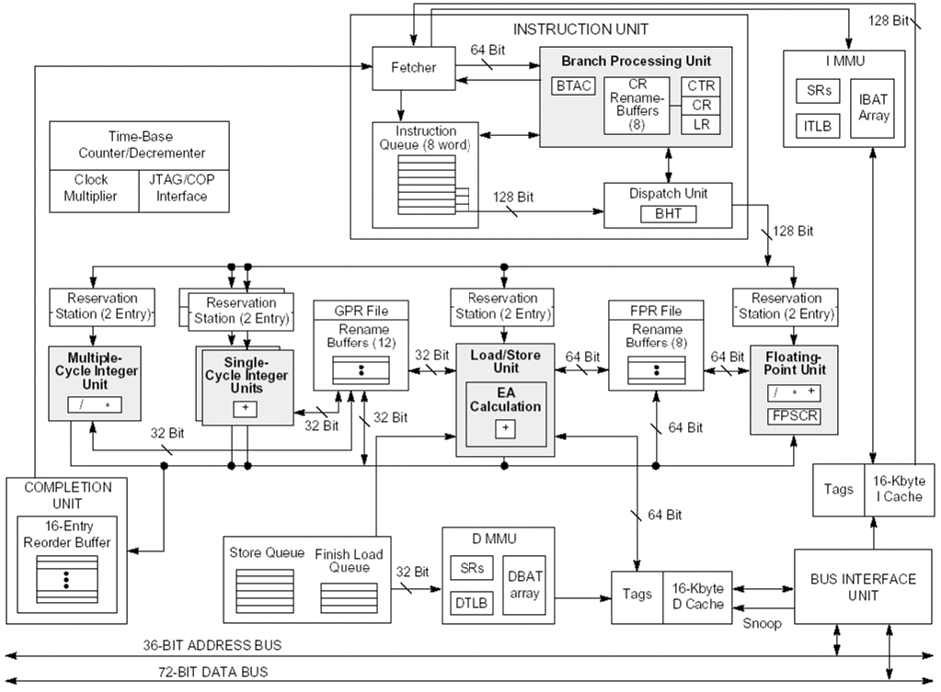
Block Diagram

Slide 40
PowerPC 604e : Reorder Buffer
The reorder buffer does not hold speculative results
It only holds the information needed to complete the instruction when it commits
The register sets (both GPRs and FPRs) are extended with 8 extra registers in each set
These extra registers are used to hold the speculative results until the instruction commits
At which time the results are written from these “renaming” registers to the standard registers
All operands still are loaded into reservation stations as soon as they are available

Slide 41
Pipeline Stages : Fetch
The fetch unit
Loads the instruction queue in the dispatch unit with instructions from the i-cache
Determines the next PC
A 256-entry BTB is used as the first source for predicting the next address
Another 2048-entry BPB is used when there is no hit in the BTB
But a branch is decoded
Still another stack of return address registers is used to predict subroutine returns
This is the indirect branch processing unit

Slide 42
Pipeline Stages : Instruction Decode
The next four instructions are decoded in this stage and passed on to the issue stage

Slide 43
Pipeline Stages : Instruction Issue
The instructions are issued to the appropriate reservation stations during this stage
The 604e calls this operation dispatch
An entry in the reorder buffer is allocated to ensure in-order completion
Operands are read from the register file and passed to either the functional unit or into the reservation station
A rename register is allocated to hold the result of the instruction

Slide 44
Pipeline Stages : Execute 1/2
Only when all operands are available in a reservation station
At the end of execution, the result is written on the appropriate result bus(CDB)
An execution can take from 1 to 31 cycles
The waiting reservation stations and rename buffer (renaming registers) get the result from the bus
The completion unit is notified that the instruction completed

Slide 45
Pipeline Stages : Execute 2/2
If it is a mispredicted branch
Notifying the instruction unit and the completion unit
Causing instruction fetch to restart at the corrected address
Causing the completion unit to discard any speculated instructions
Free the renaming registers holding the speculated results

Slide 46
Pipeline Stages : Commit
This occurs when all previous instructions have been committed
The results in the rename registers are written to the standard registers and the rename registers are freed
Upon completing a store instruction, the load/store unit is also notified so the corresponding store buffer can be sent to the data cache

Slide 47
Next…
Intel P6 Architecture

Slide 48
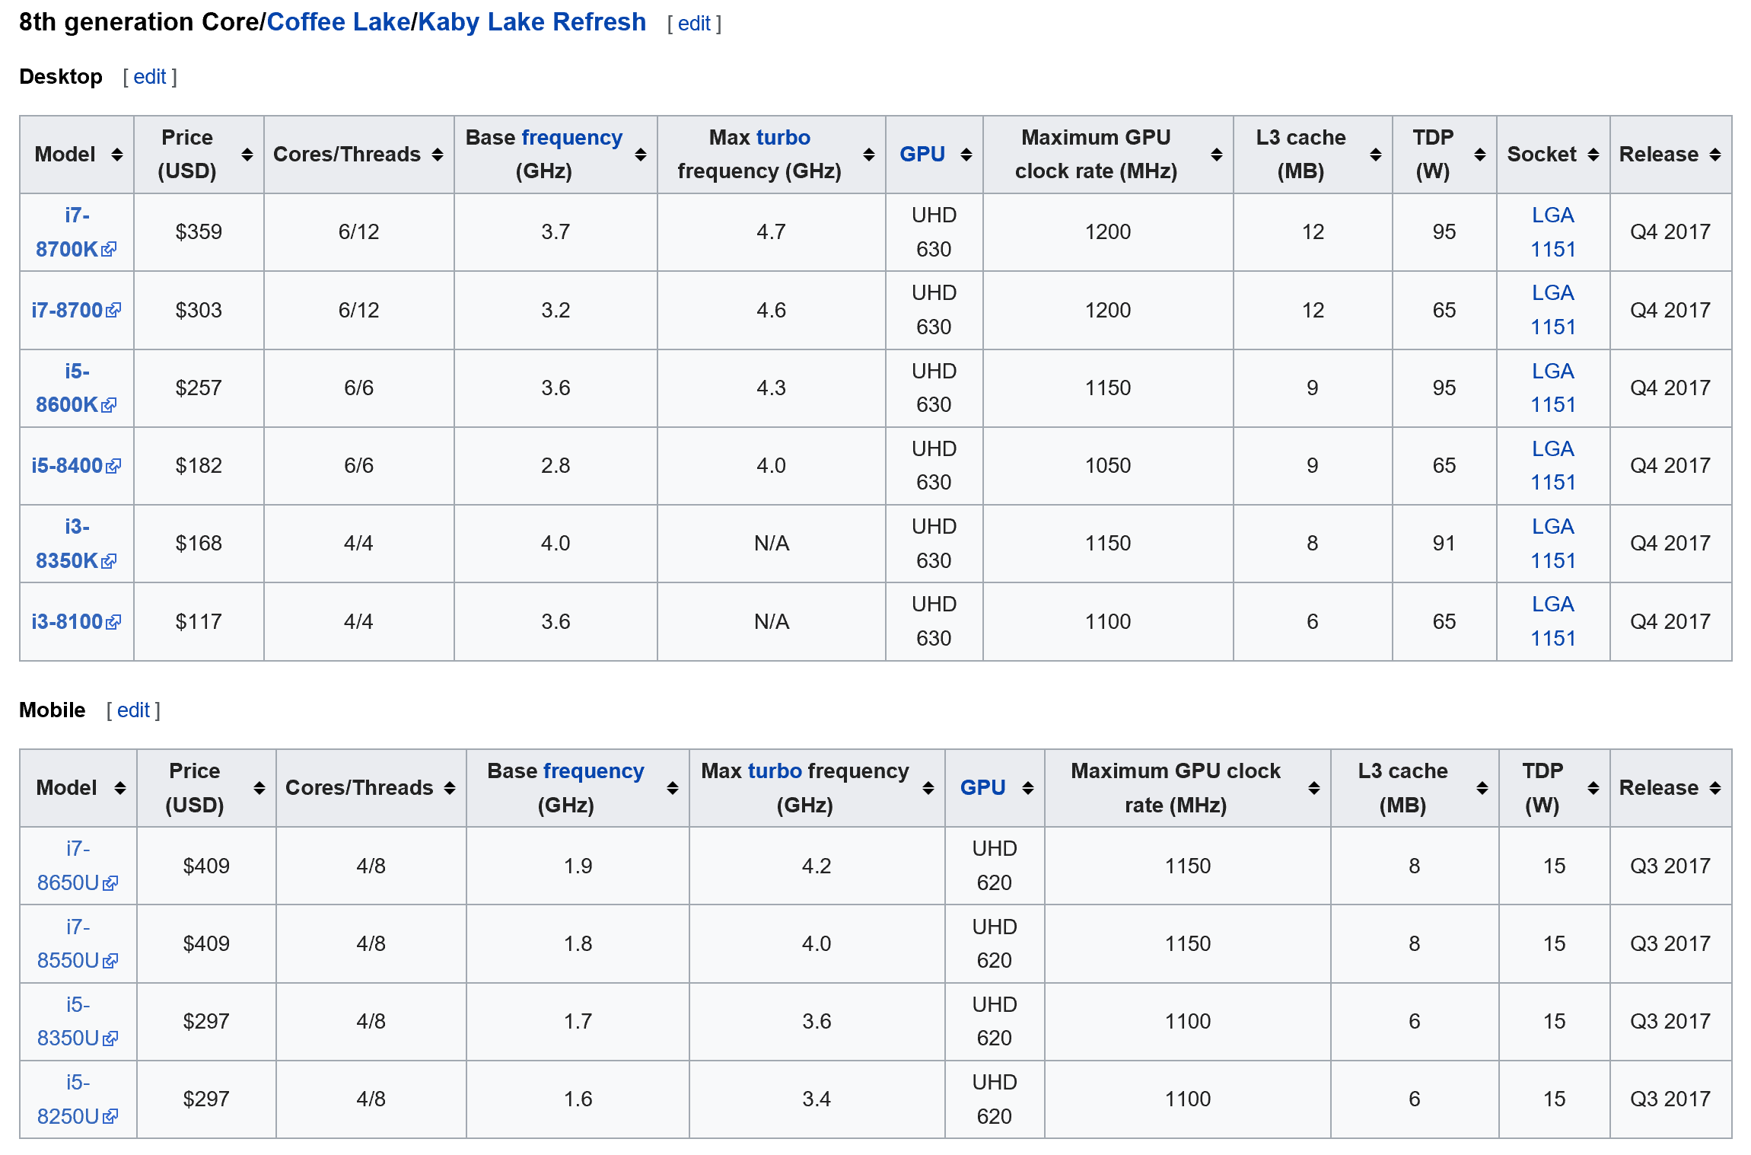

Slide 49
x86 Microarchitectures, Released
8086: the first 16-bit processor
i186: a SoC like 8086
i286: the first 16-bit VM processor with 24-bit address
i386: the first 32-bit x86 processor
i486: Intel's second-generation of 32-bit x86 processors with RISK technology
P5: Original Pentium microprocessors, two-way superscale integer pipeline, named U and V
P6: Used in Pentium Pro, Pentium II, Pentium II Xeon, Pentium III, and Pentium III Xeon microprocessors

Slide 50
x86 Microarchitectures, Released and Current
NetBurst: Used in Pentium 4, Pentium D, and some Xeon microprocessors
Pentium M -- Updated version of Pentium III's P6 microarchitecture designed from the ground up for mobile computing
Enhanced Pentium M -- Updated, dual core version of the Pentium M microarchitecture used in Core microprocessors.
Core: New microarchitecture, based on the P6 architecture, used in Core 2 and Xeon microprocessors, built on a 65nm process.
Penryn: 45nm shrink of the Core microarchitecture with larger cache, faster FSB and clock speeds, and SSE4.1 instructions.
Atom: Low-power, in-order x86-64 processor for use in Mobile Internet Devices
Nehalem: was released in 2008, built on a 45nm process
It will be an enhanced version of the Core microarchitecture

Slide 51
x86 Multiprocessor: Xeon Phi (Wikipedia)
Intel Many Integrated Core Architecture or Intel MIC (pronounced Mike) is a multiprocessor computer architecture developed by Intel incorporating earlier work on the Larrabee many core architecture, the Teraflops Research Chip multicore chip research project and the Intel Single-chip Cloud Computer multicore microprocessor
Larrabee: Multi-core in-order x86-64 processor with wide SIMD vector units and texture sampling hardware for use in graphics
See also: Larrabee (microarchitecture), Teraflops Research Chip, and Single-chip Cloud Computer
Intel MIC (Redirected from Xeon Phi)

Slide 52
Intel P6: the 6th Generation Microarchitecture
The first implementation of the P6 core was the Pentium Pro CPU in 1995
From Pentium Pro to Pentium III
It was succeeded by the NetBurst in 2000
Revived in the Pentium M line of microprocessors
The successor to the Pentium M variant of the P6 is the Intel Core microarchitecture
Intel has found that the superpipelined NetBurst pipelines and eneygy efficiency are lower then P6

Slide 53
Intel P6 Charactors
The P6 is a CISC/RISC hybrid
The Pentium Pro, Pentium II, Pentium III
A CISC instruction sets
A RISC micro-architecture as a core
The Pentium Pro and Pentium II were developed by the company’s design team in Hillsboro, Oregon
They earlier worked on the i960, a RISC design
Previous x86 Intel processors came from their facility in Santa Clara, CA

Slide 54
The First P6: Pentium Pro (on November 1995)
L1 cache: 8 + 8 KB (Data + Instructions)
L2 cache: 256, 512 KB (one die) or 1024 KB (two 512 KB dies) in a multi-chip module clocked at CPU-speed
Socket: Socket 8
Front side bus: 60 and 66 MHz
VCore: 3.1-3.3 V
Fabrication: 0.50 µm or 0.35 BiCMOS
Transistors: 5.5 million
Clockrate: 150, 166, 180, 200 MHz

Slide 55
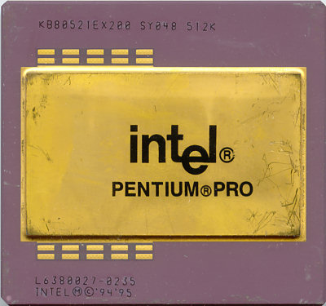
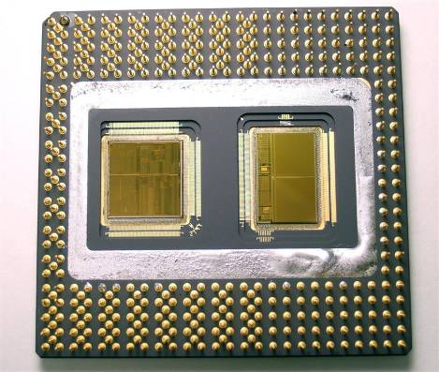
Pentium Pro

Slide 56
Pentium II (on May 7, 1997)
Produced: From mid 1997 to early 1999
Max CPU clock: 233 MHz to 450 MHz
FSB speeds: 66 to 100
Min feature size: 0.35 µm to 0.25 µm
Instruction set: x86, MMX
Socket(s): Slot 1
VCore: 1.5, 1.55, 1.6 V, 2.0 V, 2.8 V
Transistors: 7.5 million
Others
Core name(s): Klamath, Deschutes, Tonga, Dixon
In early 1999, it was superseded by the Pentium III

Slide 57
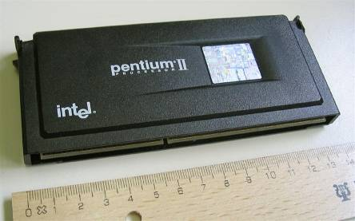
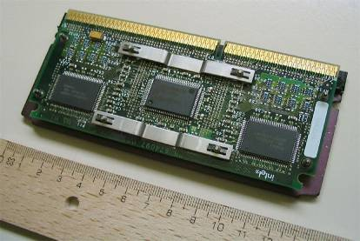
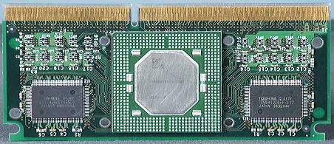
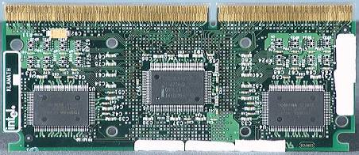
Pentium II, Slot 1

Slide 58
The Intel P6 Competitors
Using a RISC core for the x86 architecture is not original to Intel
Similar designs appeared earlier in
The NextGen Nx586 -> AMD K6
The AMD K5
The Cyrix 6x86 and MII -> National Semiconductor -> VIA C
IDT WinChip -> VIA

Slide 59
Intel P6 Organization
A three-issue, superscalar micro-architecture
A 14-stage pipeline
Intel sometimes counts them as 12 stages
Six parallel execution units
Two integer
One load
One store
One FP unit
One MMX unit
The first separate MMX unit processor

Slide 60
The Latency and Repeat Rate For uOPs
Instruction name | Pipeline stages | Repeat rate
Integer ALU | 1 | 1
Integer load | 3 | 1
Integer multiply | 4 | 1
FP add | 3 | 1
FP multiply | 5 | 2
FP divide (64-bit) | 32 | 32

Slide 61
P6 Microarchitecture
Data Cache Unit (L1)
External bus
Chip boundary
Memory
Cluster
Bus Cluster
Memory Order Buffer
Bus interface unit
AGU
Instruction Fetch Unit
Instruction Fetch Unit
MMX
Control
Flow
IEU/JEU
BTB/BAC
IEU/JEU
Restricted
Data
Flow
FEU
Instruction Fetch Cluster
MIU
Instruction
Decoder
Instruction
Decoder
Register Alias Table
Reservation Station
Out-of-order
Cluster
Microcode Sequencer
Allocator
ROB & Retire RF
Issue Cluster

Slide 62
Intel P6 : Stage 1
The instruction fetch unit (IFU) calculates the value of the next PC
The 512 entry BTB helps the IFU choose an instruction address
If the updated PC points to a recently used branch instruction
Whether or not that branch is predicted to be taken or not

Slide 63
Intel P6 : Stages 2-4 1/3
The IFU fetches two cache lines of 128 bits each from the instruction cache during these three stages
I-cache fetches are pipelined with a new instruction line fetch starting on every cycle

Slide 64
Intel P6 : Stages 2-4 2/3
A miss in the 16KB I-cache causes the hardware to go back to the L2 cache
L2 can fetch 2 x 64 bits every 2 cycles
Two I-cache lines are fetched by the IFU
The x86 instructions can be long (up to 120 bits) and may wrap from one cache line to another

Slide 65
Intel P6 : Stages 2-4 3/3
The IFU marks the boundary of each instruction
Passes 16 aligned bytes to the decoder
Three decoders, working in parallel, convert x86 instructions into micro-ops

Slide 66
Intel P6 : Stages 5-6 Decoder 1/2
Two decoders handle simple instructions (mostly integer operations) and generate 1 micro-op per cycle
One decoder handles more complex instructions and generates up to 4 micro-ops per cycle

Slide 67
Intel P6 : Stages 5-6 Decoder 2/2
Attach flags and status bits to prepare for the out-of-order execution
Some x86 instructions are too complex for the decoders
Passed to the micro-code instruction sequencer, which corresponds to the micro-code ROM in early x86 chips

Slide 68
Intel P6 : Micro-ops 1/2
Have a fixed length of 118 bits
A very long instruction?
Contain an operation and three operands
Two sources and a destination
Each source and destination field has 32-bits, enough to hold a result
Like a buffer, or a temporary variable

Slide 69
Intel P6 : Micro-ops 2/2
Use a load/store model
So an x86 instruction that operates on memory is broken into a sequence of load, ALU, and store micro-ops
Many x86 instructions will translate into a single micro-op
The average will be 1.5 to 2.0 micro-ops per x86 instruction

Slide 70
X86 Instruction Decoder
IFU3
Next 3 inst | #Inst to dec
S,S,S | 3
S,S,C | First 2
S,C,S | First 1
S,C,C | First 1
C,S,S | 3
C,S,C | First 2
C,C,S | First 1
C,C,C | First 1
complex
(1-4)
simple
(1)
simple
(1)
Micro-instruction sequencer (MS)
Instruction decoder queue
(6 μops)
4-1-1 decoder
Decode rate depends on instruction alignment
DEC1: translate x86 into micro-operation’s (μops)
DEC2: move decoded μops to ID queue
MS performs translations either
Generate entire μop sequence from microcode ROM
Receive 4 μops from complex decoder, and the rest from microcode ROM
S: Simple
C: Complex

Slide 71
Intel P6 : Stage 7 1/4
The register renaming occurs
Using the register alias table (RAT)
The micro-ops pass through the reorder buffer (ROB) on their way to the reservation station
The ROB logs each micro-op (at stage 8) so it can later be retired in program order

Slide 72
Intel P6 : Stage 7 2/4
Each of the 40 ROB entries has room to store the result of a load or a calculation
References to the real x86 registers (GPRs and FPRs) are reassigned by the RAT to ROB entries
Whenever there is a dependency and the real register cannot be used

Slide 73
Intel P6 : Stage 7 3/4
The ROB gives an extra 40 physical registers
Any of the entries in the ROB can represent the logical register that x86 programs expect to see
40 entries are wide enough to hold integer or FP values as well as some status bits that are added in stage 8

Slide 74
Intel P6 : Stage 7 4/4
As each micro-op executes
It reads its data from either the register file or the ROB
It writes its results to the ROB or the memory order buffer (MOB)
The ROB is implemented as a 40-entry array of content-addressable memory (CAM) that is arranged in a FIFO buffer

Slide 75
Intel P6 : Stage 8 1/2
The status bits that record the state of each micro-op are added to the registers in the reorder buffer (ROB)
Up to three micro-ops can be renamed and logged in the ROB on each cycle
These three then flow into the reservation station

Slide 76
Intel P6 : Stage 8 2/2
Additional bits define
Which execution unit can handle this micro-op
If the instruction contains a dependency
A time stamp
Branch information
Including the target and fall through addresses

Slide 77
Intel P6 : Stage 9, 10 and 11 1/3
Out-of-order execution of the micro-ops occur
The reservation station (RS) holds 20 micro-ops
The micro-ops wait in the RS until their source operands are all available
Any micro-ops with all operands available are marked as ready

Slide 78
Intel P6 : Stage 9, 10 and 11 2/3
Each cycle, up to 6 micro-ops can be dispatched
Two calculations
A load
A store
A MMX
A store address

Slide 79
Intel P6 : Stage 9, 10 and 11 3/3
There are some hardware restrictions on the micro-ops that can be dispatched together
One FP unit
Dual-ported data cache

Slide 80
The Characteristics of the Execution Units 1/3
The integer units
Add/subtract in 1 cycle
Multiply in 4 cycles
Divide in 12-36 cycles
The FP unit
Adds in 3 cycles
Multiplies in 5 cycles

Slide 81
The Characteristics of the Execution Units 2/3
These units are pipelined
The add and multiply can be executed in parallel
The two address generation units each have 4-input adders to handle x86 addressing

Slide 82
The Characteristics of the Execution Units 3/3
The ROB can accept three results per cycle
One from each of the two arithmetic units
One from a load micro-op
After a micro-op writes its results to the ROB or the MOB, it is eligible to be retired

Slide 83
Intel P6 : Stages 12, 13 and 14 1/2
After a micro-op has executed, it is returned to the ROB with its status flag changed to show completion
The ROB will retire up to three micro-ops per cycle, always in program order, by writing their results to the register file
The ROB uses the time-stamp field to retire micro-ops in order

Slide 84
Intel P6 : Stages 12, 13 and 14 2/2
If an exception occurs, the uncommitted results in the ROB are flushed
As if the instructions had executed in order up to the point of the exception

Slide 85
Intel P6 : Pipeline Summary

Slide 86
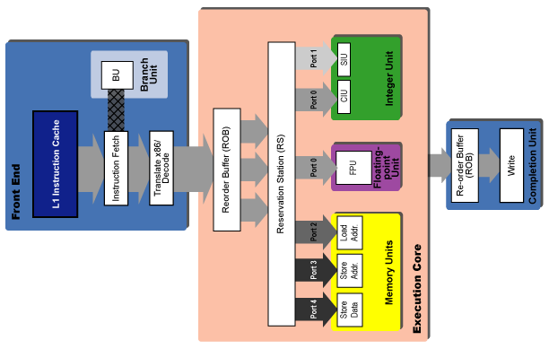
P6: Instruction Flow

Slide 87
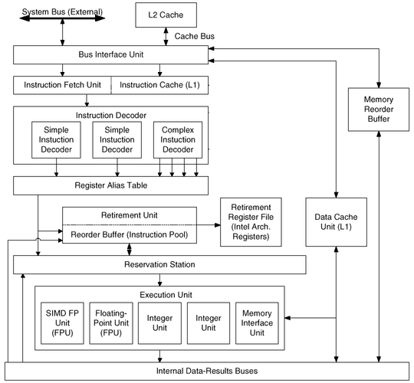
P6: Another Point of View

Slide 88
Next ...
Example: Intel Pentium 4

Slide 89
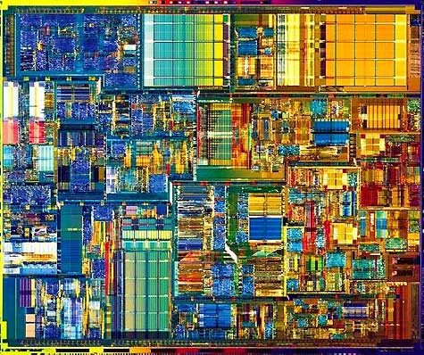
Intel Pentium 4
400 MHz System
Bus
Advanced
Transfer
Cache
Advanced Dynamic Execution
Hyper
Pipelined Technology
Rapid
Execution
Engine
Streaming
SIMD Extensions 2
Execution
Trace Cache
Enhanced Floating
Point / Multi-Media

Slide 90
Intel® Pentium® 4 Processor Design Goals
Two main goals
Deliver world class performance across both existing and emerging applications
Deliver performance headroom and scalability for the future
Micro-architecture that will drive performance leadership for the next several years
Processor | Clock Speed (MHz) | Intro Date | Process (micron) | Transistors (million)
Pentium 4 | 1.4G-2G | 2000.11 | 0.18 | 42
Pentium 4 HT | 3.06G | 2002.11 | 0.13 | 55

Slide 91
P5, P6 & NetBurst: Hyper-Pipelined = Higher Frequency
Basic Pentium Pipeline
PREF
DEC
DEC
EXEC
WB
P5 Microarchitecture
Basic Pentium Pro Pipeline
IFU1
IFU2
IFU3
DEC1
DEC2
RAT
ROB
DIS
EX
RET1
RET2
P6 Microarchitecture
Basic Pentium® 4 Processor Pipeline
TC NextIP
TC Fetch
Drive
Alloc
Rename
Queue
Schedule
Dispatch
Reg File
Exec
Flags
Br Ck
Drive
NetBurst Microarchitecture

Slide 92
NetburstTM Micro-architecture Pipeline vs P6
Basic P6 Pipeline
Intro at
733MHz
.18µ
1
2
3
4
5
6
7
8
9
10
Fetch
Fetch
Decode
Decode
Decode
Rename
ROB Rd
Rdy/Sch
Dispatch
Exec
Basic Pentium® 4 Processor Pipeline
1
2
3
4
5
6
7
8
9
10
11
12
13
14
15
16
17
18
19
20
TC Nxt IP
TC Fetch
Drive
Alloc
Rename
Que
Sch
Sch
Sch
Disp
Disp
RF
RF
Ex
Flgs
Br Ck
Drive
Intro at
≥ 1.4GHz
.18µ

Slide 93
Pentium 4 Microarchitectue
front-end BTB
(4k entries)
I-TLB/Prefetcher
64 bits, Core clock
IA32 Decoder
100/133MHz
64-bit
System
Bus
μCode ROM
μop Queue
Trace Cache BTB
(512~4K entries)
Execution Trace Cache
(12K uops)
Allocator / Register Renamer
Quad
Pumped
400/533MH
3.2/4.3GB/s
BIU
INT / FP μop Queue
Memory μop Queue
INT scheduler
Slow INT Fast INT Fast INT memory
FP scheduler
General FP FP mem
INT Register File/Bypass Network
FP RF / Bypass Ntwk
2x ALU
2x ALU
Slow ALU
AGU
AGU
FP
MMX
SSE/2
U-L2 Cache
256KB 8-way
128B line, WB,
48GB/s@1.5GHz
FP Move
Simple
Inst.
Simple
Inst.
Complex
Inst.
Ld addr
St addr
L1 Data Cache (8KB 4-way, 64B line, WT, 1rd+1wr port)
256 bits, Core CLK

Slide 94
Pentium 4 Block Diagram
L2 Cache and Control
L2 Cache and Control
BTB
Store
AGU
3.2 GB/s System Interface
Load
AGU
ALU
Integer RF
ALU
ALU
Trace Cache
3
3
ALU
Decoder
BTB & I-TLB
Rename/Alloc
uop Queues
L1 D-Cache and D-TLB
Schedulers
FP move
FP store
FP RF
FMul
FAdd
MMX
SSE
uCode
ROM

Slide 95
Hyper Pipelined Technology 1/13
1
2
3
4
5
6
7
8
9
10
11
12
13
14
15
16
17
18
19
20
TC Nxt IP
TC Fetch
Drive
Alloc
Rename
Que
Sch
Sch
Sch
Disp
Disp
RF
RF
Ex
Flgs
Br Ck
Drive
TC Nxt IP: Trace cache next instruction pointer
Pointer from the BTB, indicating location of
next instruction.
L2 Cache and Control
L2 Cache and Control
BTB
AGU
System Interface
AGU
ALU
Integer RF
ALU
3
3
ALU
Trace Cache
ALU
Decoder
BTB & I-TLB
Rename/Alloc
uop Queues
L1 D-Cache and D-TLB
Schedulers
Fms
FP RF
ROM
Fop

Slide 96
Hyper Pipelined Technology 2/13
1
2
3
4
5
6
7
8
9
10
11
12
13
14
15
16
17
18
19
20
TC Nxt IP
TC Fetch
Drive
Alloc
Rename
Que
Sch
Sch
Sch
Disp
Disp
RF
RF
Ex
Flgs
Br Ck
Drive
TC Fetch: Trace cache fetch
Read the decoded instructions (uOPs) out of
the Execution Trace Cache
L2 Cache and Control
L2 Cache and Control
BTB
AGU
System Interface
AGU
ALU
Integer RF
ALU
Trace Cache
ALU
3
3
Trace Cache
ALU
Decoder
BTB & I-TLB
Rename/Alloc
uop Queues
L1 D-Cache and D-TLB
Schedulers
Fms
FP RF
ROM
Fop
Notes:
Primary instruction cache.

Slide 97
Hyper Pipelined Technology 3/13
1
2
3
4
5
6
7
8
9
10
11
12
13
14
15
16
17
18
19
20
TC Nxt IP
TC Fetch
Drive
Alloc
Rename
Que
Sch
Sch
Sch
Disp
Disp
RF
RF
Ex
Flgs
Br Ck
Drive
Drive: Wire delay
Drive the uOPs to the allocator
L2 Cache and Control
L2 Cache and Control
BTB
AGU
System Interface
AGU
ALU
Integer RF
ALU
3
3
ALU
Trace Cache
ALU
Decoder
BTB & I-TLB
Rename/Alloc
uop Queues
L1 D-Cache and D-TLB
Schedulers
Fms
FP RF
ROM
Fop

Slide 98
Hyper Pipelined Technology 4/13
1
2
3
4
5
6
7
8
9
10
11
12
13
14
15
16
17
18
19
20
TC Nxt IP
TC Fetch
Drive
Alloc
Rename
Que
Sch
Sch
Sch
Disp
Disp
RF
RF
Ex
Flgs
Br Ck
Drive
Alloc: Allocate
Allocate resources required for execution. The
resources include Load buffers, Store buffers, etc..
L2 Cache and Control
L2 Cache and Control
BTB
AGU
System Interface
AGU
ALU
Integer RF
ALU
3
3
ALU
Trace Cache
Decoder
Rename/Alloc
ALU
BTB & I-TLB
Rename/Alloc
uop Queues
L1 D-Cache and D-TLB
Schedulers
Fms
FP RF
ROM
Fop

Slide 99
Hyper Pipelined Technology 5/13
1
2
3
4
5
6
7
8
9
10
11
12
13
14
15
16
17
18
19
20
TC Nxt IP
TC Fetch
Drive
Alloc
Rename
Que
Sch
Sch
Sch
Disp
Disp
RF
RF
Ex
Flgs
Br Ck
Drive
Rename: Register renaming
Rename the logical registers (EAX) to the physical
register space (128 are implemented).
L2 Cache and Control
L2 Cache and Control
BTB
AGU
System Interface
AGU
ALU
Integer RF
ALU
3
3
ALU
Trace Cache
Decoder
Rename/Alloc
ALU
BTB & I-TLB
Rename/Alloc
uop Queues
L1 D-Cache and D-TLB
Schedulers
Fms
FP RF
ROM
Fop

Slide 100
Hyper Pipelined Technology 6/13
1
2
3
4
5
6
7
8
9
10
11
12
13
14
15
16
17
18
19
20
TC Nxt IP
TC Fetch
Drive
Alloc
Rename
Que
Sch
Sch
Sch
Disp
Disp
RF
RF
Ex
Flgs
Br Ck
Drive
Que: Write into the uOP Queue
uOPs are placed into the queues, where they
are held until there is room in the schedulers
L2 Cache and Control
L2 Cache and Control
BTB
AGU
System Interface
AGU
ALU
Integer RF
ALU
3
3
ALU
Trace Cache
uop Queues
ALU
Decoder
BTB & I-TLB
Rename/Alloc
uop Queues
L1 D-Cache and D-TLB
Schedulers
Fms
FP RF
ROM
Fop
Notes:
The combination of the uOP queues and the schedulers are analogous to P6’s reservation stations.
This is the last part of the in order machine.

Slide 101
Hyper Pipelined Technology 7/13
1
2
3
4
5
6
7
8
9
10
11
12
13
14
15
16
17
18
19
20
TC Nxt IP
TC Fetch
Drive
Alloc
Rename
Que
Sch
Sch
Sch
Disp
Disp
RF
RF
Ex
Flgs
Br Ck
Drive
Sch: Schedule
Write into the schedulers and compute
dependencies. Watch for dependency to resolve.
L2 Cache and Control
L2 Cache and Control
BTB
AGU
System Interface
AGU
ALU
Integer RF
ALU
3
3
ALU
Trace Cache
Schedulers
Decoder
ALU
BTB & I-TLB
Rename/Alloc
uop Queues
L1 D-Cache and D-TLB
Schedulers
Fms
FP RF
ROM
Fop
Notes:
Heart of the out of order machine. Traffic cops making sure that uOPs execute in the right order.

Slide 102
Hyper Pipelined Technology 8/13
1
2
3
4
5
6
7
8
9
10
11
12
13
14
15
16
17
18
19
20
TC Nxt IP
TC Fetch
Drive
Alloc
Rename
Que
Sch
Sch
Sch
Disp
Disp
RF
RF
Ex
Flgs
Br Ck
Drive
Disp: Dispatch
Send the uOPs to the appropriate
execution unit.
L2 Cache and Control
L2 Cache and Control
BTB
AGU
System Interface
AGU
ALU
Integer RF
ALU
3
3
ALU
Trace Cache
ALU
Decoder
BTB & I-TLB
Rename/Alloc
uop Queues
L1 D-Cache and D-TLB
Schedulers
Fms
FP RF
ROM
Fop

Slide 103
Hyper Pipelined Technology 9/13
1
2
3
4
5
6
7
8
9
10
11
12
13
14
15
16
17
18
19
20
TC Nxt IP
TC Fetch
Drive
Alloc
Rename
Que
Sch
Sch
Sch
Disp
Disp
RF
RF
Ex
Flgs
Br Ck
Drive
RF: Register File
Read the register file. These are the source(s)
for the pending operation (ALU or other).
L2 Cache and Control
L2 Cache and Control
BTB
AGU
System Interface
AGU
Integer RF
ALU
Integer RF
ALU
3
3
ALU
Trace Cache
ALU
Decoder
BTB & I-TLB
Rename/Alloc
uop Queues
L1 D-Cache and D-TLB
Schedulers
Fms
FP RF
FP RF
ROM
Fop
Notes:
Includes bypassing from things just finishing execution.

Slide 104
Hyper Pipelined Technology 10/13
1
2
3
4
5
6
7
8
9
10
11
12
13
14
15
16
17
18
19
20
TC Nxt IP
TC Fetch
Drive
Alloc
Rename
Que
Sch
Sch
Sch
Disp
Disp
RF
RF
Ex
Flgs
Br Ck
Drive
Ex: Execute
Execute the uOPs on the appropriate
execution port.
L2 Cache and Control
L2 Cache and Control
BTB
AGU
AGU
AGU
System Interface
AGU
ALU
ALU
Integer RF
ALU
ALU
ALU
3
3
ALU
Trace Cache
ALU
Decoder
ALU
BTB & I-TLB
Rename/Alloc
uop Queues
L1 D-Cache and D-TLB
Schedulers
Fms
Fms
FP RF
Fop
ROM
Fop

Slide 105
Hyper Pipelined Technology 11/13
1
2
3
4
5
6
7
8
9
10
11
12
13
14
15
16
17
18
19
20
TC Nxt IP
TC Fetch
Drive
Alloc
Rename
Que
Sch
Sch
Sch
Disp
Disp
RF
RF
Ex
Flgs
Br Ck
Drive
Flgs: Flags
Compute flags (zero, negative, etc..). These
are typically the input to a branch instruction.
L2 Cache and Control
L2 Cache and Control
BTB
AGU
System Interface
AGU
ALU
ALU
Integer RF
ALU
ALU
ALU
3
3
ALU
Trace Cache
ALU
Decoder
BTB & I-TLB
Rename/Alloc
uop Queues
ALU
L1 D-Cache and D-TLB
Schedulers
Fms
FP RF
ROM
Fop

Slide 106
Hyper Pipelined Technology 12/13
1
2
3
4
5
6
7
8
9
10
11
12
13
14
15
16
17
18
19
20
TC Nxt IP
TC Fetch
Drive
Alloc
Rename
Que
Sch
Sch
Sch
Disp
Disp
RF
RF
Ex
Flgs
Br Ck
Drive
Br Ck: Branch Check
The branch operation compares the result of the
actual branch direction with the prediction.
L2 Cache and Control
L2 Cache and Control
BTB
AGU
System Interface
AGU
ALU
ALU
Integer RF
ALU
ALU
ALU
3
3
ALU
Trace Cache
ALU
Decoder
ALU
BTB & I-TLB
Rename/Alloc
uop Queues
L1 D-Cache and D-TLB
Schedulers
Fms
FP RF
ROM
Fop

Slide 107
Hyper Pipelined Technology 13/13
1
2
3
4
5
6
7
8
9
10
11
12
13
14
15
16
17
18
19
20
TC Nxt IP
TC Fetch
Drive
Alloc
Rename
Que
Sch
Sch
Sch
Disp
Disp
RF
RF
Ex
Flgs
Br Ck
Drive
Drive: Wire delay
Drive the result of the branch check to the front
end of the machine.
L2 Cache and Control
L2 Cache and Control
BTB
AGU
System Interface
AGU
ALU
Integer RF
ALU
3
3
ALU
Trace Cache
ALU
Decoder
BTB & I-TLB
Rename/Alloc
uop Queues
L1 D-Cache and D-TLB
Schedulers
Fms
FP RF
ROM
Fop

Slide 108
The Intel Core i7: Nehalem Architecture
The i7 uses an aggressive out-of-order speculative microarchitecture
With reasonably deep pipelines
With the goal of achieving high instruction throughput
By combining multiple issue
And high clock rates
The total pipeline depth is 14 stages
branch mispredictions costing 17 cycles
There are 48 load and 32 store buffers
The six independent functional units can each begin execution of a ready micro-op in the same cycle

Slide 109
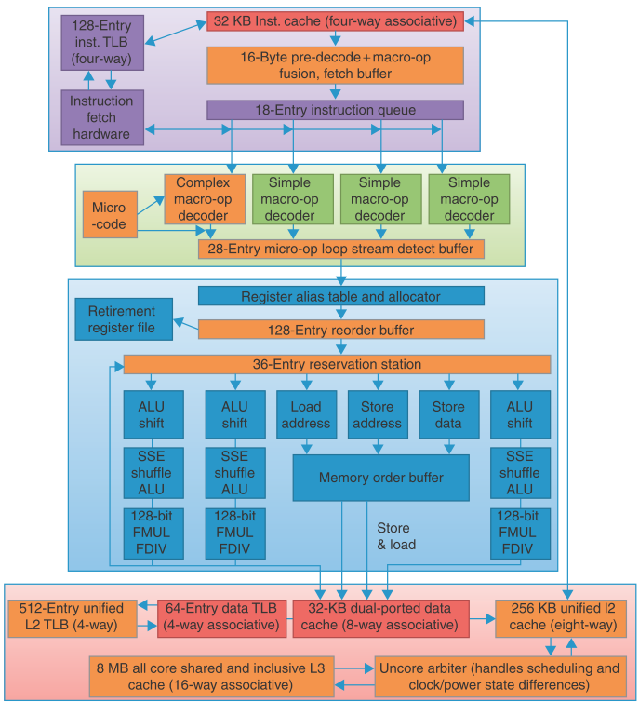
Cache
Micro-OP
Handling
Micro-OP
Decode and
loop stream
detect
New or
Improved in
Nehalem

Slide 110
i7 Pipeline Steps 1: Instruction Fetch
The processor uses a multilevel branch target buffer to achieve a balance between speed and prediction accuracy
There is also a return address stack to speed up function return
Mispredictions cause a penalty of about 15 cycles
Using the predicted address, the instruction fetch unit fetches 16 bytes from the instruction cache

Slide 111
i7 Pipeline Steps 2: Placed in the Predecode Instruction
The 16 bytes are placed in the predecode instruction buffer
a process called macro-op fusion is executed
Macro-op fusion takes instruction combinations such as compare followed by a branch and fuses them into a single operation

Slide 112
i7 Pipeline Steps 2: Placed in the Predecode Instruction
The predecode stage also breaks the 16 bytes into individual x86 instructions
This predecode is nontrivial since the length of an x86 instruction can be from 1 to 17 bytes and the predecoder must look through a number of bytes before it knows the instruction length
Individual x86 instructions (including some fused instructions) are placed into the 18-entry instruction queue

Slide 113
i7 Pipeline Steps 3: Micro-op Decode
Individual x86 instructions are translated into micro-ops
Micro-ops are simple MIPS-like instructions that can be executed directly by the pipeline
This approach of translating the x86 instruction set into simple operations that are more easily pipelined was introduced in the Pentium Pro in 1997 and has been used since

Slide 114
i7 Pipeline Steps 3: Micro-op Decode
Three of the decoders handle x86 instructions that translate directly into one micro-op
For x86 instructions that have more complex semantics, there is a microcode engine that is used to produce the micro-op sequence
It can produce up to four micro-ops every cycle and continues until the necessary micro-op sequence has been generated
The micro-ops are placed according to the order of the x86 instructions in the 28-entry micro-op buffer

Slide 115
i7 Pipeline Steps 4: Loop Stream Detection
The micro-op buffer preforms loop stream detection and microfusion
If there is a small sequence of instructions (less than 28 instructions or 256 bytes in length) that comprises a loop, the loop stream detector will find the loop and directly issue the micro-ops from the buffer, eliminating the need for the instruction fetch and instruction decode stages to be activated

Slide 116
i7 Pipeline Steps 4: Microfusion
Microfusion combines instruction pairs such as load/ALU operation and ALU operation/store and issues them to a single reservation station (where they can still issue independently), thus increasing the usage of the buffer
In a study of the Intel Core architecture, which also incorporated microfusion and macrofusion, Bird et al. [2007] discovered that microfusion had little impact on performance, while macrofusion appears to have a modest positive impact on integer performance and little impact on floating-point performance

Slide 117
i7 Pipeline Steps 5: Basic Instruction Issue
Perform the basic instruction issue
Looking up the register location in the register tables
Renaming the registers
Allocating a reorder buffer entry
And fetching any results from the registers or reorder buffer
Before sending the micro-ops to the reservation stations

Slide 118
i7 Pipeline Steps 6: to Reservation Station
The i7 uses a 36-entry centralized reservation station shared by six functional units
Up to six micro-ops may be dispatched to the functional units every clock cycle

Slide 119
i7 Pipeline Steps 7: Execution
Micro-ops are executed by the individual function units and then results are sent back to any waiting reservation station as well as to the register retirement unit, where they will update the register state, once it is known that the instruction is no longer speculative
The entry corresponding to the instruction in the reorder buffer is marked as complete

Slide 120
i7 Pipeline Steps 8: Commit
When one or more instructions at the head of the reorder buffer have been marked as complete, the pending writes in the register retirement unit are executed, and the instructions are removed from the reorder buffer

Slide 121
Performance of the i7
A single-thread pipeline performance
The cost of a branch mispredict is 15 cycles
the cost of an L1 miss is about 10 cycles
L2 misses are slightly more than three times as costly as an L1 miss
L3 misses cost about 13 times what an L1 miss costs (130–135 cycles)
Although the processor will attempt to find alternative instructions to execute for L3 misses and some L2 misses, it is likely that some of the buffers will fill before the miss completes, causing the processor to stop issuing instructions

Slide 122
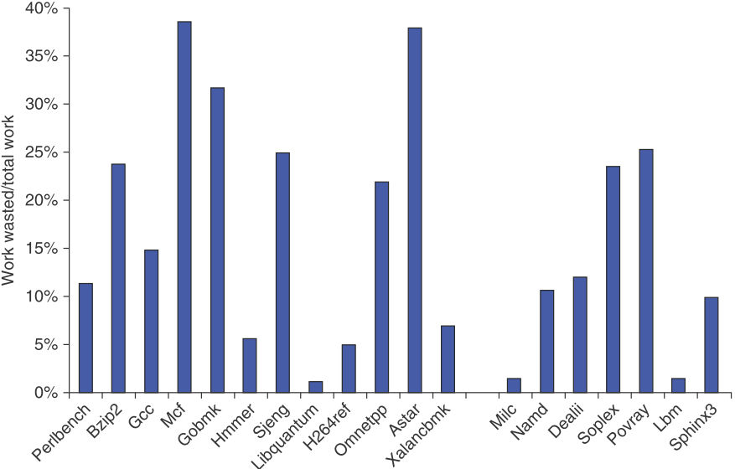
The Amount of “Wasted Work”
The ratio of dispatched micro-ops that do not graduate to all dispatched micro-ops

Slide 123
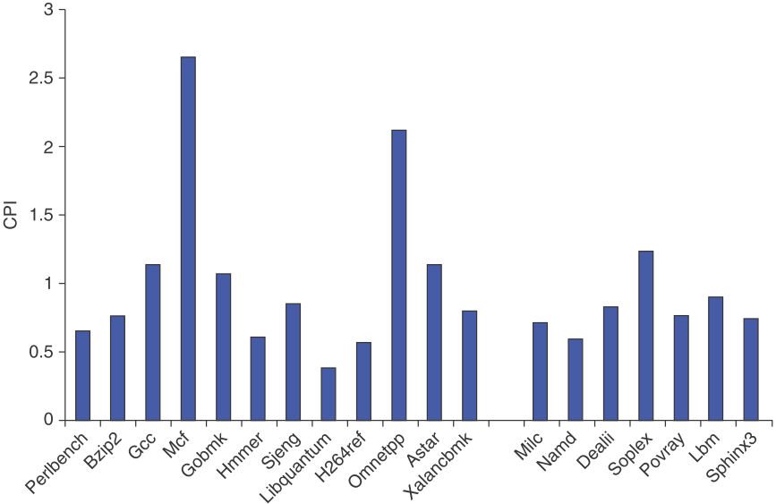
The CPI for the 19 SPECCPU2006
- An average CPI for 0.83
- In the integer case, the CPI values range from 0.44 to 2.66 with a standard deviation of 0.77
- The FP case is from 0.62 to 1.38 with a standard deviation of 0.25

Slide 124
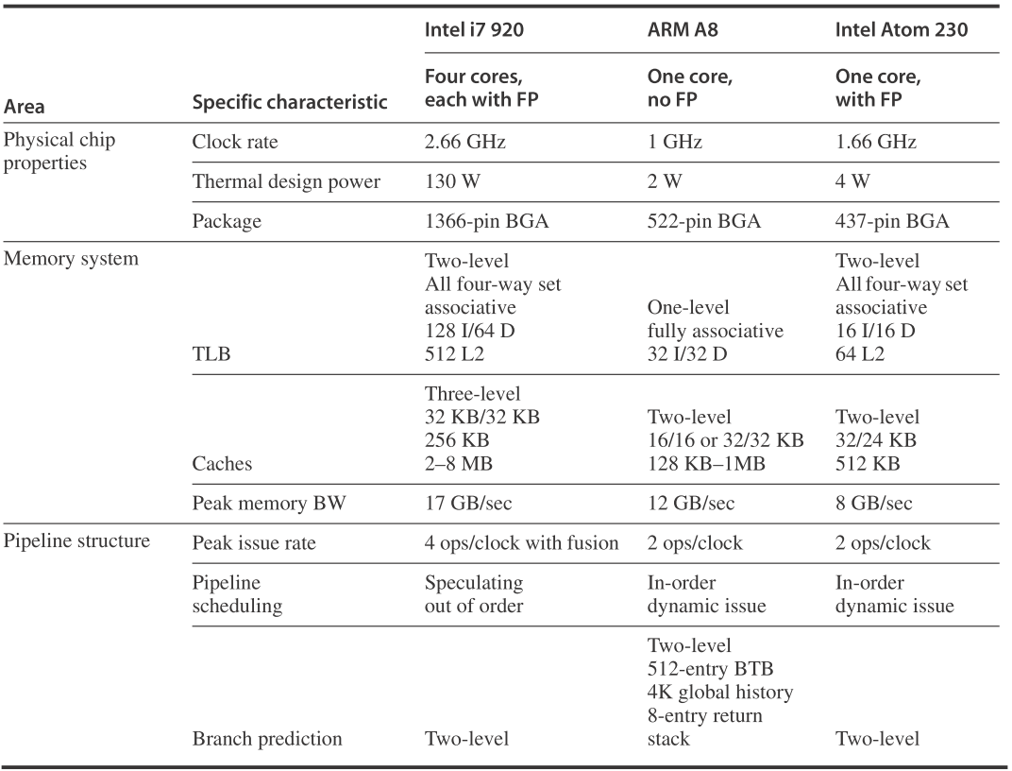
The Four-core Intel i7 920, ARM A8 and the Intel Atom 230

Slide 125
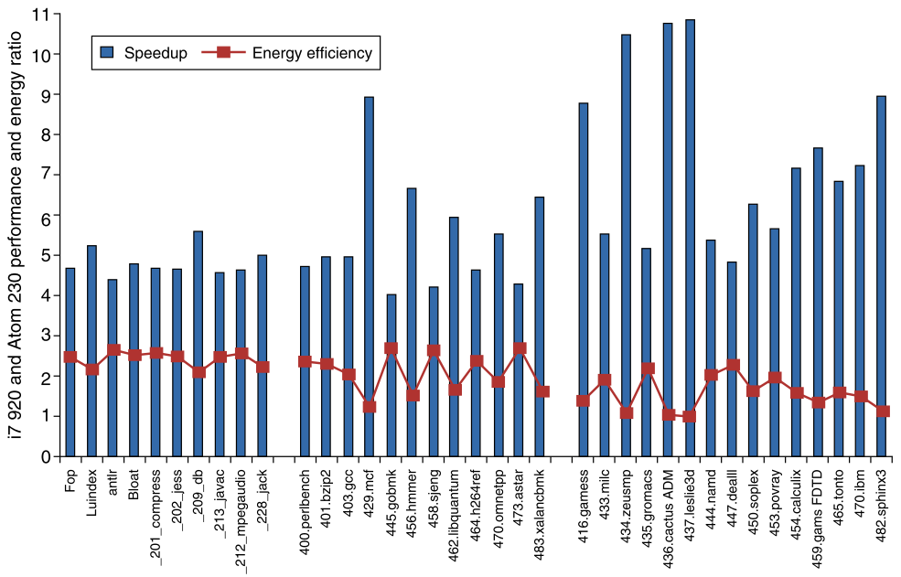
The Relative Performance And Energy Efficiency
the i7 920 is 4 to over 10 times faster than the Atom 230 but that it is about 2 times less power efficient on average!

Slide 126
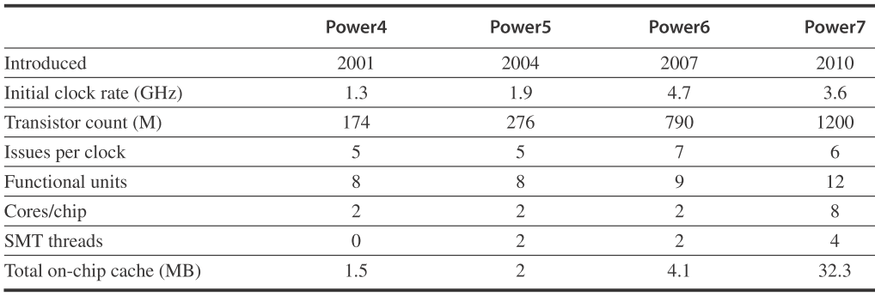
Characteristics of Four IBM Power Processors
All except the Power6 were dynamically scheduled, which is static, and in-order, and all the processors support two load/store pipelines. The Power6 has the same functional units as the Power5 except for adecimal unit. Power7 uses DRAM for the L3 cache

Slide 127
Homework
Textbook
3.13
Paper
"The MIPS R10000 Superscalar microprocessor", Yeager, IEEE Micro 16(2), 1996
https://www.realworldtech.com/jaguar/
References
https://en.wikipedia.org/wiki/X86
https://en.wikipedia.org/wiki/List_of_Intel_microprocessors

Slide 128
Next …
Vector, SIMD and GPU

