Slide 1
Advanced Computer Architecture (ACA2020)
Dr. ZHANG Chun-yuan
College of Computer, NUDT
Fall, 2020

Slide 2
Lecture 12 Thread-Level Parallelism - TLP

Slide 3
3.12 TLP
Multithreading: Exploiting Thread-Level Parallelism to Improve Uniprocessor Throughput
A thread: a separate process with own instructions and data
Each thread has all the state necessary to allow it to execute
Thread state
instructions, data, PC, register state, and so on
There can be much higher natural parallelism in some applications
e.g., database or scientific codes

Slide 4
Thread Level Parallelism (TLP)
TLP is program can logically structured as separate threads of execution
TLP is explicitly represented by the use of multiple threads of execution that are inherently parallel
What is a ILP?
ILP exploits implicit parallel operations
TLP could be more cost-effective than ILP
TLP, multiple instruction streams to improve
Throughput that run many programs
Execution time of multi-threaded programs

Slide 5
Multithreaded Execution
For running independent programs, the processor must duplicate independent state of each thread e.g.
a separate copy of register file
a separate PC
a separate page table
Memory shared through the virtual memory mechanisms which already support multiple processes

Slide 6
Multithreaded Switch
HW for fast thread switch
Usually done in a round-robin fashion, skipping any stalled threads
When switch?
Fine grain: alternate instruction per thread
CPU must be able to switch threads every clock
Coarse grain: when a thread is stalled, another thread can be executed
Switches threads only on costly stalls, such as L2 cache misses
The thread start time << stall time

Slide 7
Fine-Grained Multithreading
Advantage
It can hide both short and long stalls, since instructions from other threads executed when one thread stalls
Disadvantage
It slows down execution of individual threads, since a thread ready to execute without stalls will be delayed by instructions from other threads

Slide 8
Course-Grained Multithreading
Advantages
Relieves need to have very fast thread-switching
Doesn’t slow down thread, since instructions from other threads issued only when the thread encounters a costly stall
Disadvantages
It is hard to overcome throughput losses from shorter stalls, due to a thread start-up costs
Since CPU issues instructions from 1 thread, when a stall occurs, the pipeline must be emptied or frozen
New thread must fill pipeline before instructions can complete

Slide 9
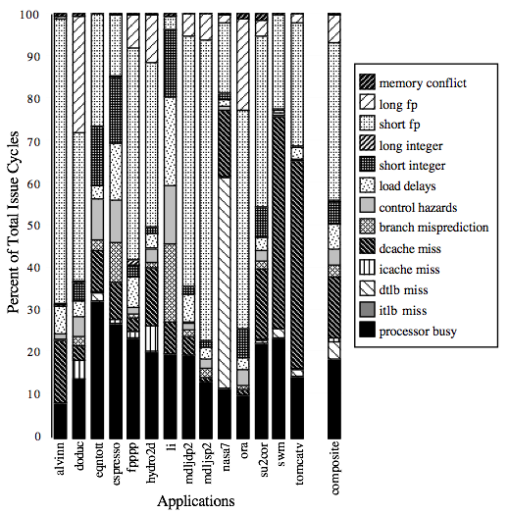
Superscalar: Most Execution Units Lie Idle
For most apps, most execution units lie idle: an 8-way superscalar
From: Tullsen, Eggers, and Levy, Simultaneous Multithreading: Maximizing On-chip Parallelism, ISCA 1995.

Slide 10
Simultaneous Multithreading (SMT)
SMT: dynamically scheduled already has HW to support multithreading
Large set of virtual registers to hold the register sets of independent threads
Register renaming provides unique register identifiers, so multiple threads instructions can be mixed in datapath without confusing
Out-of-order completion allows out-of-order execution, and gets better HW utilization
Just adding a per thread RAT and keeping separate PCs and ROBs for each thread

Slide 11
Processors and SMT Technology
Processors without SMT
Architecture States
Processor Execution Resources
Processor Interface
Processors with SMT
Architecture States | Architecture States
Processor Execution Resources
Processor Interface

Slide 12
Simultaneous Multi-Threading (SMT) Execution
One thread, 8 units
CYCLE | M | M | FX | FX | FP | FP | BR | CC
1
2
3
4
5
6
7
8
9
Two threads, 8 units
CYCLE | M | M | FX | FX | FP | FP | BR | CC
1
2
3
4
5
6
7
8
9
M = Load/Store, FX = Fixed Point, FP = Floating Point, BR = Branch, CC = Condition Codes

Slide 13
Multithreaded Categories
Coarse-Grained
Simultaneous
Multithreading
Superscalar
Fine-Grained
Multiprocessing
Time (processor cycle)
Thread 1
Thread 3
Thread 5
Thread 2
Thread 4
Idle slot

Slide 14
Simple Multithreaded Pipeline
PC
1
X
PC
1
GPR1
I$
IR
GPR1
PC
1
GPR1
PC
1
GPR1
D$
Y
+1
2
Thread select
2
Have to carry thread select down pipeline to ensure correct state bits read/written at each pipe stage
Appears to software (including OS) as multiple, albeit slower, CPUs

Slide 15
For most apps, most execution units lie idle in an OoO superscalar
For an 8-way superscalar.
From: Tullsen, Eggers, and Levy,
“Simultaneous Multithreading: Maximizing On-chip Parallelism”, ISCA 1995.

Slide 16
Superscalar Machine Efficiency
Issue width
Instruction issue
Completely idle cycle (vertical waste)
Time
Partially filled cycle, i.e., IPC < 4
(horizontal waste)
Notes:
Focus is switching to function unit efficiency (as a measure of throughput).

Slide 17
Vertical Multithreading
Issue width
Instruction issue
Second thread interleaved cycle-by-cycle
Time
Partially filled cycle, i.e., IPC < 4
(horizontal waste)
Cycle-by-cycle interleaving removes vertical waste, but leaves some horizontal waste

Slide 18
Chip Multiprocessing (CMP)
What is the effect of splitting into multiple processors?
reduces horizontal waste,
leaves some vertical waste, and
puts upper limit on peak throughput of each thread.
Issue width
Time

Slide 19
Ideal Superscalar Multithreading [Tullsen, Eggers, Levy, UW, 1995]
Interleave multiple threads to multiple issue slots with no restrictions
Issue width
Time

Slide 20
O-o-O Simultaneous Multithreading [Tullsen, Eggers, Emer, Levy, Stamm, Lo, DEC/UW, 1996]
Add multiple contexts and fetch engines and allow instructions fetched from different threads to issue simultaneously
Utilize wide out-of-order superscalar processor issue queue to find instructions to issue from multiple threads
OOO instruction window already has most of the circuitry required to schedule from multiple threads
Any single thread can utilize whole machine

Slide 21
SMT adaptation to parallelism type
For regions with high thread-level parallelism (TLP) entire machine width is shared by all threads
For regions with low thread-level parallelism (TLP) entire machine width is available for instruction-level parallelism (ILP)
Issue width
Issue width
Time
Time
Notes:
Amdahl’s law…

Slide 22
Performance with SMT
SMT makes sense only with fine-grained implementation
Impact of fine-grained scheduling on single thread performance?
A preferred thread approach sacrifices neither throughput nor single-thread performance?
Unfortunately, with a preferred thread, the processor is likely to sacrifice some throughput, when preferred thread stalls

Slide 23
Design Challenges in SMT
Larger register files needed to hold multiple contexts
Clock cycle time, especially in
Instruction issue - more candidate instructions need to be considered
Instruction completion - choosing which instructions to commit may be challenging
Ensuring that cache and TLB conflicts generated by SMT do not degrade performance

Slide 24
Sun T1 and Intel i7
Effectiveness of Fine-Grained Multithreading on the Sun T1
T1 Multithreading Unicore Performance
Effectiveness of Simultaneous Multithreading on Superscalar Processors
The Intel i7 supports SMT with two threads

Slide 25

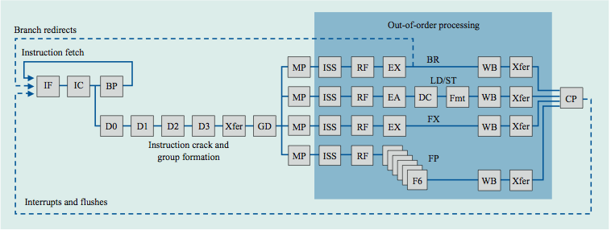
Power 4
Single-threaded predecessor
8 execution units in out-of-order engine, each may issue an instruction each cycle

Slide 26
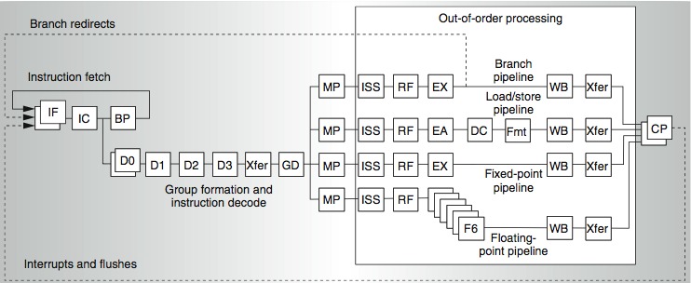
Power 4 and 2-threaded Power 5
2 commits (architected register sets)
2 fetch (PC), 2 initial decodes

Slide 27
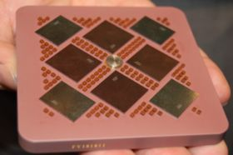
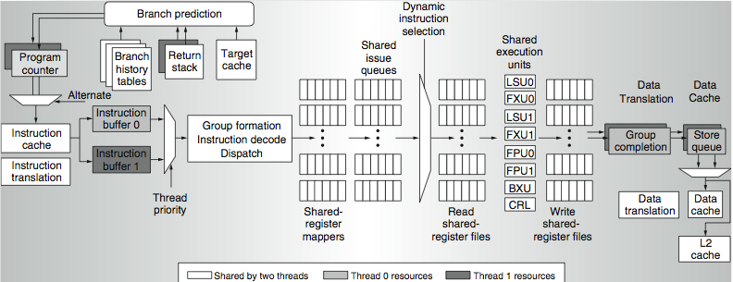
Power 5 data flow ...
Why only 2 threads? With 4, one of the shared resources (physical registers, cache, memory bandwidth) would be prone to bottleneck

Slide 28
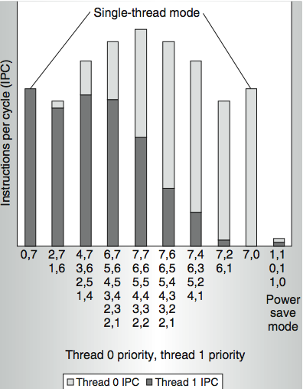
Power 5 Thread Performance ...
Relative priority of each thread controllable in hardware
For balanced operation, both threads run slower than if they “owned” the machine

Slide 29
Changes in Power 5 to Support SMT
The Power5 core is about 24% larger than the Power4 core because of the addition of SMT support
Increased associatively of L1 I-cache and the instruction address translation buffers
Added per thread load and store queues
Increased size of the L2 (1.92 vs. 1.44 MB) and L3 caches
Added separate instruction prefetch and buffering per thread
Increased the virtual registers from 152 to 240
Increased the size of several issue queues

Slide 30
Performance Gains of Power5
Power 5, 8 processor server
1.23 faster for SPECint_rate with SMT
1.16 faster for SPECfp_rate
Power 5 running 2 copies of each app speedup between 0.89 and 1.41
Most gained some
FP apps had most cache conflicts and least gains

Slide 31
Intel’s Hyper-Threading (HT) Technology
Intel’s hyper-threading (HT) technology brings the concept of simultaneous multi-threading (SMT) to the Intel architecture
HT technology makes a single physical processor appear as two processors
The physical execution resources are shared and the architecture state is duplicated for the two logical processors
Intel’s HT is first implemented on the Intel Xeon processor

Slide 32
Intel® Xeon™ Processor Pipeline

Slide 33
Out-of-order Execution Engine Detailed Pipeline

Slide 34
Single-task and Multi-task Modes

Slide 35
Performance on an OLTP workload

Slide 36
Web Server Benchmark Performance

Slide 37
Performance of HT
Pentium 4 HT is a dual threaded SMT
Speedup
1.01 for SPECint_rate
1.07 for SPECfp_rate
Running on Pentium 4 each of 26 SPEC benchmarks paired with every other
Speed-ups from 0.90 to 1.58
Average was 1.20

Slide 38
Head to Head ILP Competition
Processor | Micro architecture | Fetch / Issue / Execute | FU | Clock Rate (GHz) | Transis-tors Die size | Power
Intel Pentium 4 Extreme | Speculative dynamically scheduled; deeply pipelined; SMT | 3/3/4 | 7 int. 1 FP | 3.8 | 125 M 122 mm² | 115 W
AMD Athlon 64 FX-57 | Speculative dynamically scheduled | 3/3/4 | 6 int. 3 FP | 2.8 | 114 M 115 mm² | 104 W
IBM Power5 (1 CPU only) | Speculative dynamically scheduled; SMT; 2 CPU cores/chip | 8/4/8 | 6 int. 2 FP | 1.9 | 200 M 300 mm² (est.) | 80W (est.)
Intel Itanium 2 | Statically scheduled VLIW-style | 6/5/11 | 9 int. 2 FP | 1.6 | 592 M 423 mm² | 130 W

Slide 39
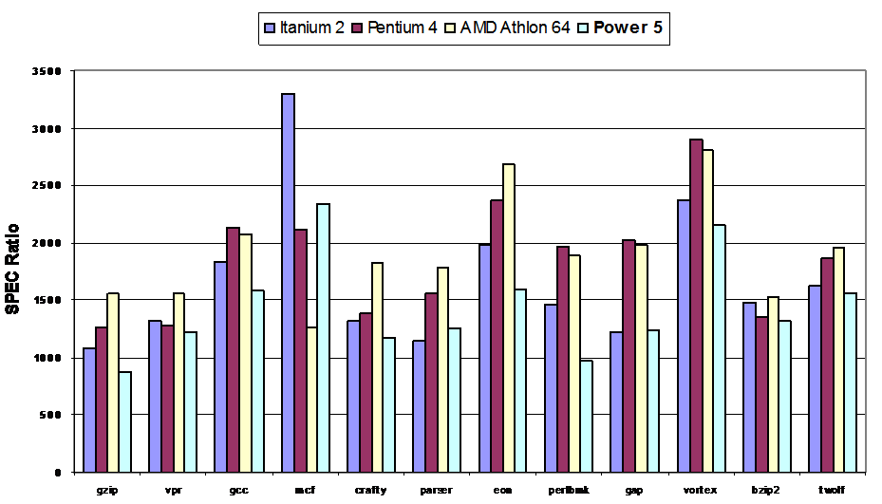
Performance on SPECint2000

Slide 40
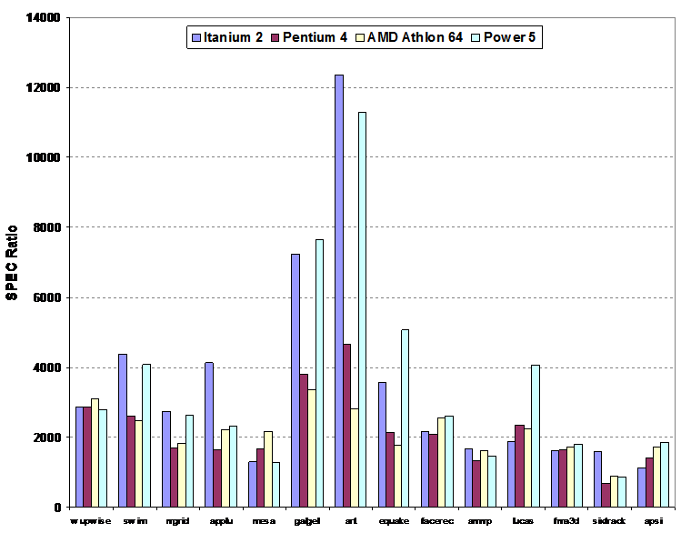
Performance on SPECfp2000

Slide 41
Normalized Performance: Efficiency
Rank | I tanium2 | Pen t I um4 | A t h l on64 | Powe r 5
Int/Trans | 4 | 2 | 1 | 3
FP/Trans | 4 | 2 | 1 | 3
Int/area | 4 | 2 | 1 | 3
FP/area | 4 | 2 | 1 | 3
Int/Watt | 4 | 3 | 1 | 2
FP/Watt | 2 | 4 | 3 | 1

Slide 42
No Obvious Over All Leader in Performance
The Athlon leads on SPECInt
Then Pentium4, Itanium2, and Power5
Athlon and Pentium 4 both make good use of transistors and area
IBM Power5 is the most effective user of energy on SPECFP
Essentially tied on SPECINT
Itanium 2 is the most inefficient processor both for FP and integer code
But one efficiency measure (SPECFP/Watt)

Slide 43
Limits to ILP: Microarchitecture
Doubling issue rates above today’s 3-6 instructions per clock, say to 6 to 12 instructions, probably requires a processor to
issue 3 or 4 data memory accesses per cycle,
resolve 2 or 3 branches per cycle,
rename and access more than 20 registers per cycle, and
fetch 12 to 24 instructions per cycle

Slide 44
Limits to ILP: Complexities
The complexities of implementing these capabilities is likely to mean sacrifices in the maximum clock rate
E.g, widest issue processor is the Itanium 2, but it also has the slowest clock rate, despite the fact that it consumes the most power!

Slide 45
Limits to ILP: Energy Efficient
Most techniques for increasing performance increase power consumption
The key question is whether a technique is energy efficient:
Does it increase power consumption faster than it increases performance?
Multiple issue processors techniques all are energy inefficient:
Issuing multiple instructions incurs some overhead in logic that grows faster than the issue rate grows

Slide 46
ILP or TLP
Right balance of ILP and TLP is unclear today
Perhaps right choice
For server market, which can exploit more TLP
May differ from desktop, where single-thread performance may continue to be a primary requirement (ILP)

Slide 47
Homework
Review
3.12, 3.13
Papers
Tullsen, Eggers, and Levy, “Simultaneous Multithreading: Maximizing On-chip Parallelism”, ISCA 1995
IBM Power8的单线程性能为何如此孱弱？

Slide 48
Next...
Professor Wang

Slide 49
Thank u 4 your attention!
CU in final examination ☺

