Slide 1
5.6 Models of Memory Consistency: An Introduction
Cache coherence ensures that multiple processors see a consistent view of memory. It does not answer the question of how consistent the view of memory must be.
By “how consistent” we mean, when must a processor see a value that has been updated by another processor?
Computer School, NUDT Fall, 2020

Slide 2
Since processors communicate through shared variables (used both for data values and for synchronization), the question boils down to this: In what order must a processor observe the data writes of another processor?
Computer School, NUDT Fall, 2020

Slide 3
Since the only way to “observe the writes of another processor” is through reads, the question becomes, what properties must be enforced among reads and writes to different locations by different processors?
Although the question of how consistent memory be seems simple, it is remarkably complicated, as we can see with a simple example.
Computer School, NUDT Fall, 2020

Slide 4
Here are two code segments from processes P1 and P2, shown side by side:
P1：A＝0； P2： B＝0；
…… ……
A=1； B=1；
L1：if(B==0)…… L2：if(A==0)……
Assume that the processes are running on different processors, and that locations A and B are originally cached by both processors with the initial value of 0.
Computer School, NUDT Fall, 2020

Slide 5
If writes always take immediate effect and are immediately seen by other processors, it will be impossible for both if-statements (labeled L1 and L2) to evaluate their conditions as true, since reaching the if-statement means that either A or B must have been assigned the value 1.
Computer School, NUDT Fall, 2020

Slide 6
But suppose the write invalidate is delayed, and the processor is allowed to continue during this delay; then it is possible that both P1 and P2 have not seen the invalidations for B and A (respectively) before they attempt to read the values.
The question is, should this behavior be allowed, and if so, under what conditions?
Computer School, NUDT Fall, 2020

Slide 7
The most straightforward model for memory consistency is called sequential consistency.
Sequential consistency requires that the result of any execution be the same as if the memory accesses executed by each processor were kept in order and the accesses among different processors were arbitrarily interleaved.
Sequential consistency eliminates the possibility of some nonobvious execution in the previous example, because the assignments must be completed before the if statements are initiated.
Computer School, NUDT Fall, 2020

Slide 8
The simplest way to implement sequential consistency is to require a processor to delay the completion of any memory access until all the invalidations caused by that access are completed.
It is equally effective to delay the next memory access until the previous one is completed. Remember that memory consistency involves operations among different variables: the two accesses that must be ordered are actually to different memory locations.
Computer School, NUDT Fall, 2020

Slide 9
In the example, we must delay the read of A or B (A==0 or B==0) until the previous write has completed (B=1 or A=1).
Under sequential consistency, we cannot, for example, simply place the write in a write buffer and continue with the read.
Although sequential consistency presents a simple programming paradigm, it reduces potential performance, especially in a multiprocessor with a large number of processors or long interconnect delays, as we can see in the following Example.
Computer School, NUDT Fall, 2020

Slide 10
EXAMPLE Suppose we have a processor where a write miss takes 50 cycles to establish ownership, 10 cycles to issue each invalidate after ownership is established, and 80 cycles for an invalidate to complete and be acknowledged once it is issued. Assuming that four other processors share a cache block, how long does a write miss stall the writing processor if the processor is sequentially consistent? Assume that the invalidates must be explicitly acknowledged before the directory controller knows they are completed. Suppose we could continue executing after obtaining ownership for the write miss without waiting for the invalidates; how long would the write take?
Computer School, NUDT Fall, 2020

Slide 11
ANSWER When we wait for invalidates, each write takes the sum of the ownership time plus the time to complete the invalidates. Since the invalidates can overlap, we need only worry about the last one, which starts 10 + 10 + 10 + 10 = 40 cycles after ownership is established. Hence the total time for the write is 50 + 40 + 80 = 170 cycles. In comparison, the ownership time is only 50 cycles. With appropriate write-buffer implementations it is even possible to continue before ownership is established.
Computer School, NUDT Fall, 2020

Slide 12
To provide better performance:
1.Developed ambitious implementations that preserve sequential consistency but use latency hiding techniques to reduce the penalty.
2.Developed less restrictive memory consistency models that allow for faster hardware. Such models can affect how the programmer sees the multiprocessor.
Computer School, NUDT Fall, 2020

Slide 13
The Programmer’s View
The sequential consistency model has the advantage of simplicity. The challenge is to develop a programming model that is simple to explain and yet allows a high performance implementation.
One such programming model that allows us to have a more efficient implementation is to assume that programs are synchronized. A program is synchronized if all access to shared data is ordered by synchronization operations.
Computer School, NUDT Fall, 2020

Slide 14
A data reference is ordered by a synchronization operation if, in every possible execution, a write of a variable by one processor and an access (either a read or a write) of that variable by another processor are separated by a pair of synchronization operations, one executed after the write by the writing processor and one executed before the access by the second processor.
Computer School, NUDT Fall, 2020

Slide 15
Cases where variables may be updated without ordering by synchronization are called data races, because the execution outcome depends on the relative speed of the processors, and like races in hardware design, the outcome is unpredictable, which leads to another name for synchronized programs: data-race-free.
Computer School, NUDT Fall, 2020

Slide 16
It is a broadly accepted observation that most programs are synchronized. This observation is true primarily because if the accesses were unsynchronized, the behavior of the program would be quite difficult to determine because the speed of execution would determine which processor won a data race and thus affect the results of the program.
Computer School, NUDT Fall, 2020

Slide 17
Even with sequential consistency, reasoning about such programs is very difficult.
Programmers could attempt to guarantee ordering by constructing their own synchronization mechanisms, but this is extremely tricky, can lead to buggy programs, and may not be supported architecturally, meaning that they may not work in future generations of the multiprocessor.
Computer School, NUDT Fall, 2020

Slide 18
Almost all programmers will choose to use synchronization libraries that are correct and optimized for the multiprocessor and the type of synchronization.
The use of standard synchronization primitives ensures that even if the architecture implements a more relaxed consistency model than sequential consistency, a synchronized program will behave as if the hardware implemented sequential consistency.
Computer School, NUDT Fall, 2020

Slide 19
Relaxed Consistency Models: The Basics and Release Consistency
The key idea in relaxed consistency models is to allow reads and writes to complete out of order, but to use synchronization operations to enforce ordering, so that a synchronized program behaves as if the processor were sequentially consistent.
Computer School, NUDT Fall, 2020

Slide 20
There are a variety of relaxed models that are classified according to what read and write orderings they relax. We specify the orderings by a set of rules of the form X → Y, meaning that operation X must complete before operation Y is done.
Sequential consistency requires maintaining all four possible orderings: R → W, R → R,W → R, andW → W. The relaxed models are defined by the subset of four orderings they relax:
Computer School, NUDT Fall, 2020

Slide 21
1. The W→R ordering: which yields a model known as total store ordering or processor consistency. Because this ordering retains ordering among writes, many programs that operate under sequential consistency operate under this model, without additional synchronization.
Computer School, NUDT Fall, 2020

Slide 22
2. Relaxing both the W → R ordering and
the W→W ordering: which yields a model known as partial store order.
3. Relaxing all four orderings yields a variety of models including weak ordering, the PowerPC consistency model, and release consistency, the RISC V consistency model.
Computer School, NUDT Fall, 2020

Slide 23
By relaxing these orderings, the processor may obtain significant performance advantages, which is the reason that RISC V, ARMv8, as well as the C++ and C language standards chose release consistency as the model.
Release consistency distinguishes between synchronization operations that are used to acquire access to a shared variable (denoted SA) and those that release an object to allow another processor to acquire access (denoted SR).
Computer School, NUDT Fall, 2020

Slide 24
Release consistency is based on the observation that in synchronized programs, an acquire operation must precede a use of shared data, and a release operation must follow any updates to shared data and also precede the time of the next acquire.
This property allows us to slightly relax the ordering by observing that a read or write that precedes an acquire need not complete before the acquire, and also that a read or write that follows a release need not wait for the release.
Computer School, NUDT Fall, 2020

Slide 25
Thus the orderings that are preserved involve only SA and SR, as shown in Figure 5.23; as the example in Figure 5.24 shows, this model imposes the fewest orders of the five models.
Release consistency ensures that synchronized programs will see a sequentially consistent execution.
Although most synchronization operations are either an acquire or a release, some operations, such as a barrier, act as both an acquire and a release and cause the ordering to be equivalent to weak ordering.
Computer School, NUDT Fall, 2020

Slide 26
Although synchronization operations always ensure that previous writes have completed, we may want to guarantee that writes are completed without an identified synchronization operation.
In such cases, an explicit instruction, called FENCE in RISC V, is used to ensure that all previous instructions in that thread have completed, including completion of all memory writes and associated invalidates.
Computer School, NUDT Fall, 2020

Slide 27
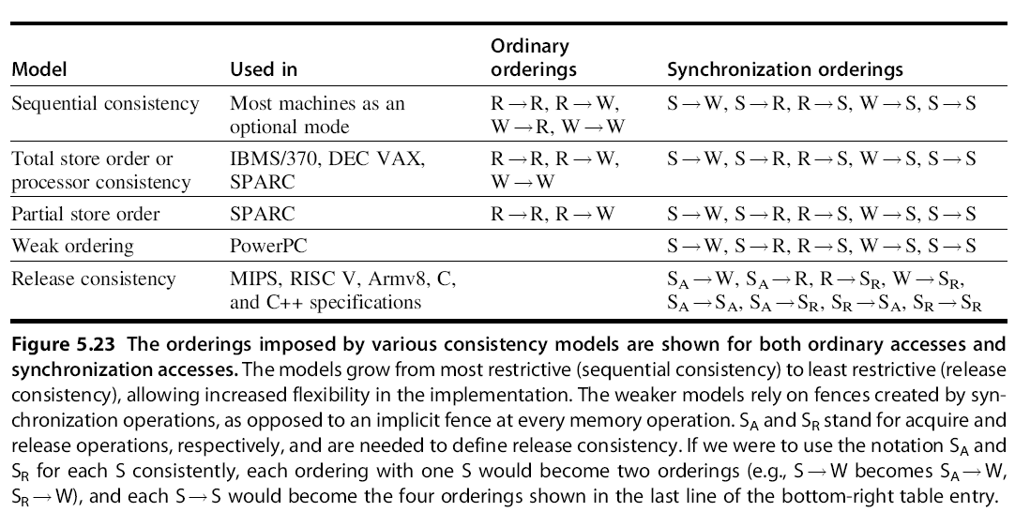
Computer School, NUDT Fall, 2020

Slide 28
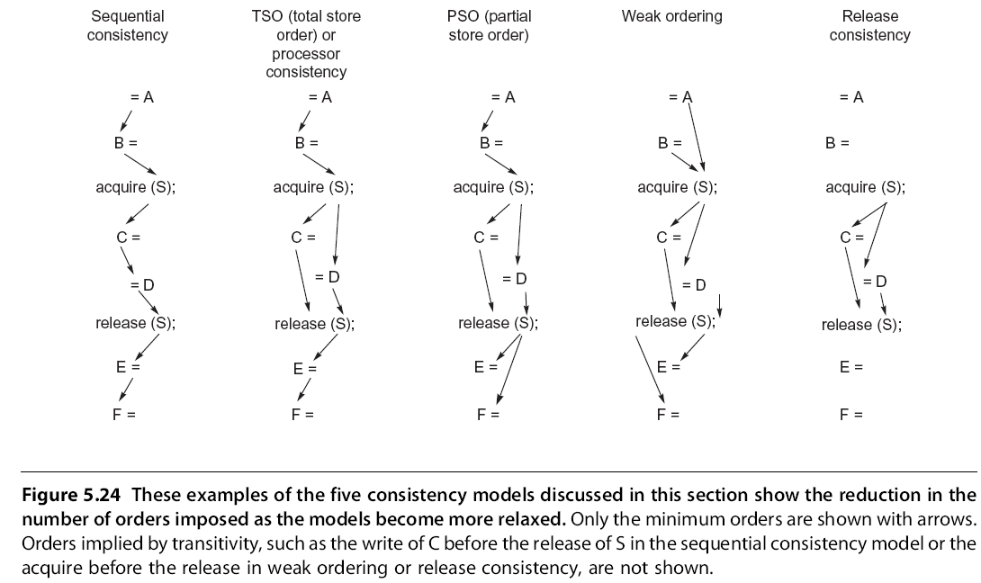
Computer School, NUDT Fall, 2020

Slide 29
Final Remarks on Consistency Models
At the present time, many multiprocessors being built support some sort of relaxed consistency model, varying from processor consistency to release consistency.
Since synchronization is highly multiprocessor specific and error prone, the expectation is that most programmers will use standard synchronization libraries and will write synchronized programs, making the choice of a weak consistency model invisible to the programmer and yielding higher performance.
Computer School, NUDT Fall, 2020

Slide 30
5.7 Crosscutting Issues
Compiler Optimization and the Consistency Model
Another reason for defining a model for memory consistency is to specify the range of legal compiler optimizations that can be performed on shared data. In explicitly parallel programs, unless the synchronization points are clearly defined and the programs are synchronized, the compiler could not interchange a read and a write of two different shared data items, because such transformations might affect the semantics of the program.
Computer School, NUDT Fall, 2020

Slide 31
This prevents even relatively simple optimizations, such as register allocation of shared data, because such a process usually interchanges reads and writes. In implicitly parallelized programs—for example, those written in High Performance FORTRAN (HPF)—programs must be synchronized and the synchronization points are known, so this issue does not arise.
Computer School, NUDT Fall, 2020

Slide 32
Using Speculation to Hide Latency in Strict Consistency Models
As we saw in before, speculation can be used to hide memory latency. It can also be used to hide latency arising from a strict consistency model, giving much of the benefit of a relaxed memory model.
The key idea is for: the processor to use dynamic scheduling to reorder memory references, letting them possibly execute out-of-order. Executing the memory references out-of-order may generate violations of sequential consistency, which might affect the execution of the program.
Computer School, NUDT Fall, 2020

Slide 33
This possibility is avoided by using the delayed commit feature of a speculative processor.
Assume the coherency protocol is based on invalidation. If the processor receives an invalidation for a memory reference before the memory reference is committed, the processor uses speculation recovery to back-out the computation and restart with the memory reference whose address was invalidated.
Computer School, NUDT Fall, 2020

Slide 34
If the reordering of memory requests by the processor yields an execution order that could result in an outcome that differs from what would have been seen under sequential consistency, the processor will redo the execution.
The key to using this approach is that the processor need only guarantee that the result would be the same as if all access were completed in order, and it can achieve this by detecting when the results might differ.
Computer School, NUDT Fall, 2020

Slide 35
Inclusion and Its Implementation
Many multiprocessors use multilevel cache hierarchies to reduce both the demand on the global interconnect and the latency of cache misses.
If the cache also provides multilevel inclusion — every level of cache hierarchy is a subset of the level further away from the processor—then we can use the multilevel structure to reduce the contention between coherence traffic and processor traffic.
The inclusion property is also called the subset property.
Computer School, NUDT Fall, 2020

Slide 36
EXAMPLE Assume that L2 has a block size four times that of L1. Show how a miss for an address that causes a replacement in L1 and L2 can lead to violation of the inclusion property.
Computer School, NUDT Fall, 2020

Slide 37
ANSWER Assume that L1 and L2 are direct mapped and that the block size of L1 is b bytes and the block size of L2 is 4b bytes. Suppose L1 contains two blocks with starting addresses x and x + b and that x mod 4b = 0, meaning that x also is the starting address of a block in L2, then that single block in L2 contains the L1 blocks x, x + b, x + 2b, and x + 3b. Suppose the processor generates a reference to block y that maps to the block containing x in both caches and hence misses. Since L2 missed, it fetches 4b bytes and replaces the block containing x, x + b, x + 2b, and x + 3b, while L1 takes b bytes and replaces the block containing x. Since L1 still contains x + b, but L2 does not, the inclusion property no longer holds.
Computer School, NUDT Fall, 2020

Slide 38
To maintain inclusion with multiple block sizes, we must probe the higher levels of the hierarchy when a replacement is done at the lower level to ensure that any words replaced in the lower level are invalidated in the higher-level caches.
Most systems chose this solution rather than the alternative of not relying on inclusion and snooping the higher-level caches.
Computer School, NUDT Fall, 2020

Slide 39
5.8 Putting It All Together
The Wildfire Architecture
Wildfire attempts to maximize the benefits of SMP, while allowing scalability by creating a DSM architecture using large SMPs as the nodes. The individual nodes in the Wildfire design are Sun E series multiprocessors (E6x00, E5x00, E4x00, or E3x00, here using E6000).
Wildfire can connect 2 to 4 E6000 multiprocessors by replacing one dual processor (or I/O) board with a Wildfire Interface board (WFI), yielding up to 112 processors (4 x 28),
Computer School, NUDT Fall, 2020

Slide 40
Wildfire is a cache-coherent nonuniform memory access architecture (cc-NUMA) with large nodes. Within each node of 28 processors, memory is uniformly accessible, only processes that span nodes need to worry about the non uniformity in memory access times.
The WFI plugs into the bus and sees all memory requests; it implements the global coherence across up to four nodes. Each WFI has three ports that connect to up to three additional Wildfire nodes, each with a dual directional 800 MB/sec connection. WFI uses a simple directory scheme.
Computer School, NUDT Fall, 2020

Slide 41
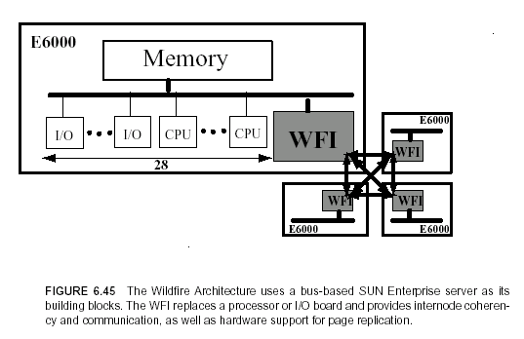
Computer School, NUDT Fall, 2020

Slide 42
T1 Multiprocessor
T1 is a multicore multiprocessor introduced by Sun in 2005 as a server processor. It almost totally focused on exploiting thread-level parallelism rather than instruction-level parallelism. It uses both multiple core and multithreading to produce throughput.
Each Ti processor contains 8 processor core, each supporting 4 threads. Each processor core consists of a simple six-stage, single-issue pipeline. T1 uses fine-grained multithreading, switching to a new thread on each clock cycle.
Computer School, NUDT Fall, 2020

Slide 43
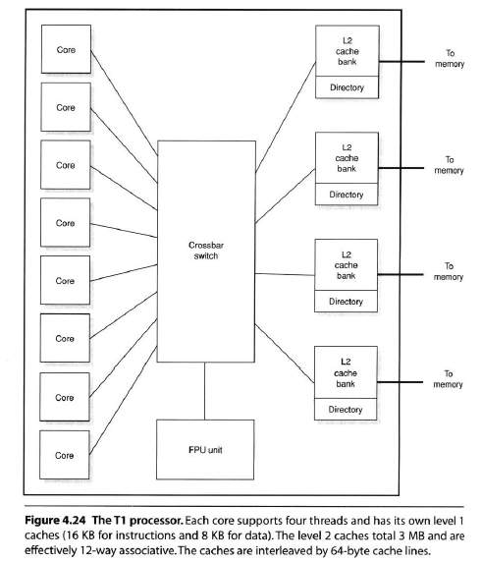
Computer School, NUDT Fall, 2020

Slide 44
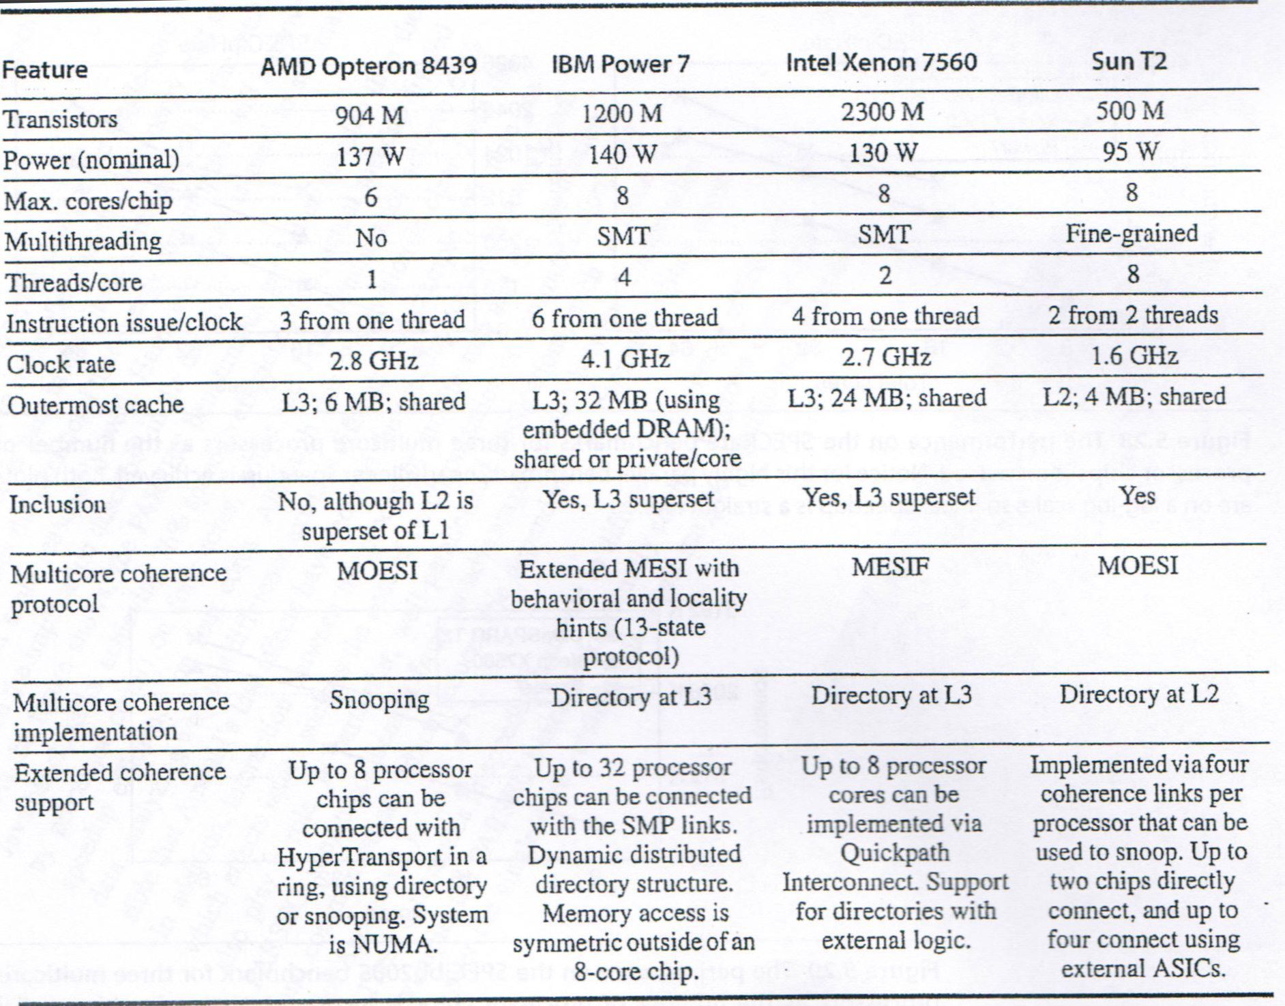
Computer School, NUDT Fall, 2020

Slide 45
Multicore Processors and Their Performance
We examine the design of three different multicores, the support they provide for larger multiprocessors, and some performance
characteristics, before doing a broader evaluation of small to large multiprocessor Xeon systems, and concluding with a detailed evaluation of the
multicore i7 920, a predecessor of the i7 6700.
Computer School, NUDT Fall, 2020

Slide 46
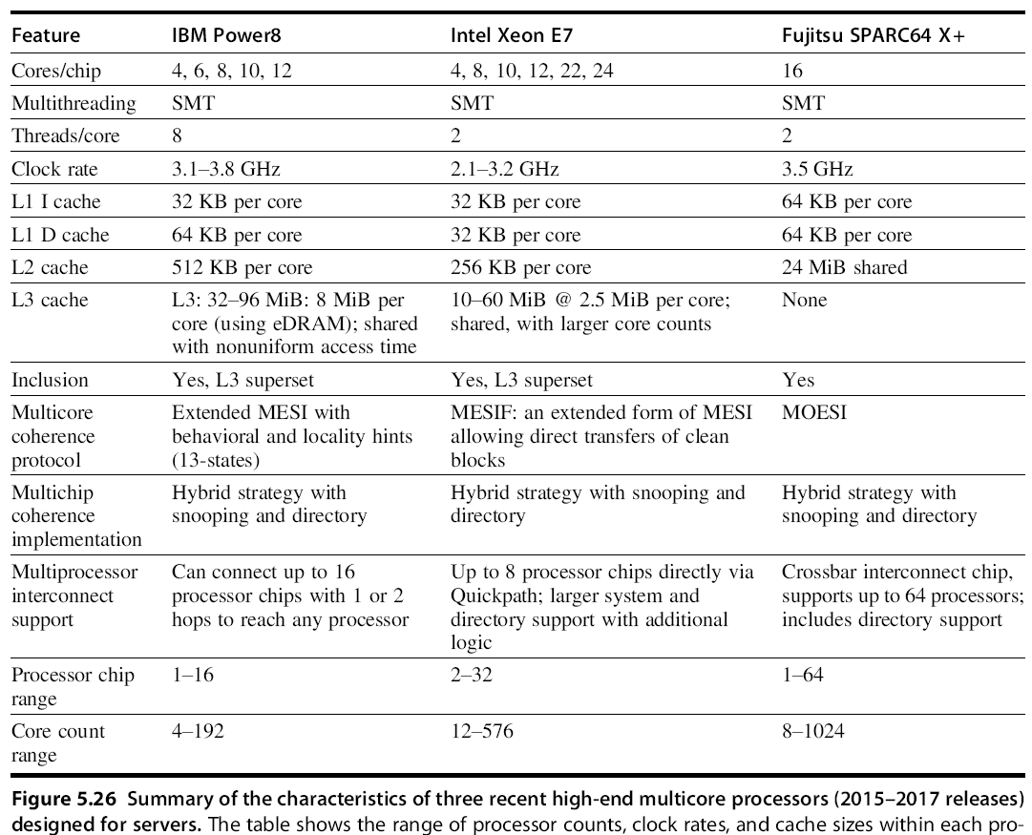
Computer School, NUDT Fall, 2020

Slide 47
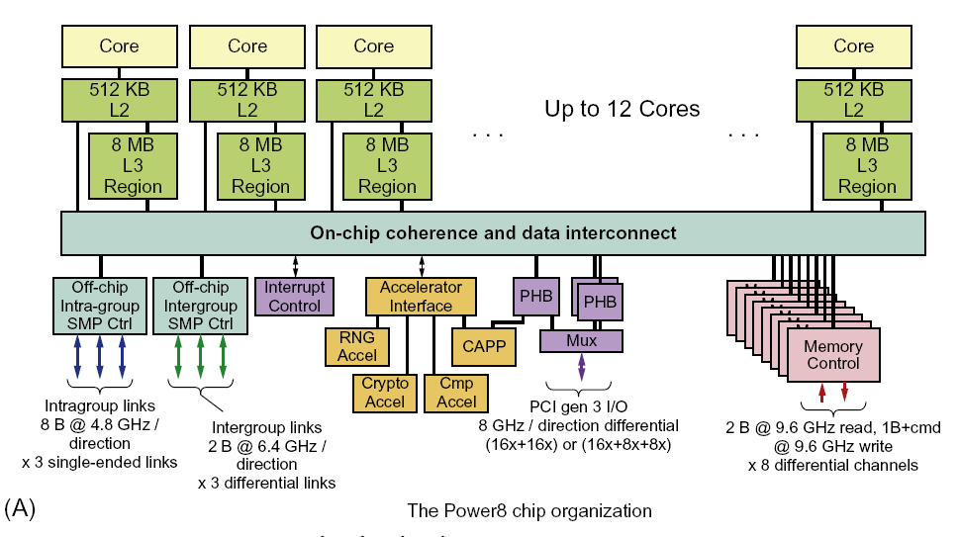
Computer School, NUDT Fall, 2020

Slide 48
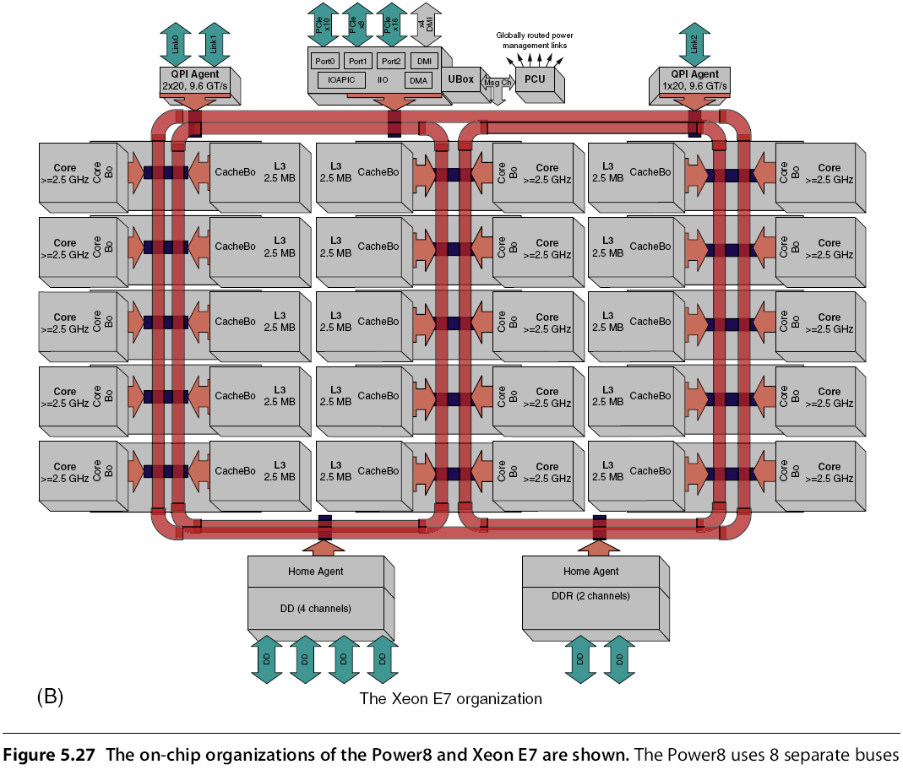
Computer School, NUDT Fall, 2020

Slide 49
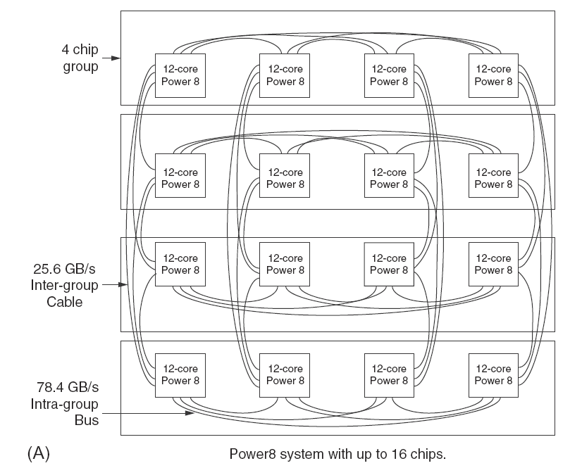
Computer School, NUDT Fall, 2020

Slide 50
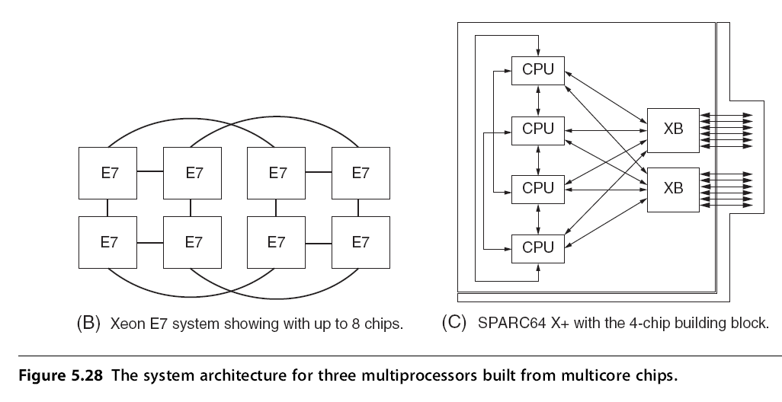
Computer School, NUDT Fall, 2020

Slide 51
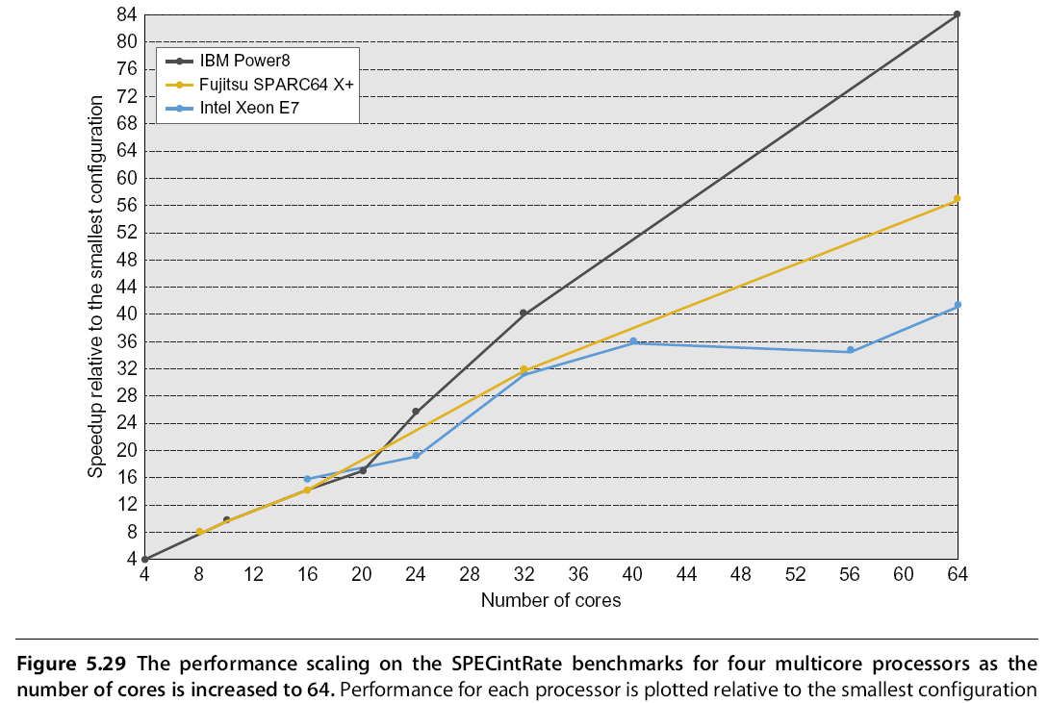
Computer School, NUDT Fall, 2020

Slide 52
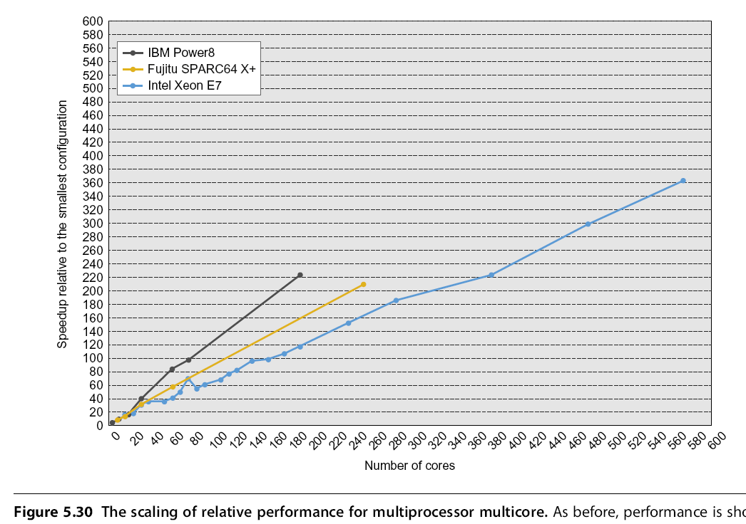
Computer School, NUDT Fall, 2020

Slide 53
5.9 Fallacies and Pitfalls
Pitfall: Measuring performance of multiprocessors by linear speedup versus execution time.
Comparing execution times is fair only if you are comparing the best algorithms on each computer. Comparing the identical code on two processors may seem fair, but it is not; the parallel program may be slower on a uniprocessor than a sequential version.
Computer School, NUDT Fall, 2020

Slide 54
In summary, comparing performance by comparing speedups is at best tricky and at worst misleading.
Comparing the speedups for two different multiprocessors does not necessarily tell us anything about the relative performance of the multiprocessors.
Even comparing two different algorithms on the same multiprocessor is tricky, since we must use true speedup, rather than relative speedup, to obtain a valid comparison.
Computer School, NUDT Fall, 2020

Slide 55
Fallacy: Amdahl’s Law doesn’t apply to parallel computers.
The basis for the statement that Amdahl’s Law had been “overcome” was the use of scaled speedup.
The dangers of relating scaled speedup as true speedup.
Computer School, NUDT Fall, 2020

Slide 56
Fallacy: Linear speedups are needed to make multiprocessors cost-effective.
The problem with this argument is that cost is not only a function of processor count, but also depends on memory and I/O.
In comparing the cost/performance of two computers, we must be sure to include accurate assessments of both total system cost and what performance is achievable. For many applications with larger memory demands, such a comparison can dramatically increase the attractiveness of using a multiprocessor.
Computer School, NUDT Fall, 2020

Slide 57
Pitfall: Not developing the software to take advantage of, or optimize for, a multiprocessor architecture.
There is a long history of software lagging behind on massively parallel processors, possibly because the software problems are much harder. Two examples from mainstream, bus-based multiprocessors illustrate the difficulty of developing software for new multiprocessors. The first has to do with not being able to take advantage of a potential architectural capability, and the second arises from the need to optimize the software for a multiprocessor.
Computer School, NUDT Fall, 2020

Slide 58
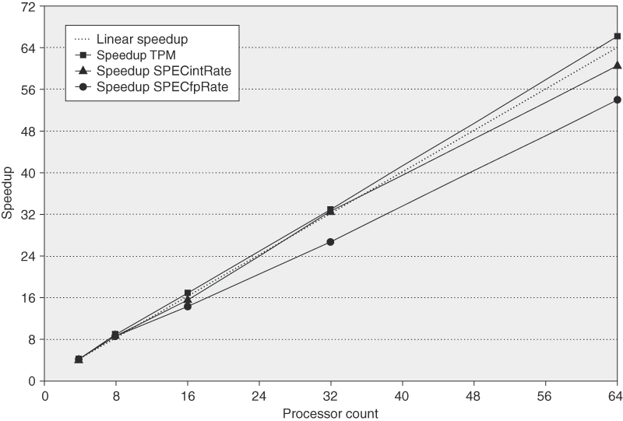
Figure 5.32 Speedup for three benchmarks on an IBM eServer p5 multiprocessor when configured with 4, 8, 16,
32, and 64 processors. The dashed line shows linear speedup.
Computer School, NUDT Fall, 2020

Slide 59
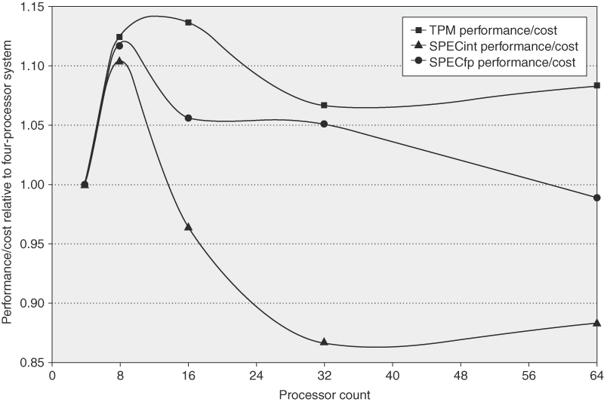
Figure 5.33 The performance/cost relative to a 4-processor system for three benchmarks run on an IBM eServer p5 multiprocessor containing from 4 to 64 processors shows that the larger processor counts can be as cost effective as the 4-processor configuration. For TPC-C the configurations are those used in the official runs, which means that disk and memory scale nearly linearly with processor count, and a 64-processor machine is approximately twice as expensive as a 32-processor version. In contrast, the disk and memory are scaled more slowly (although still faster than necessary to achieve the best SPECRate at 64 processors). In particular, the disk configurations go from one drive for the 4-processor version to four drives (140 GB) for the 64-processor version. Memory is scaled from 8 GB for the 4-processor system to 20 GB for the 64-p-rocessor system.
Computer School, NUDT Fall, 2020

Slide 60
Pitfall: Neglecting data distribution in a distributed shared-memory multiprocessor.
This analysis only considers latency, and assumes that contention effects do not lead to increased latency, which is very optimistic.
Computer School, NUDT Fall, 2020

Slide 61
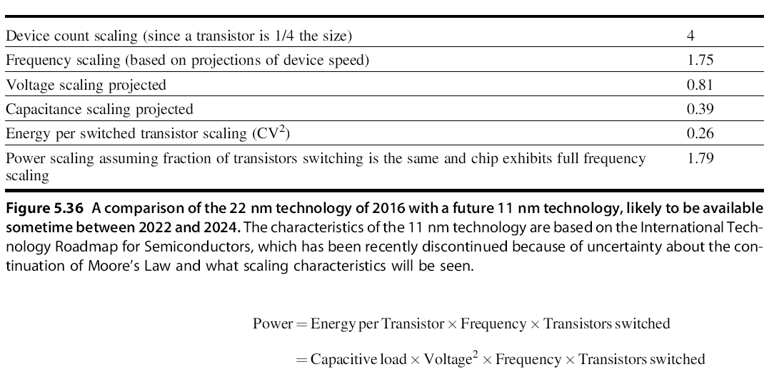
5.10 The Future of Multicore Scaling
Computer School, NUDT Fall, 2020

Slide 62
Example: Suppose we have a 96-core future generation processor, but on average only 54 cores can be busy. Suppose that 90% of the time, we can use all available cores; 9% of the time, we can use 50 cores; and 1% of the time is strictly serial. How much speedup might we expect? Assume that cores can be turned off when not in use and draw no power and assume that the use of a different number of cores is distributed so that we need to worry only about average power consumption. How would the multicore speedup compare to the 24-processor count version that can use all its processor 99% of the time?
Computer School, NUDT Fall, 2020

Slide 63
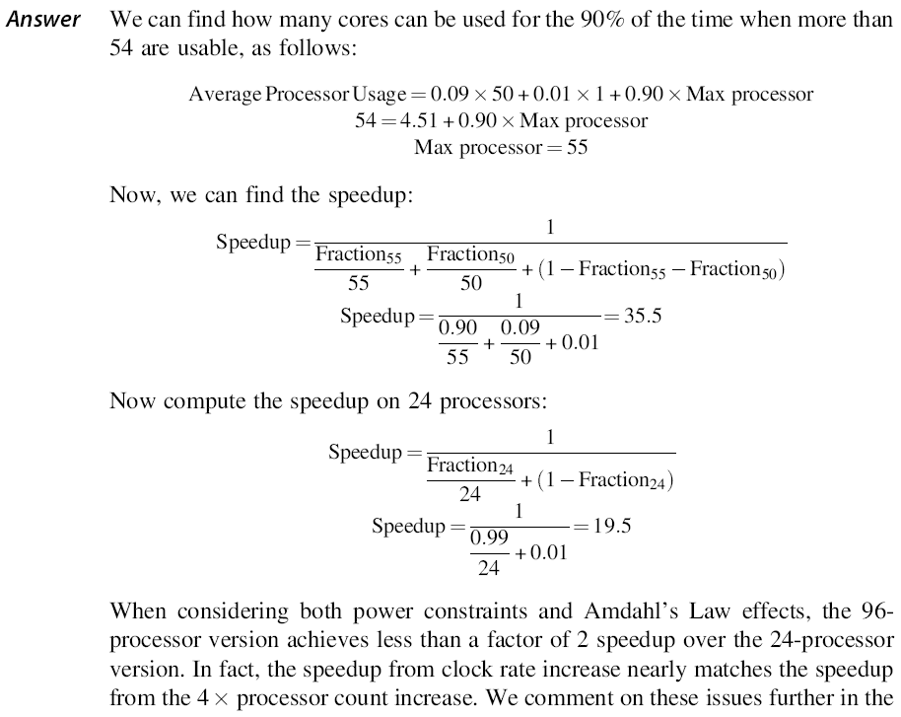
Computer School, NUDT Fall, 2020

Slide 64
5.11 Concluding Remarks
The Future of MPP Architecture
The Future of Microprocessor Architecture
Evolution Versus Revolution
Combining domain-specific processors with general-purpose processors is perhaps the best road forward to achieve increased performance and energy efficiency while maintaining some of the flexibility that general-purpose processors offer.
Computer School, NUDT Fall, 2020

Slide 65
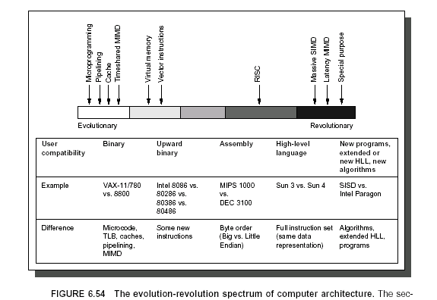
Computer School, NUDT Fall, 2020

