Slide 1
Intelligent Running TrackFeatures
Report: Wu Xuechen

Slide 2
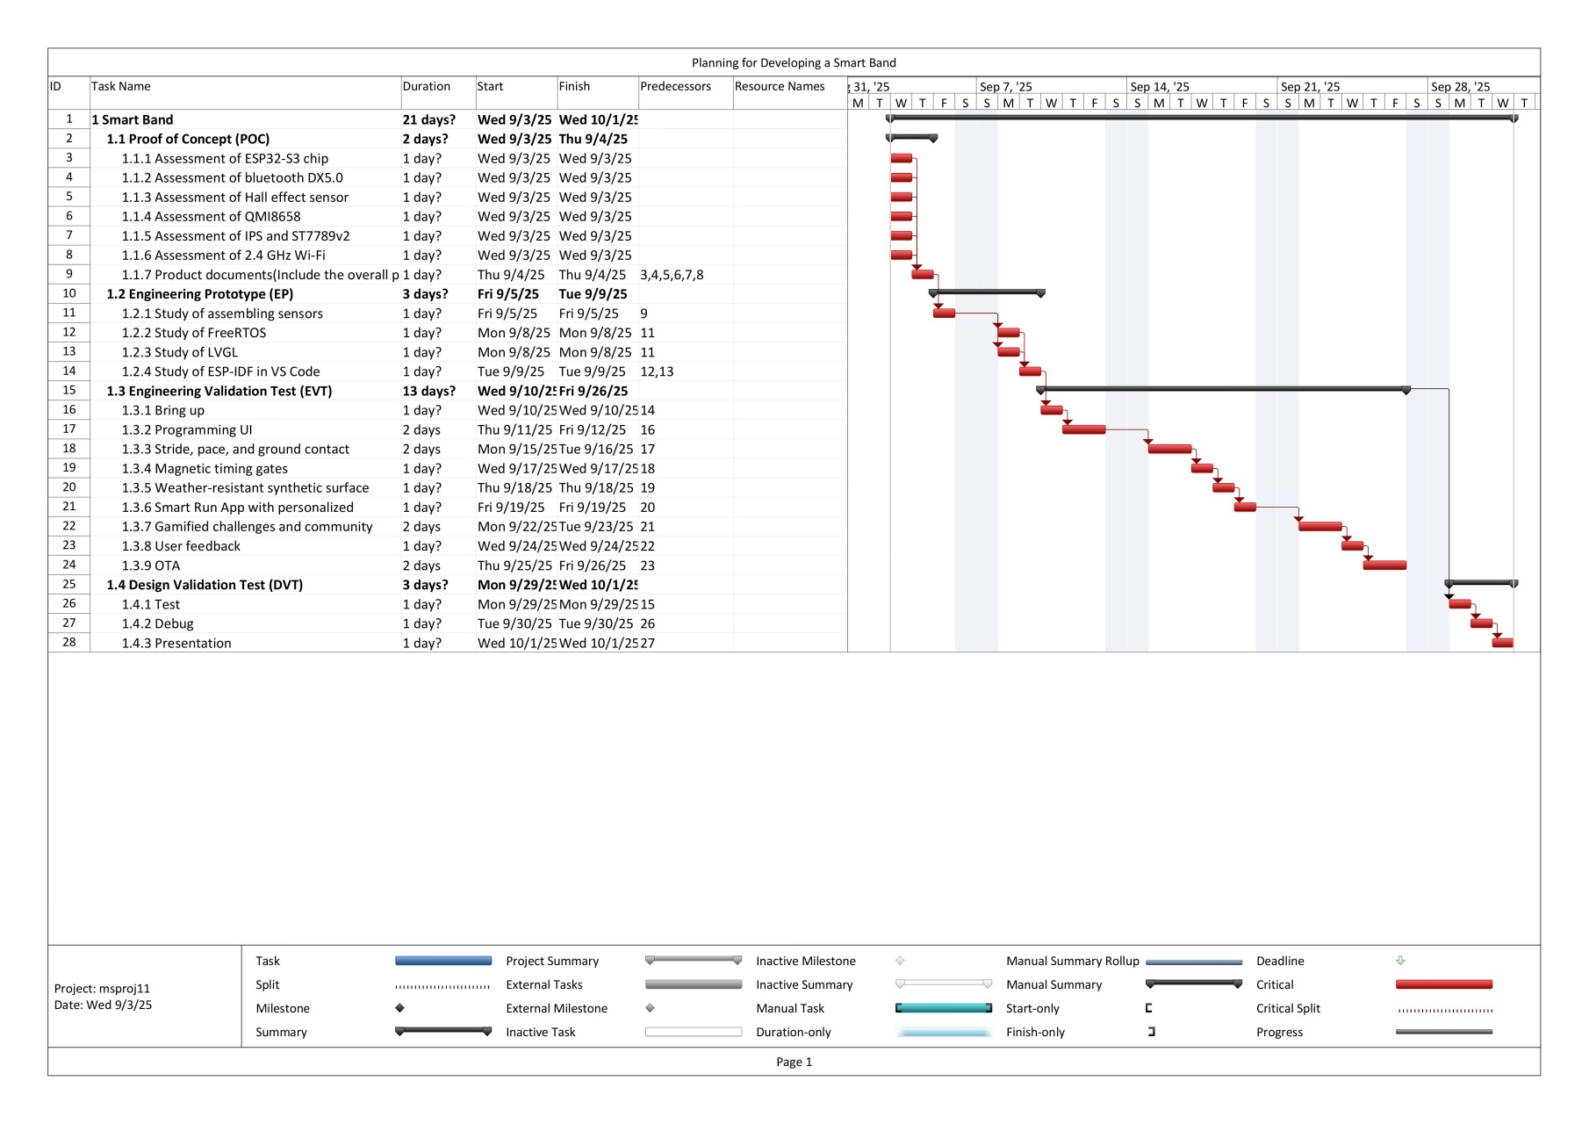
Planning

Slide 3
Assessment of Hardware

Slide 4
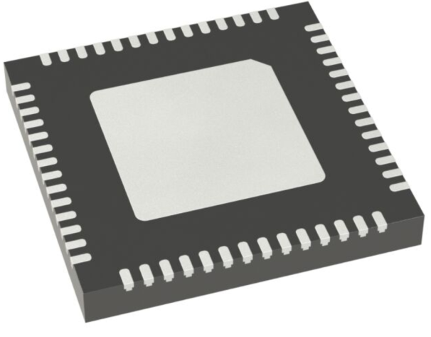
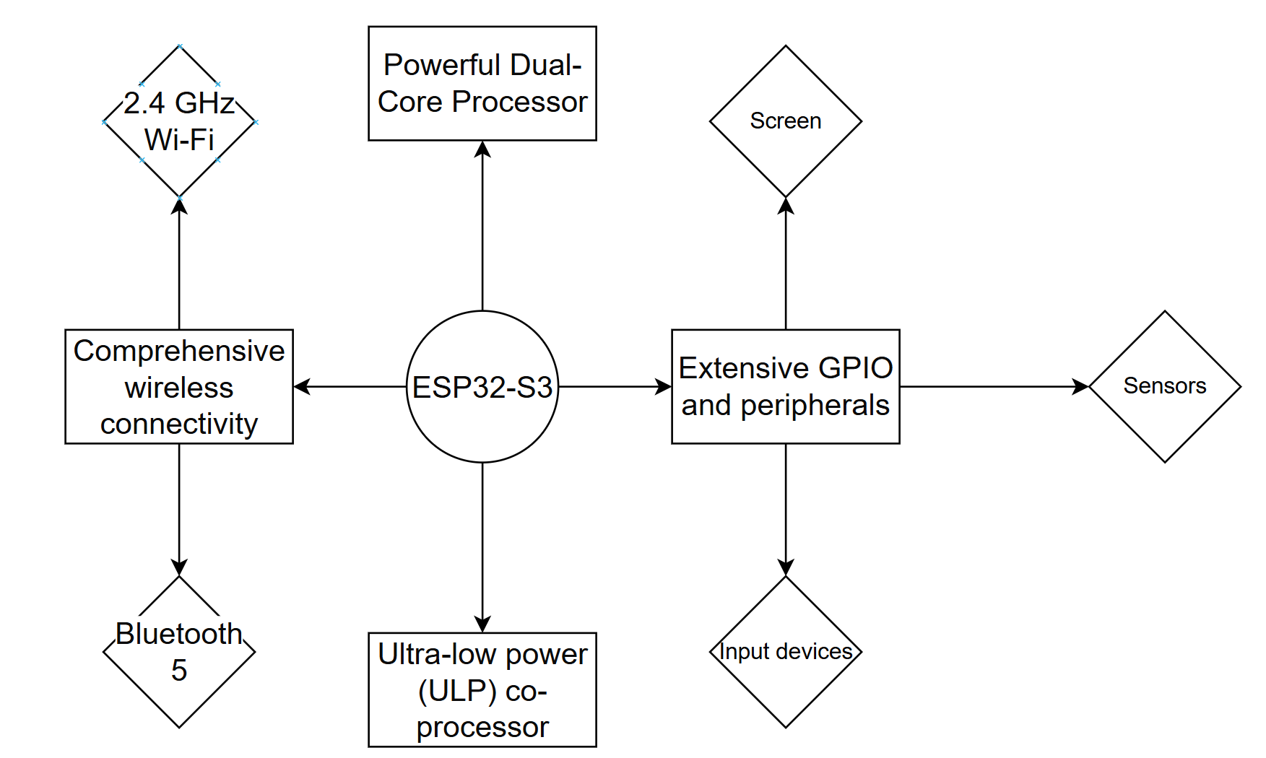
ESP32-S3 chip

Slide 5
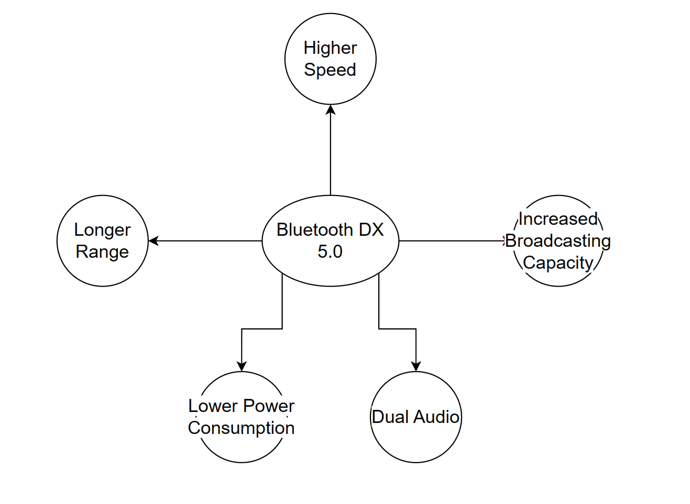
Bluetooth DX 5.0

Slide 6
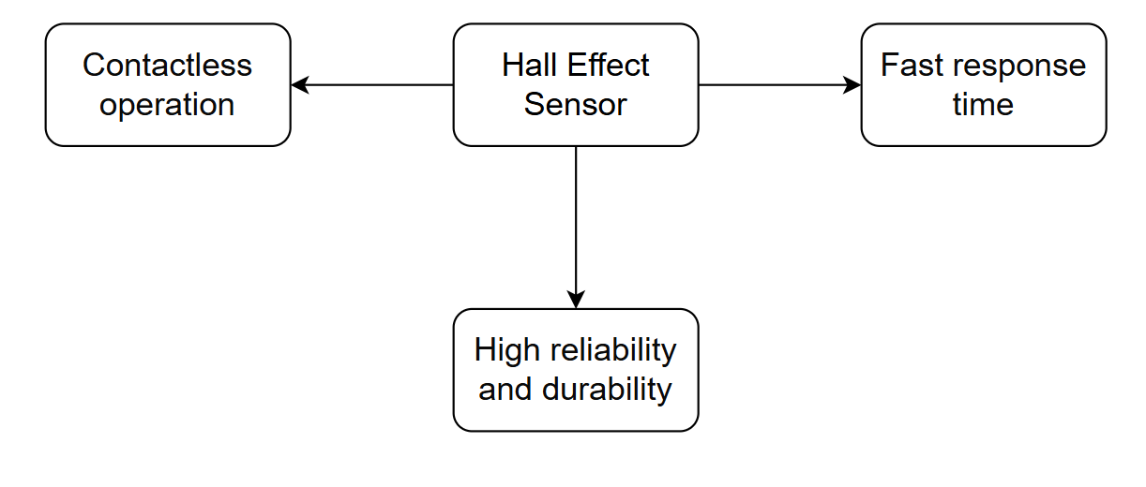
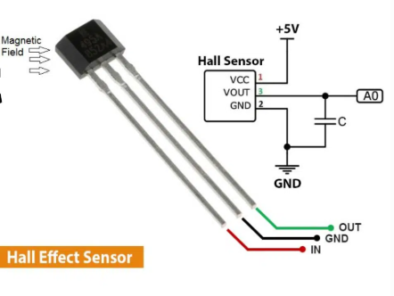
Hall Effect Sensor

Slide 7
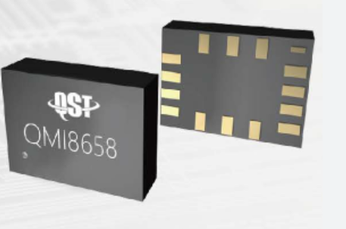
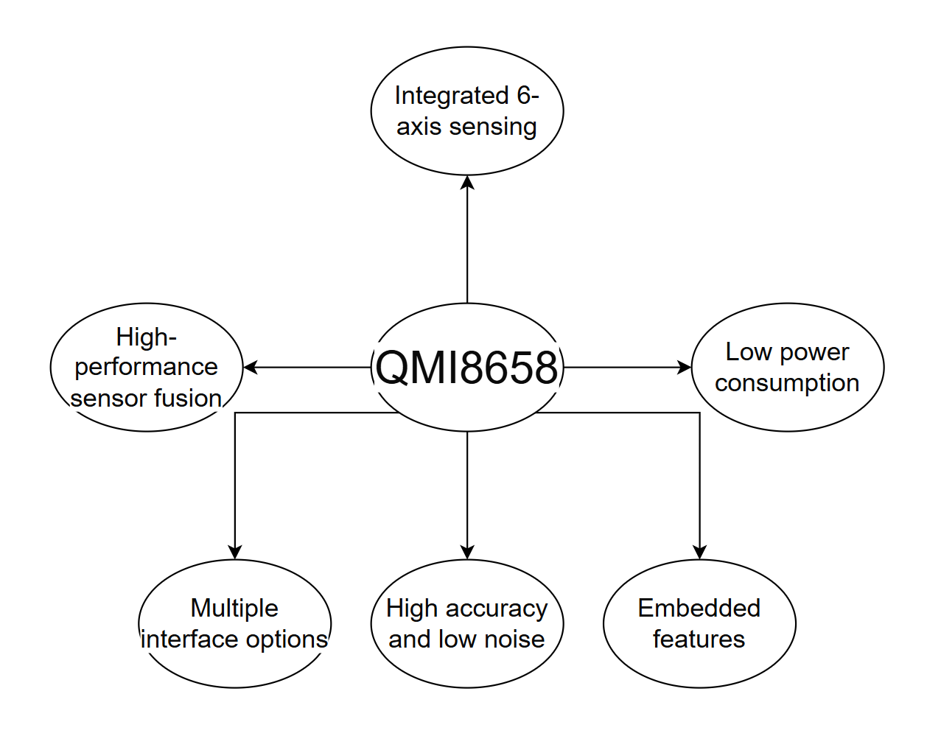
QMI8658

Slide 8
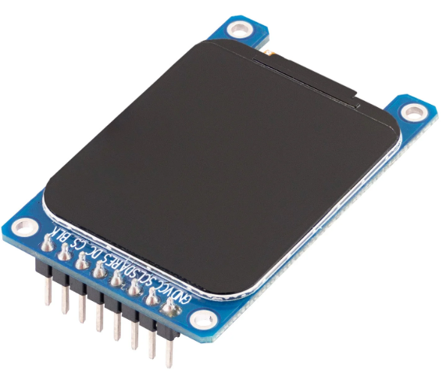
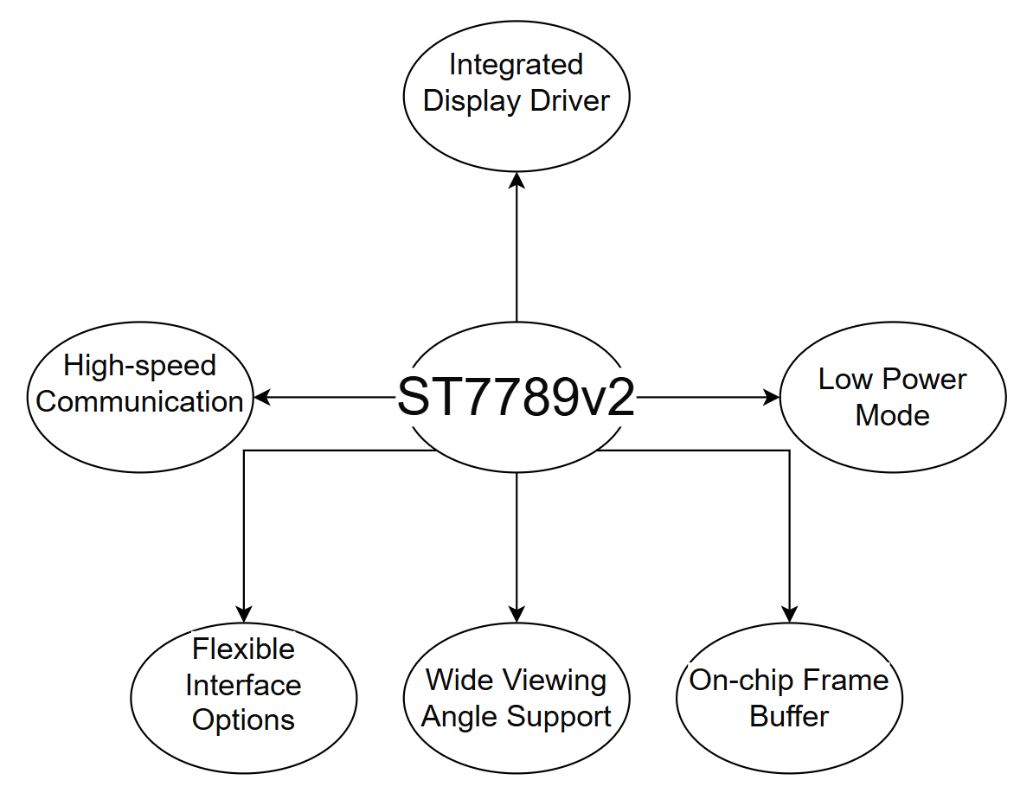
ST7789v2

Slide 9
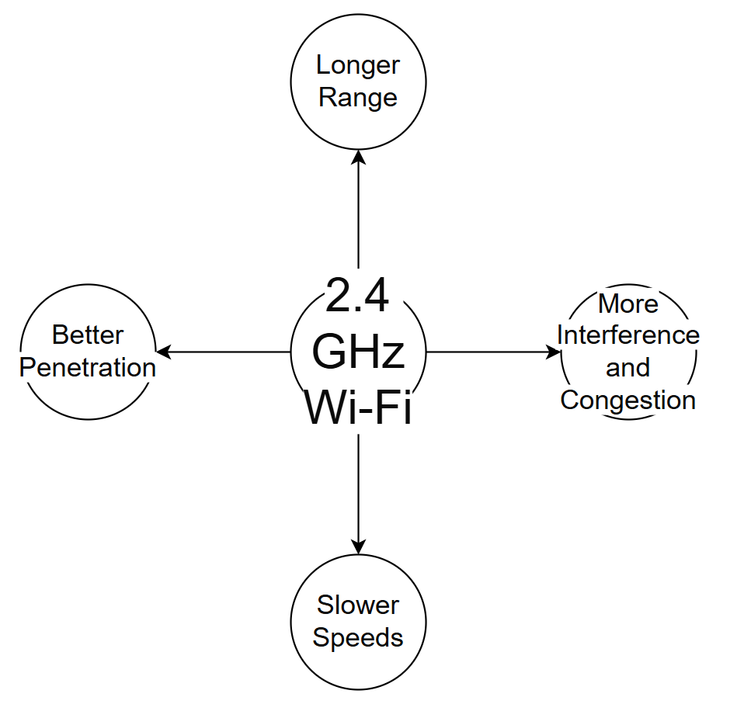
2.4 GHz Wi-Fi

Slide 10
Requirement of Development

Slide 11
Bring up
Bootloader: The device requires a custom bootloader to initialize the system, load the firmware, and enable Over-the-Air (OTA) updates.
Hardware Initialization: The software must correctly initialize all hardware components, including the display, Bluetooth module, and internal sensors (accelerometer and gyroscope) upon power-on.
Low-Power State: The firmware must support and transition between multiple low-power modes to conserve battery life. The "bring up" process must include a quick wake-up from these modes

Slide 12
Programming UI
Display Management: The software must use a low-power, graphical UI engine optimized for the smart band's limited screen size (e.g., AMOLED display).
Navigation: The UI must be easily navigable via physical buttons, gestures (swipes, taps), or touch input. The design should be minimalist to prioritize essential information and avoid clutter.
Screen Customization: Users should be able to configure watch faces and data displayed during activities.
Activity Visualization: The UI must be capable of displaying real-time running metrics (like pace and duration) in a clear, at-a-glance format.
Notifications and Alerts: The band should display notifications for successful connections, run completion, and low battery.

Slide 13
Stride, pace, and ground contact
Sensor Data Fusion: The smart band's firmware must integrate data from its internal accelerometer and gyroscope. Advanced algorithms must be developed to process this raw data to calculate running metrics like stride length, cadence, pace, and ground contact time.
Magnetic Gate Integration: When running on the track, the smart band's magnetic sensor must detect the embedded timing gates. This data must be logged and reconciled with internal sensor data to provide highly accurate lap times and interval feedback.
Data Storage: The band needs sufficient on-chip storage (flash memory) to log run data, including sensor readings and timestamps, even when not connected to a mobile app.
Real-time feedback: The band should provide real-time vibration feedback to the user as they cross a timing gate.
Accuracy Calibration: The band must have a calibration feature, allowing users to manually correct data discrepancies (e.g., pace) for more reliable records, especially for indoor running.

Slide 14
Gamified challenges and community
Achievement Tracking: The smart band must track progress towards gamified challenges locally and display user achievements on the UI.
Community Connection: The smart band should be capable of syncing with other bands via Bluetooth to display real-time leaderboard data or challenge progress

Slide 15
OTA
Firmware Updates: The device's firmware must be capable of being updated over-the-air via a Bluetooth connection with the mobile app.
Update Process: The OTA process must be resilient and power-aware. The band's battery must be at a sufficient level (e.g., above 20%) to initiate an update, and the process must be restartable in case of a disconnection.
Security: The OTA update process must be secure, using digital signatures to verify the authenticity of the firmware and prevent malicious updates.

Slide 16
User feedback
Local Data Logging: The band's firmware should log internal issues, crashes, and sensor anomalies.
Data Export: The band should be able to transmit error logs to the mobile app for user reporting.

Slide 17
Wireless connectivity
Bluetooth Low Energy (BLE) Stack: The band requires a low-power BLE stack for reliable and efficient communication with the mobile application.
Connection Management: The software must manage BLE connection states, including pairing, reconnection, and disconnection, to ensure seamless data synchronization.
Wi-Fi Connection: While the mobile app and server are primarily responsible for Wi-Fi communication, the smart band must have a robust 2.4 GHz Wi-Fi antenna and driver to communicate directly with the track's processing unit.

Slide 18
Engineering Prototype

Slide 19
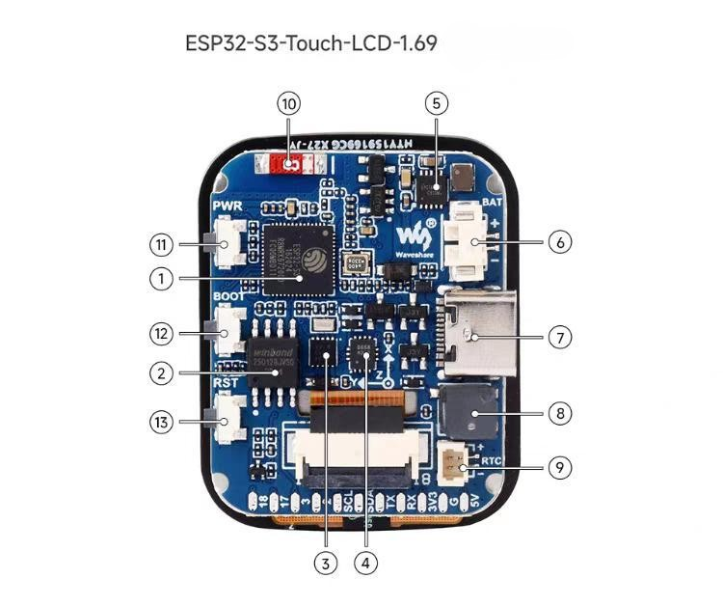
Assembling of hardware
ESP32-S3R8 Chip
W25Q128JVSIQ 16M NOR-Flash
PCF85063 RTC Clock
QMI8658 IMU
ETA6098 Charging Chip
MX1.25 Battery Interface
Type-C ESP-S3 USB
Buzzer
RTC Battery Interface
2.4 GHz WiFi and Bluetooth 5
Power Button
Boot Key
Reset Key

Slide 20
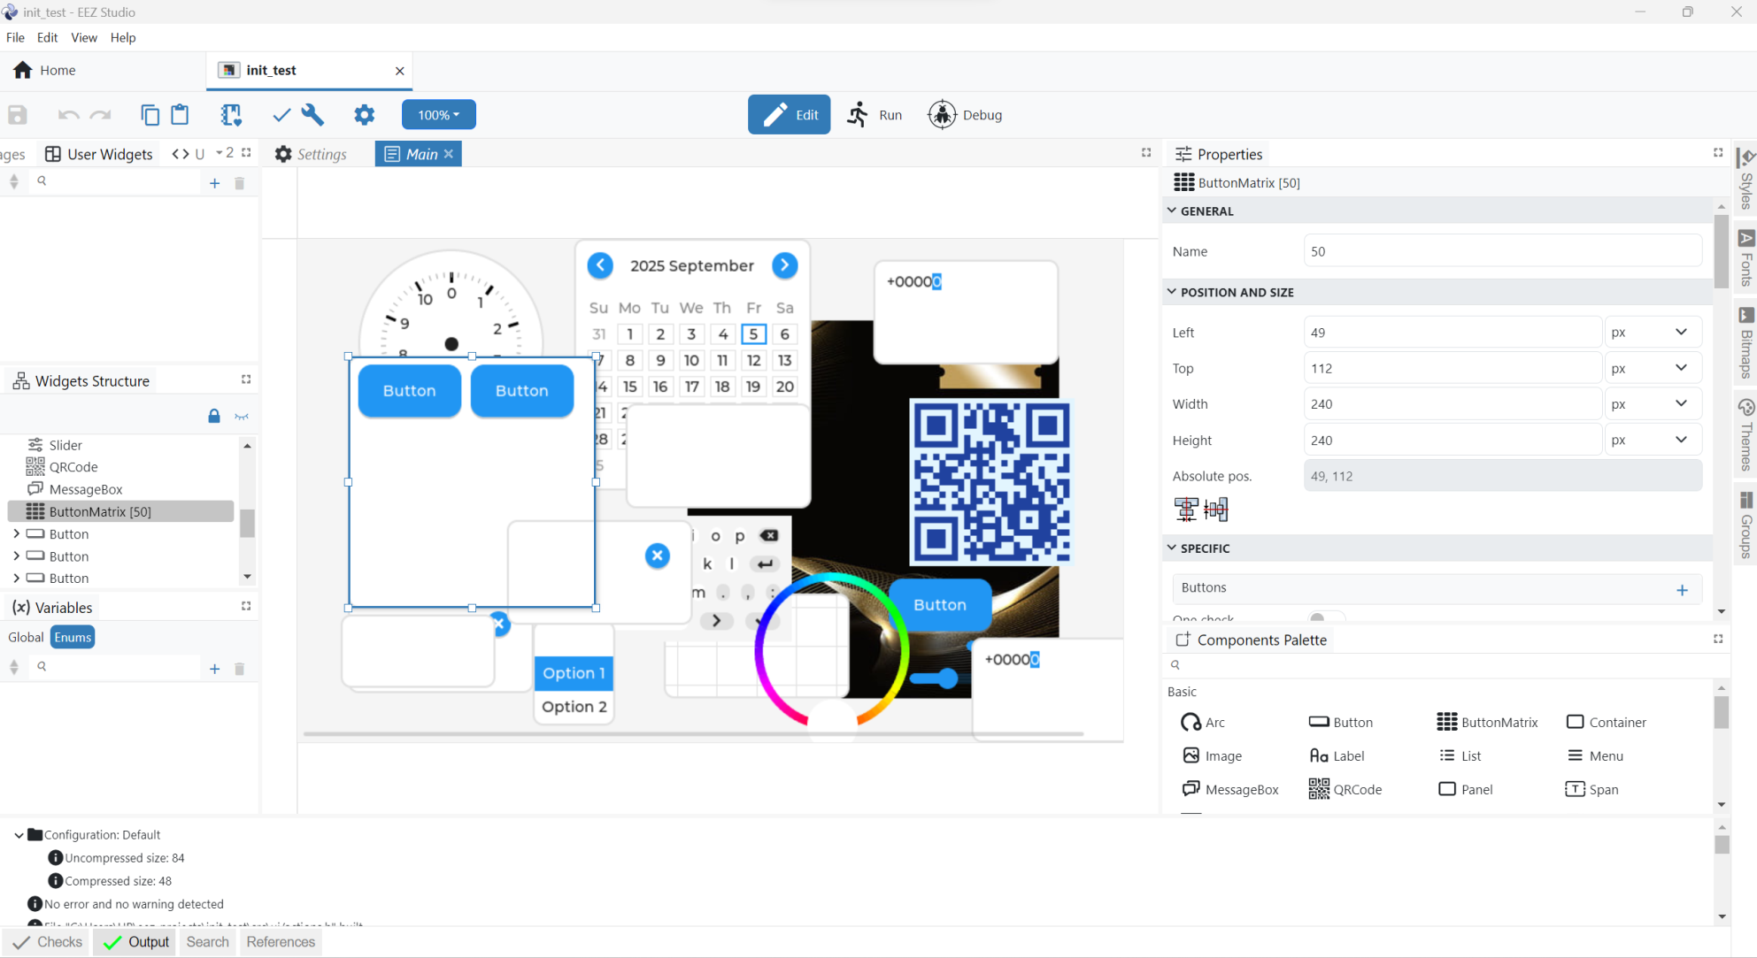
EEZ Studio

Slide 21
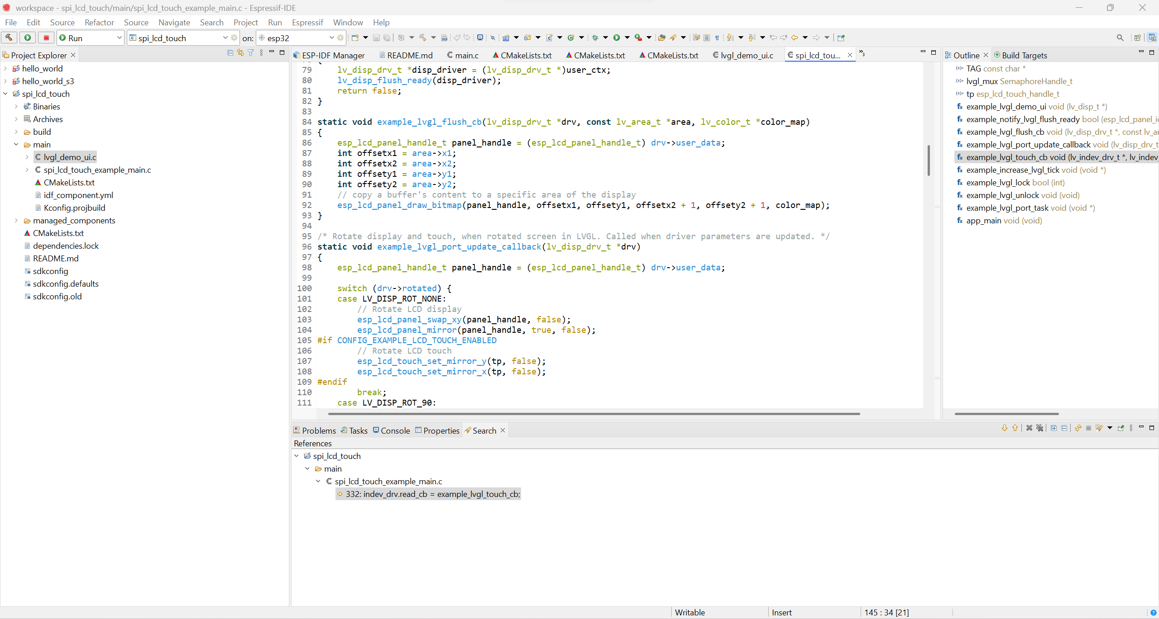
ESPRessif-IDE

Slide 22
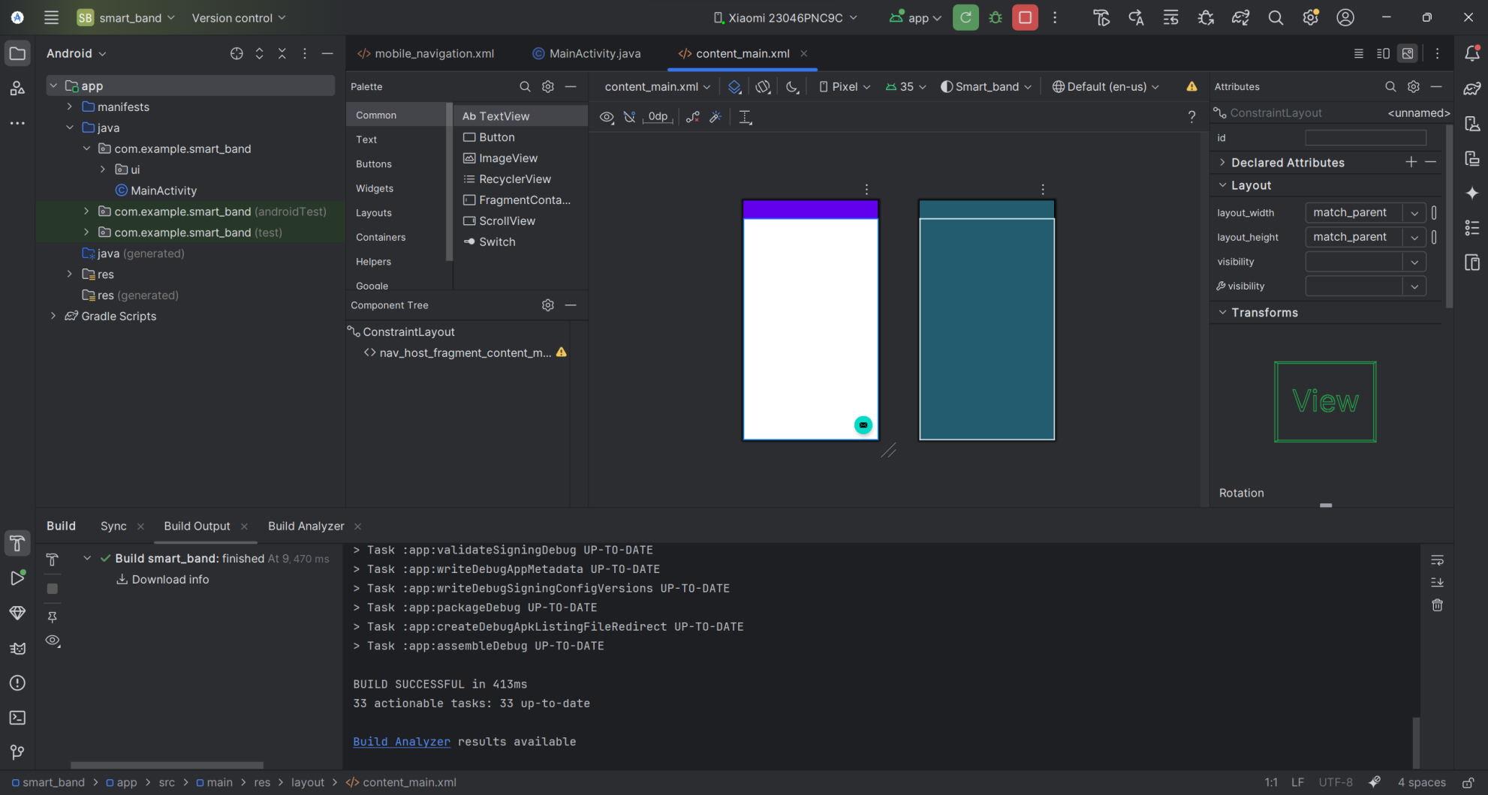
Android Studio

Slide 23
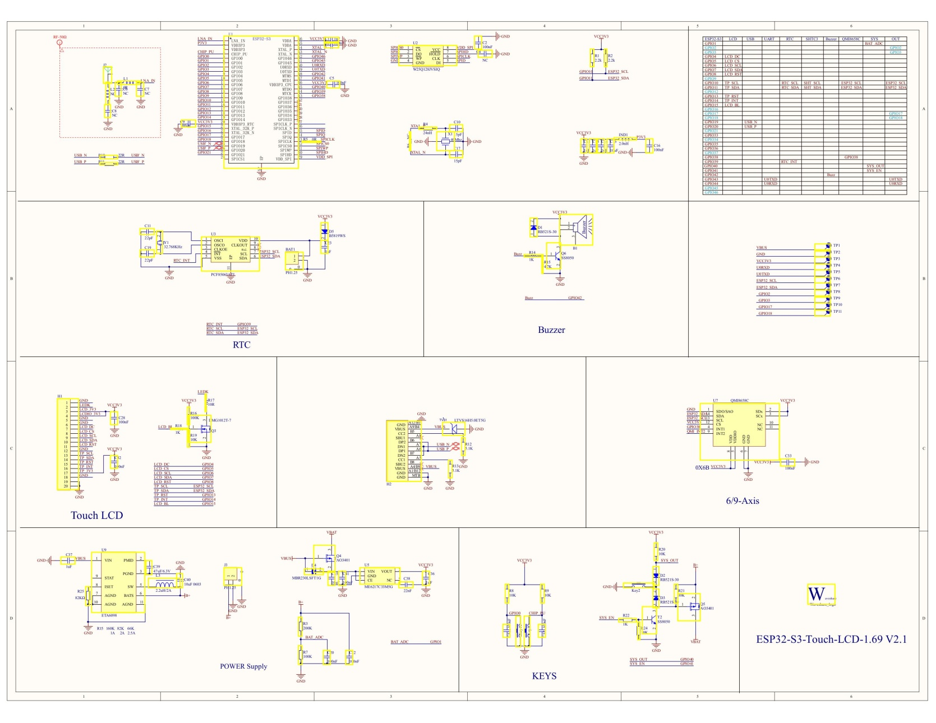
Schematic Diagram

Slide 24
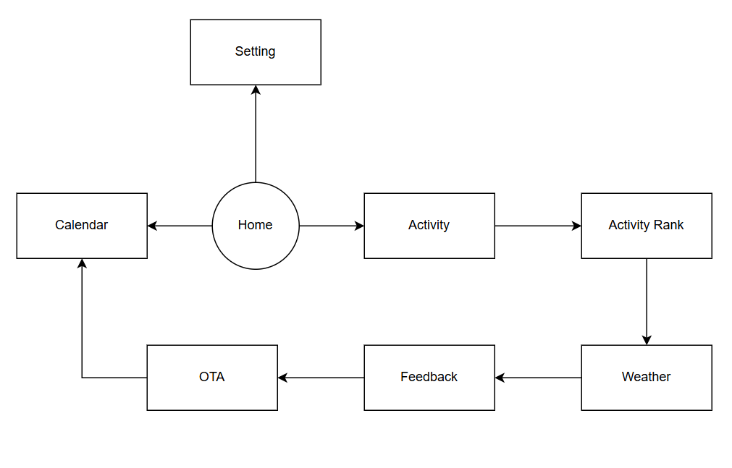
UI Schematic

