Slide 1
Programming Assignment 3 (1/3)
Multinomial NB Classifier:
  Text collection:
    The 1095 news documents.
    13 classes (id 1~13), each class has 15 training documents.
      https://ceiba.ntu.edu.tw/course/88ca22/content/training.txt
    The remaining documents are for testing.
      Send your result to Kaggle.
      See kaggle教學詳細版.pdf for the detail of the output format
class_id training doc ids
11 19 29 113 …
1 2 3 4 …
…
13 485 520 523 …
training.txt

Slide 2
Programming Assignment 3 (2/3)
Note:
  For each class, you have to calculate M P(X=t|c) parameters.
    M is the size of your vocabulary.
  Then, the total number of parameters in your system will be |C|*M ← can be a huge number.
  We know that many terms in the vocabulary are not indicative.
  Employ at least one feature selection method and use only 500 terms in your classification.
    Χ² test.
    Likelihood ratio.
    Pointwise/expected MI.
    Frequency-based methods.
  When classify a testing document, terms not in the selected vocabulary are ignored.

Slide 3
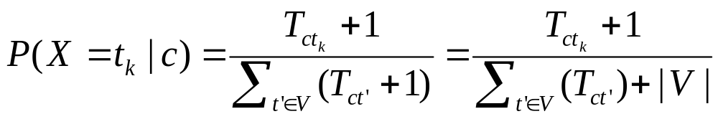
Programming Assignment 3 (3/3)
To avoid zero probabilities, calculate P(X=t|c) by using add-one smoothing.
Test your result on Kaggle!!
Please zip and submit ^{1.}source code and ^{2.}a report to TA.
  3 weeks to complete, that is, 2020/12/14.

