Slide 1
Final report
組名:51818
組員: 許紘碩、吳逸邦

Slide 2
OUTLINE
• Preprocessing
• Segmentation Model pytorch library
• Model comparison
• Dice Coefficient
• Training Process
• Discussion
• Ideas to Improve the Result

Slide 3


Preprocessing
Step1 Read JSON File (convert into mask)
Extract
1716*942 mask (png)

Slide 4
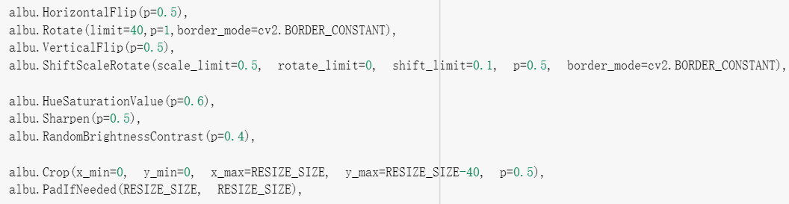

Preprocessing
Step2 Data Augmentation (Albumentations)

Slide 5
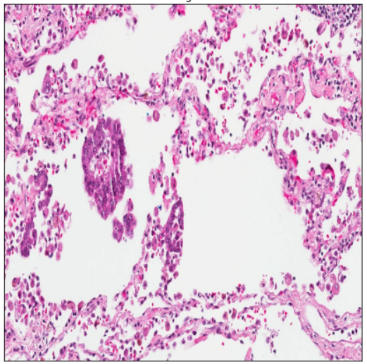
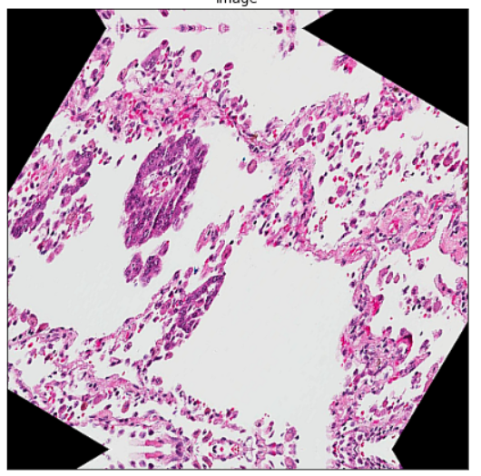
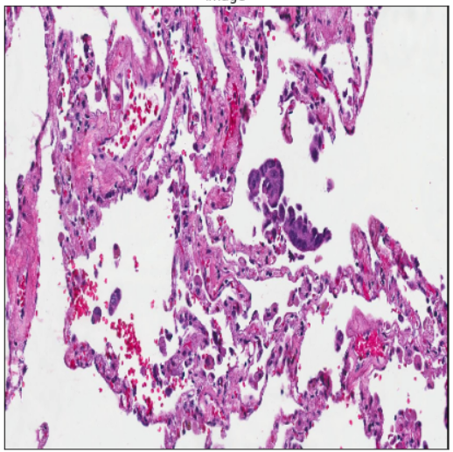
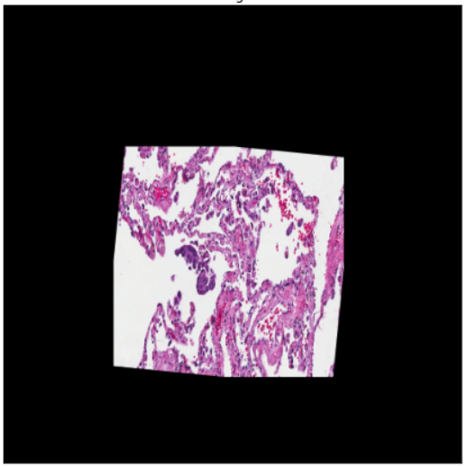
Preprocessing
Example
example1
Resize(640*640)
Flip
ShiftScaleRotate
Sharpen
RandomBrightnessContrast
Crop
Padding
example2

Slide 6

Segmentation Model pytorch library
Github Link: https://github.com/qubvel/segmentation_models.pytorch

Slide 7
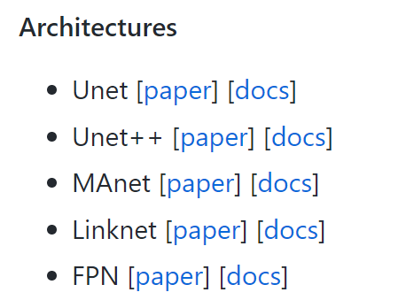
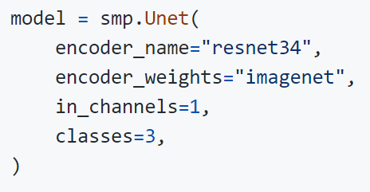
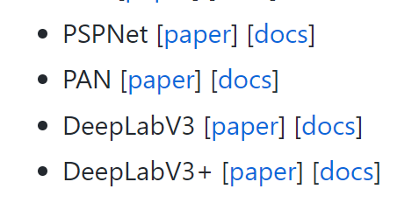
Segmentation Model pytorch library
Provide several segmentation model architectures and pretrained encoder backbone which make the training process much more convenient.
Model initialization example:

Slide 8
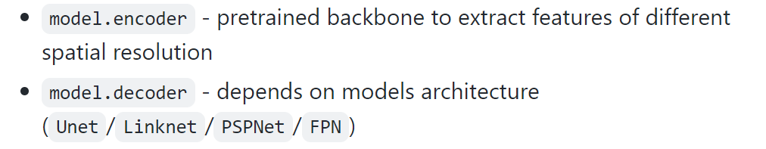
Segmentation Model pytorch library
Encoders: resnet (resnet50, resnet101…..) , VGG (vgg16, vgg19…….)
efficient net (efficientnet_b0, b1……),
densenet (densenet121, 169….).....etc.

Slide 9
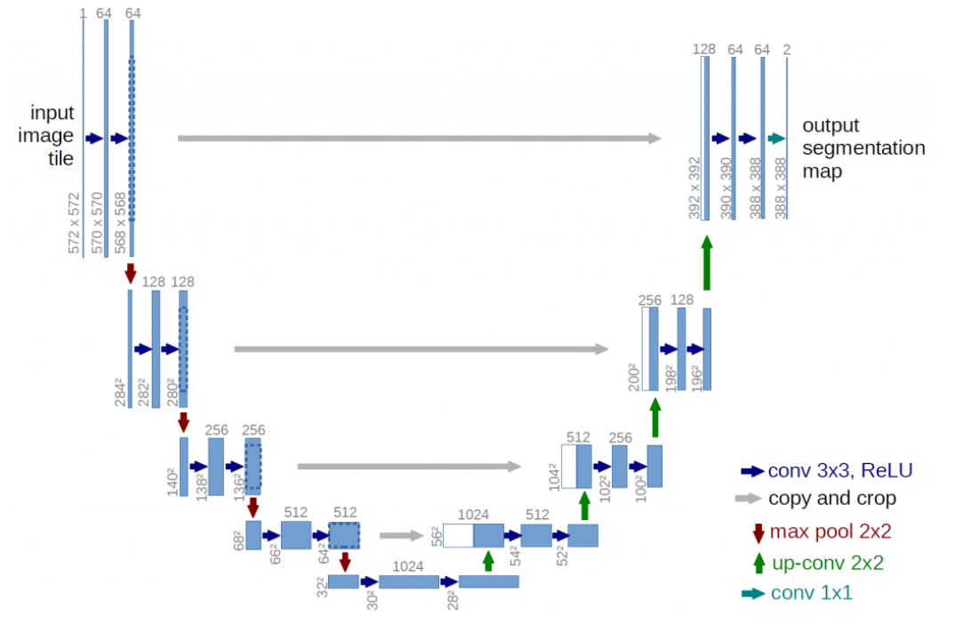
Model comparison - Unet vs Unet++
Unet:

Slide 10
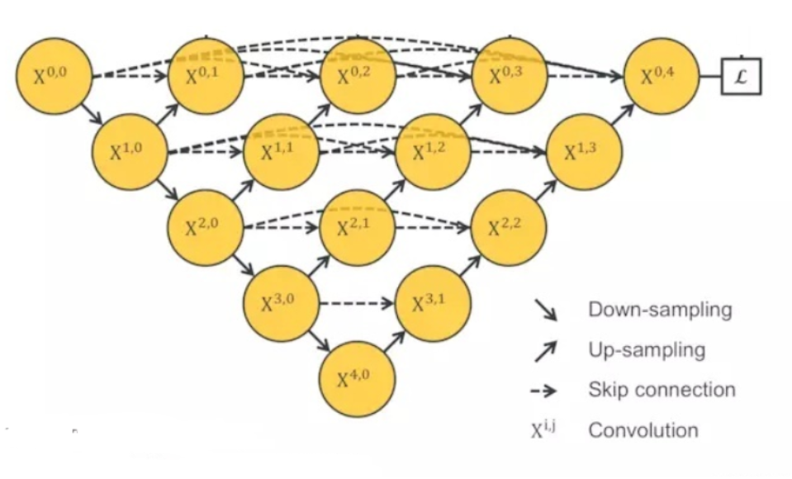
Model comparison - Unet vs Unet++
Unet++ (nested Unet)

Slide 11

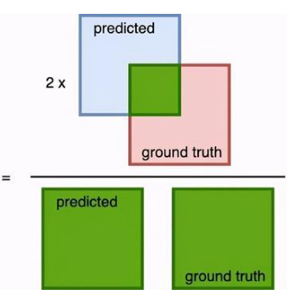

Dice Coefficient
這次project拿來評斷準確度的dice coefficient，常在醫學影像分割的問題拿來當作評斷準確度的標準
計算方式是，將兩張圖都predict為1的面積乘2，再除上兩張圖1的數量，換句話說就是兩張圖的交集面積乘2除兩張圖的聯集面積

Slide 12
Training Process
中心思想: trial and error, 各種亂試
Training hyperparameters:
Loss Function: Diceloss
2. Evaluation metrics: Dice Coefficient (F1)
3. Optimizer: Adam, weight decay
4. Learning Rate: 0.0001
Train-test split
Total data 1053 images
Trainset: 0.8 (846)
Validset: 0.1 (105)
Testset: 0.1 (106)

Slide 13
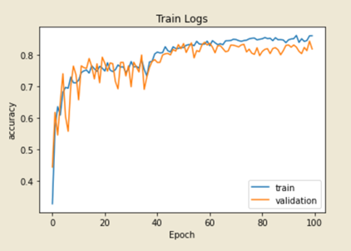
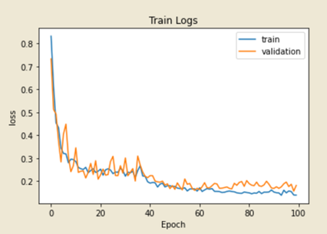
Training Process - 1st try
Architecture: Unet Encoder: Resnet50 Epochs: 100
Validation DSC: 0.8440 Test DSC: 0.8358

Slide 14
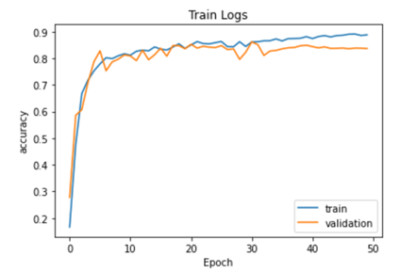
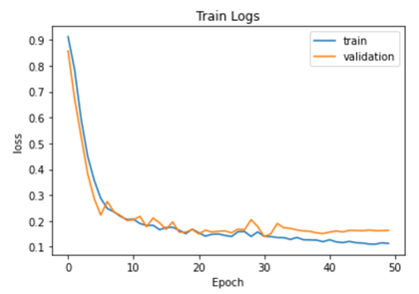
Training Process - 2nd try
Architecture: Unet Encoder: efficientnet_b1 Epochs: 50
Validation DSC: 0.8616 Test DSC: 0.8474

Slide 15
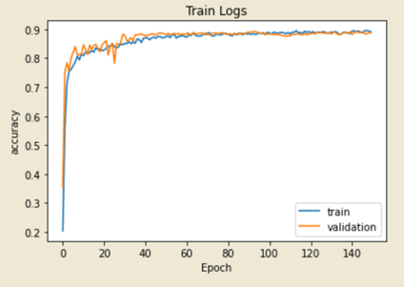
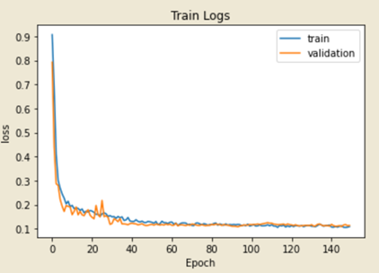
Training Process - 3rd try
Architecture: Unet Encoder: efficientnet_b1 Epochs: 150
Validation DSC: 0.8926 Test DSC: 0.8649

Slide 16
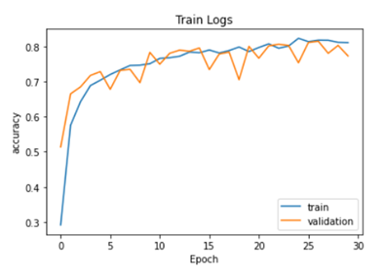
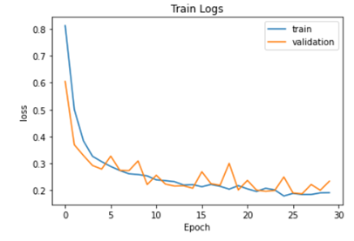
Training Process - 4th try
Architecture: DeepLab_v3 Encoder:efficientnet_b1 Epochs: 30
Validation DSC: 0.8149 Test DSC: 0.8155

Slide 17
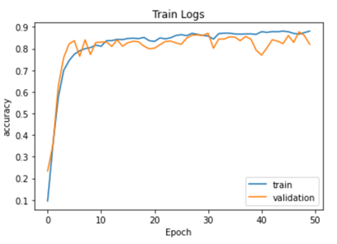
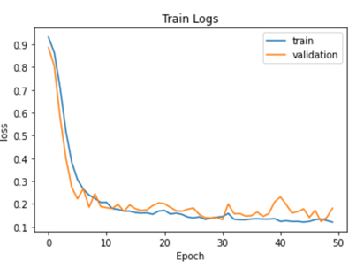
Training Process - 5th try
Architecture: Unet++ Encoder: efficientnet_b1 Epochs: 50
Validation DSC: 0.8782 Test DSC: 0.8682

Slide 18
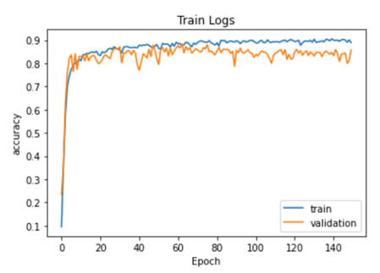
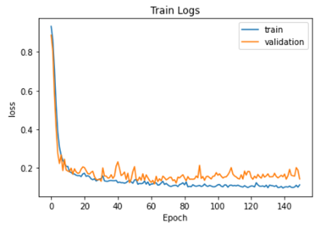
Training Process - 6th try (best result)
Architecture: Unet++ Encoder: efficientnet_b1 Epochs: 150
Validation DSC: 0.8884 Test DSC: 0.8682

Slide 19
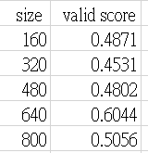
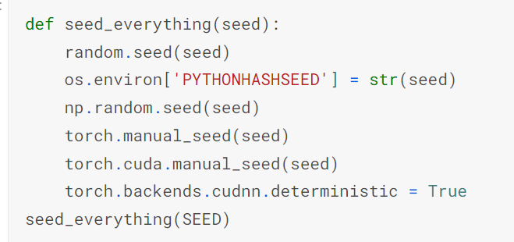
Discussion
Image size
原圖為1716*942，如果用原圖大小下去跑，memory會不夠，我們最後選擇size = 640*640, batch size = 4去跑，memory不會出現不夠的問題
2. Test set
因為我們這組沒報名AI CUP，所以我們沒有比賽的private test，所以我們有控制各個random seed 來控制我們的test set，增加模型的可信度

Slide 20
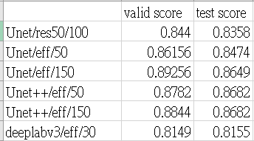
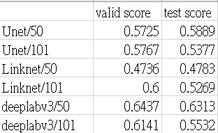
Discussion
3. Architecture
一開始選擇Unet，後來嘗試過library裡面其它種模型和encoder，像是Deeplabv3，經過嘗試後最後選擇了Unet++搭配efficientnet_b1
Deeplabv3 > Unet > linknet
我們測試結果Unet++ >Unet >Deeplabv3

Slide 21
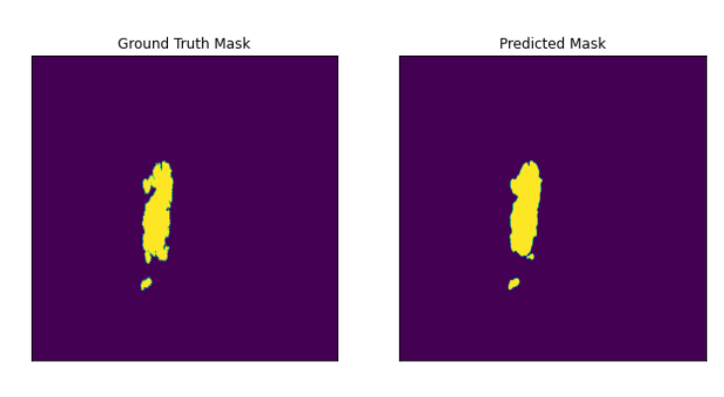
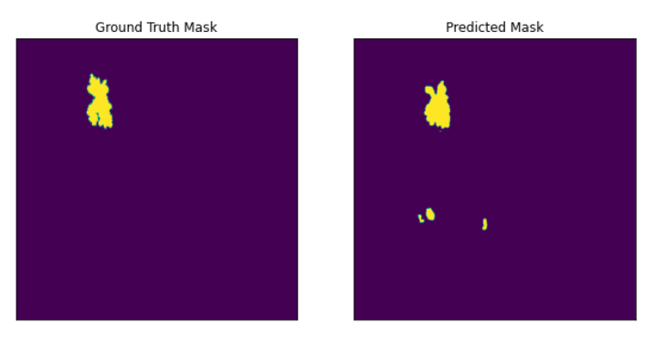
Ideas to Improve the Result
Postprocessing
有一個想法是將predict出來的結果假設有很小一點的那種刪掉當作prediction，這樣的方法在某些圖上會有好的結果，有些則沒有，以下兩種例子

Slide 22
Ideas to Improve the Result
2. model ensemble
3. Keep trying

