Slide 1

PrIU: A provenance-based approach for incrementally updating regression models
Yinjun Wu, Val Tannen, Susan B. Davidson
University of Pennsylvania
Notes:
University names in this slide

Slide 2
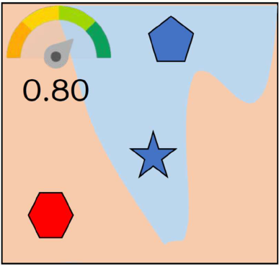
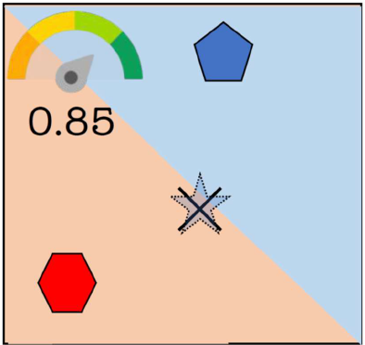
Importance of training samples [Ghorbani, ICML 2019]
Leave one out
Incrementally update the model!!
Retrain the model?

Slide 3
From the perspective of DB researchers
Materialized view maintenance on ML models with small number of deletions of input training samples
Classical materialized view maintenance problem:
Provenance-semiring model can be used to propagate the deletions of base relation tuples to the view instance [Green, VLDB 2007]
Use provenance!

Slide 4
Outline
State of the art
PrIU and optimizations
Experiments

Slide 5

State of the art
1
1
Our goal:
PrIU for linear regression/logistic regression model (GD/SGD)
Goal:
General ML models (GD/SGD)
≈1
≈1
0
0
Model complexity
Similarity to the retrained model:
1
1
Simple models with closed form solutions:
e.g. Linear Regression/Naïve Bayes Model [Deshpande, SIGMOD 06] [Gupta, 2015]
Influence function method [Koh, ICML 17] for general ML models
More similar
0
0
Providing solutions for general models (trained by GD/SGD) is hard [Schelter, 2019] [Ginart, NIPS 19]

Slide 6
Outline
State of the art
PrIU and optimizations
Experiments

Slide 7
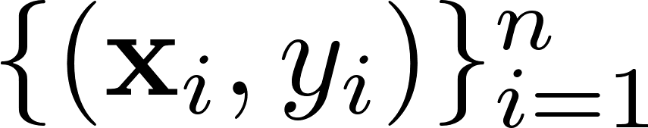
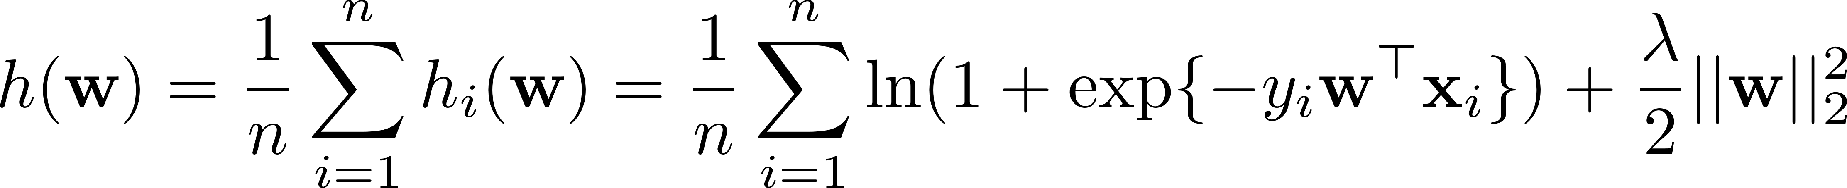
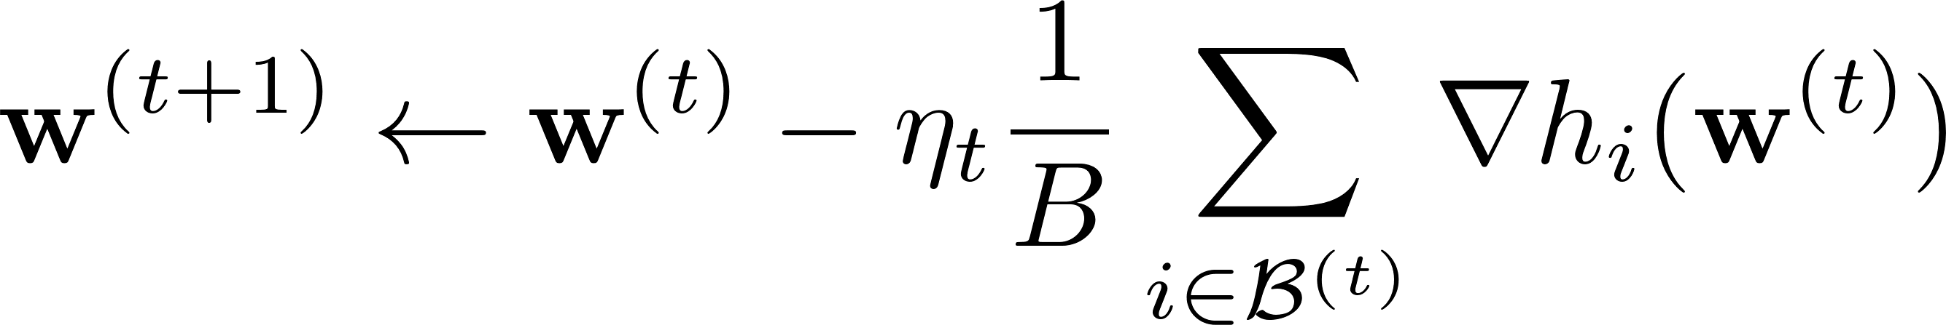
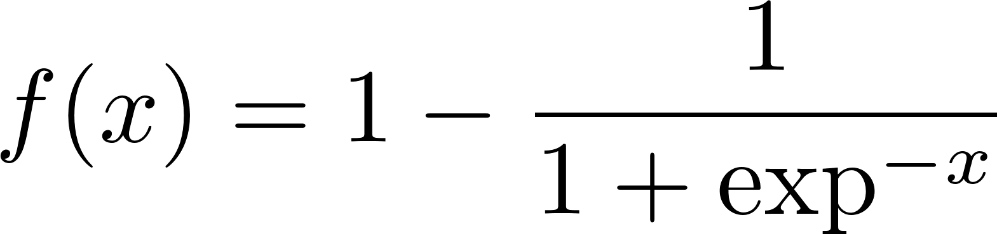
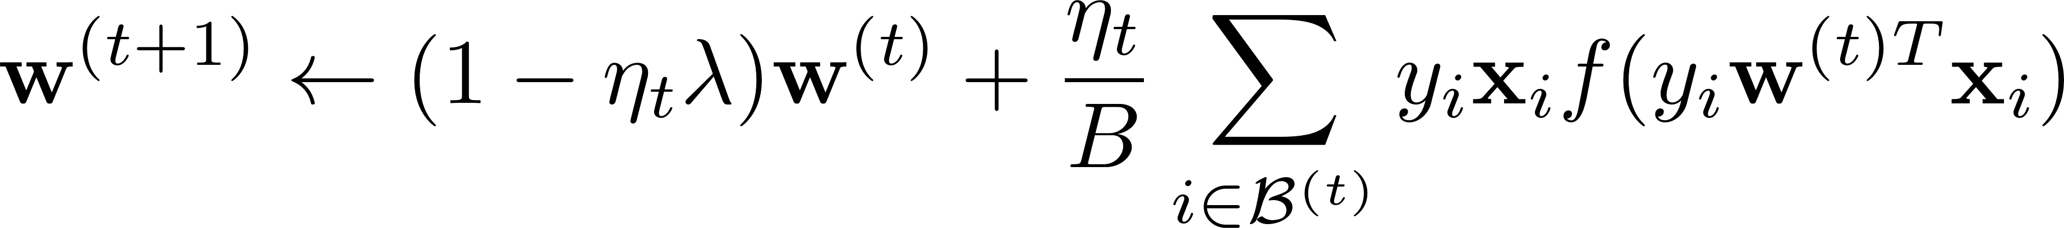

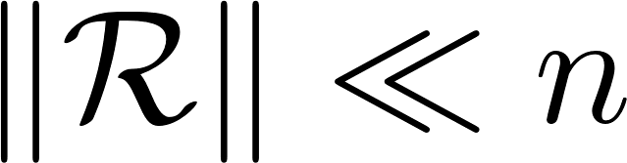
Intuition behind PrIU
Training data set:
Logistic regression model with L2 regularization:
Objective function:
Stochastic Gradient Descent (SGD) update rule:
: Set of removed samples
a mini-batch
Stochastic Gradient Descent (SGD) update rule after deletions:

Slide 8
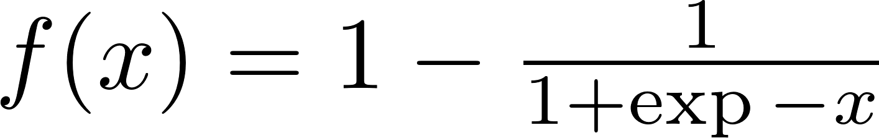
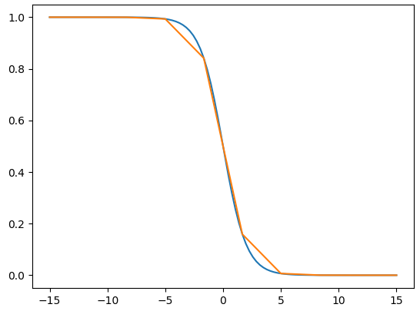
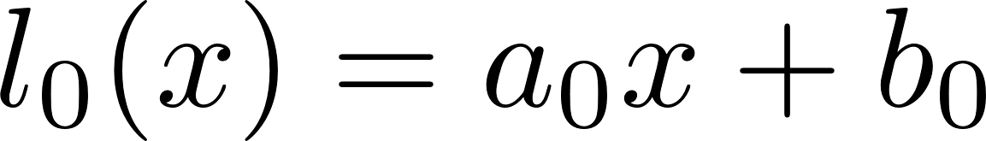
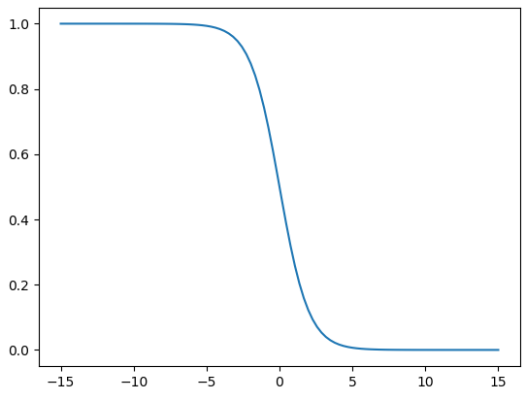
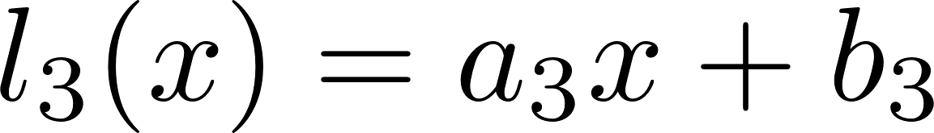
Starting from Linearization
SGD update rule on the full training dataset:
Piecewise linear interpolation

Slide 9
Provenance analysis
Linear coefficients from interpolations
Linearized SGD update rule on the full training dataset:
This is a linear algebra expression:
We can use provenance-semiring model on linear algebra operators [Yan, TaPP 16]
Some theoretical results: Convergence of provenance expression?
Related to convergence of the updated model parameters

Slide 10
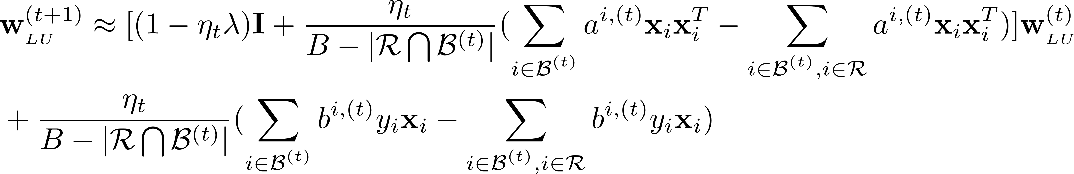

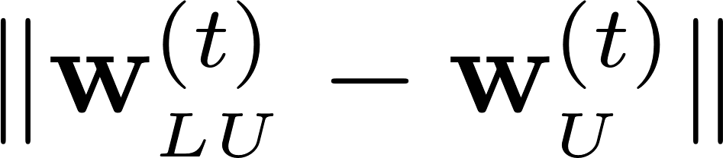
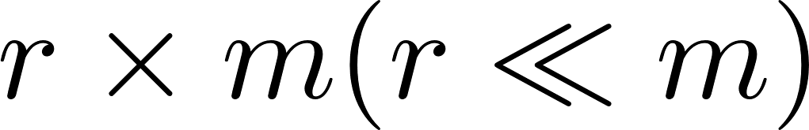
For incremental updates
Linearized SGD update rule on the full training dataset:
Provenance information!
Linearized SGD update rule after deletions:
Some theoretical results:
Size: (m is the number of features)
Observations: Small mini-batch size -> low rank
is negligible
Solutions: SVD to maintain the main components such that the maintenance overhead is
Model parameters trained without using linearization

Slide 11
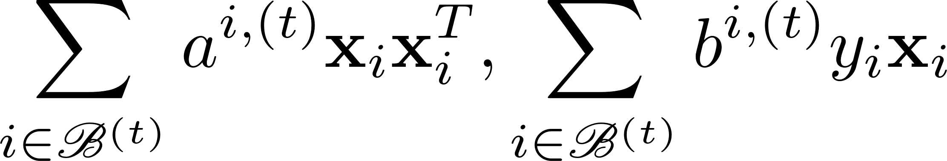
Further optimizations (PrIU-opt)
Observation:
The two intermediate formulas become stabilized even before the convergence.
Stop capturing provenance early
Reference our paper for more details about the optimizations as well as detailed complexity analysis and approximation analysis

Slide 12
Outline
State of the art
PrIU and optimizations
Experiments

Slide 13
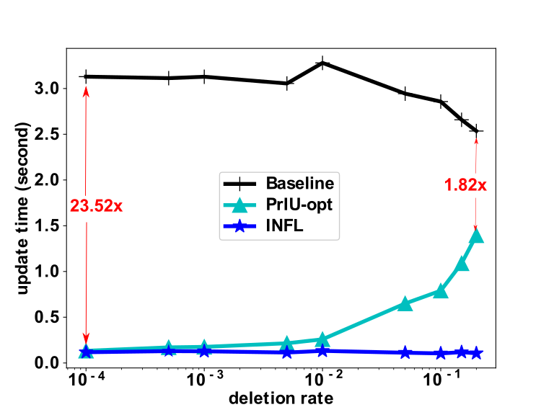
Experimental results
Covtype (minibatch = 10000, Iterations = 500)
 | Distance to the results by Baseline | Validation accuracy
Baseline |  | 48.76%
PrIU-opt | 0.0016 | 48.76%
INFL | 1.047 | 37.99%
Time to update the model
Varying the number of removed samples VS the entire training dataset size
Observations:
Speed-up of PrIU-opt is up to 24x compared to Baseline
Baseline (retrain from scratch)/PrIU-opt/INFL(Influence function) [Koh, ICML 17]
INFL is most efficient but is not robust to deletions

Slide 14
Other experiments
Influence of hyperparameters is also explored
Mini-batch size, # of iterations, etc.
Experiments on repetitive deletions of training samples

Slide 15
Conclusions
Contributions:
Build a connection between data provenance and incremental ML model updates.
Provide an efficient incremental update approach, PrIU, for linear regression and logistic regression.
Provide rigorously theoretical guarantee on the correctness of the incrementally updated results
Experimentally test the effectiveness of PrIU.
Extended solutions:
See our publication “DeltaGrad: Rapid retraining of machine learning models” in ICML 2020 for more general ML models

Slide 16
References
[Ghorbani, ICML 2019] Amirata Ghorbani and James Zou, Data shapley: Equitable valuation of data for machine learning, International Conference on Machine Learning, 2019, pp. 2242–2251
[Koh, ICML 17] Koh, P.W. and Liang, P., 2017, August. Understanding black-box predictions via influence functions. In Proceedings of the 34th International Conference on Machine Learning-Volume 70 (pp. 1885-1894). JMLR. org.
[Schelter, 2019] Schelter, S., “Amnesia”-A Selection of Machine Learning Models That Can Forget User Data Very Fast. suicide, 8364(44035), p.46992.
[Yan, TaPP 16] Yan, Z., Tannen, V. and Ives, Z.G., 2016, June. Fine-grained Provenance for Linear Algebra Operators. In TaPP.
[Green, VLDB 2007] Green, T.J., Karvounarakis, G., Ives, Z.G. and Tannen, V., 2007, September. Update exchange with mappings and provenance. In Proceedings of the 33rd international conference on Very large data bases (pp. 675-686). VLDB Endowment.
[Green, PODS 2007] Green, T.J., Karvounarakis, G. and Tannen, V., 2007, June. Provenance semirings. In Proceedings of the twenty-sixth ACM SIGMOD-SIGACT-SIGART symposium on Principles of database systems (pp. 31-40).
[Ginart, NIPS 19] Ginart, A., Guan, M., Valiant, G. and Zou, J.Y., 2019. Making AI forget you: Data deletion in machine learning. In Advances in Neural Information Processing Systems (pp. 3513-3526).
[Deshpande, SIGMOD 06] Deshpande, A. and Madden, S., 2006, June. MauveDB: supporting model-based user views in database systems. In Proceedings of the 2006 ACM SIGMOD international conference on Management of data (pp. 73-84).
[Gupta, 2015] Gupta, P., Koudas, N., Shang, E., Johnson, R. and Zuzarte, C., 2015. Processing analytical workloads incrementally. arXiv preprint arXiv:1509.05066.

Slide 17
Q&A

Slide 18
References – cont.

Slide 19
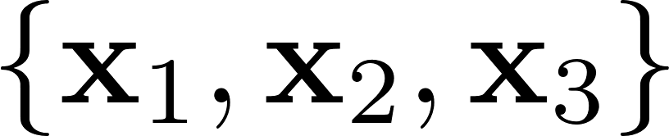
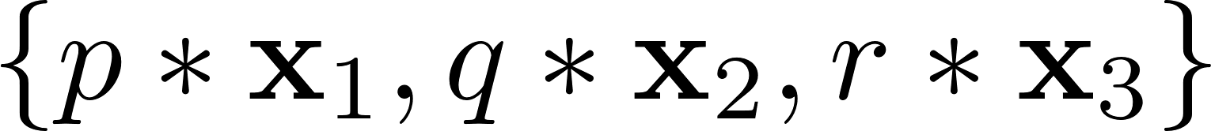
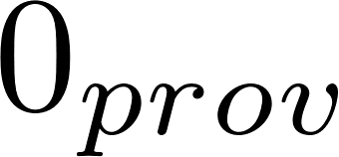
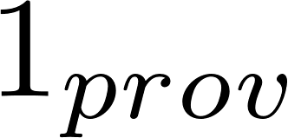
Provenance semi-ring model on linear algebra operators [Yan, TaPP 16]
Input samples:
Annotate provenance tokens:
For a linear algebra expression:

Slide 20
The state of the art
1
1
≈1
≈1
Approximation rate:
1
More similar
1
0
0
Quantized K-means [Ginart, NIPS 19] for K-means (iterative computation)
Require explicit changes for the training algorithm
Our goal:
PrIU for linear regression/logistic regression model (GD/SGD)
Goal:
General ML models (GD/SGD)
0
0
Model complexity
1
1
Simple models with closed form solutions:
e.g. Linear Regression/Naïve Bayes Model [Deshpande, SIGMOD 06] [Gupta, 2015]
Influence function method [Koh, ICML 17] for general ML models (requires iterative computation)
Only target deleting one sample
Not robust to outliers
0
0
Providing solutions for general models (trained by GD/SGD) is hard [Schelter, 2019] [Ginart, NIPS 19]

Slide 21
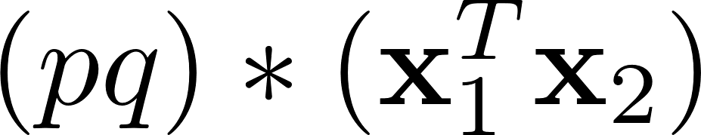
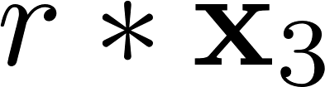
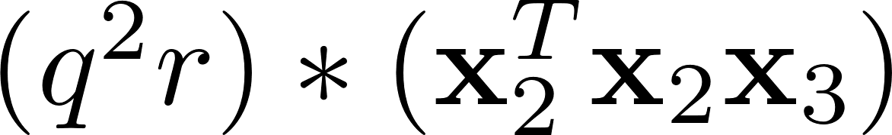
Provenance semi-ring model on linear algebra operators
Provenance-semiring model for relational database [Green, PODS 2007]
Extended for linear algebra operators in [Yan, TaPP 16]
Input samples:
For a linear algebra expression:
Annotate provenance tokens:

Slide 22
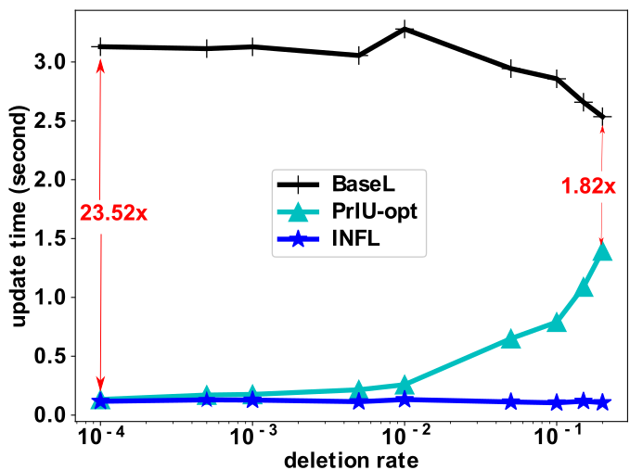
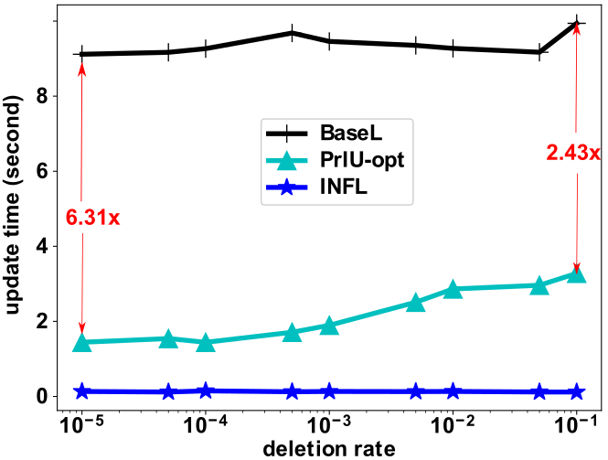
Experimental results
Covtype (minibatch = 10000, Iterations = 500)
Covtype (minibatch = 200, Iterations = 500)
Observation:
Minibatch size is smaller, the speed-ups of PrIU are smaller

Slide 23
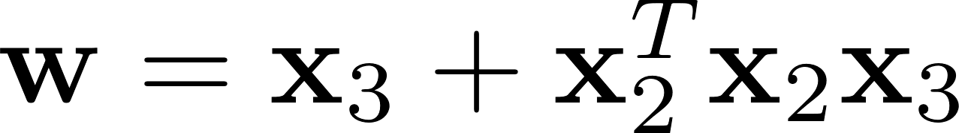
Provenance semi-ring model on linear algebra operators
Provenance-semiring model for relational database [Green, PODS 2007]
Extended for linear algebra operators in [Yan, TaPP 16]
Input samples:
For a linear algebra expression:
Annotate provenance tokens:

Slide 24
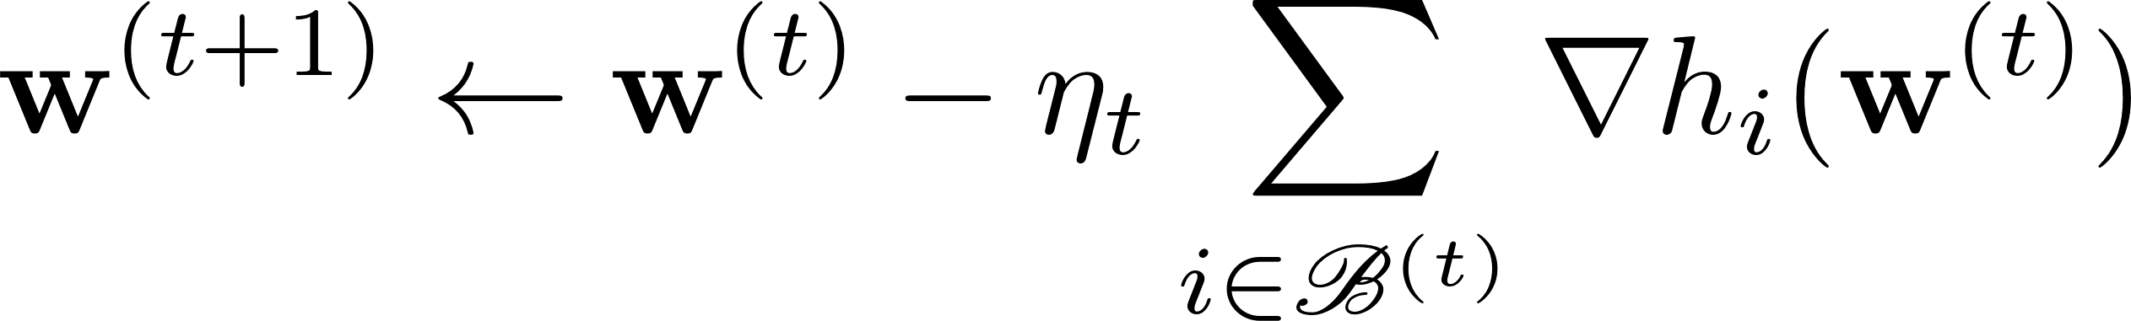
But the practice is more complicated
Training data set:
Logistic regression model with L2 regularization:
Objective function:
Stochastic Gradient Descent update rule:
Challenges:
Include non-linear operations
a mini-batch
Iterative computations -> provenance overhead

Slide 25
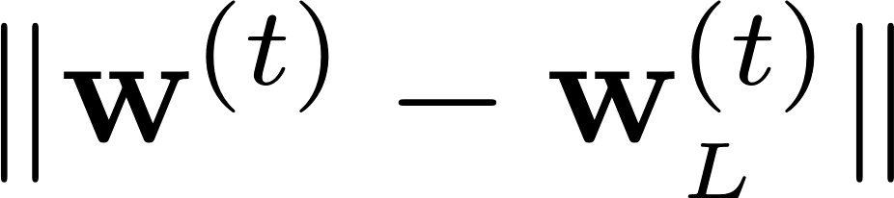
How to deal with non-linear operations?
Linear coefficients from interpolations
Linearized Stochastic Gradient Descent update rule:
Annotating provenance in this approximated formula:
Some theoretical results:
Convergence of provenance expression?
Approximation rate of linear interpolations?
negligible

Slide 26

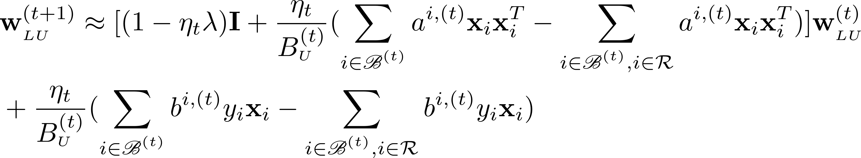
Capturing provenance in PrIU
Linearized Stochastic Gradient Descent update rule before deletions:
provenance
Linearized Stochastic Gradient Descent update rule after deletions:
Computation on the removed samples
Cache the results on the full mini-batch
Provenance polynomial is too much, an alternative way to store provenance is needed:
Linear coefficients after interpolations
Two intermediate formulas

Slide 27
Other applications
GDPR issue: [Voigt, gpdr 2017]
Robust learning: effect of outliers [Yu, 2017]
Deletion diagnostics: [Cook, 1977]
……

Slide 28
Experimental designs
Alternative approaches:
Baseline (BaseL): retrain from scratch
Influence function methods (INFL) [Koh, ICML 17]
Datasets:
Various standard benchmark datasets:
Dense/sparse
Large/small feature space
Adding some noisy data into those datasets for deletions

Slide 29
The state of the art
1
1
≈1
≈1
Approximation rate:
1
More similar
1
0
0
Quantized K-means [Ginart, NIPS 19] for K-means (iterative computation)
Require explicit changes for the training algorithm
Our goal:
PrIU for linear regression/logistic regression model (GD/SGD)
Goal:
General ML models (GD/SGD)
0
0
Model complexity
1
1
Simple models with closed form solutions:
e.g. Linear Regression/Naïve Bayes Model [Deshpande, SIGMOD 06] [Gupta, 2015]
Influence function method [Koh, ICML 17] for general ML models (requires iterative computation)
0
0
Providing solutions for general models (trained by GD/SGD) is hard [Schelter, 2019] [Ginart, NIPS 19]

