Slide 1

A Novel 3D Human Action Recognition
Framework for Video Content Analysis
Authors：Lianglei Wei, Yirui Wu, Wenhai Wang and Tong Lu
The 24th International Conference on Multimedia Modeling(MMM'18),
Bangkok, Thailand 2018. (EI, CCF-C)
Reporter：钟惠英
College of Computer and Information, Hohai University

Slide 2

1
2
3
4
5
6
Background
Motivation
Contributions
Method
Result
Conclusions
Future
CONTENTS

Slide 3
1
Background
Understanding the meanings of human actions from 3D skeleton data embedded videos is a new challenge in content-oriented video analysis.
Based on the obtained 3D skeleton data, many existing action recognition methods use hand-crafted features such as HOG and Cuboids.Recently, Recurrent Neural Networks (RNNs) have achieved promising performance
in 3D action recognition with the variant structure of neural nets to handle sequential data of body joints.However, utilizing a RGB-D camera for action recognition may still suffer from the robust problem due to the fact that recognized skeletons are not always accurate especially considering illumination, noise and occlusion variations.
College of Computer and Information, Hohai University

Slide 4
2
Motivation
In fact, most of the previous methods require a reliable input stream for action recognition, which is not suitable to deal the stream in real-life scenario .
we propose a novel method for robust 3D action recognition by exploiting temporal patterns and spatio-temporal relations of body joints. To cope with the noisy input of RGB-camera, we incorporate additional and useful information from temporal patterns and spatio-temporal relations of joints for robust recognition results. The method achieves accurate recognition results on the most popular dataset for 3D actions, which proves that our idea improves the robustness of 3D action recognition.
College of Computer and Information, Hohai University

Slide 5
Contributions
3
WTP feature based on temporal patterns in time-frequency domain, which is invariant to translations of the human body and robust to noises or temporal misalignment;
R-LSTM feature based on joint relations in spatio-temporal domain, which considers the modeling and retaining of relation factors;
A highly-efficient fusing method is further introduced to support the fusion between the proposed hand-crafted features.
College of Computer and Information, Hohai University

Slide 6
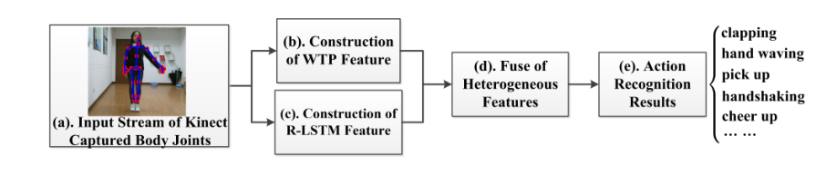
Method
4
represent the patterns of each sub-action,
various kinds of labels.
define a more discriminative representation of action
Auto-encoder network
represent the spatio-temporal relations of body joints
College of Computer and Information, Hohai University

Slide 7
4.1
Construction of WTP feature
By modeling the temporal relationship of sub-actions, we can distinguish between similar actions.Based on this idea, we propose the WTP feature to adaptively divide each action into combinations of sub-actions by DTW-based hierarchy clustering at first, and then utilize 2D-wavelet transform to extract patterns of sub-actions in the time-frequency domain.
College of Computer and Information, Hohai University

Slide 8
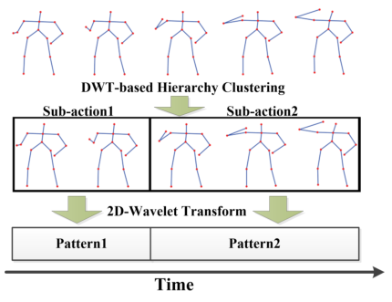
Construction of WTP feature
4.1
The construction of WTP feature consists of two parts:
DTW-based hierarchy clustering and 2D-wavelet transform.
For example, the ”drink water” action may consist of two sub-actions, namely, ”raise the cup” and then ”drink”.
College of Computer and Information, Hohai University

Slide 9
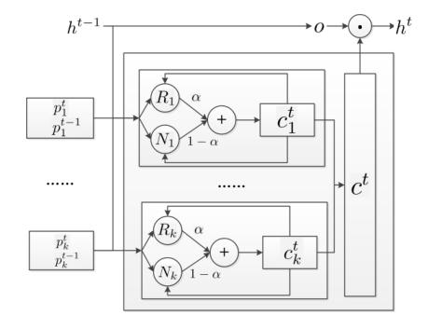
Construction of R-LSTM feature
4.2
The structure of R-LSTM unit, where R and N denote the relation-aware part and typical LSTM part respectively.R is built to describe the spatial relation between body parts
we extract features from the proposed LSTM, which is trained as a multi-label classifier assigning labels to the input stream of body joints.
College of Computer and Information, Hohai University

Slide 10
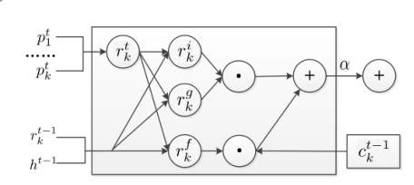
Construction of R-LSTM feature
4.2
The structure of our relation-aware part R in R-LSTM unit.
After constructing R-LSTM network,we extract the features of softmax as our proposed R-LSTM feature , which represents the spatio-temporal relation of body parts.
College of Computer and Information, Hohai University

Slide 11
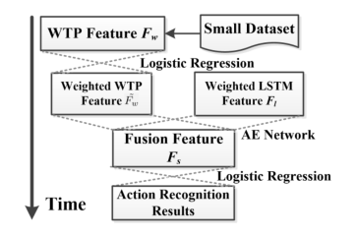
Fusion of Heterogeneous Features
4.3
The fusion model is constructed by Auto-Encoder Network. Before fusing, we adopt logistic regression to assign pre-fused weights for WTP feature.
College of Computer and Information, Hohai University

Slide 12
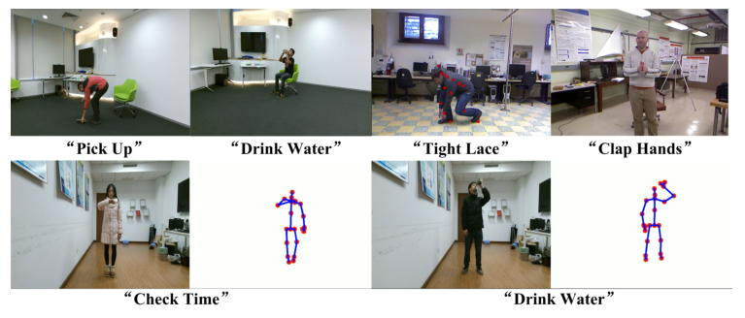
5
Results
Action recognition examples of the proposed method on NTU RGB+D, UT-Kinect, Florence 3D actions and our captured action sequences. Note that action recognition results are given under double quotes.
College of Computer and Information, Hohai University

Slide 13
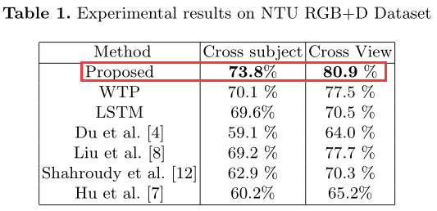
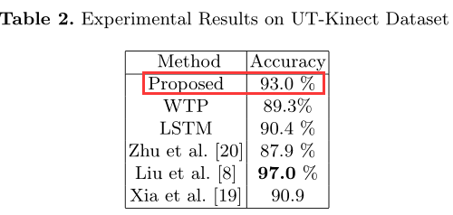
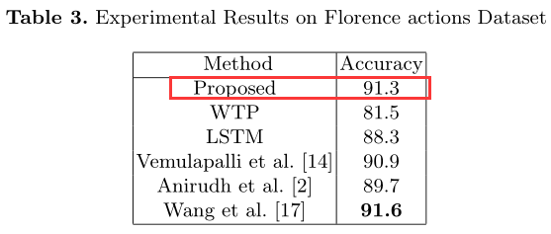
Results
5
Table 1, Table 2 and Table 3 give the detailed statistics of our method and other competing methods on NTU RGB+D, UT-Kinect and Florence acactions,respectively.
College of Computer and Information, Hohai University

Slide 14
Results
5
from three tables we can know:
Our method achieves the highest 73.8 % and 80.9 % on the challenging NTU RGB+D dataset,the second highest 93.0 % on UT-Kinect dataset and the almost equally highest 91.3 % on Florence 3D actions dataset.
However, we find the pro-posed method is low in accuracy for Florence 3D actions dataset and UT-Kinect dataset, LSTM needs quantity of training examples. However, these two datasets are small ones with only 200 and 215 action sequences compared to NTU RGB-D which consists of 56000 action sequences.
College of Computer and Information, Hohai University

Slide 15
Conclusions
6
In this paper, we propose a robust 3D action recognition method by jointly learning the temporal patterns and spatio-temporal relations of body joints. We first propose Wavelet Temporal Pattern (WTP) to model temporal patterns in time-frequency domain, which adaptively divides action into sub-actions and extracts convinced representations in temporal patterns for sub-actions. The proposed Relation-aware LSTM (R-LSTM) is then proposed to model the strong dependency between body parts in spatio-temporal domain. Regarding WTP and R-LSTM features as heterogeneous representations for actions, we finally fuse both features to define a robust and discriminative descriptor for action recognition.
College of Computer and Information, Hohai University

Slide 16
Future
7
(1) ill health
(2)Computer-human interaction
supplement:
Monitor alarm - identify malicious damage（the event of Red and yellow blue kindergarten)
Home care (Care for the elderly and children)
Public safety
College of Computer and Information, Hohai University

Slide 17
Thanks for your listening very much!
College of Computer and Information, Hohai University

