Slide 1
Operating System Auditing & Monitoring
Wu Yongzheng

Slide 2
Overview
What is OS monitoring?
OS: resource management & abstraction
OS monitoring: collect useful information on application-OS interaction.
What can we do with OS monitoring?
Study Software
Program Comprehension
Debugging, Diagnostics
Better Resource Management
Detect & Prevent Attacks

Slide 3

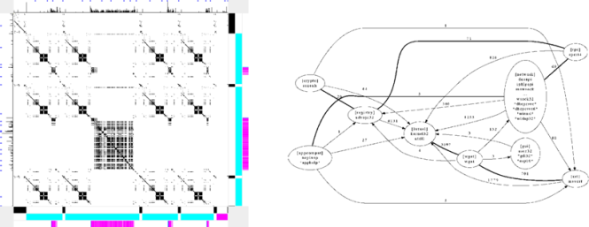

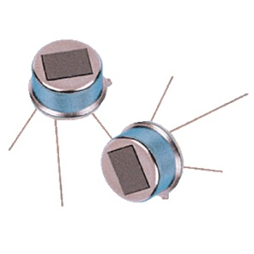
Overview
Execution Trace
Visualization
Monitoring Infrastructure:
LBox, WinResMon
Binary Integrity
System Trace
Secure Monitoring
External Sensor

Slide 4
Monitoring Infrastructure
Lack of existing secure and efficient system monitoring infrastructures
Two infrastructures developed:
LBox: user-level logging in Linux
WinResMon: resource monitoring in Windows

Slide 5
Monitoring Infrastructure
Execution Trace
Visualization
Monitoring Infrastructure:
LBox, WinResMon
Binary Integrity
System Trace
Secure Monitoring
External Sensor

Slide 6
LBox: User-level Logging in Linux
User-level: Safe to give it to normal users
Most tools are for root/admin: syslog, DTrace, auditd, LTT, KProbes/SystemTap
Guarantee
Interested events are not escaped
Interested process are not escaped
Simple but Flexible interface
Specify a group of processes to monitor
Specify a list of events to watch
Efficient
Acceptable impact on monitored process
Minimum impact on un-monitored process

Slide 7
Our Monitor Definition
A monitor is a user-space process which audits the behavior of other processes.
Described by two specifications
Process specification
Which process are monitored?
Event specification
Which events are monitored?
Types: file, network, process/thread, user defined.

Slide 8
A monitor example
/* initialize context. It will open the /proc/lbox file descriptor */
lbox_open();
/* PART 1: create events spec: current directory and executable, and information to gather */
lbox_addevent_file(event_spec, ".", SELF|SUBDIRECTORIES,
F_R|F_W|F_X, I_INO|I_DEV|I_PID|I_ACC|I_PATH);
lbox_addevent_file(event_spec, "/bin/bash", SELF, F_X,
I_INO|I_DEV|I_PID|I_ACC|I_PATH);
/* PART 2: create a process specification */
pid = (get root pid of process tree from argv)
proc_spec =
lbox_OR(
lbox_AND( lbox_OR( lbox_PROC(pid), lbox_CHILDOF(pid)),
lbox_NOT(lbox_PROC(inetd_pid))),
lbox_EUID("apache")
);

Slide 9
A monitor example (cont.)
/* PART 3: now create the lbox */
lbox_create(proc_spec, event_spec, 4096);
/* PART 4: read and process events. */
for (;;) {
/* lbox_next_event takes a timeout value, -1 means to block forever */
event = lbox_next_event(-1);
switch (event->type) {
lbox_FILE_EVENT:
event_file = (struct lbox_event_file *)event;
printf("pid=%d, dev=%lu, ino=%lu, access=%d, path=%s\n",
event_file->pid, event_file->dev,
event_file->ino, event_file->access,
event_file->path);
}
}

Slide 10
Explanation (1. event spec)
lbox_addevent_file(list_ptr, path, inclusion_flag, access_flag, returned_info);
list_ptr: event list, used to create monitor
path: path name, e.g. “/etc”
inclusion_flag: SELF, SUBDIRECTORIES
access_flag: read, write and execute
returned_info: can be time, pid, inode, path, access, data.

Slide 11
Explanation (2. process spec)
C macros which can be used to construct a binary expression
<spec> := lbox_OR(<spec>, <spec>)
<spec> := lbox_AND(<spec>, <spec>)
<spec> := lbox_NOT(<spec>)
<spec> := lbox_PROC(<pid>)
<spec> := lbox_CHILDOF(<pid>)
<spec> := lbox_EXEC(<binary path>)
<spec> := lbox_UIDNAME(<user>)
OR
AND
EUID
OR
NOT
PROC
PROC
CHILDOF

Slide 12
Security Consideration
Preserving confidentiality
A non-root user cannot monitor processes owned by other users.
Cascading Monitors
We allow monitoring arbitrary processes, including another monitor.
Need to prevent cyclic monitoring
E.g. A monitors B, B monitors C, C monitors A.
Can cause deadlock/infinite events.

Slide 13
Comparing to DTrace
DTrace: Solaris’ dynamic tracing framework. One of the key features of Solaris 10.
Tracing code execution
LBox: native code in user mode
Slow in context switch, memory copy.
DTrace: managed code in kernel mode
Slow in execution
Limited capability, e.g. no loops

Slide 14
Experimental Evaluation (micro benchmark)
15%
119%

Slide 15
WinResMon
A discovery and system debugging/ monitoring tool for determining a program's resource usage; as well as resource usage interactions between multiple programs:
Consistently monitor resource usage;
Maintain a log database;
Query the log database for diagnosis;
Low impact on system performance.

Slide 16
Software maintenance problems in Microsoft Windows
Dependency breaks
Cannot find a certain DLL file
DLL version mismatch due to OS/app software updates
Dependency conflicts
Software A overwrites Software B’s shared components (e.g. DLLs, COM objects)
Two pieces of software are trying to use the same port, create the same named pipe, mutex, etc.

Slide 17
How can WinResMon help?
WinResMon can assist system administrator to answer:
Can we safely remove a particular DLL file?
Who else is using (may use) it?
Why does a program need administrator privilege to run?
Make policy for lease privilege system.
Tweak the system so that admin privilege is not needed.
Monitoring sensitive registry locations to detect malware.
(Auto-start, Web browser plugin, Logon script, DLL injection, File association, Service)

Slide 18
How to solve them?
By understanding the life cycle of the system and programs therein
By monitoring the resource used by programs
What are logged?
File operations
Registry accesses
Process/Thread-related operations (e.g. process/thread creation)
Network accesses
Synchronization objects and IPCs operations

Slide 19
WinResMon Architecture
Performance monitor
IDS
Logger
.....
User
Event buffer
Kernel
Event module
File module
Registry module
Process/threads module
Network module
.....
File System Filter API
System call hooks
ProcessNotify callbacks
TDI hooks

Slide 20
WinResMon Logging Architecture
Main components:
Kernel event generator
Fill the event buffer
When the buffer is full, then drop event
Strategies to avoid dropping ....
User space event logger
Process events: write to file, console display, trigger alerts …
Kernel-User interface:
Shared memory for data
Double buffer
event_buffer_readyevent event for synchronization
Kernel sets the event
User clears the event after processing

Slide 21
Sample Events in Log
Log Record Format:
Sequence No ║ Timestamp ║ PID ║ Thread ID ║
Program path ║ User name ║ Return status
Operation ║ Object Path ║ Additional info
27 128347550987031250 1436 1456
C:\WINDOWS\System32\svchost.exe
NT AUTHORITY\SYSTEM STATUS_SUCCESS
file_read \Device\HarddiskVolumme1\WINDOWS\system32\wbem\Repository\FS\OBJECTS.DATA addr=32768, reqs=8192, rets=8192
674 128347551012187500 1244 1572
C:\WINDOWS\Explorer.EXE
SOCCF-CSS-019\atp STATUS_OBJECT_NAME_NOT_FOUND
reg_open
\REGISTRY\USEER\S-1-5-21-790525478-854245398-725345543-1003_CLASSES\Applications\cmd.exe
handle=0x0, access=0x2000000

Slide 22
Querying the Log
Show all the programs which read C:\foo.txt after 2012/1/1
trace_select(
"file.path == 'C:\foo.txt'",
"prog_path",
"2012-1-1 00:00:00 TO NOW",
FORWARD);

Slide 23
Micro-benchmark
F1: Open an existing file
F2: Create a new file
F3: Read 1 byte
F4: Read 4K bytes
F5: Write 1 byte
F6: Write 4K bytes
F7: Create a new directory
R1: Open an existing registry key
R2: Create a new key
R3: Create a new volatile key (REG_OPTION_VOLATILE)
R4: Query value
R5: Set value
P1: Create a dummy console process
P2: Create a dummy GUI process

Slide 24
Overhead: Micro-benchmark

Slide 25
Overhead: Macro-benchmark

Slide 26
Overview
Execution Trace
Visualization
Monitoring Infrastructure:
LBox, WinResMon
Binary Integrity
System Trace
Secure Monitoring
External Sensor

Slide 27
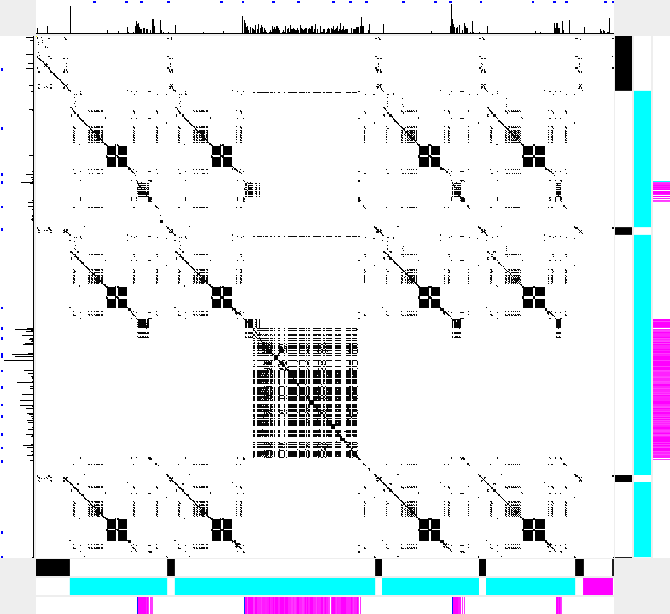
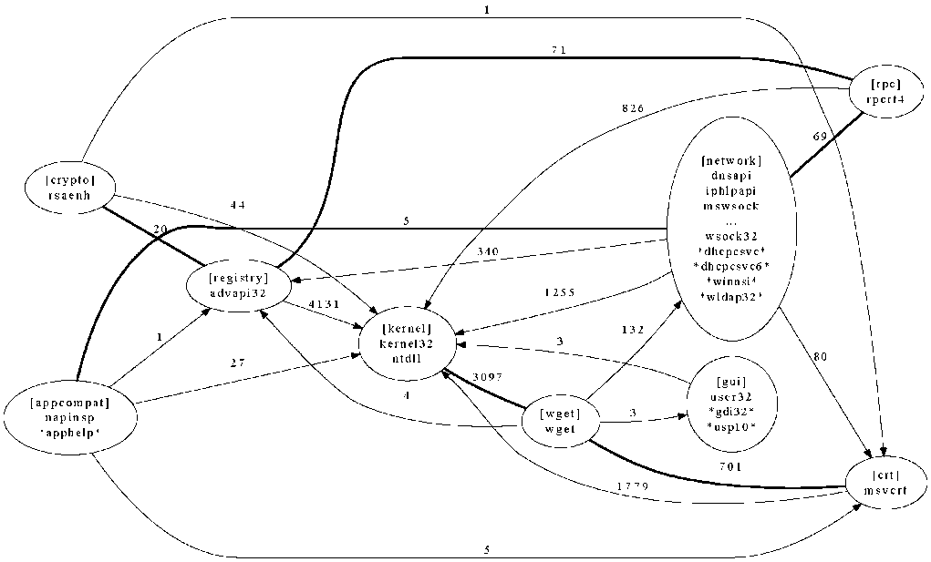
Visualizing Software Behavior

Slide 28
Problems
Software is complex
Large codebase
Interaction between components
Components from different vendor
Closed source, closed API
Why understand software?
As developer => less bugs
As administrator => diagnosis
Curiosity?
Execution trace contains software behavior information, but it’s huge.

Slide 29
What is DotPlot?
Trace X
 | E | A | C | B | E | E | E | D | C
A
C
B
C
D
E
B
C
E
Trace Y

Slide 30
What is DotPlot?
Trace X
 | E | A | C | B | E | E | E | D | C
A
C
B
C
D
E
B
C
E
Trace Y

Slide 31
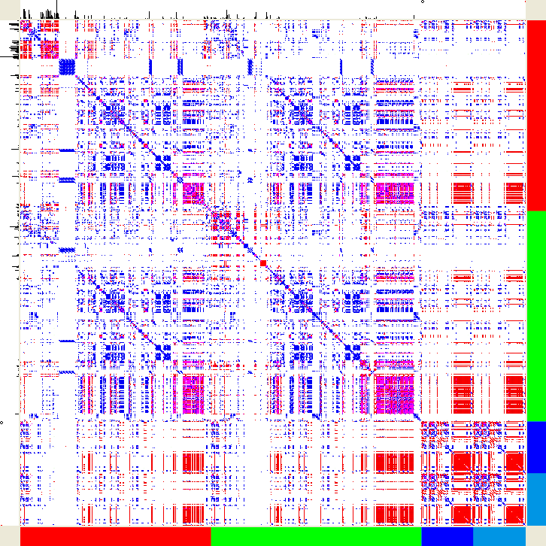
An Example
Visualization comparing:
MS PowerPoint,
MS Word,
OO Word, and
OO PowerPoint.

Slide 32
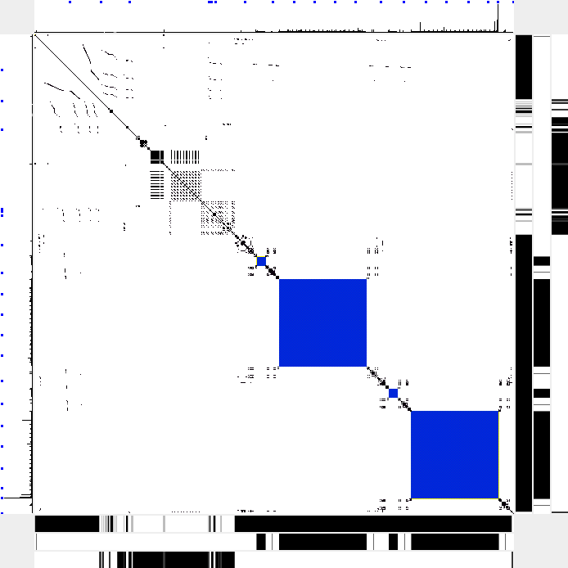
Elements of VDP
2
3
4
1
1: Extended DotPlot
2,3: Axis Histogram
4,5: Barcode
3
Notes:
Configurable

Slide 33
Extended DotPlot
Matching Rule
Define whether two events match
By fields: e.g. “if PIDs and resource paths are the same”, “if program names are the same”
DP Coloring Rule
Define color for matched events
Traditional DP uses black only
Use RGB model on black background, CMY on white background
Use regular expression to specify events
E.g. “.*file_open.*”→blue. “.*reg_.*”→cyan

Slide 34
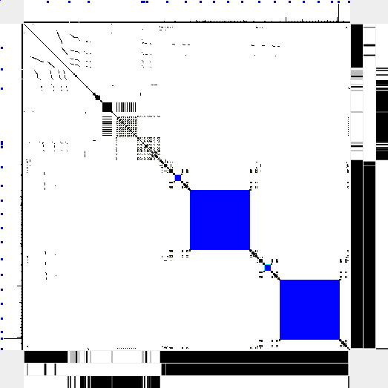
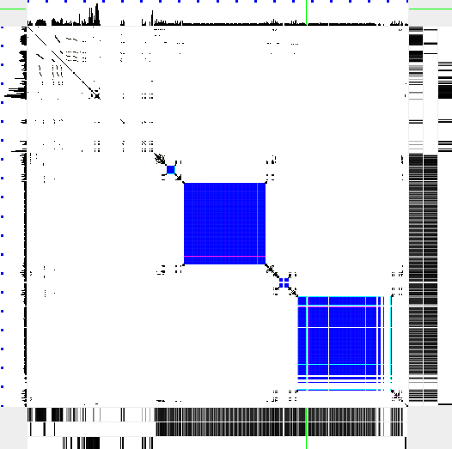
Event-ordered and Time-ordered
Each event takes different time
The meaning/unit of each axis
Event-ordered
Time-ordered

Slide 35
Axis Histogram
Ticks mark unit time (e.g. 1 second)
Histogram
Event density (time-ordered)
Time spent (event-ordered)

Slide 36
Barcode
One dimensional
Highlight user chosen events
E.g. file_open → red
One or more (e.g. three below)
Barcode coloring rules

Slide 37
Case Study: Software Build
X: succeed; Y: failed due to missing .c file
DP match : program + operation + value (pathname)
DP color : black → any
Bar1 color : black → nmake.exe
Bar2 color : cyan → cl.exe; magenta → link.exe
Bar3 color : cyan → reading .c files; magenta → reading .h files
X: succeed
Y: Failed due to missing .c file

Slide 38
Number of Executions
X: 4 compiles (cl.exe), 1 link (link.exe)
Y: 3 compiles, 0 link
Y: Third compile doesn’t read .c or .h.
Bar2 color : cyan → cl.exe; magenta → link.exe
Bar3 color : cyan → reading .c files; magenta → reading .h files
Y: 3 compiler, 0 linker
X: 4 compiler, 1 linker

Slide 39
Similarity & Difference
Two traces are similar.
Y (failed) trace terminates earlier.
Right before reading .c file

Slide 40
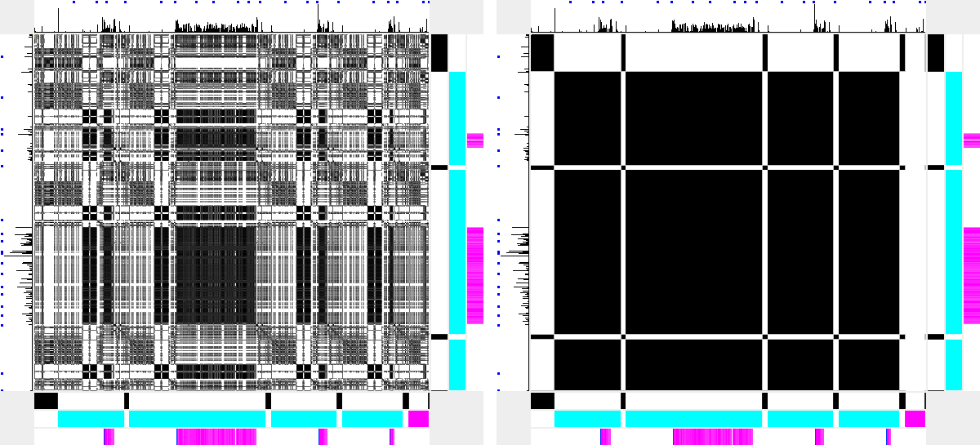
Different Matching Rule
Operation Type
Program Name
Notes:
Workload
Different phrase

Slide 41
Demo

Slide 42
Visualizing Module Dependencies
The problem
There’s vulnerability in X. Which software uses X?
Why my software uses X? I never call it.
Is it safe to uninstall X?
Software module
Windows DLLs
UNIX .so
Java class, packages

Slide 43
Examples of dependencies (1)
Binaries used by notepad
c:\windows\apppatch\acgenral.dll
c:\windows\system32\avgrsstx.dll
c:\windows\system32\imm32.dll
c:\windows\system32\lpk.dll
c:\windows\system32\msacm32.dll
c:\windows\system32\msctf.dll
c:\windows\system32\msctfime.ime
c:\windows\system32\shimeng.dll
c:\windows\system32\usp10.dll
c:\windows\system32\uxtheme.dll
c:\windows\system32\winmm.dll
c:\windows\system32\winspool.drv
c:\windows\winsxs\x86_microsoft.windows.common-controls_6595b64144ccf1df_6.0.2600.5512_x-ww_35d4ce83\comctl32.dll

Slide 44
Examples of dependencies (2)
Simple boot (only Windows installed)
DLLs: 154
EXEs: 10
Drivers: 1
Ime: 1
Typical boot (Windows + applications)
DLLs: 274
EXEs: 15
Telephony/Modem: 6
Drivers: 3
ActiveX: 2
Ime: 1

Slide 45
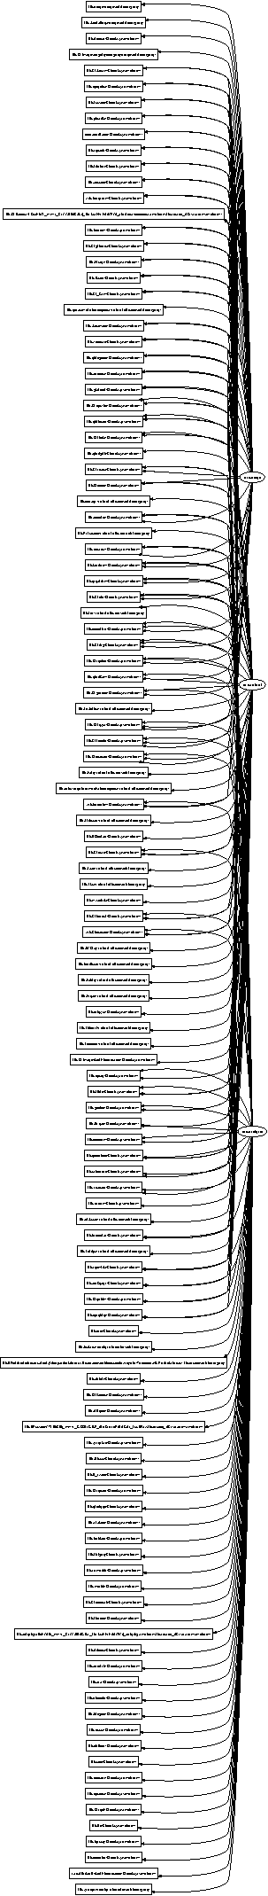
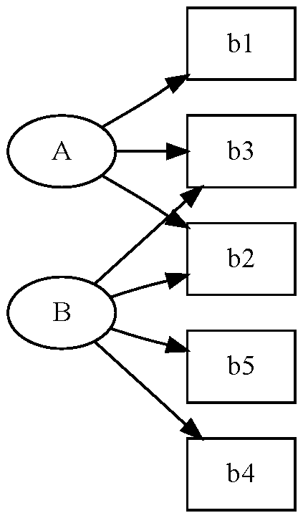
Visualization (1)
Basic dependency graph
Graph is too dense

Slide 46
Binary Dependency Visualization
Two types of nodes: EXE, DLL + etc
Three types of directed edges
EXE X launches another EXE Y
EXE X load a DLL Y
A function in binary X calls a function in binary Y
How are binaries shared among programs?
EXE Dependency Graph
Only Type 1 and 2 edge
Group DLLs by loader
How binaries interact?
DLL Dependency Graph
Only Type 2 and 3 edge
Group DLLs manually by functionality or software vendor

Slide 47
Visualization (1)
Basic dependency graph
Graph is too dense

Slide 48
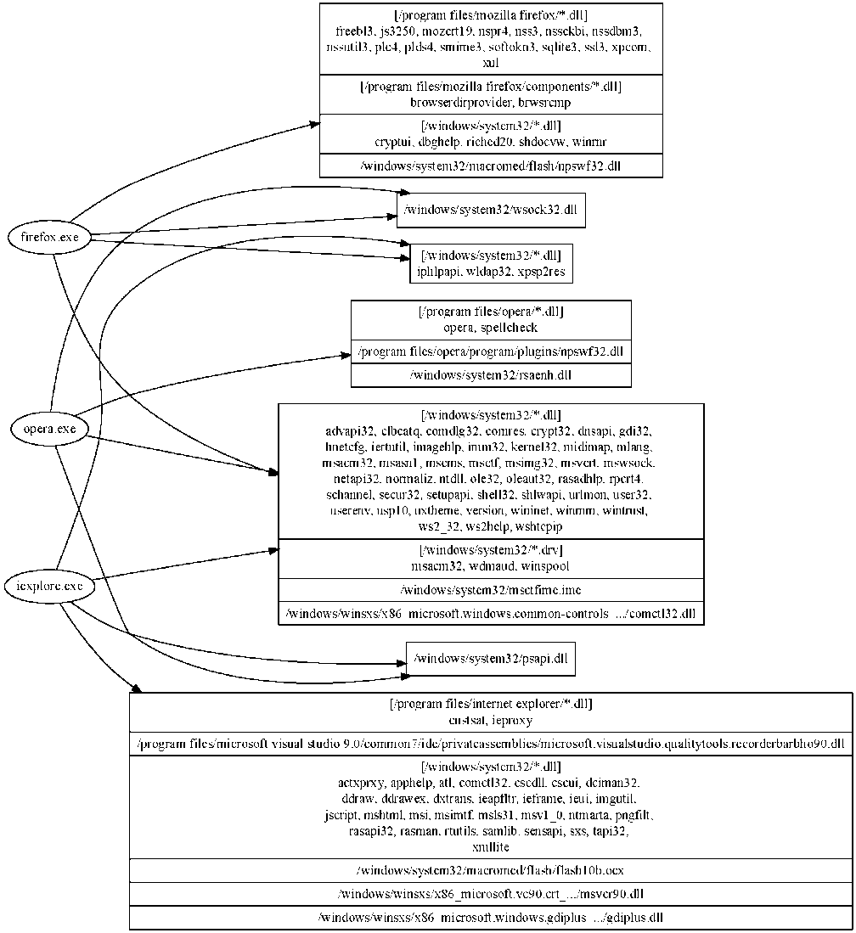
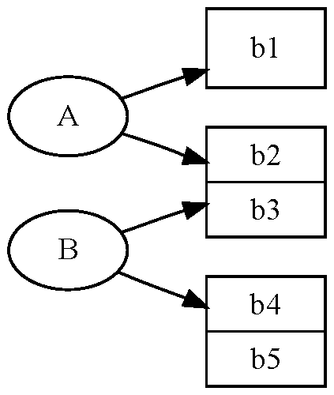
A more usable Visualization: EXE Dependency Graph
Grouped dependency graph
1
2
1
2
1

Slide 49
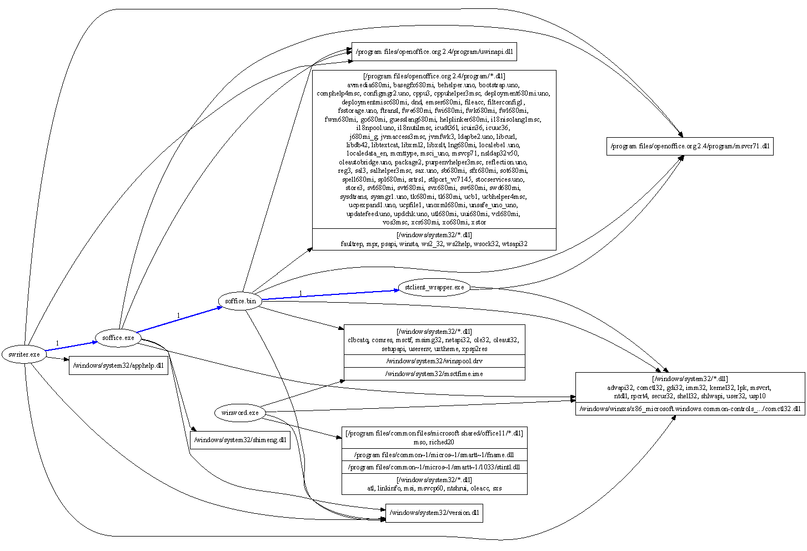
Comparing Microsoft Word and Open Office Writer

Slide 50
DLL Dependency Graph: actual binary usage
Some definitions:
An EXE-DLL dependency in a DLL Dependency Graph is when there is has a control transfer from code in executable x to code in DLL y. We say that x has an EXE-DLL dependency on y.
A DLL-DLL dependency in a DLL Dependency Graph is when there is has a control transfer from code in DLL x to code in DLL y. We say that x has a DLL-DLL dependency on y

Slide 51
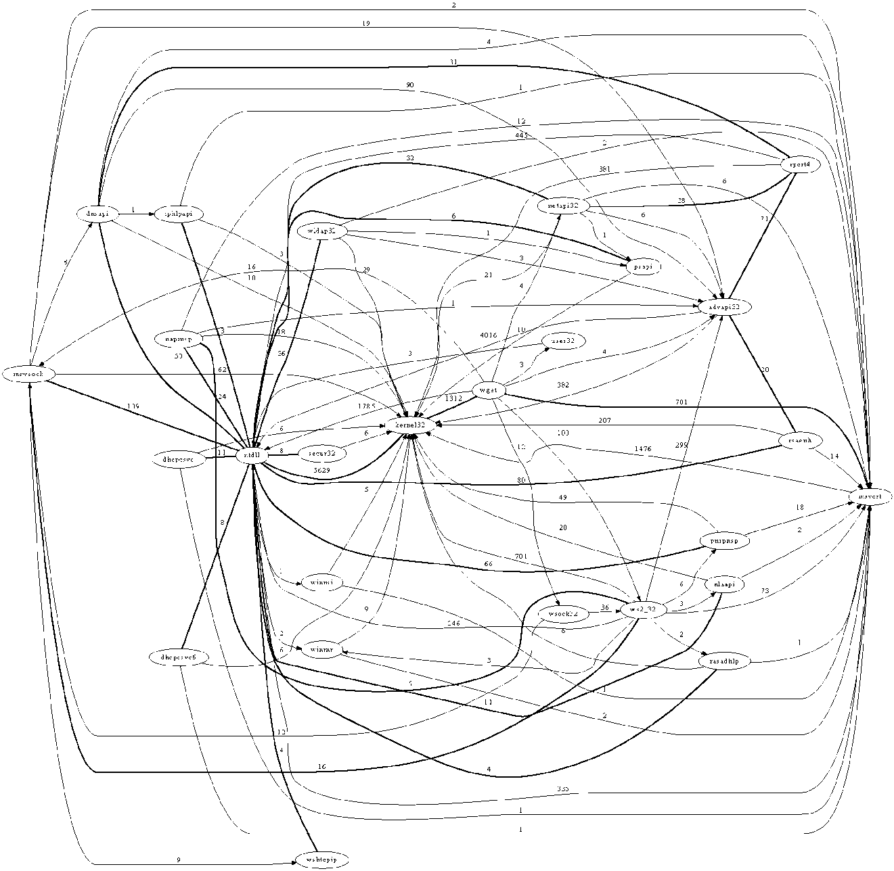
wget: DLL dependency without grouping

Slide 52
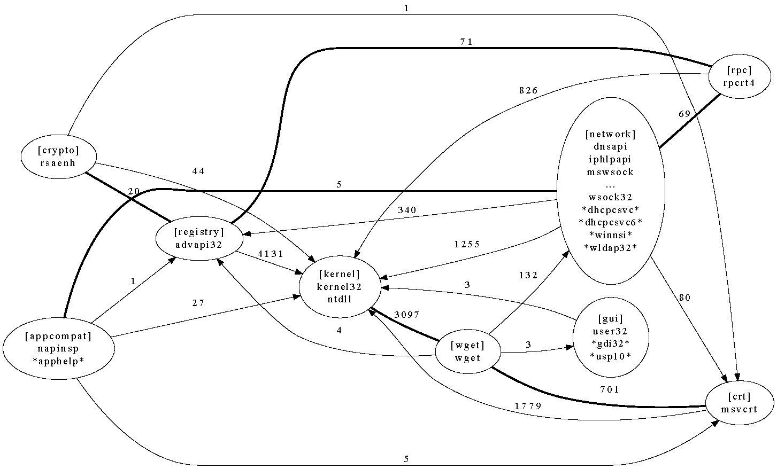
wget: DLL dependency group by functionality

Slide 53
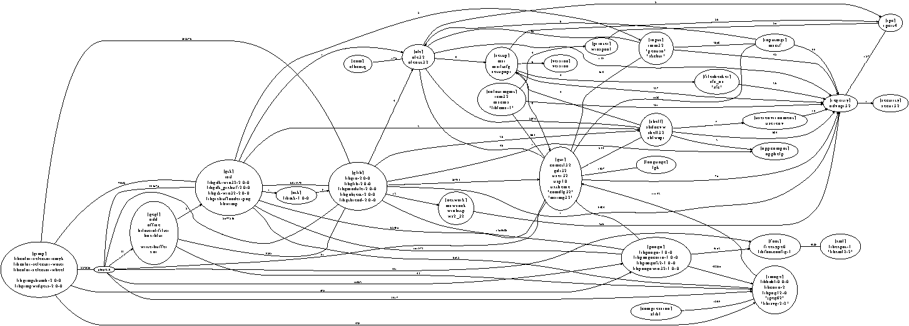
Examples of grouping By functionality (GIMP)

Slide 54
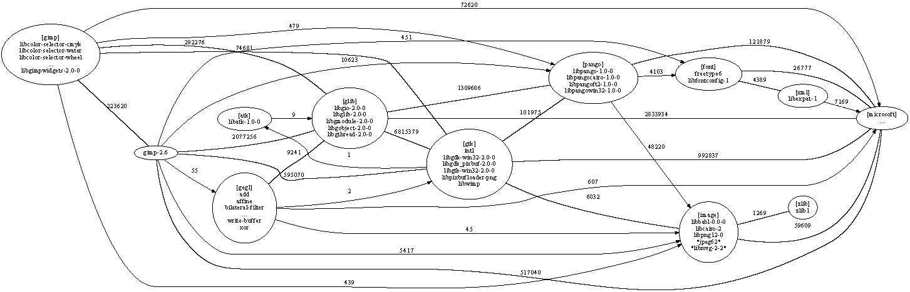
Examples of grouping By software vendor (GIMP)

Slide 55
Two Operations
Diff
Compare two graphs.
E.g. from same program but different environment/input
E.g. from two related programs
Diff graph G1 and G2 to get G3.
Projection
Focus on a particular module X
Only show modules that calls X or called by X (recursive definition)
Project graph G1 on module M to get G2
Not a simple subgraph problem

Slide 56
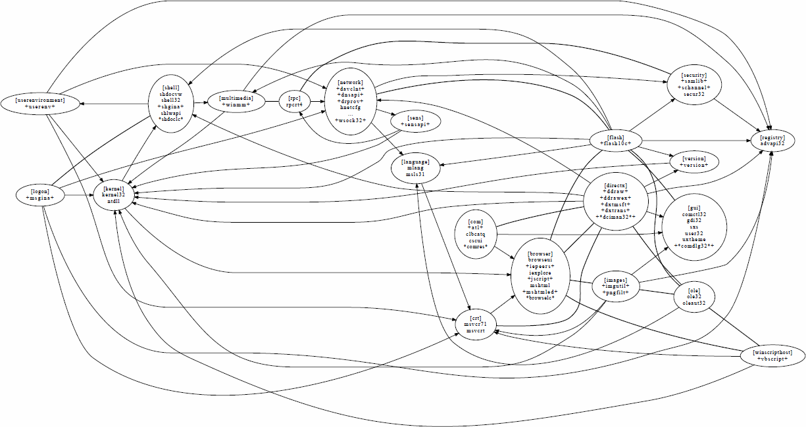
Diff of DLL dependency graph of Internet Explorer with Flash and without

Slide 57
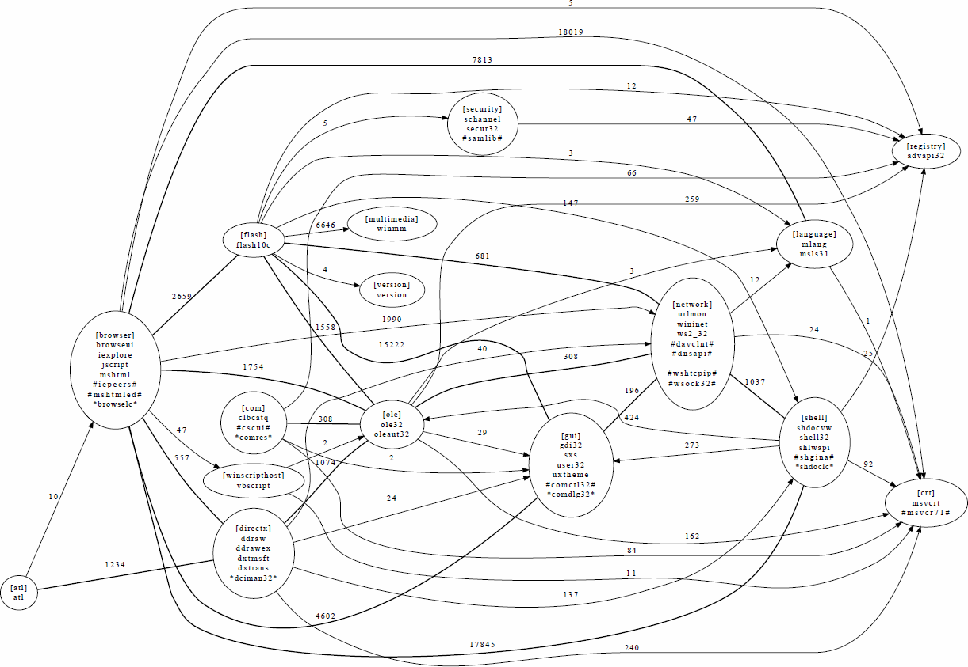
Projection of the DLL dependency graph of Internet Explorer on Flash

Slide 58
Projection
void main (void) {
A();
B(1);
}
void A (void) {
B(0);
}
void B (int i) {
if (i) D();
else C();
}
void C (void) {}
void D (void) {}
Full Graph
A
C
main
B
D
Project on A
A
C
main
B

Slide 59
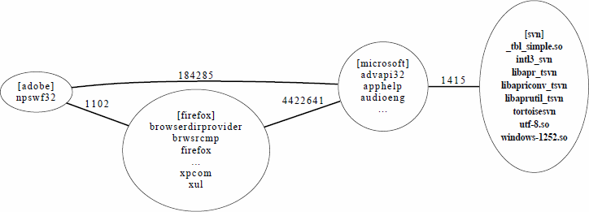
Firefox using tortoisesvn

Slide 60
Overview
Execution Trace
Visualization
Monitoring Infrastructure:
LBox, WinResMon
Binary Integrity
System Trace
Secure Monitoring
External Sensor

Slide 61
Secure Monitoring
Problem
When host is compromized, host-based monitoring can’t be trusted
How to tell if a host is compromized?
Our Solution
External Monitoring
collect external information
E.g. CPU temperature, keyboard sound, human infrared emission
Fuse external information with host information

Slide 62
Application
Extrusion Detecting
Compromized zombie host
Sending spam email
Password cracking
DDoS
Web search spam
Combine host activity with user presence information
Access Control & Rate Control
Use user presence/activity information to restrict/limit resource usage
Example
Keyboard/mouse activity -> sending email
User present physically -> use network printer

Slide 63
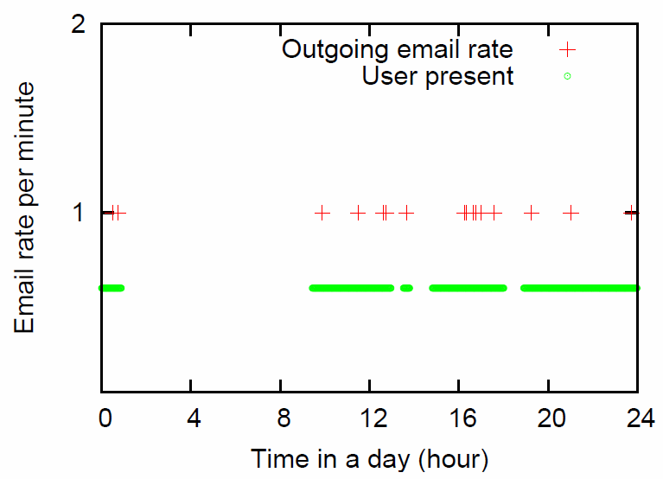
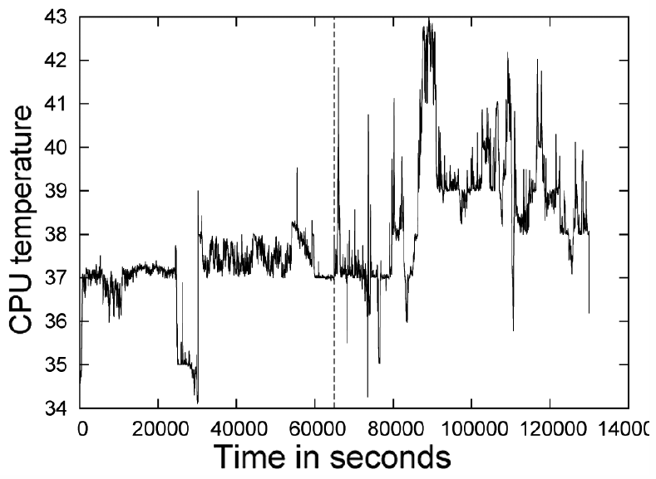
Example
Spammer detection
Computer sending email when user is absent
Zombie bot-net: computing farm
High CPU temperature when user is absent

Slide 64
Overview
Execution Trace
Visualization
Monitoring Infrastructure:
LBox, WinResMon
Binary Integrity
System Trace
Secure Monitoring
External Sensor

Slide 65
Why Binary Integrity?
Binaries are files that contain native executable code.
Examples in Windows:
EXE, DLL, SYS (driver), OCX, IME, AX …
Binaries contain most of the code.
Yes, there are interpreted (byte-)code, but they depend on the native interpreter.
Most attacks add or modify binaries.
Yes, buffer overrun attacks purely exist in memory, but they are usually used as a vector to download real malicious binary, otherwise the attack doesn’t survive reboot.

Slide 66
Binaries loaded by calc.exe
C:\windows\apppatch\acgenral.dll
C:\windows\system32\advapi32.dll
C:\windows\system32\avgrsstx.dll
C:\windows\system32\calc.exe
C:\windows\system32\gdi32.dll
C:\windows\system32\imm32.dll
C:\windows\system32\kernel32.dll
C:\windows\system32\lpk.dll
C:\windows\system32\msacm32.dll
C:\windows\system32\msctf.dll
C:\windows\system32\msctfime.ime
C:\windows\system32\msvcrt.dll
C:\windows\system32\ntdll.dll
C:\windows\system32\ole32.dll
C:\windows\system32\oleaut32.dll
C:\windows\system32\rpcrt4.dll
C:\windows\system32\secur32.dll
C:\windows\system32\shell32.dll
C:\windows\system32\shimeng.dll
C:\windows\system32\shlwapi.dll
C:\windows\system32\user32.dll
C:\windows\system32\userenv.dll
C:\windows\system32\usp10.dll
C:\windows\system32\uxtheme.dll
C:\windows\system32\version.dll
C:\windows\system32\winmm.dll
C:\windows\winsxs\x86_microsoft.windows.common-controls_6595b64144ccf1df_6.0.2600.5512_x-ww_35d4ce83\comctl32.dll
Antivirus’ hook.
The main program
Input method hook
Multiple versions of the same library

Slide 67
Binary Loading “Features”
Shell Extension: e.g. right-click context menu, file type association, video preview
Autostart Points: auto run programs after user login
Autorun/Autoplay: load binary in portable media
Services: auto run after boot. Many services may run in a single svchost process. Nice feature for hiding.
DLL Injection
The AppInit_DLLs registry key: loaded by every process
WriteProcessMemory+CreateRemoteThread: common technique for injecting a DLL into another process
Windows hooking API
Exploiting the DLL search order: long existed attack, but many fixes keep coming recently
Browser Helper Objects: IE’s ActiveX

Slide 68
Binary Related Attacks
File extension trick
postcard.jpg.exe with same Windows Explorer’s JPEG icon
Does actually launches the image viewer
Hard to tell the difference
References:
“Windows security - Determine file type” http://www.dedoimedo.com/computers/file_type.html
“Prevent Windows Vista from hiding file extensions in Explorer, a possible security risk” http://malektips.com/windows-vista-show-file-extensions.html
“The Hidden Danger of Hidden File Extensions” http://dewasoft.com/privacy/file-ext-security.htm
“How to NOT hide extensions in Windows” http://www.irchelp.org/irchelp/security/trojanext.html

Slide 69
Binary Related Attacks
Executable embedded in PDF
Embedded executable is auto extracted
Executable is auto launched
Acrobat Reader shows a warning dialog, but text in the dialog can be changed! (CVE-2010-1240)
Foxit Reader doesn’t show warning at all (CVE-2009-0836)
Winhelp exploit (CVE-2010-0483)
When surfing, the user is tricked to press F1.
A malicious .hlp file on network share will be opened.
.hlp files are “unsafe files” and can run arbitrary code
Notes:
http://blog.didierstevens.com/2010/03/29/escape-from-pdf
http://www.cve.mitre.org/cgi-bin/cvename.cgi?name=CVE-2010-0483
Unsafe files: http://support.microsoft.com/kb/291369

Slide 70
Binary Related Attacks
Binary Planting Attack
When loading a DLL by only file name, a list of directories are searched in order. CWD is in the list.
CWD can be controlled by the attacker. E.g. Desktop with many downloaded files; network share.
Many software are vulnerable
256 products, 103 vendors (by Secunia Research)
Microsoft Patches: MS10-087, MS10-093, MS10-094, MS10-095, MS10-096, MS10-097, MS11-001, MS11-003, MS11-015, MS11-016, MS11-017 (Three patches in Mar 2011)
Notes:
http://secunia.com/advisories/windows_insecure_library_loading/
http://www.microsoft.com/technet/security/advisory/2269637.mspx

Slide 71
Existing Security Models
Biba Models
Suitable for static pre-configured system (no binary creation, process creation?)
Manual labeling
How about DLLs?
Isolation Models (virtual machine, sandbox)
no file + resource sharing (Windows software default is share all, which is not too compatible)
Sandbox system does not protect software in sandbox
Dealing with IPC is hard
Signed Binaries
Security relies on the trust of the signing keys, i.e. Stuxnet
Revocation checking is expensive
Cannot assume all software vendors sign their binaries

Slide 72
Usability v.s. Security
Security
Protects against many of the binary attack + modification mechanisms
Usability
Easy to use and maintain software
Work with existing software updating mechanisms
Windows UAC: too many security prompt

Slide 73
BinInt Integrity Model
Observation
Software normally changes its own binary
Huge number of binaries, much less software
Idea
Sign binary installers
Restrict binary modification using labels and rules
Propagate labels through processes and binaries

Slide 74
BinInt Integrity Model
Processes run in execution modes: (security policy rules based on mode + software group)
d-mode: default mode (binary loading required valid software group, can only create invalid binaries)
i-mode: install mode
t-mode: temporary trusted mode (can load binaries, can only create invalid binaries)
Need privilege to change mode to i/t-modes
Assign software group to files and processes
Binary can only changed/created by i-mode process with same software group

Slide 75
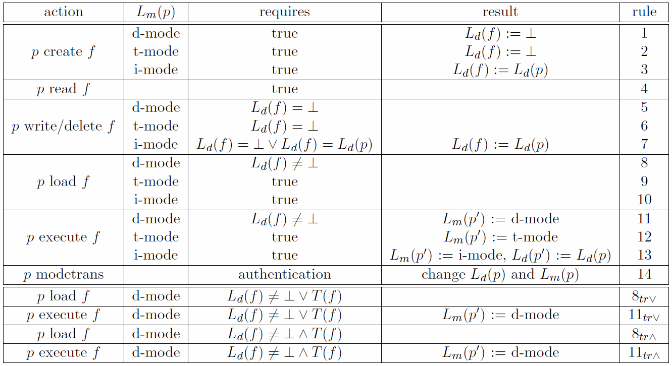
Labels and Rules

Slide 76
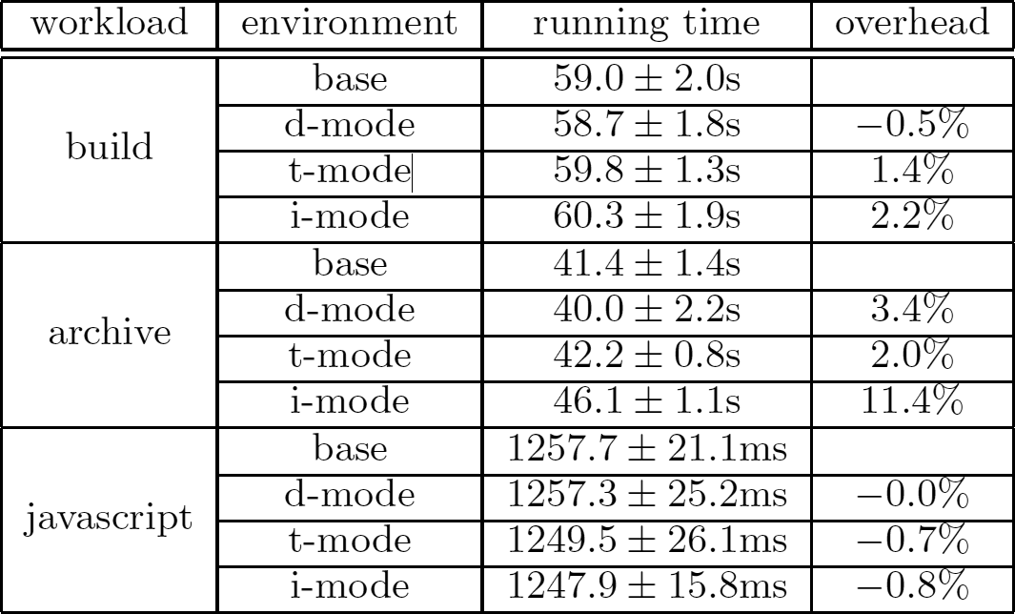
Performance
Overheads almost neglible in d-mode
i-mode has small overheads except when many files are created but higher install overhead is reasonable

Slide 77
Thanks. Questions?

Slide 78
Why Windows Binary
Popular OS
large installation base => more malware
large user population => more malware
large application/software base => compatibility problems
Many specific issues on Windows:
micro kernel: kernel splits to a few components
closed source
Many features on binary loading: large attack surface (more on this later)
No central software management system
Most Linux distro has package manager
Software can modify each other (no separation). E.g. plugins, hooks
Complicated binary dependency (DLL hell) (see next slide)
Users mostly (by default) run as administrator.

Slide 79
Overview
Execution Trace
Visualization
Monitoring Infrastructure:
LBox, WinResMon
Binary Integrity
System Trace
Secure Monitoring
External Sensor

